Slide 1

Leveraging Global Talent for Effective Agility
Todd Little, Accelinnova
Notes:
Over the past 3 years Landmark has been incorporating Agile methodologies in our development processes.

Slide 2
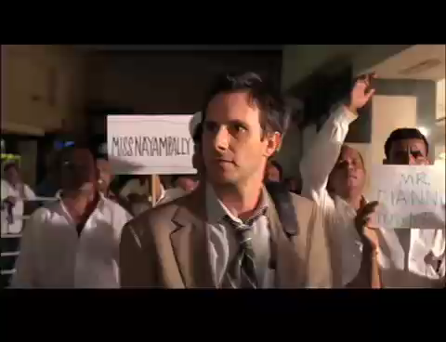

Slide 3
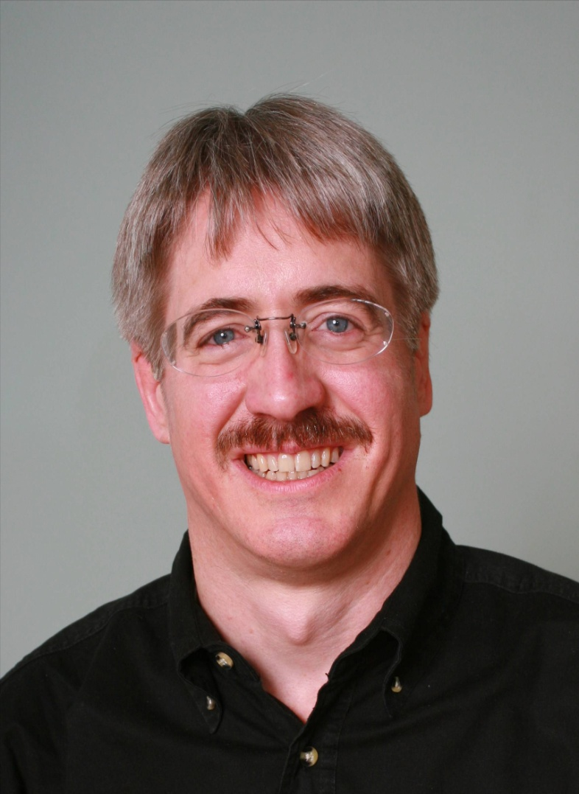

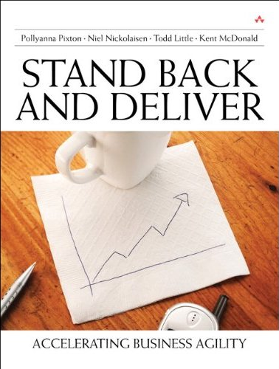





About Todd
  @toddelittle
Chemical & Petroleum Engineer
30+ Years in Software Development
Founding Consultant at
Executive roles as VP Product Development, Director of Software & Technology
Pioneer and Agile Community Builder

Slide 4
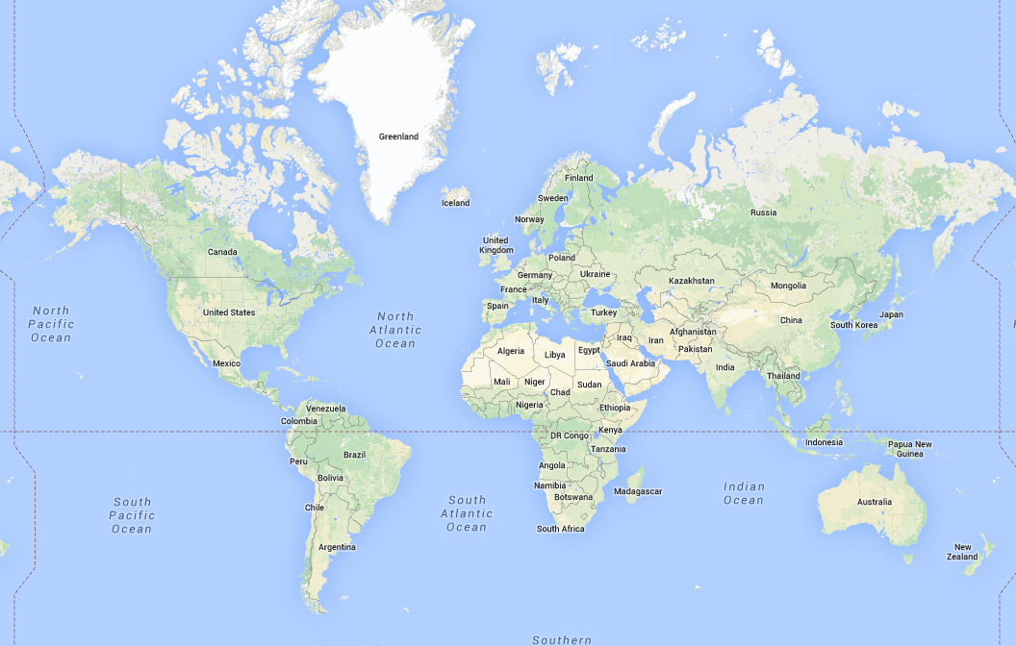
Globally Distributed Teams

Slide 5
Long Ago and Far, Far Away…

Slide 6
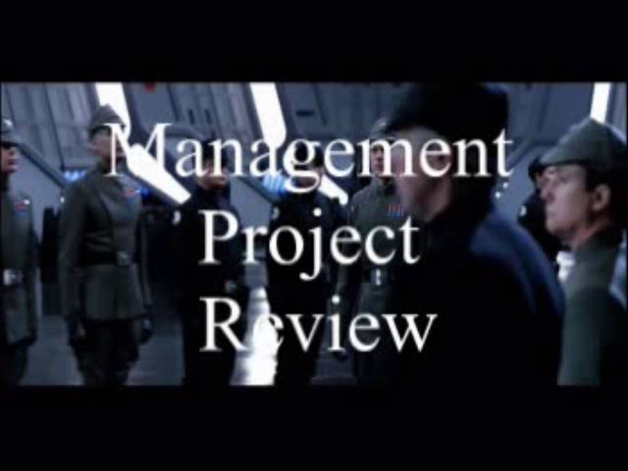

Slide 7

Agile Leadership

Slide 8
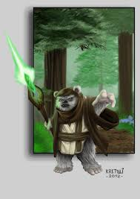

From Coding Monkey to Empowered Ewok

Slide 9
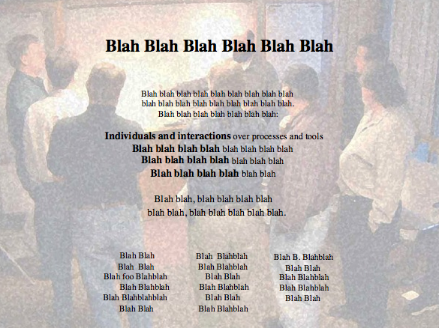
Alexey Krivitsky

Slide 10
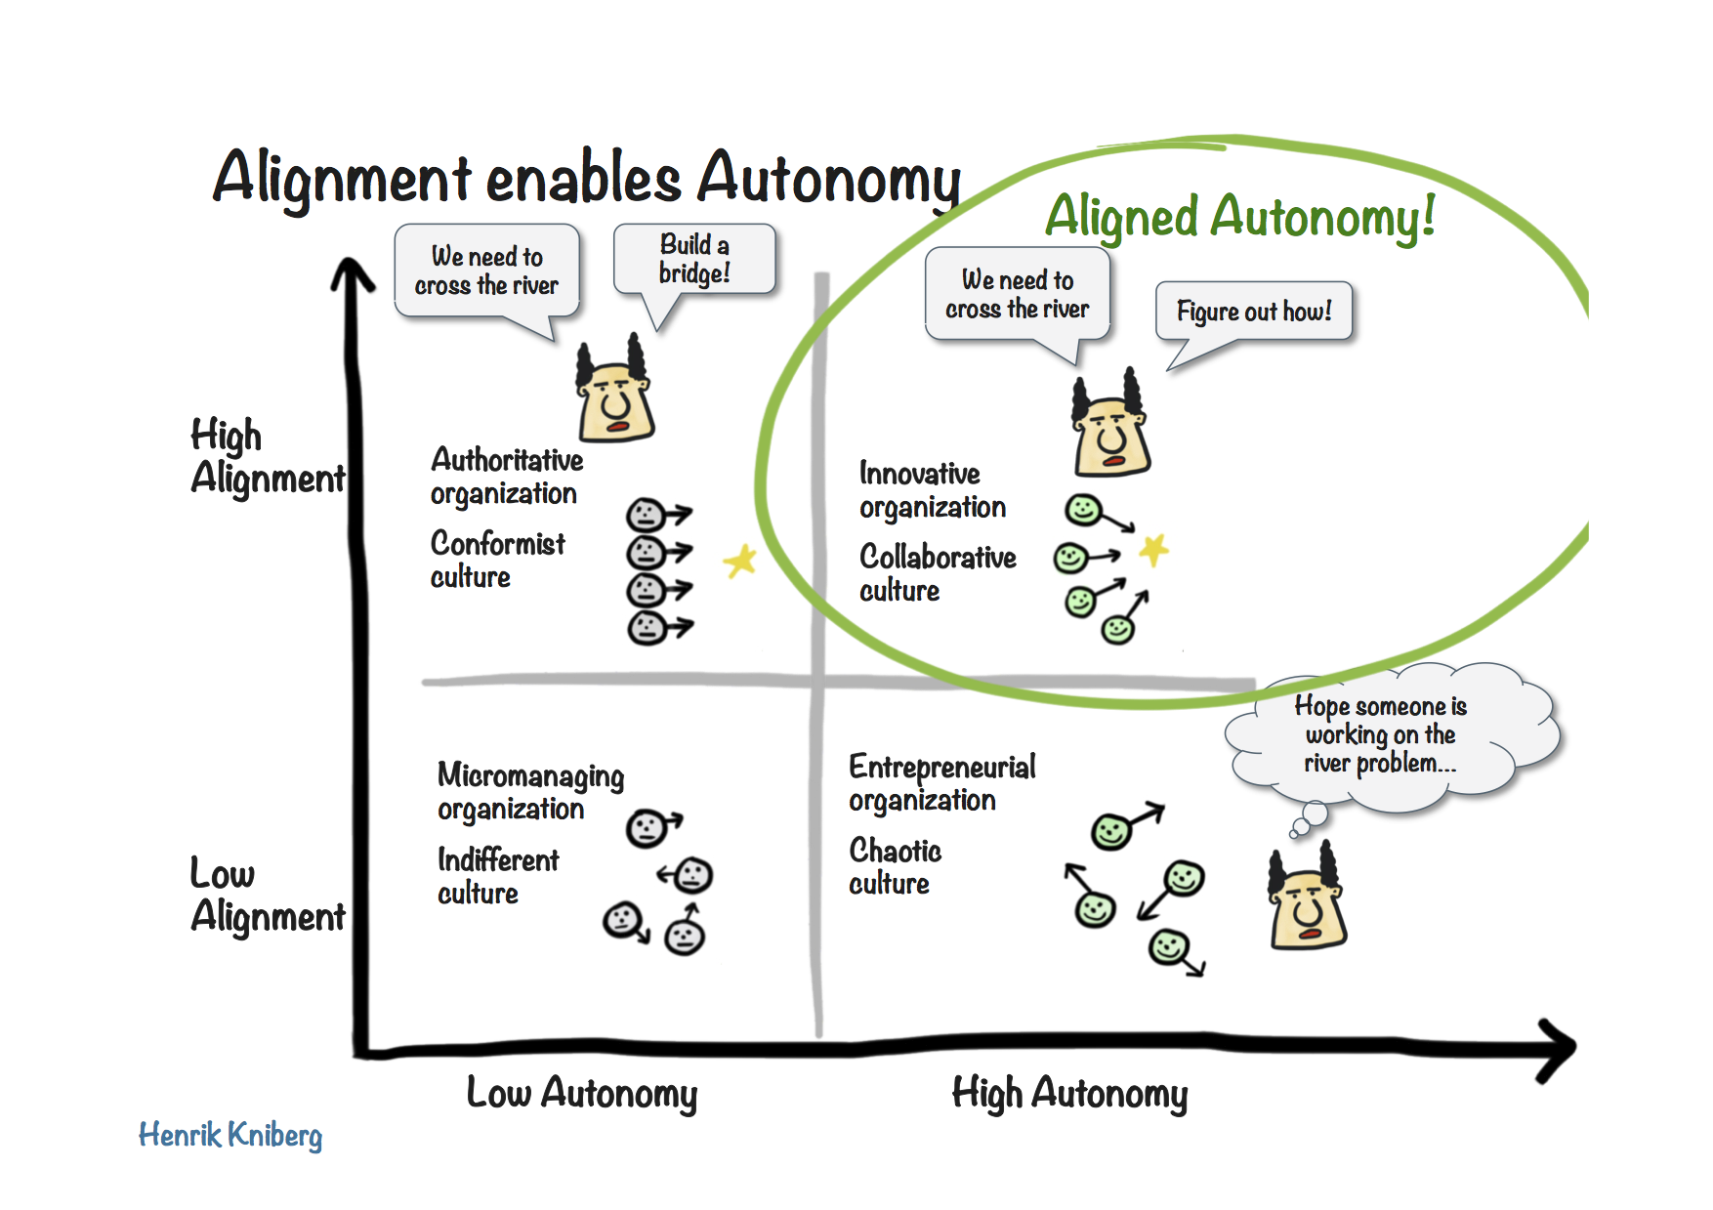
Autonomy and Alignment

Slide 11

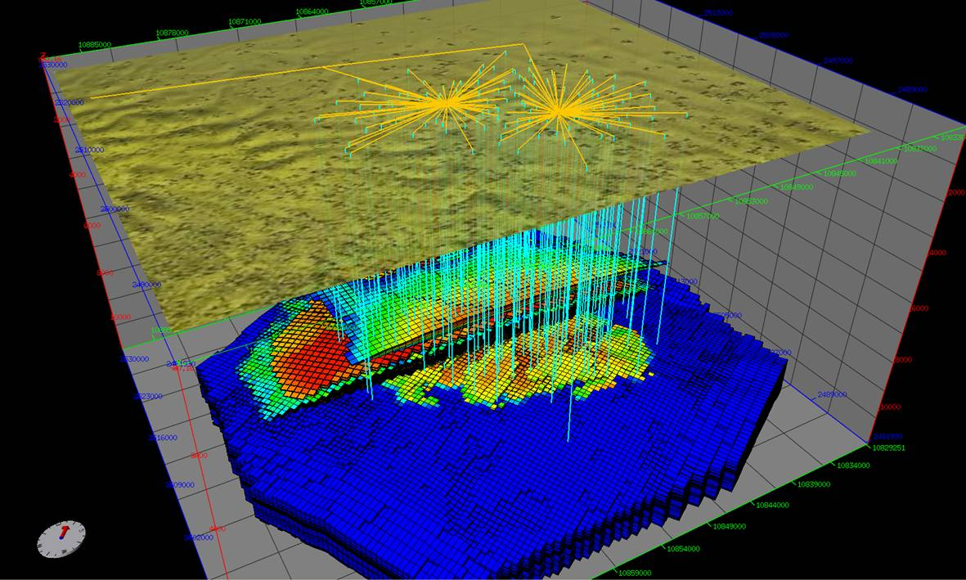

Nexus Reservoir Simulation
Next Generation Reservoir Simulation

Slide 12
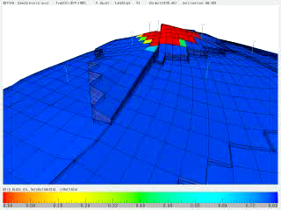
Petroleum Reservoir Simulation

Slide 13
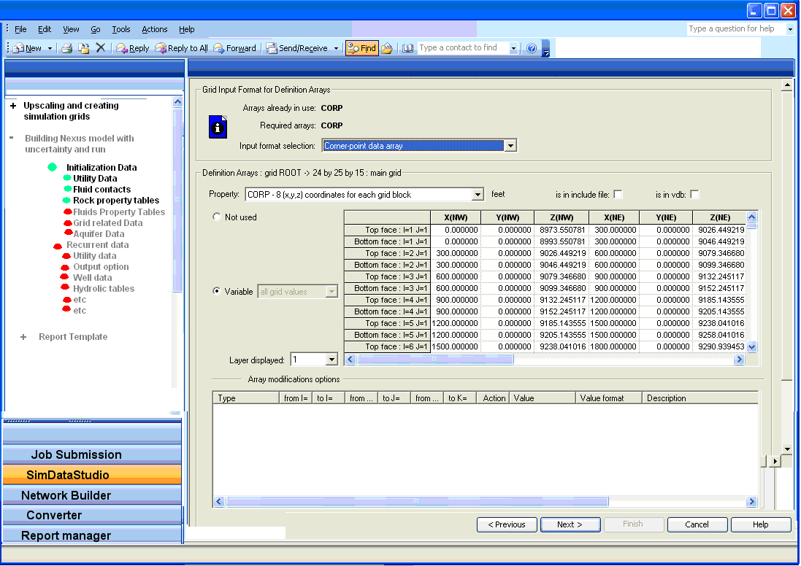
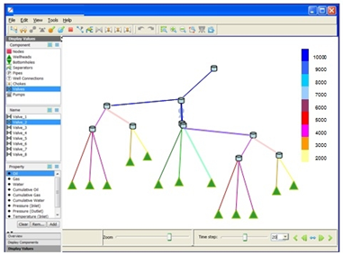
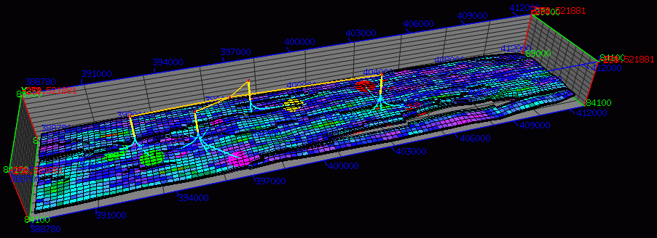
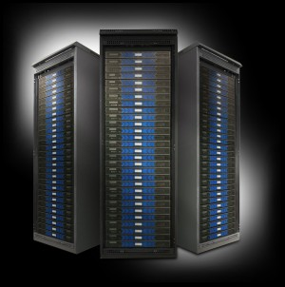
System Workflow
User Interface
Graphical Pre-Processing
3D Vizualization
High Performance Cluster

Slide 14
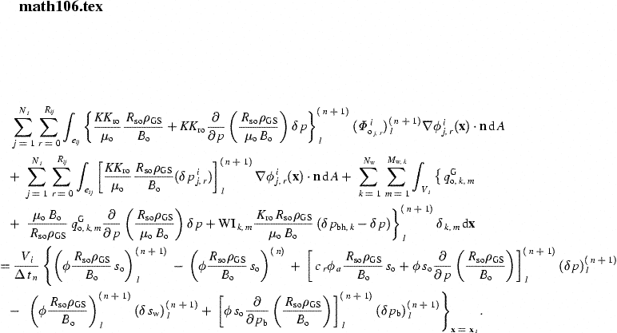

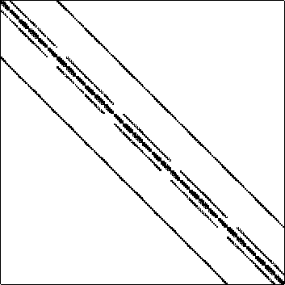
Computing
Challenges
Not Rocket Science!
Some Simulations take hours or even days, or even …
Our Testers were Petroleum Engineers, not Test Automation Specialists
Numerical Simulation is an approximation and as such is subject to round-off and/or perturbation differences

Slide 15




Managing the Coming Storm
Inside the Tornado
Project Kickoff
When will we get the requirements?
All in good time, my little pretty, all in good time
But I guess it doesn't matter anyway
Just give me your estimates by this afternoon
Team Unity
Not so fast! Not so fast! ... I'll have to give the matter a little thought. Go away and come back tomorrow
No, we need something today!
Ok then, it will take 2 years.
No, we need it sooner.
Doesn't anybody believe me?
I already promised the customer it will be out in 6 months
You're a very bad man!
Notes:
We look at a typical software project…..

Slide 16


We’re not in Kansas Anymore
Developer Hero
I may not come out alive, but I'm goin' in there!
Reorg
The Great and Powerful Oz has got matters well in hand.
My! People come and go so quickly here!
Testing
"Hee hee hee ha ha! Going so soon? I wouldn't hear of it! Why, my little party's just beginning!

Slide 17
We had a quality problem
Too many defects found in beta
Too much back end testing
Not getting sufficient coverage early
Tests take a long time
Global shortage of Petroleum Engineers
Our testers do not have automation skills
Limited unit tests
Approximation breaks abstraction

Slide 18
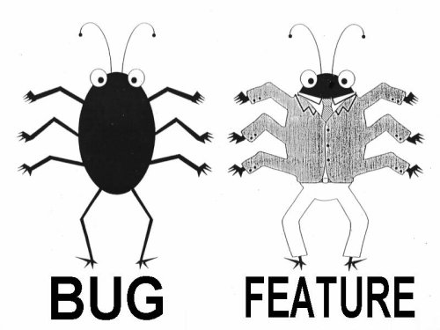
Lan Cao - Estimating Agile Software Project Effort: An Empirical Study
2X
Uncertainty
Notes:
Lessons learned: If uncertainty is high, work on it earlier. Reduce Technical Debt—Get to potentially shippable at each iteration. Finding and fixing the last bugs has high uncertainty – plan on there being uncertainty.

Slide 19
Our Strength(s)
Experienced and committed team
Passionate about the domain
Good collection of lightweight integration tests
Developer discipline
Excellent collaborative relationship with customers
Access to challenging customer data
Willingness to invest

Slide 20
Executive Perspective
Problem:
  A 5 year arrangement with an offshore outsourcer had not progressed as rapidly as Sr. Executives had hoped
Executive Mandate:
  Find a major outsourcer that will promise that they will provide good talented developers and strong domain experts.

Slide 21
Results With major Indian Outsourcer
Could not find domain expertise (Petroleum Reservoir Simulation).
  Join and Jolt – 3 times. Then finally hire Petroleum Engineer that was pretty good. Lasted 2 months.
Made very little progress in 12 months

Slide 22
Why Domain Matters - Dialog
PO Story: As a user a I need a flimflam so I can flam the flim.
Remote Dev: WTF is a flimflam?
Remote Team: IDK. Let’s send a query to PO and Dev Lead.
Dead Time
Dev Lead or PO: Crap! I need to write every little detail about a flimflam.

Slide 23
The next day….or maybe later
PO Story: much more detail about the flimflam
Remote Dev: Now I get it. I can start designing and coding.
I wonder what they mean by the flimflam must have a whatchamacallit?
Remote Team: WTF is a whatchamacallit? Better ask the PO or Dev Lead.
Dead Time
Dev Lead or PO: Crap!

Slide 24
Our Proposed Solution
Understand our current testing strategy and look to fill in gaps and automate where possible.
Augment current team with global teams with the appropriate domain experience and full autonomy to do their job
Find partners to augment missing skills
  Romania (Petroleum Engineers/Software Developers)
  Vietnam (Test Automation specialists)

Slide 25
System Workflow
User Interface
Graphical Pre-Processing
Graphical Post-Processing
High Performance Cluster

Slide 26
Test Automation Workflow
Input
Simulate
Output
Difference Engine
Report
Baseline

Slide 27
Testing and Automation Strategy
Customer Models
Weekly
Complexity of Tests
Smoke Tests (manual)
Nightly
Every Checkin
Developer Tests
Breadth of Coverage

Slide 28
Testing and Automation Strategy
Customer Models
Weekly
Gap
Complexity of Tests
Smoke Tests (manual)
Nightly
Every Checkin
Developer Tests
Breadth of Coverage

Slide 29
Testing and Automation Strategy
Customer Models
Weekly
Nightly
Complexity of Tests
Mid-Tier Tests
GUI Tests (automated)
Smoke Tests (manual)
Nightly
Developer Tests
Every Checkin
Breadth of Coverage

Slide 30
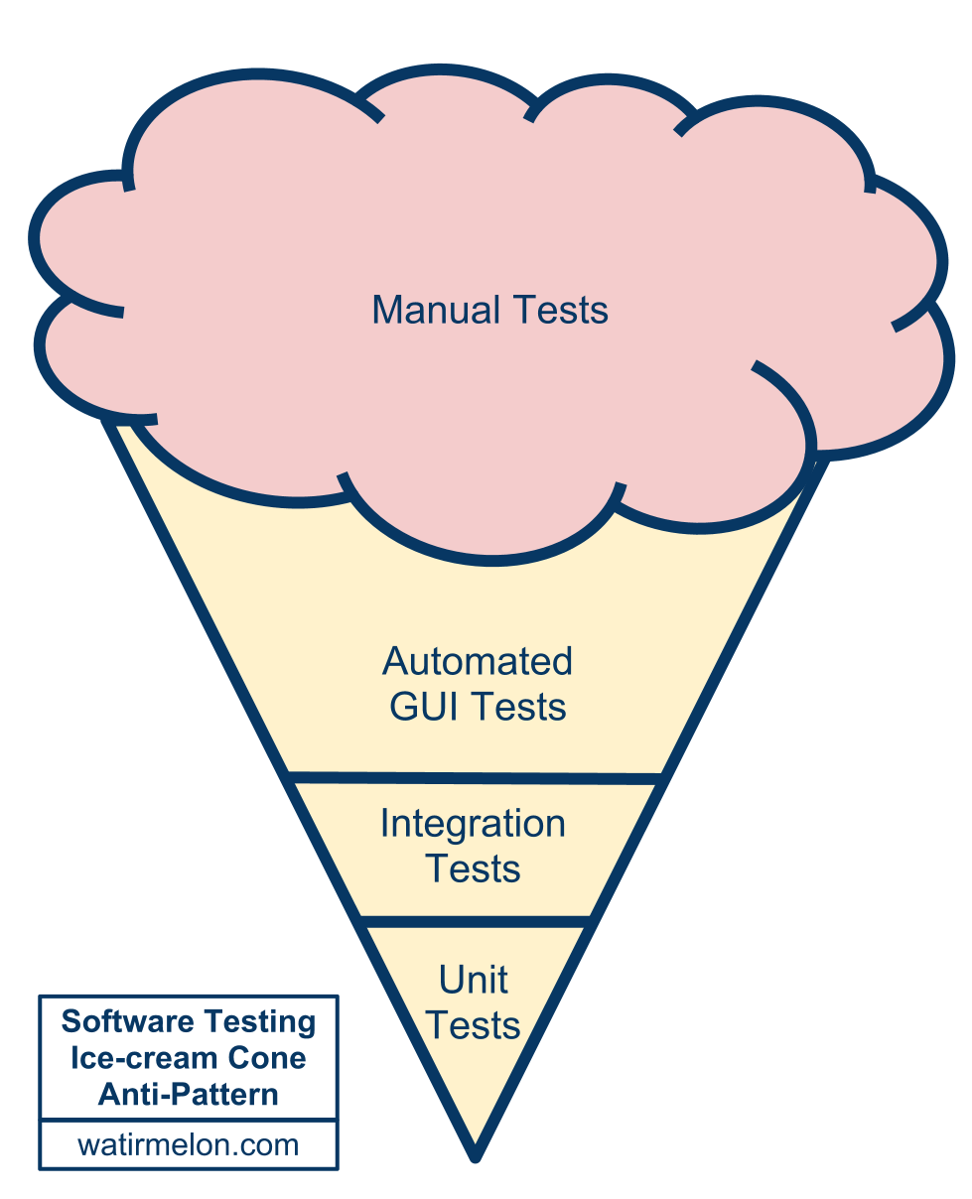
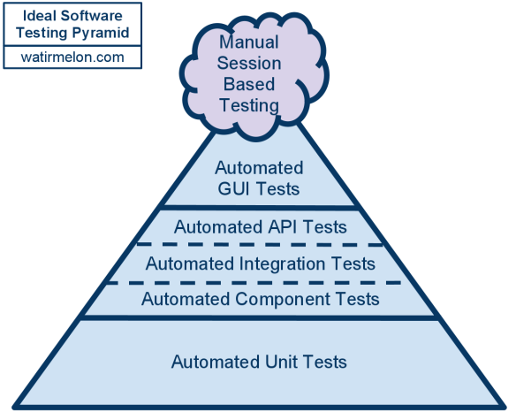
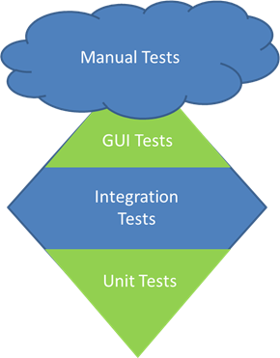
Testing Pyramids

Slide 31
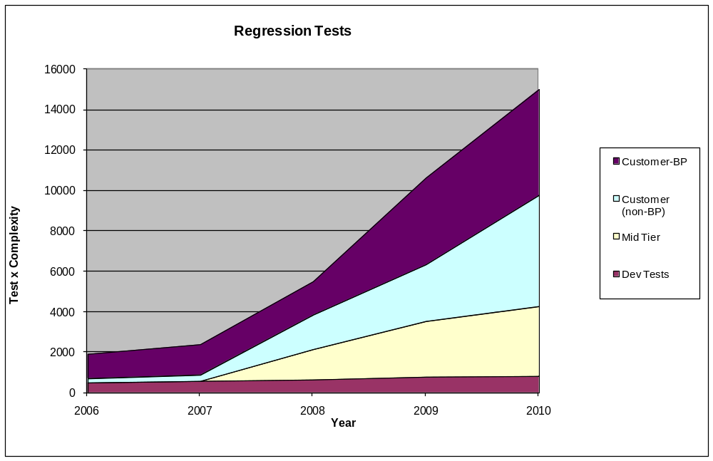
Simulator Regression Tests over time
Customer X
Customer Other

Slide 32
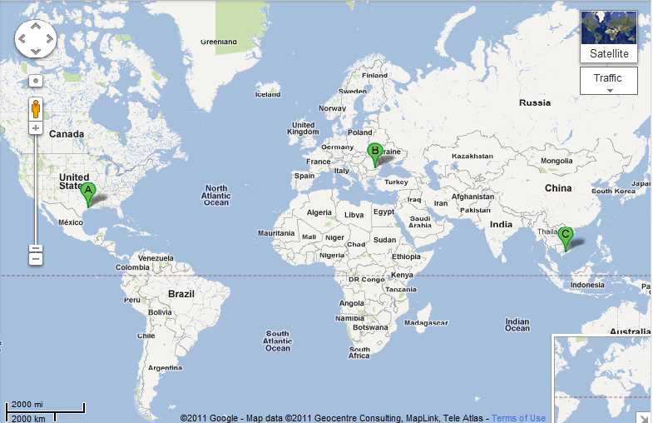


Global Expertise
(Houston, Bucharest, Ho Chi Minh City)
3 Dev
3 PE Test
15 Dev
6 PE Test
2 Pgm Mgr
2 Prod Mgr
4 Auto Test

Slide 33
Working with Partners
Romania
  3 Software Developers
  3 Reservoir Simulation Experts
  Owner was Professor of Reservoir Simulation
  Communicated in the language of reservoir simulation
Vietnam
  4 automation test experts
  Specialized in Action Based Testing
  Communication from domain experts (US and Romania) via Camtasia videos.
3 Dev
3 PE Test

Slide 34
Why Domain Matters – Alternate Universe
PO Story: As a user a I need a flimflam so I can flam the flim.
Remote PE: Why do you want to flam the flim?
PO: So that the flim will flam properly
Remote Team: So you’re probably thinking you need a whatumacallit?
PO: That’s right.
Remote Team: Well have you considered a yazamazig? That might work better

Slide 35
The Bottom Line
97% Reduction

Slide 36

Distributed and Offshore Teams

Slide 37
Autonomy and Alignment

Slide 38
Control Systems
Processes
Inputs
Inputs
Inputs
Command & Control
Processes
Inputs
Inputs
Inputs
Agile Leadership
Outputs

Slide 39

Outsourcing/Distributed Challenges

Slide 40
















Outsourcing Challenge: Proprietary Data

Slide 41
Distributed Challenge: Time Shift
8 hours
12 hours

Slide 42
Distributed Challenge: Time Shift
8 hours
12 hours

Slide 43
Distributed Challenge: Time Shift
8 hours
12 hours

Slide 44


Distributed Challenge: Xenophobia

Slide 45

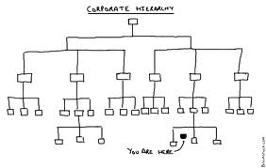
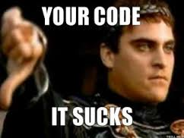
Outsourcing Challenge: Transparency and Honesty

Slide 46
Key Take Aways
  Software Quality
  Build Quality in
  Find and Correct Defects Early to Reduce Uncertainty
  A Testing Strategy Helps to Maximize Efficiency
  The Integration layer is critical – Test Diamond
  Test Automation Helps to Maintain Velocity
  Test Automation Does not Replace Exploratory Testing
  Action Based Testing Reduces Test Brittleness
  Distributed Teams
  Distributed Teams Can be Effective
  Complete teams needed for Autonomy
  Treat Outsourcer as a Partner
  Distributed Teams are Reality -- Leverage Global Talent

Slide 47
Think Globally and Optimize the Whole

Slide 48

Contact
Todd Little
  toddelittle@gmail.com
  @toddelittle
  www.toddlittleweb.com
  www.accelinnova.com
May the Force Be With You

