Slide 1
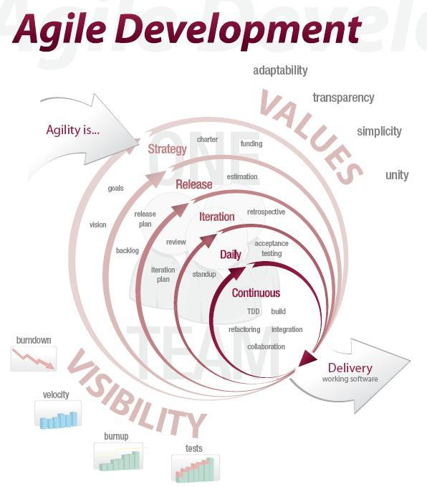
Agile Test Automation & Outsourcing
Todd Little
Sr. Development Manager, Landmark/Halliburton
Notes:
Over the past 3 years Landmark has been incorporating Agile methodologies in our development processes.

Slide 2






Landmark Software and Services
Reservoir /
Fluid data
Production data
Geophysics
Engineering
Seismic data
Structural /
Stratigraphic data
Common Model
Representation
Common Model
Representation
Velocity data
Well data
Geology

Slide 3




A typical software project
Project Kickoff
When will we get the requirements?
All in good time, my little pretty, all in good time
But I guess it doesn't matter anyway
Just give me your estimates by this afternoon
Team Unity
Not so fast! Not so fast! ... I'll have to give the matter a little thought. Go away and come back tomorrow
No, we need something today!
Ok then, it will take 2 years.
No, we need it sooner.
Doesn't anybody believe me?
I already promised the customer it will be out in 6 months
You're a very bad man!
Notes:
We look at a typical software project…..

Slide 4


We’re not in Kansas Anymore
Developer Hero
  I may not come out alive, but I'm goin' in there!
Reorg
  The Great and Powerful Oz has got matters well in hand.
  My! People come and go so quickly here!
Testing
  "Hee hee hee ha ha! Going so soon? I wouldn't hear of it! Why, my little party's just beginning!

Slide 5
Hurricane Rita
Notes:
The actual path of Rita is shown in yellow. Planning of software is much like this. Almost everything we do is “new” and when we followed a more waterfall model, we took lots of time designing and gathering estimates of tasks before starting. From that initial Plan, the one thing we really knew, was that the project would not turnout looking like the plan and it would change. We know that as we gain more knowledge during development the plan would be refined many times. So, with Agile, we don’t spend a lot of time in upfront planning.

Slide 6
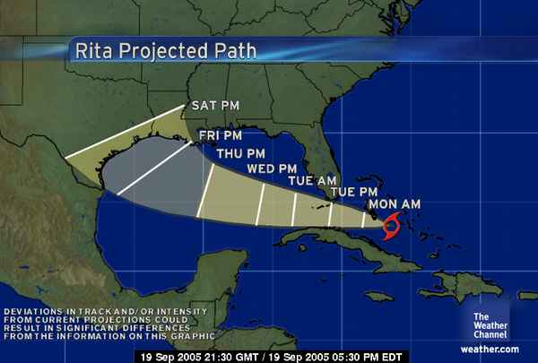
Uncertainty
We expect uncertainty and manage for it through iterations, anticipation and adaptation.
Inspect and Adapt

Slide 7

Test Automation is the Safety Net

Slide 8
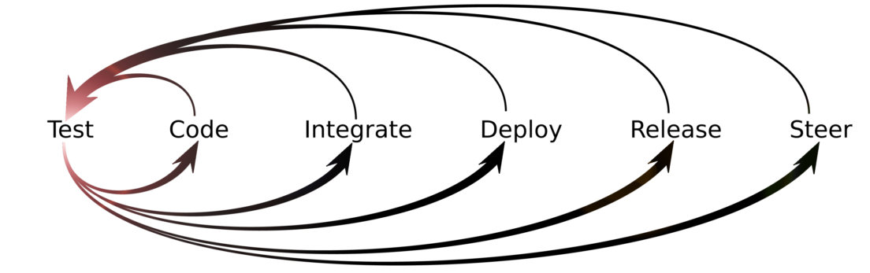
Designing Quality into the Solution
Acceptance
Tests
UI
Integration
Tests
Business Layer
Unit Tests
Unit Tests
Unit Tests
Class
Class
Class
Notes:
Let me talk briefly about testing. Testing and quality is part of everyone’s job. With Agile, developers design in unit tests for the new functionality. These unit tests are typically based on the acceptance criteria that are set down for each story. These unit tests are run with each nightly build of the product.

Slide 9
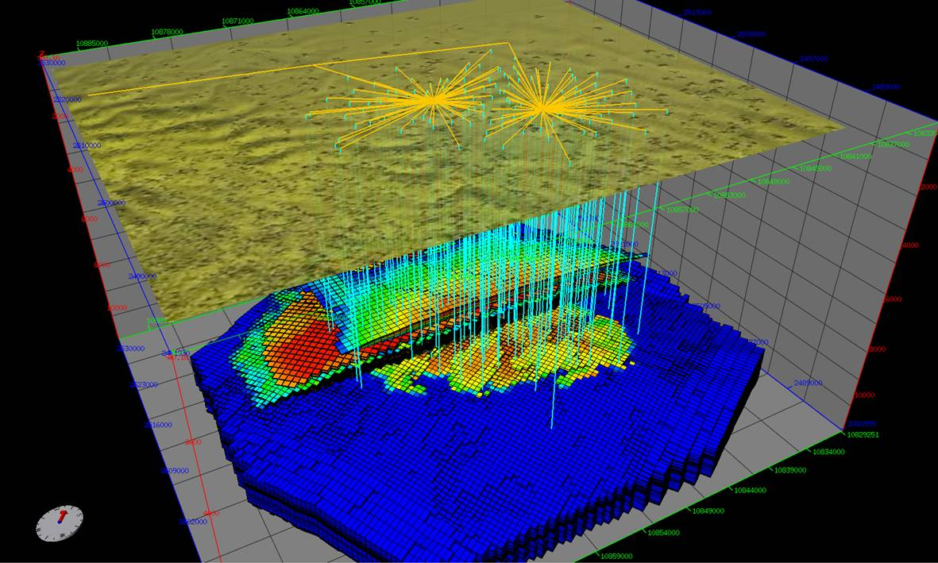
Nexus Reservoir Simulation
Next Generation Reservoir Simulation

Slide 10
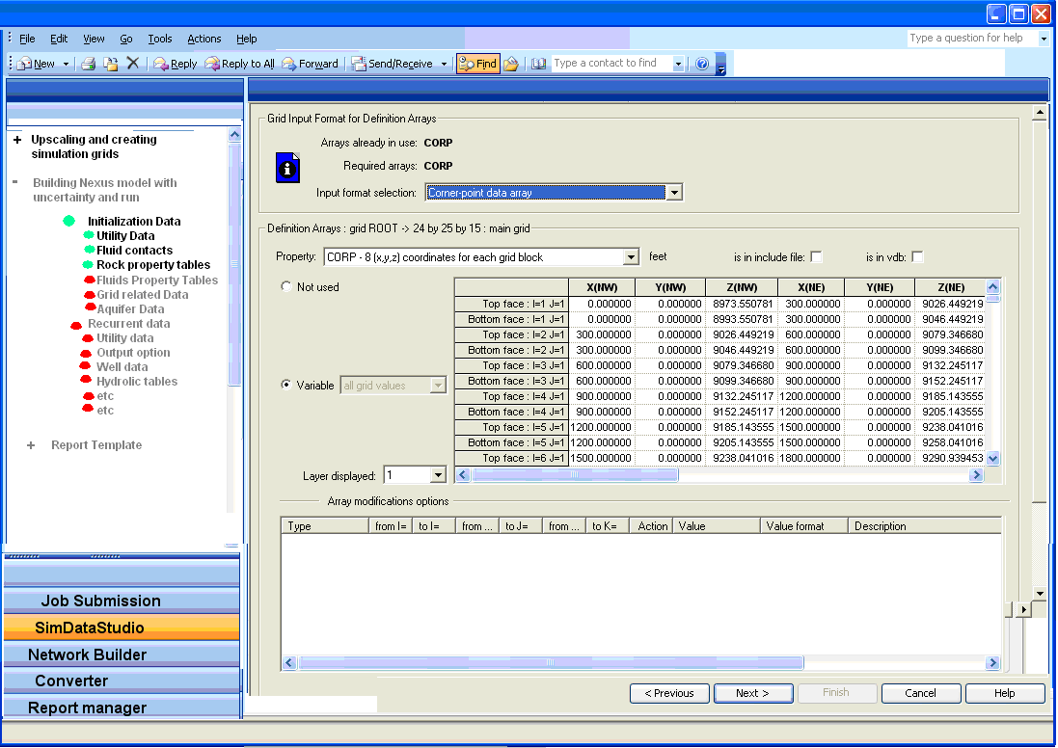
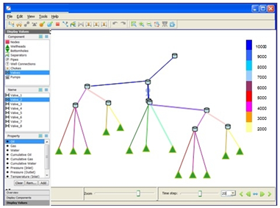
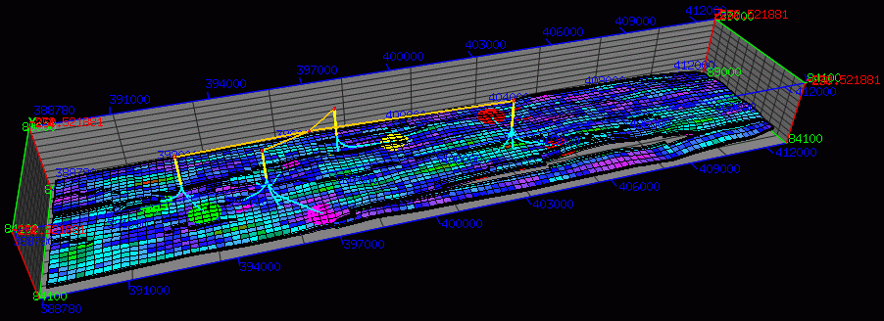
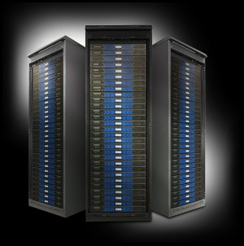
System Workflow
User Interface
Graphical Pre-Processing
Graphical Post-Processing
High Performance Cluster

Slide 11
Challenges
Some Simulations take hours or even days
Our Testers are Petroleum Engineers, not Test Automation Specialists
Numerical Simulation is an approximation and as such is subject to round-off and/or perturbation differences

Slide 12
System Workflow
User Interface
Graphical Pre-Processing
Graphical Post-Processing
High Performance Cluster

Slide 13
Test Automation Approach
Customer Models
Weekly
Complexity of Tests
Nightly
Mid-Tier
GUI Tests (automated)
Smoke Tests (manual)
Nightly
Developer Tests
Every Checkin
Breadth of Coverage

Slide 14
Simulator Regression Tests over time
Customer X
Customer Other

Slide 15
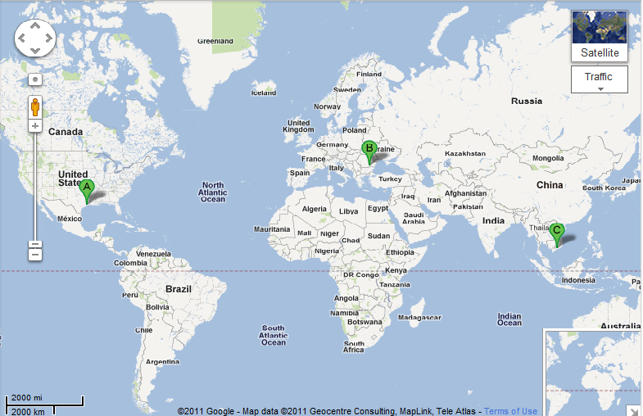


Global Expertise
(Houston, Bucharest, Ho Chi Minh City)
3 Dev
3 PE Test
18 Dev
8 PE Test
4 Auto Test

Slide 16
The Bottom Line

Slide 17

Leverage Global Talent

Slide 18

Think Globally and Optimize the Whole

Slide 19
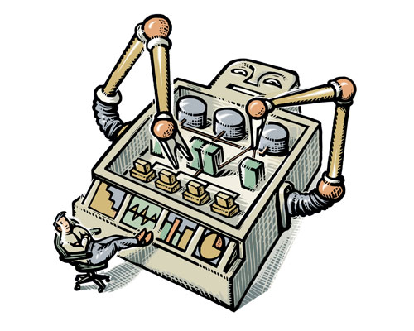
Automate – Automate - Automate

Slide 20
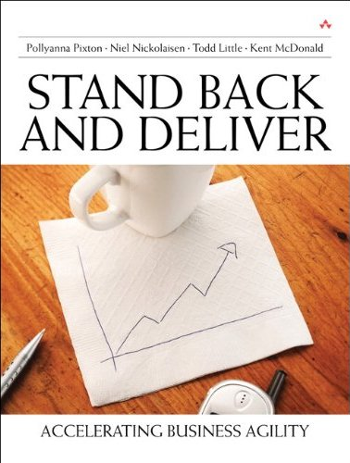
Contact
Todd Little
  tlittle@lgc.com
  www.toddlittleweb.com
Joe Hughes
  joeh@logigear.com
  www.logigear.com

