Slide 1
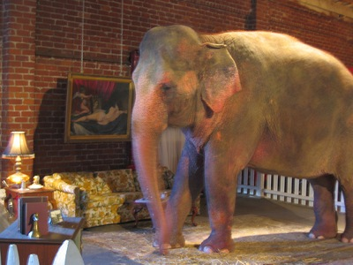
Elephants in the Agile Room

Slide 2

Reflections on 10 Years of Agility
Todd Little
Sr. Development Manager
Landmark Graphics

Slide 3
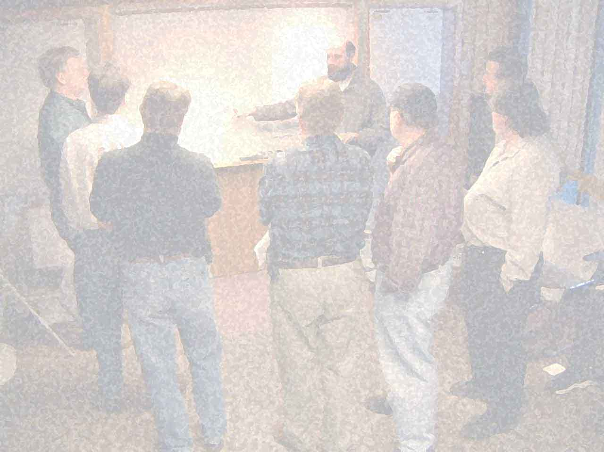
Manifesto for Agile Software Development
We are uncovering better ways of developing
software by doing it and helping others do it.
Through this work we have come to value:
Individuals and interactions over processes and tools
Working software over comprehensive documentation
Customer collaboration over contract negotiation
Responding to change over following a plan
That is, while there is value in the items on
the right, we value the items on the left more.
Kent Beck Mike Beedle Arie van Bennekum Alistair Cockburn Ward Cunningham Martin Fowler | James Grenning Jim Highsmith Andrew Hunt Ron Jeffries Jon Kern Brian Marick | Robert C. Martin Steve Mellor Ken Schwaber Jeff Sutherland Dave Thomas

Slide 4
Manifesto for Agile Software Development
We are uncovering better ways of developing
software by doing it and helping others do it.
Through this work we have come to value:
Individuals and interactions over processes and tools
Working software over comprehensive documentation
Customer collaboration over contract negotiation
Responding to change over following a plan
That is, while there is value in the items on
the right, we value the items on the left more.
Kent Beck Mike Beedle Arie van Bennekum Alistair Cockburn Ward Cunningham Martin Fowler | James Grenning Jim Highsmith Andrew Hunt Ron Jeffries Jon Kern Brian Marick | Robert C. Martin Steve Mellor Ken Schwaber Jeff Sutherland Dave Thomas

Slide 5
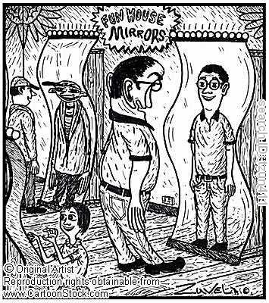
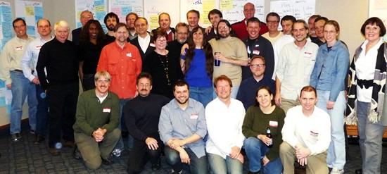
The Mirror at Snowbird February 12th, 2011

Slide 6
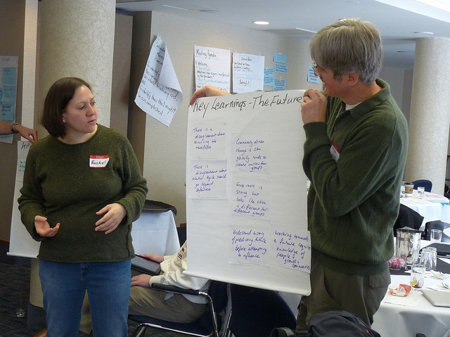
The Retrospective and the Look Into the Future

Slide 7

“There’s an Elephant in the Room”
Notes:
7

Slide 8
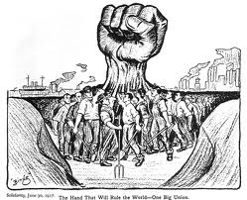

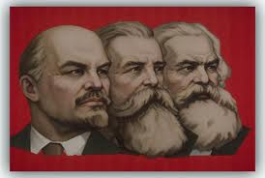
What does Community Leadership Look Like?

Slide 9
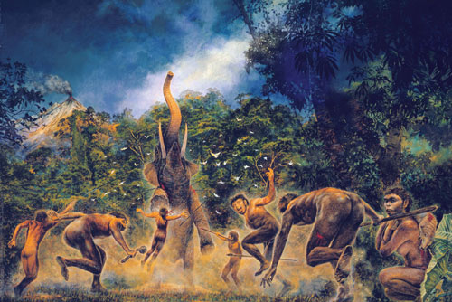
A Group of 15 Decided to Hunt Elephants

Slide 10
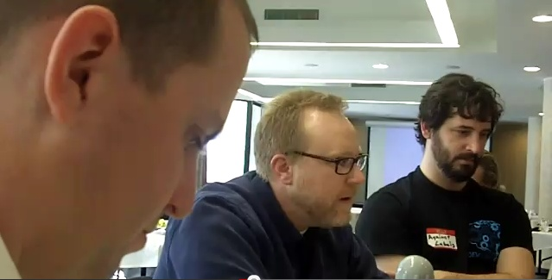
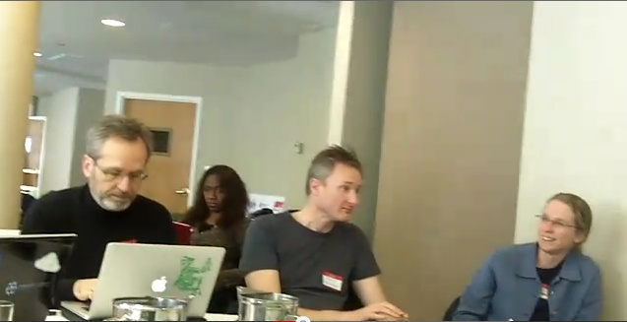
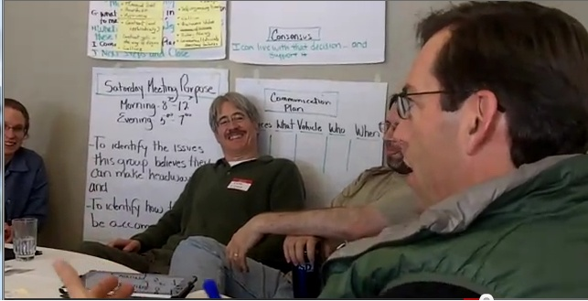
Phillipe Krutchen
Ghennipher Weeks
David Andersen
Kay Johansen
The Elephant Hunters
Erik Huddleston
Jeff Patton
Andrew Shafer
Not Pictured
Tracy Bialik
Mike Hugos
Zhon Johansen
Nate Jones
Janice Linden-Reed
Kay Johansen
Todd Little
Russ Rufer
Ryan Martens

Slide 11
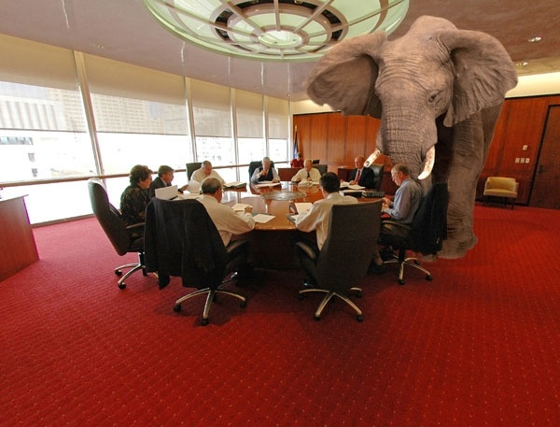

Slide 12
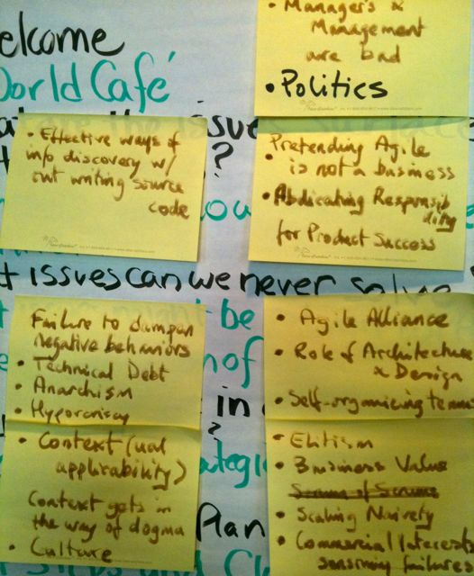
Some Elephants

Slide 13

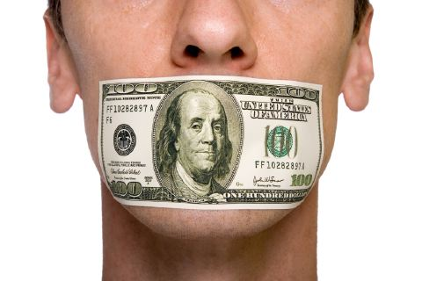
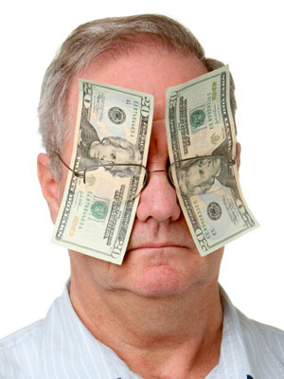

Pretending Agile is not a business
Commercial interests censoring failures
Failure to dampen negative behaviors
Dogma sells
Hypocrisy

Slide 14


Individuals and Interactions over Processes and Tools

Slide 15



Anarchism in the community

Slide 16
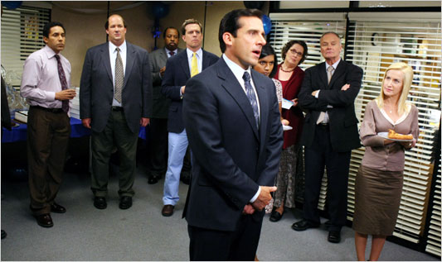
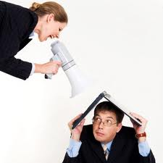
Managers are bad

Slide 17

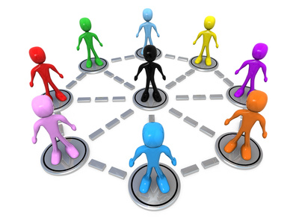
Self Organization

Slide 18





Collaboration is great, but can lead to groupthink

Slide 19
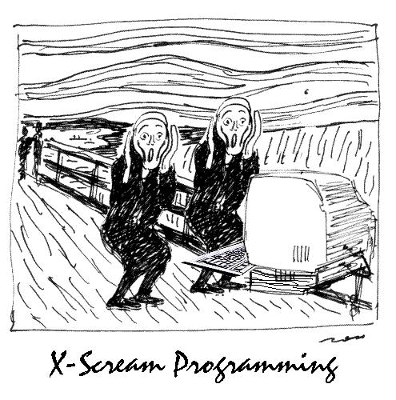

Slide 20
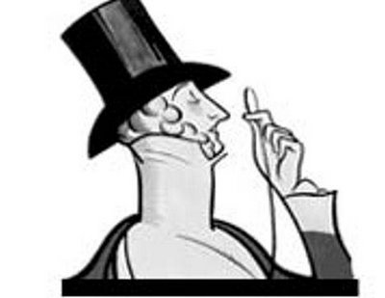

Elitism as an Excuse for Failures

Slide 21


Distributed Teams are a Reality

Slide 22
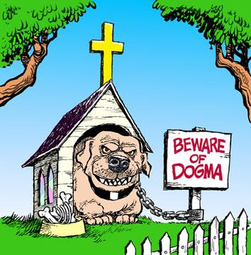


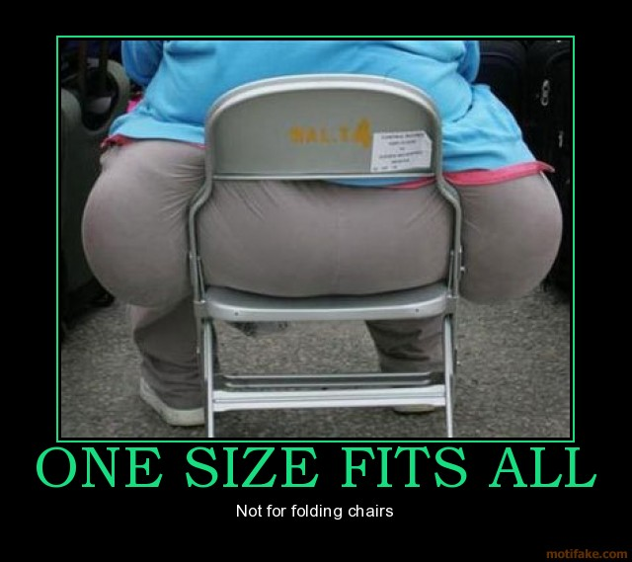
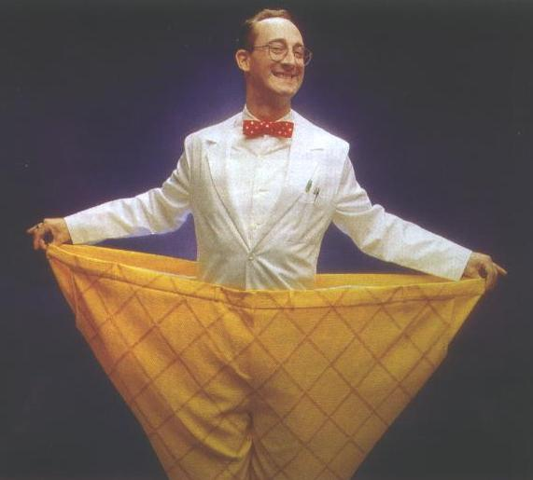
Context gets in the way of Dogma

Slide 23

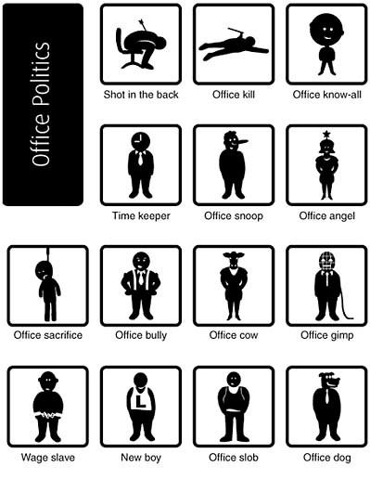

Politics are a huge cultural issue

Slide 24
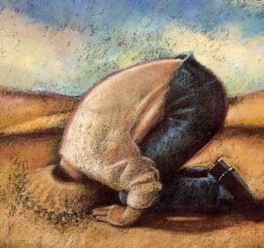

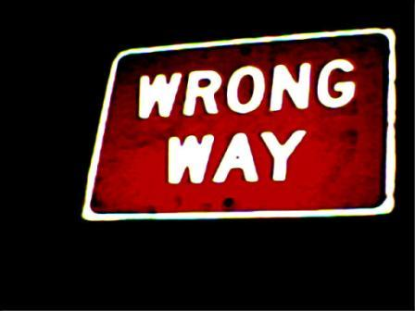
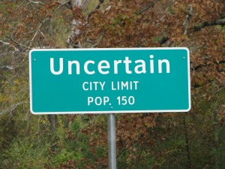
Many people would rather be wrong than uncertain

Slide 25
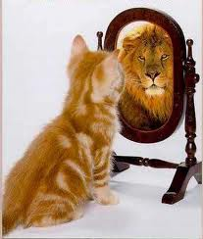
Perception Trumps Reality

Slide 26
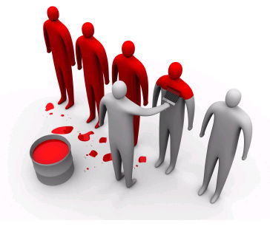
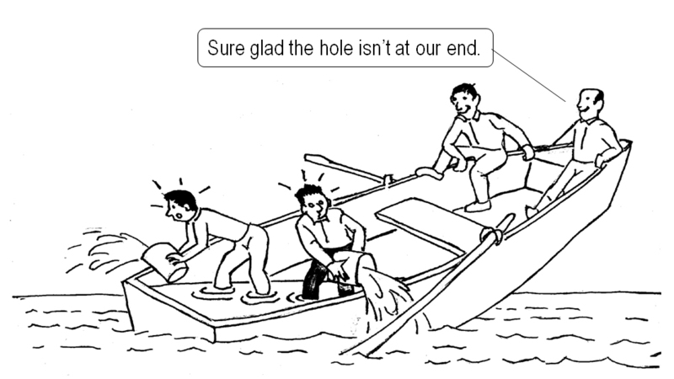
Agile needs to adopt to culture as much or more than culture needs to adopt to agility

Slide 27


The Voice of THE Customer

Slide 28
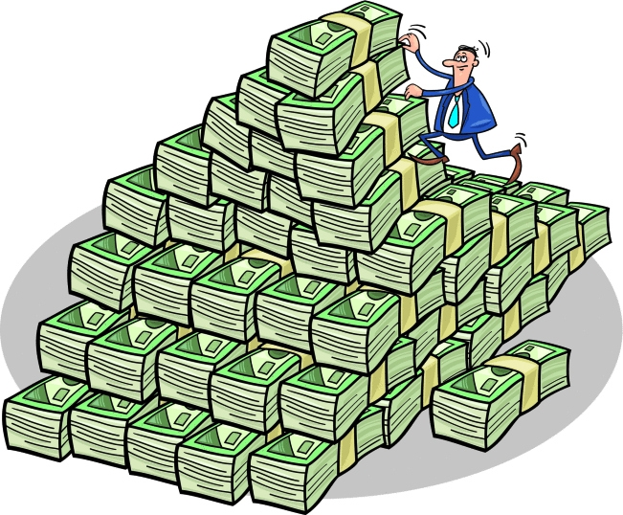
Business Value

Slide 29


Technical Excellence over Technical Debt

Slide 30
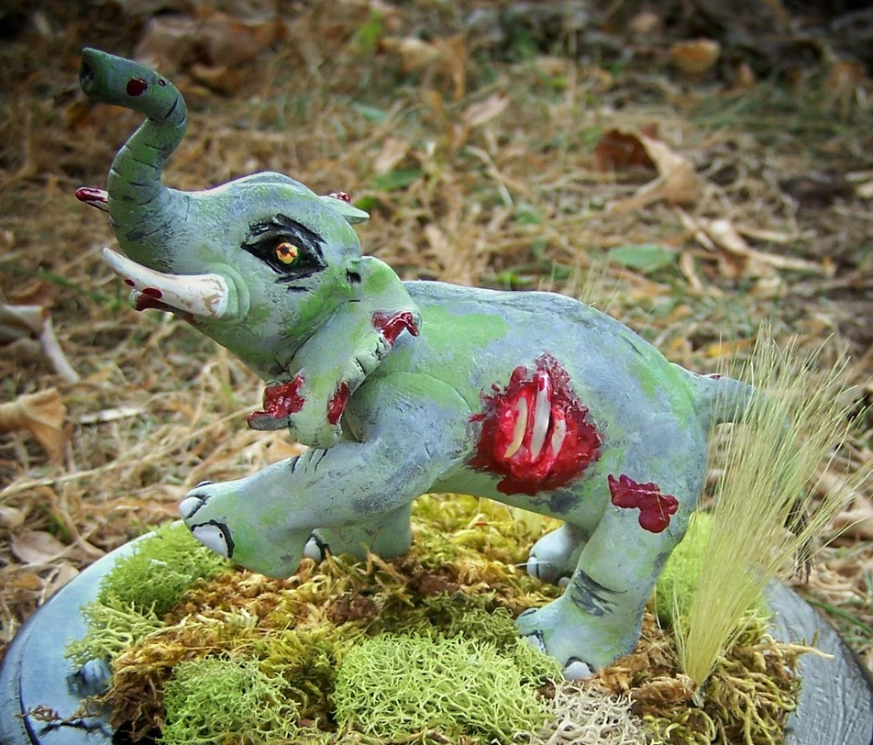
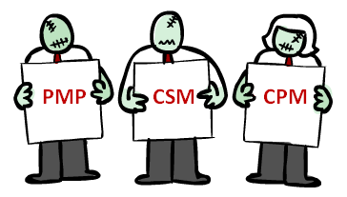



Certification (the “zombie elephant”)

Slide 31

Agile Successes!

Slide 32
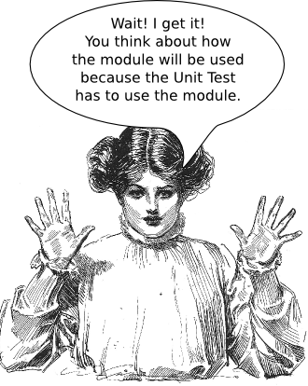
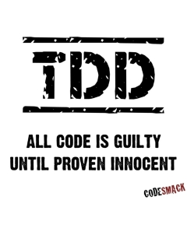
Heightened Focus on Unit Testing and Automation

Slide 33
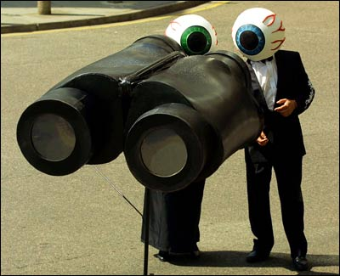
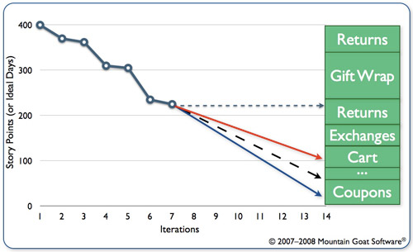
Transparency, Reporting and Tracking

Slide 34

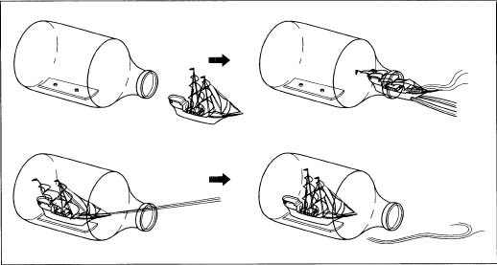
Emphasis on Shipping and Feedback

Slide 35
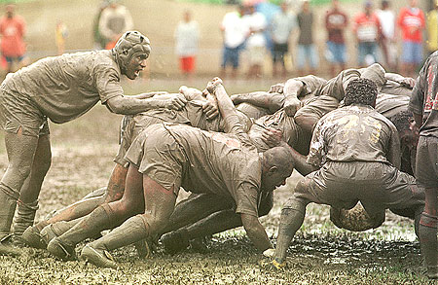
Software Development is a Team Sport

Slide 36
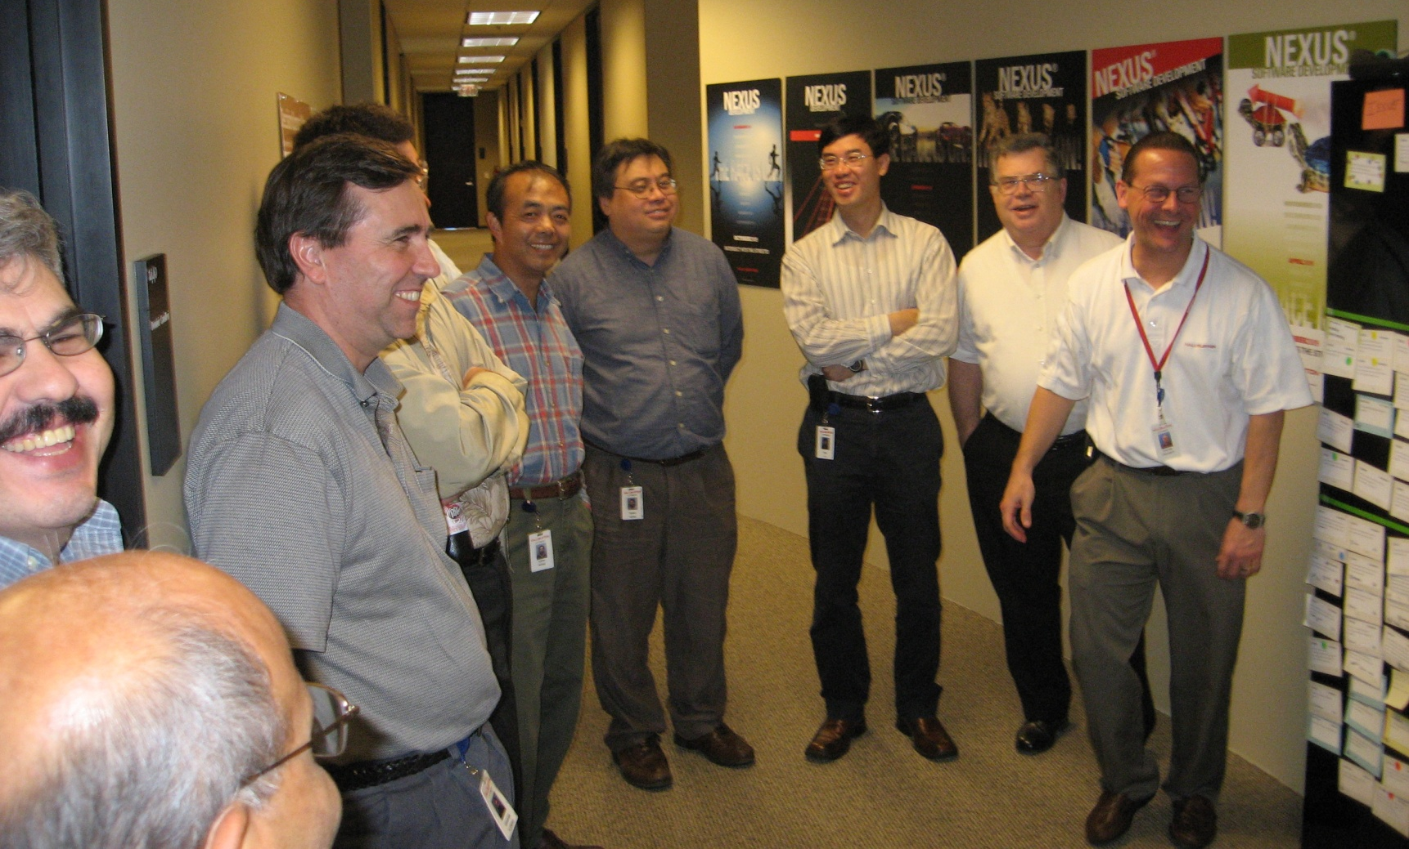
Teams are Enjoying Developing Software

Slide 37
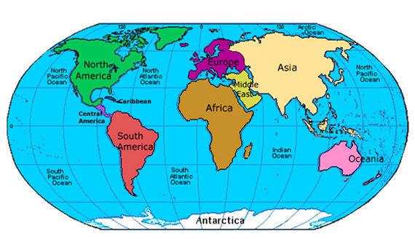
Global Spread – 91 Countries

Slide 38
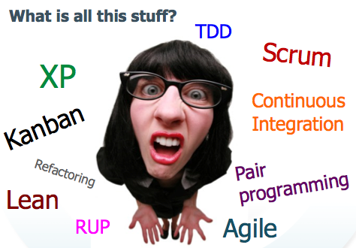
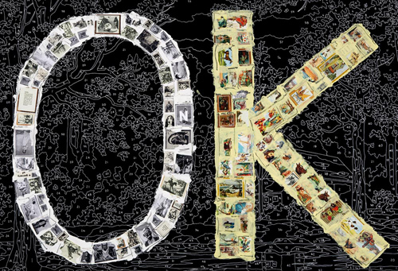
It’s OK to be Agile

Slide 39
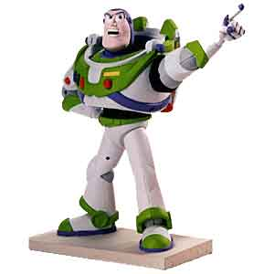
To Agility and Beyond
Four Value Propositions
Demand Technical Excellence
Promote Individual Change and Lead Organizational Change
Organize Knowledge and Improve Education
Maximize Value Creation Across the Entire Process

Slide 40
Relevant Blog Postings from the 10 Year Event
http://pkruchten.wordpress.com/2011/02/13/the-elephants-in-the-agile-room/
http://agilemanagement.net/index.php/Blog/reflections_on_10_years_of_agile/
http://www.dennisstevens.com/2011/02/13/whats-next-for-the-agile-manifesto/

Slide 41


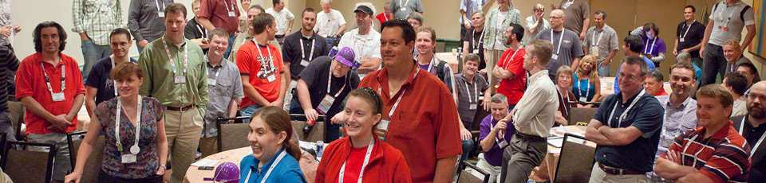
Join us as we continue the conversations

Slide 42
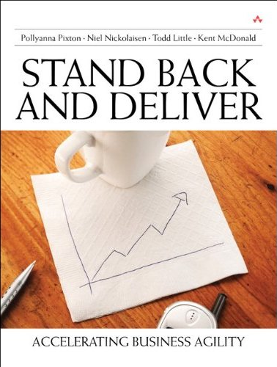
Contact
Todd Little
  tlittle@lgc.com
  www.toddlittleweb.com
Notes:
42

