Slide 1
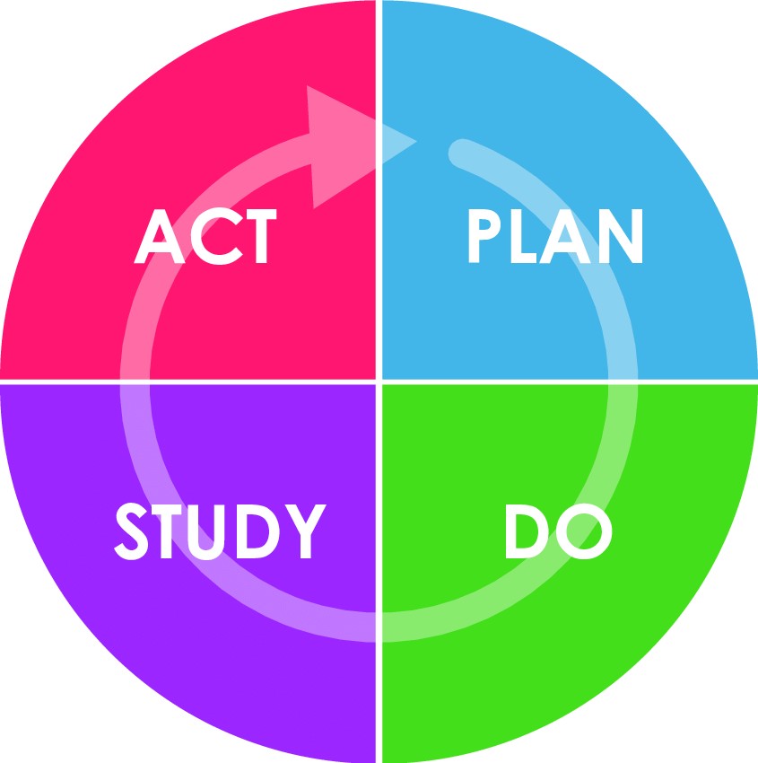
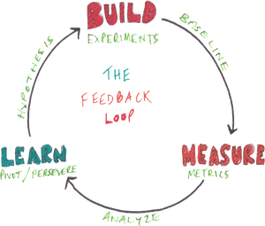
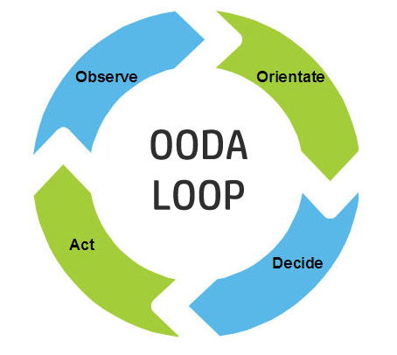
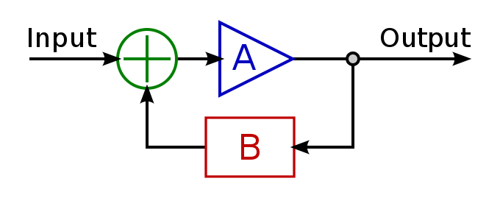
Foundation of Business Agility: Feedback Loops
Todd Little

Slide 2
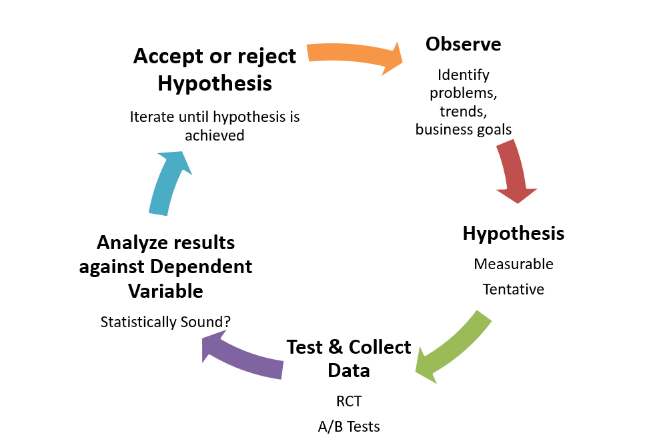
The Scientific Method

Slide 3
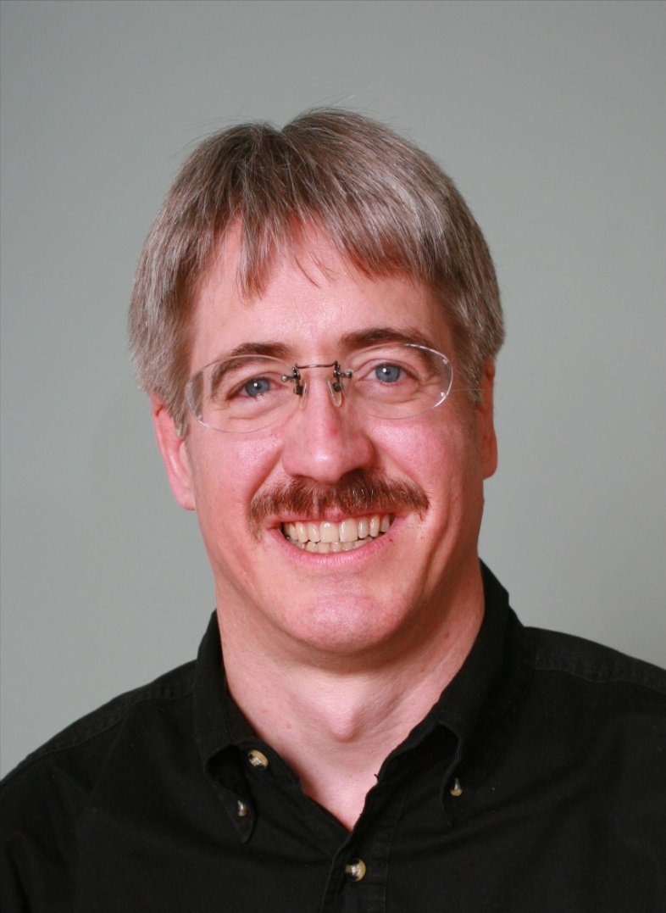




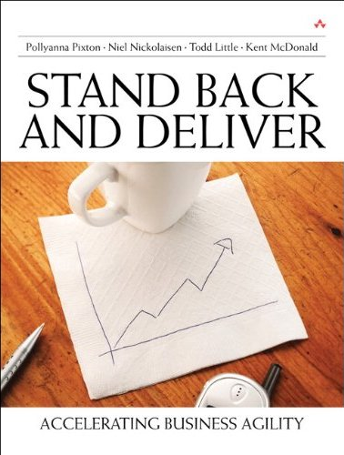

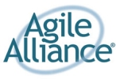

About Todd
Chemical and Petroleum Engineer
Executive roles as VP Product Development, Director of Software & Technology
@toddelittle

Slide 4
What is Business Agility?

Slide 5
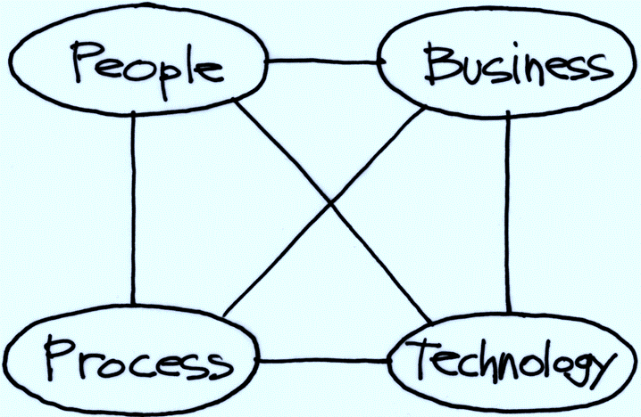
Business Agility
Where business agility generally is
I have come to value business agility over Agile transformations
Where many agile transformations focus

Slide 6

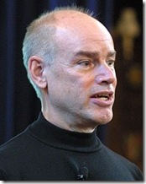
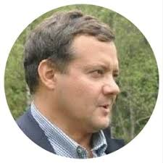
Empirical Process Control

Slide 7

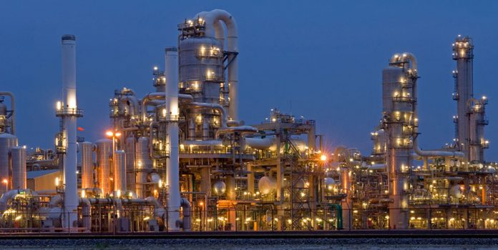

Slide 8
Control Systems
Processes
Inputs
Inputs
Inputs
Open
Loop
Processes
Inputs
Inputs
Inputs
Closed
Loop
Outputs

Slide 9
Open Loop Control
Desired Output Response
Controller
Process
Output

Slide 10
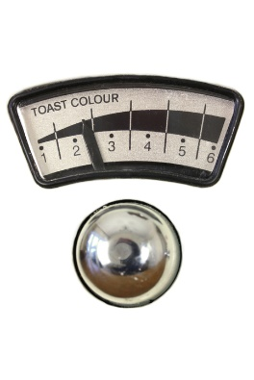

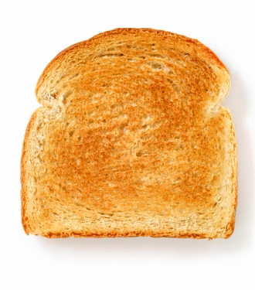
Open Loop Control
Desired Output Response

Slide 11
Open Loop Control
Speak
Mic
Amplifier
Sound

Slide 12
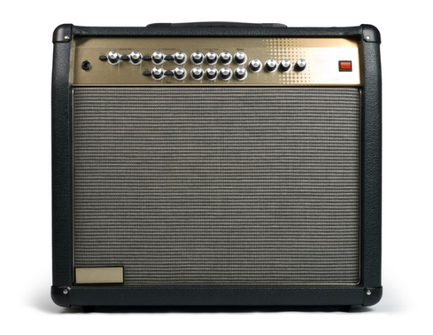

Open Loop System
Speak

Slide 13
Reinforcing Feedback
Speak

Slide 14
Closed Loop Control (Balancing Feedback loop)
Deviation from desired state
Assessment
Actual Output
+
+
Corrective Action
Process
-
Sensor
Feedback Signal

Slide 15
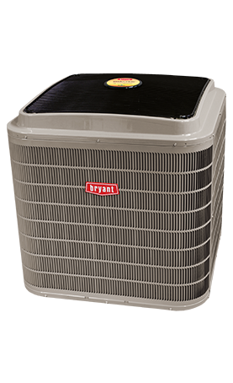
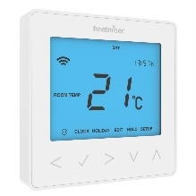
Closed Loop Control Example
Deviation from desired state
Assessment
Actual Output
+
+
Turn on or off
-
Temperature
Feedback Signal

Slide 16

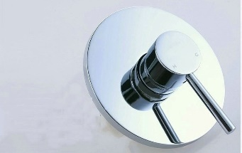
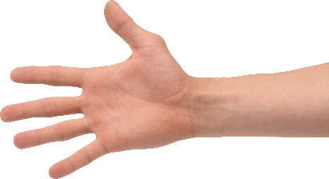
Shower Control System
Deviation from desired state
Adjust
Assessment
Actual Output
+
+
-
Feedback Signal
Temperature

Slide 17
Shower Control System
Deviation from desired state
Adjust
Assessment
Actual Output
+
+
-
Feedback Signals
Temperature
Flow Rate

Slide 18
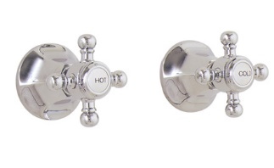
Shower Control System
Deviation from desired state
Adjust
Assessment
Actual Output
+
+
-
Feedback Signals
Temperature
Flow Rate

Slide 19
Closed Loop Control (Feedback loop)
Deviation from desired state
Assessment
Actual Output
+
+
Corrective Action
Process
-
Sensor
Feedback Signal

Slide 20
Observe-Orient-Decide-Act (John Boyd)

Slide 21
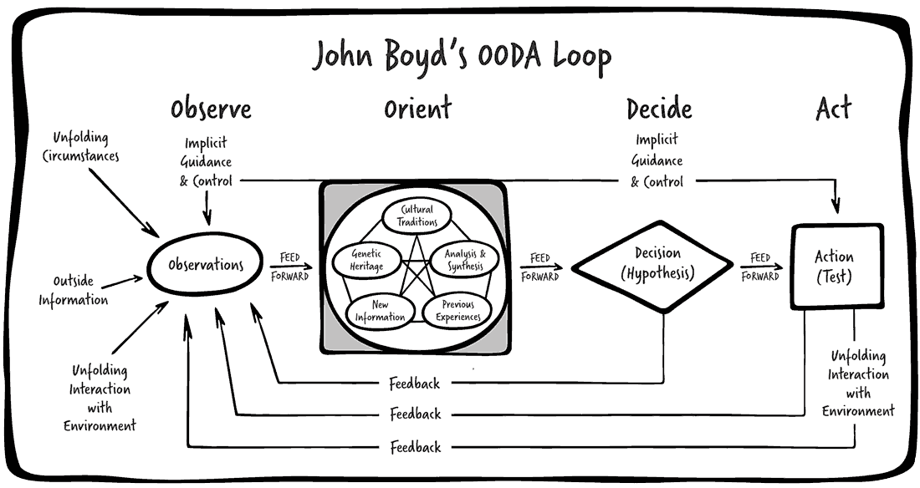

Slide 22
Complex Control System
Desired Output Response
Controller
Process
Output Variables
Measurement
Multi Input Multi Output (MIMO) System

Slide 23
Control System Classification
Adjust Scope
Adjust Date
Adjust Team
Adjust Quality
Adjust Process
Desired Output Response
Controller
Process
Output Variables
Value
Schedule
Cost
Quality
Measurement
Multi Input Multi Output (MIMO) System

Slide 24
Lockdown
Desired Output Response
Controller
Process
Output Variables
Value
Schedule
Cost
Quality
Measurement
Multi Input Multi Output (MIMO) System

Slide 25
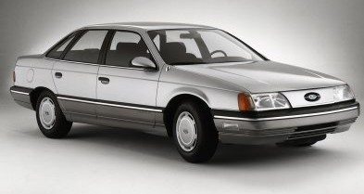
Delivery Goals

Slide 26

Calendar of Innovation

Slide 27
Open Loop?
Desired Output Response
Controller
Process
Output Variables
Value
Schedule
Cost
Quality
Measurement
Multi Input Multi Output (MIMO) System

Slide 28
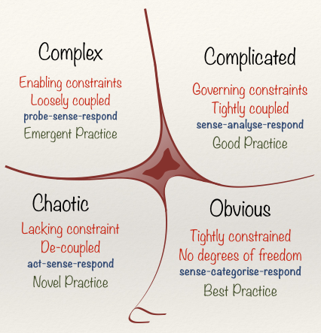
Cynefin Framework(Snowden)

Slide 29
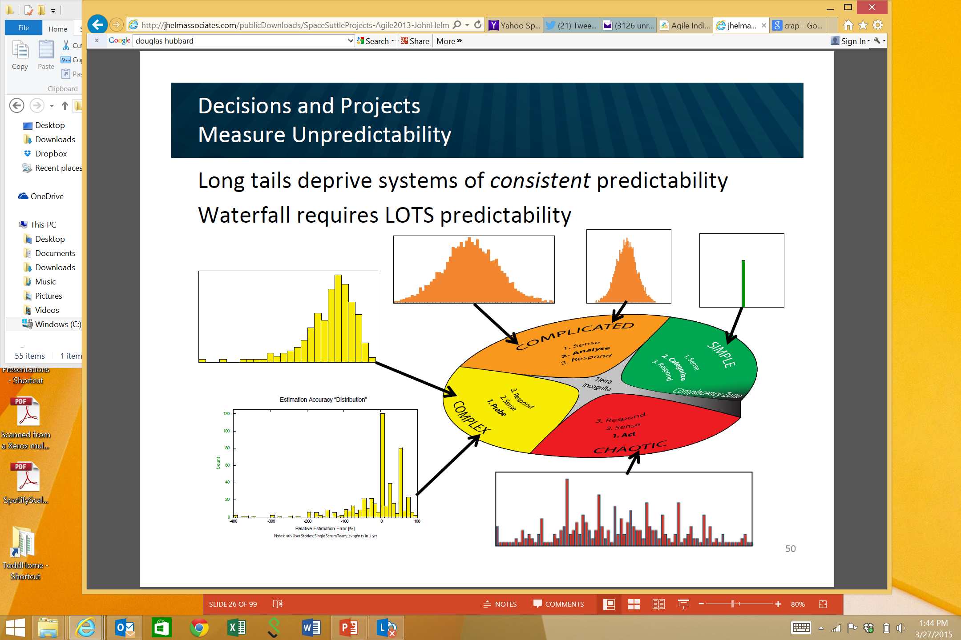
Obvious
Distribution
Input
Output
Cause and Effect Obvious to all
Known - Knowns
Sense - Categorize - Respond
apply best practice
Example: Manufacturing

Slide 30
Complicated
Analysis
Input
Output
Distribution
Cause and Effect Requires Analysis
Known - Unknowns
Sense - Analyze – Respond
apply good practice
Example: Incremental Product Development

Slide 31
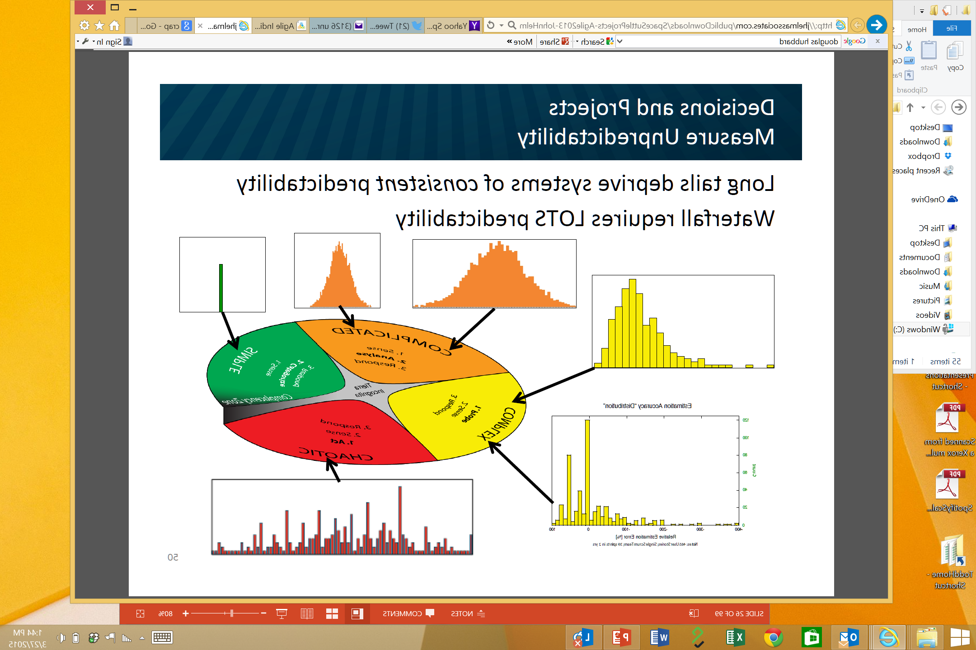
Complex
Distribution
Input
Output
Cause and Effect perceived in retrospect
Unknown - Unknowns
Probe - Sense – Respond
sense emergent practice
Example: New Product Development

Slide 32
Shower Control System
Deviation from desired state
Adjust
Assessment
Actual Output
+
+
-
Feedback Signals
Temperature
Flow Rate

Slide 33
Chaotic
Output
Distribution
Input
No Relationship between Cause and Effect
Unknowables
Act - Sense - Respond
discover novel practice.
Example: Medical Emergency

Slide 34
John Helm
Agile 2013

Slide 35
Business Process Value Chain
Market
Product
Development
Sales
Product Company
Specifications
Development
Delivery
Contract Model
Business Need
Development
Delivery
Internal IT

Slide 36
Business Process Value Chain
Market
Product
Development
Sales
Product Company
Specifications
Development
Delivery
Contract Model
Business Need
Development
Delivery
Internal IT

Slide 37
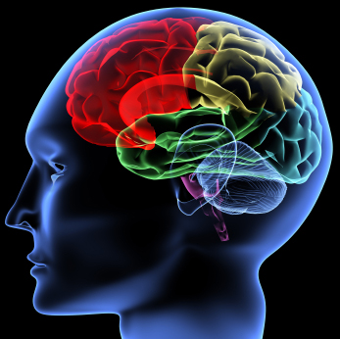
Learning
Feedback Loop

Slide 38
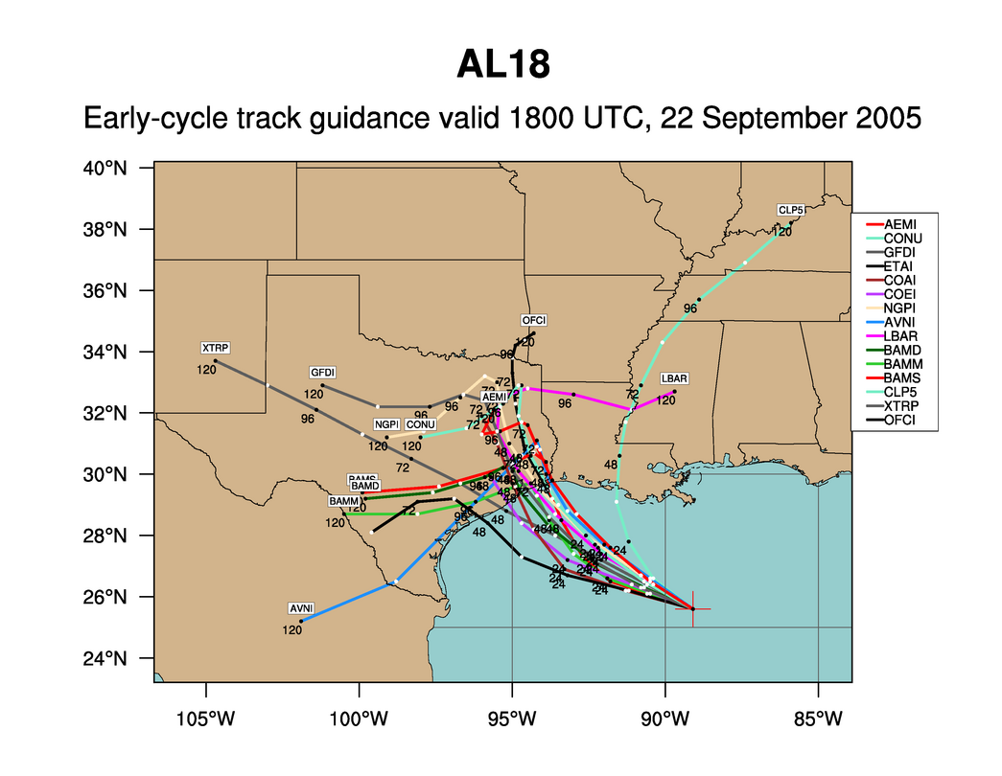
Hurricane Rita
Notes:
We like to use forecasting a hurricane track as an analogy to software development. This is an example of the various news agencies early forecast of hurricane’s Rita track. One thing we know is that all of these tracks are wrong.

Slide 39
Hurricane Rita
Notes:
The actual path of Rita is shown in yellow. Planning of software is much like this. Almost everything we do is “new” and when we followed a more waterfall model, we took lots of time designing and gathering estimates of tasks before starting. From that initial Plan, the one thing we really knew, was that the project would not turnout looking like the plan and it would change. We know that as we gain more knowledge during development the plan would be refined many times. So, with Agile, we don’t spend a lot of time in upfront planning.

Slide 40
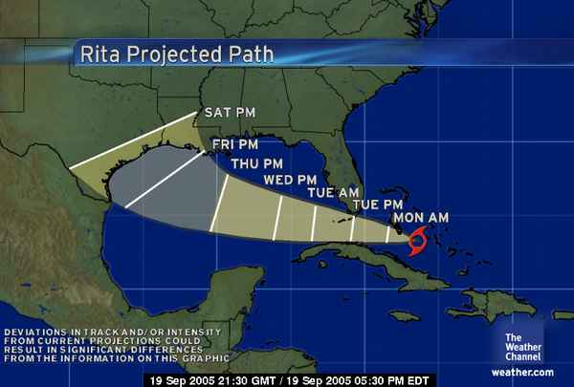

Slide 48
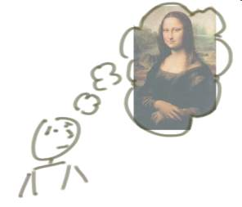


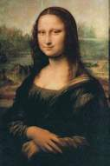
“Incrementing” Builds a Bit at a Time
But, incrementing calls for a fully formed idea
1
2
3
Jeff Patton

Slide 49
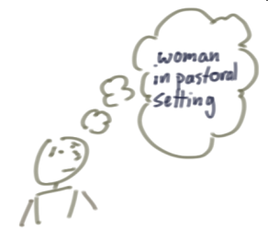
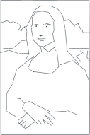
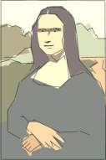

“Iterating” Builds a Rough Version, Validates it, Then Slowly Builds Up Quality
Iterating allows you to move from vague idea to realization
1
2
3

Slide 50
Learning
The objective is to get it right at the end
1
2
3

Slide 51
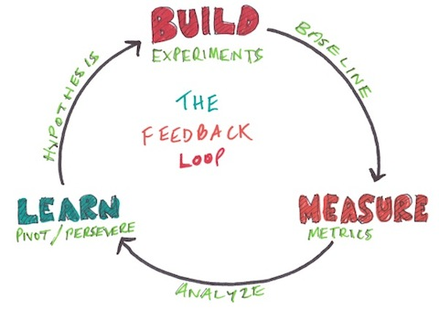
Lean Startup

Slide 52


Slide 53
How does Kanban work with feedback?

Slide 54
Kanban and Feedback Loops
What people think Kanban is
To Do
In Progress
Done

Slide 55
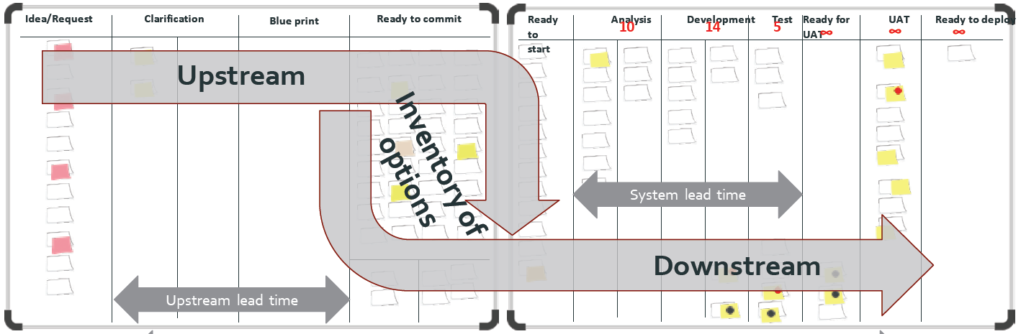
What is Kanban?
The Kanban Method teaches organizations how to understand, visualize and measure systems of work to continually improve and consistently deliver results.
The Kanban Method provides a set of proven practices and approaches that scale from individuals and teams to the enterprise.

Slide 56
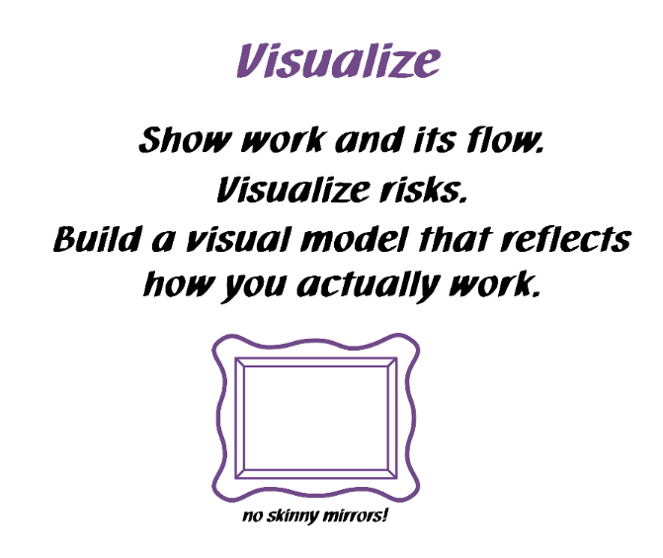
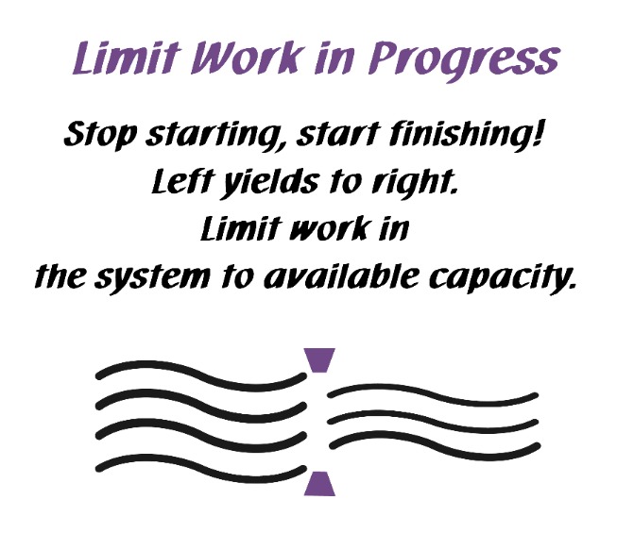
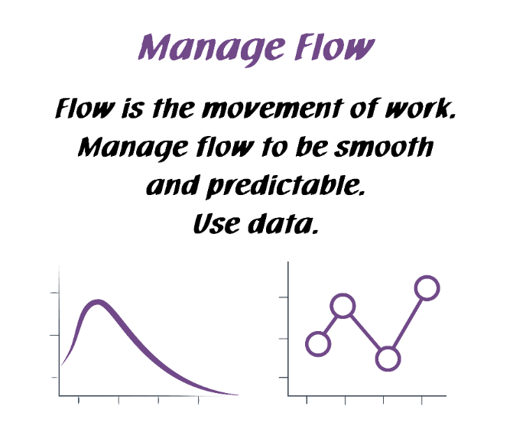
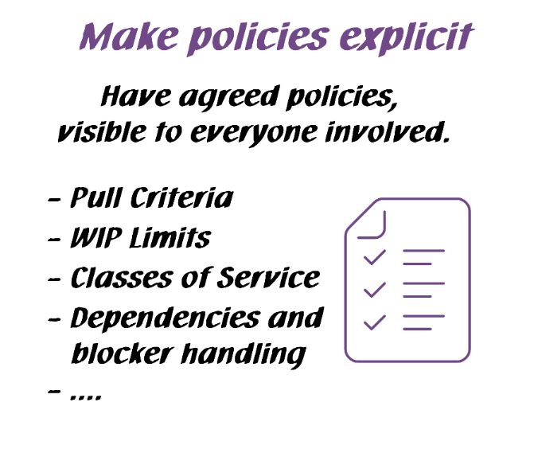
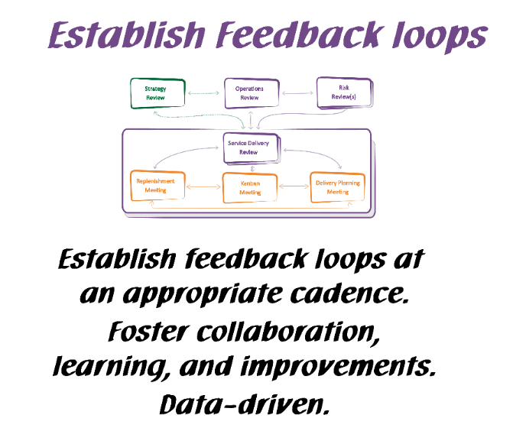
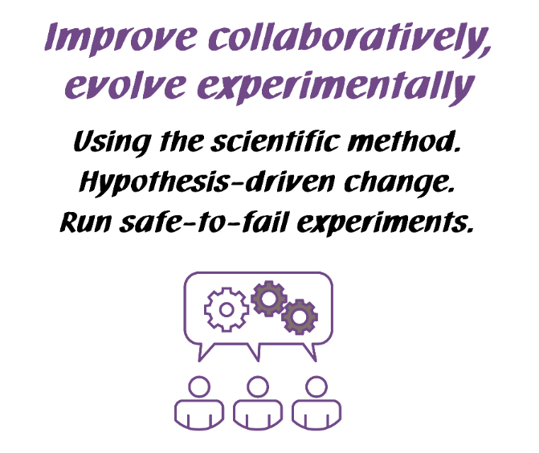
Kanban General Practices
Kanban General Practices
Notes:
Walk the class through the Kanban practices.
There are 6 General Practices in the Kanban Method. [Walk briefly through each of the 6 Practices. See David Anderson’s blog at http://www.djaa.com/principles-general-practices-kanban-method if you want help with how to explain]
Instead of using this slide, you can also create a flipchart with similar info etc.
You might revise this after the simulation.

Slide 57
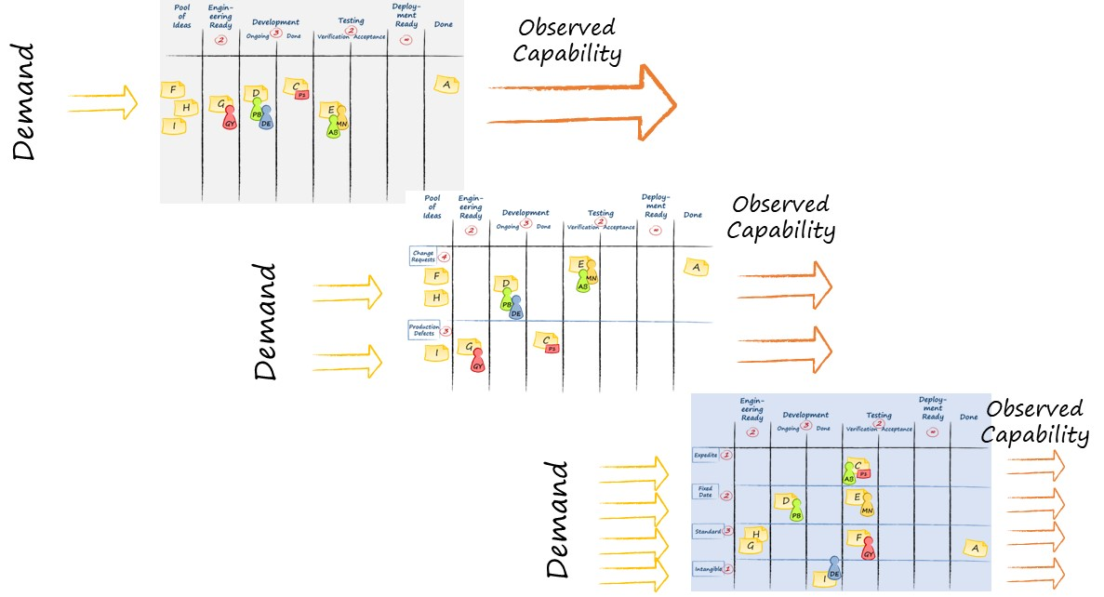

Visualize
Ideas

Slide 58
Visualize
Ideas
Understand the system

Slide 59

Systems Thinking Approach to Introducing Kanban (STATIK)
Identify Services. For each service:
Understand what makes the service “fit for purpose”
Understand sources of dissatisfaction regarding current delivery
Analyze sources of and nature of demand
Analyze current delivery capability
Model the service delivery workflow
Identify & define classes of service
Design the Kanban system
Socialize, design & negotiate implementation
This process tends to be iterative
Notes:
We develop a Kanban system for each service using STATIK.
With STATIK, we consider the unique needs of the customer and our capability to fulfill that need. The Kanban system we design is unique to match that customer demand and our capability.
We have walked through the Systems Thinking Approach to Introducing Kanban (in Kanban System Design class). This process tends to be iterative. Don’t be afraid to go back and adjust your Kanban system as new information emerges or your needs change.
8. Covered in this class as well!

Slide 60
Visualize
Ideas
Understand the system

Slide 61
Visualize
Ideas
Understand the system
FLOW

Slide 62

Visualize
Ideas
Understand the system
FLOW
Balance Demand and Capacity

Slide 63
Visualize
Ideas
Understand the system
FLOW
Balance Demand and Capacity
Limit WIP

Slide 64
Visualize
Ideas
Understand the system
FLOW
Balance Demand and Capacity
Limit WIP
Bottleneck

Slide 65
Kanban and Feedback Loops
Visualize
Ideas
Understand the system
Scale
FLOW
Balance Demand and Capacity
Limit WIP
Bottleneck

Slide 66
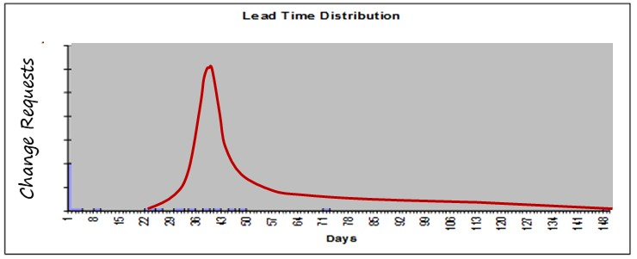
Kanban and Feedback Loops
Visualize
Ideas
Incremental process improvement through measurement
Understand the system
Scale
FLOW
Balance Demand and Capacity
Limit WIP
Bottleneck

Slide 67
Kanban and Feedback Loops
Visualize
Ideas
Incremental process improvement through measurement
Understand the system
Scale
FLOW
Balance Demand and Capacity
Limit WIP
Bottleneck
Double loop learning

Slide 68
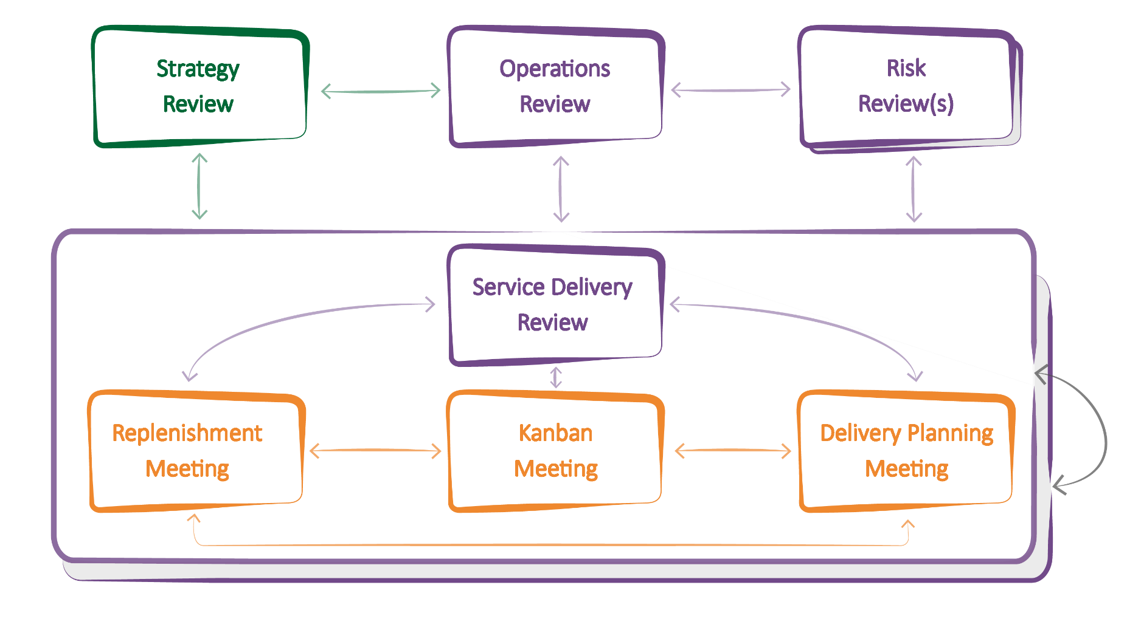
The Kanban Cadences: The Full Set
Notes:
Kanban gives you a PATTERN of 7 meetings / reviews and their interactions that helps you properly implement your feedback loops.
You will not need to understand or memorize all of them at this point. We will explore them step by step, so that you will have the full picture at the end of the class.
WHAT DO THE ARROWS MEAN? THEY SUGGEST FLOW OF COMMUNICATION THAT YOU MIGHT EXPECT TO SEE
Highlight the general type of information that is schematically represented by the arrows in the diagram.
Information delivered from one feedback mechanism to another. The information is considered for possible decisions.
Actions and Decisions made at one meeting that will have a direct effect on data reviewed, capability observed and discussions held in other meetings.

Slide 69

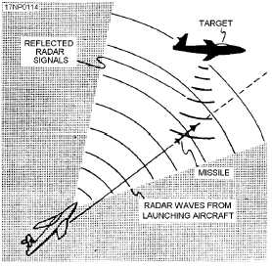
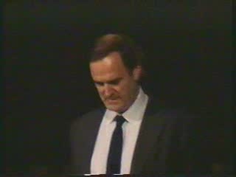
Gordon the Guided Missile

Slide 70
Contact
Todd Little
  todd@mauvius.com
  toddelittle@gmail.com
  www.toddlittleweb.com
  www.linkedin.com/in/toddelittle/
  @toddelittle

