Slide 1
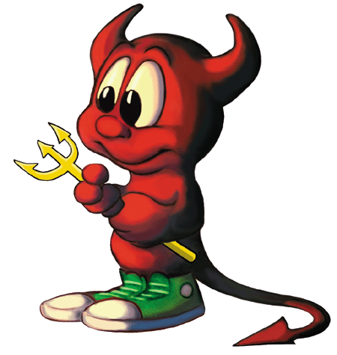
7 Sins of Scaling and other Agile Anti-Patterns
Todd Little
@toddelittle

Slide 2
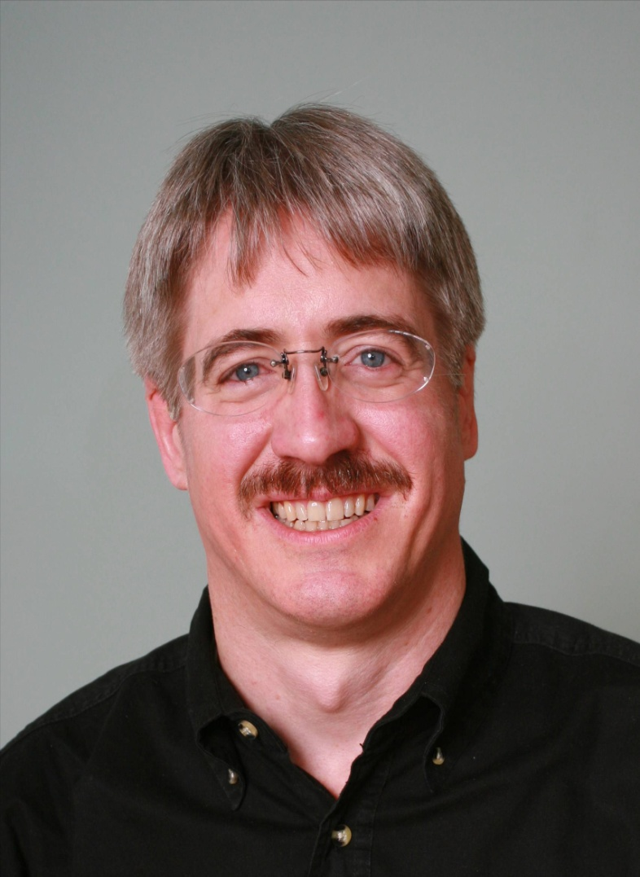
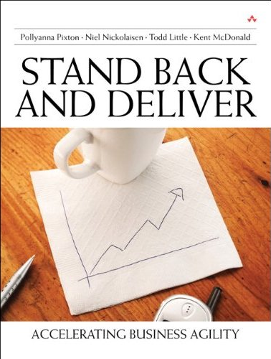
About Todd
Executive roles as VP Product Development, Director of Software & Technology
@toddelittle

Slide 3
Disclaimer
!7
!Sins
!Scaling

Slide 4
Agile Manifesto
We are uncovering better ways of developing software by doing it and helping others do it. Through this work we have come to value:
Individuals and interactions | over | processes and tools
Working software | over | comprehensive documentation
Customer collaboration | over | contract negotiation
Responding to change | over | following a plan
That is, while there is value in the items on the right, we value the items on the left more.

Slide 5
Antipatterns
Jim Coplien: “An anti-pattern is something that looks like a good idea, but which backfires badly when applied.”

Slide 7
Auditor Manifesto
We are uncovering better ways of auditing software development by forcing others do it how we tell them. Through this work we have come to value:
Processes and tools | over | individuals and interactions
Comprehensive documentation | over | working software
Contract negotiation | over | customer collaboration
Following a plan | over | responding to change
That is, while there may be value in the items on the right, we have chosen to ignore them as they are difficult to audit. We only care about the items on the left and we will make sure that you do too!

Slide 8
Sinner’s Manifesto
We think we know what we are doing. It looks like a good idea or someone told us that is the best way to do it so we’ll do more of it. Through this we may have accidentally come to value:
Potential Sin | Over | Virtue
The sin is not always a bad idea. There may be significant value in moderation, but in excess it can be an anti-pattern. The path the redemption is to look to the virtue.

Slide 9
Sample Sin
Potential Sin |  | Virtue
 | Over

Slide 10
Heresy

Slide 11
Potential Sin #1
Potential Sin |  | Virtue
Scaling Tools & Processes | Over | Scaling the Mindset

Slide 12
Alexey Krivitsky

Slide 13
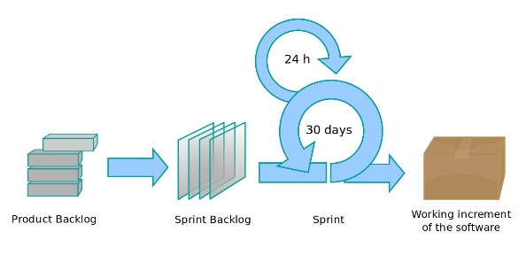
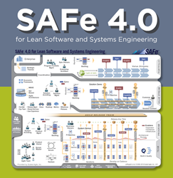
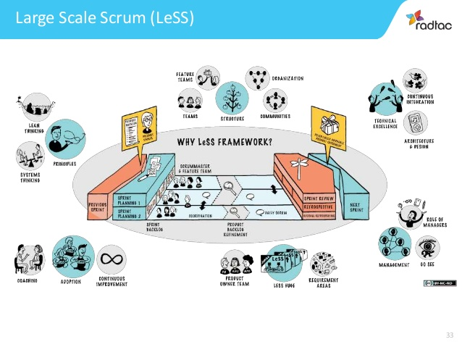
Potential Sin #1: Scaling Processes and Tools Over Scaling Mindset
Potential Sin |  | Virtue
Agile is a process | Over | Agility is a mindset

Slide 14
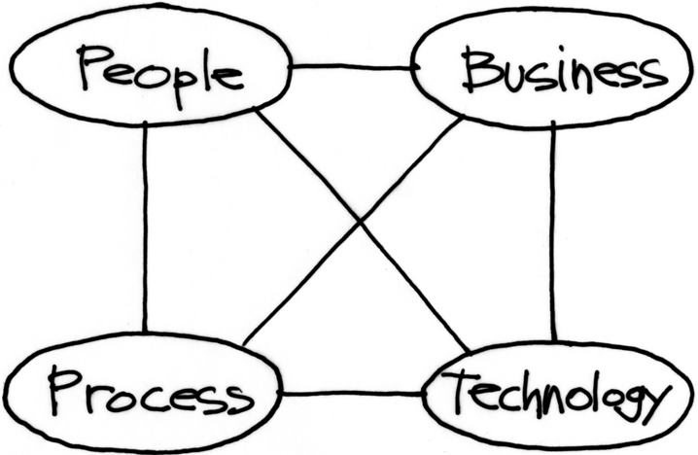
Potential Sin #1: Scaling Processes and Tools Over Scaling Mindset
Where the mindset leverage is
Where many agile transformations focus

Slide 15
Potential Sin #1: Scaling Processes and Tools Over Scaling Mindset
Potential Sin |  | Virtue
Agile is the Tool | Over | The tools support agility

Slide 16
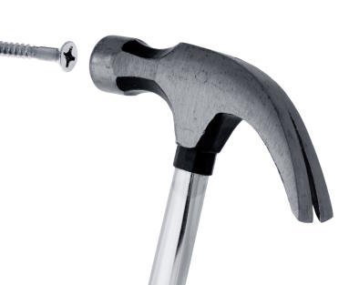
Potential Sin #1: Scaling Processes and Tools Over Scaling Mindset
Potential Sin |  | Virtue
One size fits all | Over | Context

Slide 17
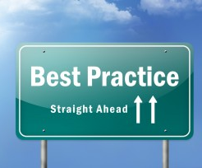
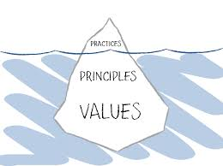
Potential Sin #1: Scaling Processes and Tools Over Scaling Mindset
Potential Sin |  | Virtue
Best Practices | Over | Principles and Values

Slide 18
Potential Sin #1: Scaling Processes and Tools Over Scaling Mindset
Potential Sin |  | Virtue
Collaboration | Over | Shared Ownership

Slide 19
Potential Sin #2
Potential Sin |  | Virtue
Status | Over | Flow of Value

Slide 20
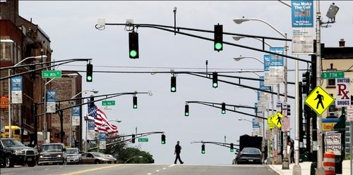
Potential Sin #2: Status over Flow of Value
Potential Sin |  | Virtue
Showing Progress | Over | Delivering Value

Slide 21
Potential Sin #2: Status over Flow of Value
Potential Sin |  | Virtue
Checking Boxes | Over | Learning and Adapting
Feedback Loop

Slide 22
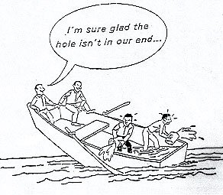
Potential Sin #2: Status over Flow of Value
Potential Sin |  | Virtue
My part is done | Over | Team is done

Slide 23
Potential Sin #2: Status over Flow of Value
Potential Sin |  | Virtue
Starting | Over | Finishing

Slide 24
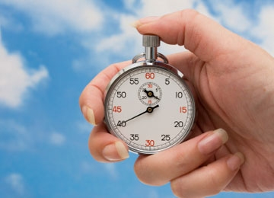
Potential Sin #2: Status over Flow of Value
Potential Sin |  | Virtue
Individual Utilization | Over | Team Throughput

Slide 25
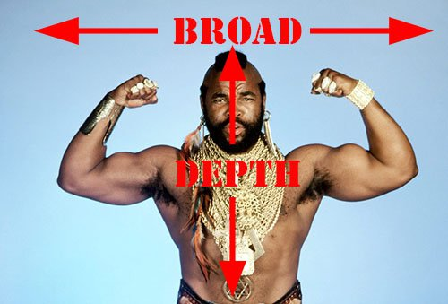
Potential Sin #2: Status over Flow of Value
Potential Sin |  | Virtue
Specialization | Over | Generalization

Slide 26
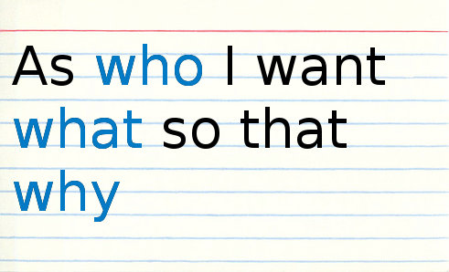
Potential Sin #3
Potential Sin |  | Virtue
Stories | Over | Strategy

Slide 27
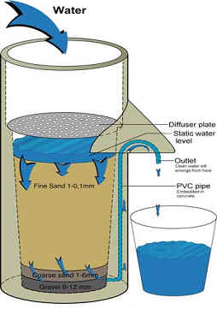
Potential Sin #3: Stories over Strategy
Potential Sin |  | Virtue
Buckets | Over | Filters

Slide 28
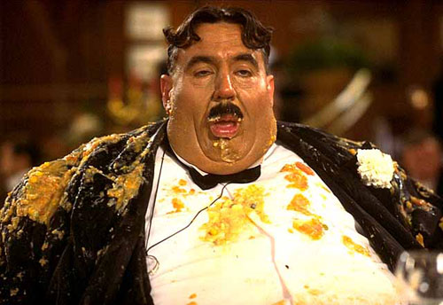
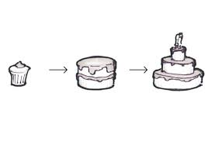
Potential Sin #3: Stories over Strategy
Potential Sin |  | Virtue
I want it all (Gluttony) | Over | Minimum Viable Product

Slide 29
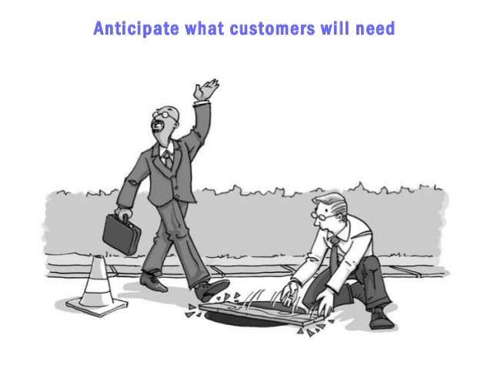
Potential Sin #3: Stories over Strategy
Potential Sin |  | Virtue
Listening to Customers | Over | Learning what they really need

Slide 30
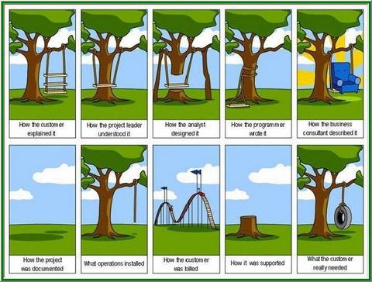
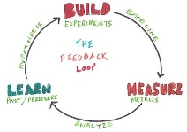
Potential Sin #3: Stories over Strategy
Potential Sin |  | Virtue
I know what they need | Over | Validating hypothesis

Slide 31
Potential Sin #3: Stories over Strategy
Potential Sin |  | Virtue
Tasks | Over | Stories

Slide 32
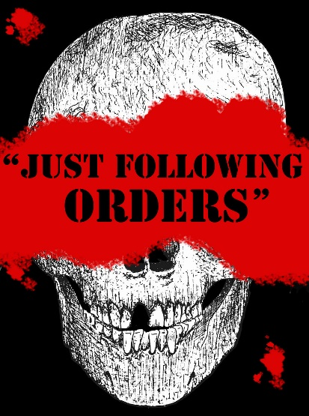
Potential Sin #3: Stories over Strategy
Potential Sin |  | Virtue
Following orders | Over | Understanding Why

Slide 33
Potential Sin #4
Potential Sin |  | Virtue
Crap | Over | Craftsmanship

Slide 34
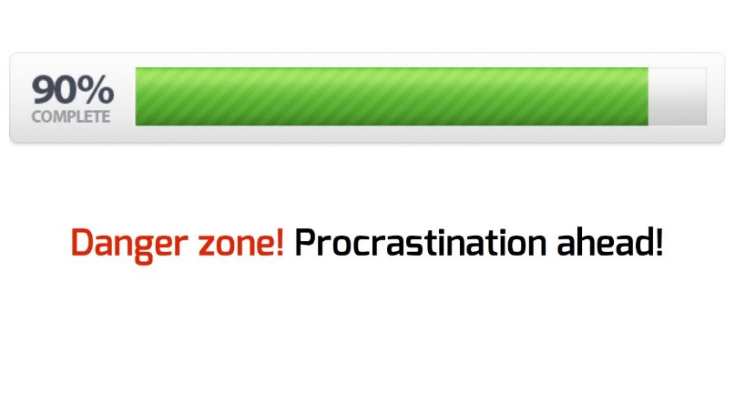
Potential Sin #4: Crap over Craftsmanship
Potential Sin |  | Virtue
Almost done | Over | Really done

Slide 35
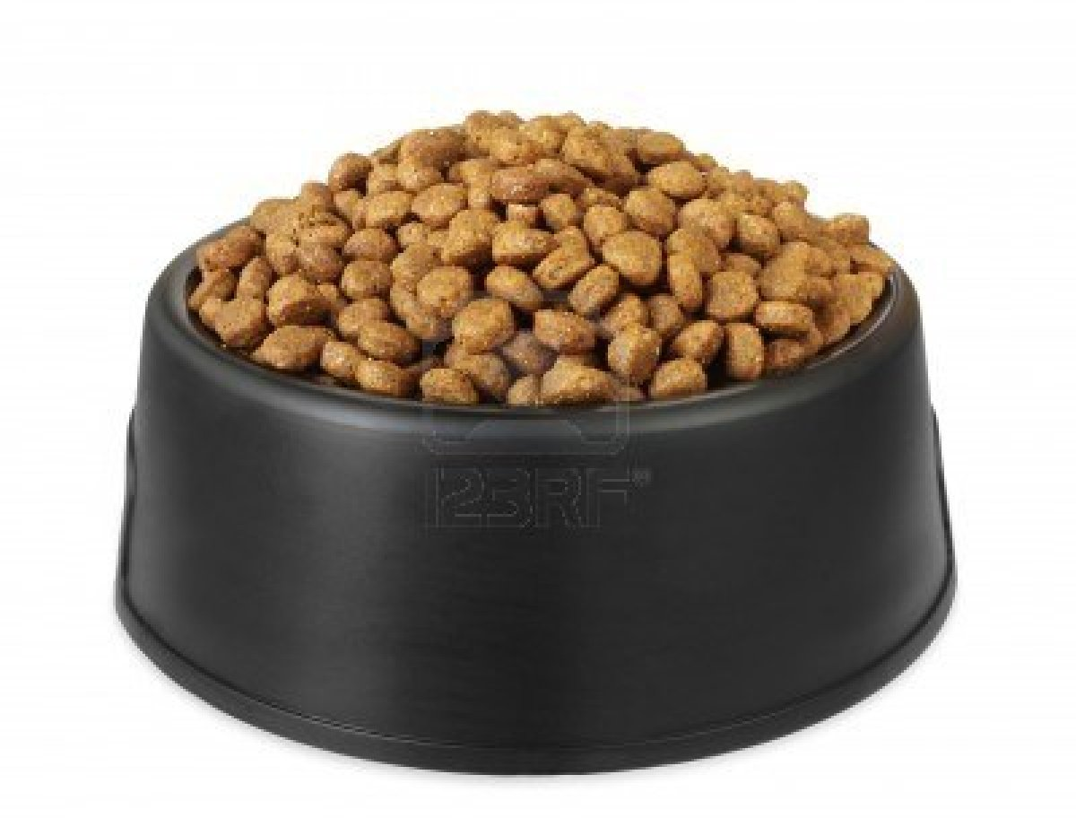
Potential Sin #4: Crap over Craftsmanship
Potential Sin |  | Virtue
Velocity | Over | Quality

Slide 36
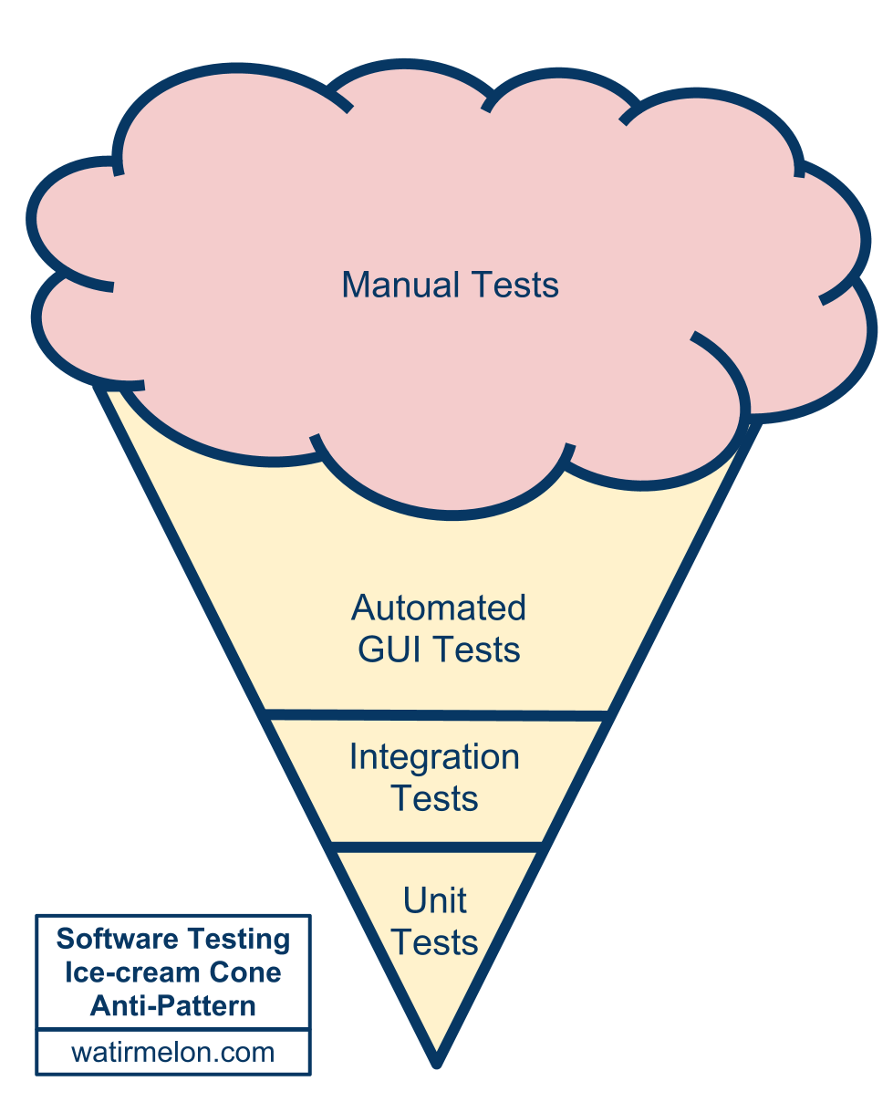
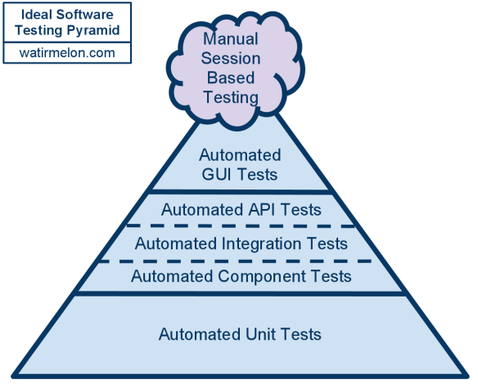
Potential Sin #4: Crap over Craftsmanship
Potential Sin |  | Virtue
Testing quality in | Over | Building quality in

Slide 37
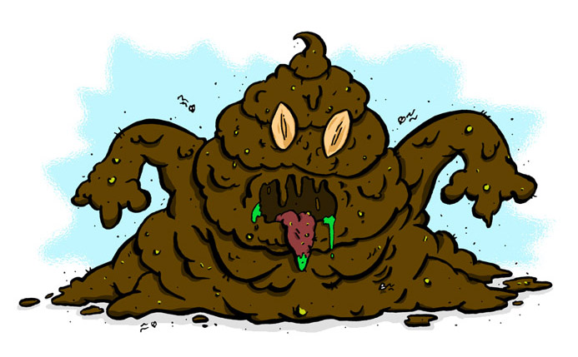
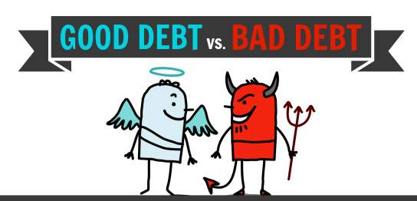
Potential Sin #4: Crap over Craftsmanship
Potential Sin |  | Virtue
Technical debt is evil | Over | Technical debt is debt

Slide 38
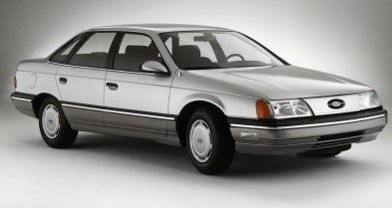
Potential Sin #4: Crap over Craftsmanship
Potential Sin |  | Virtue
Crap on Time | Over | Impact of Delay

Slide 39
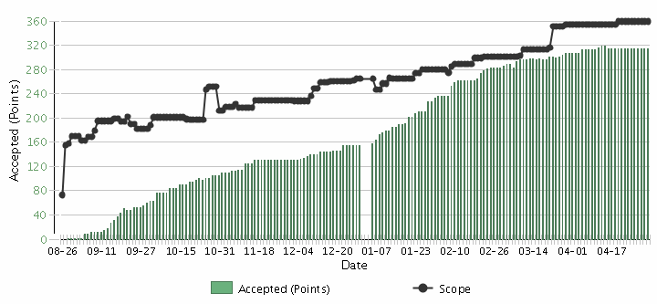
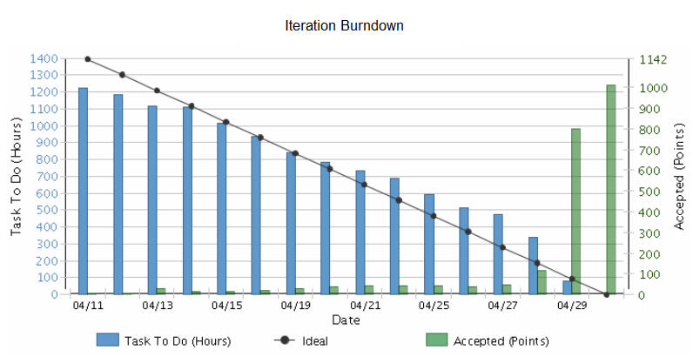
Potential Sin #5
Potential Sin |  | Virtue
Iterations | Over | Releases

Slide 40
Potential Sin #5: Iterations over Releases
Potential Sin |  | Virtue
Commitment | Over | Focus on Value

Slide 41
Potential Sin #5: Iterations over Releases
Potential Sin |  | Virtue
Potentially Shippable Increments (PSIs) | Over | Releases

Slide 42
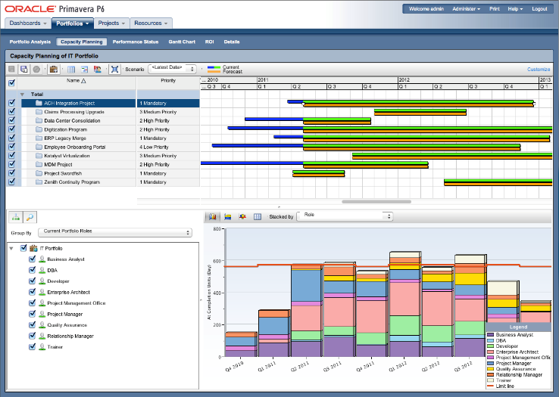
Potential Sin #5: Iterations over Releases
Potential Sin |  | Virtue
Capacity planning | Over | Velocity planning

Slide 43
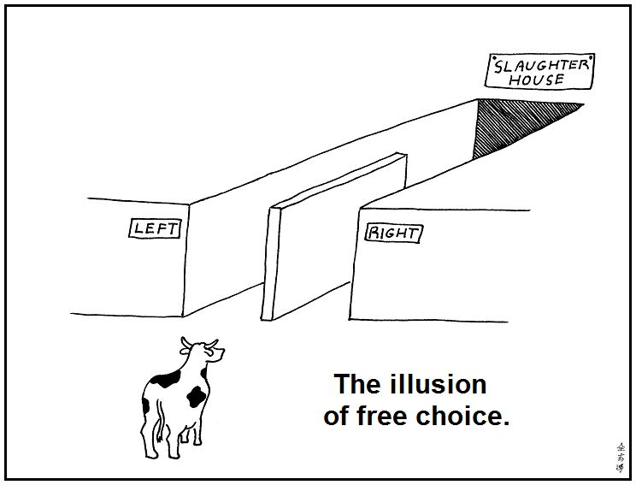
Potential Sin #6
Potential Sin |  | Virtue
Illusion | Over | Reality

Slide 44
Potential Sin #6: Illusion over Reality
Potential Sin |  | Virtue
Gross velocity | Over | Net velocity
Scope Creep
Velocity
Velocity

Slide 45
Potential Sin #6: Illusion over Reality
Potential Sin |  | Virtue
Velocity | Over | Quality

Slide 46
Potential Sin #6: Illusion over Reality
Potential Sin |  | Virtue
Estimation | Over | Forecasting
Scope Creep
Velocity

Slide 47
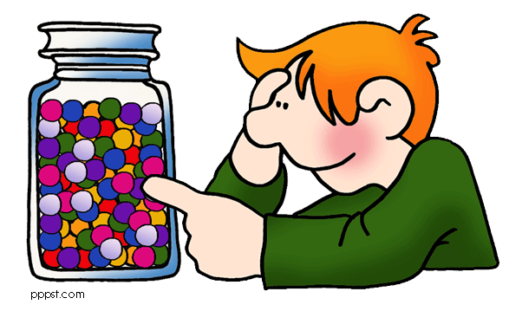
Potential Sin #6: Illusion over Reality
Potential Sin |  | Virtue
Microestimation | Over | Macroestimation

Slide 48
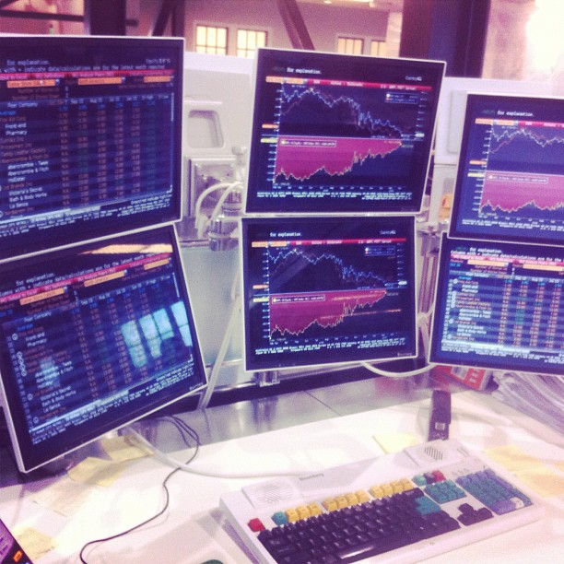
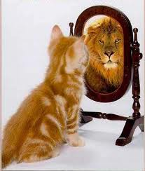
Potential Sin #6: Illusion over Reality
Potential Sin |  | Virtue
Vanity metrics | Over | Decision metrics

Slide 49
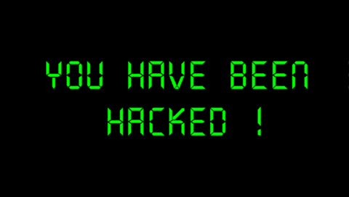
Potential Sin #7
Potential Sin |  | Virtue
Organizational Hacks | Over | Leadership

Slide 50
Potential Sin #7: Organizational Hacks over Leadership
Potential Sin |  | Virtue
Controlling inputs | Over | Controlling outputs/outcomes
Processes
Inputs
Inputs
Inputs
Processes
Inputs
Inputs
Inputs
Outputs
Outcomes
Micromanagement
Agile Leadership

Slide 51
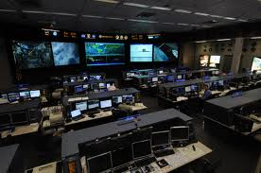
Potential Sin #7: Organizational Hacks over Leadership
Potential Sin |  | Virtue
Micromanagement | Over | Macromanagement

Slide 52
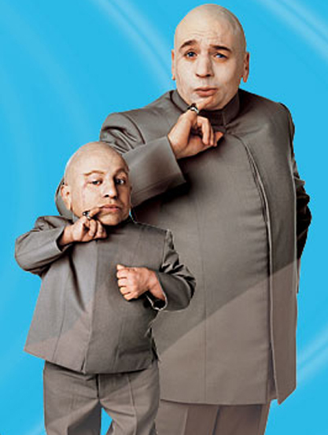
Potential Sin #7: Organizational Hacks over Leadership
Potential Sin |  | Virtue
Mini-Me | Over | Diversity

Slide 53
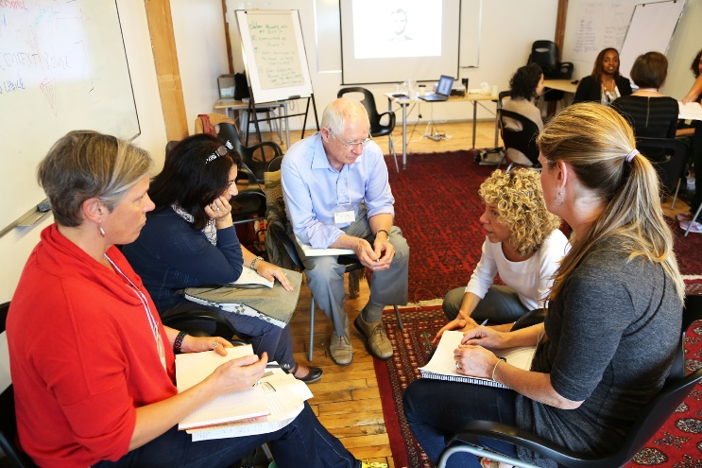
Potential Sin #7: Organizational Hacks over Leadership
Potential Sin |  | Virtue
Taking sides | Over | Serving the whole team

Slide 54
Potential Sin #7: Organizational Hacks over Leadership
Potential Sin |  | Virtue
Meetings | Over | Actions & Resolutions

Slide 55
The Sinner Summary
Processes and Tools | Over | Individuals and Interactions
Status | Over | Flow of Value
Stories | Over | Strategy
Crap | Over | Craftsmanship
Iterations | Over | Releases
Illusion | Over | Reality
Organizational Hacks | Over | Leadership

Slide 56
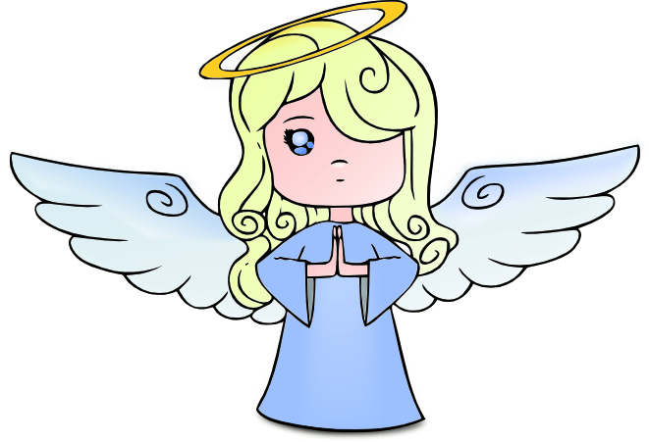
The Virtuous Path
Use Retrospectives
Improve Incrementally
1-2 Items
Get Coaching as needed

Slide 57
Contact
Todd Little
toddelittle@gmail.com
www.toddlittleweb.com
www.accelinnova.com
www.linkedin.com/in/toddelittle/en
@toddelittle

Slide 58
Thank you!
Questions?

