Slide 1
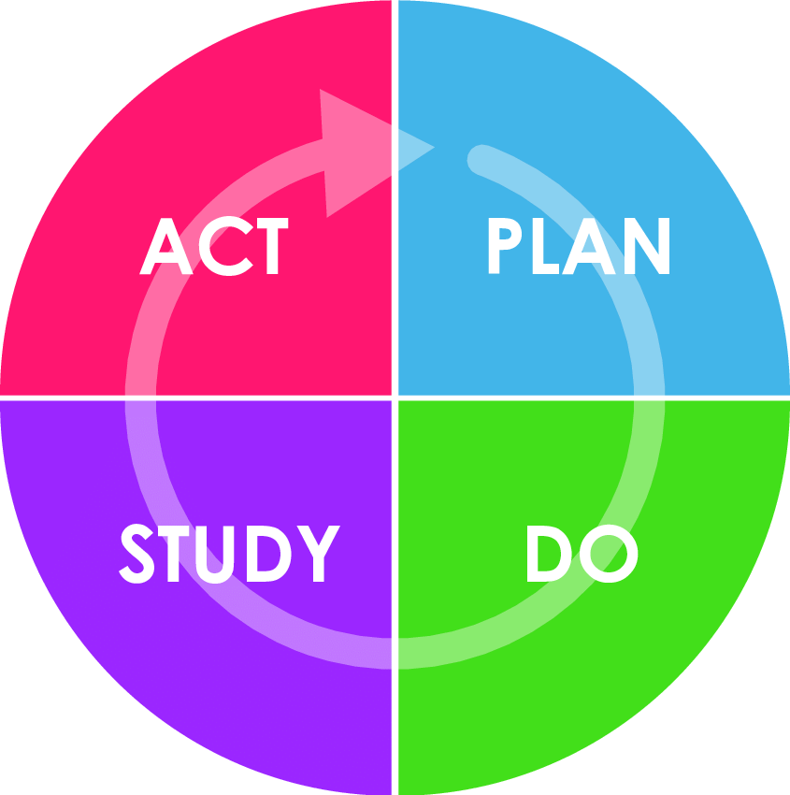
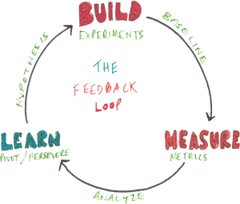
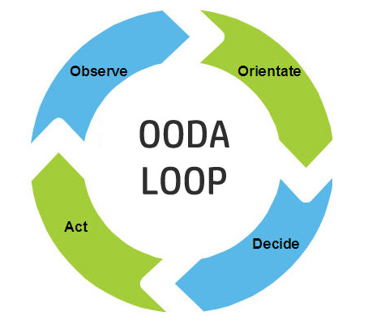
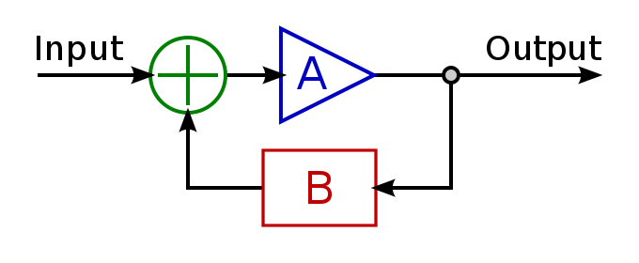
Foundation of Business Agility: Feedback Loops
Todd Little

Slide 2
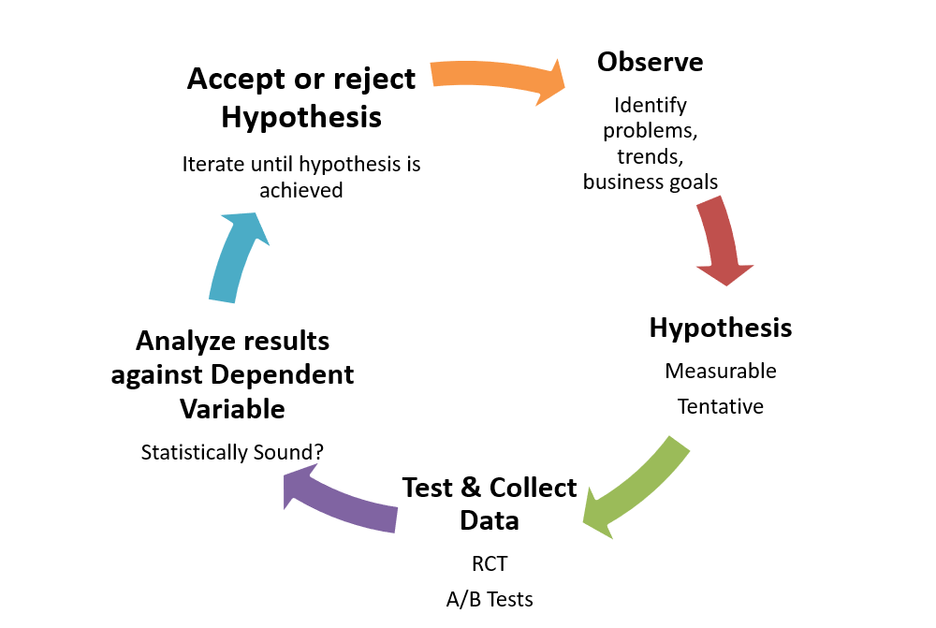
The Scientific Method

Slide 3
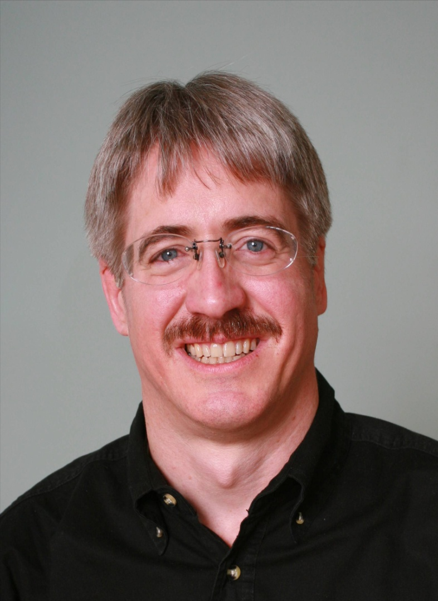
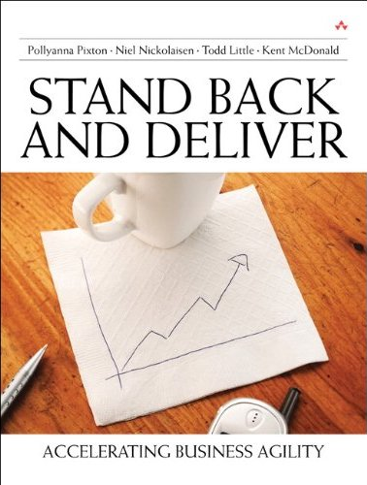
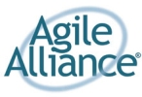
About Todd
Chairman, Kanban University
Chemical and Petroleum Engineer
Executive roles as VP Product Development, Director of Software & Technology
@toddelittle

Slide 4
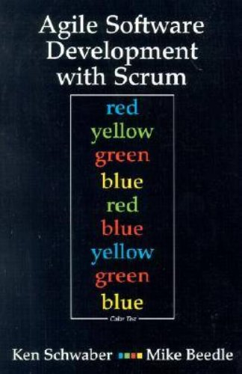
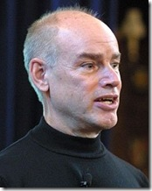
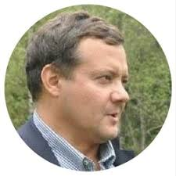
Empirical Process Control

Slide 5
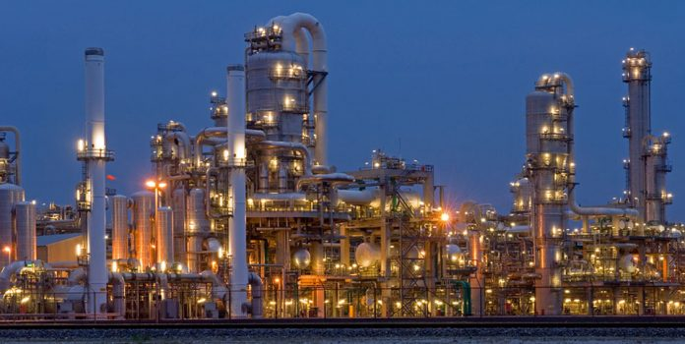

Slide 6
Control Systems
Processes
Inputs
Inputs
Inputs
Open
Loop
Processes
Inputs
Inputs
Inputs
Closed
Loop
Outputs

Slide 7
Open Loop Control
Desired Output Response
Controller
Process
Output

Slide 8
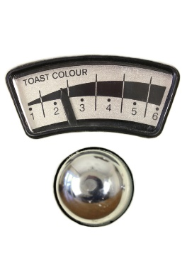
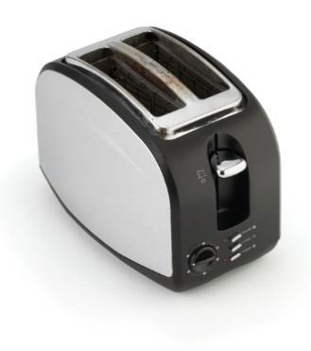
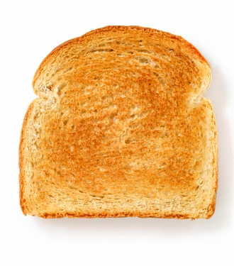
Open Loop Control
Desired Output Response

Slide 9
Closed Loop Control (Balancing Feedback loop)
Deviation from desired state
Assessment
Actual Output
+
+
Corrective Action
Process
-
Sensor
Feedback Signal

Slide 10
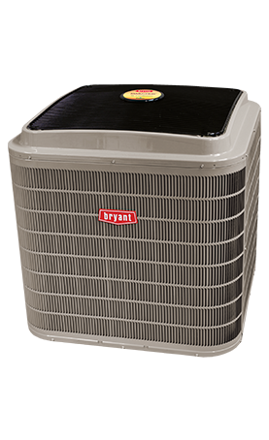
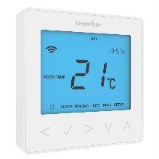
Closed Loop Control Example
Deviation from desired state
Assessment
Actual Output
+
+
Turn on or off
-
Temperature
Feedback Signal

Slide 11
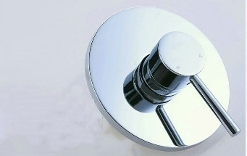
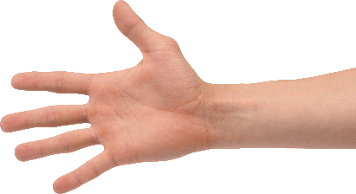
Shower Control System
Deviation from desired state
Adjust
Assessment
Actual Output
+
+
-
Feedback Signal
Temperature

Slide 12
Shower Control System
Deviation from desired state
Adjust
Assessment
Actual Output
+
+
-
Feedback Signals
Temperature
Flow Rate

Slide 13
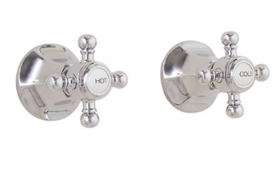
Shower Control System
Deviation from desired state
Adjust
Assessment
Actual Output
+
+
-
Feedback Signals
Temperature
Flow Rate

Slide 14
Cynefin Framework(Snowden)

Slide 15
Obvious
Distribution
Input
Output
Cause and Effect Obvious to all
Known - Knowns
Sense - Categorize - Respond
apply best practice
Example: Manufacturing

Slide 16
Complicated
Analysis
Input
Output
Distribution
Cause and Effect Requires Analysis
Known - Unknowns
Sense - Analyze – Respond
apply good practice
Example: Incremental Product Development

Slide 17
Complex
Distribution
Input
Output
Cause and Effect perceived in retrospect
Unknown - Unknowns
Probe - Sense – Respond
sense emergent practice
Example: New Product Development

Slide 18
Shower Control System
Deviation from desired state
Adjust
Assessment
Actual Output
+
+
-
Feedback Signals
Temperature
Flow Rate

Slide 19
Observe-Orient-Decide-Act (John Boyd)

Slide 20
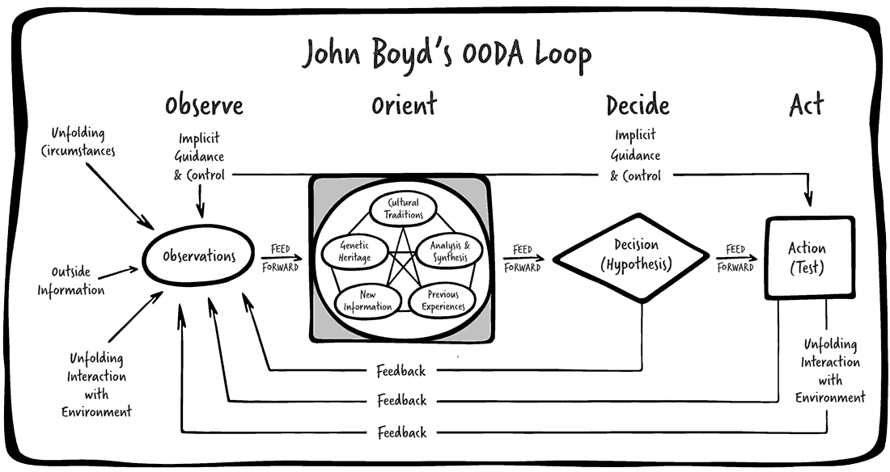

Slide 21
Complex Control System
Desired Output Response
Controller
Process
Output Variables
Measurement
Multi Input Multi Output (MIMO) System

Slide 22
Complex Control
Adjust Scope
Adjust Date
Adjust Team
Adjust Quality
Adjust Process
Desired Output Response
Controller
Process
Output Variables
Value
Schedule
Cost
Quality
Measurement
Multi Input Multi Output (MIMO) System

Slide 23
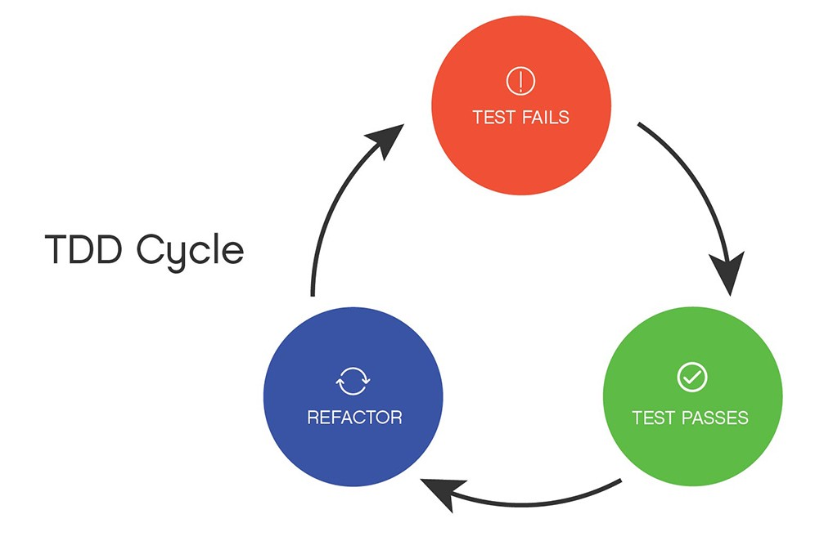
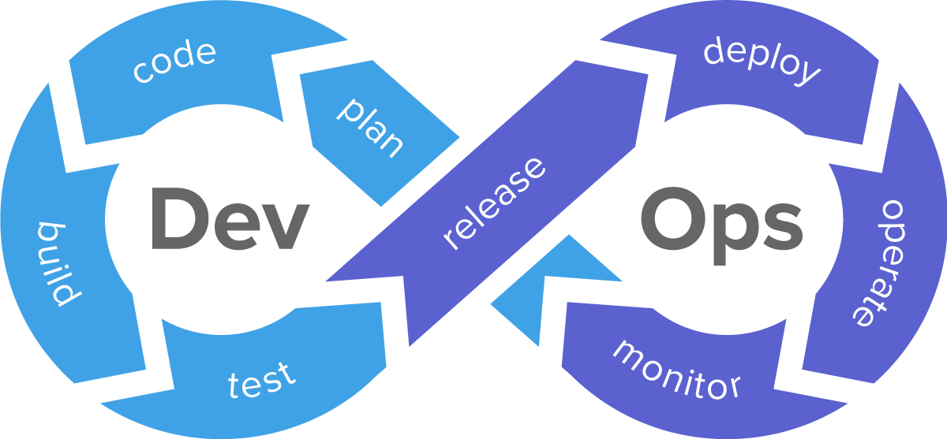
Enhancing Feedback

Slide 24
Lockdown
Desired Output Response
Controller
Process
Output Variables
Value
Schedule
Cost
Quality
Measurement
Multi Input Multi Output (MIMO) System

Slide 25
Delivery Goals

Slide 26
Calendar of Innovation

Slide 27
Open Loop?
Desired Output Response
Controller
Process
Output Variables
Value
Schedule
Cost
Quality
Measurement
Multi Input Multi Output (MIMO) System

Slide 28
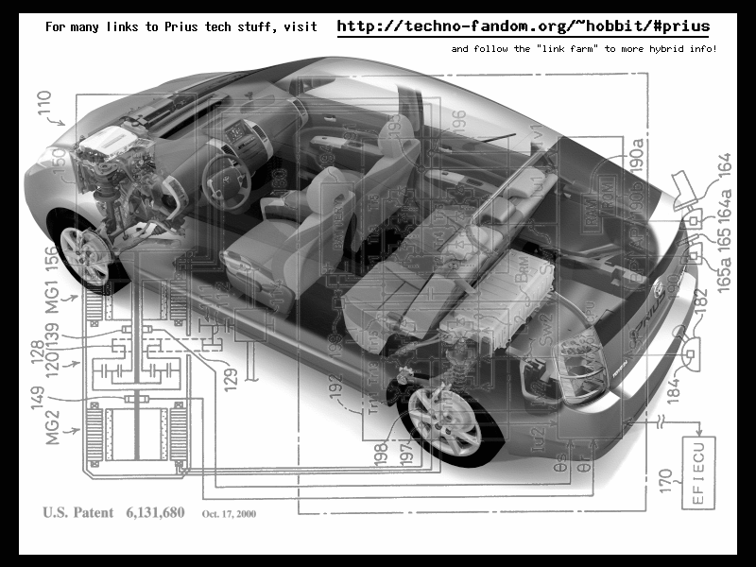
Value of Flexibility
Notes:
9 research projects for drive train
1 chassis – same hole for all 9 drive trains
VOI from 9 research projects, VOF from chassis design
Contrast this with the development of the Prius. Toyota had 9 different research projects running to develop hybrid engine technologies. Normally they would choose a drivetrain first, and build a car around it. Instead Toyota decided to keep its options open, and designed the Prius with a hole in it for the drive train. The 9 research projects continued, and 9+ months after the Prius development project was started, a drive train was chosen. Toyota knew that this car needed a radically new drive train architecture. Instead of guessing and choosing one, they let all 9 research projects continue their work, and as they did, the best option for the car's engine became clear. So was 9 research projects a waste? No because each project was generating factual information about the options for hybrid engine design, information that Toyota engineering management needed to make an informed choice.

Slide 29
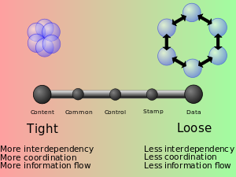
Value of Flexibility from Loose Coupling

Slide 30
Ongoing Feedback

Slide 31
Business Process Value Chain
Market
Product
Development
Sales
Product Company
Business Need
Development
Delivery
Internal IT
Specifications
Development
Delivery
Contract Model

Slide 32
How does Kanban work with feedback?

Slide 33
Kanban and Feedback Loops
What people think Kanban is
To Do
In Progress
Done

Slide 34
What is Kanban?
The Kanban Method teaches organizations how to understand, visualize and measure systems of work to continually improve and consistently deliver results.
The Kanban Method provides a set of proven practices and approaches that scale from individuals and teams to the enterprise.

Slide 35
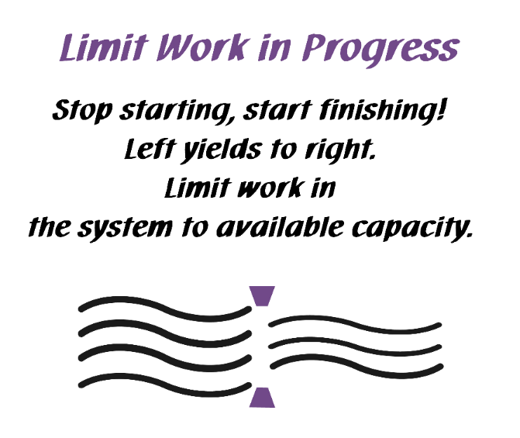
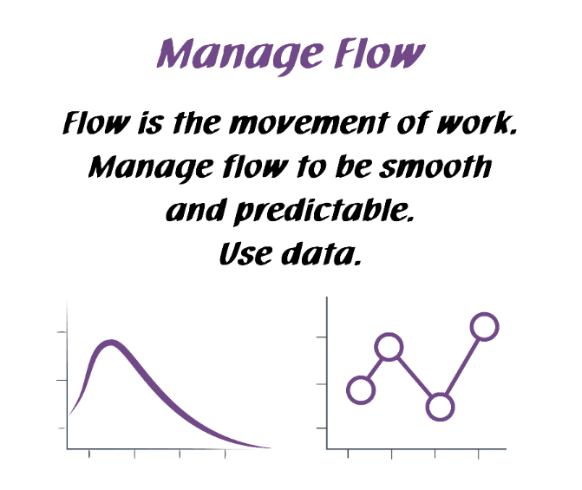
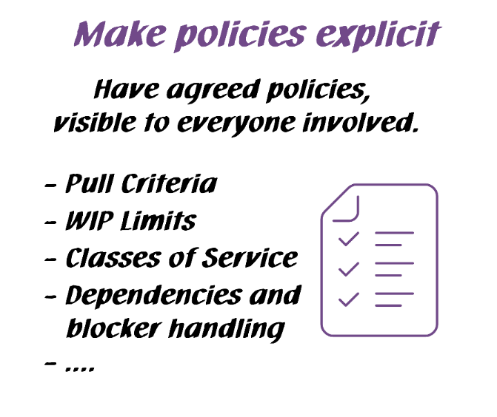
Kanban General Practices
Kanban General Practices
Notes:
Walk the class through the Kanban practices.
There are 6 General Practices in the Kanban Method. [Walk briefly through each of the 6 Practices. See David Anderson’s blog at http://www.djaa.com/principles-general-practices-kanban-method if you want help with how to explain]
Instead of using this slide, you can also create a flipchart with similar info etc.
You might revise this after the simulation.

Slide 36
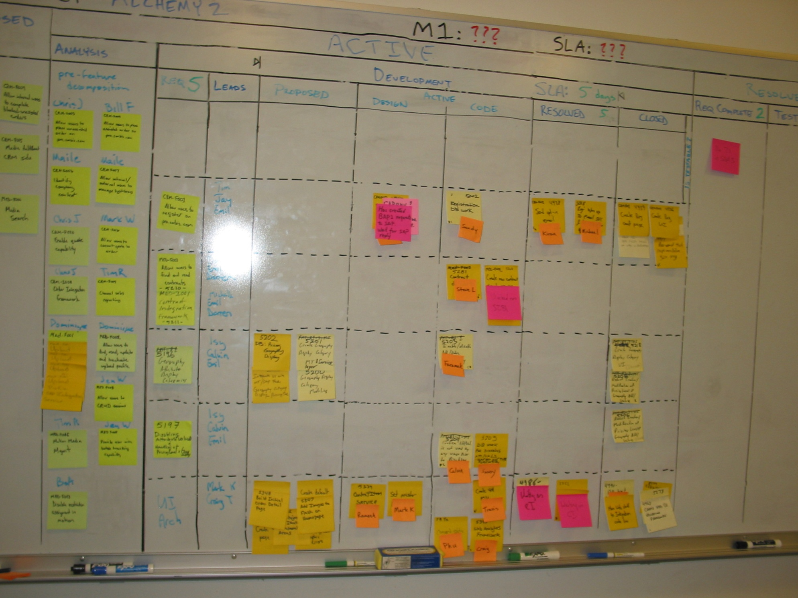
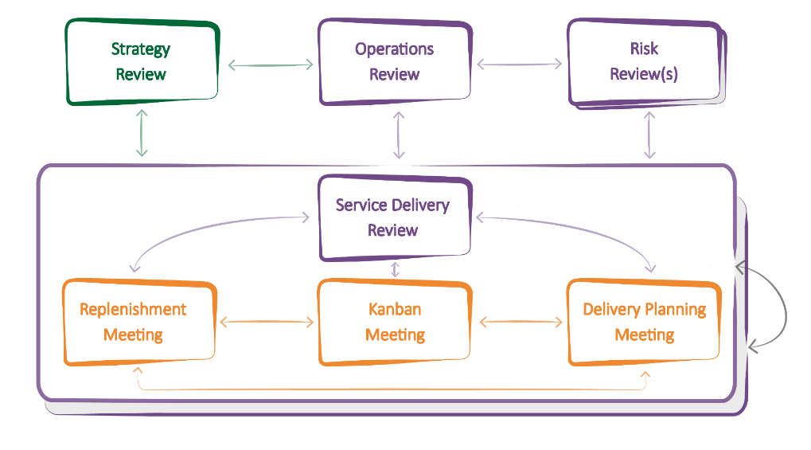
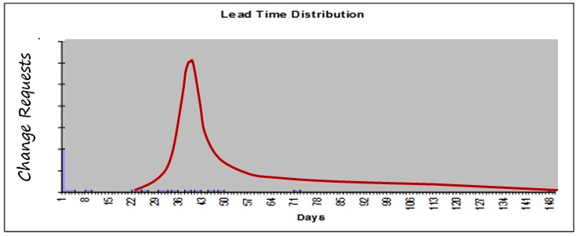
Feedback in Kanban
Boards
Meetings/Cadences
Metrics

Slide 37
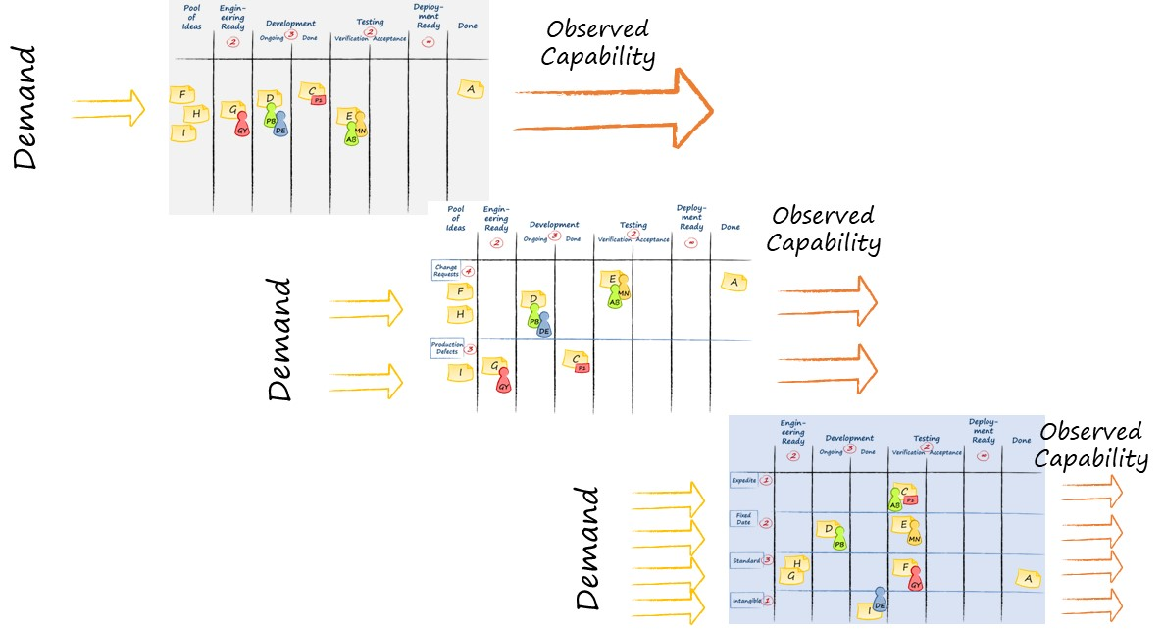
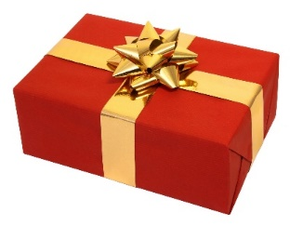
Visualize
Ideas

Slide 38
Visualize
Ideas
Understand the system

Slide 39
Visualize
Ideas
Understand the system
FLOW

Slide 40
Visualize
Ideas
Understand the system
FLOW
Balance Demand and Capacity

Slide 41
Visualize
Ideas
Understand the system
FLOW
Balance Demand and Capacity
Limit WIP

Slide 42
Visualize
Ideas
Understand the system
FLOW
Balance Demand and Capacity
Limit WIP
Bottleneck

Slide 43
Kanban and Feedback Loops
Visualize
Ideas
Understand the system
Scale
FLOW
Balance Demand and Capacity
Limit WIP
Bottleneck

Slide 44
Kanban and Feedback Loops
Visualize
Ideas
Incremental process improvement through measurement
Understand the system
Scale
FLOW
Balance Demand and Capacity
Limit WIP
Bottleneck

Slide 45
Kanban and Feedback Loops
Visualize
Ideas
Incremental process improvement through measurement
Understand the system
Scale
FLOW
Balance Demand and Capacity
Limit WIP
Bottleneck
Double loop learning

Slide 46
The Kanban Cadences: The Full Set
Notes:
Kanban gives you a PATTERN of 7 meetings / reviews and their interactions that helps you properly implement your feedback loops.
You will not need to understand or memorize all of them at this point. We will explore them step by step, so that you will have the full picture at the end of the class.
WHAT DO THE ARROWS MEAN? THEY SUGGEST FLOW OF COMMUNICATION THAT YOU MIGHT EXPECT TO SEE
Highlight the general type of information that is schematically represented by the arrows in the diagram.
Information delivered from one feedback mechanism to another. The information is considered for possible decisions.
Actions and Decisions made at one meeting that will have a direct effect on data reviewed, capability observed and discussions held in other meetings.

Slide 47
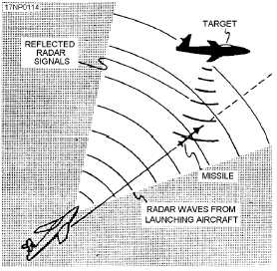
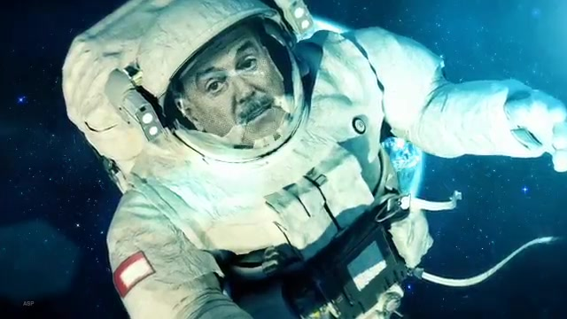
Gordon the Guided Missile

Slide 48
What is Business Agility?

Slide 49
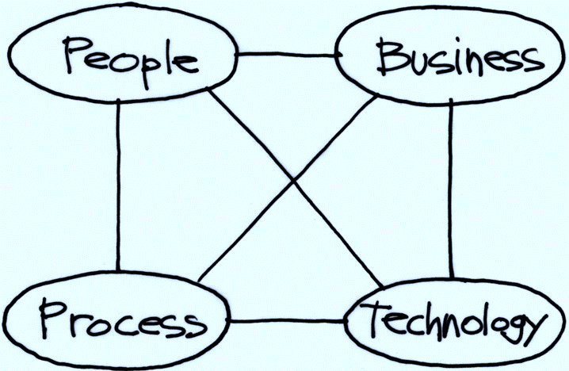
Business Agility
Where business agility generally is
I have come to value business agility over Agile transformations
Where many agile transformations focus

Slide 50
Contact
Todd Little
todd@kanban.university
toddelittle@gmail.com
www.toddlittleweb.com
www.linkedin.com/in/toddelittle/
@toddelittle

Slide 51
Your Agile Software Co-development Partner
Accelerate delivery of your product/technology roadmap
Address technology skills gap in your inhouse team
Save >50% with India based software development talent
Leverage US based professionals to make it easy for your inhouse team to collaborate

Slide 52
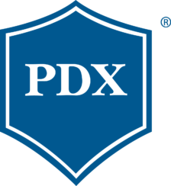
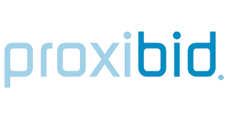
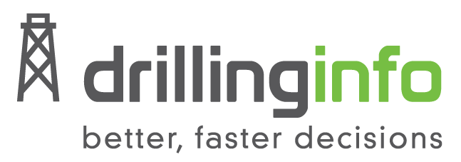
Synerzip Clients - Representative Sample
Texas
Silicon Valley
Texas/Florida
Texas
Silicon Valley
Silicon Valley/NYC
Texas
Texas
Texas
Nebraska
Texas
Silicon Valley
Texas
Texas
Michigan
Oregon
Silicon Valley
Florida
Texas
Silicon Valley
…100s more

Slide 53
Upcoming Webinar
Forecasting Using Data
Tuesday, March 17, 2020
@ 1pm ET | Noon CT | 10am PT
Presenter:
Troy Magennis
Founder, Focused Objective

Slide 54
TEXAS | SILICON VALLEY | NYC | INDIA

