Slide 1


To Estimate or
#NoEstimates,
that is the question
Webinar Presenter: Todd Little, IHS
Alas, Poor Yorick, I knew him well…
Yet another software death march
Webinar Series 2016
©Todd Little, IHS 1
www.synerzip.com

Slide 2
To Estimate, or #NoEstimates, that is the question:
Whether ‘tis nobler in the mind to suffer
The Slings and Arrows of outrageous errors,
Or to take Arms against a Sea of troubles,
And by opposing, end them? #NoEstimates, so easy;
No more; and by #NoEstimates, focus on value and end
The headaches and the thousands of natural unknowns
That estimation is prone to, ‘tis a consumption
Devouring all resources. #NoEstimates; so easy;
So easy; perchance it seems: ay, there’s the rub;
For in #NoEstimates what surprises may come,
When we develop in earnest and begin our toil.
Must give us pause. There’s the respect
That makes calamity of software’s life;

Slide 3

To Estimate or #NoEstimates, That is the Question
Todd Little
VP Product Development, IHS
Chris Verhoef
CS Professor, VU, Amsterdam
  @toddelittle

Slide 4
How many of you consider it to be a major part of your job to either create estimates or deliver against someone’s estimates?

Slide 5
“
It is difficult to get a man to understand something when his salary depends upon his not understanding it.
”
        Upton Sinclair
Webinar Series 2016
©Todd Little, IHS 5
www.synerzip.com

Slide 6
Why do we Estimate?
Notes:
Get the crowd to throw out their ideas. Capture on the flipchart

Slide 7
Decisions
Decisions at project sanction | What is the cost, is it worth doing? When is the target delivery? What is the critical scope? Do we have the right investment?
Decisions to steer towards the release | Are we on target to meet our commitments? What are the scope/schedule tradeoffs? Is it worth continuing? Can we do anything to accelerate delivery? What is the cost of delay?
Decisions to help with managing iterations | Can we make our iteration commitment? What is our capacity?

Slide 8
What do we Estimate?
Notes:
Get the crowd to throw out their ideas. Capture on the flipchart

Slide 9
What do we Estimate?
Release – duration, effort, cost
Feature/Epic – story points, T-shirt sizes
Stories – story points
Tasks – hours
#NoEstimates

Slide 10

What is #NoEstimates
“#NoEstimates is a hashtag for the topic of exploring alternatives to estimates [of time, effort, cost] for making decisions in software development. That is, ways to make decisions with ‘No Estimates’.”
Woody Zuill

Slide 11
One Approach Suggested by #NoEstimates
Discontinue estimating story points
Instead simply count number of completed stories per iteration (throughput)
Forecast using a burnup or burndown based on throughput

Slide 12
We collected and analyzed some real data
Webinar Series 2016
©Todd Little, IHS 12
www.synerzip.com

Slide 13
About the Data
Data collected anonymously by Vasco Duarte
55 Projects from 9 companies
https://bitly.com/NoEstimatesProjectsDB

Slide 14
Definitions
 | Instantaneous | Average
Velocity | Story points delivered in an iteration | Average story points delivered over all iterations
Throughput | Number of stories delivered in an iteration | Average number of stories delivered over all iterations

Slide 15
Basic Burnup

Slide 16
What does the Data show?
Notes:
First thing we note is that there is not a lot of difference between Velocity and Throughput.
The second thing we note is that neither Velocity nor Throughput address the Hardening cycle that we see in 50% of the projects.

Slide 17
What does the Data show?
2-12% Hardening for 50% of projects
Notes:
First thing we note is that there is not a lot of difference between Velocity and Throughput.
The second thing we note is that neither Velocity nor Throughput address the Hardening cycle that we see in 50% of the projects.

Slide 18

Beware … statistics ahead

Slide 19


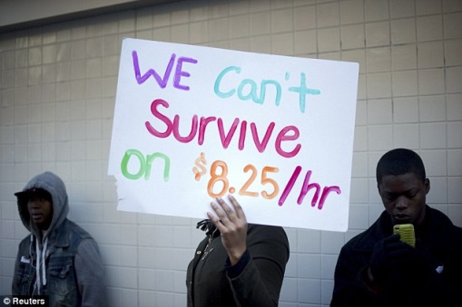

P90 and P10
20
12 | P90
10
8
7
6
5
3
2 | P10
1
P90/P10 = 12/2 = 6

Slide 20
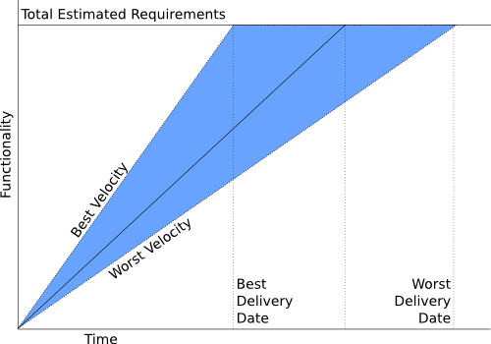
P90/P10 Ratio
P10=10% confidence
P90=90% confidence
Example
P10 = 6 months
P90 =12 months
P90/P10 = 2
P10
P90

Slide 21
Question:
Do we get better at estimating the further we go in a project?
(or: does our velocity become more stable over time?)

Slide 22
What do we see in Velocity?
Discovery: Velocity predictability does not get better over time.
Notes:
Velocity predictability does not get better over time. It starts out sucking (P90/P10 of 4.0 and actually gets a bit worse at 6.0+ This is counter to what we have been led to believe by the Cone of Uncertainty.

Slide 23
Question:
If we just use throughput (story count) to forecast completion, is it any more/less accurate than using velocity (story points)?

Slide 24
Basic Burnup

Slide 25
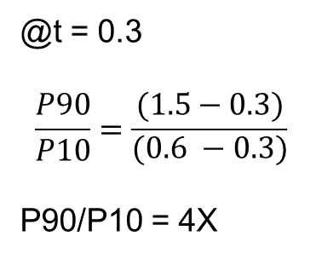
Burnup Projection to P10 and P90
@t = 0.3
P90 = 1.5
P10 = 0.6
@t = 0.3
$$\frac{P90}{P10}=\frac{(1.5−0.3)}{\begin{aligned}(0.6 −0.3) \\ \end{aligned}}$$
P90/P10 = 4X
P10
P90

Slide 26
What do we see in Projections?
Discovery: Velocity and Throughput provide comparable accuracy in forecasting release date
Notes:
Velocity and Throughput projection error bounds are nearly identical. The ratio of P90/p10 is roughly 4 for both. The ratio of the Velocity P90/P10 to the Throughput P90/P10 is basically 1.0.

Slide 27
Conclusions from the Data
Story point estimations did not provide any improvement in predictive power over just counting stories.
Velocity and throughput both showed a high variance and that variance did not decrease (actually increased) over time.
About 50% of the projects required a “hardening” phase of from 2-12%.
While throughput is as good of a predictor as velocity, neither is a great predictor as the P90/P10 ratio is about 3.5.
  if the burnup forecasts 6 months remaining, the P10 to P90 bands are roughly 3.2 to 11.2 months.

Slide 28
How about a Simulation
Simulated 1000 projects with 50 stories per project
  Story Point Distribution
  Estimation Accuracy
  Bucketing Approach
  Hardening Effort
Output
  Distribution of Projections
    Velocity
    Throughput
Monte Carlo Engine
SP Distribution
Estimation Accuracy

Slide 29
How about a Simulation
Discovery: We can run a computer
simulation that produces results similar to the measured data.
Notes:
Main point here is that we were able to come close to matching the raw data with the simulation,. That let’s us explore some of the parameters to see which ones influence the results.

Slide 30
Simulation Results – What If?
What if we look at the observed data?
  Throughput and Velocity give nearly identical results (Throughput slightly better)
What if we have a large distribution in story size?
  Velocity is better
What if we are really good at estimation?
  Somewhat surprisingly, if Story Point Distribution is not large, improving Estimation Accuracy helps Throughput as much as it helps Velocity
What if we use buckets such at Fibonacci (planning poker) or 2X etc.?
  Using buckets, such as Planning Poker modified Fibonacci, power of 2, or even power of 4 did not significantly impact the difference between velocity and throughput accuracy.

Slide 31
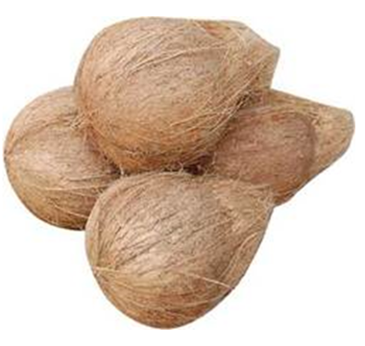
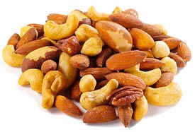
What do the simulations tell us
Estimating Mixed nuts…..

Slide 32
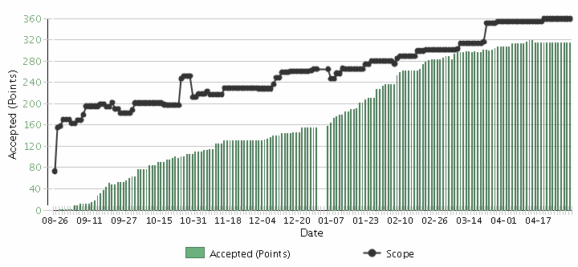
What does this tell us about Estimation?
Decisions to steer towards the release | Velocity and Throughput are equally good AND equally bad predictors, but better than nothing.
Scope Creep
Velocity

Slide 33
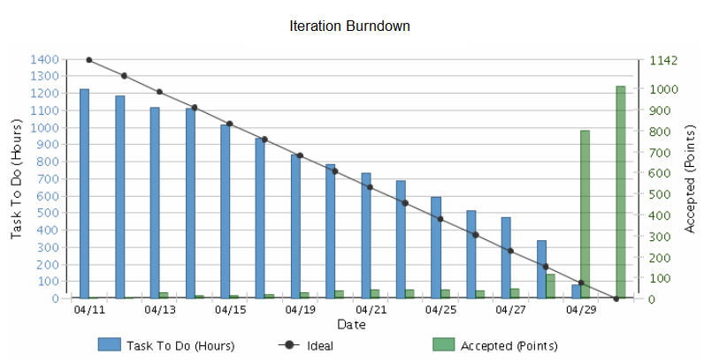
What does this tell us about Estimation?
Decisions to help with managing iterations | Do task estimates add value? What decisions are you making based on what you assume?

Slide 34
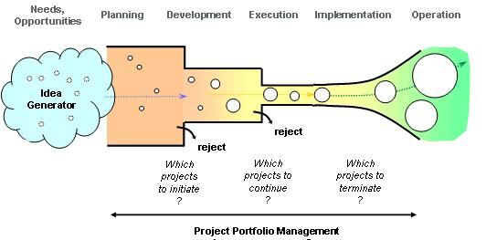

What does this tell us about Estimation?
Decisions at project sanction | Some level of macro-estimation of costs and benefits is likely necessary for business decisions. In general it is waste to spend more time on cost estimation than on benefits.

Slide 35
Comparison to other Research

Slide 36
IEEE Software, May/June 2006
Notes:
This is from an IEEE Software article that I published in May 2006

Slide 37
Accuracy of Initial Estimate

Slide 38
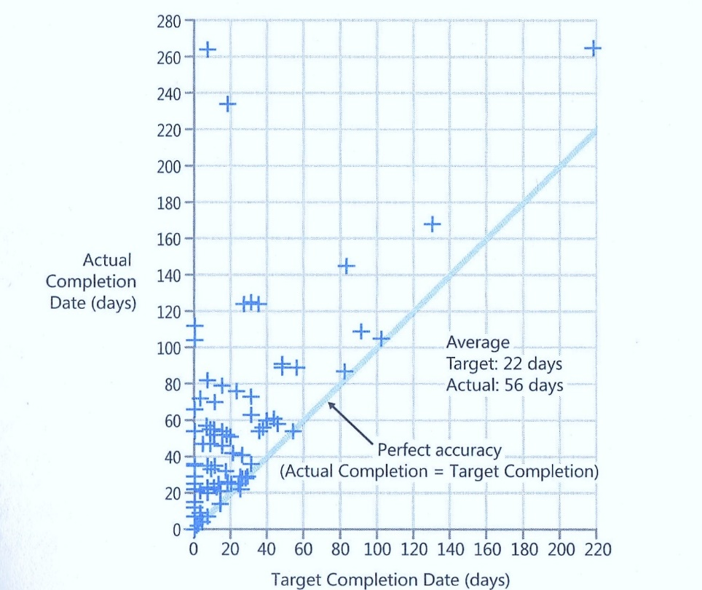
Data From Steve McConnell

Slide 39
Actual vs. Original Estimate
P90/P10 = 4

Slide 40
Jørgensen 2013
Put software development project for bid on online marketplace vWorker.com
Received 16 bids.
Reduced down to 6 bids from vendors that had high (9.5) client satisfaction.
All 6 bidders went ahead and built the software

Slide 41
Jørgensen 2013
Highest Estimate 8x the Lowest
Actual/Estimate Range: 0.7 – 2.9 (4x)
Actual Performance Range: Worst took 18X the effort of the best

Slide 42
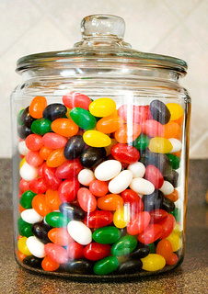
Estimation Exercise
Number of Jellybeans in the jar

Slide 43

Jellybean Results
Type of Estimate | Typical Ranges
Individual Estimates | 0.30 – 1.8 (6X)
Groups (of ~6) | 0.75 – 1.50 (2X)
Average of the Individuals | 0.80 – 1.20

Slide 44
Now What?

Slide 45
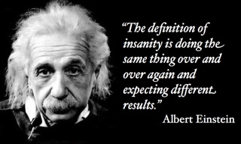
Option 1:
Continue to do the same thing

Slide 46
Option 2:
What about giving a distribution range?

Slide 47




Probability Distribution
Estimate/Actual
TELL ME HOW LONG
IT IS GOING TO TAKE
MEDIAN?
P50
WHAT PEOPLE
EXPECT
Frequency
P10
WHAT PEOPLE
HEAR
MEAN
P90
Actual/Estimated
DeMarco, Little (approximated)

Slide 48

Option 3:
Get Better at Estimating?

Slide 49
Option 4:
Get Better at Story Splitting?

Slide 50
Option 5:
Get Better at Managing Uncertainty?

Slide 51
The A/B/C List sets proper expectations
A | MUST be completed in order to ship the product and the schedule will be slipped if necessary to make this commitment. The Product Owner will take the heat for the schedule slippage.
B | Is WISHED to be completed in order to ship the product, but may be dropped without consequence.
C | Is NOT TARGETED to be completed prior to shipping, but might make it if time allows.
Only “A” features may be committed to customers.
If more than 50% of the planned effort is allocated to “A” items the project is at risk.
Notes:
(MoSCoW for Pre-Schoolers) But actually an improvement on MoSCoW. The English language is loaded. “Should” implies that if I don’t deliver it is a failure. On the other hand, by calling a “B” a “wish” I’m actually happy if it is delivered. The definition of “A” is critical. It is the Product Owner that is taking the heat for a schedule slip. This is a huge change for many teams.

Slide 52
A/B/C List
50%
25%
25%
A
B
C
D
Typical Delivery
C
A
B
Backlog Plan
Target Delivery Date
50%
100%
Notes:
We devise a plan where we look to lock down the “A” features but we create a buffer capacity by only allocating 50%. If our estimates are close then deliver all the “A”s, but we find that some of the “C”s were actually higher priority and that there were a number of “D”s that were discovered during the development. But, what if the “A”s turn out to be harder than we thought?

Slide 53
A/B/C List
A
50%
25%
25%
A
B
C
D
Uncertainty Risk
C
A
B
Backlog Plan
Target Delivery Date
50%
100%
Notes:
We devise a plan where we look to lock down the “A” features but we create a buffer capacity by only allocating 50%. If our estimates are close then deliver all the “A”s, but we find that some of the “C”s were actually higher priority and that there were a number of “D”s that were discovered during the development. But, what if the “A”s turn out to be harder than we thought?

Slide 54
Option 6:
Get Better at Continuous Delivery (DevOps)?

Slide 55
Option 7:
Count Stories?

Slide 56
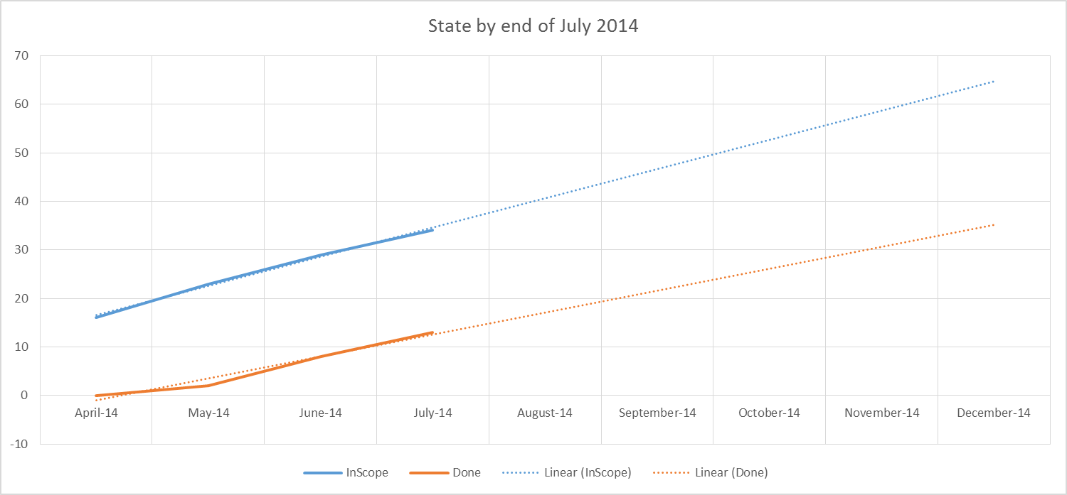
#NoEstimates Example
Count Stories

Slide 57
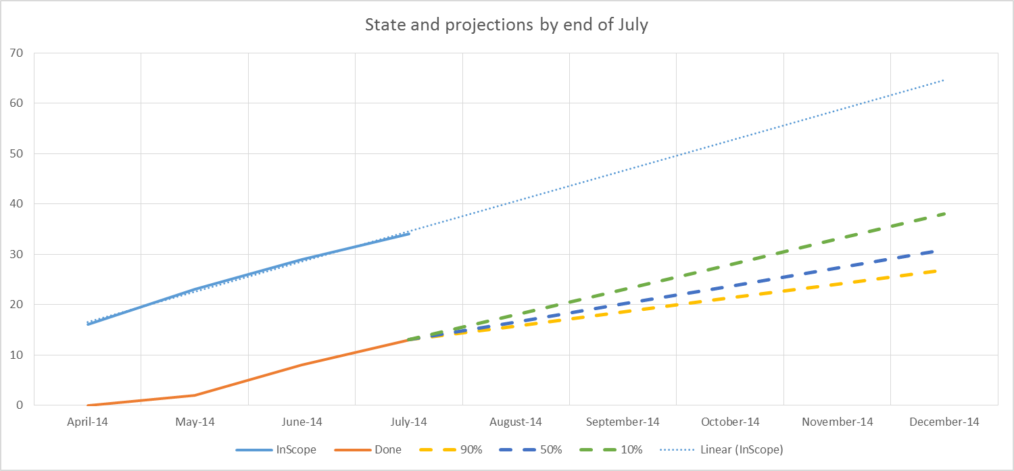
#NoEstimates Example
Count Stories

Slide 58
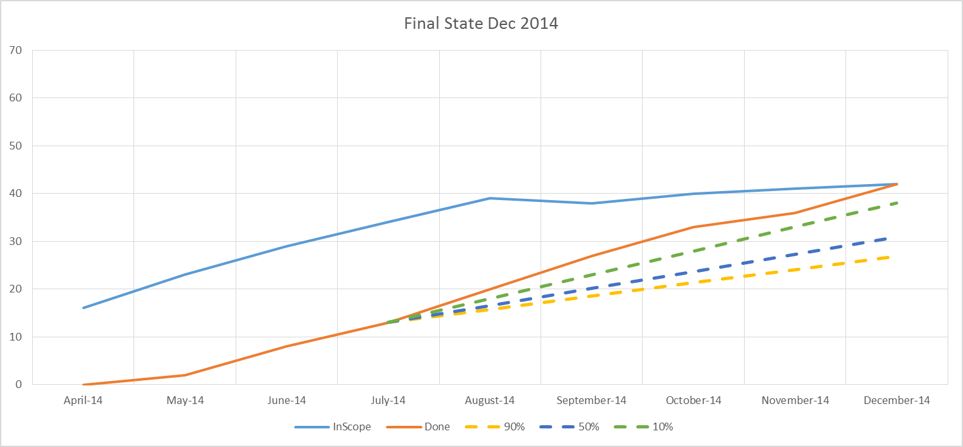
#NoEstimates Example
Count Stories

Slide 59
Macro-estimates for cost/value tradeoff decisions | Sometimes useful
Story Point estimates | Marginal at best
Task estimates | Probably Waste
Focus on value and use data to make decisions | Priceless
There are sometimes that estimates are useful, for everything else there's #NoEstimates

Slide 60

Estimation Values
Macro-estimates for cost/value tradeoff decisions
  Sometimes useful
Story Point estimates
  Marginal at best
Task estimates
  Probably Waste
Focus on value and use data to make decisions
  Priceless
There are sometimes that estimates are useful, for everything else there's #NoEstimates

Slide 61
What would Polonius Say?
Neither an Estimator nor a #NoEstimation bigot be, for estimation oft implies a false sense of both accuracy and certainty, while NO estimates may make suboptimal decisions. To thine own self (and team) be true.
“
”
Webinar Series 2016
©Todd Little, IHS 61
www.synerzip.com

Slide 62
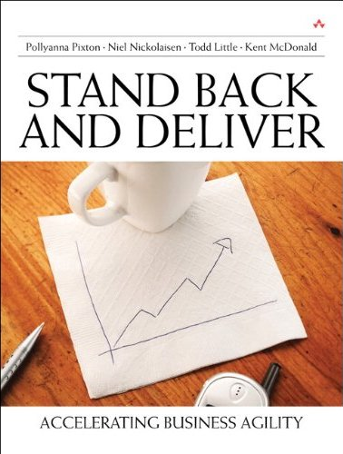
Contact
Todd Little
  toddelittle@gmail.com
  www.toddlittleweb.com
  @toddelittle
  www.linkedin.com/in/toddelittle/

Slide 63


www.synerzip.com
Todd Chipman
todd@synerzip.com
469.374.0500
63

Slide 64
Synerzip
Your trusted outsourcing partner for
Agile software product development.
Accelerate the delivery of your product roadmap
Address technology skill gaps
Save at least 50% with offshore software development
Augment your team with optional on-site professionals
Notes:
Our process is end-to-end: feature development includes frequent release schedules, daily collaboration to ensure alignment, user stories and requirement validation. Test engineering and automation happen in parallel with development to ensure each release is production-ready.
With Synerzip, you have a dedicated team of fully functioning software professionals who are already used to working together. You direct resources, product roadmap, schedule and priorities. The Synerzip team fully integrates with your in-house team; and, we have very low attrition, which ensures business continuity. Teams easily adjust to changing business needs - no change requests are required. All of our clients are references

Slide 65


























































































Synerzip Clients

Slide 66

Next Webinar
4 iPaaS Use Cases:
Accelerating Hybrid Cloud and Big Data Integration
on Wednesday, July 20, 2016 at noon CST
Webinar Presenter:
Darren Cunningham,
Vice President Marketing
at SnapLogic

Slide 67



Connect with Synerzip
@Synerzip
linkedin.com/company/synerzip
facebook.com/Synerzip
Todd Chipman
todd@synerzip.com
469.374.0500

