Slide 1
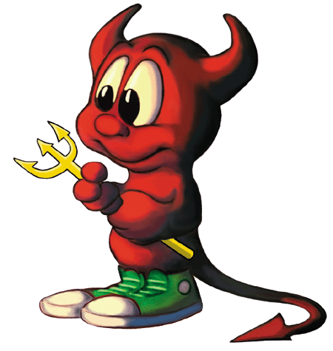
7 Sins of Scrum and other Agile Anti-Patterns
Todd Little
VP Product Development
September 2015
www.synerzip.com
Webinar Series 2015

Slide 2
Disclaimer
!7
!Sins
!Scrum

Slide 3
Agile Manifesto
We are uncovering better ways of developing software by doing it and helping others do it. Through this work we have come to value:
Individuals and interactions | over | processes and tools
Working software | over | comprehensive documentation
Customer collaboration | over | contract negotiation
Responding to change | over | following a plan
That is, while there is value in the items on the right, we value the items on the left more.

Slide 4
Antipatterns
Jim Coplien: “An anti-pattern is something that looks like a good idea, but which backfires badly when applied.”

Slide 5
Sinner’s Manifesto
We think we know what we are doing. It looks like a good idea or someone told us that is the best way to do it so we’ll do more of it. Through this we may have accidentally come to value:
Potential Sin | Over | Virtue
The sin is not always a bad idea. There may be significant value in moderation, but in excess it can be an anti-pattern. The path the redemption is to look to the virtue.

Slide 6
Heresy

Slide 7
Potential Sin #1
Potential Sin |  | Virtue
Processes and Tools | Over | Individuals and Interactions

Slide 8
Alexey Krivitsky

Slide 9
Potential Sin #1: Processes and Tools Over Individuals and Interactions
Potential Sin |  | Virtue
Agile is the Tool | Over | The tools support agility

Slide 10
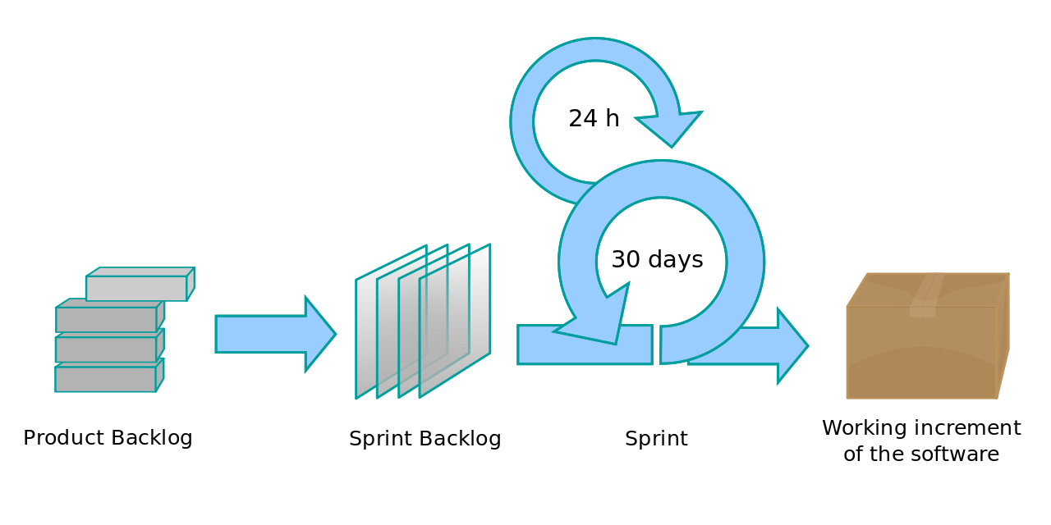
Potential Sin #1: Processes and Tools Over Individuals and Interactions
Potential Sin |  | Virtue
Agile is a process | Over | Agility is a mindset

Slide 11
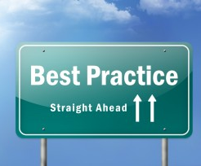
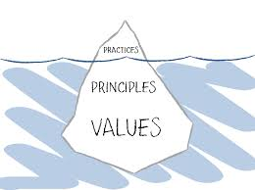
Potential Sin #1: Processes and Tools Over Individuals and Interactions
Potential Sin |  | Virtue
Best Practices | Over | Principles and Values

Slide 12
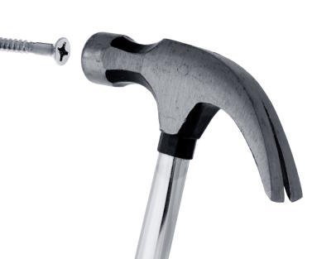
Potential Sin #1: Processes and Tools Over Individuals and Interactions
Potential Sin |  | Virtue
One size fits all | Over | Context

Slide 13
Potential Sin #1: Processes and Tools Over Individuals and Interactions
Potential Sin |  | Virtue
Collaboration | Over | Shared Ownership

Slide 14
Potential Sin #2
Potential Sin |  | Virtue
Status | Over | Flow of Value

Slide 15
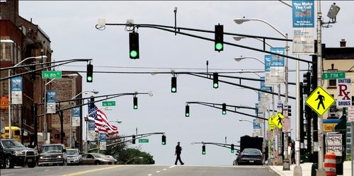
Potential Sin #2: Status over Flow of Value
Potential Sin |  | Virtue
Showing Progress | Over | Delivering Value

Slide 16
Potential Sin #2: Status over Flow of Value
Potential Sin |  | Virtue
Checking Boxes | Over | Learning and Adapting
Feedback Loop

Slide 17
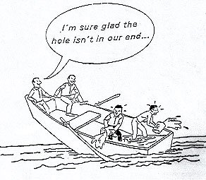
Potential Sin #2: Status over Flow of Value
Potential Sin |  | Virtue
My part is done | Over | Team is done

Slide 18
Potential Sin #2: Status over Flow of Value
Potential Sin |  | Virtue
Individual Utilization | Over | Team Throughput

Slide 19
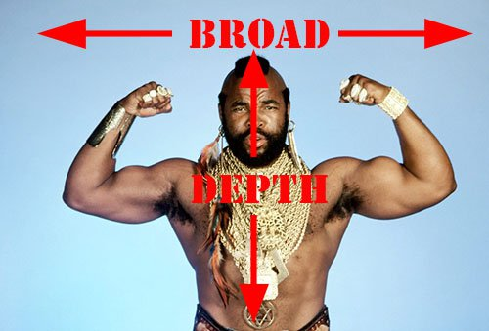
Potential Sin #2: Status over Flow of Value
Potential Sin |  | Virtue
Specialization | Over | Generalization

Slide 20
Potential Sin #3
Potential Sin |  | Virtue
Stories | Over | Strategy

Slide 21
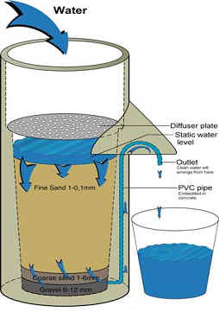
Potential Sin #3: Stories over Strategy
Potential Sin |  | Virtue
Buckets | Over | Filters

Slide 22
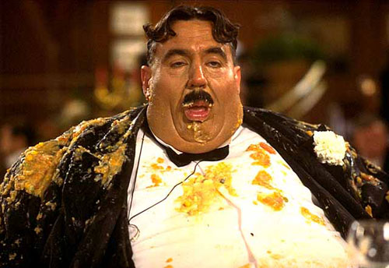
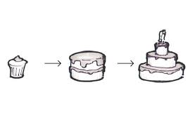
Potential Sin #3: Stories over Strategy
Potential Sin |  | Virtue
I want it all (Gluttony) | Over | Minimum Viable Product

Slide 23
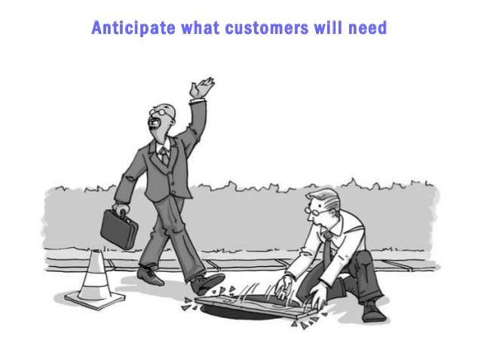
Potential Sin #3: Stories over Strategy
Potential Sin |  | Virtue
Listening to Customers | Over | Learning what they really need

Slide 24
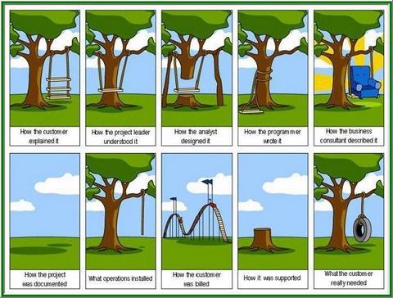
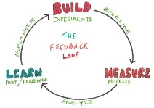
Potential Sin #3: Stories over Strategy
Potential Sin |  | Virtue
I know what they need | Over | Validating hypothesis

Slide 25
Potential Sin #3: Stories over Strategy
Potential Sin |  | Virtue
Tasks | Over | Stories

Slide 26
Potential Sin #3: Stories over Strategy
Potential Sin |  | Virtue
Following orders | Over | Understanding Why

Slide 27
Potential Sin #4
Potential Sin |  | Virtue
Crap | Over | Craftsmanship

Slide 28
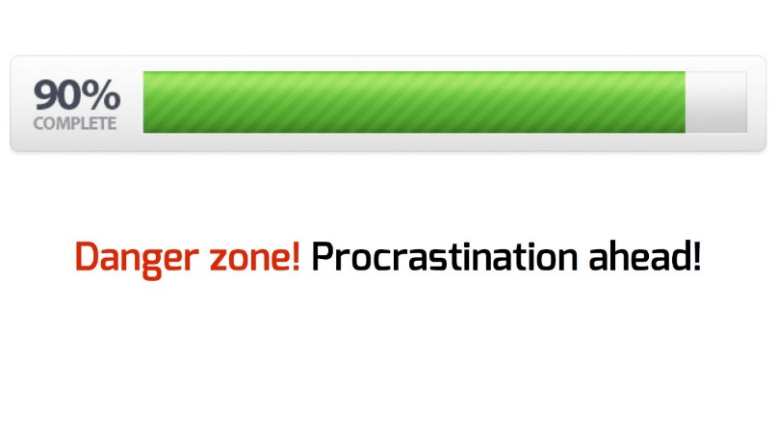
Potential Sin #4: Crap over Craftsmanship
Potential Sin |  | Virtue
Almost done | Over | Really done

Slide 29
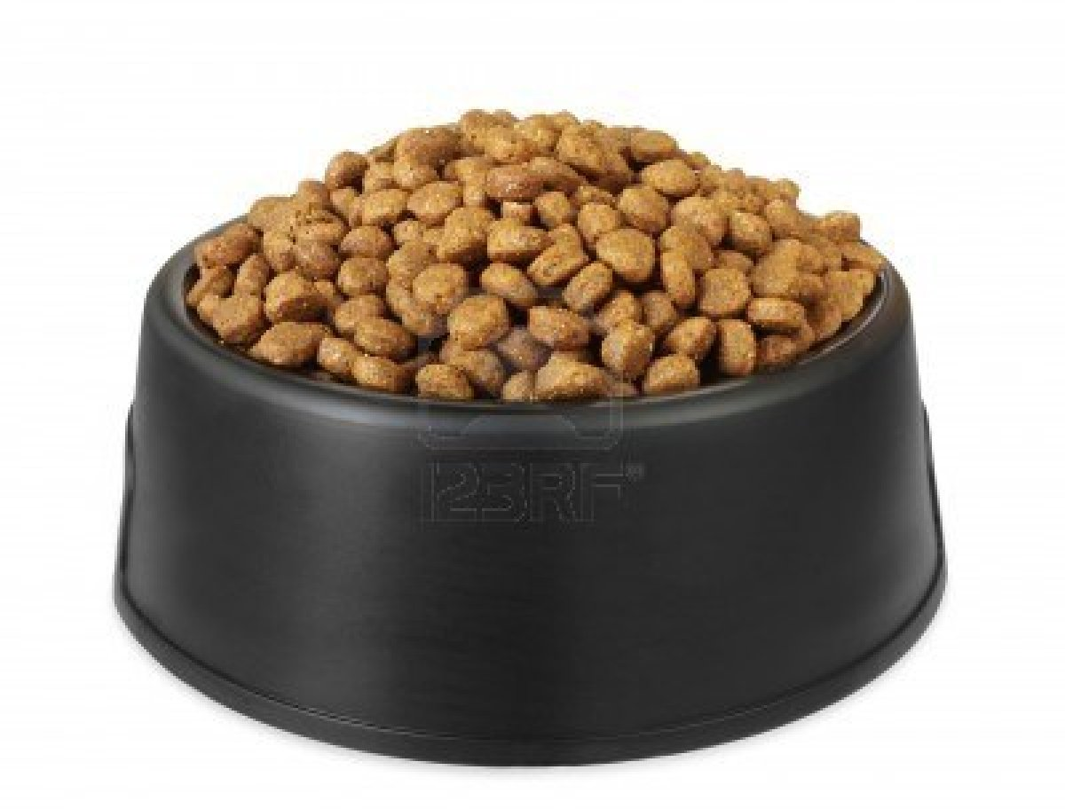
Potential Sin #4: Crap over Craftsmanship
Potential Sin |  | Virtue
Velocity | Over | Quality

Slide 30
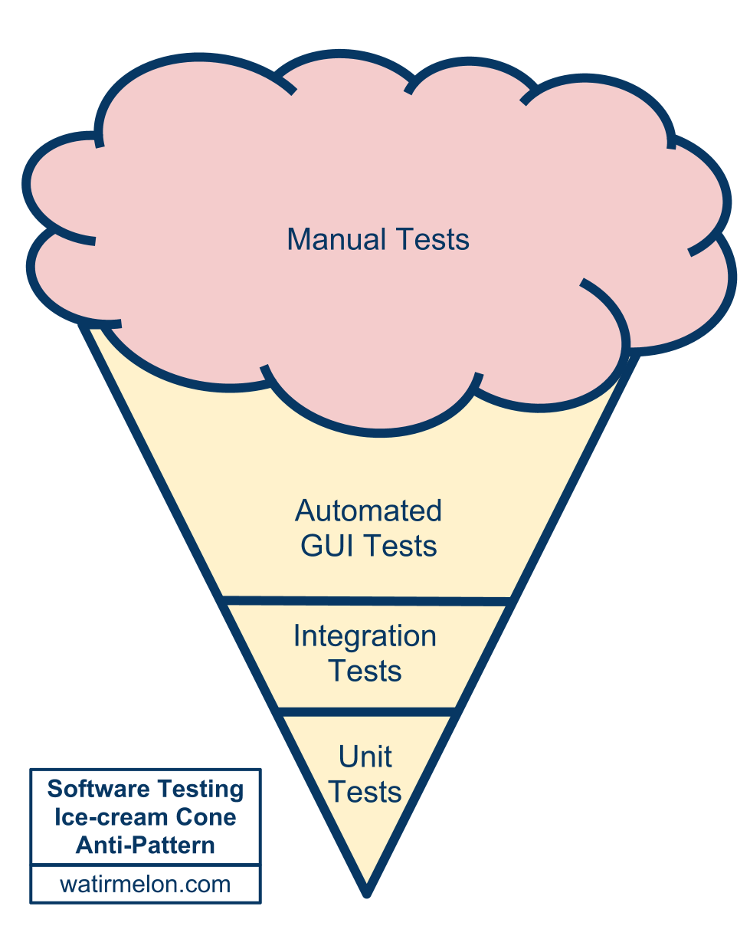
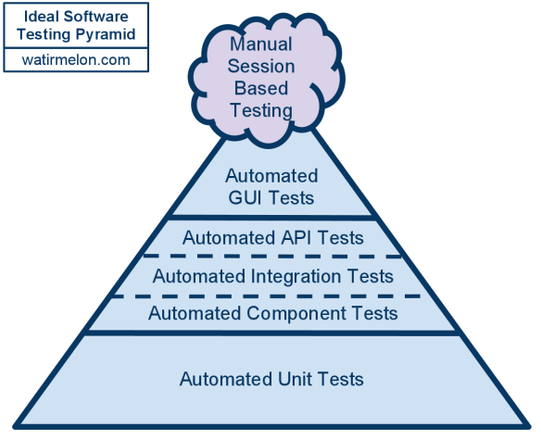
Potential Sin #4: Crap over Craftsmanship
Potential Sin |  | Virtue
Testing quality in | Over | Building quality in

Slide 31
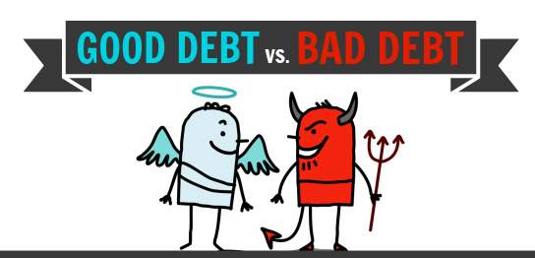
Potential Sin #4: Crap over Craftsmanship
Potential Sin |  | Virtue
Technical debt is evil | Over | Technical debt is debt

Slide 32
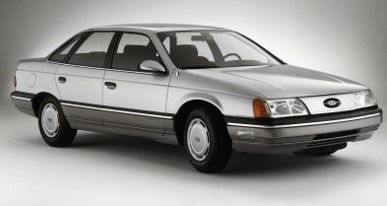
Potential Sin #4: Crap over Craftsmanship
Potential Sin |  | Virtue
Cost of Crap | Over | Cost of Delay

Slide 33
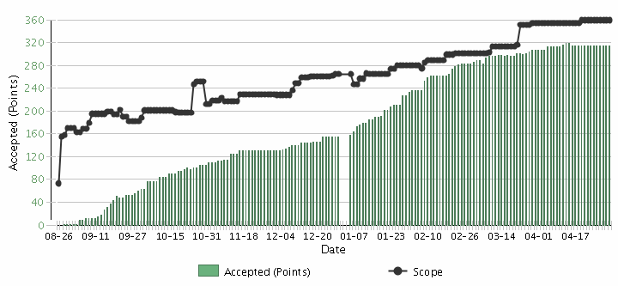
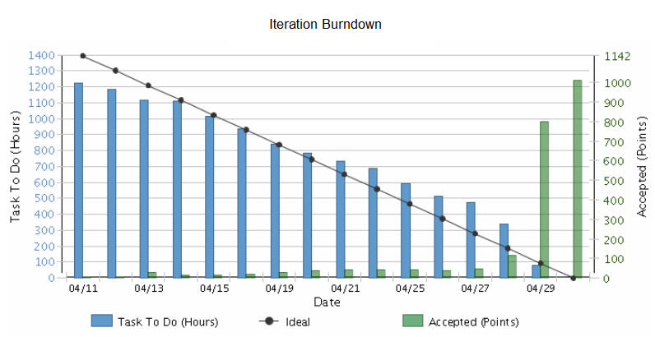
Potential Sin #5
Potential Sin |  | Virtue
Iterations | Over | Releases

Slide 34
Potential Sin #5: Iterations over Releases
Potential Sin |  | Virtue
Potentially Shippable Increments (PSIs) | Over | Releases

Slide 35
Potential Sin #5: Iterations over Releases
Potential Sin |  | Virtue
Commitment | Over | Focus on Value

Slide 36
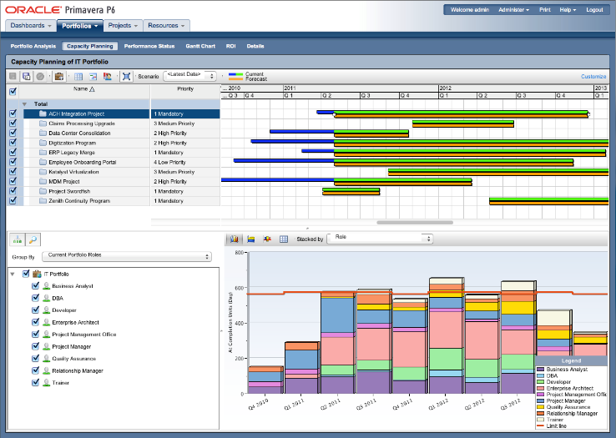
Potential Sin #5: Iterations over Releases
Potential Sin |  | Virtue
Capacity planning | Over | Velocity planning

Slide 37
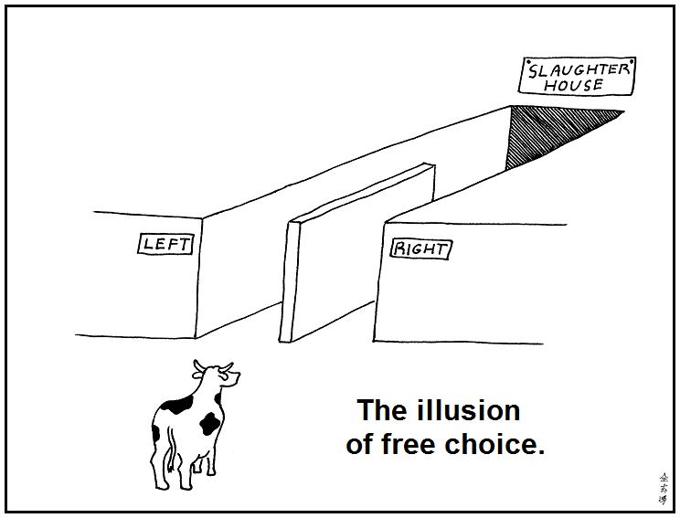
Potential Sin #6
Potential Sin |  | Virtue
Illusion | Over | Reality

Slide 38
Potential Sin #6: Illusion over Reality
Potential Sin |  | Virtue
Gross velocity | Over | Net velocity
Scope Creep
Velocity
Velocity

Slide 39
Potential Sin #6: Illusion over Reality
Potential Sin |  | Virtue
Unpointed stories | Over | Best estimate

Slide 40
Potential Sin #6: Illusion over Reality
Potential Sin |  | Virtue
Velocity | Over | Quality

Slide 41
Potential Sin #6: Illusion over Reality
Potential Sin |  | Virtue
Estimation | Over | Forecasting
Scope Creep
Velocity

Slide 42
Potential Sin #6: Illusion over Reality
Potential Sin |  | Virtue
Microestimation | Over | Macroestimation

Slide 43
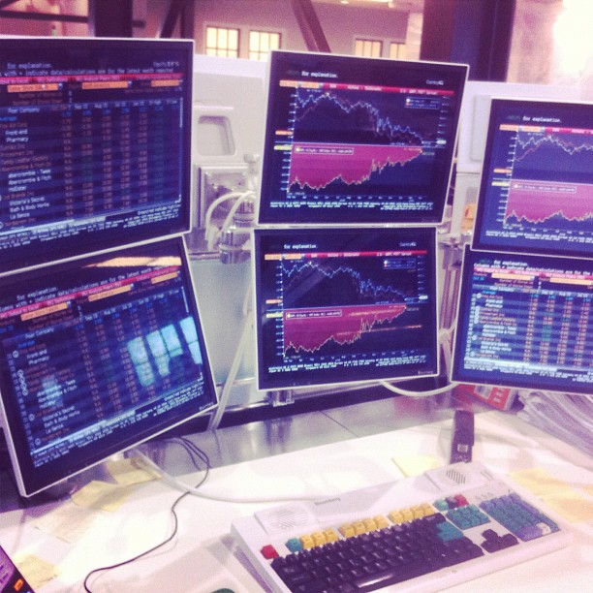
Potential Sin #6: Illusion over Reality
Potential Sin |  | Virtue
Vanity metrics | Over | Decision metrics

Slide 44
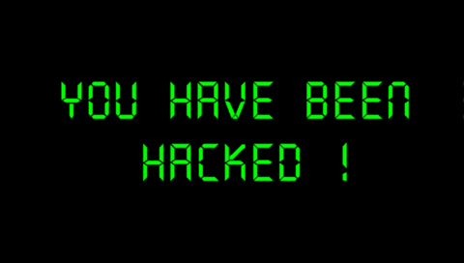
Potential Sin #7
Potential Sin |  | Virtue
Organizational Hacks | Over | Leadership

Slide 45
Potential Sin #7: Organizational Hacks over Leadership
Potential Sin |  | Virtue
Controlling inputs | Over | Controlling outputs/outcomes
Processes
Inputs
Inputs
Inputs
Processes
Inputs
Inputs
Inputs
Outputs
Micromanagement
Agile Leadership

Slide 46
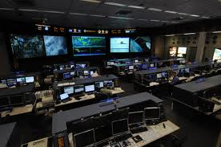
Potential Sin #7: Organizational Hacks over Leadership
Potential Sin |  | Virtue
Micromanagement | Over | Macromanagement

Slide 47
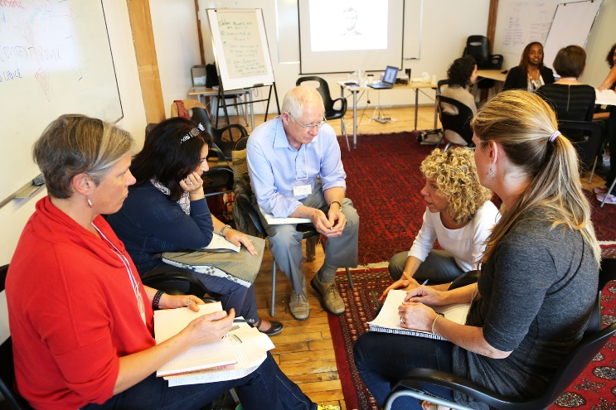
Potential Sin #7: Organizational Hacks over Leadership
Potential Sin |  | Virtue
Taking sides | Over | Serving the whole team

Slide 48
Potential Sin #7: Organizational Hacks over Leadership
Potential Sin |  | Virtue
Meetings | Over | Actions & Resolutions

Slide 49
Potential Sin #7: Organizational Hacks over Leadership
Potential Sin |  | Virtue
Certification | Over | Qualification

Slide 50
The Sinner Summary
Processes and Tools | Over | Individuals and Interactions
Status | Over | Flow of Value
Stories | Over | Strategy
Crap | Over | Craftsmanship
Iterations | Over | Releases
Illusion | Over | Reality
Organizational Hacks | Over | Leadership

Slide 51
The Virtuous Path
Use Retrospectives
Improve Incrementally
1-2 Items
Get Coaching as needed

Slide 52
Thank you!
Questions?

Slide 53
www.synerzip.com
Hemant Elhence
hemant@synerzip.com
469.374.0500
53

Slide 54
Synerzip in a Nutshell
Software product development partner for small/mid-sized technology companies
Exclusive focus on small/mid-sized technology companies, typically venture-backed companies in growth phase
By definition, all Synerzip work is the IP of its respective clients
Deep experience in full SDLC – design, dev, QA/testing, deployment
Dedicated team of high caliber software professionals for each client
Seamlessly extends client’s local team offering full transparency
Stable teams with very low turn-over
NOT just “staff augmentation, but provide full management support
Actually reduces risk of development/delivery
Experienced team – uses appropriate level of engineering discipline
Practices Agile development – responsive yet disciplined
Reduces cost – dual-site team, 50% cost advantage
Offers long-term flexibility – allows (facilitates) taking offshore team captive – aka “BOT” option

Slide 55
Synerzip Clients
Notes:
55
55

Slide 56
Next Webinar
Technical Webinar: Running your MicroServices on Docker - An Experience Report Complimentary Webinar: Tuesday, October 21, 2015 @ Noon CST
Presented by: Robert Bastian
Director, Platform Architecture at DrillingInfo

Slide 57
Connect with Synerzip
@Synerzip_Agile
linkedin.com/company/synerzip
facebook.com/Synerzip
Hemant Elhence
hemant@synerzip.com
469.374.0500
Notes:
57
57

