Slide 1
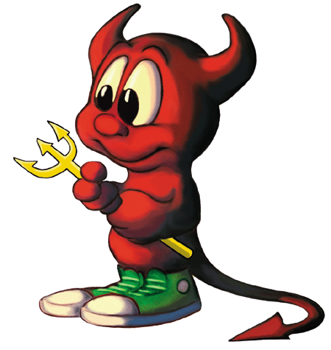
7 Sins of Scrum and other Agile Anti-Patterns
Todd Little
VP Product Development
June 2015

Slide 2
Disclaimer
!7
!Sins
!Scrum

Slide 3
Agile Manifesto
We are uncovering better ways of developing software by doing it and helping others do it. Through this work we have come to value:
Individuals and interactions | over | processes and tools
Working software | over | comprehensive documentation
Customer collaboration | over | contract negotiation
Responding to change | over | following a plan
That is, while there is value in the items on the right, we value the items on the left more.

Slide 4
Auditor Manifesto
We are uncovering better ways of auditing software development by forcing others do it how we tell them. Through this work we have come to value:
Processes and tools | over | individuals and interactions
Comprehensive documentation | over | working software
Contract negotiation | over | customer collaboration
Following a plan | over | responding to change
That is, while there may be value in the items on the right, we have chosen to ignore them as they are difficult to audit. We only care about the items on the left and we will make sure that you do too!

Slide 5
Antipatterns
Jim Coplien: “an anti-pattern is something that looks like a good idea, but which backfires badly when applied.”

Slide 6
Sinner’s Manifesto
We think we know what we are doing. It looks like a good idea or someone told us that is the best way to do it so we’ll do more of it. Through this we may have accidentally come to value:
Potential Sin | Over | Virtue
The sin is not always a bad idea. There may be significant value in moderation, but in excess it can be an anti-pattern. The path the redemption is to look to the virtue.

Slide 7
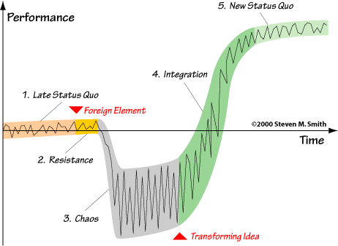
Satir Change Model
We suck less

Slide 8
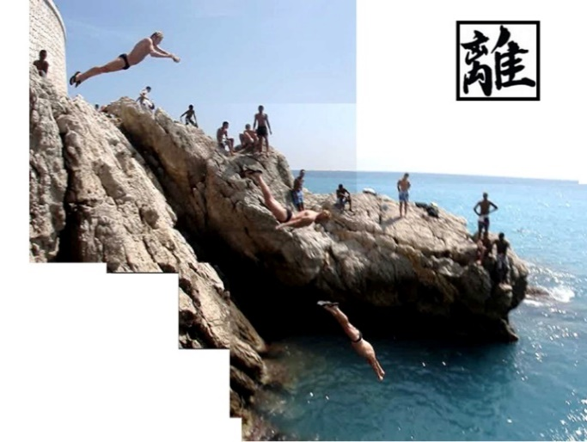
Shu – Ha – Ri (learn, detach, and transcend) Learner – Practitioner – Mastery
Read
Write
Delete

Slide 9
Shu-Ha-Ri applied to Meetings
Beginner –Read
Call a Meeting
Practitioner - Write
Run a Meeting
Mastery - Delete
Cancel Meetings

Slide 10
Danger
Do try this at home or with your team, just not all at once
Use Retrospectives
Improve Incrementally
1-2 Items
Ask for Coaching

Slide 11
Heresy

Slide 12
Potential Sin #1
Potential Sin |  | Virtue
Processes and Tools | Over | Individuals and Interactions

Slide 13
Alexey Krivitsky

Slide 14
Potential Sin #1: Processes and Tools Over Individuals and Interactions
Potential Sin |  | Virtue
Agile is the Tool | Over | The tools support agility

Slide 15
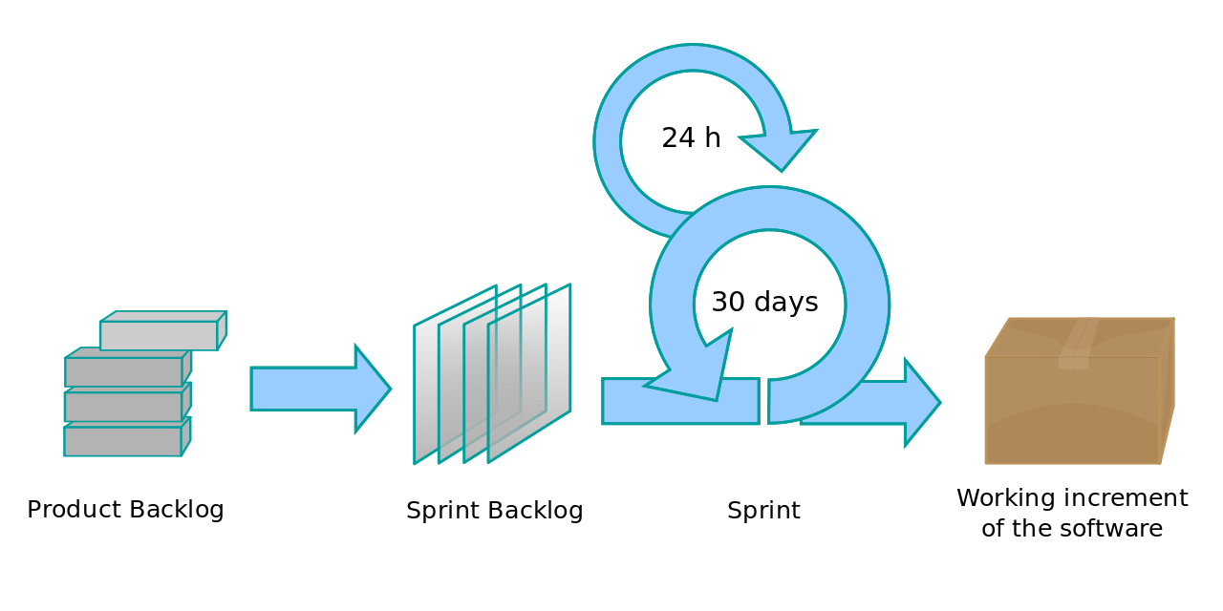
Potential Sin #1: Processes and Tools Over Individuals and Interactions
Potential Sin |  | Virtue
Agile is a process | Over | Agile is a mindset

Slide 16
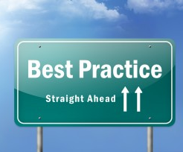
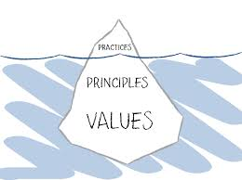
Potential Sin #1: Processes and Tools Over Individuals and Interactions
Potential Sin |  | Virtue
Best Practices | Over | Principles and Values

Slide 17
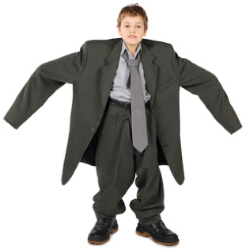
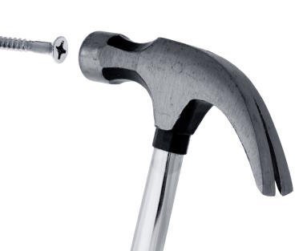
Potential Sin #1: Processes and Tools Over Individuals and Interactions
Potential Sin |  | Virtue
One size fits all | Over | Context

Slide 18
Potential Sin #1: Processes and Tools Over Individuals and Interactions
Potential Sin |  | Virtue
Collaboration | Over | Shared Ownership

Slide 19
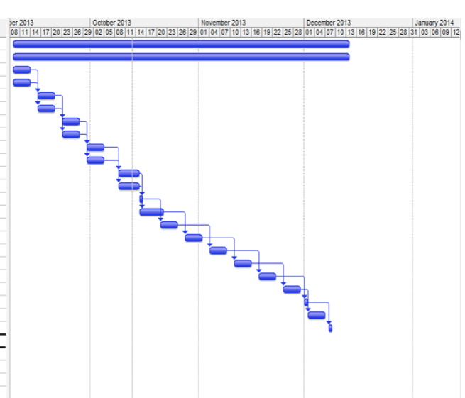
Potential Sin #1: Processes and Tools Over Individuals and Interactions
Potential Sin |  | Virtue
Projects | Over | Teams

Slide 20
Potential Sin #2
Potential Sin |  | Virtue
Status | Over | Flow

Slide 21
Potential Sin #2: Status over Flow
Potential Sin |  | Virtue
Checking Boxes | Over | Learning and Adapting
Feedback Loop

Slide 22
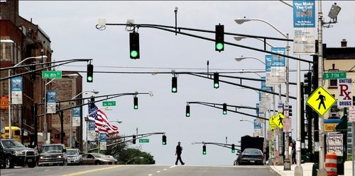
Potential Sin #2: Status over Flow
Potential Sin |  | Virtue
Showing Progress | Over | Delivering Value

Slide 23
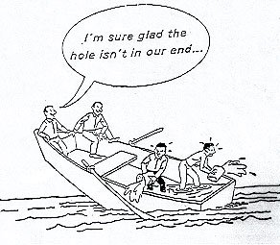
Potential Sin #2: Status over Flow
Potential Sin |  | Virtue
My part is done | Over | Team is done

Slide 24
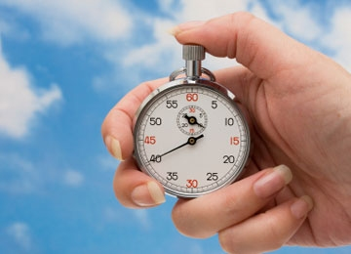
Potential Sin #2: Status over Flow
Potential Sin |  | Virtue
Individual Utilization | Over | Team Throughput

Slide 25
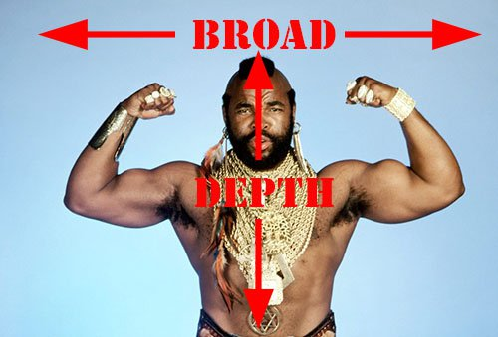
Potential Sin #2: Status over Flow
Potential Sin |  | Virtue
Specialization | Over | Generalization

Slide 26
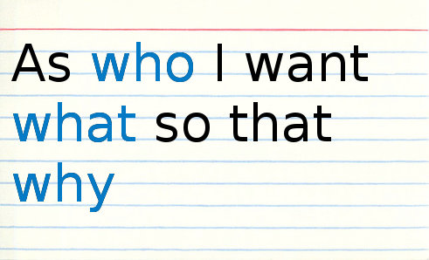
Potential Sin #3
Potential Sin |  | Virtue
Stories | Over | Strategy

Slide 27
Potential Sin #3: Stories over Strategy
Potential Sin |  | Virtue
Tasks | Over | Stories

Slide 28
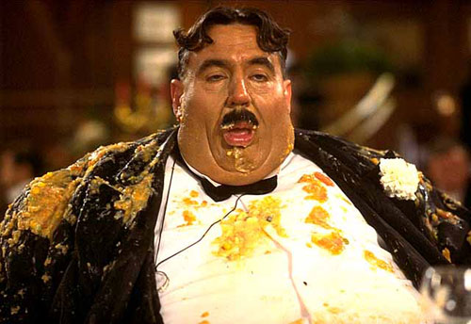
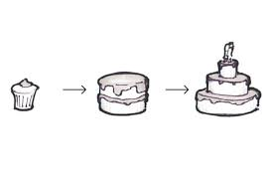
Potential Sin #3: Stories over Strategy
Potential Sin |  | Virtue
I want it all (Gluttony) | Over | Minimum Viable Product

Slide 29
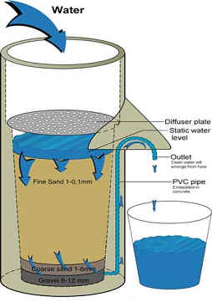
Potential Sin #3: Stories over Strategy
Potential Sin |  | Virtue
Buckets | Over | Filters

Slide 30
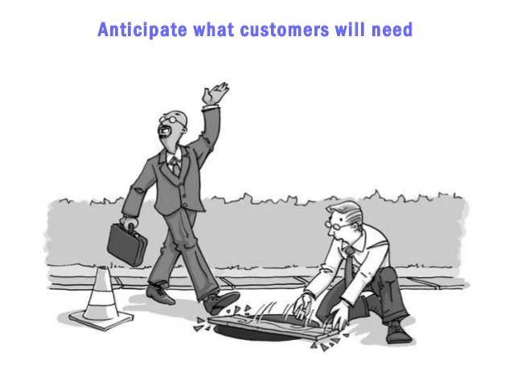
Potential Sin #3: Stories over Strategy
Potential Sin |  | Virtue
Listening to Customers | Over | Learning what they really need

Slide 31
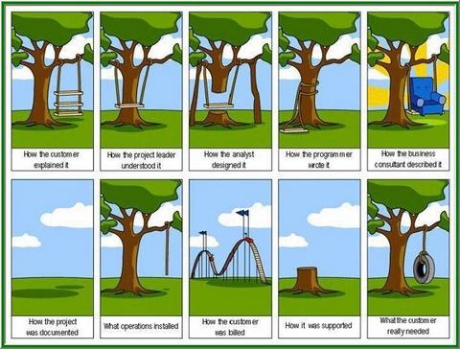
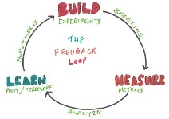
Potential Sin #3: Stories over Strategy
Potential Sin |  | Virtue
I know what they need | Over | Validating hypothesis

Slide 32
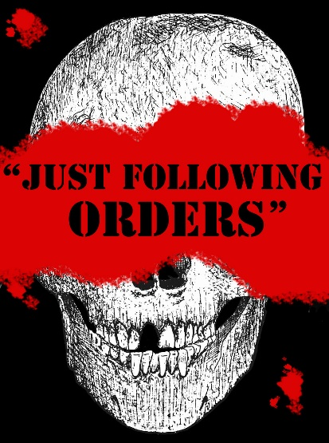
Potential Sin #3: Stories over Strategy
Potential Sin |  | Virtue
Following orders | Over | Understanding Why

Slide 33
Potential Sin #4
Potential Sin |  | Virtue
Crap | Over | Craftsmanship

Slide 34
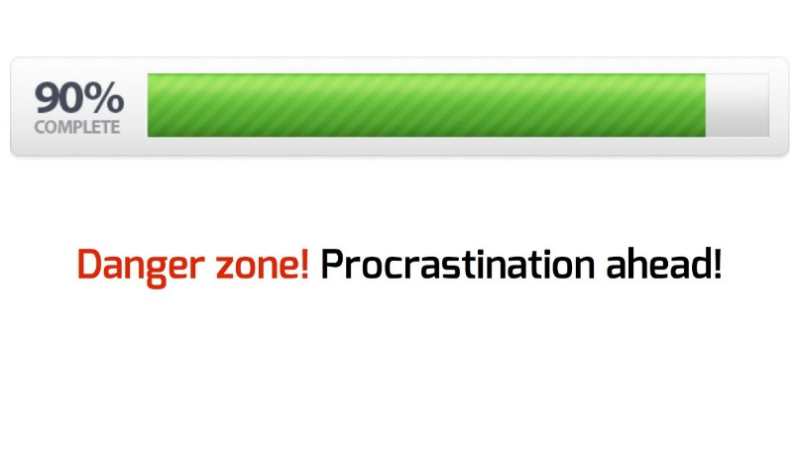
Potential Sin #4: Crap over Craftsmanship
Potential Sin |  | Virtue
Almost done | Over | Really done

Slide 35
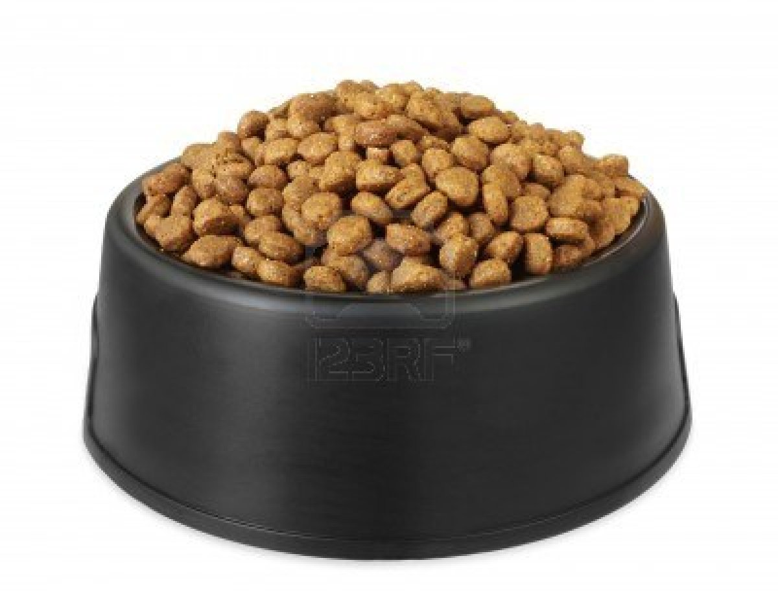
Potential Sin #4: Crap over Craftsmanship
Potential Sin |  | Virtue
Velocity | Over | Quality

Slide 36
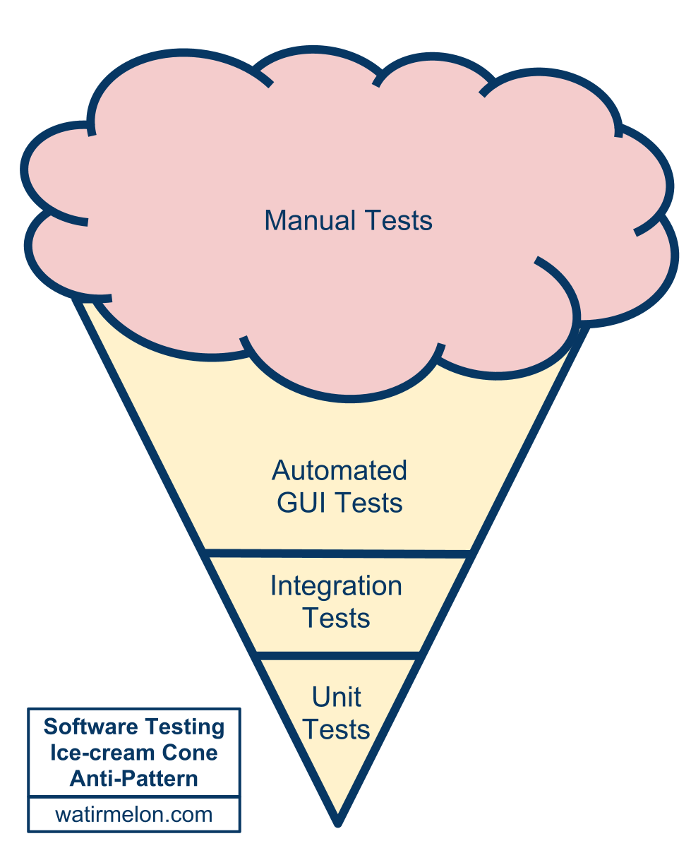
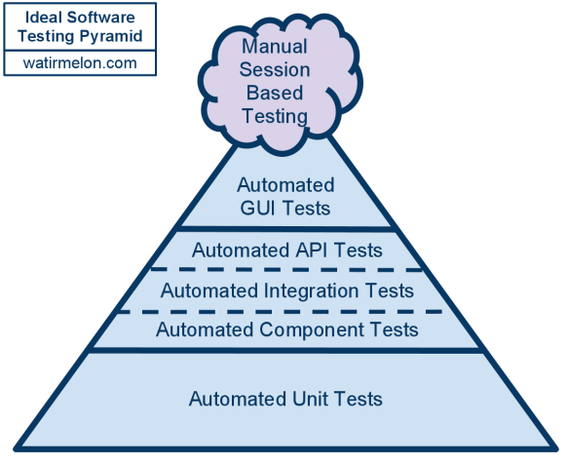
Potential Sin #4: Crap over Craftsmanship
Potential Sin |  | Virtue
Testing quality in | Over | Building quality in

Slide 37
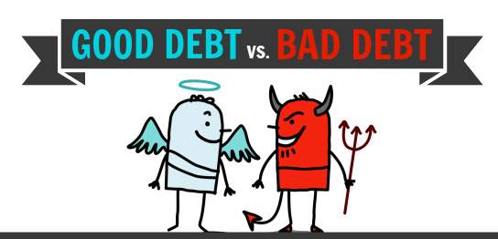
Potential Sin #4: Crap over Craftsmanship
Potential Sin |  | Virtue
Technical debt is evil | Over | Technical debt is debt

Slide 38
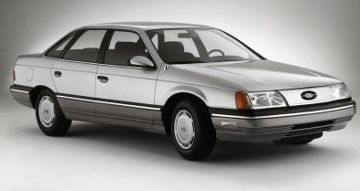
Potential Sin #4: Crap over Craftsmanship
Potential Sin |  | Virtue
Cost of Crap | Over | Cost of Delay

Slide 39
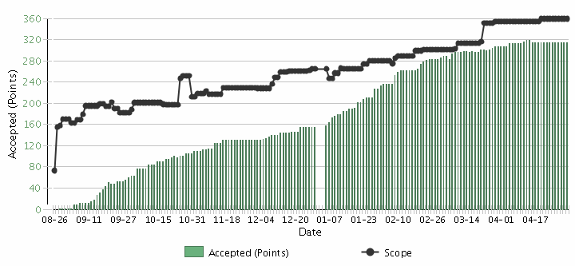
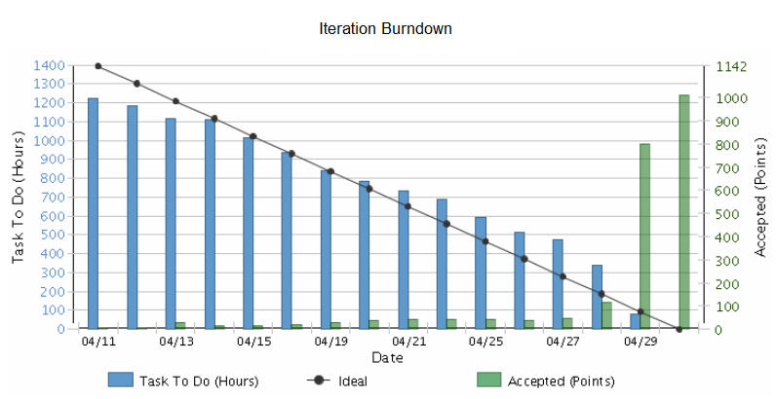
Potential Sin #5
Potential Sin |  | Virtue
Iterations | Over | Releases

Slide 40
Potential Sin #5: Iterations over Releases
Potential Sin |  | Virtue
Potentially Shippable Increments (PSIs) | Over | Releases

Slide 41
Potential Sin #5: Iterations over Releases
Potential Sin |  | Virtue
Commitment | Over | Focus

Slide 42
Potential Sin #5: Iterations over Releases
Potential Sin |  | Virtue
Time boxes | Over | Value

Slide 43
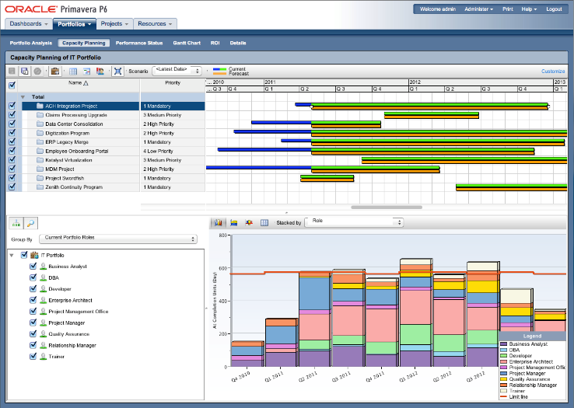
Potential Sin #5: Iterations over Releases
Potential Sin |  | Virtue
Capacity planning | Over | Velocity planning

Slide 44
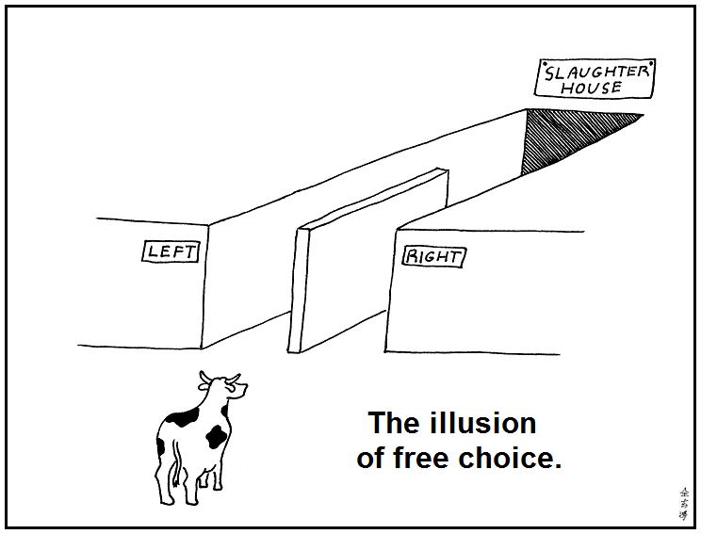
Potential Sin #6
Potential Sin |  | Virtue
Illusion | Over | Reality

Slide 45
Potential Sin #6: Illusion over Reality
Potential Sin |  | Virtue
Gross velocity | Over | Net velocity
Scope Creep
Velocity
Velocity

Slide 46
Potential Sin #6: Illusion over Reality
Potential Sin |  | Virtue
Unpointed stories | Over | Best estimate

Slide 47
Potential Sin #6: Illusion over Reality
Potential Sin |  | Virtue
Velocity | Over | Quality

Slide 48
Potential Sin #6: Illusion over Reality
Potential Sin |  | Virtue
Estimation | Over | Forecasting
Scope Creep
Velocity

Slide 49
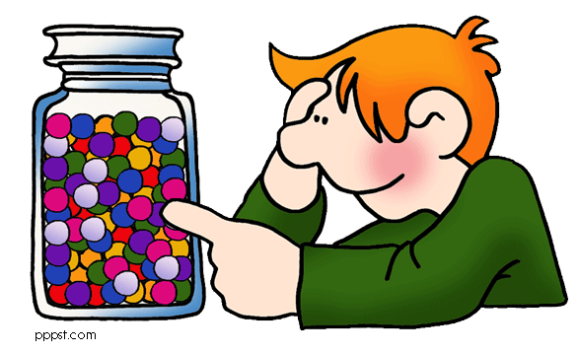
Potential Sin #6: Illusion over Reality
Potential Sin |  | Virtue
Microestimation | Over | Macroestimation

Slide 50
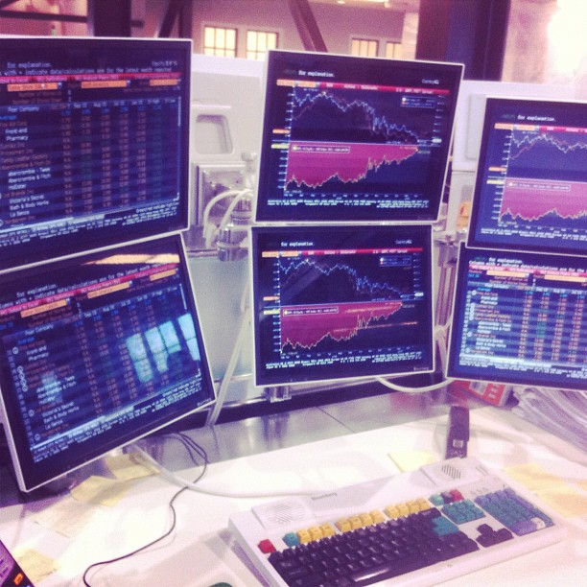
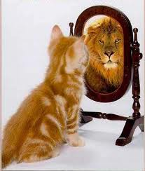
Potential Sin #6: Illusion over Reality
Potential Sin |  | Virtue
Vanity metrics | Over | Decision metrics

Slide 51
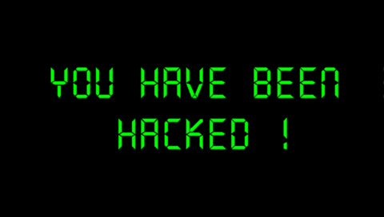
Potential Sin #7
Potential Sin |  | Virtue
Organizational Hacks | Over | Leadership

Slide 52
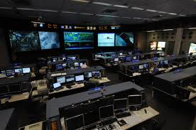
Potential Sin #7: Organizational Hacks over Leadership
Potential Sin |  | Virtue
Micromanagement | Over | Macromanagement

Slide 53
Potential Sin #7: Organizational Hacks over Leadership
Potential Sin |  | Virtue
Controlling inputs | Over | Controlling outputs/outcomes
Processes
Inputs
Inputs
Inputs
Processes
Inputs
Inputs
Inputs
Outputs
Micromanagement
Agile Leadership

Slide 54
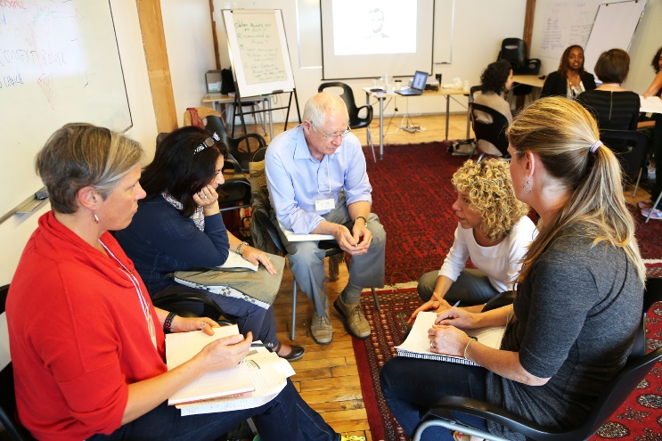
Potential Sin #7: Organizational Hacks over Leadership
Potential Sin |  | Virtue
Taking sides | Over | Serving the whole team

Slide 55
Potential Sin #7: Organizational Hacks over Leadership
Potential Sin |  | Virtue
Meetings | Over | Actions & Resolutions

Slide 56
Potential Sin #7: Organizational Hacks over Leadership
Potential Sin |  | Virtue
Certification | Over | Qualification

Slide 57
The Sinner Summary
Processes and Tools | Over | Individuals and Interactions
Status | Over | Flow
Stories | Over | Strategy
Crap | Over | Craftsmanship
Iterations | Over | Releases
Illusion | Over | Reality
Organizational Hacks | Over | Leadership

Slide 58
The path to Ri
Do try this at home or with your team, just not all at once
Use Retrospectives
Improve Incrementally
1-2 Items
Ask for Coaching

Slide 59
Thank you!
Questions?

Slide 60
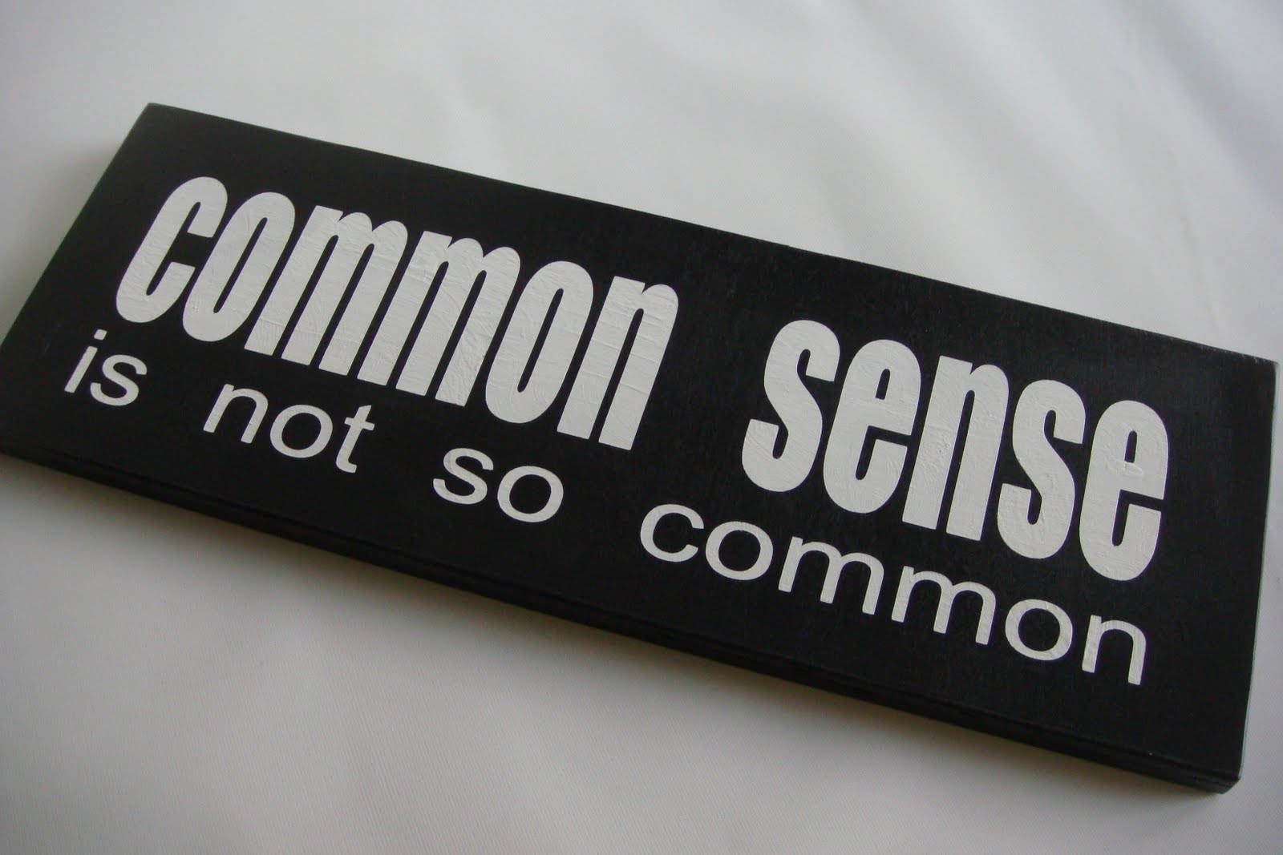
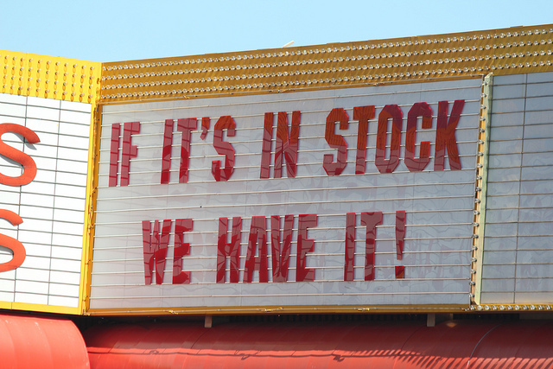
Potential Sin #2: Status over Flow
Potential Sin |  | Virtue
Tautology | Over | Common Sense

Slide 61
Potential Sin #2: Status over Flow
Potential Sin |  | Virtue
Over-Planning | Over | Barely Sufficient Planning

Slide 62
Potential Sin #3: Stories over Strategy
Potential Sin |  | Virtue
Efficiency | Over | Effectiveness

Slide 63
Potential Sin #3: Stories over Strategy
Potential Sin |  | Virtue
Outputs | Over | Outcomes

