Slide 1
What are Executives Saying about Agile Development?
Todd Little
Sr. Development Manager
Landmark Software and Services

Slide 2





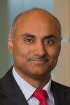
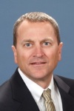


Agile Executive Forum 2013
Susan Courtney Sr VP BCBS Nebraska | Charles Evans CTO Intergraph | Julia Chicowski VP User Experience Fidelity Investments
Brad Jaehn VP Product Gogo . | Simon Galbraith CEO Red Gate Software . | Nagaraj Srinivasan VP Technology Landmark Software and Services
Gary Gruver VP QE Macys | Hendrik Esser Director Ericsson | Ojonimi Bako Director Walmart

Slide 3


Executive Summary
Agile Executive Forum
 | Executive Forum | Executive Summary
Presenters | 9 | 1
Presentation Minutes | 270 | 36
Slides | 204 | 95
1 day, collocated with Agile2013
3rd Annual Event
For Executives, By Executives
>$20 MM software portfolio
35 Attendees
Sponsored by Agile Alliance in co-operation with Agile Leadership Network

Slide 4
Our Transformation Journey…
to enterprise stable teams and servant leadership
Susan Courtney, SVP Technology and Operations & CIO, BCBSNE

Slide 5

“Never let a good crisis go to waste” – Winston Churchill
Large program “in the ditch”
Silos, lack of trust between Business and IS
PMs must work with managers to get tasks completed by their employees
Communication was largely done by email
No visibility into any ‘real’ progress

Slide 6
The 2010 Roadmap
Foundation and Piloting
Current State Survey, Define IS Vision
Servant Leadership Transformation & 360 Surveys
IS Engagement (Town Halls, Roundtables ..)
Initiate Agile and Collaboration Rooms (CR4, CR5)
Group Facilitation Skills Transformation
Cross Team Collaboration and Process Improvement Focus

Slide 7
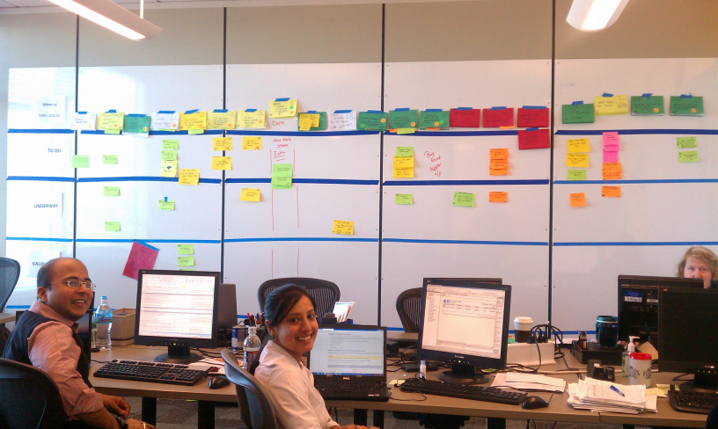
Collaboration Rooms!

Slide 8
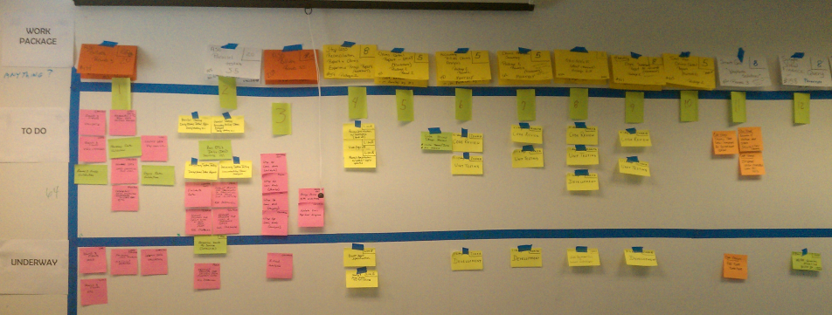
Visual Information Radiators!

Slide 9
The 2011 Roadmap – Begin Scaling
Agile For Executives and Agile Product Owner Training
Learn about Agile at the Enterprise Level
Standup Communities of Practice(ScrumMaster, PO, Req)
Design and Pilot the Enterprise Stable Delivery Teams
Train and Standup more Agile Teams
Designing a Physical Agile Environment
Agile Requirements Training

Slide 10
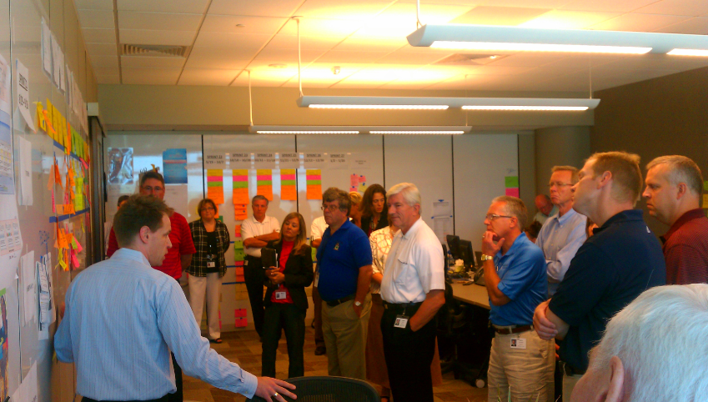
Executives Learning Agile

Slide 11
The 2012 Roadmap – Scaling Agile
Rollout and Standup Enterprise Stable Teams
Resource Manager Role Shift, Change Management
More Servant Leadership, Facilitation and Collaboration Training
Lean Power4 Growth on the Business Side
Agile Coaching for Teams and Programs
Open House Tours for the Community
Agile Testing, Agile Requirements Training

Slide 12
The 2013 Roadmap
Enterprise Agile
Standup Agile Enterprise Teams (AES, EPO, EA, ESC)
Apply Agile in the Business Operations
Form Strong Executive Steering Leadership Team
Servant Leadership Advanced Executives Training
Begin to Track Enterprise Metrics and Velocity
Agile Integration with HR, Finance, Vendor Contracts
Seed Agile as Means for Future Innovation

Slide 13

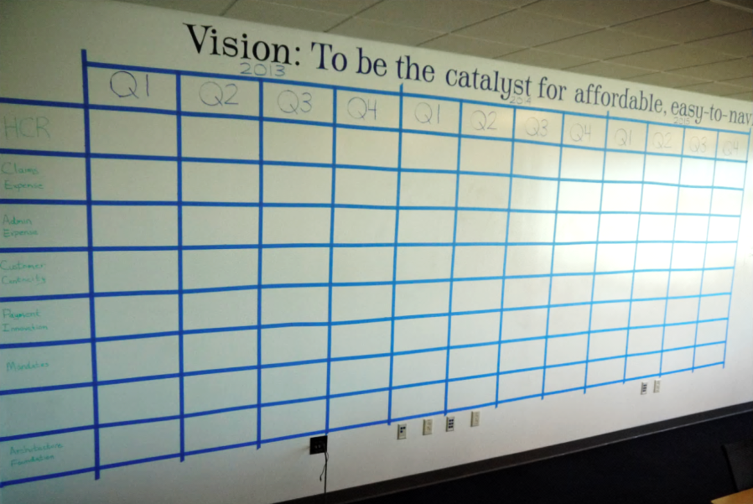

@ Team
Agile Planning
@ Enterprise
Roadmap
Release Plan
Sprint
1 year
3 mos (1Q)
4 weeks
3 years
1 year
3 mos (1Q)
Enterprise
Team

Slide 14
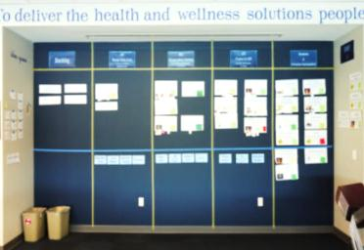
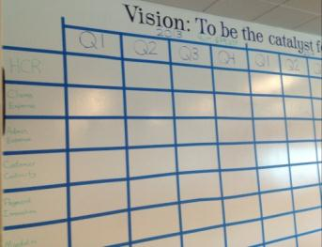
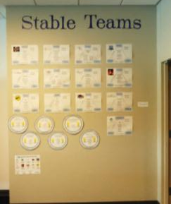
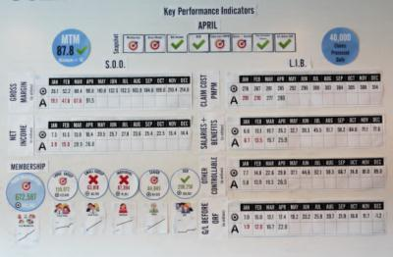
“Enterprise Command Center”
The Vision: BCBSNE will have an engaged and collaborative workforce unified in their pursuit of common goals and efficiently delivering on key initiatives.
Strategic Objectives & Projects
3 Year Roadmap
Stable Teams
Key Performance Indicators

Slide 15






Agile Transformation is Cultural Transformation
Culture = People + Process
Process Skills
People Skills
Facilitation
Architecture
Just
Enough
Servant
Leadership
Agile/
Scrum
Collaboration
Lean
Stable
Teams

Slide 16

Expect…to lose some people
(good people)
Notes:
Different directions

Slide 17

Expect…to be overwhelmed
“The essence of strategy is deciding what NOT to do” – Michael Porter

Slide 18


Expect…squishiness
Be comfortable with ambiguity…
Inspect & Adapt
Notes:
Different directions

Slide 19

Cultural DNA Change
Transparency builds CONFIDENCE, ALIGNMENT and TRUST.

Slide 20

Agile is a Way of Thinking
Agile embraces REALITY.

Slide 21





We’ve been to the Moon!
How hard could Mars be?
Charles Evans
CTO/EVP Development
Agile 2013 Executive Summit

Slide 22

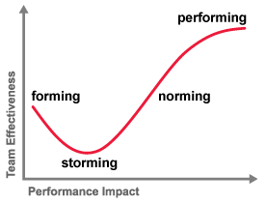

Agile Enterprise
Our Journey
Scrum Coach
Exec Scrum
Full Time Internal Coach
Co-located Pilot with Champions
US & India Pilot
SG&I Adoption Begins
PP&M Global Rollout
Notes:
Bruce Tuckman defined four phases of development which a team must experience before it will truly perform to its full potential - See more at: http://www.globalblackswan.com/articles/transforming-team-performance
Toronto conference with the Exec Team in 2008

Slide 23

Forming
Executive Support (“Alpha” Scrum Team)
  CTO/EVP Driven including PM, Development & QA
  We learned 1st hand how to time box & manage a backlog
  Clear Vision & Plan
Everyone was (and is) involved, not just development
  QA, Documentation, User Experience
  Product Management (lack of such involvement would be an impediment to adoption)
Initial and ongoing investment in training and coaching
  Started with external consultant guidance
  Internal coach/trainer role reports directly to CTO/EVP
Team Building
  Global Events (many had worked together and never met)
  Encourage & Fund Team Events

Slide 24


Storming
Distributed Teams are HARD!
Scaling Scrum is HARD (and were uncharted)
Open Space
  Really a status issue (office, desk, etc.)
Cultural Challenges (country and corporate)
Power Adjustments for Management
  PO, Development, QA (Authority vs. Democracy)
Challenges breaking down complexity
  Architecture & Design
A well prepared and timely backlog is crucial
  ATP “Tax” on Productivity
"we’ve been doing it this way for years“
Notes:
Hans:
[HPS] We've been doing this for X years and don't see need to change - patience, mentoring, coaching, showing people when other teams have had success [HPS] Movement to common space - we made it work well for 80-90% of people [HPS] Scrum "religion" (eg agile means "self management") - focus on the pragmatic

Slide 25



Norming
It's not about “doing Agile/Scrum,” but becoming more effective.
  Incremental approach important – can’t make all changes in one step.
  Start with foundational items – Scrum team, velocity, basic Scrum practices
  Solutions to big issues will emerge through people (e.g., distributed teams)
Engineering Practices
  Conscious investment in build and test automation
  Had a significant impact on quality and productivity
  Lack of this will be an impediment to team velocity
Constructive ISO 9000 program focused on Scrum practice
  Intergraph involved in ISO 9000 for many years
  Development uses internal audits to impact Scrum practice
  Management, teams, and internal auditors find this beneficial

Slide 26

Performing
Handling Priority Shifts
  Rule #1 – “We will never let a customer down”
  Unplanned Support “Bucket” and Agility!
Autonomous Teams
  Co-located with all critical roles regardless of Location
Passion for Excellence
  Automated Testing Frameworks
  Test Driven Design
  Pair (“Mob”) Programming & Code Reviews
  Continuous Improvement through Retrospectives
Knowledge Sharing
  Scrum Master Meetings / Lunch & Learns
  Team Sites / Scrum “Bytes”
“Consulting” Teams
  Documentation (DIN’s)
  User Experience

Slide 27

Mars What’s Next?
Cloud Virtualization
Lifecycle Traceability
High Performance Teams
User Experience Driven Design
Notes:
Hans:
[HPS] Not sure where you are up to these days so I am probably not best to comment. For SG&I "next" includes "introduction of potentially shippable increments (PSI) in release plan", "increased focus on continuous integration / automated testing", "increase understanding on how to work the total system of delivery (eg optimize the workflow between projects and the product center)" and "complete work required to do ISO certification".
Khris:
* Incorporating UX into Agile/Scum (new for us, a challenge)

Slide 28
Agile User Experience Design
Agile Executive Forum
August 5, 2013
Julia Cichowski
User Experience Design, Fidelity Investments
Notes:
.

Slide 29
User Experience Design at Fidelity
User Experience Design is an established practice and well integrated into our waterfall methodology
UXD team is centrally organized and physically distributed
Our focus is digital user experience design
Our capabilities include:
  User research
  Information architecture
  Visual design
  Content strategy and development
  Usability testing
  Design development
Notes:
Any aspect of a user’s experience within a given system … The study and evaluation of how users feel about a system, looking at such things as ease of use, perception of the value of the system, utility or efficiency in performing tasks

Slide 30
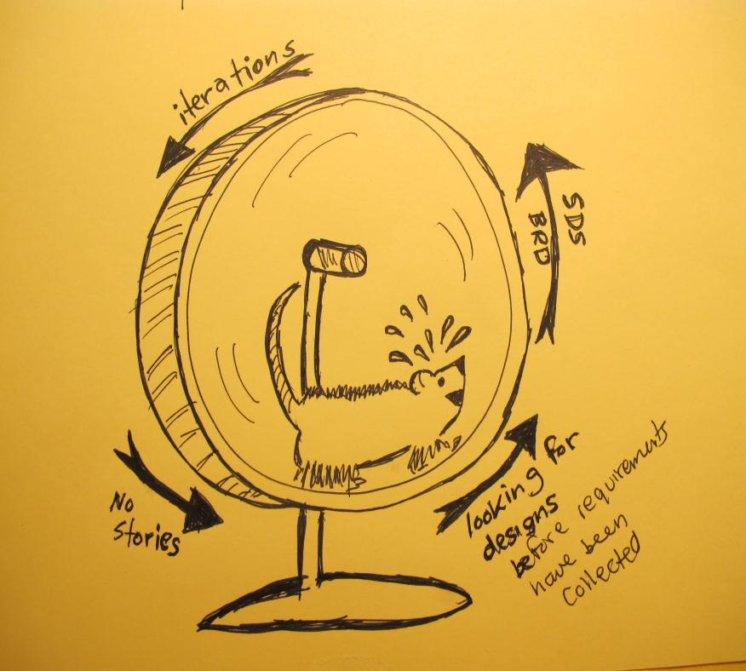
Goal Today
To share what’s helped us succeed in agile user experience design:
Setting the team up to succeed
Optimizing user involvement
Building the user experience
Notes:
Areas to focus on if you’re integrating a user experience design practice into your Agile method.

Slide 31
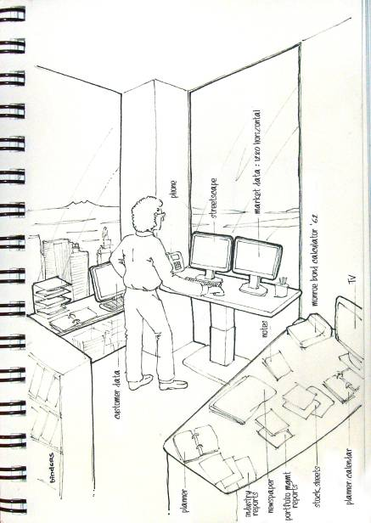
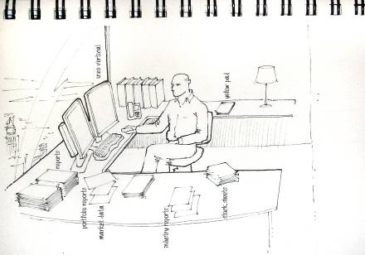
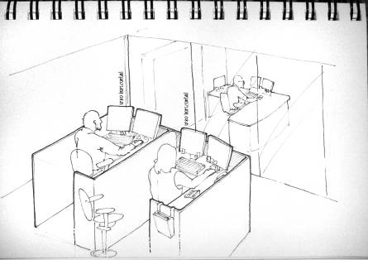
Optimizing User Involvement
Client workspaces…
Agile Challenges
Access to users – investment professionals
Lack of flexibility
Sensitivity, security, privacy
Notes:
Especially important now because of the rate of change around a user’s expectation of the user exerience – responsive, mobile

Slide 32
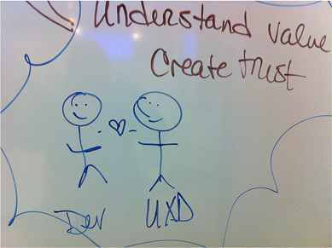
Building the User Experience
All about tightening this cycle:
Design
Build
Test & Learn
Goals:
Reduce cycle time
Reduce the need for design specifications
Reduce/eliminate fit n’ finish issues – ‘why can’t we build it right the first time?’
Increase the quality of the delivered user experience
Notes:
All about tightening this cycle:
Pair programming: partnering a designer with a developer
Reduce or eliminate the need for specification documents; detailed visual design renderings
Find developers that already have a design vocabulary
Can developers be part of the UXD team?
Co-locate them
Be crystal clear about which aspects of development is owned by whom (front-end development vs. back-end)
Level the playing field by enabling access to the needed environments and development tools
Establish coding standards (version of jquery, javascript, browser requirements, … for starters)

Slide 33
Story Model
Iteration 1
Iteration 2
Iteration 3
Iteration 4
1
2
3
4
5
6
7
8
9
10
11
12
13
14
15
16
Creative
Technology
Non-functional creative stories
Non-functional development stories
Functional development stories

Slide 34
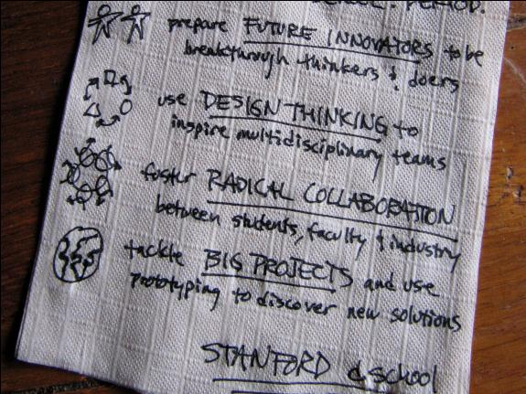
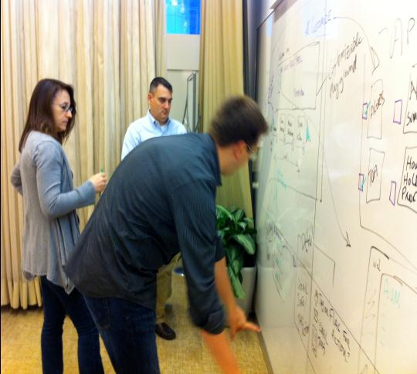
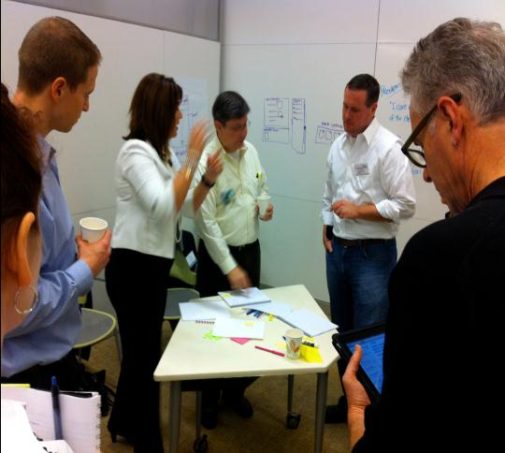
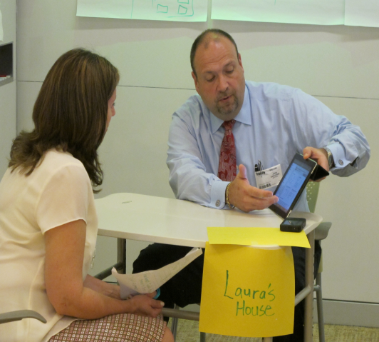
Optimizing User Involvement
Employing participatory design techniques like Design Thinking
Notes:
Cross-functional team involvement
Grounds everyone with a common understanding of user need
Very engaging interaction for our users; typically more meaningful and productive then surveys, focus groups or conference calls
Mitigates personal bias

Slide 35
Adopting and Scaling Agile at gogo
August 5, 2013
Brad Jaehn
VP, Product

Slide 36
Philosophy vs. Process
The “Speed of Trust”
“Agile done wrong is worse than no Agile at all.”
Emphasis on Organizational and Leadership Agility
Adoption and support from many dimensions

Slide 37
The quest for the one list
Everything is Number 1!
My List, Your List, Everyone has a List.
The Product Owner Role
Backlogs, Priorities, Stakeholders, and Business Owners

Slide 38
The role of the functional manager
One of the Biggest Challenges
Coach vs. Task Master
Super-doers get Promoted
HR and Performance Management

Slide 39
Social forces
Change
Self-Preservation
Tribes
Heroes

Slide 40
Momentum
By the end of 2012 – Progress!
  12 teams up and running, spiriting every 2 weeks
  Doing all the rituals and ceremonies
  Cross-functional quarterly planning sessions
  200+ team members trained
  A big part of the CEOs end of year letter
Still only adopted by less than half of the company, and hadn’t “gone deep”
Hiring team members with agile backgrounds and changing organization structure in places
Decided to move coaching investment to other areas

Slide 41
Agile in the C-Level Suite: Applying Agile to our Executive Team
Simon Galbraith
CEO & Co-Founder, Red Gate

Slide 42
Some context about Red Gate
~300 people
13 years old, with long track record of growth
Self-funded, privately-owned, profitable
We sell database and developer tooling in the Microsoft ecosystem
~1,000,000 users
Started Agile transformation in 2008 due to scaling problems
2012/13 – all projects are agile; no surprises in last 18 months.

Slide 43
Does Red Gate actually have a C-level suite?
NO!

Slide 44
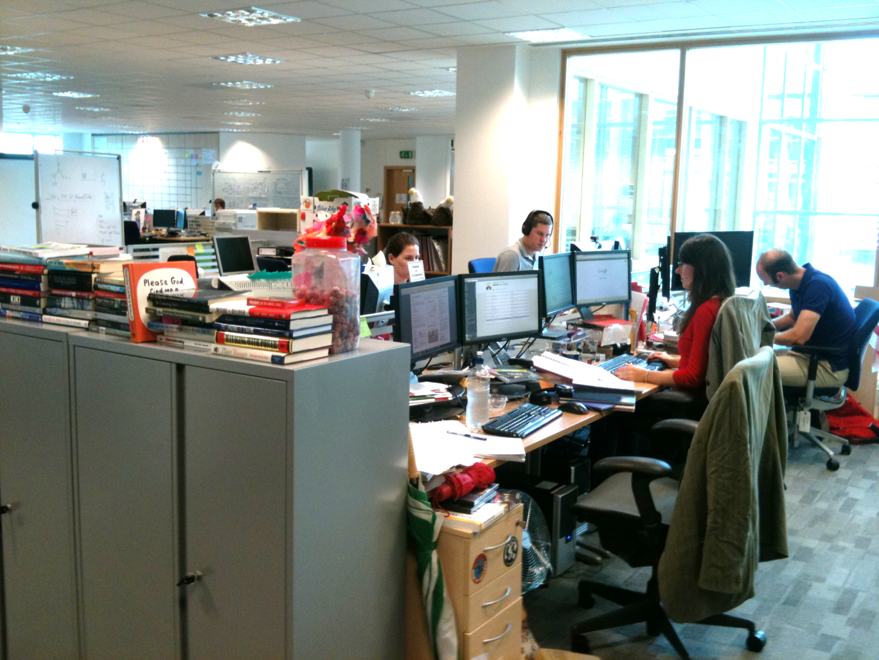
Does Red Gate actually have a C-level suite?
MY DESK
[Picture of Simon’s desk]
Notes:
Talk about flat culture, the team I’m talking about are sitting amongst the rest of the staff, whiteboards everywhere. We take culture really seriously and have been voted in the top category of places to work 6 years in a row.

Slide 45
Our team was dysfunctional.
Notes:
All brilliant individuals! Sum of parts weaker than parts.

Slide 46
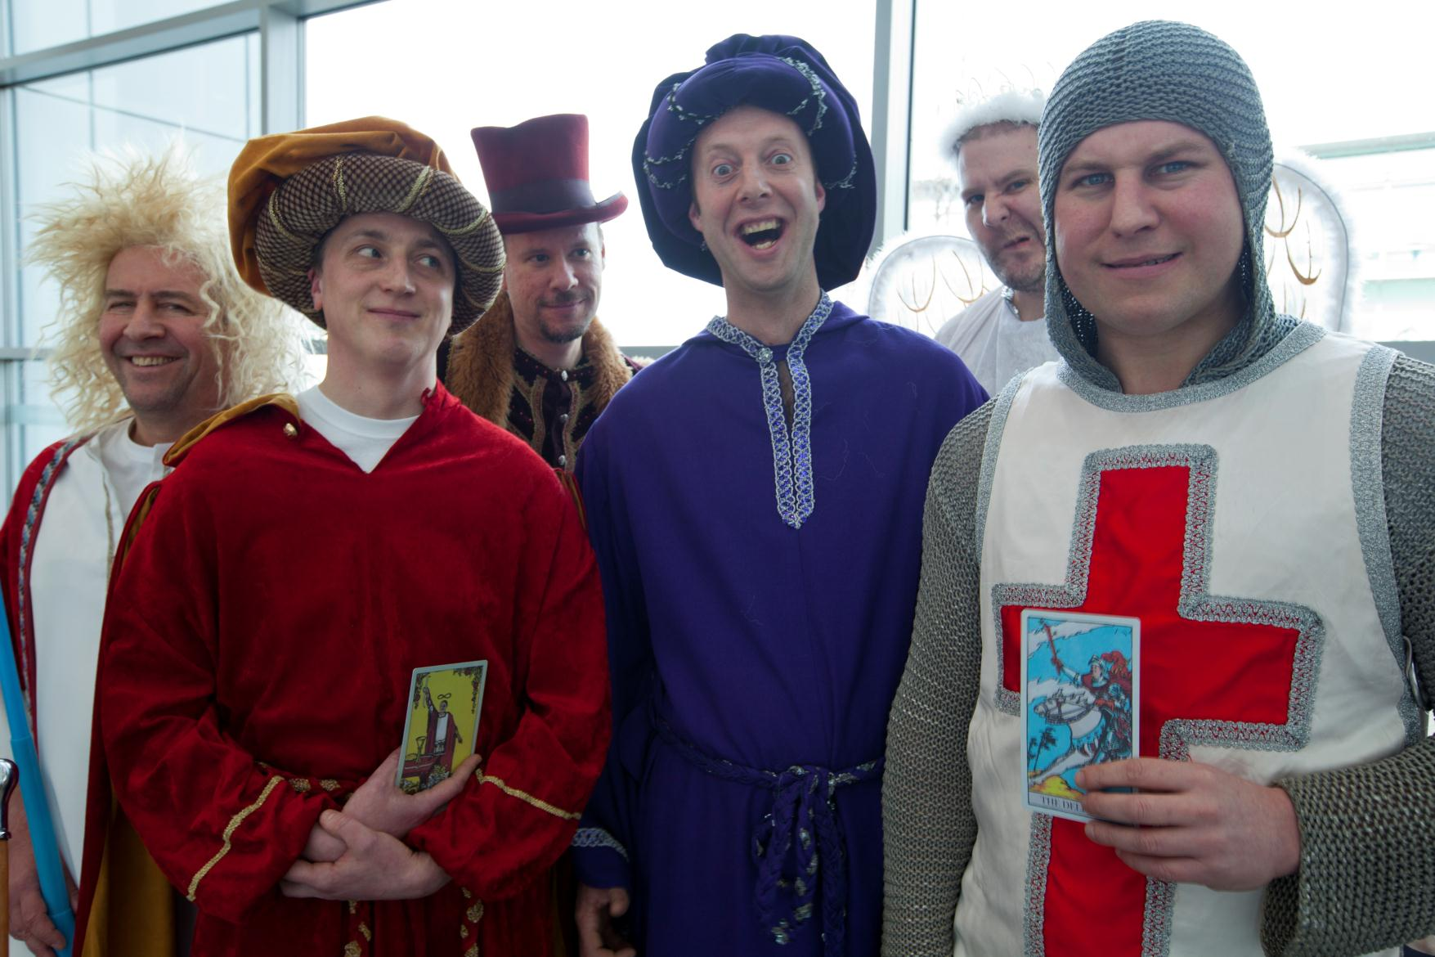
Notes:
Talk through the team – what they do!

Slide 47
Our problems
Leadership Team (2012)
Dev Teams (2007)
- No visibility on projects
- Lack of trust; people not aligned
- Hero to zero
- Death marches
- No clarified process
- Being the boss of that team
was a thankless task
Big surprises around shipping software
Developer is King
Hero to zero
Blame the team failures on the individual
Death marches
Project management process was left up to the PM

Slide 48
Plan A
- Super-light daily standup (15 mins)
- Intensive observation and coaching from agile PMs (Simon and Mark)
- That’s it!

Slide 49
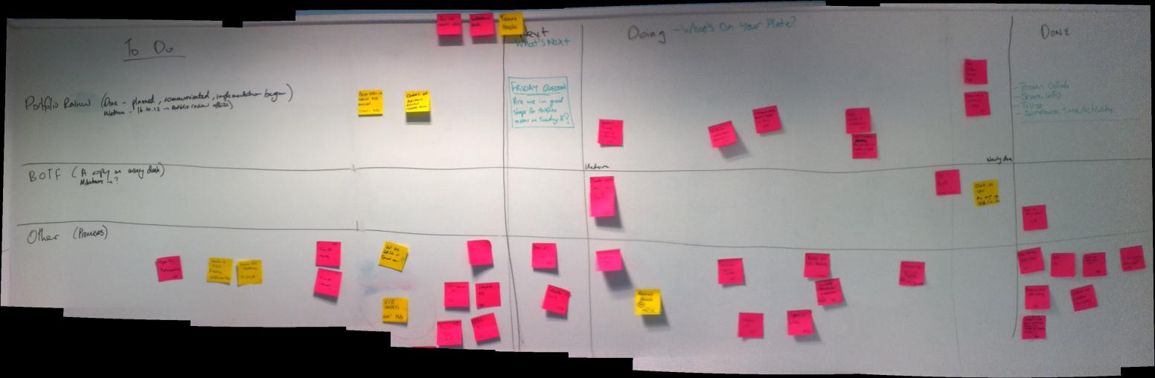
11th October 2012
Notes:
Talk through mechanics – get into the dirty details of exactly what you did every day.
Speed at which things move across is a good indicator of the size of the project.

Slide 50
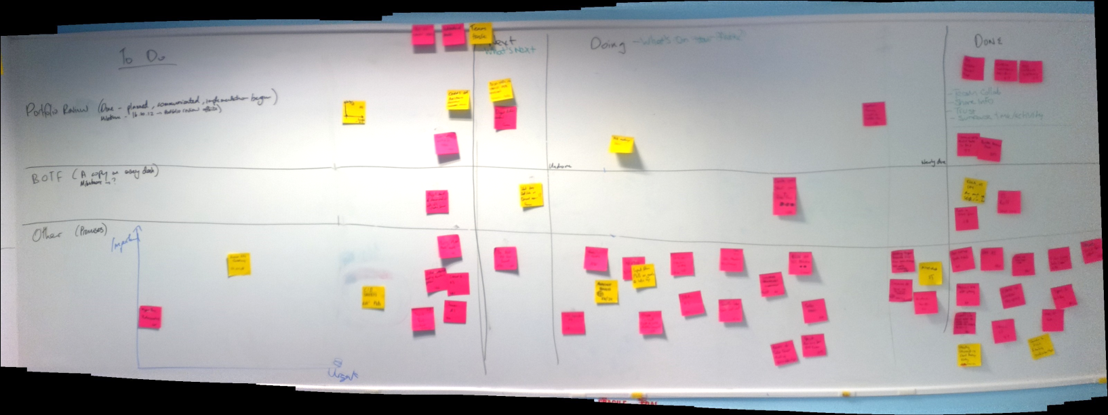
17th October 2012

Slide 51
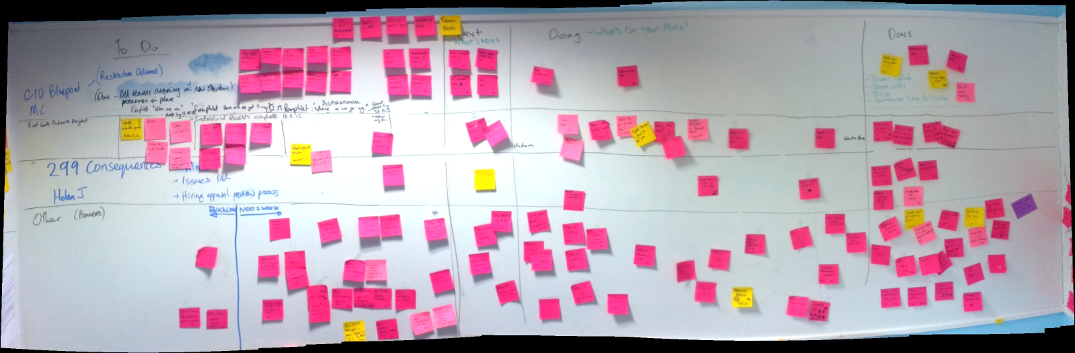
15th November 2012

Slide 52
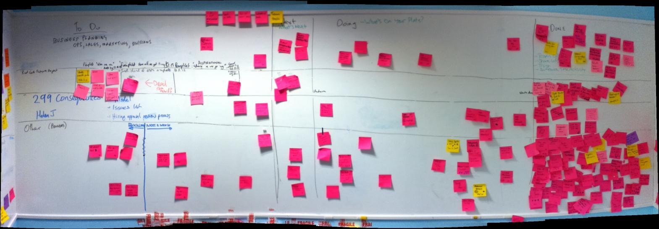
17th December 2012

Slide 53
If you take only one thing away from this talk:
BE AWARE OF HIDDEN PROJECTS

Slide 54
11th October 2012
Notes:
Talk through mechanics
Speed at which things move across is a good indicator of the size of the project.

Slide 55
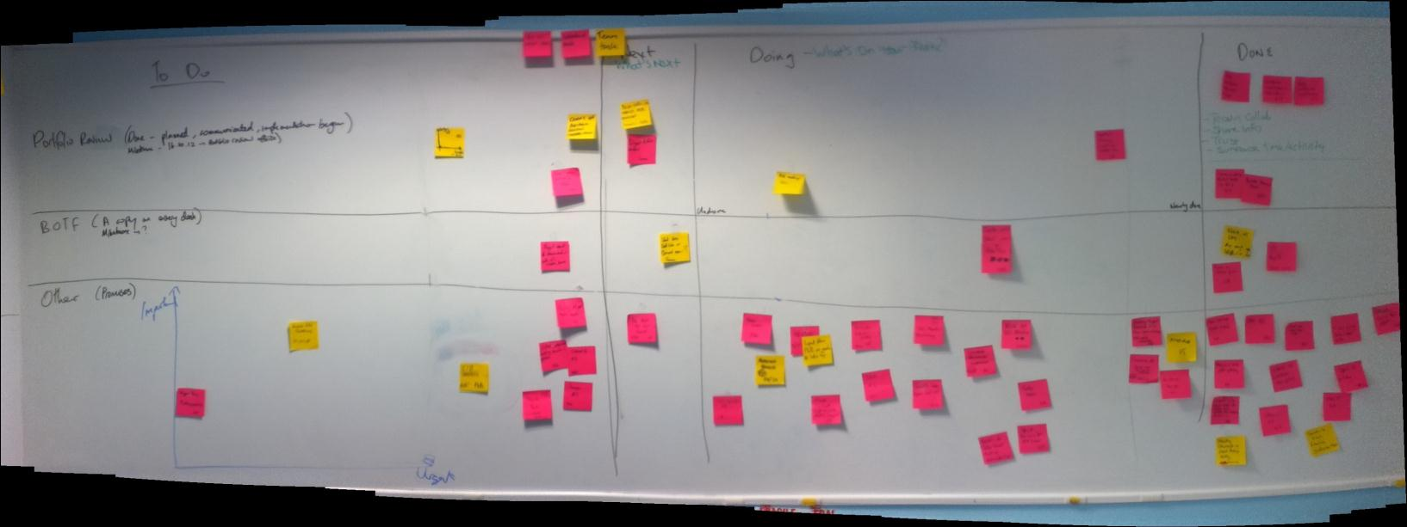
17th October 2012

Slide 56
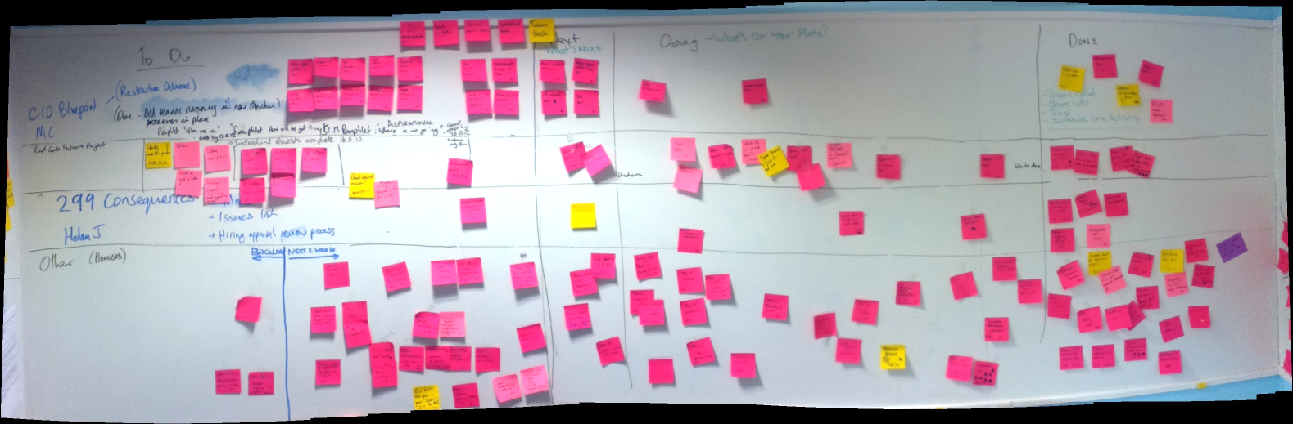
15th November 2012

Slide 57
17th December 2012

Slide 58
Big acquisition – project management universe size
Software
Legals
Project Managers
(paired project management – gamechanger?)
Checks & balances
Reporting
Expertise
Robbie reckons it will take a couple of days
Notes:
Gamechanging approach on paired project management. It is very expensive until you compare to not doing it.

Slide 59
What was the end result?
Software Project (agile)
Legals (hidden project)
All Good
Disaster
- Fixed scope, schedule and quality, 3rd party supplier, new for us.
- Team delivered millions of
dollars of value to the
company on time and on budget
- We did exactly what we set
out to do
- Purchaser has found nothing
wrong (saving us months of
anticipated effort)
Contract signed six months late (which massively increased our risk)
$150k legal fees
Massive (!) drain on key management time
Numerous other initiatives delayed
Death march
Hugely stressful for people involved

Slide 60
Checklist for a hidden project
- Other projects have been running more slowly than anticipated
- Project doesn’t really belong to anyone
- Any time devoted to it seems to disappear
- No project manager; no project management artefacts exist
- There’s a scapegoat
- It started off seeming like a task
- Not prioritised or resourced
- Someone, somewhere in your organisation, is still angry about it
Notes:
Put this up during the exercise

Slide 61
What benefits did we see from our Agile Standup?
- We got a lot better at keeping our promises
- We slowly became more careful about making promises
- We surfaced disagreements earlier
- We dealt with small crises very rapidly & effectively
- Everyone in the room knew what was going on
- Cross-divisional issues were tackled much more effectively

Slide 62
Did it stick?
NO!

Slide 63
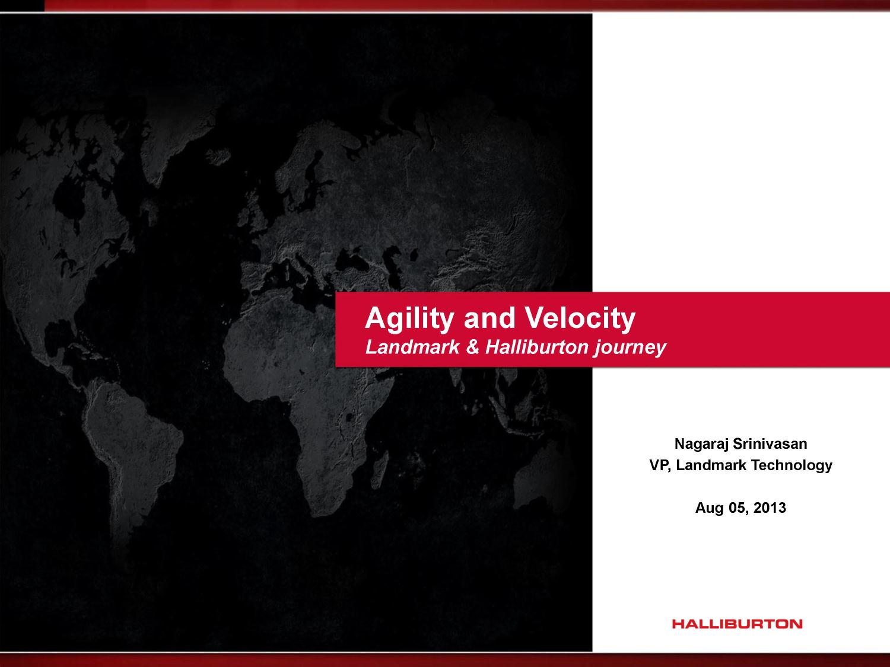

Slide 64
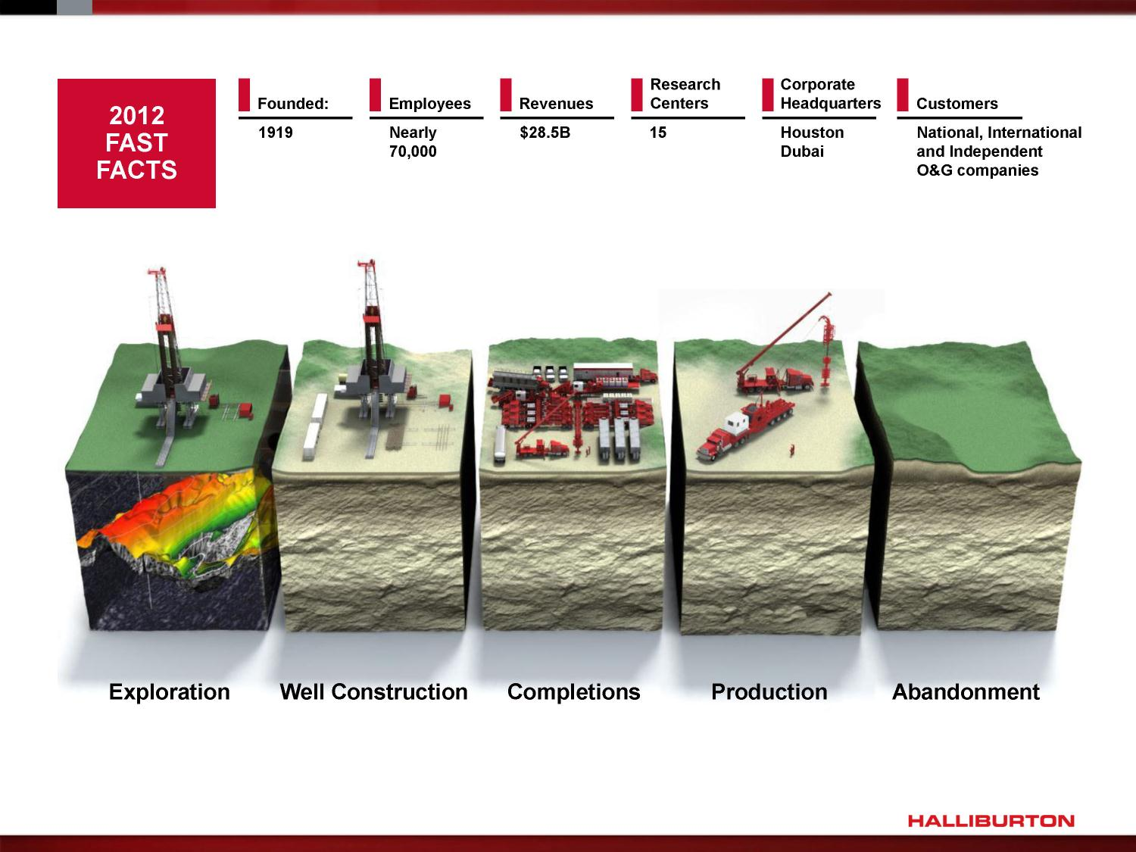

Slide 65
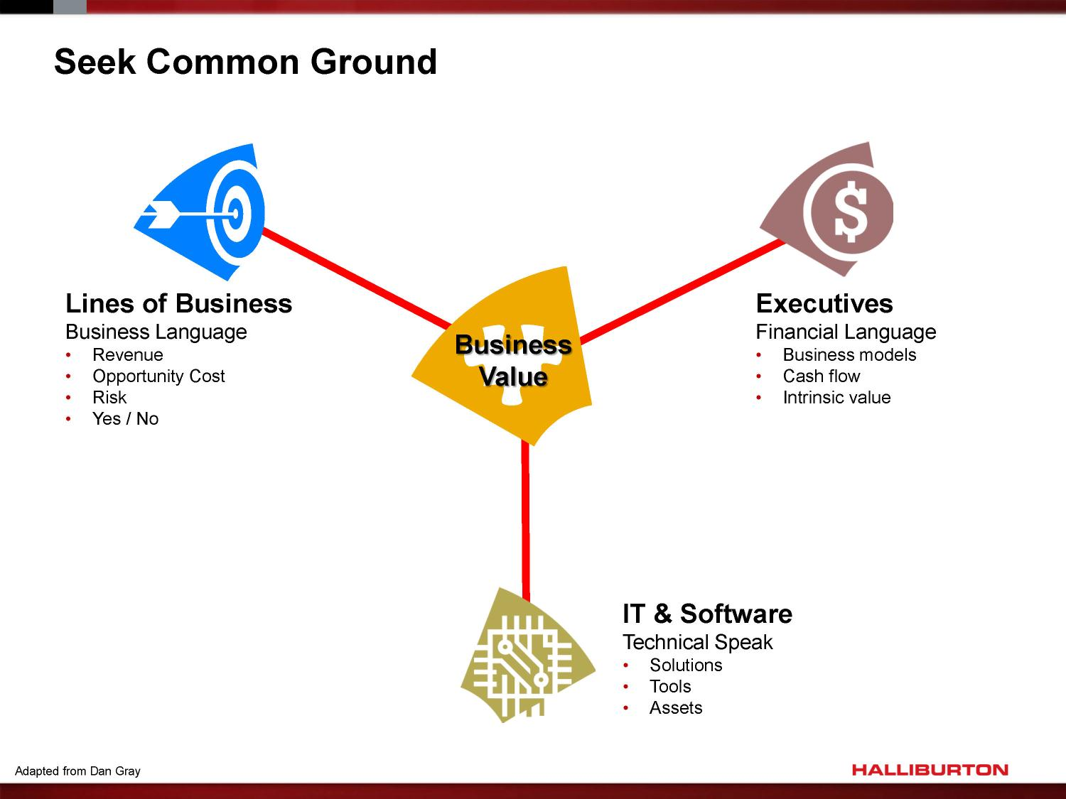

Slide 66
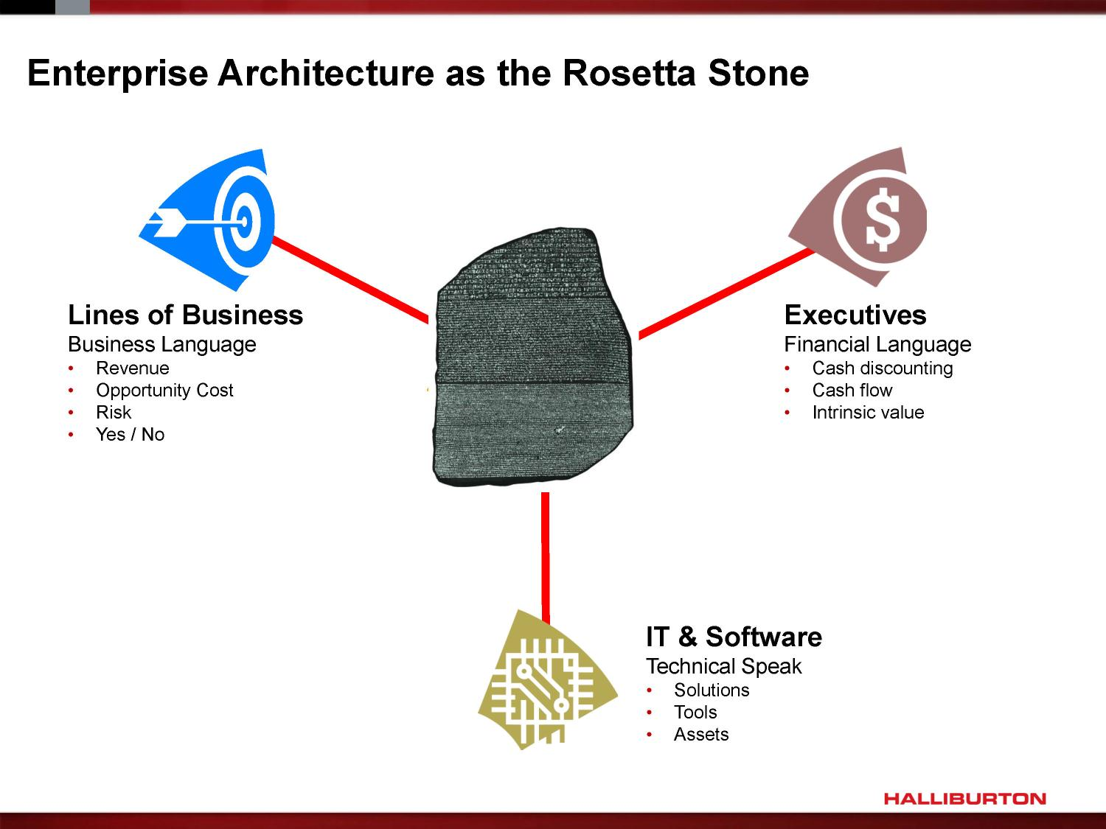

Slide 67
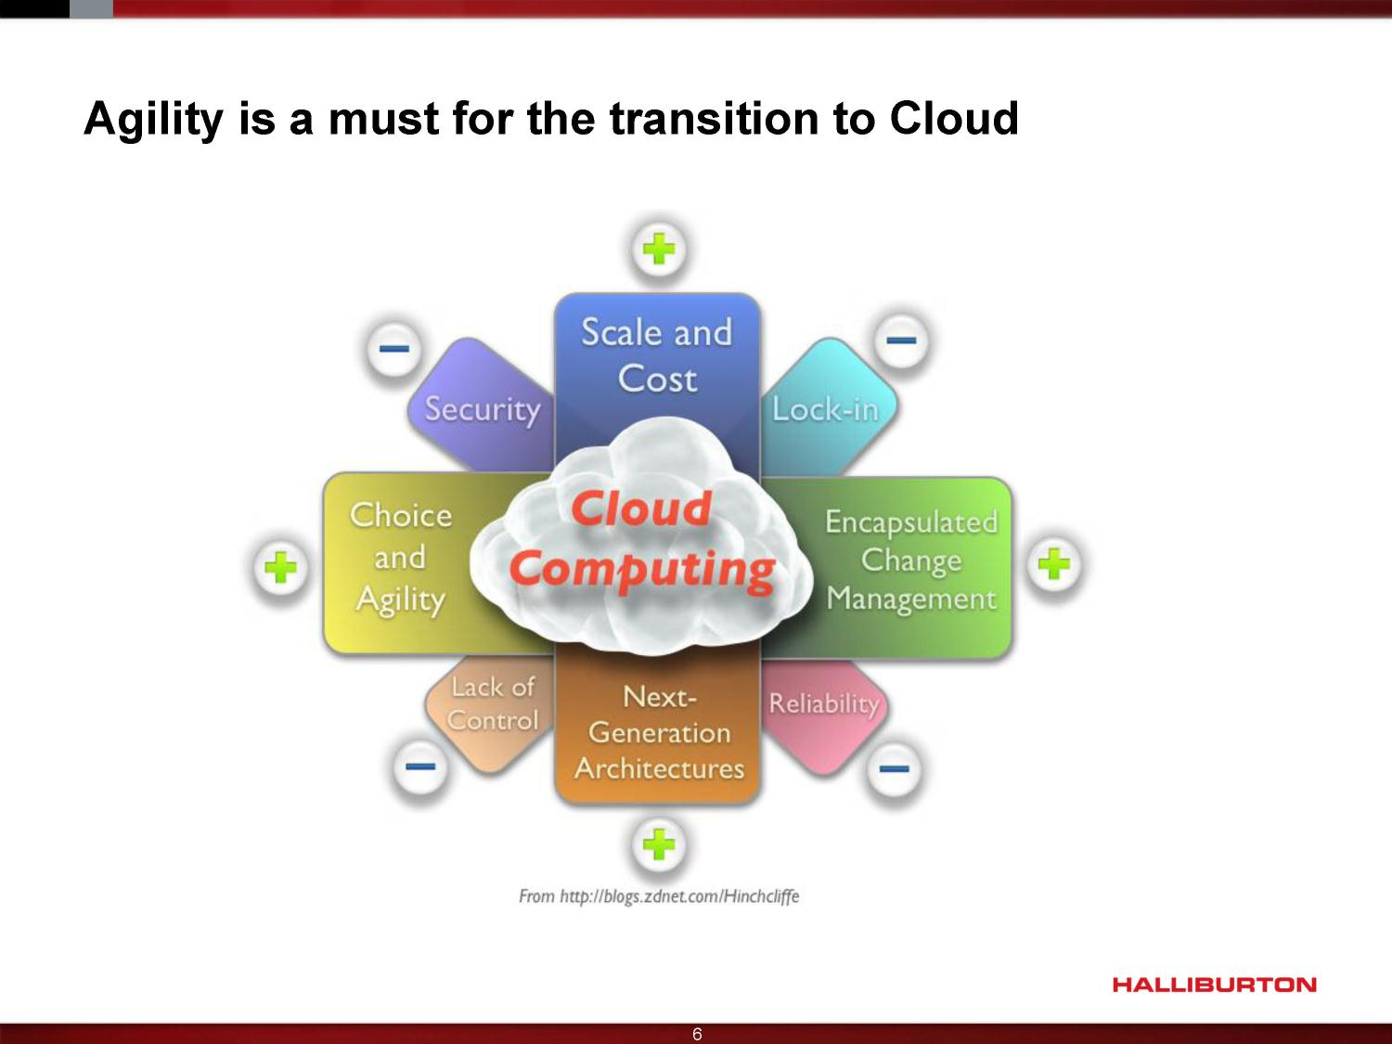

Slide 68
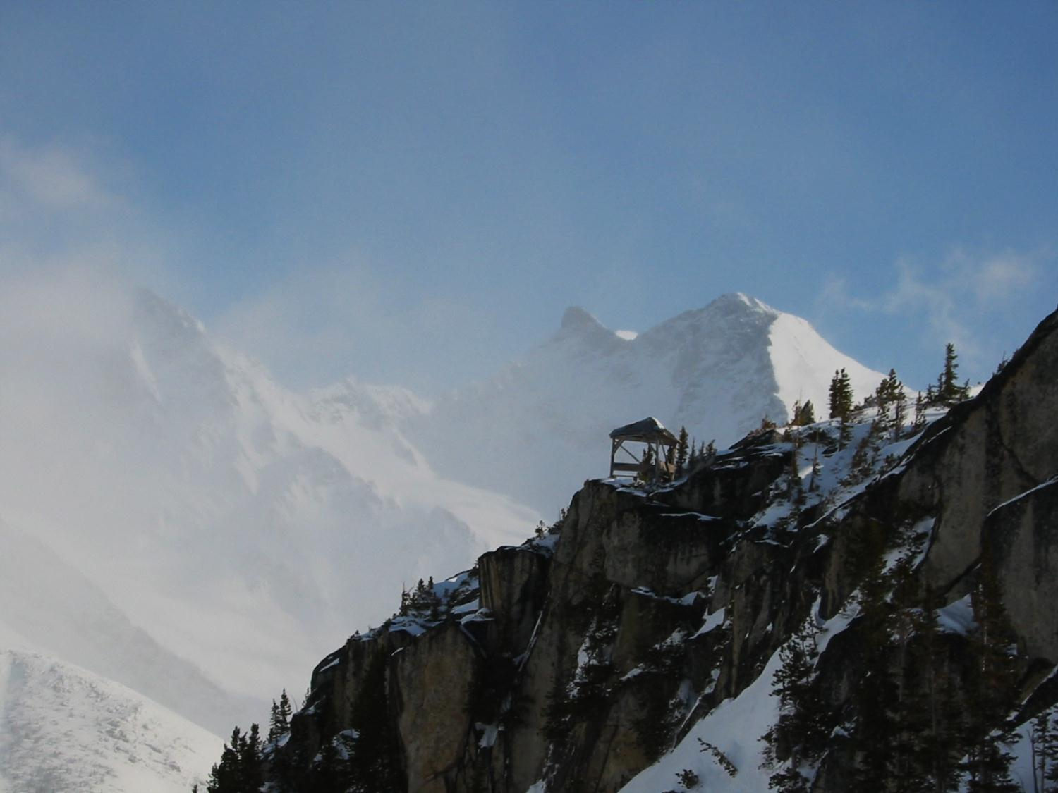
A Practical Approach to
Large Scale Agile Development
Gary Gruver
August 5, 2013

Slide 69


Gary Gruver:
24 year veteran in high tech
Led HP’s 400+ developers on a journey from waterfall to agile development
Currently VP of QE, Release, and Operations at Macys.com

Slide 70
4+ Year Large-Scale Agile Journey
400+ engineers
around the world
Complex features
Over 10M lines of code
High-end LaserJet printers and MFPs
Embedded SW & FW
Digital Sending and HP open Extensibility Platform

Slide 71


State of the Development Process: 2008
6 weeks + to get through a complete testing cycle (mainly manual)
Build integration taking 15-20% of resources a week to get fixes to main
Manual testing a key driver and constraint for adding products
Lengthy Build Integration & Testing Cycles
Ongoing customer issues with consistency and lack of features
Marketing had essentially given up asking for FW innovations
Products Lagging the Competition

Slide 72


State of the Development Process: 2008
Development costs growing 2.5X from 2004-2008 and the business was
still constrained
Up to 10 different branches (driven by each product release window) in MFP
CPE driving millions/year in CPE investments
Costs out of control
80-90% of resources just porting existing FW to new products and qualifying
Unable to add new products to the plans due to lack of FW resources
20% of resources developing plans that quickly became obsolete
Couldn’t Add Enough Resources

Slide 73
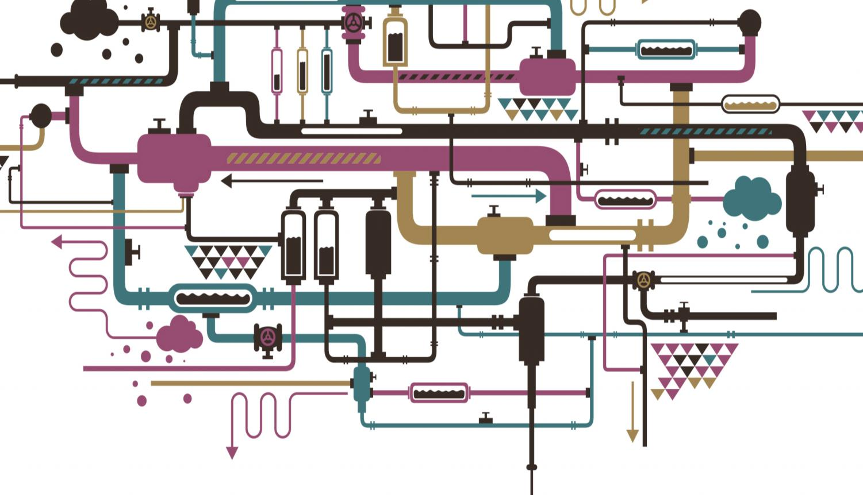
Cycletime Driver Improvements
2008
2011
Build Bosses 1 Week
Continuous Integration 3hrs
Number of Builds 1-2
Continuous Integration 10-15/Day
Feedback on Main ~10 Commits/Day
Autorevert ~100 Commits/Day
Full Manual Registration 6 Weeks
Auto Regression Testing 24 Hrs
Notes:
Fix arrow build

Slide 74
Cost Driver Improvements
2008
2011
Code Integration 10%
Continuous Integration 2%
Detailed Planning 20%
Agile Planning 5%
Porting Code 25%
One Main Branch 15%
Current Product Support 25%
One Branch CPE 5%
Manual Testing 15%
Most Testing Automated 5%
Capacity for Innovation ~5%
Capacity for Innovation ~40%

Slide 75
State of the art FW model
2008
2011
Costs out of control
~70% reduction in FW development cost per program
Couldn’t add resources fast enough
50% reduction in FW headcount
Lengthy build, integration
and testing cycles
Cont. integration, daily
automated regression
Products lagging the competition
Vintage chart unleashed
and capacity for innovation

Slide 76
Making an Enterprise
Agile
Enabling Small Agile Teams in the Enterprise
VS.

Slide 77
Taming the Planning Beast
The old way:
Today’s Philosophy:
Final feature list 12 months in advance
Every hour we spend planning a feature is an hour we don’t spend delivering it
(the real goal).
Planning resources and development resources one in the same
Always in “locked in” mode, had to say no to late-breaking requests or start over

Slide 78
Limit long-term commitments to
50-60%
Capacity

Slide 79

Getting Mgmt/Mktg Buy-in to Agile Planning
Managing Expectations
“FW will still commit to basic new product support one year ahead”
“You get to decide what we work on first”
Establish a “1-N feature request list” and the combined marketing teams decide the order
Means prioritizing “product turn-on and delivery/qualification” ahead of new features
“You will get 20% more
features this way”
“We’ll actually listen to your last-minute requests”
Easy to explain the 20% of resources previously used to estimate
Just put it at the top of the list, ahead of all the other “input queue” features

Slide 80
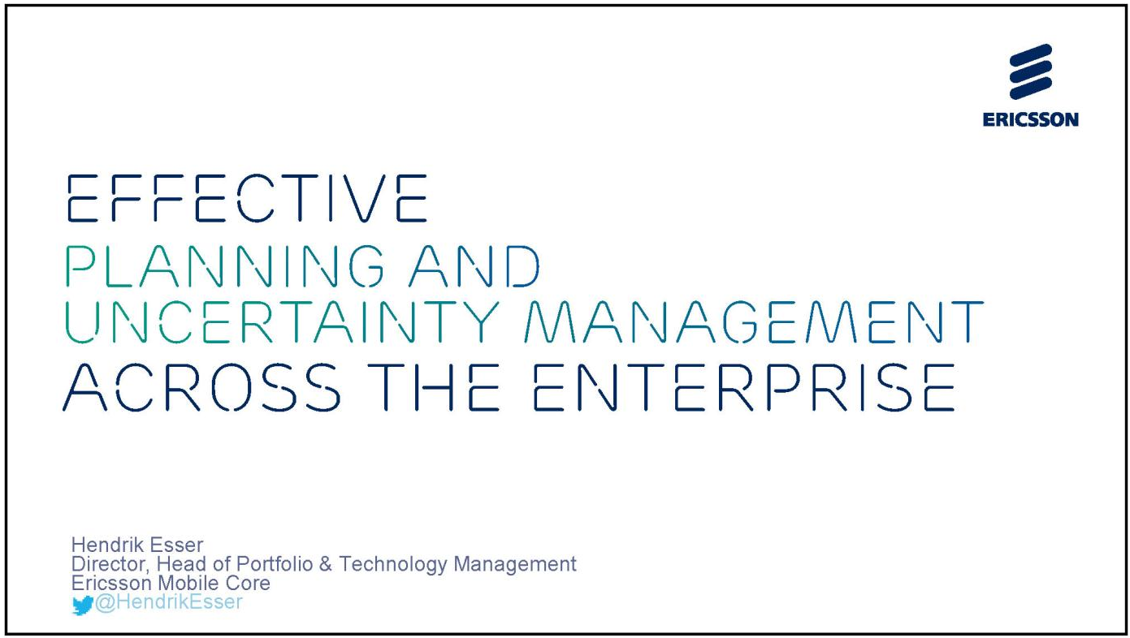

Slide 81
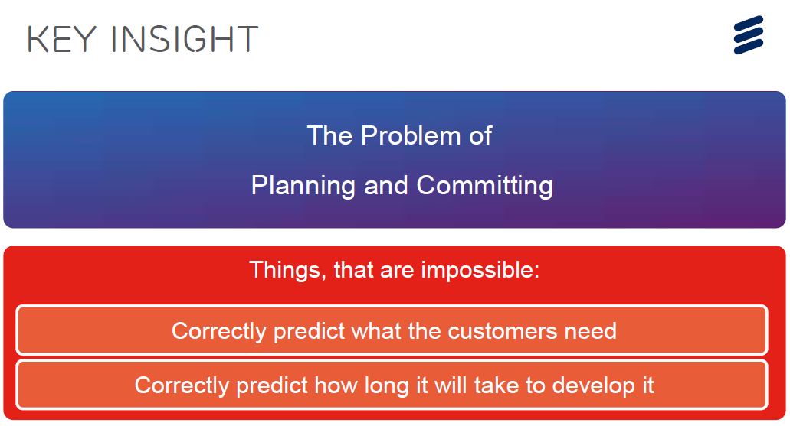

Slide 82
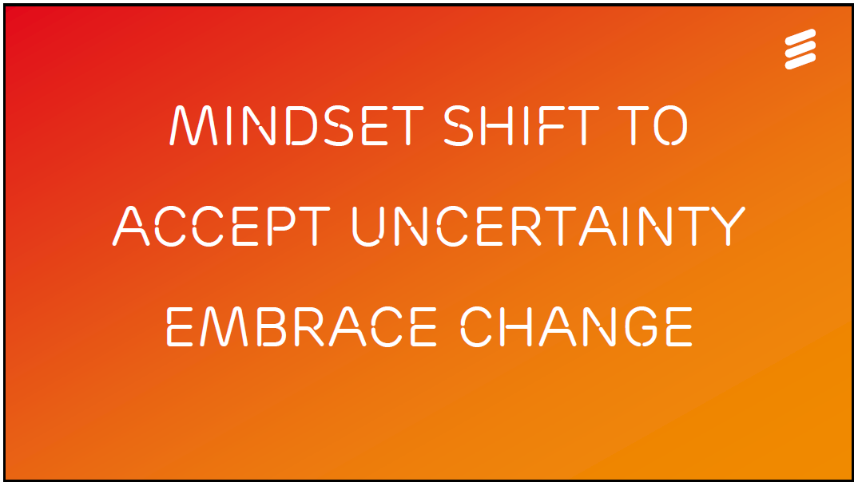

Slide 83
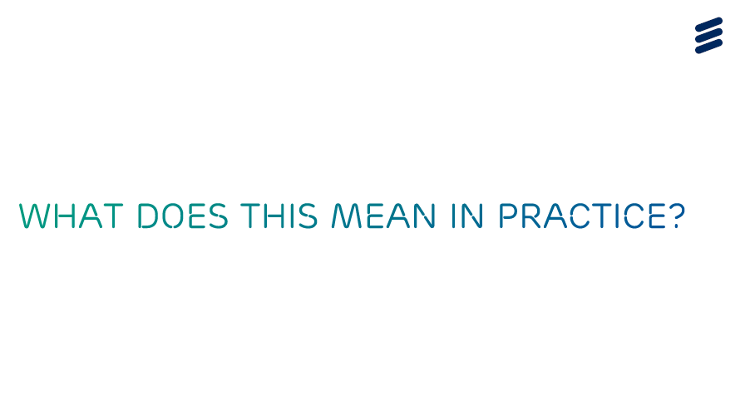

Slide 84
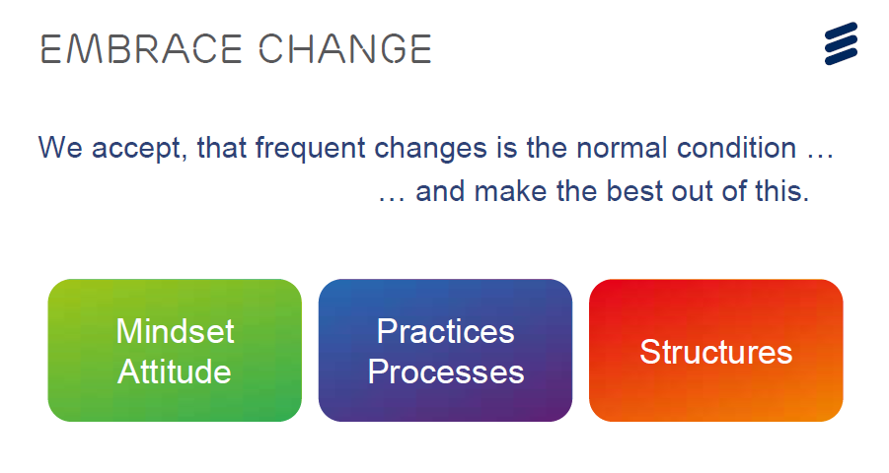

Slide 85
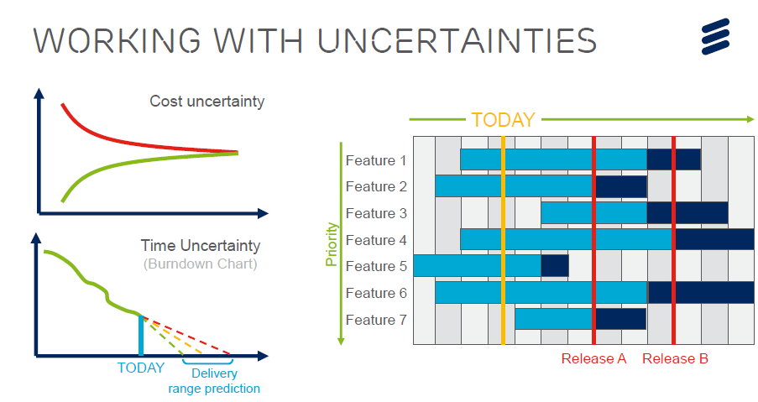

Slide 86
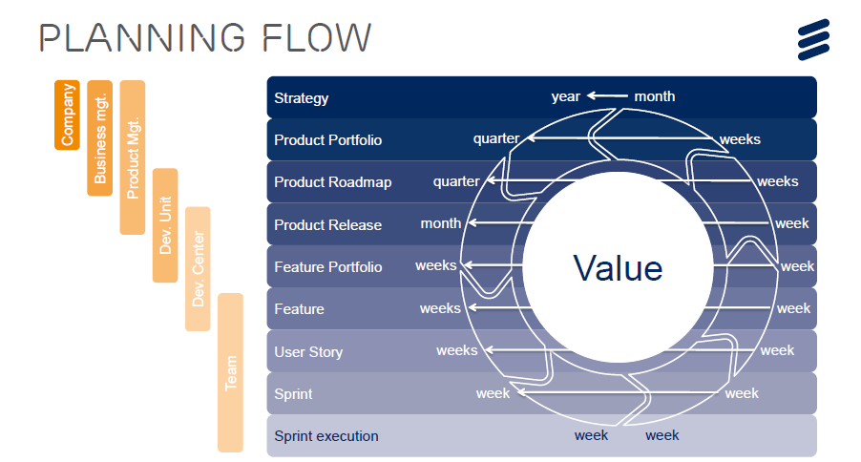

Slide 87
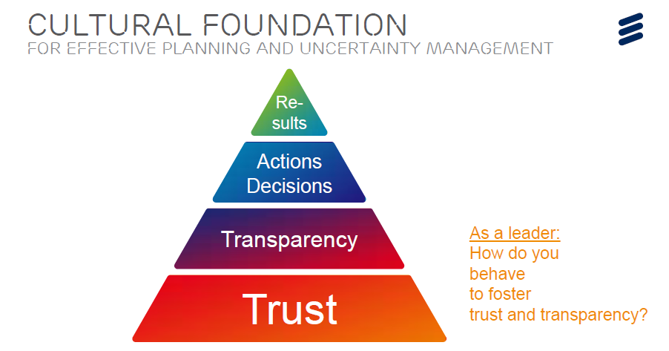

Slide 88
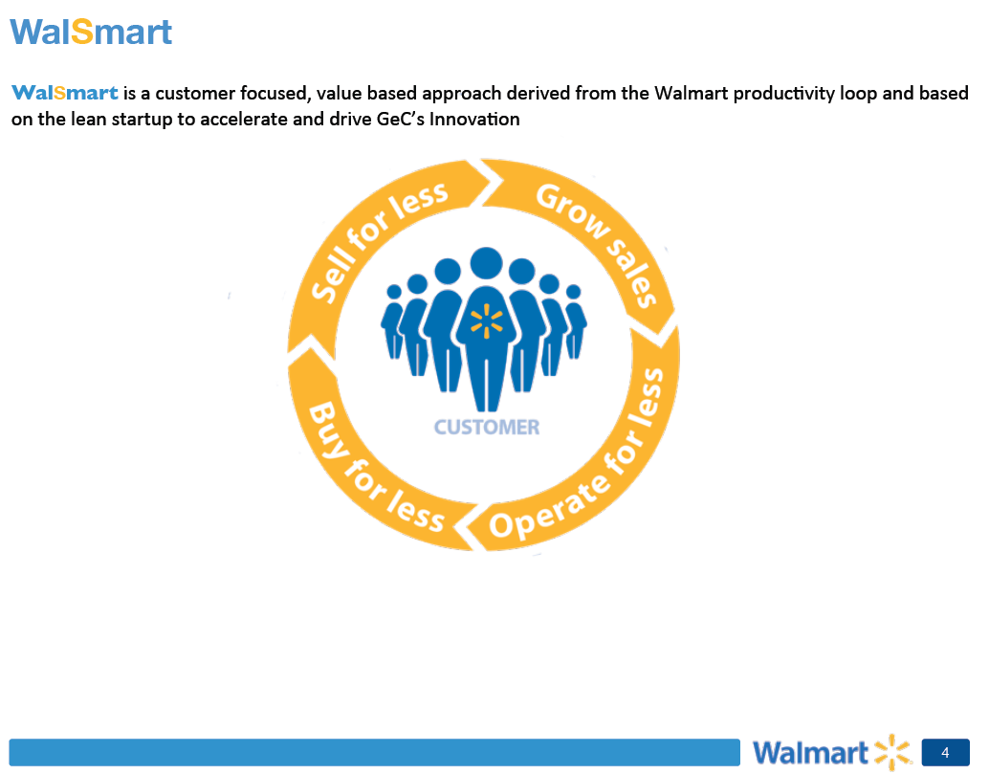
Ojonimi Bako
Director
Walmart

Slide 89
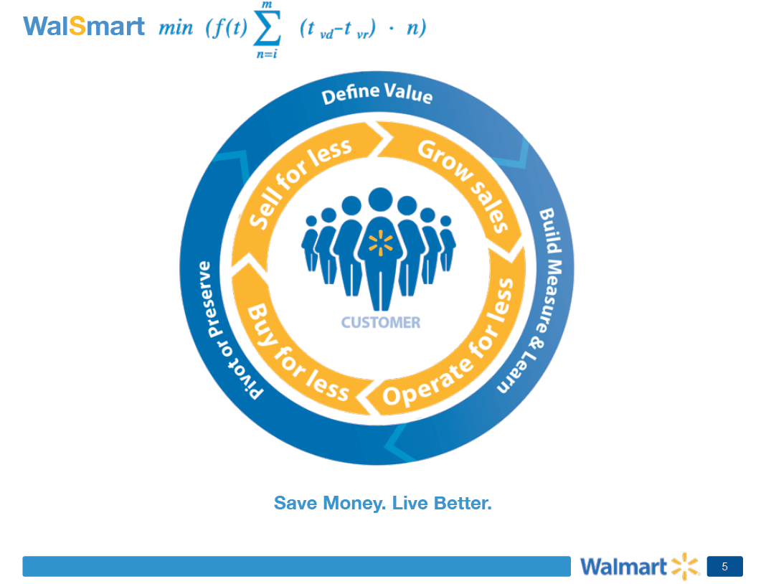

Slide 90
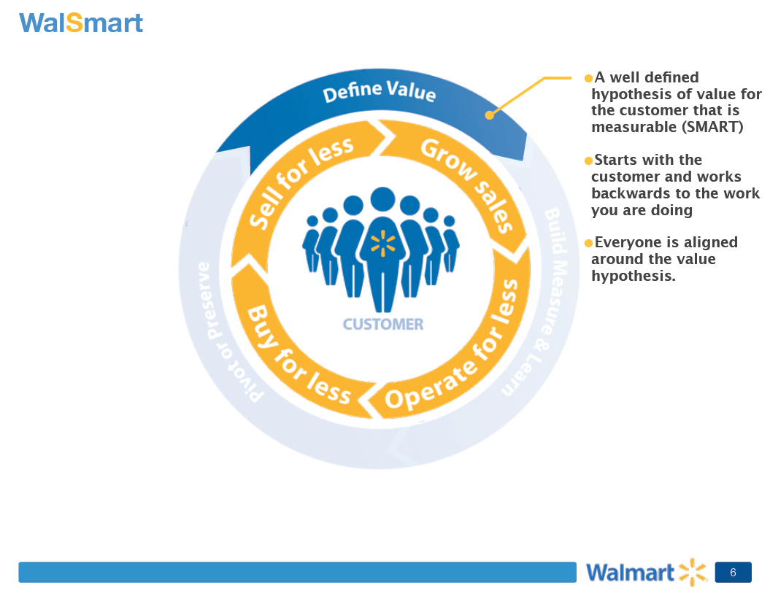

Slide 91
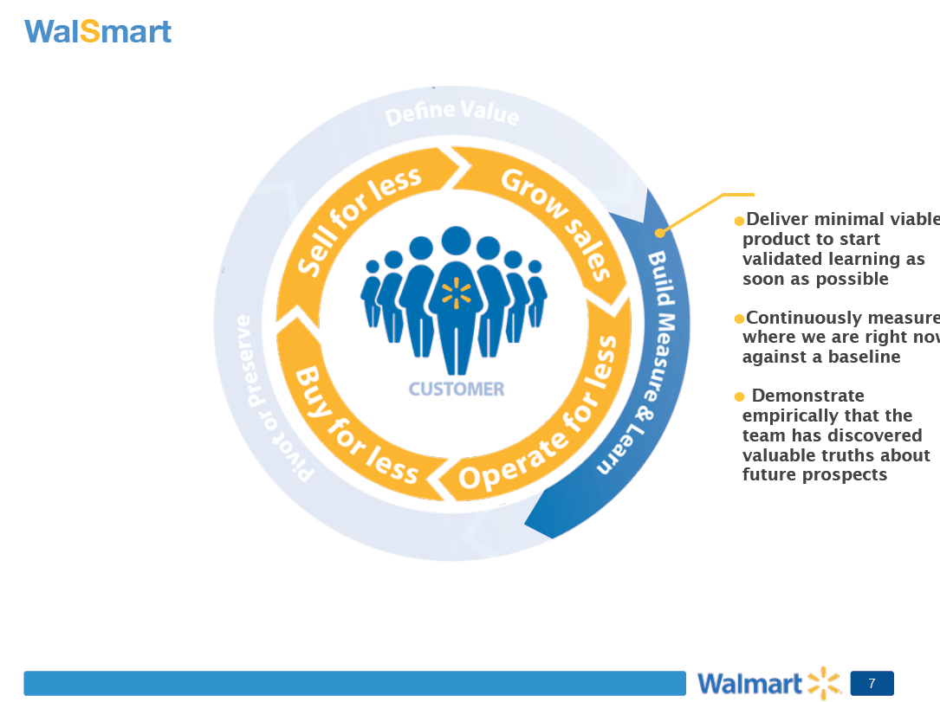

Slide 92
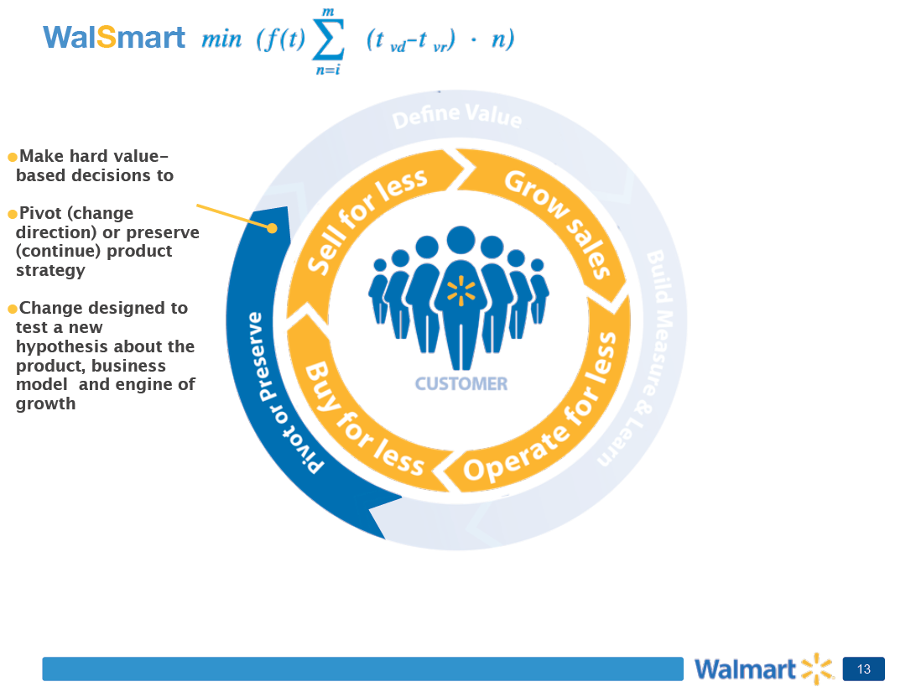

Slide 93
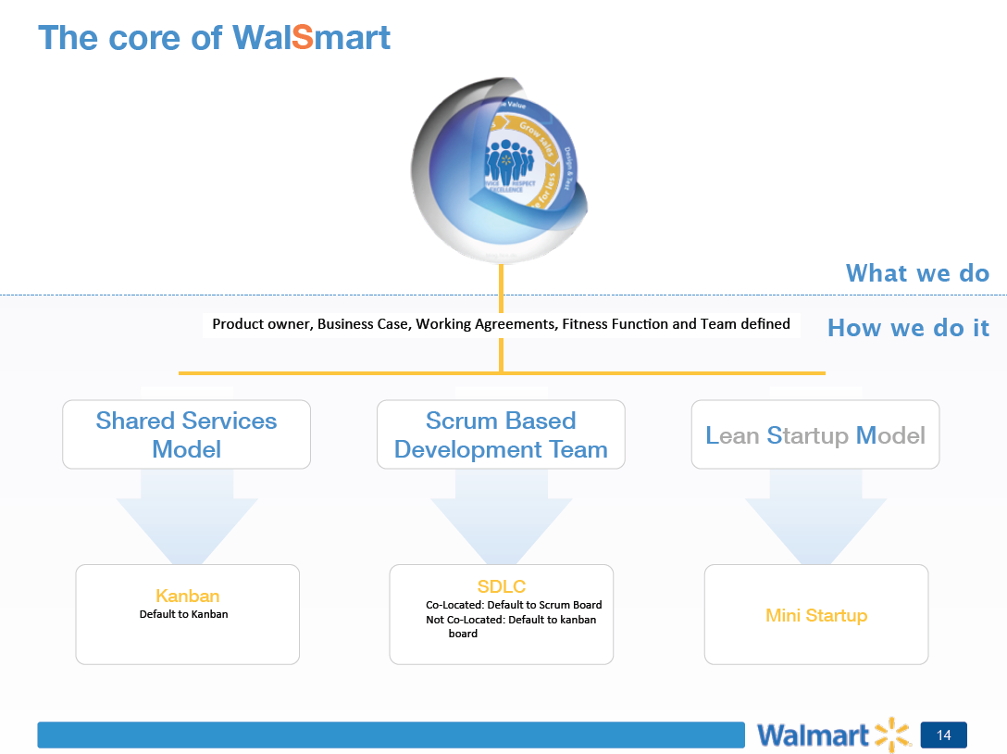

Slide 94
Agile Executive Forum 2013
Crisis Servant Leadership Enterprise Scale Executive Training | Forming Storming Norming Performing | User Experience
Prioritization Social Forces | C-Level Agile Hidden Projects | Enterprise Architecture
Make the Enterprise Agile Automation Manage Expectations | Cultural Change to Embrace Uncertainty | Lean Startup

Slide 95
