Slide 1
Agile Development @ Landmark
Todd Little
Sr. Development Manager

Slide 2






Landmark Software and Services
Reservoir /
Fluid data
Production data
Geophysics
Engineering
Seismic data
Structural /
Stratigraphic data
Common Model
Representation
Common Model
Representation
Velocity data
Well data
Geology

Slide 3
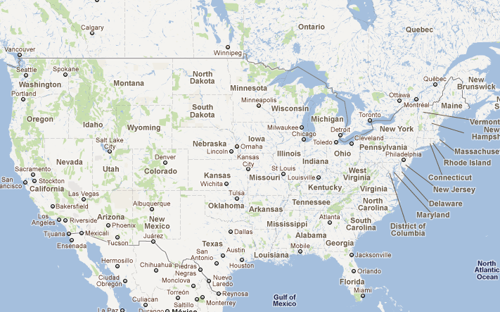
Development Sites in Houston, Denver and Calgary

Slide 4
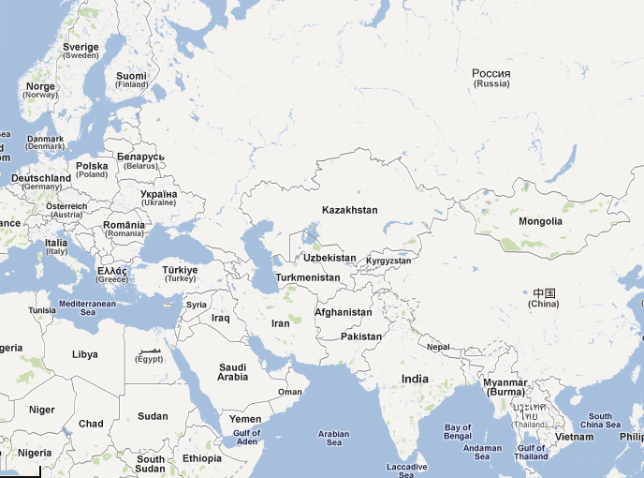
Plus International Development
Stavanger
Islamabad
New Delhi
Bucharest
Ho Chi Mihn
Chennai

Slide 5


Slide 6


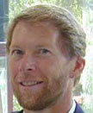
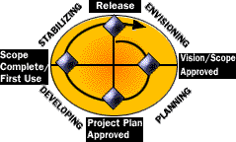
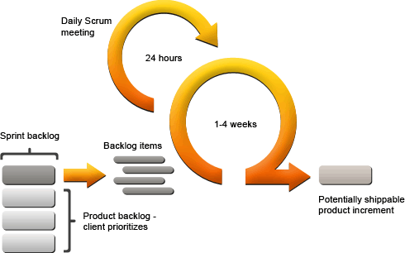


Our Agile Journey
1998 | 1999 | 2000 | 2001 | 2002 | 2003 | 2004
Agile
Manifesto

Slide 7
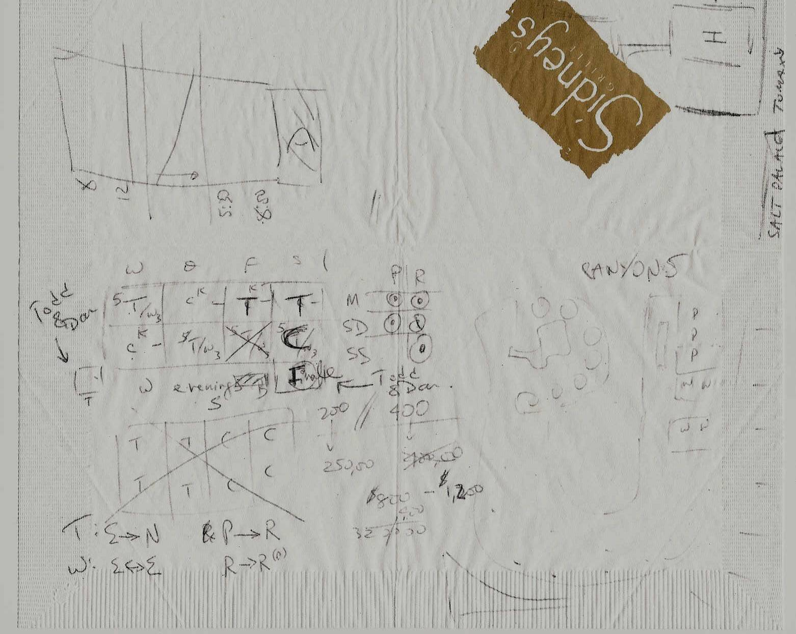

Who says Agilists don’t Document

Slide 8




Our Agile Journey
1998 | 1999 | 2000 | 2001 | 2002 | 2003 | 2004
Agile
Manifesto

Slide 9



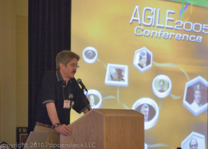
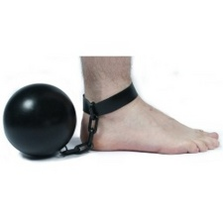


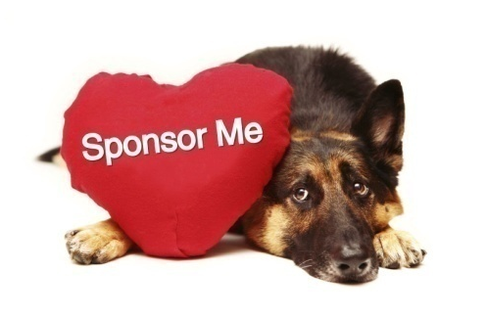

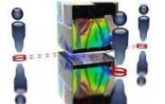



Our Agile Journey
2005 | 2006 | 2007 | 2008 | 2009 | 2010 | 2011
DecisionSpace® Desktop

Slide 10

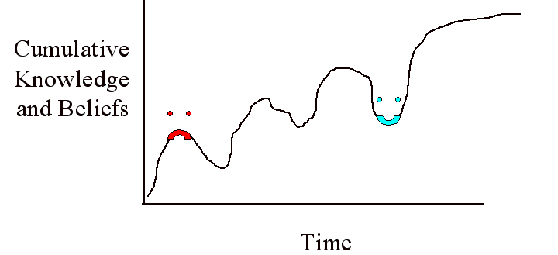

Slide 11
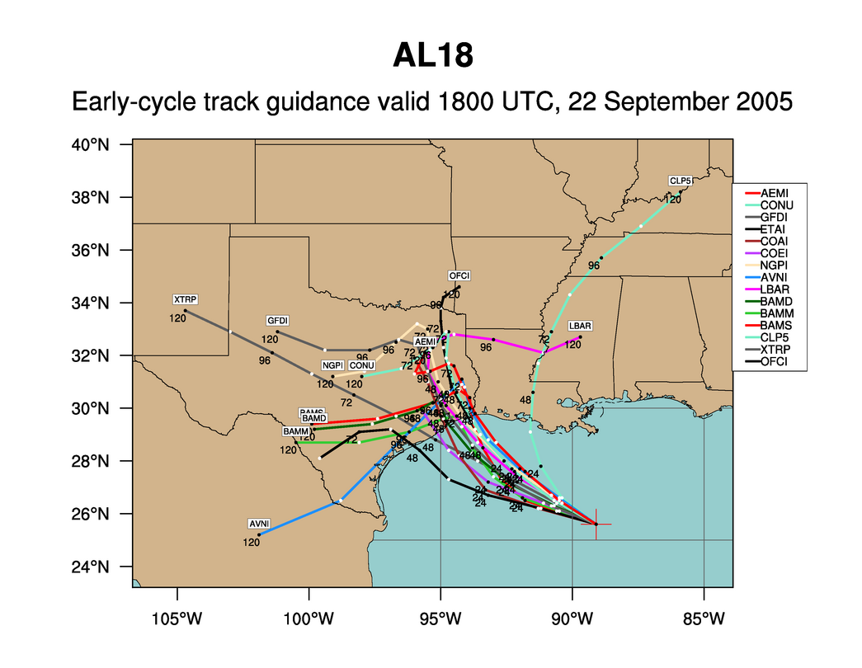
Hurricane Rita

Slide 12

It Depends
Uncertainty: We expect uncertainty and manage for it through iterations, anticipation, and adaptation.
Context: We improve effectiveness and reliability through situationally specific strategies, processes and practices.

Slide 13
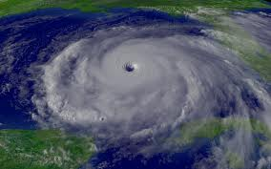
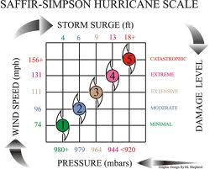
Hurricane Context
Where is it?
Where is it going?
How fast are the winds?
How big is it?
How large are the swells?

Slide 14
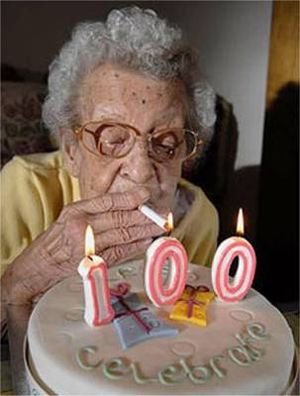


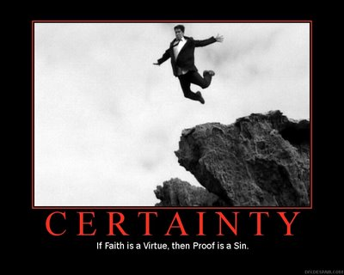

Project Context

Slide 15
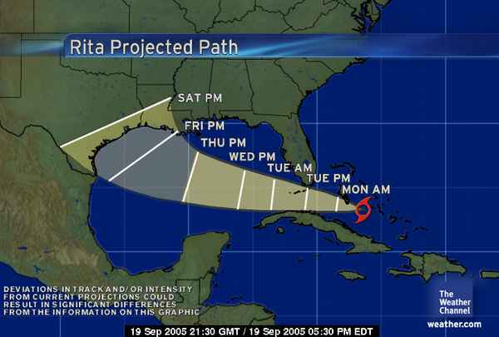
Uncertainty
Uncertainty: We expect uncertainty and manage for it through iterations, anticipation, and adaptation.

Slide 16
Context Leadership Model
High
Uncertainty
Low
Low
High
Project Complexity

Slide 17
Uncertainty and Complexity
Uncertainty |  | Complexity
Attribute | Range | Attribute | Range
Market | Mature or New | Team Size | <5 to > 100
Technical | Proven or New | Mission Critical | Speculative or Business Critical
# Customers | 1 or many | Team Location | Local or Distributed
Duration | 3 months or 2 years | Team Maturity | New or Experienced
Change | Change control or Embrace change | Domain Gaps | Gaps or Team of domain experts
 |  | Dependencies | None or Several

Slide 18

Context Leadership Model
High
Colts
Bulls
Uncertainty
Cows
SheepDogs
Low
Low
High
Project Complexity

Slide 19
Context Leadership Model
High
Colts
Bulls
Simple, young projects.
Agility to handle uncertainty
Need agility
Process definition to cope
with complexity
Tight Teams
Uncertainty
Cows
SheepDogs
Complex, mature market
laissez faire
Need defined interfaces
Low
Low
High
Project Complexity

Slide 20
Reduce Uncertainty or Complexity
Uncertainty | Complexity
Opportunities to Reduce Uncertainty: Use proven technologies Reduce project duration | Opportunities to Reduce Complexity: Collocate the team Break project into sub-projects
Attribute | Score
Market | ███
Technical | ███
# Customers | █████████
Duration | █████████
Change | ███
Attribute | Score
Team Size | █████████
Mission Critical | █████████
Team Location | █████████
Team Maturity | ███
Domain Gaps | ███
Dependencies | █████████

Slide 21
Swiss Stock Exchange
High
Colts
Bulls
User Interface
The Complete Release
Uncertainty
Cows
SheepDogs
Backend
Legacy Products
Low
Low
High
Project Complexity

Slide 22
Partitioning
Colt Project
Bull Program
SheepDog Project
Cow Project
Remember: Loose Coupling and Strong Cohesion

Slide 23
Products Lifecycle Paths
C
A
B

Slide 24
Project Leadership Guide
Create
Change
Embrace
Change
High
Invent
Deploy
Market
Differentiating
Ad Hoc
Agile
Eliminate
Change
Control Change
Manage
Offload
Low
Outsource
Structured
Low
Mission Critical
High

Slide 25
Portfolio Management
Colts
Bulls
Uncertainty
Cows
SheepDogs
Project Complexity

Slide 26
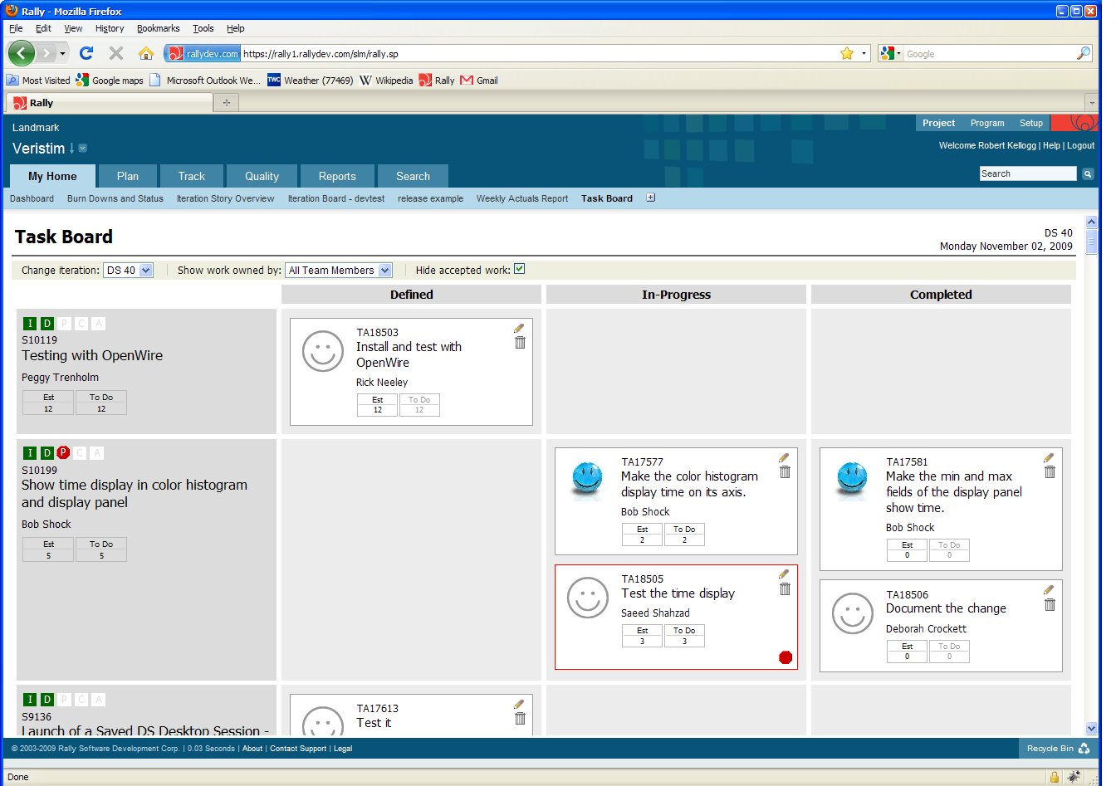
Scaling with Rally

Slide 27
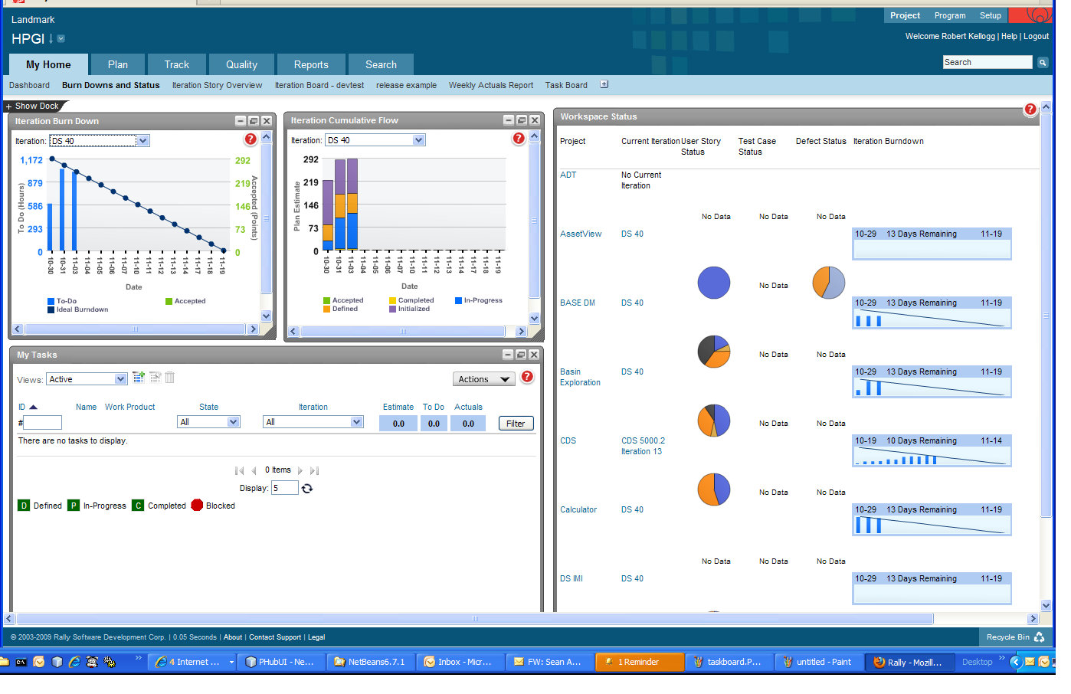
Scaling the Agile Enterprise

Slide 28
Project Dashboard

Slide 29
Expect a Journey

Slide 30
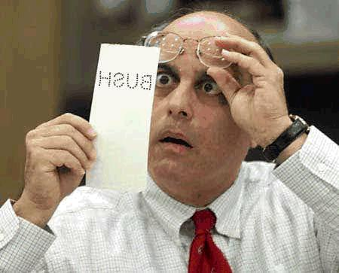

Inspect and Adapt

Slide 31

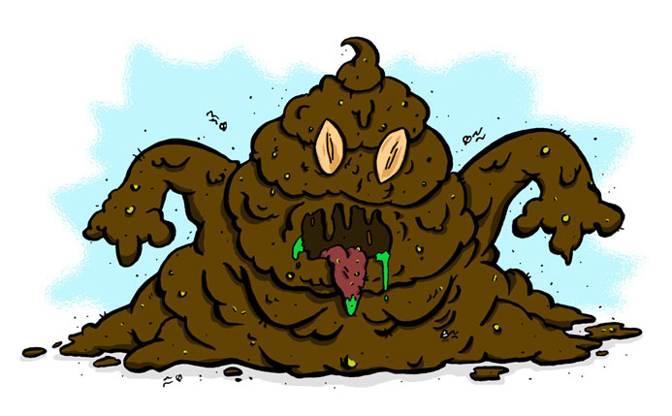
Technical Excellence over Technical Debt

Slide 32
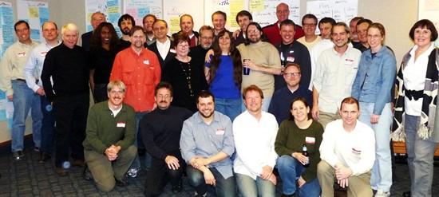
Reflections on 10 Years of Agility

Slide 33
Reflections on 10 Years of Agility
Demand Technical Excellence
Promote Individual Change and Lead Organizational Change
Organize Knowledge and Promote Education
Maximize Value Creation Across the Entire Process

Slide 34
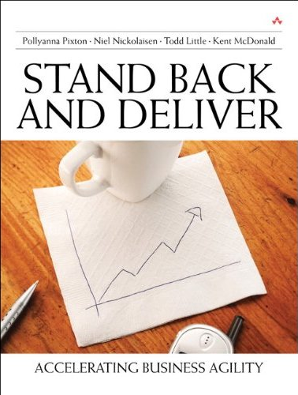
Contact
tlittle@lgc.com
www.toddlittleweb.com

