Slide 1
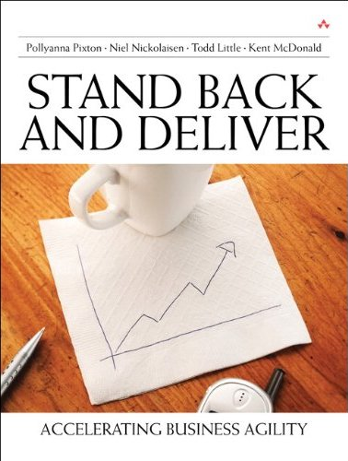
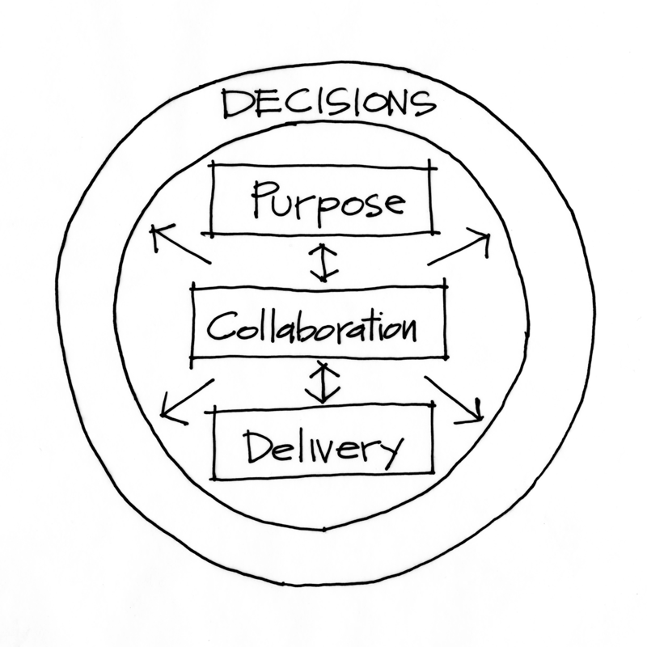
Stand Back and Deliver
With the Purpose Alignment Model
Todd Little, VP Product Development at IHS
Notes:
Over the past 3 years Landmark has been incorporating Agile methodologies in our development processes.

Slide 2
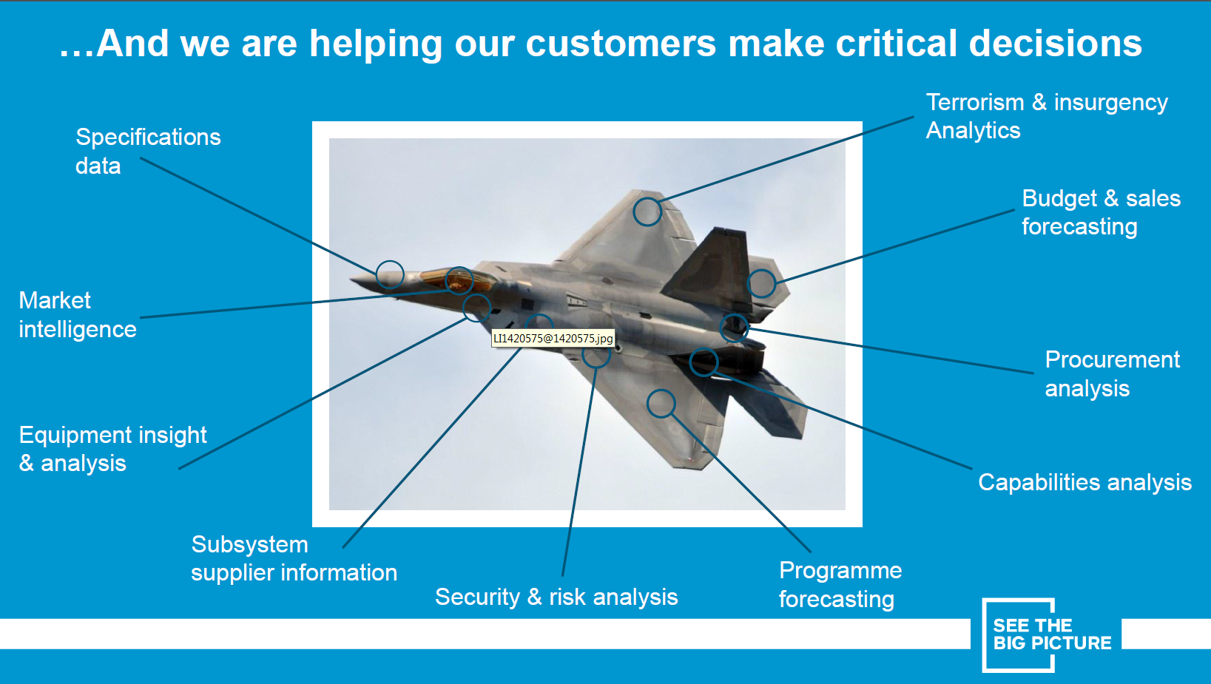
About IHS

Slide 3
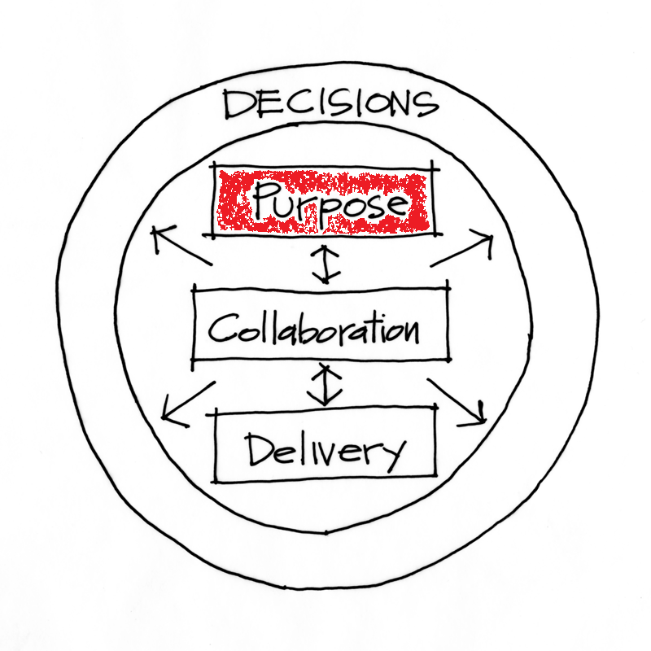
Purpose

Slide 4
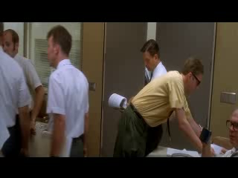
Apollo 13

Slide 5
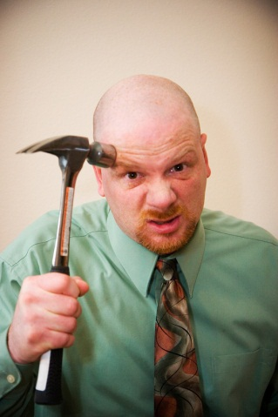
Get Alignment on the Purpose
Powerful Questions are:
What are we building?
What Business are we in?
What Building are we in?

Slide 6

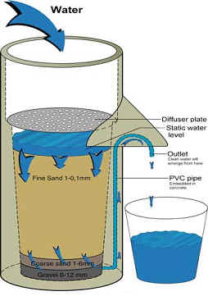
Is your Strategy a Bucket or a Filter?

Slide 7
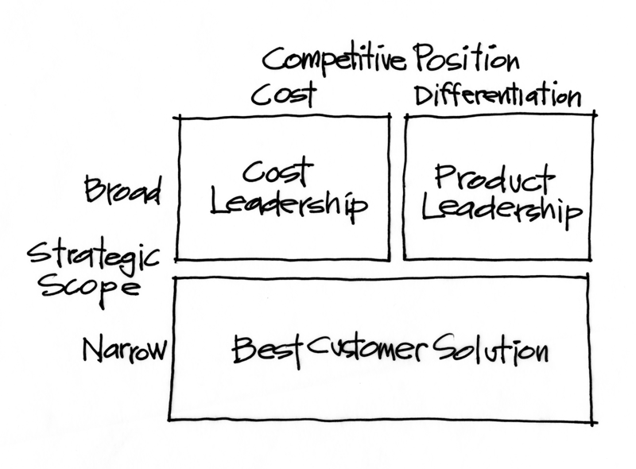
Start with Market Positioning

Slide 8
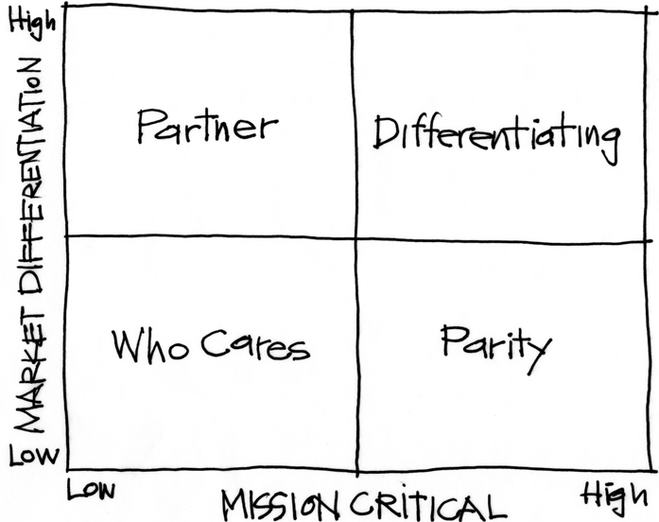
Purpose Alignment Model
Notes:
[Purpose of slide] [#]
[Information]

Slide 9
Purpose Alignment Model
CAN WE
CREATE A
DIFFERENTIATED
PARTNERSHIP?
INNOVATE,
CREATE
ACHIEVE AND
MAINTAIN PARITY, MIMIC, SIMPLIFY
MINIMIZE /
ELIMINATE
Notes:
[Purpose of slide] [#]
[Information]

Slide 10

Applicable at all Levels
Corporate Strategy
Product Strategy
Feature

Slide 11
A View of Strategy - Apple
11
NEW PRODUCT DESIGN
USER EXPERIENCE
CONTENT DISTRIBUTION
ATT
MS OFFICE
INTEL HARDWARE
OTHER SOFTWARE
PERIPHERALS
Notes:
11
[Purpose of slide] [#]
[Information]
© International Institute of Business Analysis®

Slide 12
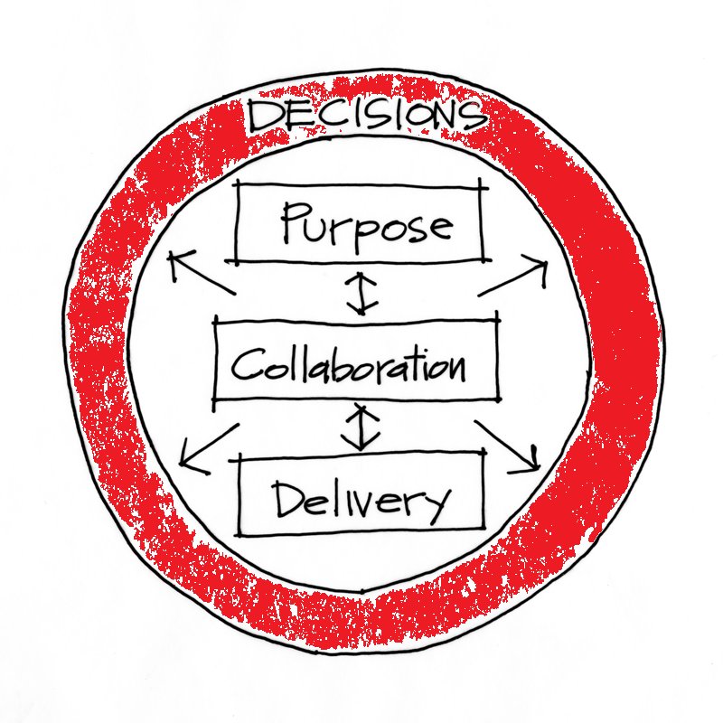
Decisions

Slide 13


Business Value Calculation
calculation
Costs
Value Calculation
Benefits
Business Value

Slide 14
Business Value Guess
calculation
Estimate
Value Calculation
Fabrication
Business Value

Slide 15
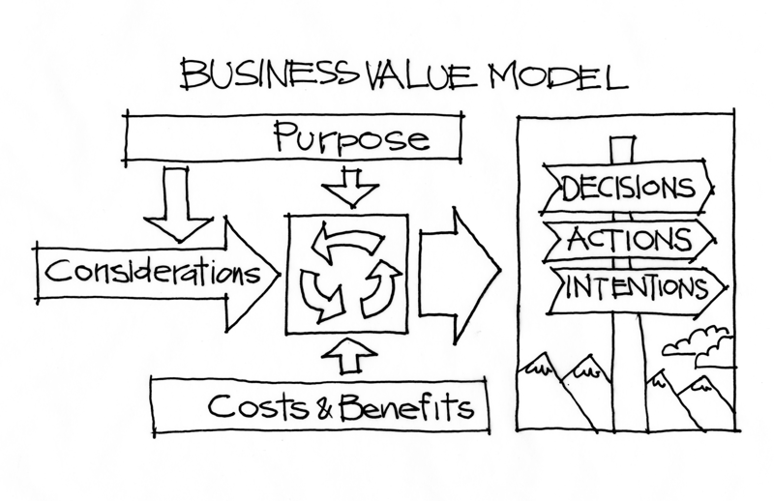
Decisions and Business Value

Slide 16
Purpose Filter
Idea
Idea
Partner | Invest
Who Cares | Parity
Critical
Items
Roughly
Estimate
Values and
Costs
Prioritize
By
Value/Cost
Idea
Prioritize
Idea
Strategic
Fit
Other
Release
Backlog
Idea
Idea
Non-
Economic
Non-
Strategic

Slide 17

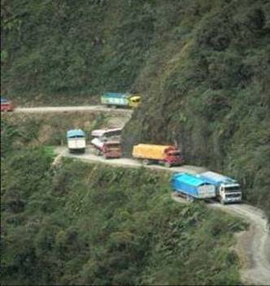
Considerations
Risks | Assumptions | Constraints
Notes:
17

Slide 18
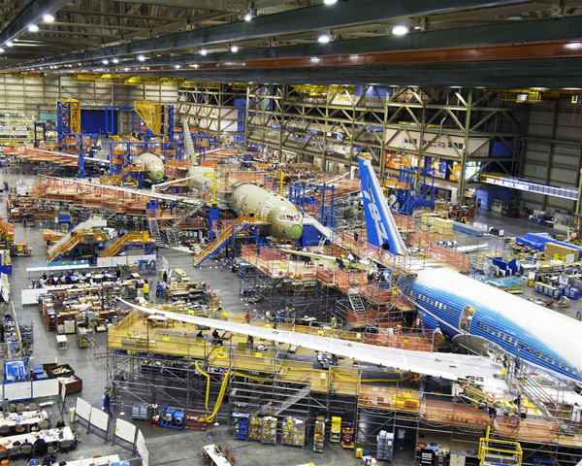

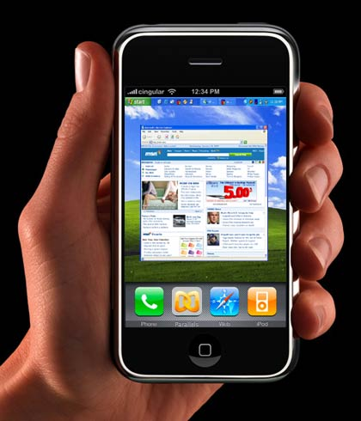
Risks – Types of Uncertainty
Cost Uncertainty
General Market Uncertainty
Feature Acceptance Uncertainty

Slide 19
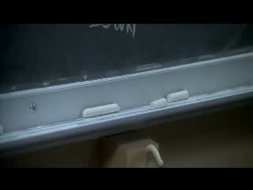
Constraints -- Failure is not an option

Slide 20

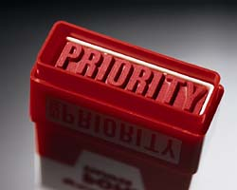

Decisions, Decisions, Decisions
What do we do?
When do we do it?
When do we decide?

Slide 21
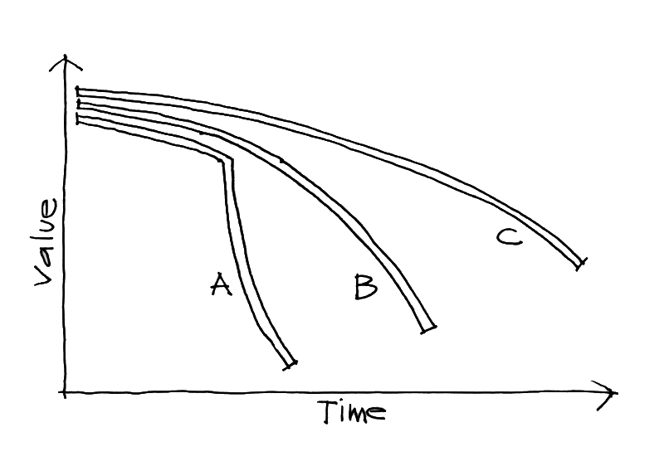
Cost of Delay

Slide 22
Is your Strategy a Bucket or a Filter?

Slide 23
Purpose

Slide 24
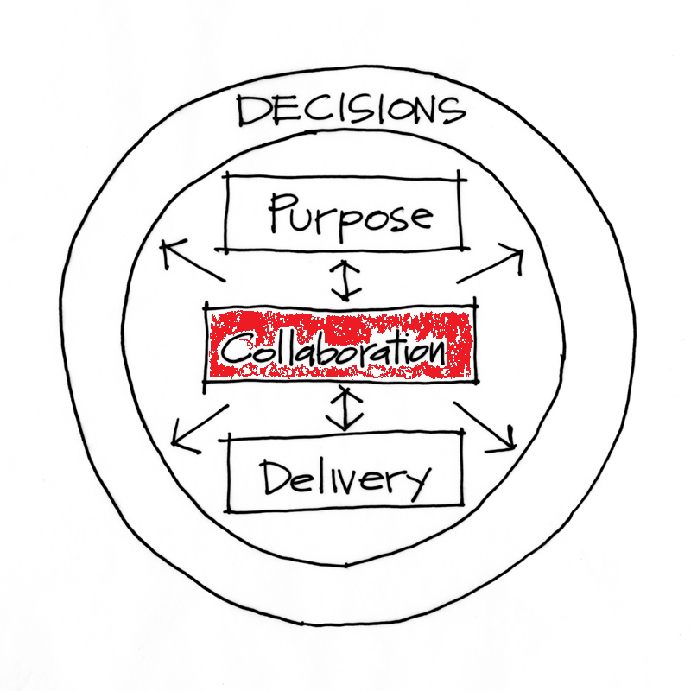
Collaboration

Slide 25
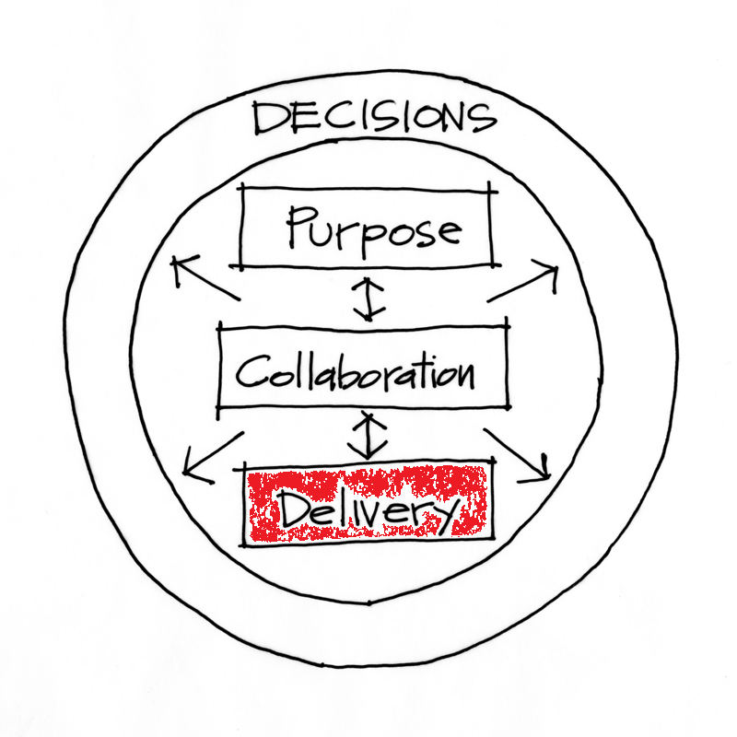
Delivery

Slide 26
Decisions

Slide 27
Contact
Todd Little
  todd.little@ihs.com
  toddelittle@gmail.com
  www.toddlittleweb.com
  www.accelinnova.com
  www.linkedin.com/in/toddelittle/en

Slide 28
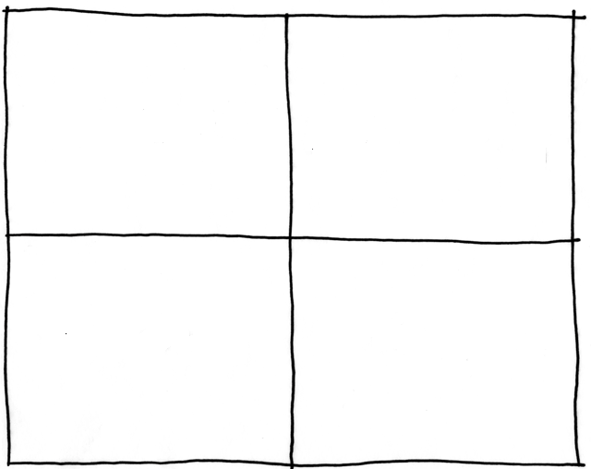
Collaborating with Non-Collaborators
Collaborator
Creative
Tension
Collegial
More useful
Drive to
Purpose
Collaboration
Non-
Collaborator
Compliance
Combative
Common Practice
Agree
Disagree
Agreement

Slide 29



Real Options

