Slide 1
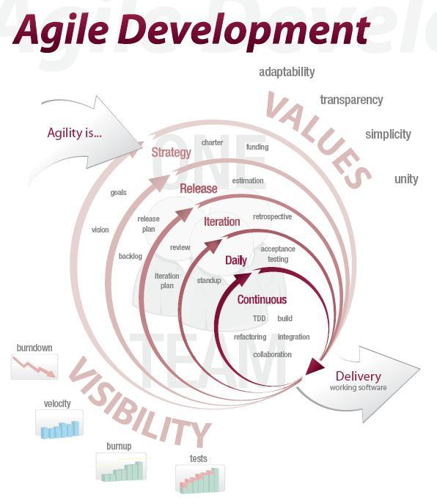
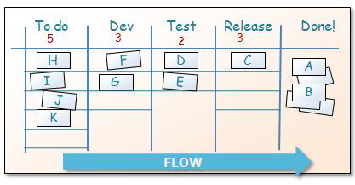
Agilility,
Kanban, and Learning
Todd Little
Sr. Software Manager
Landmark/Halliburton
Notes:
Over the past 3 years Landmark has been incorporating Agile methodologies in our development processes.

Slide 2

The Idealized Waterfall
Envisioning
Plan/Design
Develop
Test
Release
Notes:
Prior to our move toward Agile methodologies, we followed a more standard waterfall model based on the Microsoft development framework. Our predictability, using this method, was good but we didn’t always meet the needs of the market with our releases. We needed to move to a process that focused on “what” we were delivering so that the solutions we released better solved the problems of our customers.

Slide 3




What Happens in a Typical Project
Inside the Tornado
Project Kickoff
When will we get the requirements?
All in good time, my little pretty, all in good time
But I guess it doesn't matter anyway
Just give me your estimates by this afternoon
Team Unity
Not so fast! Not so fast! ... I'll have to give the matter a little thought. Go away and come back tomorrow
No, we need something today!
Ok then, it will take 2 years.
No, we need it sooner.
Doesn't anybody believe me?
I already promised the customer it will be out in 6 months
You're a very bad man!
Notes:
We look at a typical software project…..

Slide 4


We’re not in Kansas Anymore
Developer Hero
I may not come out alive, but I'm goin' in there!
Reorg
The Great and Powerful Oz has got matters well in hand.
My! People come and go so quickly here!
Testing
"Hee hee hee ha ha! Going so soon? I wouldn't hear of it! Why, my little party's just beginning!

Slide 5

Hurricane Rita
Notes:
We like to use forecasting a hurricane track as an analogy to software development. This is an example of the various news agencies early forecast of hurricane’s Rita track. One thing we know is that all of these tracks are wrong.

Slide 6
Hurricane Rita
Notes:
The actual path of Rita is shown in yellow. Planning of software is much like this. Almost everything we do is “new” and when we followed a more waterfall model, we took lots of time designing and gathering estimates of tasks before starting. From that initial Plan, the one thing we really knew, was that the project would not turnout looking like the plan and it would change. We know that as we gain more knowledge during development the plan would be refined many times. So, with Agile, we don’t spend a lot of time in upfront planning.

Slide 7

The Agile Manifesto–a statement of values
Individuals and interactions
Process and tools
over
Working software
Comprehensive documentation
over
Customer collaboration
Contract negotiation
over
Responding to change
Following a plan
over
Source: www.agilemanifesto.org
Notes:
Agile processes promote iterative development with a minimal amount of formal software development process. This methodology relies primarily on short iterations, frequent communication, regular customer interaction, and frequent review of working software.
Our highest priority is to satisfy the customer through early and continuous delivery of valuable software.
Agile welcomes changing requirements, even late in development.
Agile processes harness change for the customer's competitive advantage.
Agile delivers working software frequently, from a couple of weeks to a couple of months, with a preference to the shorter timescale.
In Agile business people and developers must work together daily throughout the project.

Slide 8

Agile Principles
Focus on value
Embrace Change
Build Quality in
Deliver chunks of functionality incrementally
Collaboration with empowered teams
Reflect and learn continuously

Slide 9
Agile in a Nutshell
24 hours
1-4 weeks
Iteration Backlog
Backlog tasks
Potentially Shippable
Product Increment
Release Backlog
Notes:
As mentioned, a release is made up of a series of iterations. Iterations are typically 1-4 weeks in length. Each iteration has a defined set of stories to be delivered. The teams goal is to have a potentially shippable product after each iteration.

Slide 10
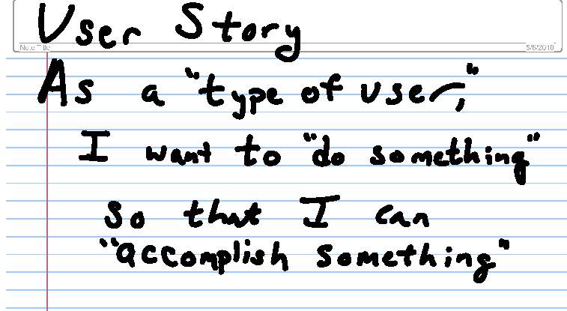
Backlog is a set of “Stories” and “Tasks”
Development
Task 1
Testing
Task 1
Development
Task 2
Testing
Task 2
Notes:
A story is a particular requirement that solves a problem. It is written in a form of -

Slide 11
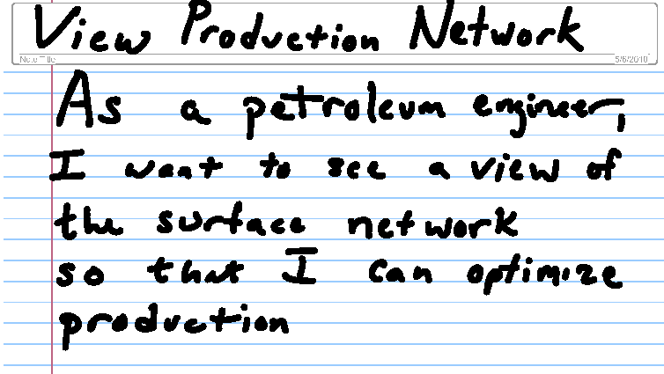
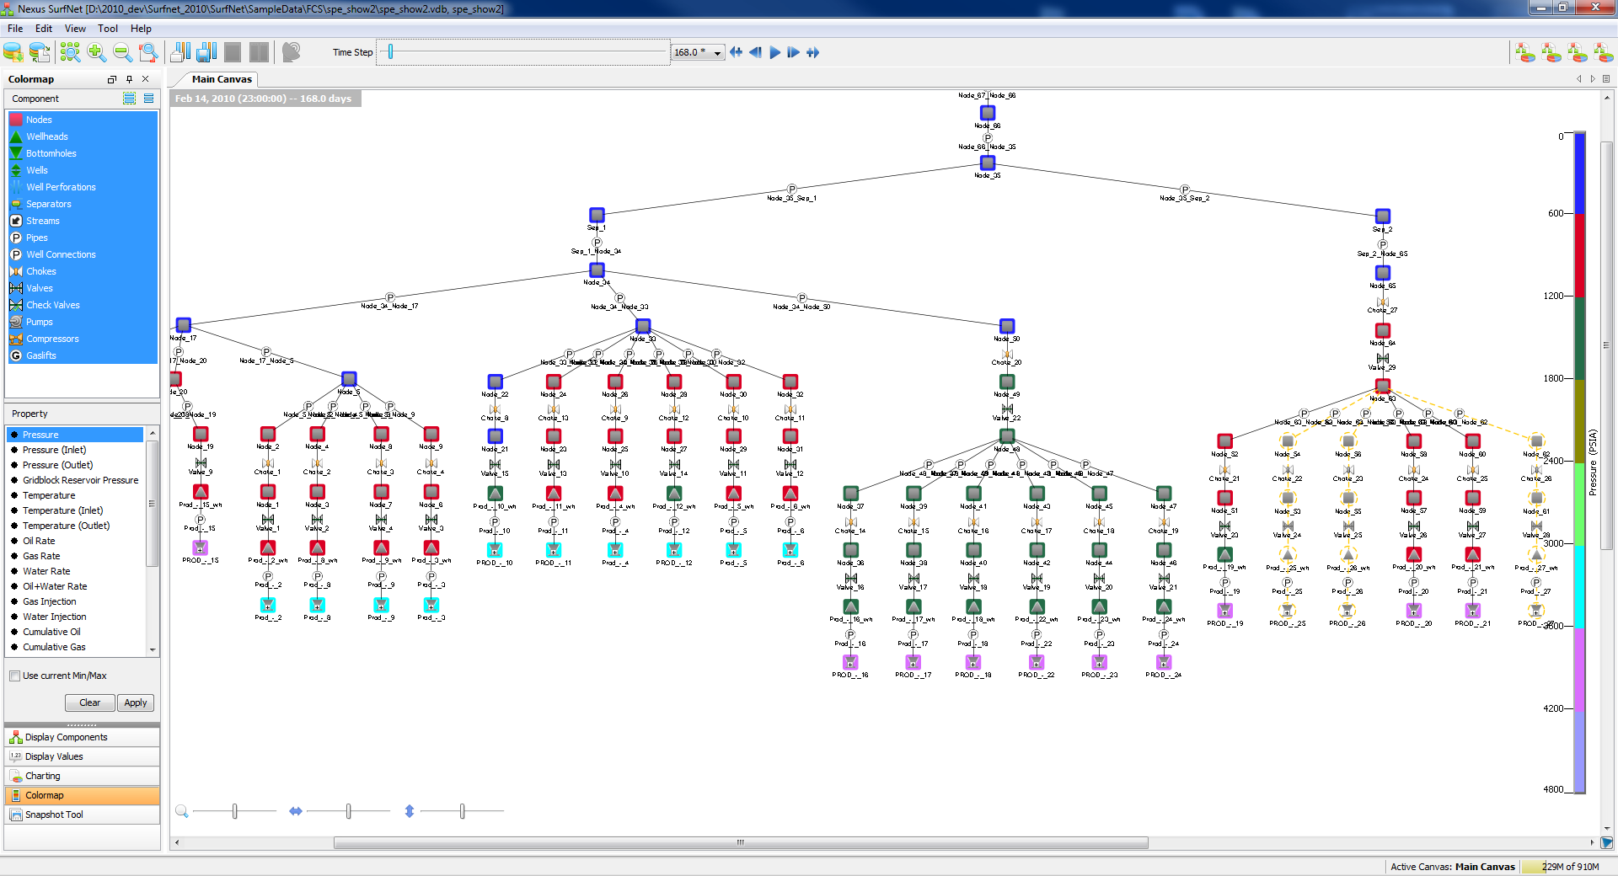
Backlog is a set of “Stories”
Notes:
An example of a story. This story is then taken and broken down into development tasks and developers put estimates to those tasks and they are assigned out to the team.

Slide 12
Agile in a Nutshell
24 hours
1-4 weeks
Iteration Backlog
Backlog tasks
Potentially Shippable
Product Increment
Release Backlog
Notes:
Another important part of Agile is the constant communication aspect of the process. Teams meet for a short period (goal is to not to exceed 15 minutes) to give status on the tasks they are working for that interation.

Slide 13
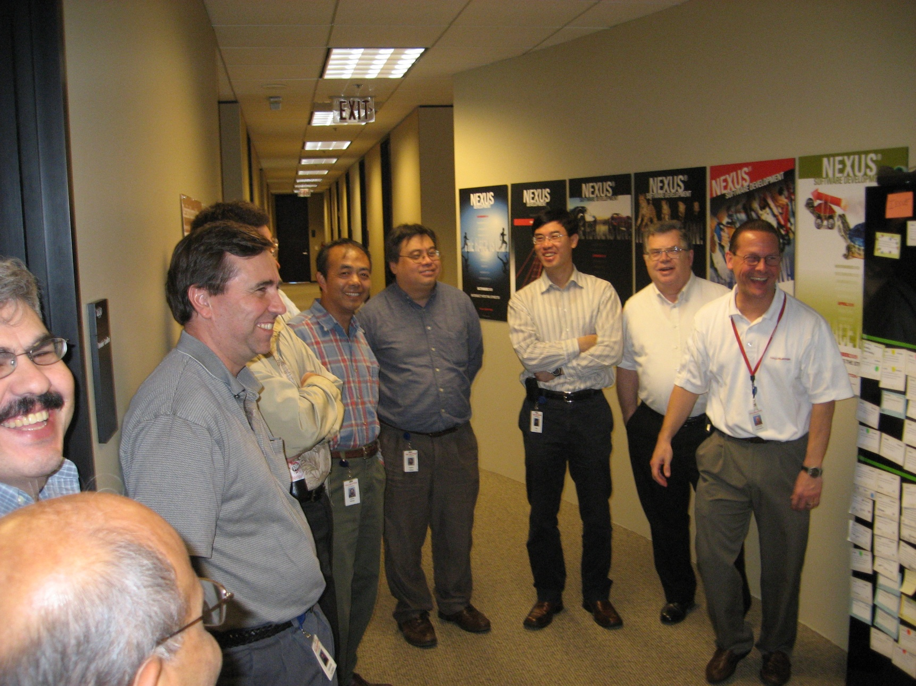
Daily Standup
Notes:
For the daily meeting team members are required to “stand”, which helps to encourage the short length of the meeting….and is how it got its name…..Daily Standup.

Slide 14
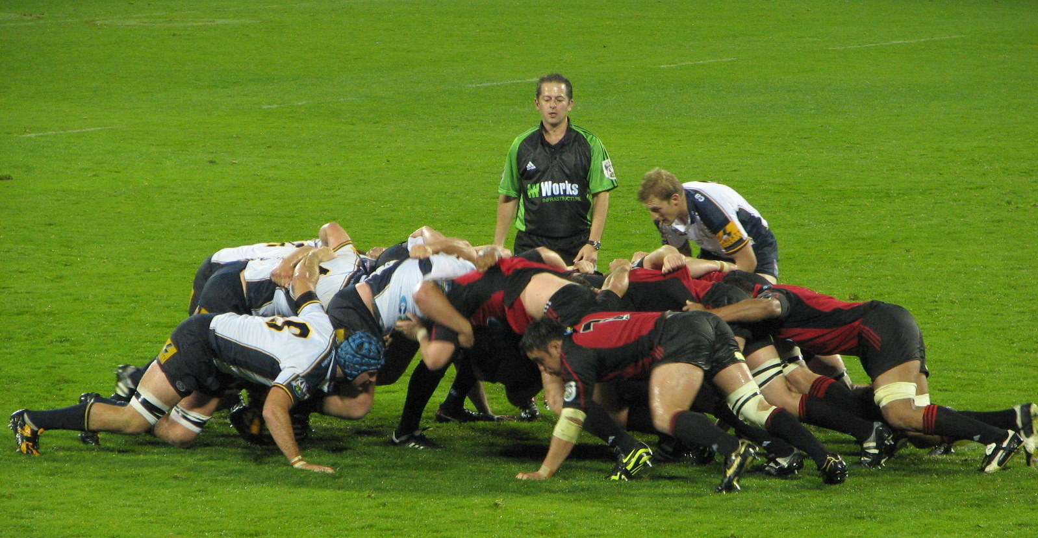
The Scrum

Slide 15

3 questions for the Daily Standup
1
What did you do yesterday?
2
What will you do today?
3
Is anything in your way?
15-minutes
24 hours
Notes:
Three questions are asked of each member of the team.

Slide 16
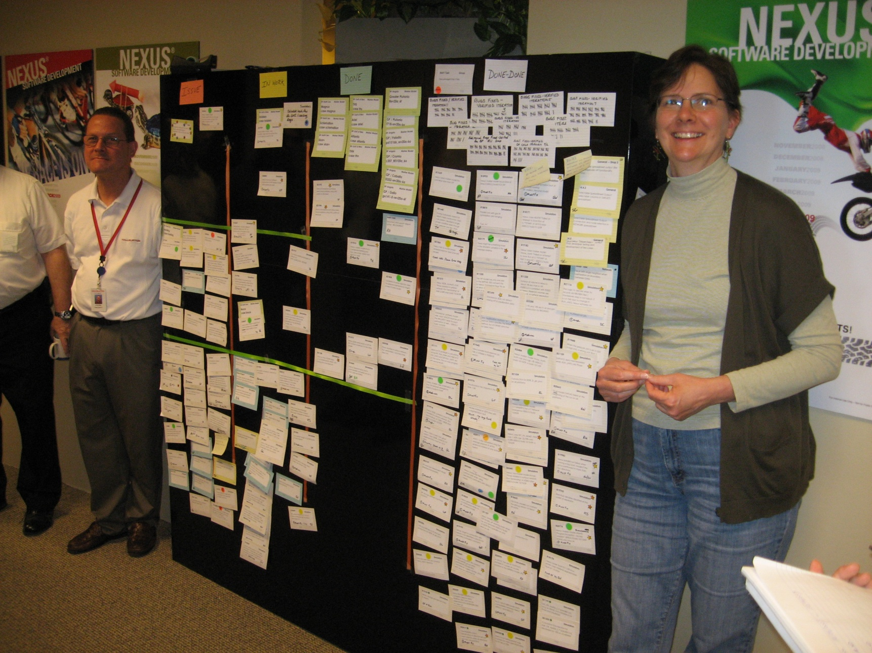
Tracking Progress
Notes:
Progress for the release is tracked by stories (requirements(. This group is tracking their progress manually as you see above. Each story is an index card which is moved along as the story is started, in-progress, completed by the developer (Done), and accepted by the product owner (Done-Done). Many teams also track their progress using a software tool called Rally at Landmark.

Slide 17
Burndown Chart
Notes:
We use dashboards like the Burndown chart, you see above, to measure our progress. This release started with approximately 820 story points. The team had 3 week iterations (except for one). At the end of each iteration, the story points completed are subtracted from the total. The shaded area (burnup chart) shows the number of story points completed as Done (developer is complete) and Done Done (it has been accepted by the product owner). The green line shows us where our projected end is for the entire release. Remember though, the goal of Agile is to have a potential releasable product after each iteration which would enable us to get completed functionality to the marketplace anytime.

Slide 18
Agile/Scrum in a Nutshell
24 hours
1-4 weeks
Iteration Backlog
Backlog tasks
Potentially Shippable
Product Increment
Release Backlog
Notes:
What do we do? The group of requirements wanted to be developed in a release are our backlog and they are designated by the boxes. These requirements or stories are prioritized and divided into iterations. Each individual box is an iteration. Development of complete stories are delivered within an iteration. Iterations are between 2-4 weeks in length. Looking at this example, the release contains 4 iterations. After each iteration, the goal is to have a potentially shippable product. So, development, testing, and validation of the stories are all done during the iteration.

Slide 19
The Kanban Board
Project Backlog | Iteration Backlog | In Work | Done | Accepted (Done Done)
 | Planned for this iteration Cutline | In Development | The Development team has declared it completed and ready for final testing | Fully tested by the test team and accepted by the Business

Slide 20
The Kanban Board
Project Backlog | Iteration Backlog | In Work | Done | Accepted (Done Done)
Story 1
Development
Task 1
Story 2
Development
Task 2
Story 3
Story 4

Slide 21
The Kanban Board
Project Backlog | Iteration Backlog | In Work | Done | Accepted (Done Done)
Story 1
Development
Task 1
Testing
Task 1
Development
Task 2
Testing
Task 2
Story 3
Story 2
Story 4

Slide 22
The Kanban Board
Project Backlog | Iteration Backlog | In Work | Done | Accepted (Done Done)
Story 1
Testing
Task 1
Testing
Task 2
Story 3
Story 2
Story 4

Slide 23
The Kanban Board
Project Backlog | Iteration Backlog | In Work | Done | Accepted (Done Done)
Story 1
Story 3
Story 2
Story 4

Slide 24

Learning
Feedback Loop

Slide 25

Gordon the Guided Missile

Slide 26

Gordon

Slide 27


Slide 28
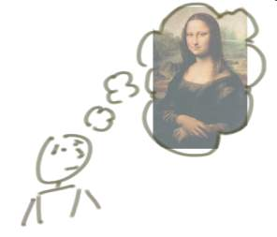



“incrementing” builds a bit at a time
But, incrementing calls for a fully formed idea
1
2
3

Slide 29
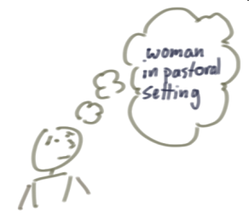
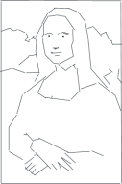


“iterating” builds a rough version, validates it, then slowly builds up quality
Iterating allows you to move from vague idea to realization
1
2
3

Slide 30
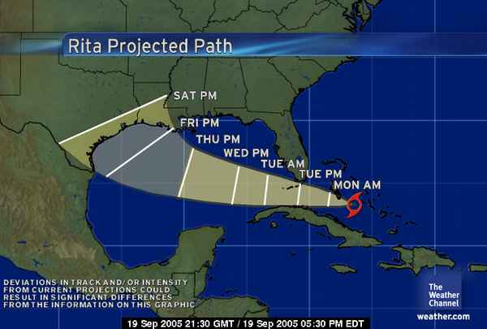
Uncertainty
We expect uncertainty and manage for it through iterations, anticipation and adaptation.
Inspect and Adapt

Slide 31
Retrospective
What went well? | What to try differently?

Slide 32
Agility is a set of Principles
Focus on value
Embrace Change
Build Quality in
Deliver chunks of functionality incrementally
Collaboration with empowered teams
Reflect and learn continuously

Slide 33
The Kanban Board
Project Backlog | Iteration Backlog | In Work | Done | Accepted (Done Done)
 | Planned for this iteration Cutline | In Development | The Development team has declared it completed and ready for final testing | Fully tested by the test team and accepted by the Business

Slide 34
Learning
The objective is to get it right at the end
1
2
3

Slide 35
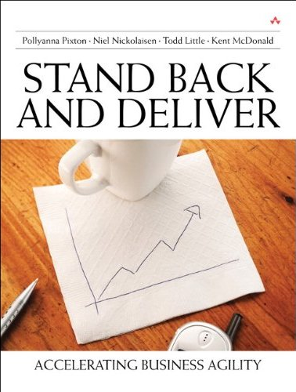
Contact
Todd Little
  todd@toddlittleweb.com
  www.toddlittleweb.com
  www.accelinnova.com

Slide 36


