Slide 1
TURBOCHARGE
YOUR
SCRUM
Joey Spooner
VP Community Development and Product Management
Todd Little
Chairman

Slide 2
Three Questions
Let’s find out what’s going on with your Scrum

Slide 3
How do you use Scrum today?
I am a Scrum practitioner
I use Scrum with SAFe
I use Disciplined Agile not Scrum
I use Scrum with Kanban
I use Kanban without Scrum
I am dabbling with Scrum
I haven’t used Scrum
I hate Scrum

Slide 4
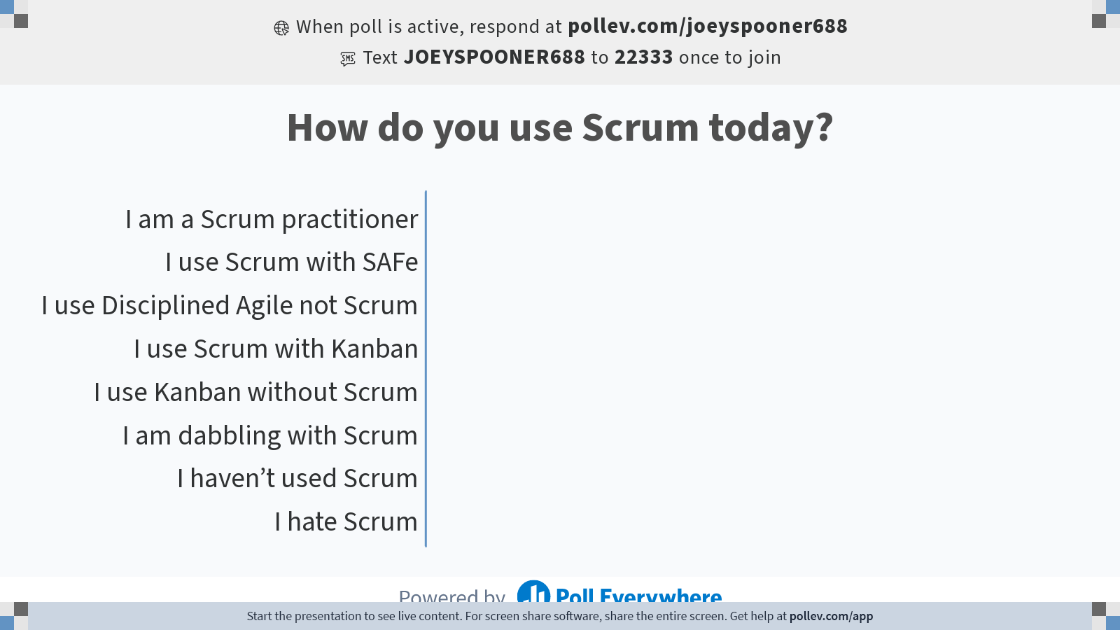
Notes:
Do not modify the notes in this section to avoid tampering with the Poll Everywhere activity.
More info at polleverywhere.com/support
How do you use Scrum today?
https://www.polleverywhere.com/multiple_choice_polls/x1eA5qqVzpCgSEKpRmYMF?state=opened&flow=Default&onscreen=persist

Slide 5
Why are you using Scrum?
I don’t know
I was told to use it
I’m part of a project team that chose to use it
I’m part of a product team that chose to use it
I’m exploring it as a way to achieve agility in my team
It’s helping us to focus on exploring both ways to deliver better products and improve at the same time

Slide 6
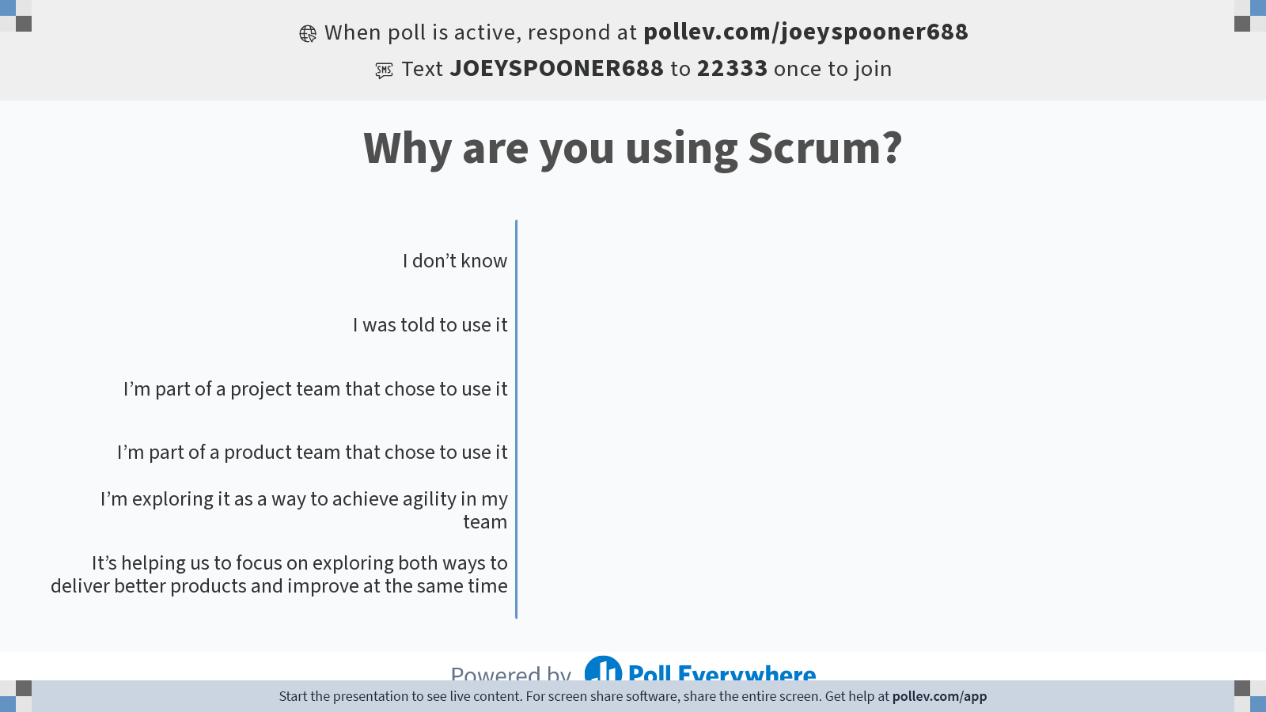
Notes:
Do not modify the notes in this section to avoid tampering with the Poll Everywhere activity.
More info at polleverywhere.com/support
Why are you using Scrum?
https://www.polleverywhere.com/multiple_choice_polls/5lLYFeuMwF7LXmQYLixyE?state=opened&flow=Default&onscreen=persist

Slide 7
How is your Scrum driving you now? Let’s check in on your Scrum.
We gave up
It’s driving me crazy
We’re compliant with how my company wants us to do Scrum
I think my team is on a regular dose of valium
We’re retro’ng but not acting on what we learn
We’re doing OK. Making progress and improving.
We’re crushing it. We’ve got a good balance and are improving and delivering regularly.

Slide 8
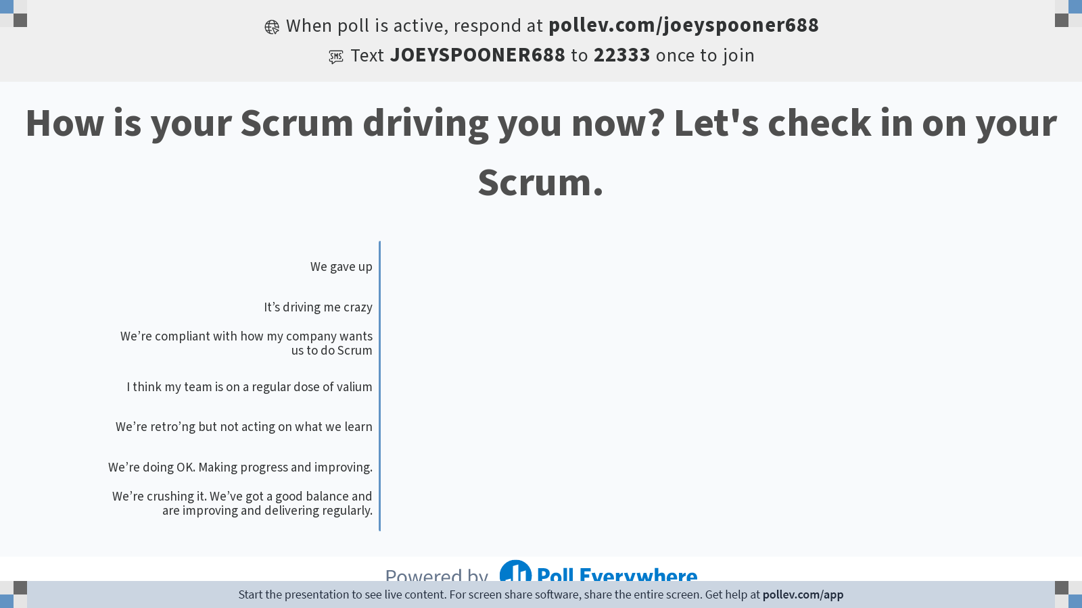
Notes:
Do not modify the notes in this section to avoid tampering with the Poll Everywhere activity.
More info at polleverywhere.com/support
How is your Scrum driving you now? Let's check in on your Scrum.
https://www.polleverywhere.com/multiple_choice_polls/SqJUP7AeIsGsWgt5wpgwx?state=opened&flow=Default&onscreen=persist

Slide 9
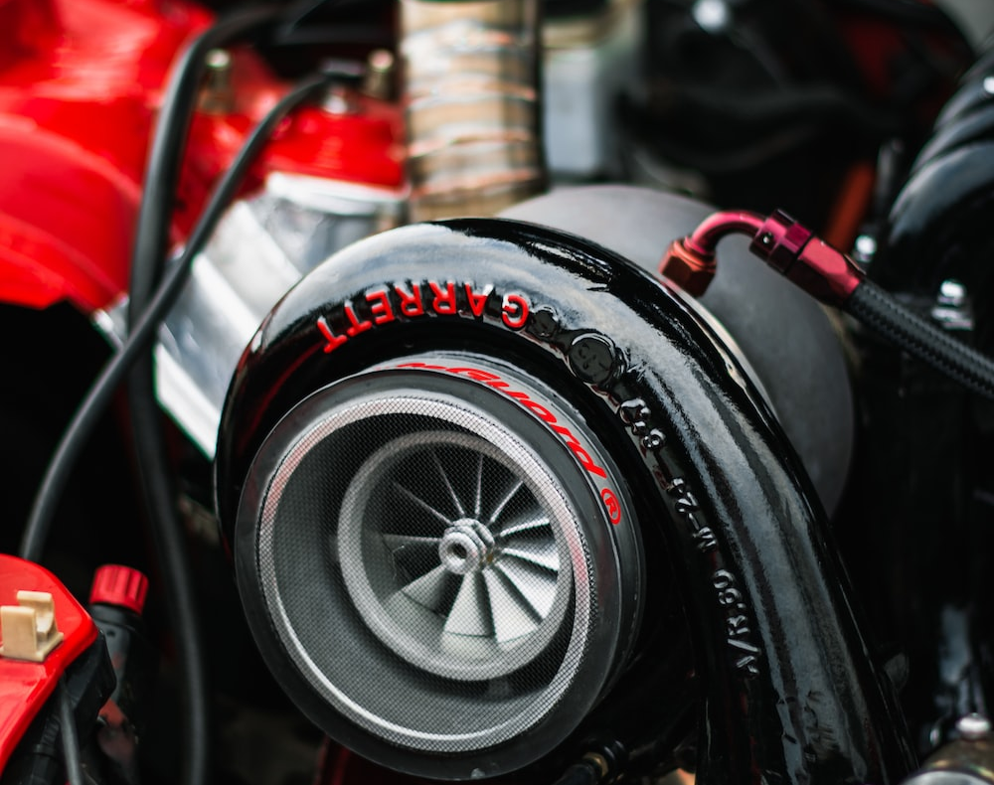
What is a turbocharger?
In addition to the extra power, turbochargers are sometimes referred to as devices that offer “free power” because unlike a supercharger, it does not require the engine’s power to drive it.
Credit: Simone Durelli
https://www.eagleridgegm.com/what-is-a-turbocharger-and-how-does-it-work/

Slide 10
A turbocharger …
Improves your team's performance without costing them a ton of energy to improve and potentially fail

Slide 11
“Over 58% of Scrum implementations are late, over budget, with unhappy customers.”
Jeff Sutherland
Co-founder of the Scrum Framework
https://www.scruminc.com/better-scrum-with-essence/

Slide 12
Where can change go wrong?
The sponsor leaves mid-change
The scope is larger than the organization or team can handle
We’re doing too much too soon
It’s unclear
This is the third or fourth time and we’re kind of over the change parties, etc. – please let us do our work
It’s been forced down on us
What else? Suggestion?

Slide 13
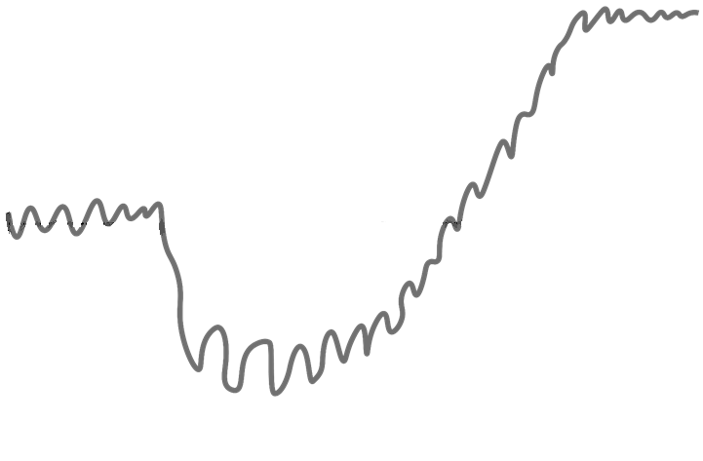
The Change Challenge
We believe that if we’re here, we’re serving someone or something better
Capability
Current State
Time
Safety!
Panic under stress
Patience!
Failure!

Slide 14
What’s the turbocharge?
Changes you can make to improve your Scrum while meeting your team where they are.

Slide 15
What can I turbocharge?
Areas of practice where turbo-grade change can occur
Making Policies Explicit
Visualization
Limit Work in Progress
Managing Flow
Feedback Loops
Collaboration and Experimentation

Slide 16
Posit Science
An example of turbocharging your Scrum

Slide 17


Posit Science Background
Posit Science was started by one of the world’s most pre-eminent neuroscientists to apply new discoveries in brain plasticity
Mike Merzenich
Dr. Michael Merzenich

Slide 18
Posit Science Background
Posit Science was started by one of the world’s most pre-eminent neuroscientists to apply new discoveries in brain plasticity
Mike Merzenich
Dr. Michael Merzenich

Slide 19
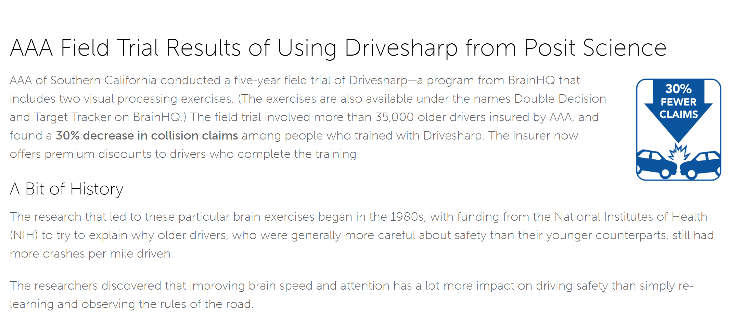
Posit Science Background
Posit Science has intellectual property providing solutions to brain aging problems such as declining peripheral vision
Effectively Posit Science’s products were computer games which were prescribed like drugs. They exercised and retrained neural pathways in the “patient” who played the game perhaps 15 minutes each day

Slide 20
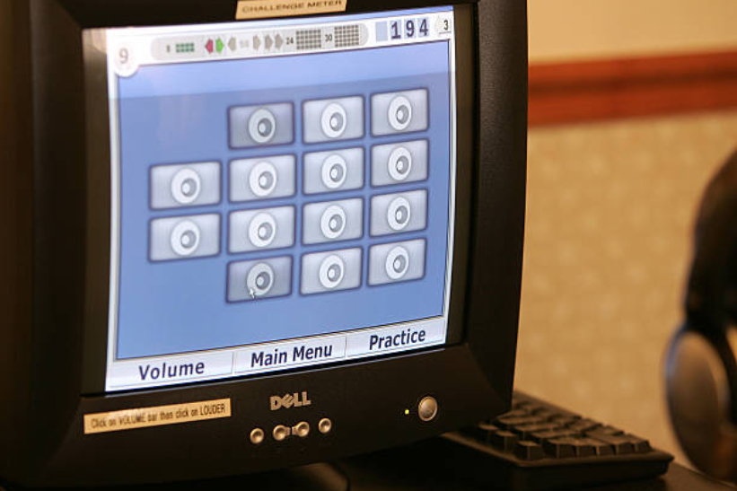
Posit Science Background
Scrum was adopted as the development process. . Rally Software’s product was adopted as a planning & tracking tool
During the “stealth” period it was necessary to develop some discipline in order to complete their new product

Slide 21
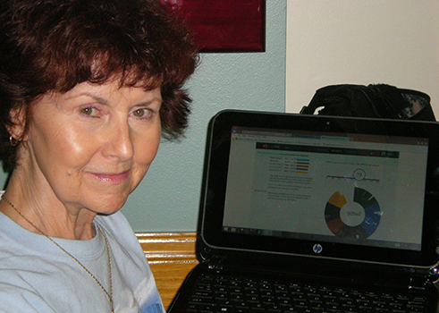
Posit Science Background
Everything worked very well initially. Scrum really helped the firm deliver its early product
Meanwhile, the original startup capital was beginning to run out. There was pressure to generate revenue and chase sales

Slide 22
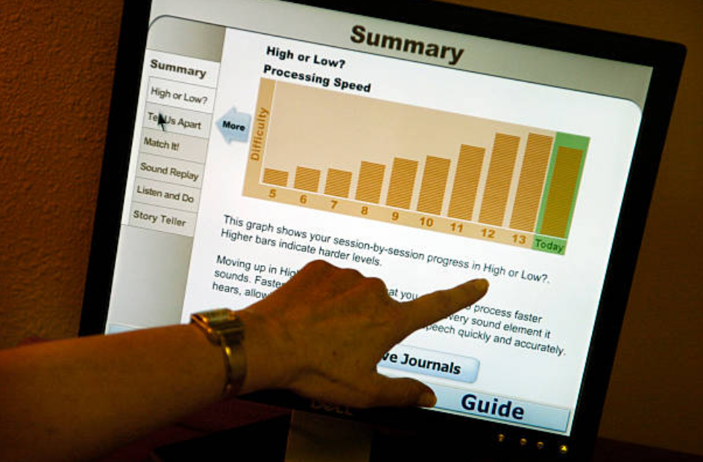
Posit Science Background
After the new product suite was released, the environment began to change.
Customers reported bugs and asked for more features. Senior executives wanted to expand into
new product lines & new markets

Slide 23
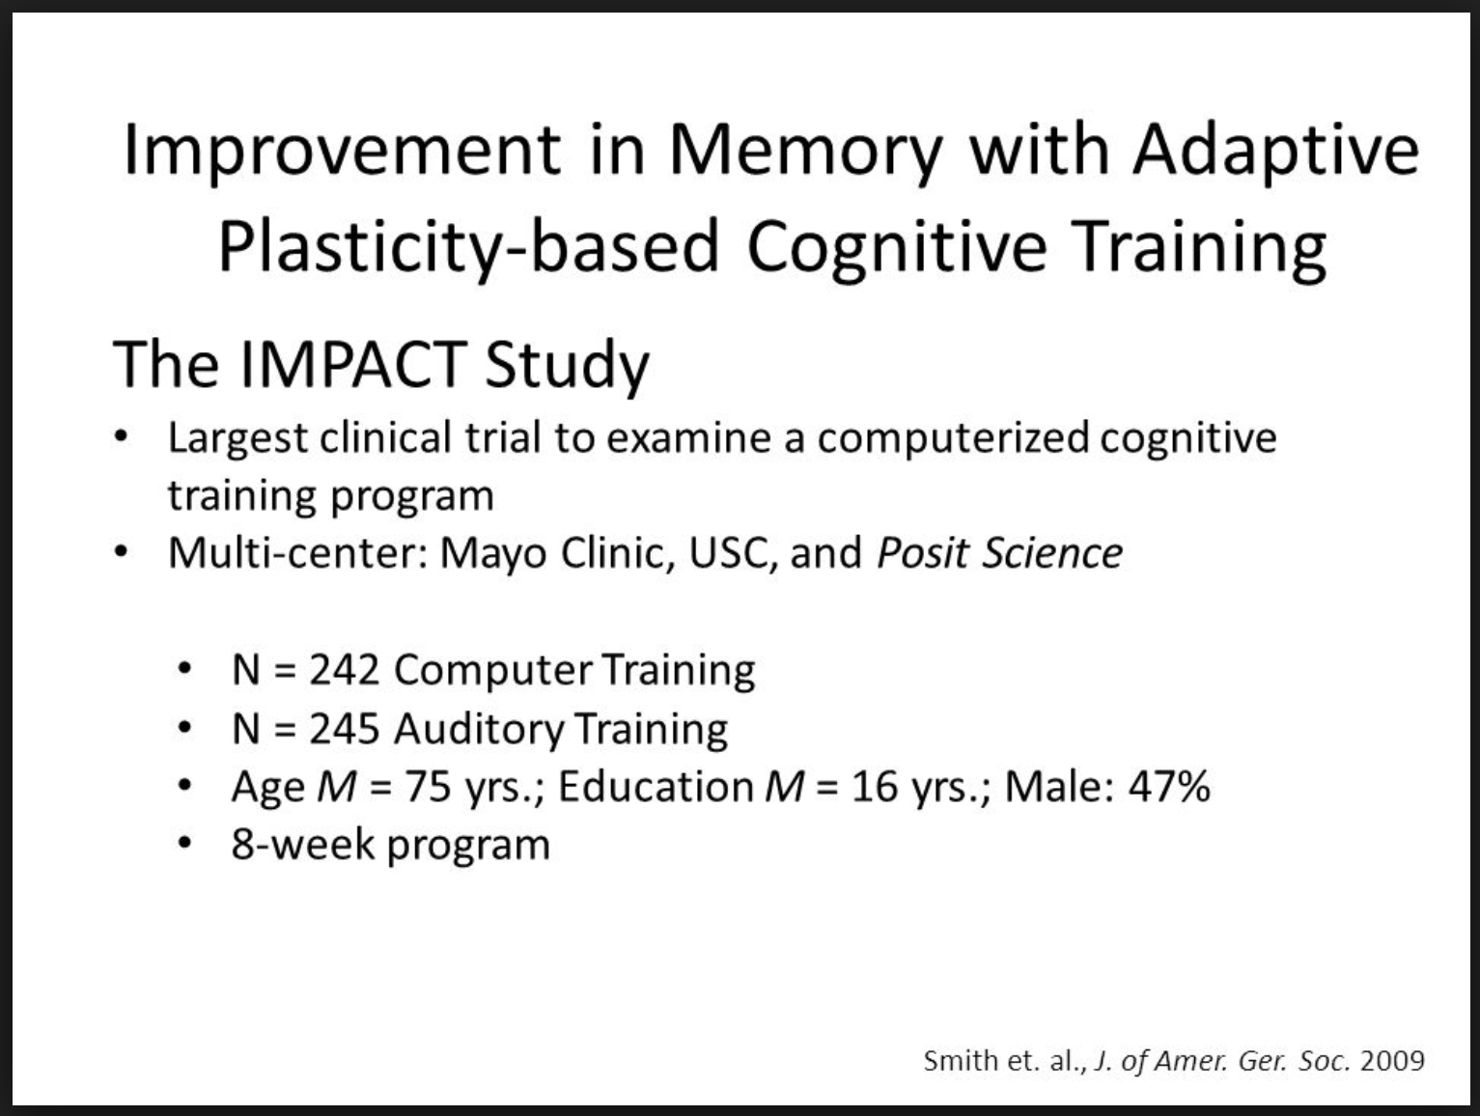
Posit Science Background
Problems started to develop using Scrum. There was constant pressure to break the boundaries of the sprint and accept late breaking work
Agile coaches insisted that the problem was with Posit Science and that they simply weren’t doing Scrum properly
Problems started to develop using Scrum. There was constant pressure to break the boundaries of the sprint and accept late breaking work.
Agile coaches insisted that the problem was with Posit Science and that they simply weren’t doing Scrum properly.

Slide 24
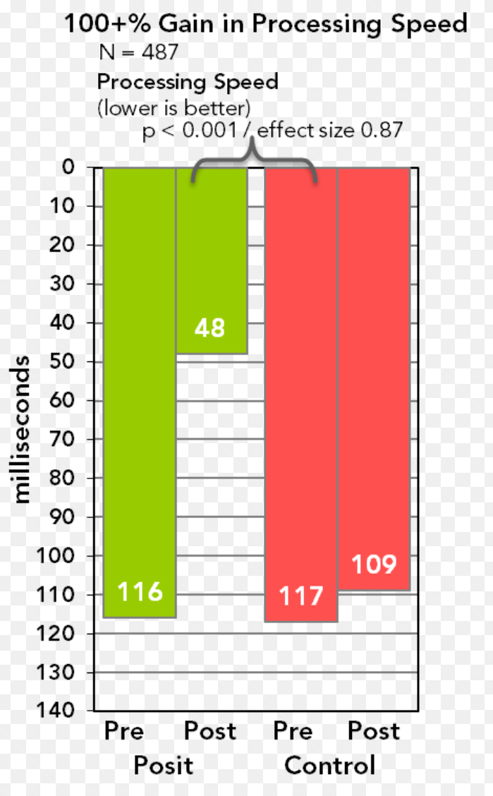
Posit Science Background
Posit Science people believed they were reacting to the environment around them and “doing Scrum properly” wasn’t a viable suggestion
The project manager began looking for alternatives…

Slide 25
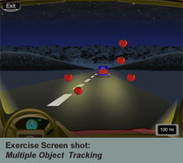
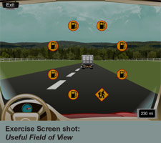
Kanban was chosen as a way forward
A rudimentary version of a way to build a Kanban system (STATIK) was used to understand the current situation

Slide 26
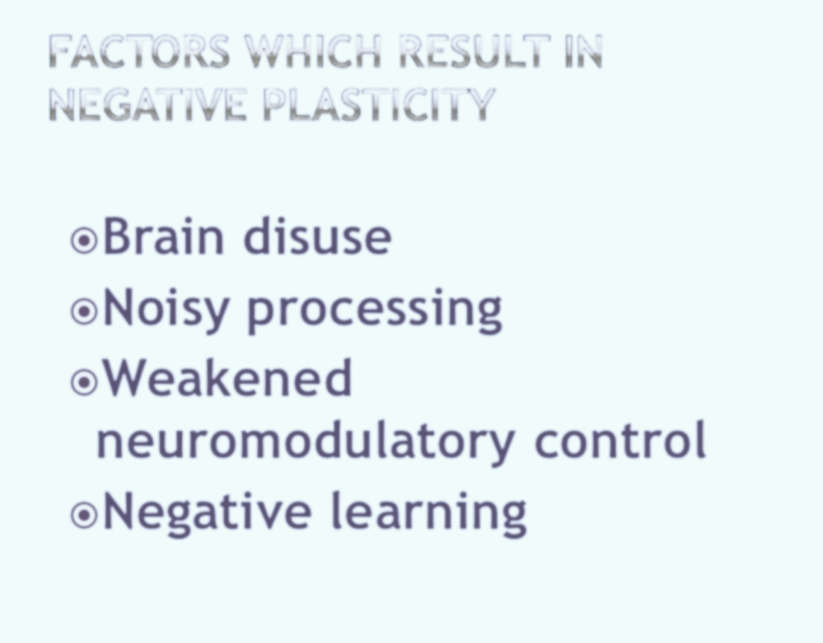
Motivation for Change
Customer Dissatisfaction (External)
Stories are not being finished
Deadlines are being missed
Team Frustration (Internal)
“Fragmentation” – pulled in many directions, priorities always changing
Task-based estimates – inaccurate, too much effort to produce

Slide 27


Motivations for Change
Customer Dissatisfaction (External)
Stories are not being finished
Deadlines are being missed
Customer Dissatisfaction (External)
Stories are not being finished
Deadlines are being missed
Team Frustration (Internal)
“Fragmentation” – pulled in many directions, priorities always changing
Task-based estimates – inaccurate, too much effort to produce
Team Frustration (Internal)
“Fragmentation” – pulled in many directions, priorities always changing
Task-based estimates – inaccurate, too much effort to produce

Slide 28

Changes were met with resistance
There was motivation to relieve the developers of what they felt was an overburdened, abusive environment.
People resisted the suggestion to implement a pull system and eliminate sprints
Three changes were agreed on

Slide 29
Initial “Kanban” adoption – October 2008
 | BEFORE | AFTER
Iterations | ✓ | ✓
Scrum Master, PO | ✓ | ✓
Sprint planning | ✓ | ✓
Daily Standup Meeting | ✓ | ✓
Product Owner accepts | ✓ | ✓
Demo | ✓ | ✓
Retrospective | ✓ | ✓
Estimation | ✓ By TASK | ✓ By User Story (T-shirt sized)
Other |  | Per Person WIP LIMIT

Slide 30
Initial Turbo Charges - October
 | BEFORE | AFTER
Iterations | ✓ | ✓
Scrum Master, PO | ✓ | ✓
Sprint planning | ✓ | ✓
Daily Standup Meeting | ✓ | ✓
Product Owner accepts | ✓ | ✓
Demo | ✓ | ✓
Retrospective | ✓ | ✓
Estimation | ✓ By TASK | ✓ By User Story (T-shirt sized)
Other |  | Per Person WIP LIMIT

Slide 31
Initial Board
Backlog
User Stories
3 items per person limit was adopted.
Collaboration on items is encouraged.
Turbo charges added on the existing Scrum board
Sprint
Backlog
Dev/Build/
Test/Deploy
Pending
Specify
Done
M
P
E
DE
H
G
GY
MN
GY
A
L
R
K
B
PB
DE
D
O
PB
MN
C
J
N
MN
GY
AB
Bench
I
F
DE
AB
PB
AB

Slide 32

After 6 Months
Six to Nine months engaged people emotionally and motivated them for the next level of change
Six to Nine months engaged people emotionally and motivated them for the next level of change
Initially, the turbo charges didn’t resolve many problems other than providing some relief from overburdening, but it gave the team a rich language for expressing their frustrations
Initially, the turbo charges didn’t resolve many problems other than providing some relief from overburdening, but it gave the team a rich language for expressing their frustrations

Slide 33
Motivations for Change
Customer Dissatisfaction (External)
Stories are not being finished
Deadlines are being missed
Customer Dissatisfaction (External)
Too Busy to discuss new work
Stories are not being finished
Deadlines are being missed
Team Frustration (Internal)
“Fragmentation” – pulled in many directions, priorities always changing
Task-based estimates – inaccurate, too much effort to produce

Slide 34
Motivations for Change
Customer Dissatisfaction (External)
Stories are not being finished
Deadlines are being missed
Team Frustration (Internal)
Too much context switching!
Too much work in progress!
Planning is disruptive and cumbersome
Uneven workflow for Clinical Testing
Massive workload at start of each sprint for developers
Priorities from stakeholders are unclear and shifting
Product Owner isn’t accepting completed stories
Team Frustration (Internal)
“Fragmentation” – pulled in many directions, priorities always changing
Task-based estimates – inaccurate, too much effort to produce

Slide 35
Continued Frustration & Dissatisfaction
Customer Dissatisfaction (External)
Too Busy to discuss new work
Stories are not being finished
Deadlines are being missed
Team Frustration (Internal)
Too much context switching!
Too much work in progress!
Planning is disruptive and cumbersome
Uneven workflow for Clinical Testing
Massive workload at start of each sprint for developers
Priorities from stakeholders are unclear and shifting
Product Owner isn’t accepting completed stories

Slide 36
Goals of new “flow” system
Goals
Reduce context switching
Reduce work in progress
Steadier workflow for QA & Deploy
Reduce massive workload at start of each sprint (achieve balance)
Clearer priorities from stakeholders

Slide 37
Goals
Reduce context switching
Reduce work in progress
Steadier workflow for QA & Deploy
Reduce massive workload at start of each sprint (achieve balance)
Clearer priorities from stakeholders

Slide 38
Transition to “flow” – August 2009
 | BEFORE | AFTER
Iterations | ✓ | ✕ Flow & SLA
Scrum Master, PO | ✓ | ✓
Sprint planning | ✓ | ✕ Triggered, per feature
Daily Standup Meeting | ✓ | ✓
Product Owner accepts | ✓ | ✓
Demo | ✓ | ✓ Calendar
Retrospective | ✓ | ✓ Calendar
Estimation | ✓ By Story | ✓ By Feature per SLA
Other |  | More detailed workflow
Other |  | Per Person WIP LIMIT

Slide 39
New turbo charges
 | BEFORE | AFTER
Iterations | ✓ | ✕ Flow & SLA
Scrum Master, PO | ✓ | ✓
Sprint planning | ✓ | ✕ Triggered, per feature
Daily Standup Meeting | ✓ | ✓
Product Owner accepts | ✓ | ✓
Demo | ✓ | ✓ Calendar
Retrospective | ✓ | ✓ Calendar
Estimation | ✓ By Story | ✓ By Feature per SLA
Other |  | More detailed workflow
Other |  | Per Person WIP LIMIT

Slide 40
The concept of cost of delay was introduced
Color | Function | Class of service and its policies
 |  | Expedite – white; critical and immediate cost of delay; can exceed other kanban limit (bumps other work); limit 1
 |  | Fixed date – orange; cost of delay goes up significantly after deadline
 |  | Standard - yellow; increasing urgency, cost of delay is shallow but accelerates before leveling out
 |  | Intangible – blue; cost of delay may be significant but is not incurred until significantly later, if at all
impact
time
impact
time
impact
time
impact

Slide 41
Feature Request
Requested by:______________________________________ Date Requested_____________
Feature name__________________________________________________________________
Format: [customer] [action] [purpose]
Description____________________________________________________________
________________________________________________________________________
________________________________________________________________________
Cost of Delay Classification (required)
Check ☑ the type of Feature per the cost of delay.
◻ Expedite – critical and immediate cost of delay
◻ Fixed date – cost of delay goes up significantly after deadline….date:_________
◻ Standard- cost of delay goes up increasingly over time
◻ Intangible – cost of delay incurred significantly later
Provide information on one or more of the following (optional)
◻ Projected Revenue______________________________________
◻ Opportunity Cost
Estimated 6 month revenue loss if not implemented_____________________________
Estimated 6 month operating expenses if not implemented_______________________
Estimated cost of man hours or other resources if not implemented_________________
◻ Qualitative Value (customer experience, quality of service, etc)____________________
Suggested stories (optional)
Cost of Delay
Required

Slide 42
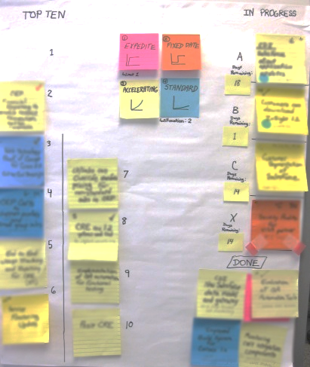
Replenishment Meeting Board
Feature per team

Slide 43
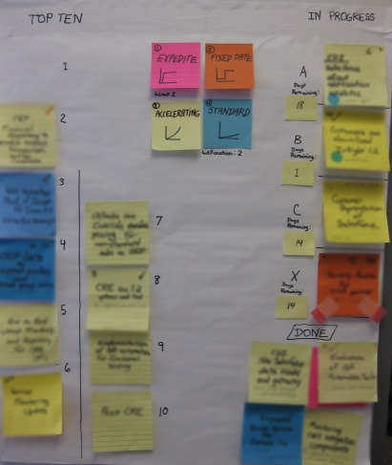
Replenishment Meeting Board
“Top 10” customer committed features
“Cost of delay” class of service index
SLA clock ticking (days remaining)
Dots depict dependencies
“Intangible” capacity allocation
Expedite
Sized as “21 days or less”
Trophy cabinet
“recent features complete”

Slide 44
“Top 10” Meetings were very short
Picking 1 feature from ~35 based on “cost of delay” and 3 week lead time is so much easier than picking 40 user stories from a huge product backlog
“Top 10” meetings took less than 30 minutes to complete. This compared favorably with lengthy Sprint planning meetings.
Stakeholders were permitted to swap items in the “Top 10” if they had something more important or urgent

Slide 45

Design/
Specify
(features into stories)
Limit 3 features
In Progress
(stories and features)
Limit 3 features
Accept
(stories & features)
Limit 5
Top 10 (features) Limit 10
Test
(stories)
Limit 3
Done
(stories & features)
Deploy Limit 2
PO must review
1
Backlog
(features)
No limit
2
3
EX
21-day SLA for completing feature starts now!

Slide 46
Design/
Specify
(features into stories)
Limit 3 features
In Progress
(stories and features)
Limit 3 features
Accept
(stories & features)
Limit 5
Top 10 (features) Limit 10
Test
(stories)
Limit 3
Done
(stories & features)
Deploy Limit 2
PO must review
1
Backlog
(features)
No limit
We are taking the risk that Features might be too big to fit into our 21-day SLA. We won’t have a better estimate until we pull the item and specify the user stories. How do we manage risk of this deferred committed strategy?
2
3
EX
21-day SLA for completing feature starts now!
We have 3 choices
  Do it anyway – we don’t care if it takes longer to complete
  Consult the owner and trim it down
  Reject it and return it to the backlog

Slide 47
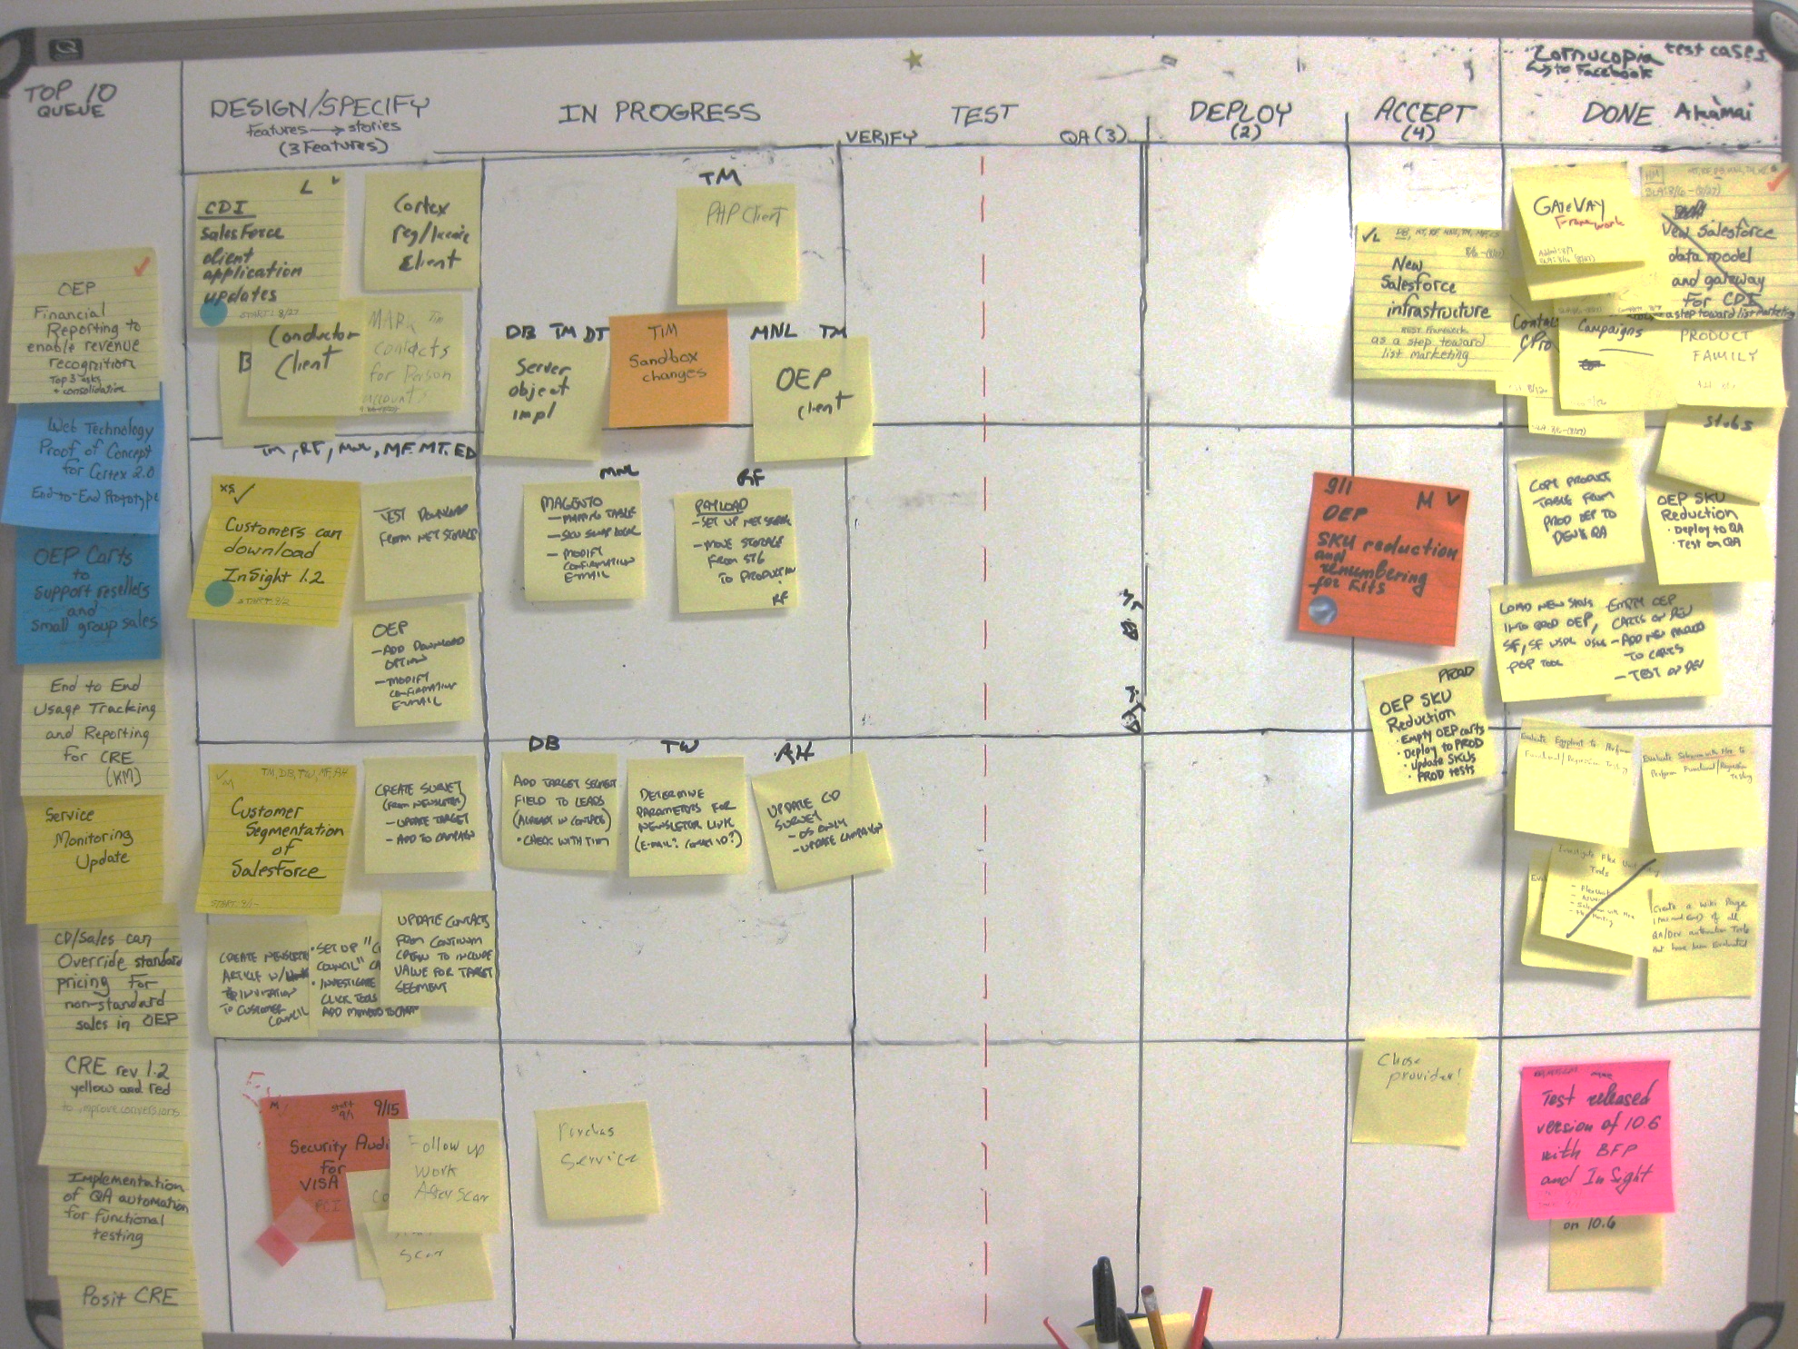

Slide 48
WIP limit to smooth flow through clinical testing
WIP limit to protect deployment bottleneck
WIP limit to hold the Product Owner accountable
Physical lane for expedite. Color shows “fixed date” item that wasn’t started early enough. Provides learning in retrospective

Slide 49

The Change Challenge
The Posit Science Path!
Managed evolutionary change with turbo charges
We believe that if we’re here, we’re serving someone or something better
Capability
Current State
Time
Safety!
Panic under stress
Patience!
Failure!

Slide 50
Would you be able to pull this off today?
Yes, this will be easy – thank you!
Yes, but help, please?
Yes, but how do I get people to listen to me?
Sorry, our leadership is clueless and will crush anything like this like they always do
No, my team has too many other issues right now
No matter what, we’ll be micromanaged
No, I don’t buy it yet

