Slide 1

Dealing with Estimation, Uncertainty, Risk, and Commitment :
An Outside-In Look at Agility and Risk Management
Todd Little
Sr. Development Manager
Landmark Software & Services
Notes:
Todd comes from Oil and Gas exploration, a business that deals with risk in many facets. Chris comes from investment banking, another area that has made it important to understand and comprehend issues associated with risk. Both Todd and Chris have spent their careers developing software in these industries.

Slide 2

Risky Business

Slide 3
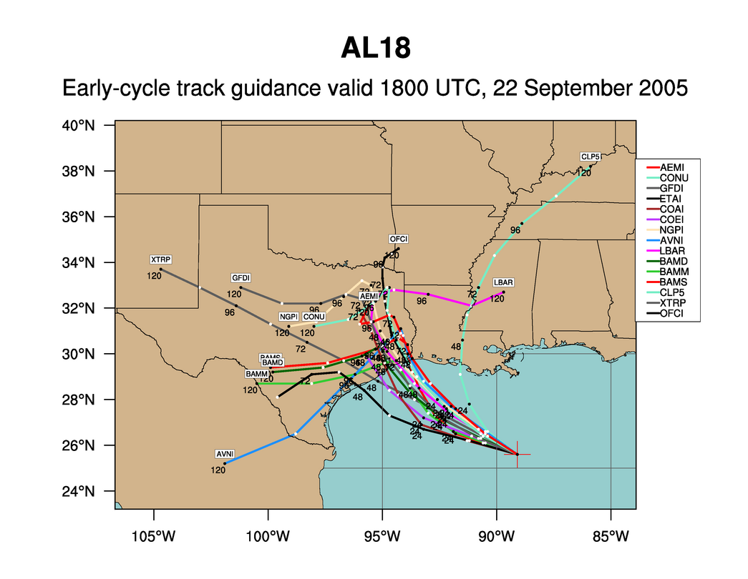
Hurricane Rita
Notes:
What can we say about every one of these predictions? They are wrong. But the collective set of predictions is quite useful. Which is more important when predicting hurricanes – where it hits or when it hits? Ok, both are important, but where is much more important than when. If you are in Florida you don’t really care when it hits. But once you know it has a chance to hit Houston then it is very important to know when it might hit.

Slide 4




Managing the Coming Storm
Inside the Tornado
Project Kickoff
When will we get the requirements?
All in good time, my little pretty, all in good time
But I guess it doesn't matter anyway
Just give me your estimates by this afternoon
Team Unity
Not so fast! Not so fast! ... I'll have to give the matter a little thought. Go away and come back tomorrow
No, we need something today!
Ok then, it will take 2 years.
No, we need it sooner.
Doesn't anybody believe me?
I already promised the customer it will be out in 6 months
You're a very bad man!
Notes:
We look at a typical software project…..

Slide 5


We’re not in Kansas Anymore
Developer Hero
I may not come out alive, but I'm goin' in there!
Reorg
The Great and Powerful Oz has got matters well in hand.
My! People come and go so quickly here!
Testing
"Hee hee hee ha ha! Going so soon? I wouldn't hear of it! Why, my little party's just beginning!

Slide 6

How do “Risky Businesses” work
“It’s tough to make predictions, especially about the future.”
Yogi Berra, Niels Bohr

Slide 7
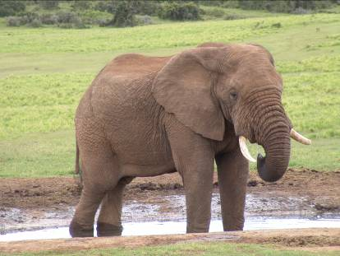
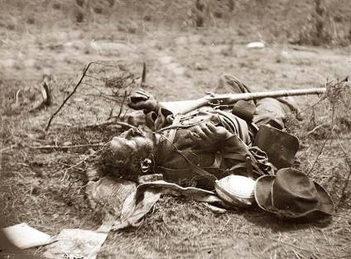
War
They couldn't hit an elephant at this dist…
General John B. Sedgwick, Union Army Civil War officer's last words, uttered during the Battle of Spotsylvania, 1864
Notes:
War – now that’s an area with lots of risk. I guess he didn’t do too well in his prediction.

Slide 8

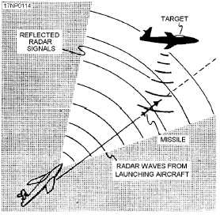
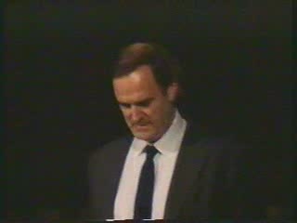
Gordon the Guided Missile

Slide 9
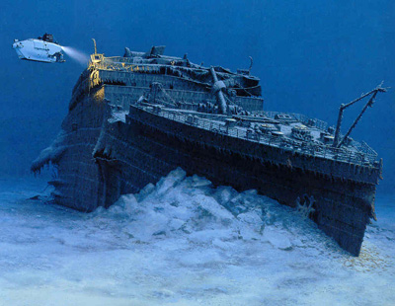

Movies
78% of Films Lose Money
6% of films make 80% of profit
Notes:
Most movies strive to be the next Titanic, the largest grossing film of all time.
The reality is that the vast majority really do end up closer to the real Titanic than to the movie Titanic.

Slide 10
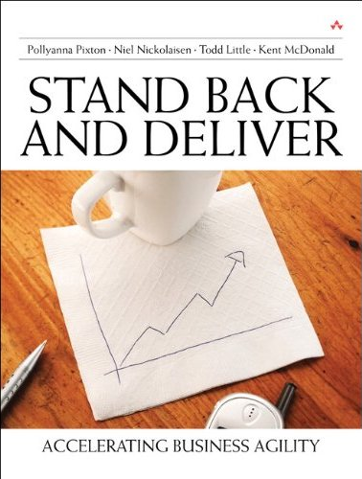
Books
300,000 books
in print 2004,
<25% sold more
Than 100 copies
Notes:
Books. Here is my book. Doesn’t it look like it is chock full of useful stuff?
But only 25% of books sell more than 100 copies. Please do your part so that I am not part of that statistic.

Slide 11

Poker

Slide 12

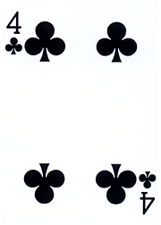
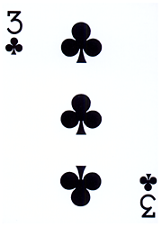

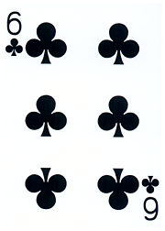

Texas Hold’em:
Which is the best hole hand?
A
B
C
33.5%
29.6%
36.5%

Slide 13
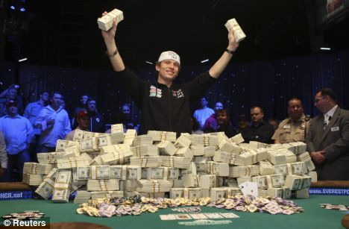
Poker Metric:
Percent of Hands Won

Slide 14
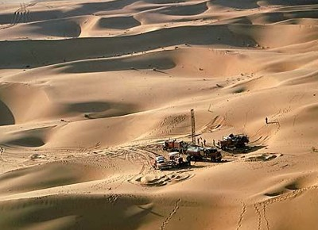
Oil & Gas Exploration
90-80% Failure
Notes:
Oil exploration is highly risky. It used to be that 10% was a good find rate for wildcat wells. Based on improvements in technology this is closer to 20%. Still risky, but that risk is acceptable because the payout is enormous. The key is having a diversified portfolio to balance the risk exposure.

Slide 15
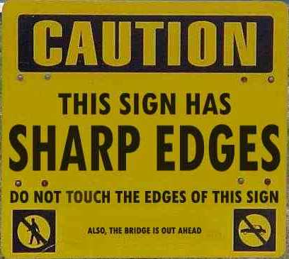
Notes:
Which risks are important? The sharp edges of the sign or the fact that the bridge is out ahead?

Slide 16
Which Risks Are Important
Notes:
Oil and gas geologists and engineers build models to help them comprehend the uncertainties. This is a tornado chart, because it looks like a tornado. This chart clearly shows that the largest uncertainty is associated with Reserves, with the next largest uncertainty being oil/gas price. This gives the engineer something to focus on. Perhaps there is additional data that can be collected to help reduce the uncertainty bars. There may not be anything that can be done about Oil/gas price. Perhaps futures contracts could be used to hedge some of the uncertainty. The other uncertainties may not be worth spending too much time since they have limited effect on the total uncertainty.

Slide 17

Real Options
The right — but not the obligation — to undertake certain actions prior to an expiry date

Slide 18
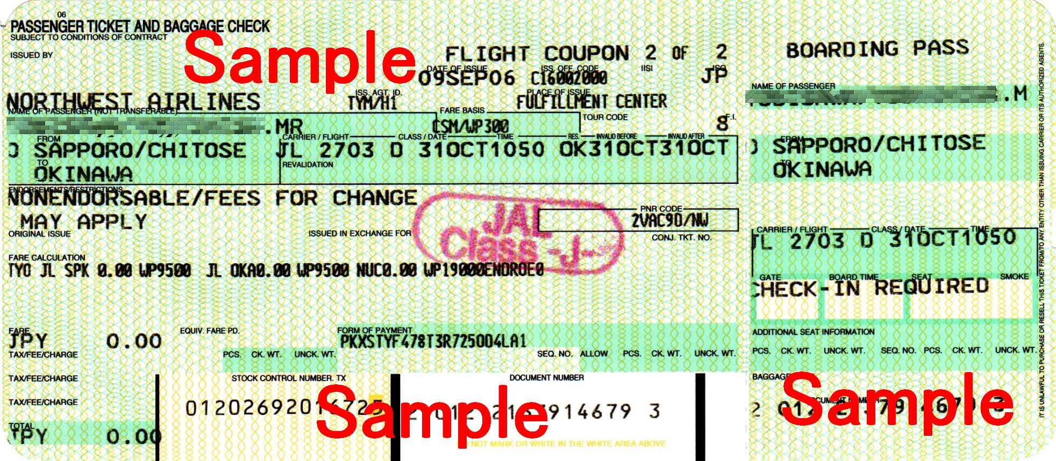
Airline Tickets

Slide 19


Slide 20
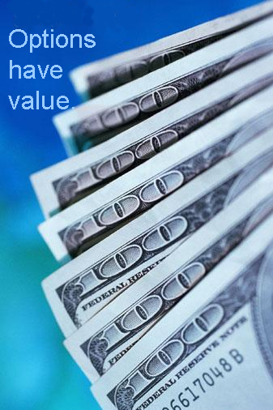
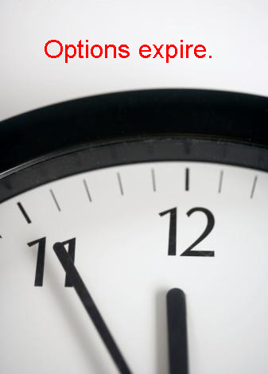
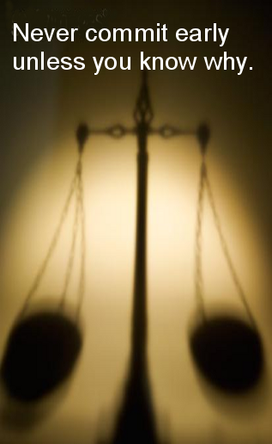
Real Options
The right, but not the obligation to take some action prior to an expiry date

Slide 21
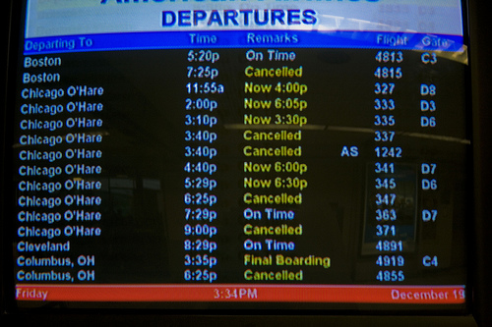
Real Options
Value of Information
Value of Flexibility

Slide 22
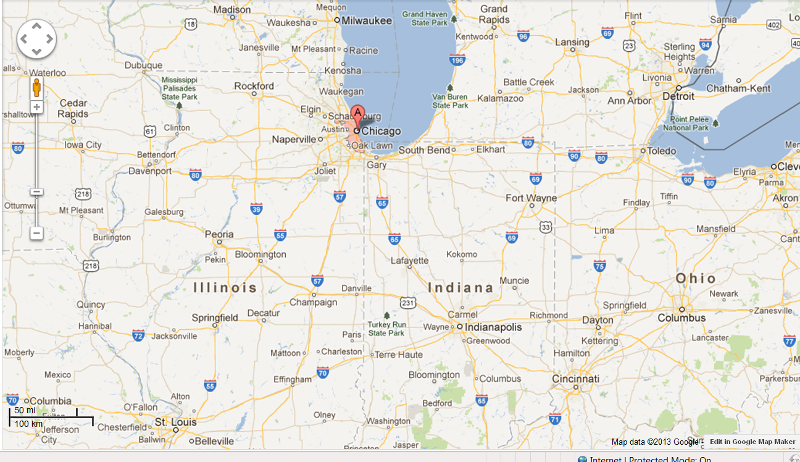

Options

Slide 23

Value of Information

Slide 24

Value of Information

Slide 25


Value of Flexibility

Slide 26
Making An Agile Conference Agile
5 Extra weeks to review sessions

Slide 28
Do you have a choice?
Option
Commitment
Decision

Slide 29

Notes:
http://www.flickr.com/photos/nick_anderson/5049751331/sizes/m/in/photostream/

Slide 30
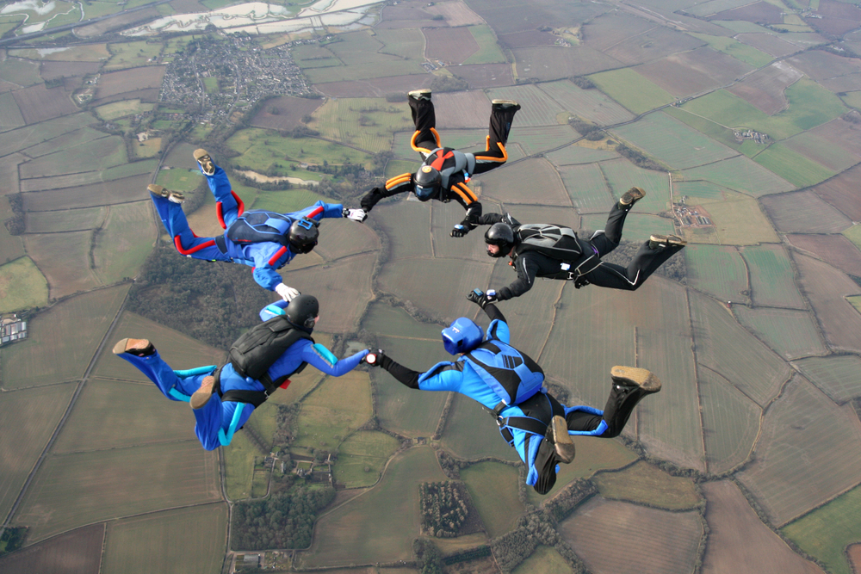
Agile projects need risk management too

Slide 31
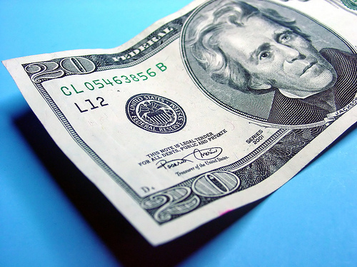



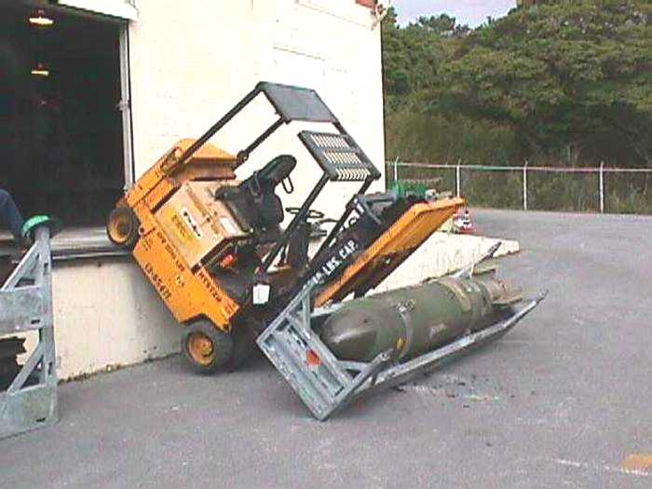
Categories of risk
Business Case
Failure
Delivery Failure
Quality and Market
Acceptance
Political Risk
Collateral Damage
Notes:
We have found it useful to categorize risk into 3 primary categories.
Delivery Failure
Business Case Failure
And Collateral Damage

Slide 32
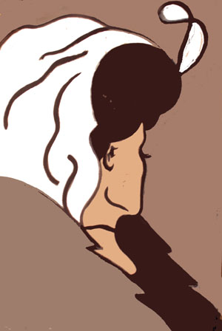


Two Risk Perspectives
Business
Perspective
Individual
Perspective

Slide 33

Delivery Failure
Over Budget
Late

Slide 34
Delivery Challenges/Failures
Standish Group 2006, reported by CEO Jim Johnson, CIO.com, ‘How to Spot a Failing Project’
Notes:
Delivery failures are well documented in the software business.
This is the classic report from Standish showing only 35% of projects delivered on time with expected features. 46% were challenged and 19% were killed. This is from 2006, and is a substantial improvement from the 19% success rate in 1996.

Slide 35
Why is Software Late?
Genuchten 1991 IEEE
General Manager | Project Manager | Item
1 | 10 | Insufficient front end planning
2 | 3 | Unrealistic project plan
3 | 8 | Project scope underestimated
4 | 1 | Customer/management changes
5 | 14 | Insufficient contingency planning
6 | 13 | Inability to track progress
7 | 5 | Inability to track problems early
8 | 9 | Insufficient Number of checkpoints
9 | 4 | Staffing problems
10 | 2 | Technical complexity
11 | 6 | Priority Shifts
12 | 11 | No commitment by personnel to plan
13 | 12 | Uncooperative support groups
14 | 7 | Sinking team spirit
15 | 15 | Unqualified project personnel

Slide 36

The Context of Feedback

Slide 37
Why is Software Late?
Genuchten 1991 IEEE
General Manager | Project Manager | Item
4 | 1 | Customer/management changes
10 | 2 | Technical complexity
2 | 3 | Unrealistic project plan
9 | 4 | Staffing problems
7 | 5 | Inability to track problems early
11 | 6 | Priority Shifts
14 | 7 | Sinking team spirit
3 | 8 | Project scope underestimated
8 | 9 | Insufficient Number of checkpoints
1 | 10 | Insufficient front end planning
12 | 11 | No commitment by personnel to plan
13 | 12 | Uncooperative support groups
6 | 13 | Inability to track progress
5 | 14 | Insufficient contingency planning
15 | 15 | Unqualified project personnel
Notes:
The project manager is much closer to the actual work being done and so I tend to think their response is closer to reality. What is of particular interest is where there is a discrepancy between the General Manager and the Project Manager.
1 4 Customer/management changes
PM: They were constantly changing their minds GM:OK, so we changed a few things once in a while
2 10 Technical complexity
PM: We were using new technology and had to discover all the limitations GM: I just to them to make it look like that cool demo I saw
3 2 Unrealistic project plan
PM: We told them it would take longer GM: I had to push them so that they would be serious
4 9 Staffing problems
PM: We couldn’t get the people we needed GM: I gave them everyone I had available
5 7 Inability to track problems early
PM/GM: agree --- We didn’t know what we didn’t know
6 11 Priority Shifts
PM: They were constantly changing their minds GM: We didn’t change that much
7 14 Sinking team spirit
PM: The team felt overworked and underappreciated GM: We’ve got a great team. What spirit they have
8 3 Project scope underestimated
PM: I didn’t really feel that we underestimated it. We told them it would be hard GM: We really didn’t think it was such a big project
9 8 Insufficient Number of checkpoints
PM/GM agree – it would have been good to have better visibility into what was going on
10 1 Insufficient front end planning
PM: We had a plan, but they didn’t like the answer and kept changing their mind GM: It all would have been fine if we could have just planned better
11 12 No commitment by personnel to plan
PM/GM agree – team was willing to commit
12 13 Uncooperative support groups
PM/GM agree – support groups were willing to help
13 6 Inability to track progress
PM: We had pretty good tracking GM: I wish I had better visibility into what was going on so I could have done something
14 5 Insufficient contingency planning
PM: We had decent contingency planning, we just weren’t able to do anything GM: We just needed better planning
15 15 Unqualified project personnel
PM/GM agree – people are our most important assets

Slide 38
Why is Software Late?
Genuchten 1991 IEEE
General Manager | Project Manager | Item
H | H | Customer/management changes
L | H | Overall complexity
H | H | Unrealistic project plan
M | H | Staffing problems
H | L | Insufficient front end planning
Notes:
The project manager is much closer to the actual work being done and so I tend to think their response is closer to reality. What is of particular interest is where there is a discrepancy between the General Manager and the Project Manager.
1 4 Customer/management changes
PM: They were constantly changing their minds GM:OK, so we changed a few things once in a while
2 10 Technical complexity
PM: We were using new technology and had to discover all the limitations GM: I just to them to make it look like that cool demo I saw
3 2 Unrealistic project plan
PM: We told them it would take longer GM: I had to push them so that they would be serious
4 9 Staffing problems
PM: We couldn’t get the people we needed GM: I gave them everyone I had available
5 7 Inability to track problems early
PM/GM: agree --- We didn’t know what we didn’t know
6 11 Priority Shifts
PM: They were constantly changing their minds GM: We didn’t change that much
7 14 Sinking team spirit
PM: The team felt overworked and underappreciated GM: We’ve got a great team. What spirit they have
8 3 Project scope underestimated
PM: I didn’t really feel that we underestimated it. We told them it would be hard GM: We really didn’t think it was such a big project
9 8 Insufficient Number of checkpoints
PM/GM agree – it would have been good to have better visibility into what was going on
10 1 Insufficient front end planning
PM: We had a plan, but they didn’t like the answer and kept changing their mind GM: It all would have been fine if we could have just planned better
11 12 No commitment by personnel to plan
PM/GM agree – team was willing to commit
12 13 Uncooperative support groups
PM/GM agree – support groups were willing to help
13 6 Inability to track progress
PM: We had pretty good tracking GM: I wish I had better visibility into what was going on so I could have done something
14 5 Insufficient contingency planning
PM: We had decent contingency planning, we just weren’t able to do anything GM: We just needed better planning
15 15 Unqualified project personnel
PM/GM agree – people are our most important assets

Slide 39
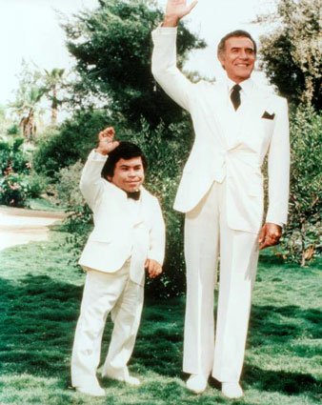
Da Plan, Boss – Da Plan

Slide 40
IEEE Software, May/June 2006
Notes:
This is from an IEEE Software article that I published in May 2006

Slide 41
Accuracy of Initial Estimate

Slide 42
Uncertainty Bounds
10% exceed 3-4x
Median project 1.7x
10-20% on time

Slide 43
How does Estimation Accuracy Improve Over Time?
Notes:
The conventional wisdom is that estimation gets better as the project progresses. This was first stated by Barry Boehm in COCOMO II, and stated by many authors subsequently, most notably Steve McConnell. At the Feasibility state the uncertainty band is 16X, while at Concept it has narrowed to 4X and by the Requirements it has reduced to 2.25X. This makes a lot of sense.

Slide 44
Landmark Cone of Uncertainty

Slide 45
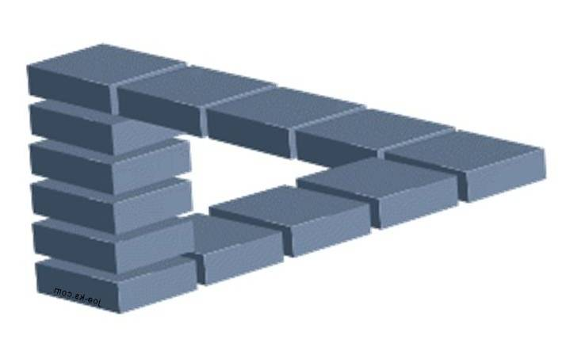
But is Uncertainty Really Reduced?
“Take away an ordinary person’s illusions and you take away happiness at the same time.”
Henrik Ibsen--Villanden

Slide 46
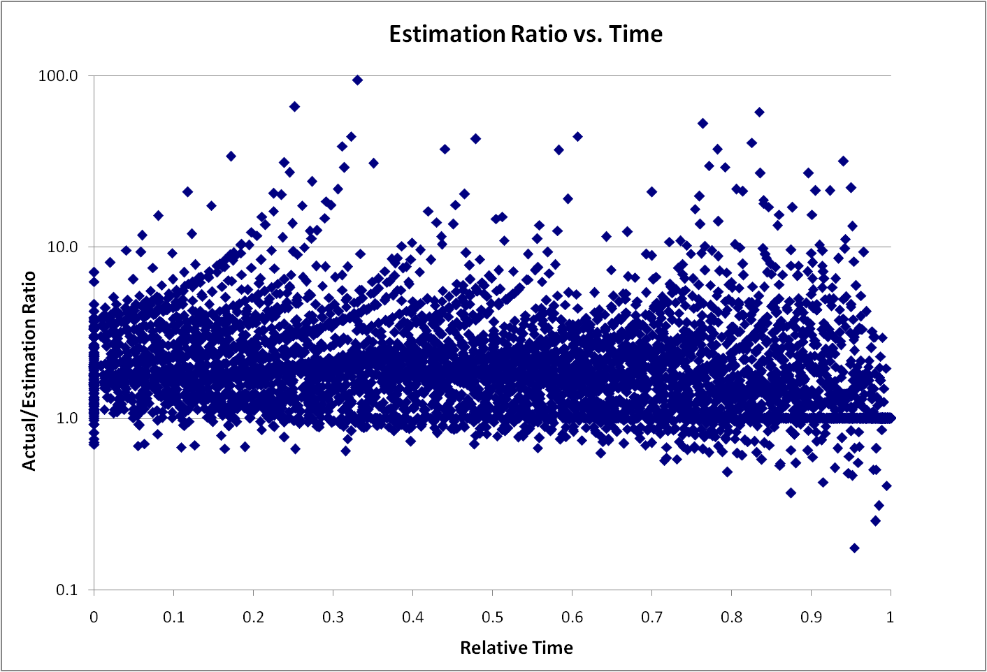
Remaining Uncertainty

Slide 47
Sources of Error
Bias
Uncertainty Range
Scope Creep

Slide 48
Sources of Error
Bias
Median
Mean
Estimate

Slide 49
Negotiation Bias
"It is difficult to get a man to understand something when his salary depends upon his not understanding it.“
        Upton Sinclair:

Slide 50
Politics and Schedule Estimation
Developers tend to be temperamentally opposed to the use of negotiating tricks. Such tricks offend their sense of technical accuracy and fair play. Developers don't want to offer lopsidedly high initial estimates even when they know that customers, marketers, or bosses will start with lopsidedly low bargaining positions.
  Steve McConnell
http://www.stevemcconnell.com/ieeesoftware/bp03.htm

Slide 51
Test 1 (Jørgensen)
Group | Guidance | Result
A | 800
B | 40
C | 4
D | None | 160

Slide 52
Test 1
Group | Guidance | Result
A | 800 | 300
B | 40 | 100
C | 4 | 60
D | None | 160

Slide 53
Test 2
Group | Guidance | Result
A | Minor Extension
B | New Functionality
C | Extension | 50

Slide 54
Test 2
Group | Guidance | Result
A | Minor Extension | 40
B | New Functionality | 80
C | Extension | 50

Slide 55
Understand Bias
"What gets us into trouble is not what we don't know. It's what we know for sure that just ain't so.“
        Mark Twain

Slide 56

Velocity/Cycle Time Helps Remove Bias
$\frac{Story Points}{\frac{Story Points}{Iteration}}=Iterations$

Slide 57
But Velocity is not a Silver Bullet
Story Estimate

Slide 58

Sources of Error
Range of Uncertainty

Slide 59
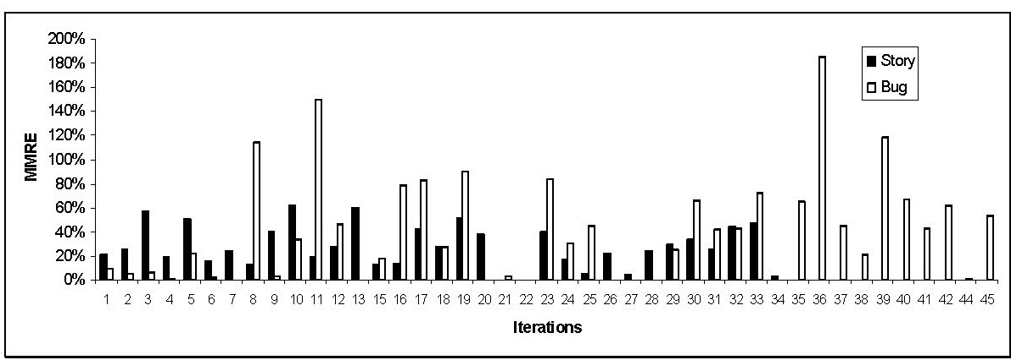
Estimation Errors
Lan Cao - Estimating Agile Software Project Effort: An Empirical Study

Slide 60
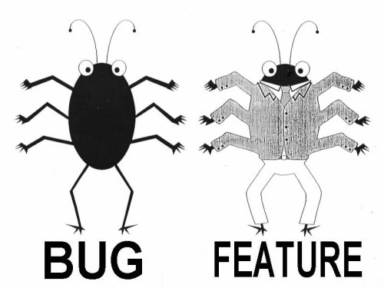
Lan Cao - Estimating Agile Software Project Effort: An Empirical Study
2X
Uncertainty,
Notes:
Lessons learned: If uncertainty is high, work on it earlier. Reduce Technical Debt—Get to potentially shippable at each iteration. Finding and fixing the last bugs has high uncertainty – plan on there being uncertainty.

Slide 61
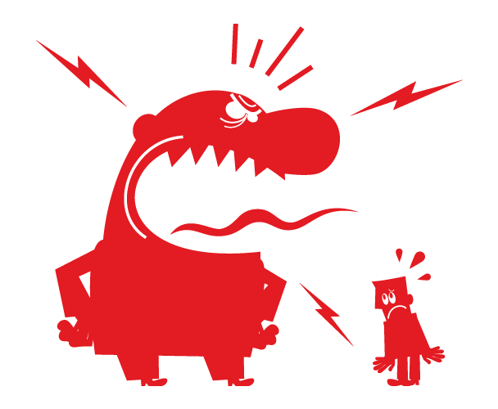
Sources of Error
Scope Creep

Slide 62
We want this
Innovation
Revenue
Predictability
Efficiency
CLOUD
Social Networking
Late projects
Mobility
Integration
SOA
Business
Intelligence
BPM
Agile
Notes:
Chris taped one of the investment bankers at his previous job

Slide 63
Uncertainty Bounds
10% exceed 3-4x
Median project 1.7x
10-20% on time

Slide 64
The A/B/C List sets proper expectations
A | MUST be completed in order to ship the product and the schedule will be slipped if necessary to make this commitment.
B | Is TARGETED to be completed in order to ship the product, but may be dropped without consequence.
C | Is NOT TARGETED to be completed prior to shipping, but might make it if time allows.
Only “A” features are commitments.
If more than 50% of the planned effort is allocated to “A” items the project is at risk.

Slide 65
A/B/C List
50%
25%
25%
A
B
C
D
Typical Delivery
C
A
B
Backlog Plan
Target Delivery Date
50%
100%

Slide 66
A/B/C List
50%
25%
25%
A
B
C
D
Typical Delivery
C
A
B
Backlog Plan
Target Delivery Date
50%
100%

Slide 67
A/B/C List
A
50%
25%
25%
Uncertainty Risk
C
A
B
Backlog Plan
Target Delivery Date
50%
100%
Notes:
Need some explanation to go along with this slide and the previous one.
--The idea is that there is uncertainty in the estimation process. A factor of 2X is a generally sufficient buffer if the team has gotten basic estimation down. Thus is it possible that what is actually delivered is only the “A” items. That is ok and actually expected.

Slide 68


Product Innovation Flow
Flexible Scope
Backlog
Hot Items
Idea Filter
Iteration
Backlog
Product
Backlog
Newly Discovered
Items
Project Sanction
RTM
Sales
Services
Customer
Support
B & C
Release
Backlog
Adaptive Activities
A
Items
CORE Activities
Most Items for consideration in next release
B/C/D
Backlog Burnup
A

Slide 69

No Surprises!
Risk Management = Expectation Management

Slide 70
Iteration Review Questions
What promises have been made, to whom were they made, and who made them?
What key decisions or commitments might we have to make within the next 2 iterations?
Questions to ask team anonymously
  When will we be ready to ship?
  Will we be able to keep our promises?
  Is the team healthy and operating effectively?
  Is the team on the right path?

Slide 71
Ask the Team When They Believe They Will Finish

Slide 72
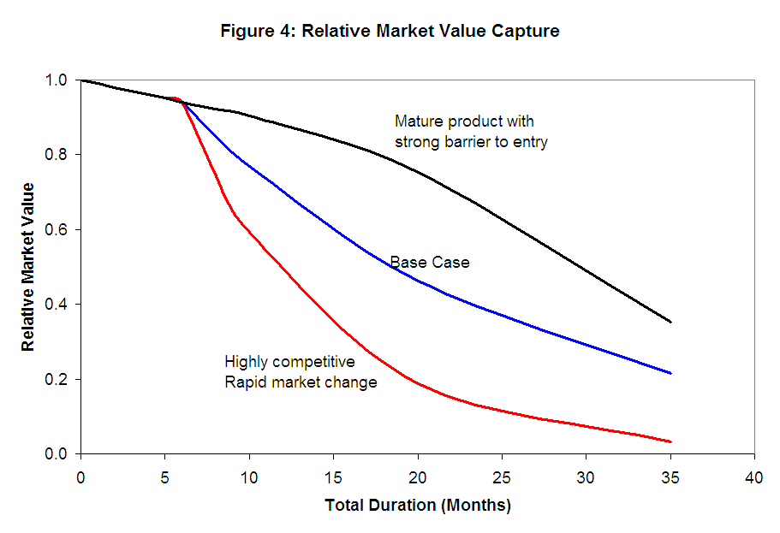
Cost of Delay

Slide 73

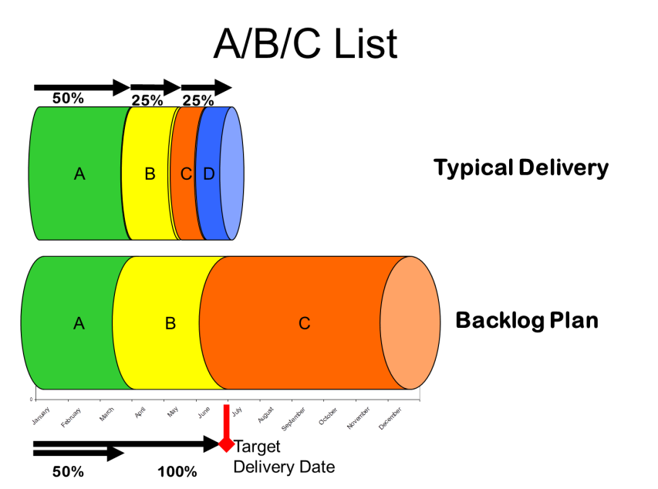
Tools for Delivery Risk
Stop Dreaming
Cost of Delay
Ask the Team

Slide 74


Delivery Risk
Business Perspective | Individual Perspective
Cost of Delay Business Credibility | Personal Credibility

Slide 75
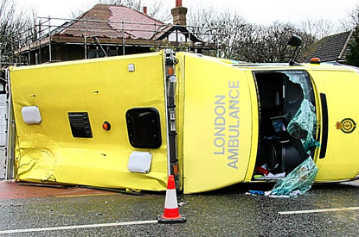
Collateral Damage
11 hour wait time
20-30 deaths
Notes:
In October 1992, the London Ambulance Service suffered a disaster that brought their operations to a virtual standstill over 36 hours, and up to 20-30 people may have died as a result of ambulances arriving too late on the scene. Upon further investigation, it was discovered that the new computer aided dispatch (CAD) software was responsible for the crisis. The problem lay in the design of the software, which was completely inadequate for the needs of the London Ambulance Service. So terribly pathetic were this software's services that response times to emergency calls were as high as 11 hours during the 36 hours crisis.

Slide 76
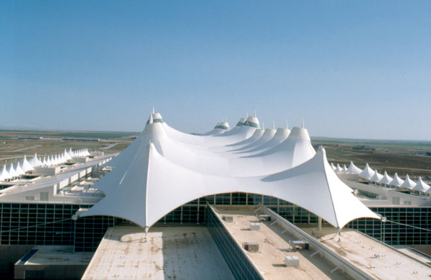
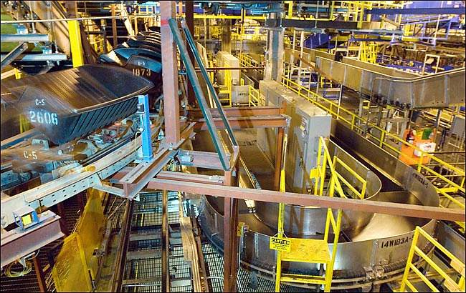
Delivery Failure results in Collateral Damage
Notes:
When the Denver Airport baggage handling system was designed, for example, no one asked what would happen if the fully automated system failed. How would baggage be handed? No one thought about it and there we no accommodations made in the airport plan. So when the system did fail there were no other alternatives to move baggage around the airport. There were no underground roadways on which to manually move luggage using tugs.

Slide 77
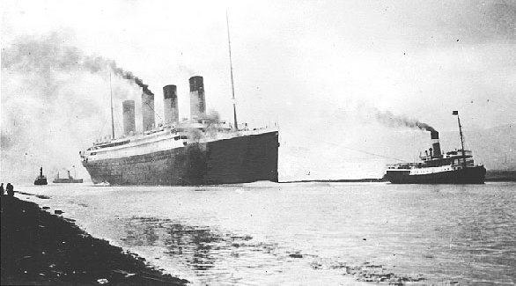
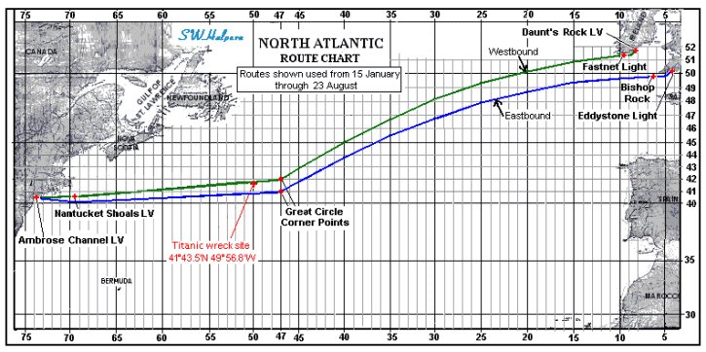
Titanic
Time pressure
Feedback blocks
Unsinkable

Slide 78
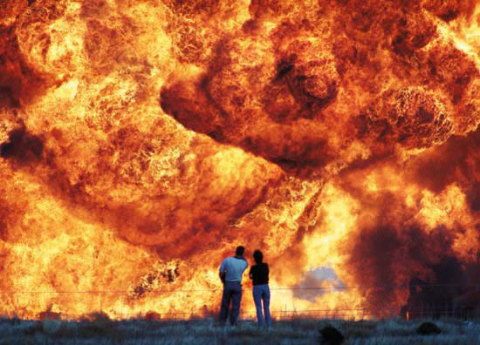
I’m beginning to think it wasn’t such a good idea to turn off those unit tests
Notes:
Safety is not to be messed with.
Test, Test, Test
Test again with real data
Test, Test, Test
Test again with real data

Slide 79
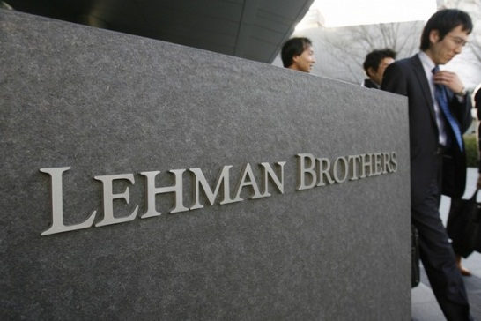
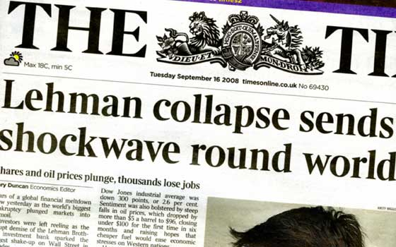
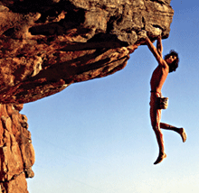
Collateral Damage
Business Perspective | Individual Perspective
Could be catastrophic | Some individuals may be willing to take on more risk than desired

Slide 80




Collateral Damage Management
Inspect
Incremental Delivery
An effective roll-back strategy
Honor feedback
Notes:
Rollback plan

Slide 81
Business Case Failure

Slide 82
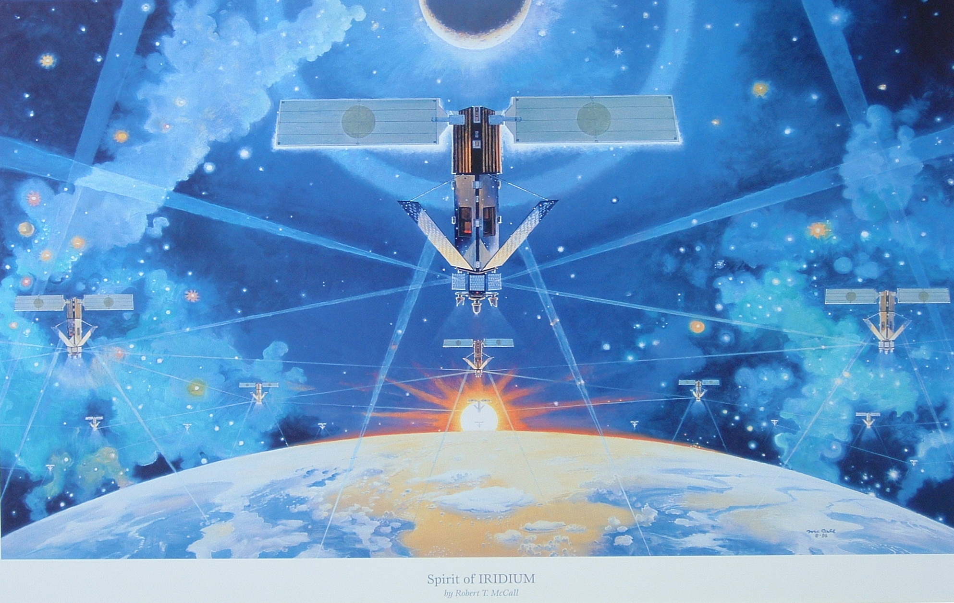
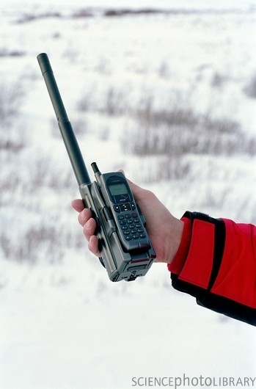

Business Case Failure
Notes:
But what if we deliver on time but the market doesn’t care? This is the classic case of Iridium. Huge undertaking, huge failure. The phones were huge, over a pound. The phones didn’t work inside buildings—not very useful. And the cost were prohibitive.

Slide 83

Features and Functions
Never or Rarely Used: 64%
Always or Often Used: 20%
Rarely
19%
Sometimes
16%
Never
45%
Often
13%
Always
7%
Standish Group Study, reported by CEO Jim Johnson, XP2002
Notes:
83
Project delivers but fails to deliver value.

Slide 84
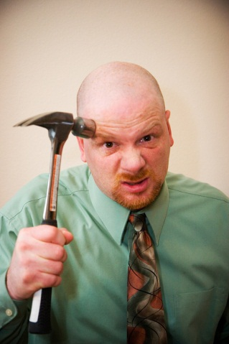
Powerful Questions are:
What are we building?
What Business are we in?
What Building are we in?

Slide 85
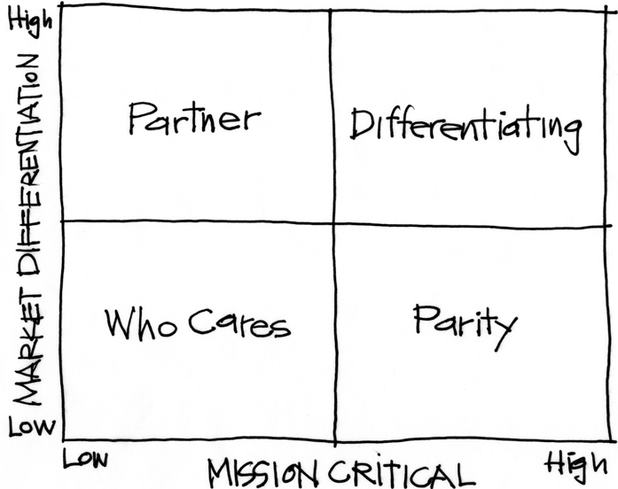
The Purpose Alignment Model
Notes:
[Purpose of slide] [#]
[Information]

Slide 86
In Practice
CAN WE
CREATE A
DIFFERENTIATED
PARTNERSHIP?
INNOVATE,
CREATE
ACHIEVE AND
MAINTAIN PARITY, MIMIC, SIMPLIFY
MINIMIZE /
ELIMINATE
Notes:
[Purpose of slide] [#]
[Information]

Slide 87

Applicable at all Levels
Corporate Strategy
Product Strategy

Slide 88
A View of Strategy - Apple
88
NEW PRODUCT DESIGN
USER EXPERIENCE
CONTENT DISTRIBUTION
ATT
MS OFFICE
INTEL HARDWARE
OTHER SOFTWARE
PERIPHERALS
Notes:
88
[Purpose of slide] [#]
[Information]
© International Institute of Business Analysis®

Slide 89

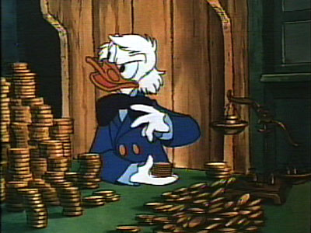
Business Case
Business Perspective | Individual Perspective
Sustainable competitive advantage | How can I sell this so that I can get more budget?

Slide 90
Market Acceptance
Features and Quality

Slide 91
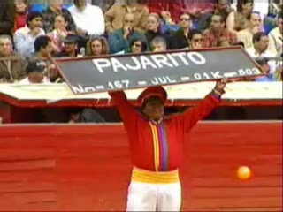
Market Acceptance

Slide 92
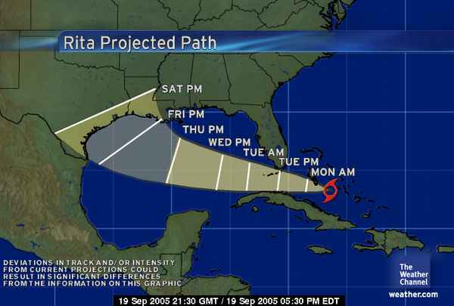
The Cone of Uncertainty
We expect uncertainty and manage for it through iterations, anticipation, and adaptation.
Notes:
Inspection and adaptation is the answer. Iterations help bring in new information

Slide 93
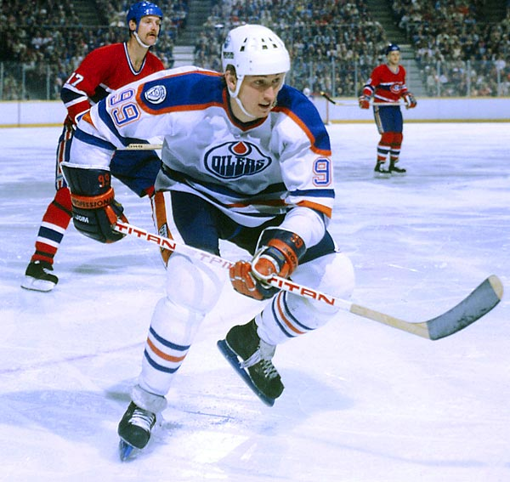
“I skate to where the puck is going to be, not where it has been.”

Slide 94


Quality and Market Acceptance Strategies
Seek and honor feedback
Incremental Delivery

Slide 95
Notes:
Which risks are important? The sharp edges of the sign or the fact that the bridge is out ahead?

Slide 96

Wrong Priorities
Notes:
The first generation of Ford Taurus turned out to be the best selling car in America in the
late 1980s. Conceived in the 1980's and introduced in 1986, it set the standard for new practices
in project management and product development. It was one of the early projects in the U.S.,
which fully utilized the concept of cross-functional teams and concurrent engineering practices.
It established close ties with vendors and subcontractors, and was characterized by a spirit of
cooperation and strong synergy among teams. The result was a remarkable market and business
success. Its revolutionary design and outstanding quality, created a new trend in the U.S.
automobile industry, and customers simply loved the car. Yet, when the project was completed,
the project manager was fired. His “sin” was that project completion was delayed by six months.
In contrast, the second generation of Ford Taurus was developed in the early 1990s and
2
completed in 1995. With increased competition and the enormous success of Japanese imports,
Ford had hoped to reestablish Taurus, once again, as the best selling car in America. But the new
project manager learned the lesson of his predecessor: He considered project schedule as a “holy
grail,” and made sticking to the completion date the ultimate goal, while sacrificing other things.
Vendor relationships, team spirit, and product integration were just few of the issues that
suffered. The second generation of Taurus turned out to be a disappointing business experience.
It did not recapture the position of the best selling car in America and Ford was not able to repeat
its outstanding success of the first Taurus.

Slide 97
Compute This
"I recently asked a colleague [CIO] whether he would prefer to deliver a project somewhat late and over-budget but rich with business benefits or one that is on-time and underbudget but of scant value to the business. He thought it was a tough call, and then went for the on-time scenario. Delivering on-time and within budget is part of his IT department's performance metrics. Chasing after the elusive business value, over which he thought he had little control anyway, is not."
Cutter Sr. Consultant Helen Pukszta

Slide 98
Software Tornado Example
Item | -15M |  | 0M |  | 15M |  | 30M |  | 45M
Product Acceptance Uncertainty |  |  | ██ | ███ | ███ | ███ | ███ | ███ | ███
Schedule Uncertainty |  |  | █ | ███ | ███ | ██
General Market Uncertainty |  |  |  |  | ██ | ██
Cost Uncertainty |  |  |  |  | ██ | █

Slide 99
Software Tornado Example
Item | -15M |  | 0M |  | 15M |  | 30M |  | 45M
Product Acceptance Uncertainty |  |  |  | ███ | ███ | ███ | ███ | ███ | ███
Schedule Uncertainty |  |  |  | ███ | ███ | ██
General Market Uncertainty |  |  |  |  | ██ | ██
Cost Uncertainty |  |  |  |  | ██ | █

Slide 100
Software Tornado Example
Item | -15M |  | 0M |  | 15M |  | 30M |  | 45M
Product Acceptance Uncertainty |  |  |  | ███ | ███
Schedule Uncertainty |  |  |  | ███ | ██
General Market Uncertainty |  |  |  | ██ | ██
Cost Uncertainty |  |  |  | ██ | █

Slide 101
Software Metric:
Projects Delivered On Time

Slide 102

Market Acceptance
Business Perspective | Individual Perspective
Impact to revenue Impact to credibility Cost of rework | Priorities are often guided by other perceived constraints

Slide 103
Political Risk

Slide 104

Change or Maintain

Slide 105
Political Challenges
Boss and above | Boss’s Peers | Boss’s Indirect Peers
You | Peers | Indirect Peers
Direct Reports | Peers’ Reports | Indirect

Slide 106
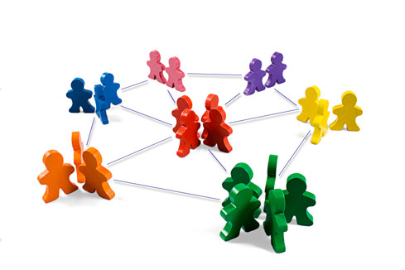
Network
What’s in it for them for everyone to succeed?
What do they worry about losing if you are successful?

Slide 107
Long Ago and Far, Far Away…

Slide 108


Slide 109

Collaborating with Non-Collaborators
Collaborator
Creative
Tension
Collegial
More useful
Drive to
Purpose
Collaboration
Non-
Collaborator
Compliance
Combative
Common Practice
Agree
Disagree
Agreement

Slide 110

Agile Leadership

Slide 111


Politics
Business Perspective | Individual Perspective
Politics do not add to business value other than by luck | Perception trumps Reality Politics forms Perception

Slide 112
Final Summary
Risk | Business Perspective | Individual Perspective | Tools
Collateral Damage | Could be catastrophic | Make or Break career. Individuals may be willing to take more risk than the organization | • Build quality in • Feedback loops
Business Case | Strategic alignment with market need | Demonstrate Confidence | • Purpose Alignment Model
Delivery of Market/ Quality Need | Impact to revenue Impact to credibility Cost of rework | Depends on the individual - Priorities are often guided by other perceived constraints | • Customer Feedback
Delivery on Time or within Budget | Cost of Delay Reduction of ROI Business Credibility | Personal credibility | • Cost of Delay • Tornado Charts
Politics | Markets only care if politics influence external perception. | Perception trumps Reality Politics forms Perception | • Networking & Transparency • Collaborating with Non-Collaborators

Slide 113

Risk Management is not Risk Aversion

Slide 114
Contact
Todd Little
  todd@toddlittleweb.com
  www.toddlittleweb.com
  www.accelinnova.com

