Slide 1
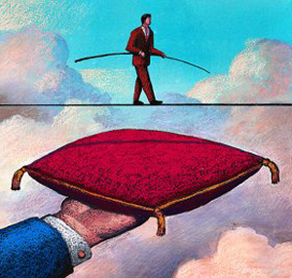
Risky Business: Real Options for Business Agility
Todd Little, CEO Kanban University @toddelittle

Slide 2
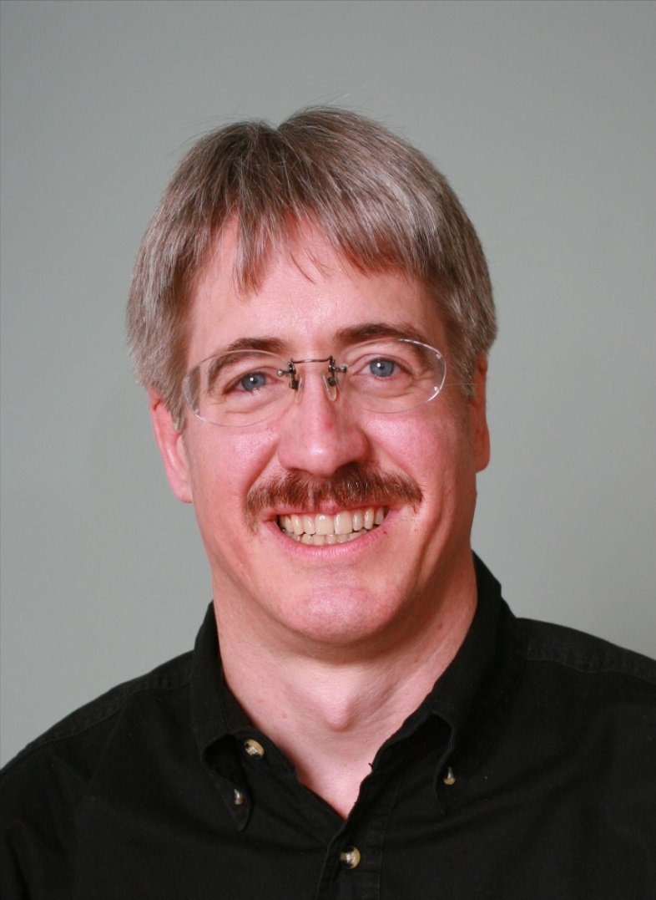



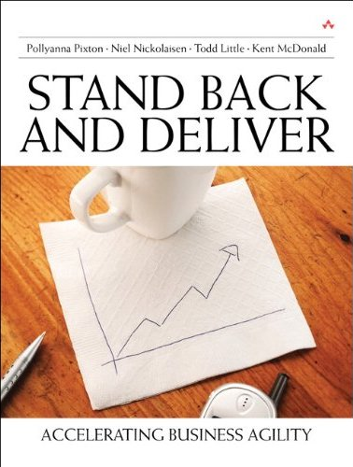


About Todd
CEO Kanban University
Executive roles as VP Product Development, Director of Software & Technology
@toddelittle

Slide 3



Managing Enterprise Agility
Project Kickoff
When will we get the requirements?
All in good time, my little pretty, all in good time
But I guess it doesn't matter anyway
Just give me your estimates by this afternoon
Team Unity
Not so fast! Not so fast! ... I'll have to give the matter a little thought. Go away and come back tomorrow
No, we need something today!
Ok then, it will take 2 years.
No, we need it sooner.
Doesn't anybody believe me?
I already promised the customer it will be out in 6 months
You're a very bad man!
Notes:
We look at a typical software project…..

Slide 4


We’re not in Kansas Anymore
Developer Hero
I may not come out alive, but I'm goin' in there!
Reorg
The Great and Powerful Oz has got matters well in hand.
My! People come and go so quickly here!
Testing
"Hee hee hee ha ha! Going so soon? I wouldn't hear of it! Why, my little party's just beginning!

Slide 5
How do businesses deal with risk and uncertainty?

Slide 6
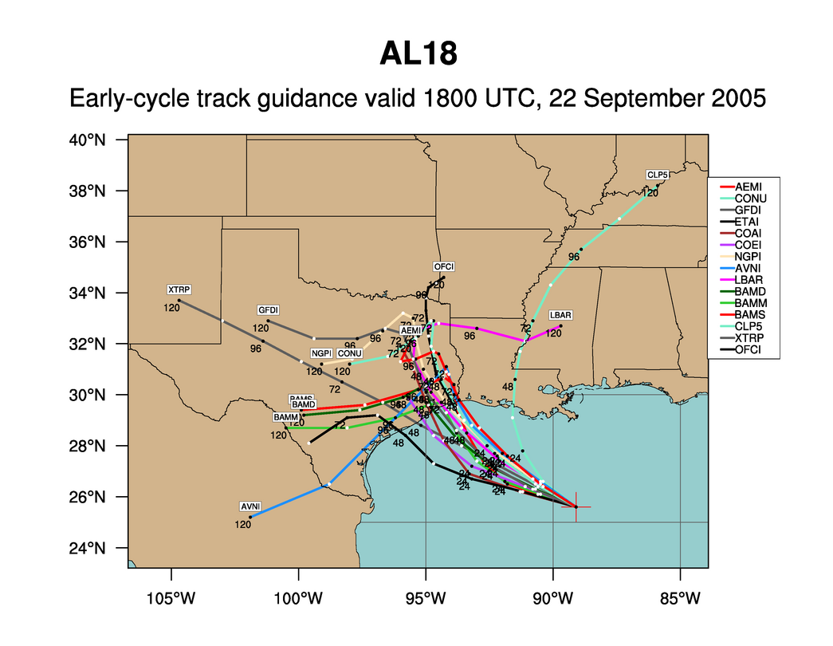
Weather Forecasting:
Hurricane Rita
Notes:
What can we say about every one of these predictions? They are wrong. But the collective set of predictions is quite useful. Which is more important when predicting hurricanes – where it hits or when it hits? Ok, both are important, but where is much more important than when. If you are in Florida you don’t really care when it hits. But once you know it has a chance to hit Houston then it is very important to know when it might hit.

Slide 7
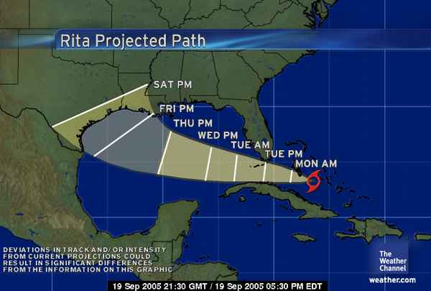
The Cone of Uncertainty
We expect uncertainty and manage for it through iterations, anticipation, and adaptation.
Notes:
Inspection and adaptation is the answer. Iterations help bring in new information

Slide 8
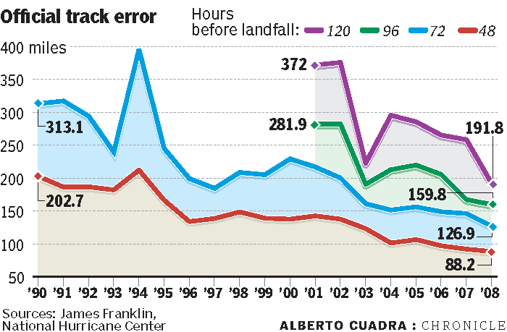
Getting Better
Notes:
Hurricane predictors have gotten much better over the years by building better and better models. They have more than doubled their accuracy.

Slide 9
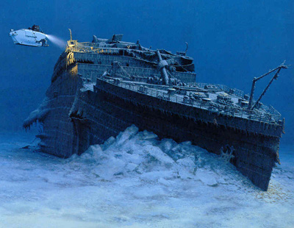

Movies
78% of Films Lose Money
6% of films make 80% of profit
Notes:
Most movies strive to be the next Titanic, the largest grossing film of all time.
The reality is that the vast majority really do end up closer to the real Titanic than to the movie Titanic.

Slide 10
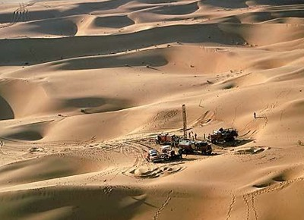
Oil & Gas Exploration
Notes:
Oil exploration is highly risky. It used to be that 10% was a good find rate for wildcat wells. Based on improvements in technology this is closer to 20%. Still risky, but that risk is acceptable because the payout is enormous. The key is having a diversified portfolio to balance the risk exposure.

Slide 11
Oil & Gas Exploration
90-80% Failure
Notes:
Oil exploration is highly risky. It used to be that 10% was a good find rate for wildcat wells. Based on improvements in technology this is closer to 20%. Still risky, but that risk is acceptable because the payout is enormous. The key is having a diversified portfolio to balance the risk exposure.

Slide 12
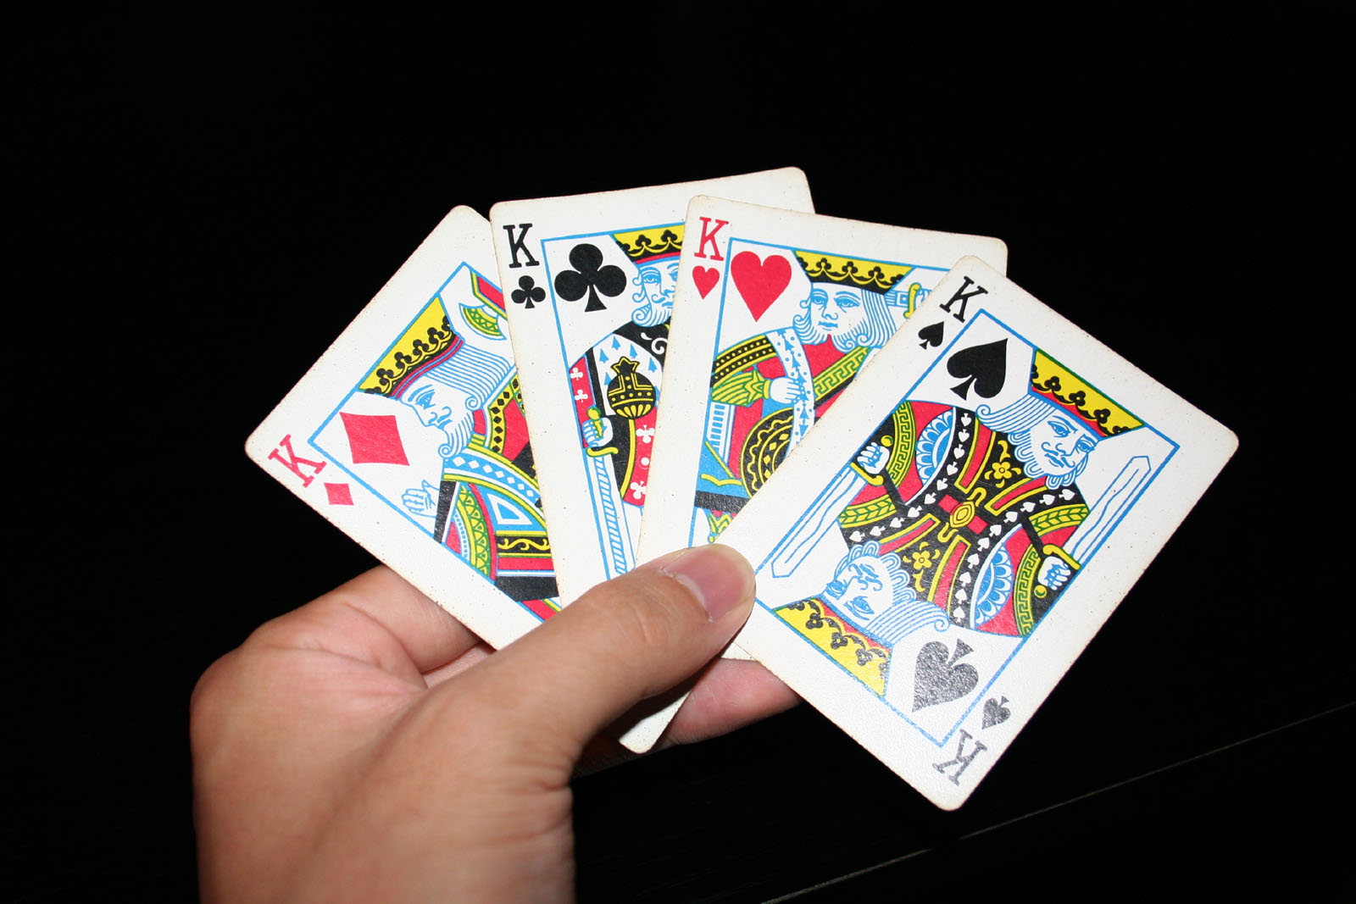
Poker

Slide 13
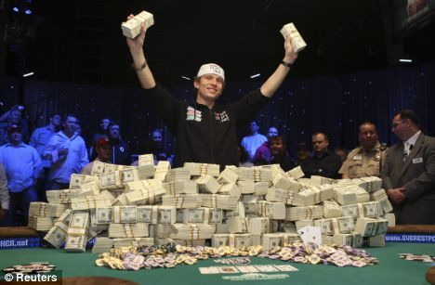
Poker Metric:
Percent of Hands Won

Slide 14
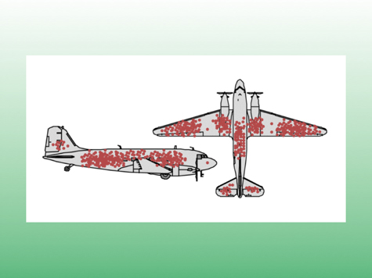
The Context of Feedback

Slide 15

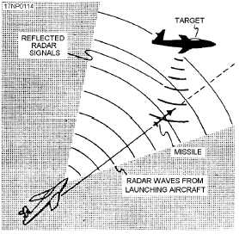
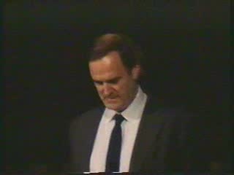
Gordon the Guided Missile

Slide 16
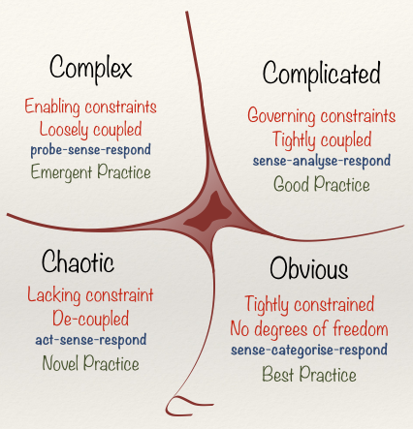
Cynefin Framework
(Snowden)

Slide 17
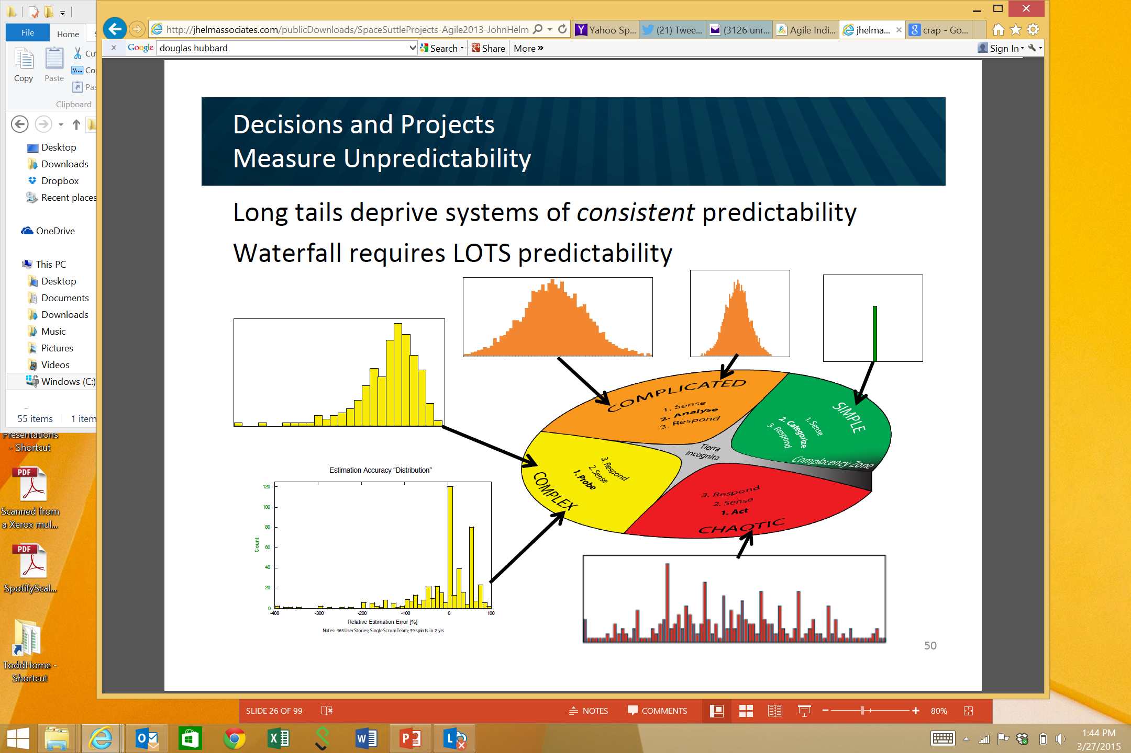
Obvious
Distribution
Input
Output
Cause and Effect Obvious to all
Known - Knowns
Sense - Categorize - Respond
apply best practice
Example: Manufacturing

Slide 18
Complicated
Analysis
Input
Output
Distribution
Cause and Effect Requires Analysis
Known - Unknowns
Sense - Analyze – Respond
apply good practice
Example: Incremental Product Development

Slide 19
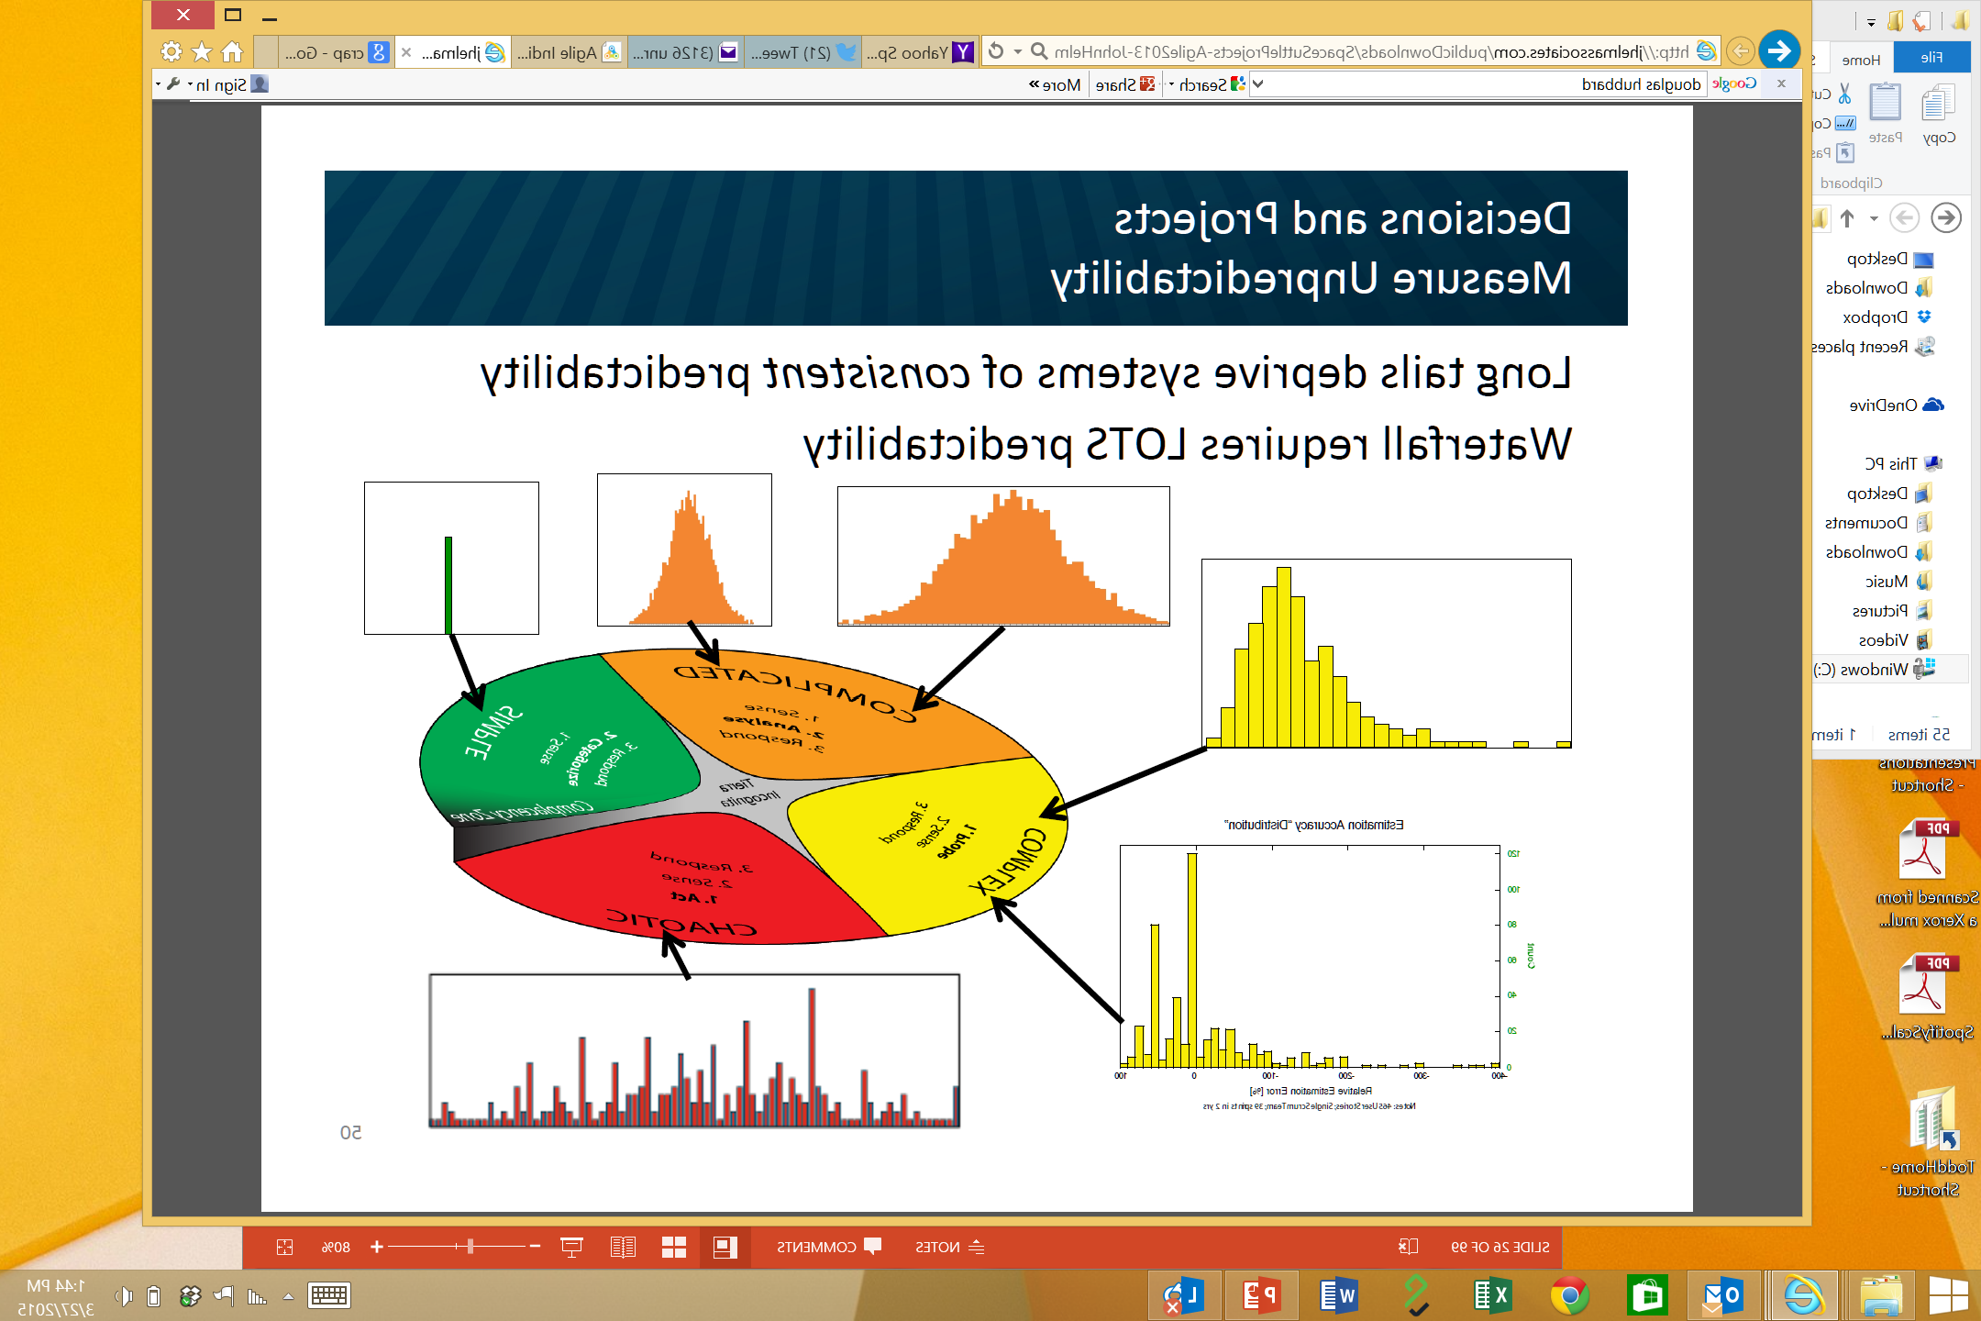
Complex
Distribution
Input
Output
Cause and Effect perceived in retrospect
Unknown - Unknowns
Probe - Sense – Respond
sense emergent practice
Example: New Product Development

Slide 20
Chaotic
Output
Distribution
Input
No Relationship between Cause and Effect
Unknowables
Act - Sense - Respond
discover novel practice.
Example: Medical Emergency

Slide 21
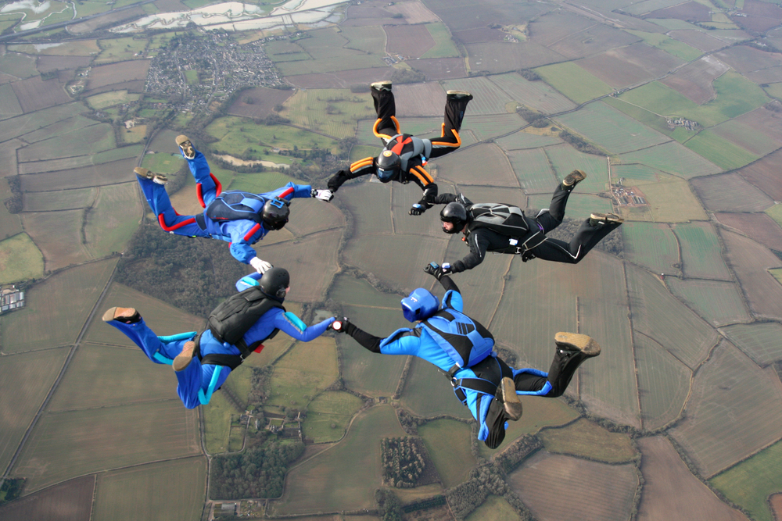
Risk management tools
Types of Risk

Slide 22
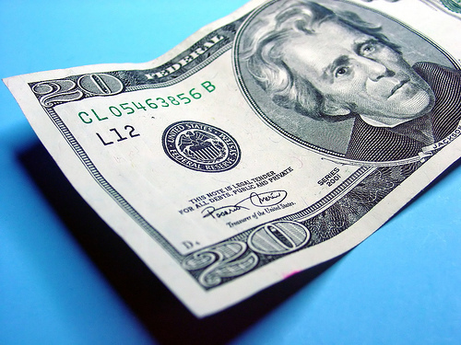

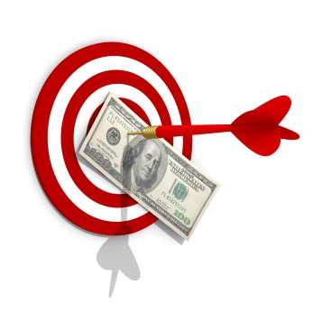
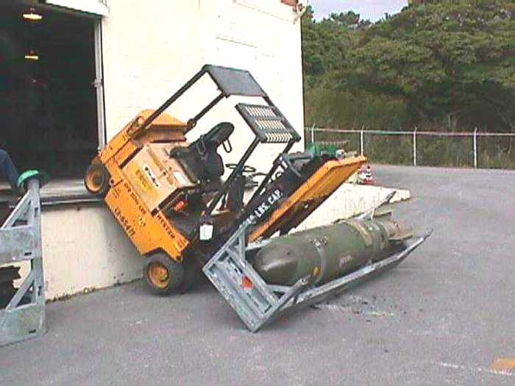
Categories of risk
Business Case
Failure
Delivery Failure
Quality and Market
Acceptance
Collateral Damage
Notes:
We have found it useful to categorize risk into 3 primary categories.
Delivery Failure
Business Case Failure
And Collateral Damage

Slide 23
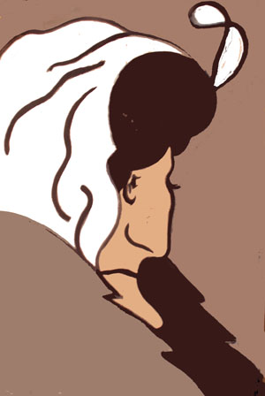


Two Risk Perspectives
Business
Perspective
Individual
Perspective

Slide 24
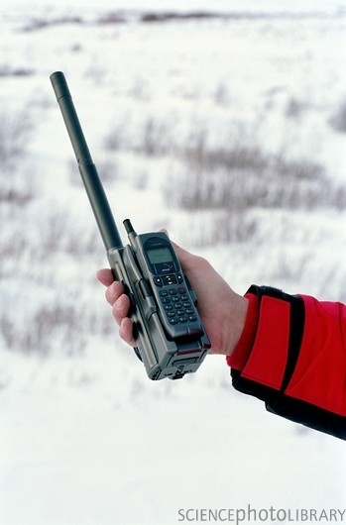
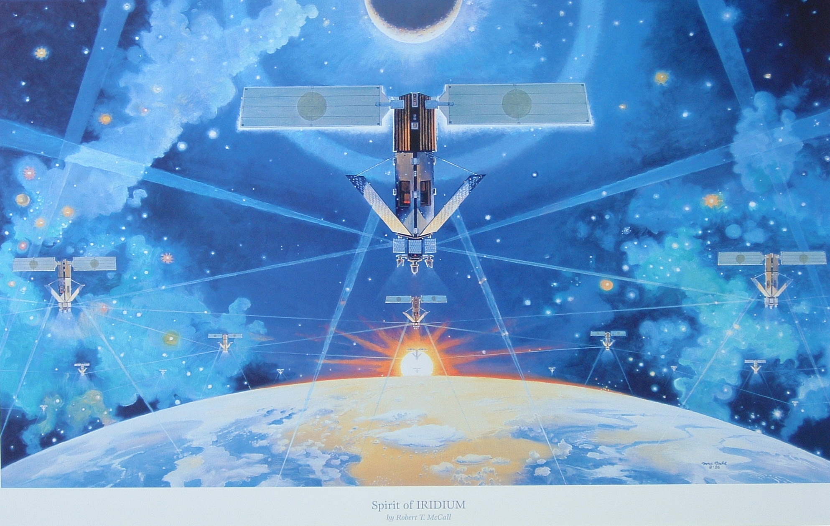
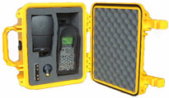
Business Case Failure
Notes:
But what if we deliver on time but the market doesn’t care? This is the classic case of Iridium. Huge undertaking, huge failure. The phones were huge, over a pound. The phones didn’t work inside buildings—not very useful. And the cost were prohibitive.

Slide 25
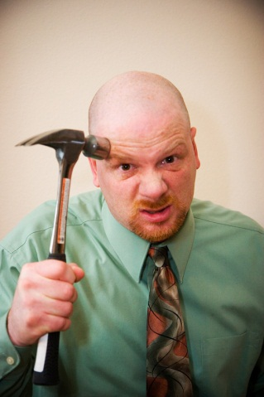
Powerful Questions are:
What are we building?
What Business are we in?
What Building are we in?

Slide 26
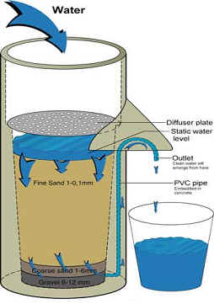

Is your Strategy a Bucket or a Filter?

Slide 27
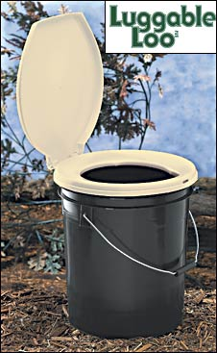
Bad Strategies (Rumelt)
Fluff
Failure to face the problem
Mistaking goals for strategy
Fuzzy or overly complex strategic objectives
  “increase market share”
  "our fundamental strategy is one of customer-centric intermediation."
  “reaching for the impossible to do the impossible"
  47 strategies and 178 action items.
  Action item number 122 was 'create a strategic plan.’

Slide 28
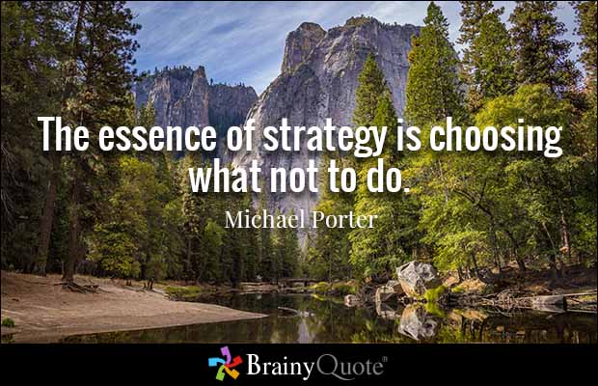

Slide 29
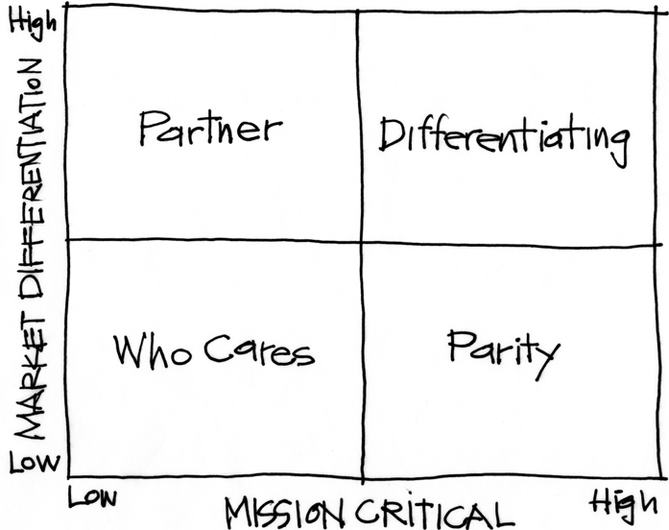
Purpose Alignment Model
Notes:
[Purpose of slide] [#]
[Information]

Slide 30
Purpose Alignment Model
CAN WE
CREATE A
DIFFERENTIATED
PARTNERSHIP?
INNOVATE,
CREATE
ACHIEVE AND
MAINTAIN PARITY, MIMIC, SIMPLIFY
MINIMIZE /
ELIMINATE
Notes:
[Purpose of slide] [#]
[Information]

Slide 31

Applicable at all Levels
Corporate Strategy
Product Strategy
Feature

Slide 32
A View of Strategy - Apple
32
NEW PRODUCT DESIGN
USER EXPERIENCE
CONTENT DISTRIBUTION
ATT
MS OFFICE
INTEL HARDWARE
OTHER SOFTWARE
PERIPHERALS
Notes:
32
[Purpose of slide] [#]
[Information]
© International Institute of Business Analysis®

Slide 33
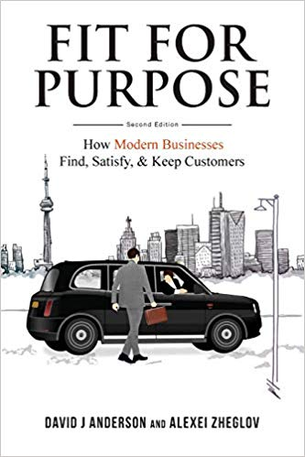
Fit for Purpose
Who are your Customers?
What is their purpose(s)?
What Problem(s) do they want solved

Slide 34

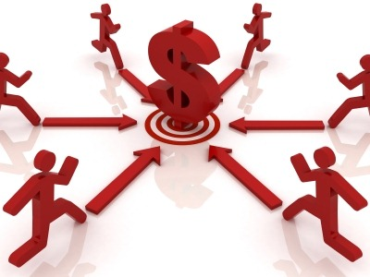
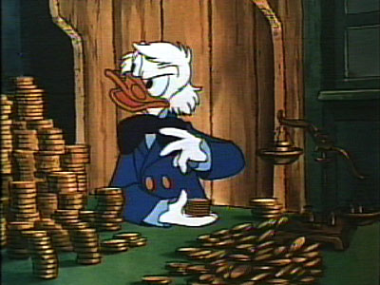
Business Case
Business Perspective | Individual Perspective
Sustainable competitive advantage | How can I sell this so that I can get more budget?

Slide 35
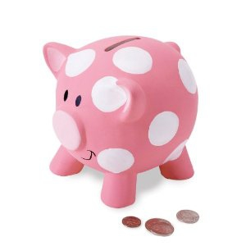
Delivery Failure
Over Budget
Late

Slide 36
Understand Bias
"What gets us into trouble is not what we don't know. It's what we know for sure that just ain't so.“
        Mark Twain

Slide 37
Negotiation Bias
"It is difficult to get a man to understand something when his salary depends upon his not understanding it.“
        Upton Sinclair:

Slide 38
Software Projects: Actual vs. Original Estimate
P90/P10 = 4

Slide 39
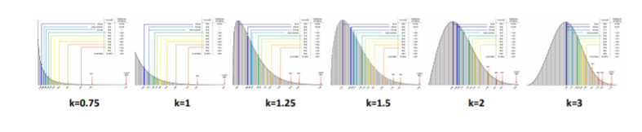
In God we trust, all others must bring data
Fat tail vs. Thin tail
Data over Estimation

Slide 40

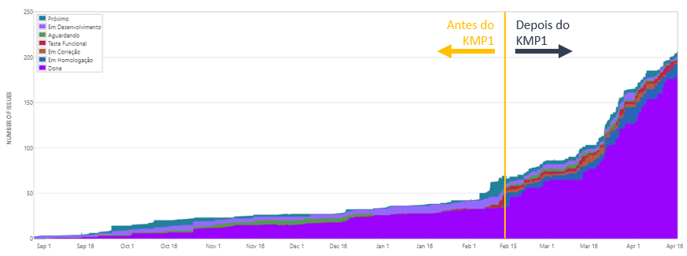
Kanban Impact at Accenture Brazil

Slide 41
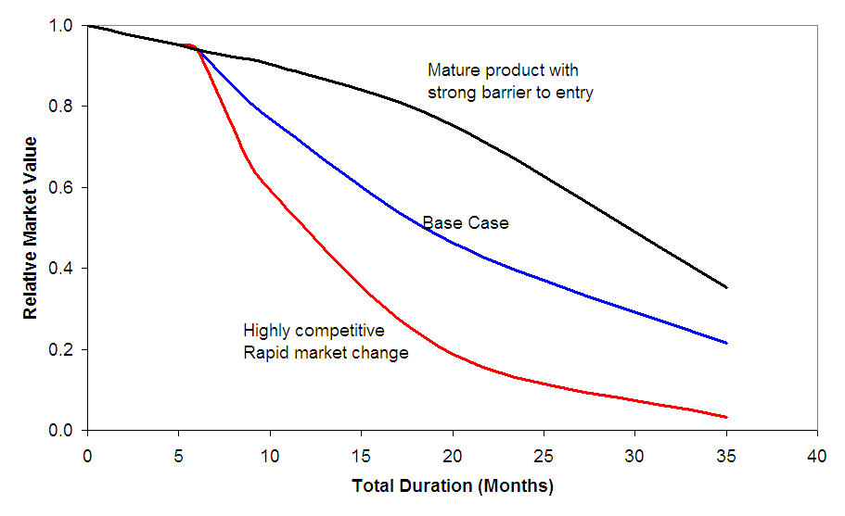
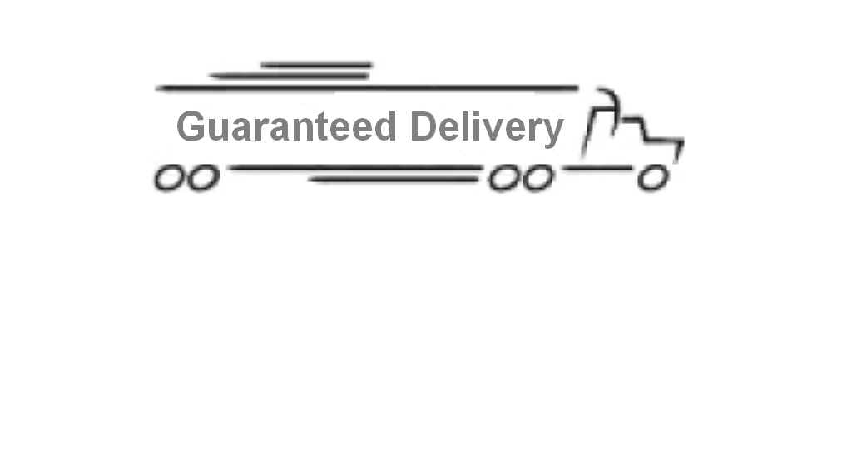
Delivery Risk
Business Perspective | Individual Perspective
Cost of Delay Business Credibility | Personal Credibility

Slide 42
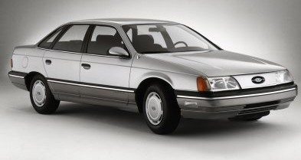
Wrong Priorities?
Notes:
The first generation of Ford Taurus turned out to be the best selling car in America in the
late 1980s. Conceived in the 1980's and introduced in 1986, it set the standard for new practices
in project management and product development. It was one of the early projects in the U.S.,
which fully utilized the concept of cross-functional teams and concurrent engineering practices.
It established close ties with vendors and subcontractors, and was characterized by a spirit of
cooperation and strong synergy among teams. The result was a remarkable market and business
success. Its revolutionary design and outstanding quality, created a new trend in the U.S.
automobile industry, and customers simply loved the car. Yet, when the project was completed,
the project manager was fired. His “sin” was that project completion was delayed by six months.
In contrast, the second generation of Ford Taurus was developed in the early 1990s and
2
completed in 1995. With increased competition and the enormous success of Japanese imports,
Ford had hoped to reestablish Taurus, once again, as the best selling car in America. But the new
project manager learned the lesson of his predecessor: He considered project schedule as a “holy
grail,” and made sticking to the completion date the ultimate goal, while sacrificing other things.
Vendor relationships, team spirit, and product integration were just few of the issues that
suffered. The second generation of Taurus turned out to be a disappointing business experience.
It did not recapture the position of the best selling car in America and Ford was not able to repeat
its outstanding success of the first Taurus.

Slide 43
Market Acceptance
Features and Quality

Slide 44
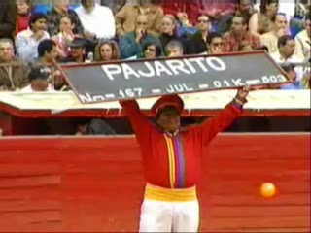
Market Acceptance

Slide 45
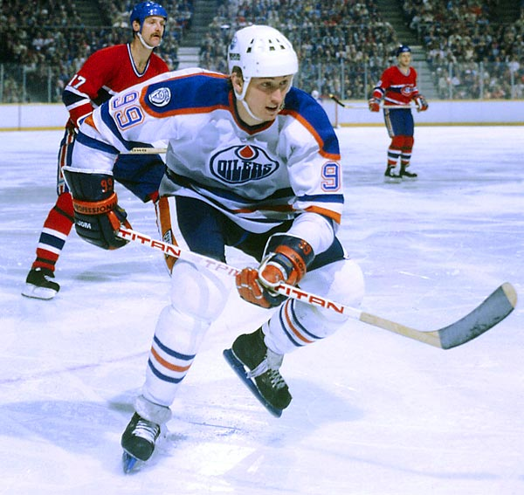
“I skate to where the puck is going to be, not where it has been.”

Slide 46
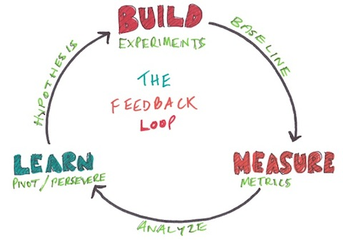
Lean Startup Feedback Loops

Slide 47
Fit for Purpose
Feedback from the front line
Fit for Purpose Box Score

Slide 48

Market Acceptance
Business Perspective | Individual Perspective
Impact to revenue Impact to credibility Cost of rework | Priorities are often guided by other perceived constraints

Slide 49
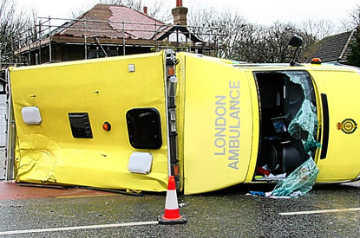
Collateral Damage
11 hour wait time
20-30 deaths
Notes:
In October 1992, the London Ambulance Service suffered a disaster that brought their operations to a virtual standstill over 36 hours, and up to 20-30 people may have died as a result of ambulances arriving too late on the scene. Upon further investigation, it was discovered that the new computer aided dispatch (CAD) software was responsible for the crisis. The problem lay in the design of the software, which was completely inadequate for the needs of the London Ambulance Service. So terribly pathetic were this software's services that response times to emergency calls were as high as 11 hours during the 36 hours crisis.

Slide 50
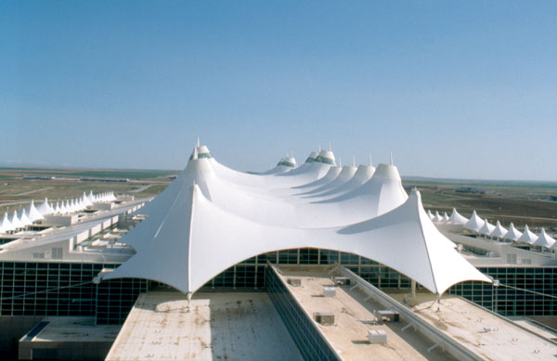
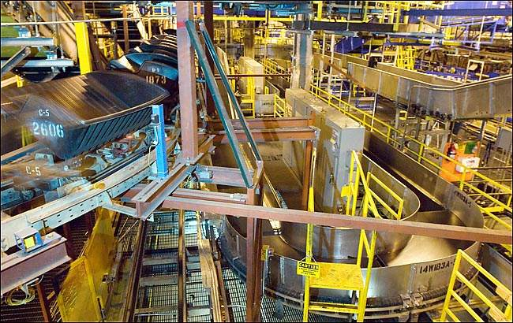
Delivery Failure results in Collateral Damage
Notes:
When the Denver Airport baggage handling system was designed, for example, no one asked what would happen if the fully automated system failed. How would baggage be handed? No one thought about it and there we no accommodations made in the airport plan. So when the system did fail there were no other alternatives to move baggage around the airport. There were no underground roadways on which to manually move luggage using tugs.

Slide 51
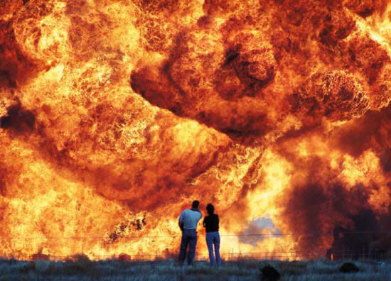
I’m beginning to think it wasn’t such a good idea to turn off those unit tests
Notes:
Safety is not to be messed with.
Test, Test, Test
Test again with real data
Test, Test, Test
Test again with real data

Slide 52
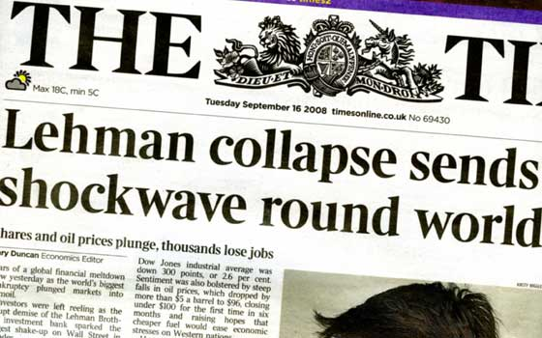
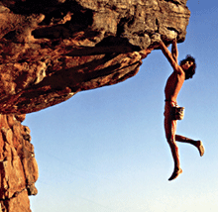
Collateral Damage
Business Perspective | Individual Perspective
Could be catastrophic | Some individuals may be willing to take on more risk than desired

Slide 53
Risk management tools
Risk Management Tools

Slide 54
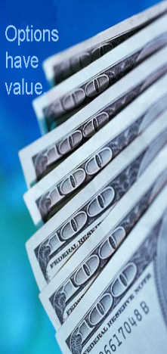
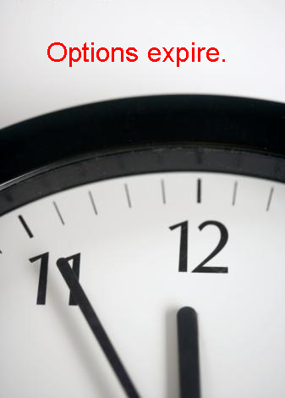
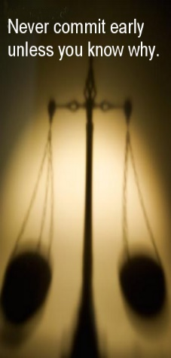



Real Options
Tornado Chart
Value of Uncertainty
Value of Information
Value of Flexibility

Slide 55

Real Options
The right — but not the obligation — to undertake certain actions prior to an expiry date

Slide 56

Airline Tickets
The right — but not the obligation — to undertake certain actions prior to an expiry date

Slide 57



Slide 58


Real Options
The right, but not the obligation to take some action prior to an expiry date

Slide 59
Do you have a choice?
Option
Decision
Commitment

Slide 60

Notes:
http://www.flickr.com/photos/nick_anderson/5049751331/sizes/m/in/photostream/

Slide 61

Which risks are important?
Notes:
Which risks are important? The sharp edges of the sign or the fact that the bridge is out ahead?

Slide 62
Tornado Chart: Which Uncertainties Are Important?
Notes:
Oil and gas geologists and engineers build models to help them comprehend the uncertainties. This is a tornado chart, because it looks like a tornado. This chart clearly shows that the largest uncertainty is associated with Reserves, with the next largest uncertainty being oil/gas price. This gives the engineer something to focus on. Perhaps there is additional data that can be collected to help reduce the uncertainty bars. There may not be anything that can be done about Oil/gas price. Perhaps futures contracts could be used to hedge some of the uncertainty. The other uncertainties may not be worth spending too much time since they have limited effect on the total uncertainty.

Slide 63

Value of Uncertainty
Efficient Frontier
Eliminating Risk/Uncertainty is not the Goal!

Slide 64
Product Delivery Tornado Example
Item | -15M |  | 0M |  | 15M |  | 30M |  | 45M
Product Acceptance Uncertainty |  |  | ██ | ███ | ███ | ███ | ███ | ███ | ███
Schedule Uncertainty |  |  | █ | ███ | ███ | ██
General Market Uncertainty |  |  |  |  | ██ | ██
Cost Uncertainty |  |  |  |  | ██ | █

Slide 65
Product Delivery Tornado Example
Item | -15M |  | 0M |  | 15M |  | 30M |  | 45M
Product Acceptance Uncertainty |  |  |  | ███ | ███ | ███ | ███ | ███ | ███
Schedule Uncertainty |  |  |  | ███ | ███ | ██
General Market Uncertainty |  |  |  |  | ██ | ██
Cost Uncertainty |  |  |  |  | ██ | █

Slide 66
Product Delivery Tornado Example
Item | -15M |  | 0M |  | 15M |  | 30M |  | 45M
Product Acceptance Uncertainty |  |  |  | ███ | ███
Schedule Uncertainty |  |  |  | ███ | ██
General Market Uncertainty |  |  |  | ██ | ██
Cost Uncertainty |  |  |  | ██ | █

Slide 67

Value of Information

Slide 68

Value of Information

Slide 69

Value of Flexibility
Notes:
9 research projects for drive train
1 chassis – same hole for all 9 drive trains
VOI from 9 research projects, VOF from chassis design
Contrast this with the development of the Prius. Toyota had 9 different research projects running to develop hybrid engine technologies. Normally they would choose a drivetrain first, and build a car around it. Instead Toyota decided to keep its options open, and designed the Prius with a hole in it for the drive train. The 9 research projects continued, and 9+ months after the Prius development project was started, a drive train was chosen. Toyota knew that this car needed a radically new drive train architecture. Instead of guessing and choosing one, they let all 9 research projects continue their work, and as they did, the best option for the car's engine became clear. So was 9 research projects a waste? No because each project was generating factual information about the options for hybrid engine design, information that Toyota engineering management needed to make an informed choice.

Slide 70

Value of Flexibility from Loose Coupling

Slide 71


Slide 72

Risk Management is NOT Risk Aversion

Slide 73
Summary
Know what business you are in
Discover the risks and uncertainties that dominate your business
Get very good at managing for those uncertainties

Slide 74

Enterprise Services Planning (ESP)

Slide 75


ESP 5 Day Training
Executive Track (Days 1 and 2) | Product Manager Track (Exit: middle of day 4) | Expert Track (Whole week)
Overview of strategy Organizational risk Fitness for purpose Custom risk assessment frameworks Alignment of strategy and capability Survivability assessment | Executive Track material plus: Cost of delay Real options Demand shaping Capacity allocation Risk hedging Portfolio Kanban | Executive Track and Product Manager’s Track material plus: Delivery and project forecasting Liquidity and volatility Scaling Working with irrefutable demand Managing dependencies Dynamic capacity reservation systems

Slide 76

Agile Pain Point Solutions (APPS) 1-day classes
Better KPIs: Metrics for Meaningful Organizational Behavior | Clear Product Requirements | Managing Large Backlogs | Managing Dependencies for Enterprise Agility | Forecasting Projects and Customer Deliveries

Slide 77
Fit for Purpose (2-day class)

Slide 78
Contact
Todd Little
  todd@mauvius.com
  @toddelittle

