Slide 1

From Product Discovery to Product Delivery
Todd Little
Chairman, Kanban University

Slide 2
What does your product pipeline look like?

Slide 3
Idealized Product Pipeline
Phase progression indicates increasing investment and decreasing risk.
Portfolio
Review
Phase
Review 1
Phase
Review 2
Phase
Review 3
Phase
Review 4
Idea
Generation
E
N
T
E
R
Phase 1:
Concept
Investigation
Phase 4:
Post
Release
Current
Product
Support
Phase 2:
Feasibility
Phase 3:
Development
E
X
I
T
Does the idea fit roughly with our strategy and resource availability?
If yes, then
concept document
approved
& sub-team allocated
Does the product make sense from marketing, technical & financial perspectives?
If yes, then
concept
approved
& full team
allocated
What is the product spec?
Can we develop it within budget and schedule?
Can we produce it at the required cost & volume?
If yes, then
prototype
approved
& full team
allocated
Has the product been fully verified and validated?
Have production objectives been met?
If yes, then
full manufacturing
approved
& sub-team
allocated
Is the product meeting safety, efficacy and business targets in the market?
If yes, then
closeout
approved
& handoff to
product support

Slide 4
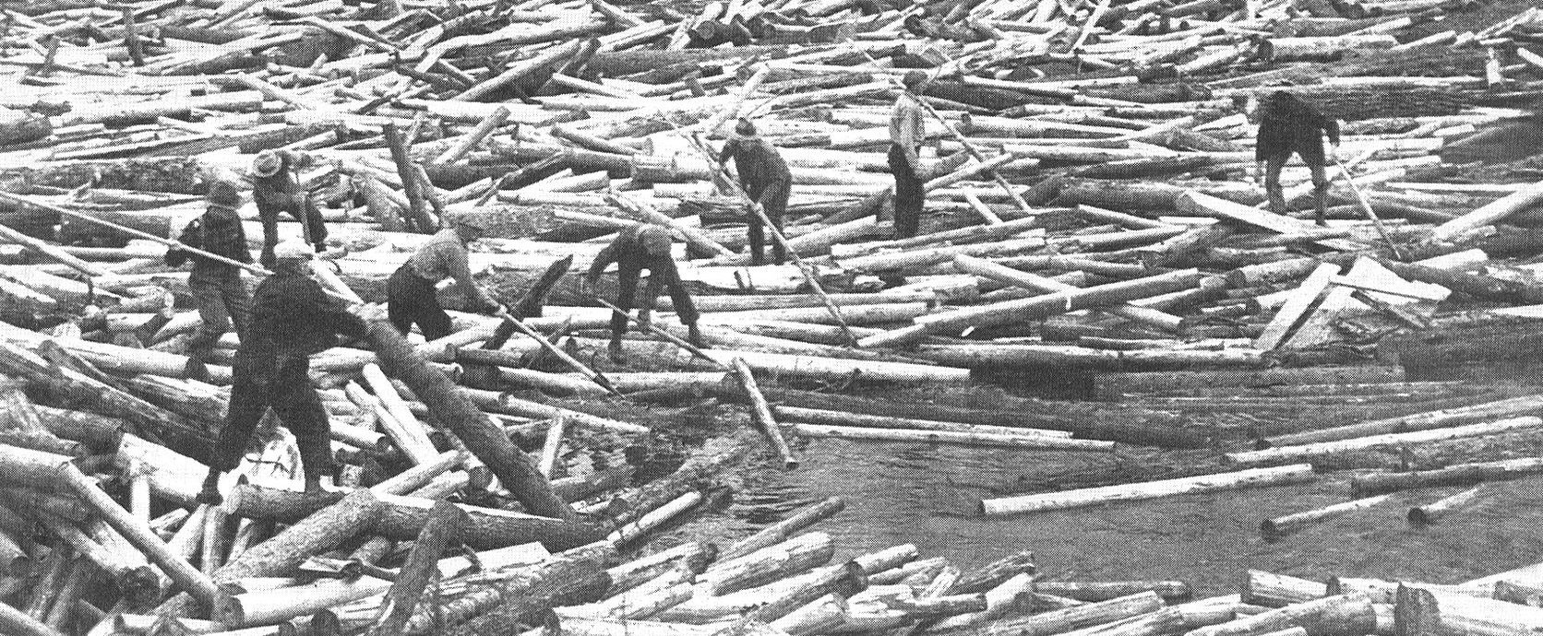
Is this your Product Pipeline?

Slide 5
Group A
Senior
Management
Injector
Marketing Inputs
Screen 1
Department Changes
Screen 2
Final Evaluation

Slide 6
Group B
Q
u
a
l
i
t
y
C
o
n
t
r
o
l
R
e
s
e
a
r
c
h
O
E
M
C
u
s
t
o
m
e
r
C
o
n
t
.
M
a
r
k
e
t
i
n
g
E
n
g
i
n
e
e
r
i
n
g
S
t
r
a
t
e
g
i
c
P
l
a
n
n
i
n
g

Slide 7
We want this
Innovation
Revenue
Predictability
Efficiency
AI
Market Influence
Late projects
API
Integration
OKRs
Cloud
Blockchain
Agile

Slide 8


Slide 9
Kanban Upstream Product Pipeline
Ideas
Ideas
Problem Hypotheses
Market
Analysis
Problem Validation
Solution Validation
Solution Development
Solution Deployment
Ideas

Slide 10
Ideas
Kanban for Product Managers
Cleanup on aisle 9 – Help fix the Scrum failures
Pursue advanced training for alumni
Focus on growth outside of IT/Software

Slide 11
Ideas
Kanban for Product Managers
Cleanup on aisle 9 – Help fix the Scrum failures
Pursue advanced training for alumni
Focus on growth outside of IT/Software

Slide 12
Observations and Hypotheses

Slide 13

Outcomes from Scrum Transformations
Scrum worked for us, and we continue to get better. | Scrum helped a bit, but we haven’t gotten much better lately.
Scrum has been a disaster. | Scrum didn’t really help, but didn’t really hurt either.

Slide 14
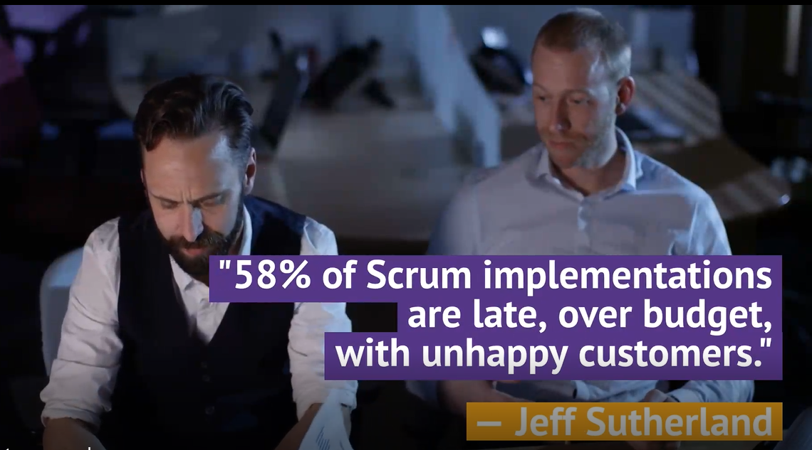

Target CSMs
Not as AKTs. The AKT candidates will continue to come we don’t need to draw more at this time.
But primary target for
  TKP, KSD
And key target for
  KMM/KCP and KMM Plus.
  Or a new KMM for Scrum class

Slide 15
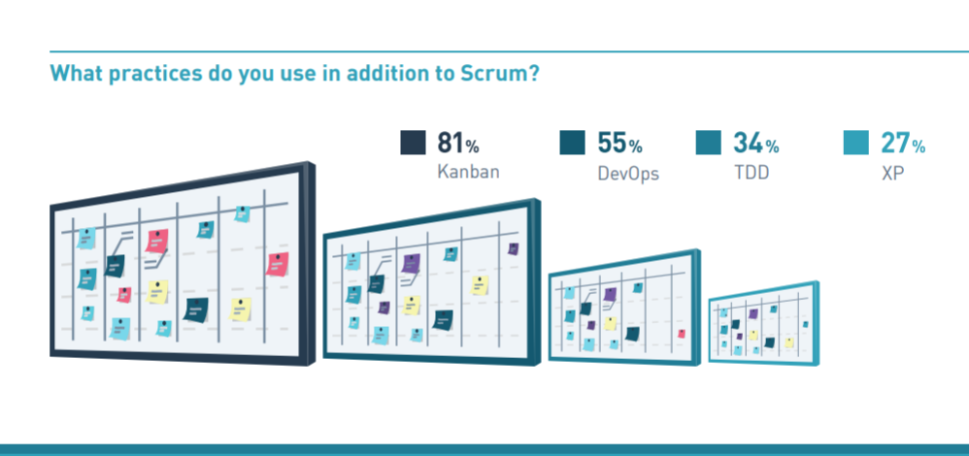
2019 Scrum Master Trends (Scrum.org)

Slide 16


Slide 17
State of Kanban 2022

Slide 18
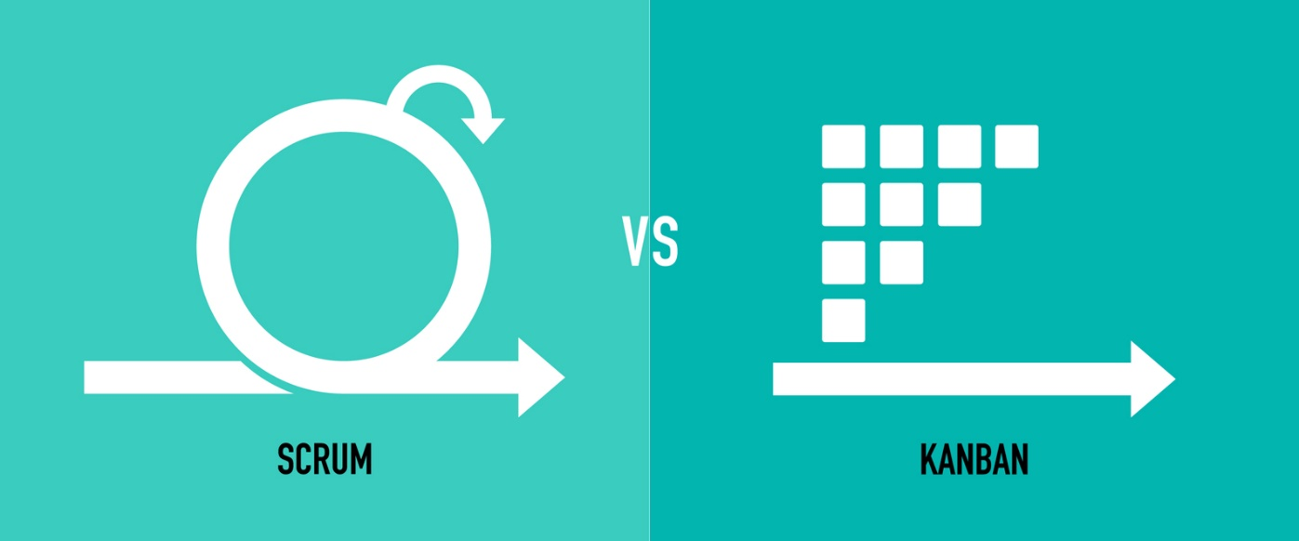

Scrum vs. Kanban
Scrum Glasses
  Scrum is a Framework, so Kanban is a Framework
  Scrum is for Products, Kanban is for Operations
  Kanban is just a board
Kanban Community
  Scrum Sucks!
  Losers!
  But one of our values is Respect!
  Start with what you do now!

Slide 19
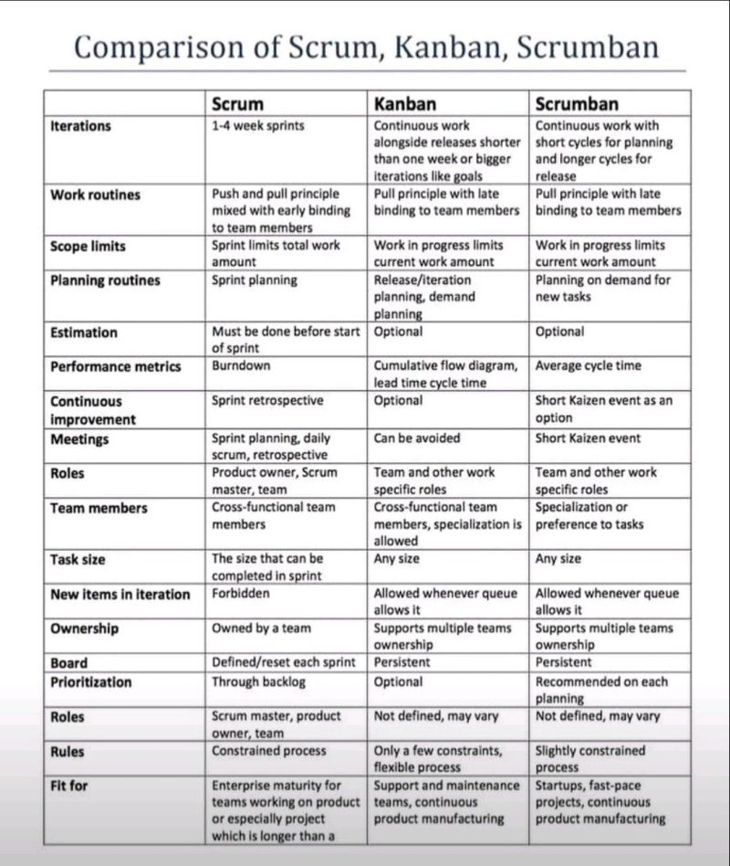
Wrong
Wrong
Wronger
Scrum Lens

Slide 20
Kanban is not a framework
Kanban is not just a board
Kanban is not something you install
Kanban is not a transformation
Any Kanban vs. Scrum comparison makes no sense
Kanban is a management method for improving the delivery of knowledge work using evolutionary change starting from where you are today
While not a transformation, Kanban can be quite transformational
Kanban is an unframework

Slide 21
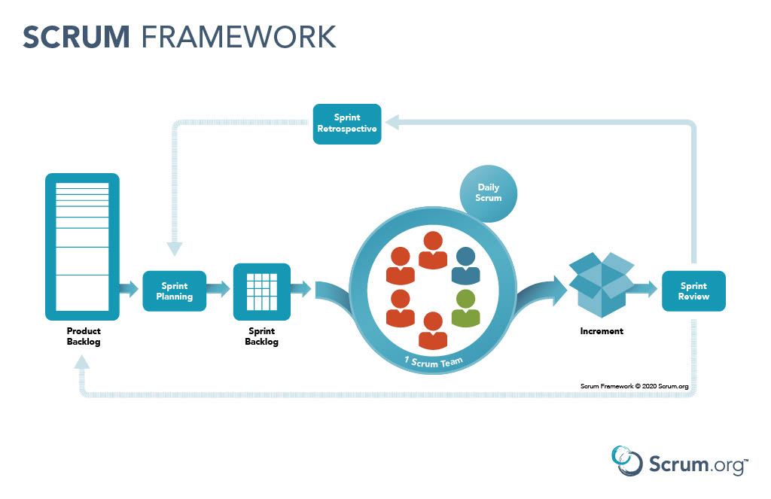
Start with what you do now

Slide 22
Market Analysis

Slide 23
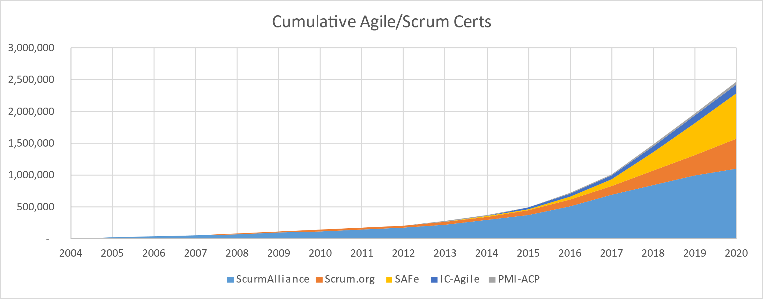

Slide 24
Market Analysis Hypothesis

Slide 25

Segmenting the Market
Seem satisfied early adopters seeing some benefits.
May be a huge market, but one that does not see any urgency
Outside IT
Oblivious
Rare Birds
58% of Scrum implementations are late, over budget with unhappy customers
Scrummer Boys
They don’t want results, they want to avoid accountability – If they go, they’re going SAFe
Laggards
Inside IT
Agile in Motion
No Agile Yet

Slide 26
What does this mean?
Aggressively pursue positioning Kanban as a way to improve the existing Scrum market without threatening Scrum practioners’ identities.

Slide 27
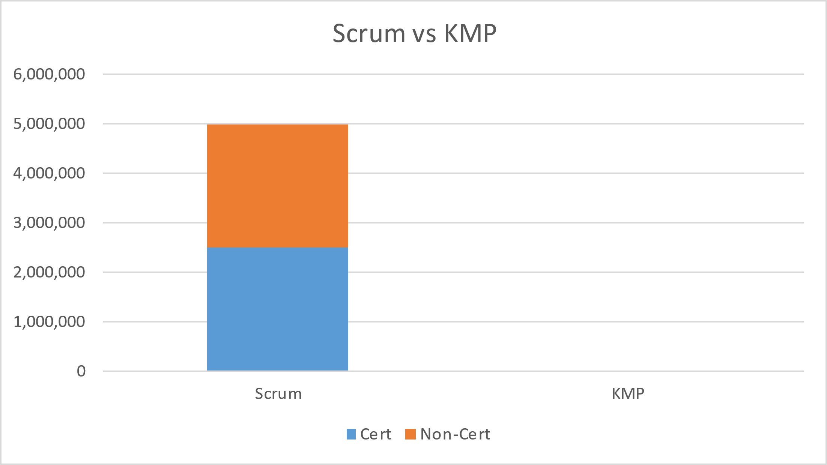
Segmenting the Market
Outside IT
Oblivious
Rare Birds
Scrummer Boys
Laggards
Inside IT
Agile in Motion
No Agile Yet

Slide 28
Customer
Surveys

Slide 29

Product Management Trap

Slide 30
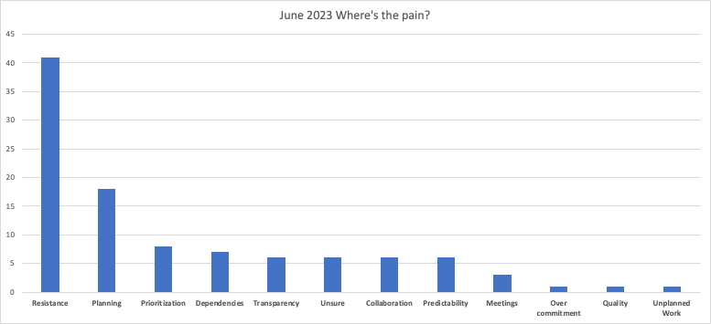
Pains We’ve Discovered
How do I improve flow/predictability
How to I handle resistance

Slide 31
Pre-Marketing and Market Testing

Slide 32

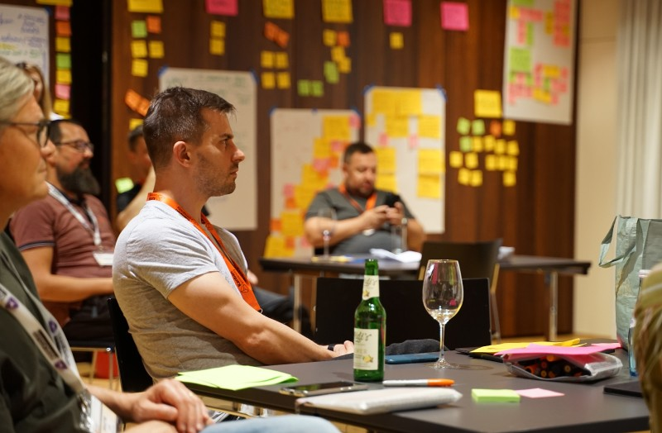
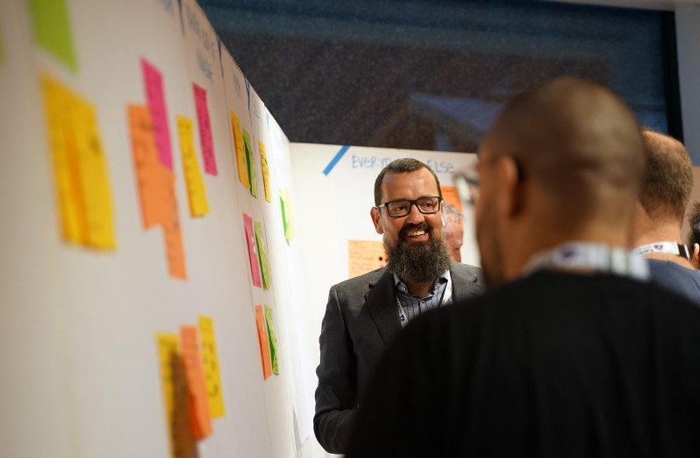

Conference Talks and Meetups
Kanban Leadership Retreat

Slide 33
Marketing

Slide 34
Marketing Goals
Position the Kanban Method as complementary to Scrum to help managers go farther without another overhaul of their process and operations.
Position Kanban University as the top destination for training and education to incorporate Kanban in existing Scrum practice.

Slide 35
Key Messages
Kanban vs Scrum is automatically wrong. It’s an incorrect paradigm.
Kanban makes whatever you’re doing better
Kanban applied to Scrum makes Scrum better - Scrum Better with Kanban

Slide 36
Feedback Loops

Slide 37
Kanban Upstream Product Pipeline
Ideas
Ideas
Problem Hypotheses
Market
Analysis
Problem Validation
Solution Validation
Solution Development
Solution Deployment
Ideas

Slide 38
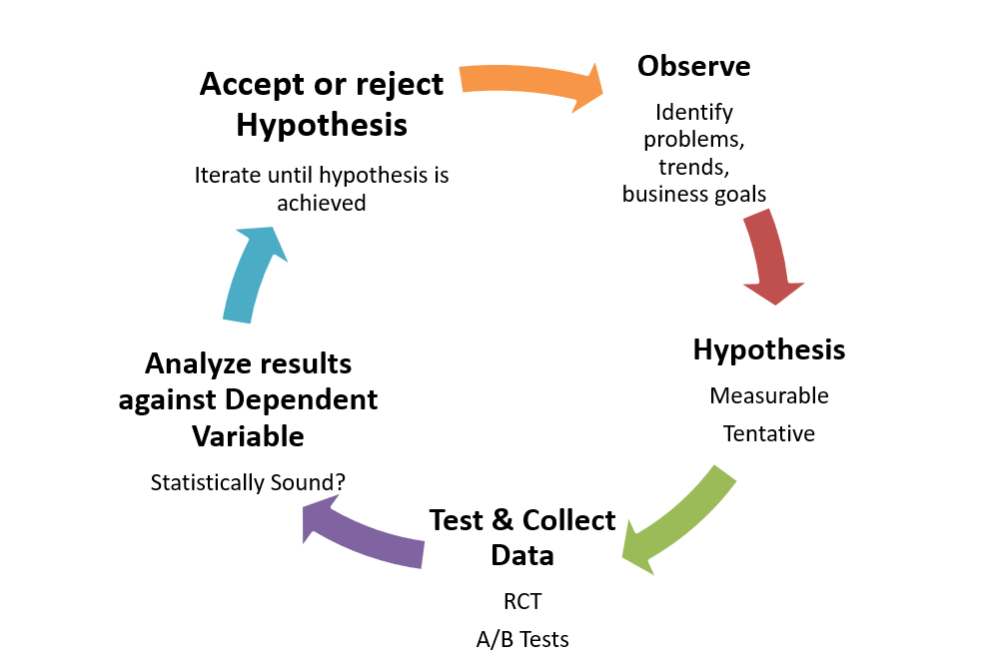
The Scientific Method

Slide 39
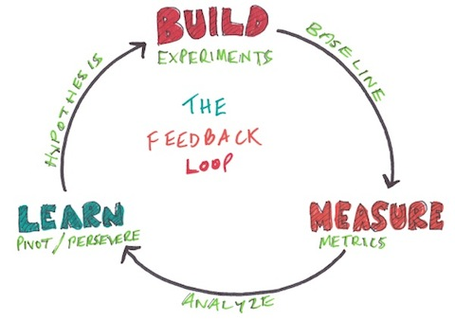
Lean Startup

Slide 40
Problem/Solution Validation

Slide 41


Who wants to play?
We hoped for 4 people
We got more than 15

Slide 42
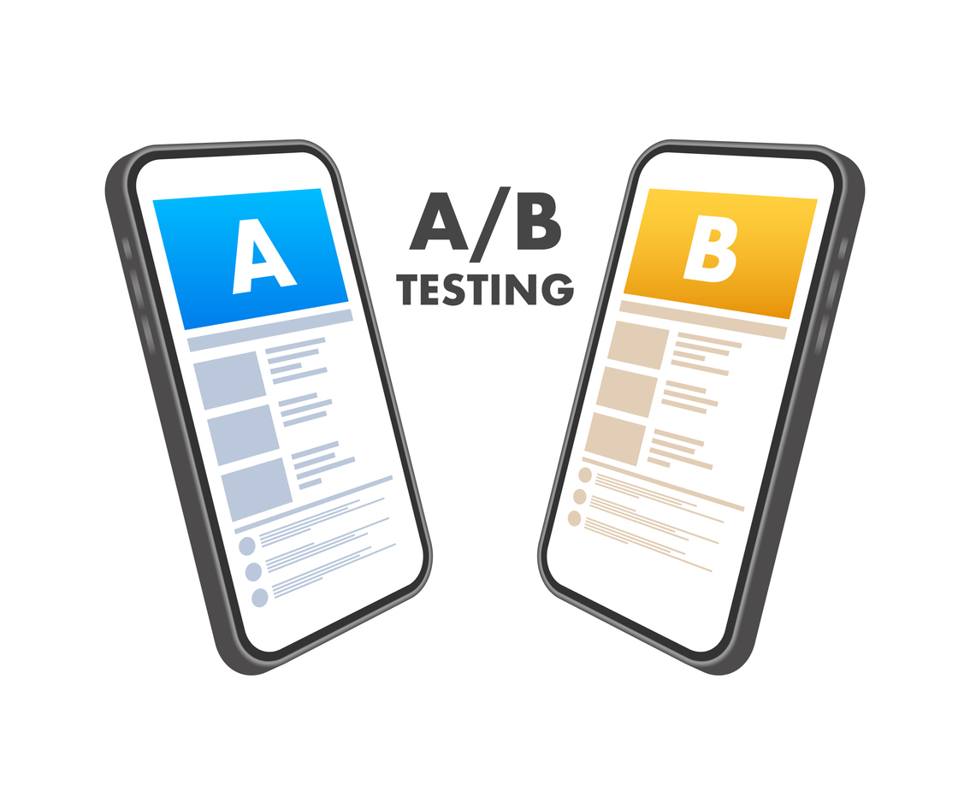

Slide 43
A/B test
A: Modified version of Kanban University Team Kanban Practitioner class with evolutionary change “translated” into Scrum language
B: Focus on problem identification within and beyond the Scrum Framework and use of evolutionary change with Kanban principles and practices

Slide 44
CAB

Slide 45
4 End User Cycles, 3 Trainer Cycles

Slide 46

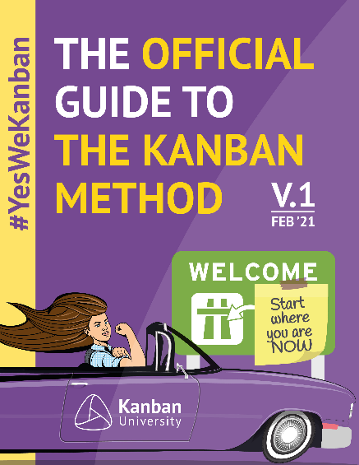



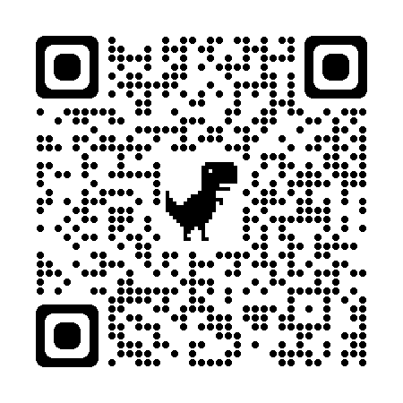
How to get started with Kanban
Kanban Guide | Case Studies | Blue Book
Essential Kanban Condensed | State of Kanban Survey | www.kanban.university

