Slide 1


Is Agile Dead Yet?
Does Kanban Care?
Todd Little
Chairman
Kanban University

Slide 2

“The agile role in our tech organization was critical to our earlier transformation phases, but as our organization matured, the natural next step is to integrate agile delivery processes directly into our core engineering practices”

Slide 3
Freddie Mac let go of 75 scrum masters
Target’s coaching team was informed that we are being laid off.

Slide 4
Discord CEO, Jason Citron, announced the layoff news in a memo to the employees and a meeting with the staff, saying that the layoffs were a difficult but necessary decision to make Discord more agile and effective.

Slide 5







Slide 6
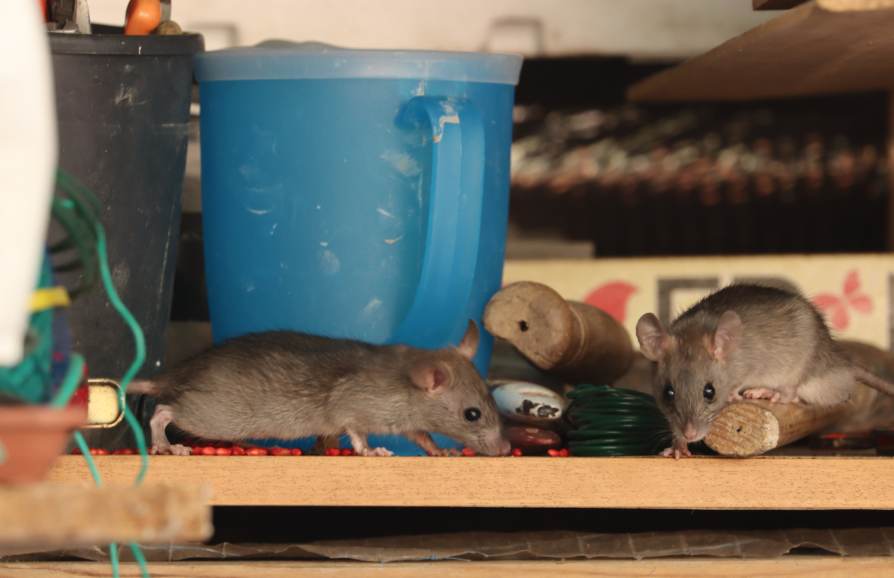
Agile is Dead!

Slide 7


Slide 8
the layoffs were a difficult but necessary decision to make Discord more agile and effective.
"This was a difficult decision that was carefully considered as part of our overall strategy and ongoing focus on becoming an ever more agile and disciplined company, said Chewy spokesperson, Diane Pelkey
Salsify is moving some roles abroad as the company aims to set itself up for a more agile and competitive future.

Slide 9
Meta did not reveal officially the reasons behind the elimination of the TPM role, but according to one of the former Instagram employees, the layoffs are related to Meta’s ongoing restructuring, known as “the flattening.” This restructuring, which started last year, is aimed to remove unnecessary layers of management and make the company more agile and efficient.
India Today 2024-01-18

Slide 10
All these PMs do at my workplace is put tons of meetings on other people's calendars.
Reddit

Slide 11
Why is Agile Struggling?

Slide 12
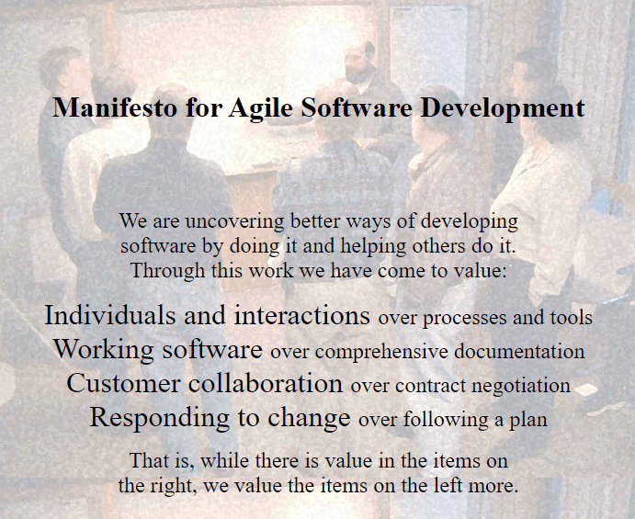
This is agile, right?

Slide 13
agile: marked by ready ability to move with quick easy grace
Merriam-Webster Dictionary

Slide 14
Manifesto: a written statement declaring publicly the intentions, motives, or views of its issuer
Merriam-Webster Dictionary

Slide 15
Religion: a personal set or institutionalized system of religious attitudes, beliefs, and practices
Merriam-Webster Dictionary

Slide 16

How many Scrum Masters does it take to change a light bulb?
It wasn’t in the Sprint Goal, so we aren’t allowed to change it.

Slide 17

How many Product Owners does it take to change a light bulb?
As a Jira Jockey who spends time in this room,
I want the light changed,
So that I csn se wht I am typngg

Slide 18

When will the light bulb be changed?
Sorry, but we can’t give a date, but assure you that we are making great progress this Sprint towards getting it changed

Slide 19
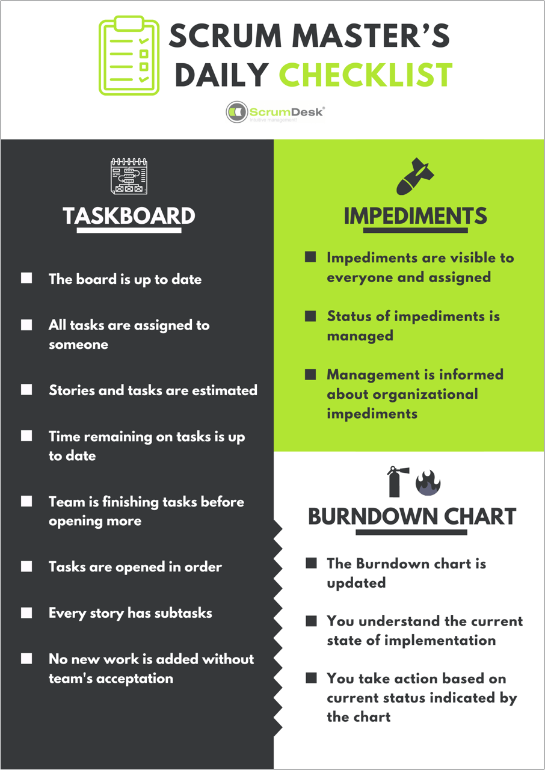
What did Agile Become?
CDD
  Ceremonies and Templates
  Checkbox mentality
  2 day certifications of a “Master”

Slide 20
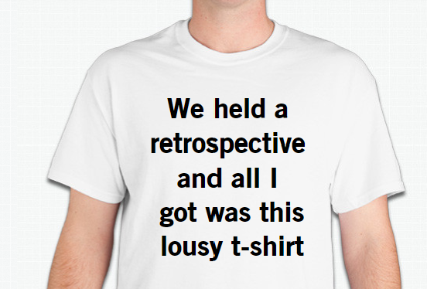
Agility?

Slide 21
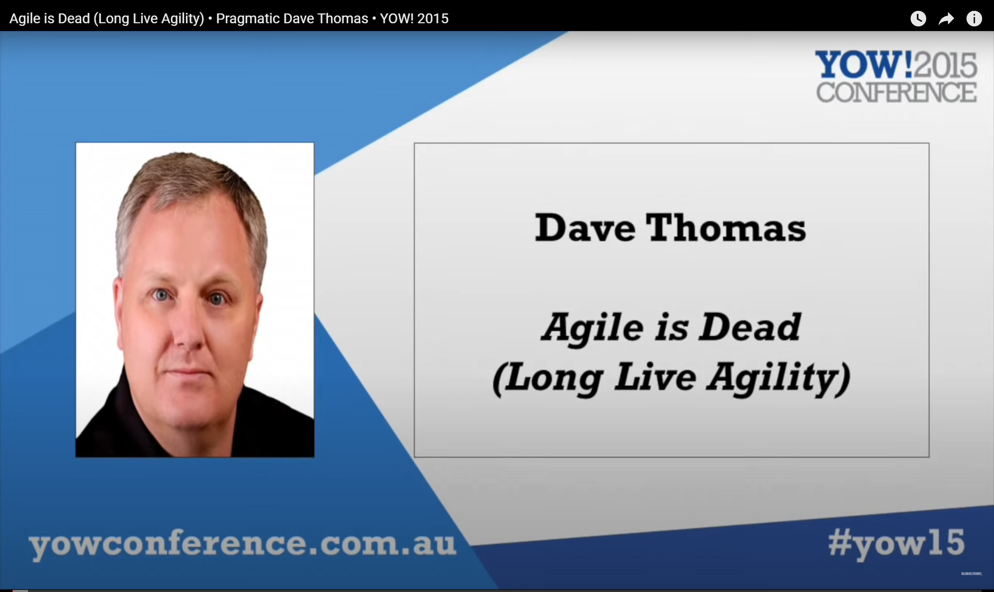

Slide 22
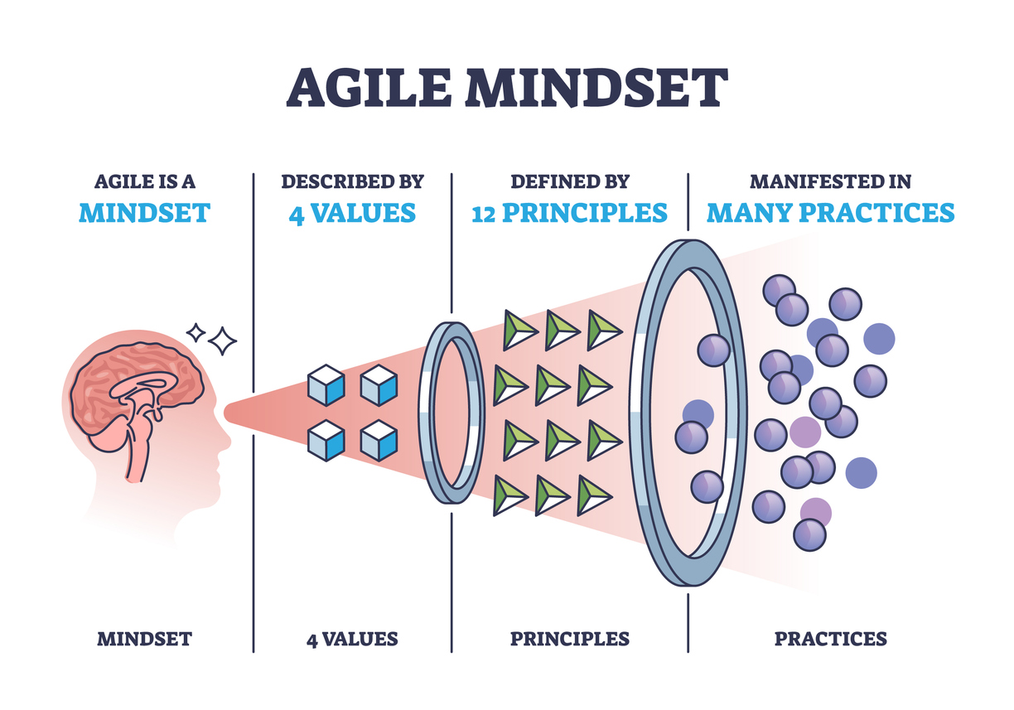
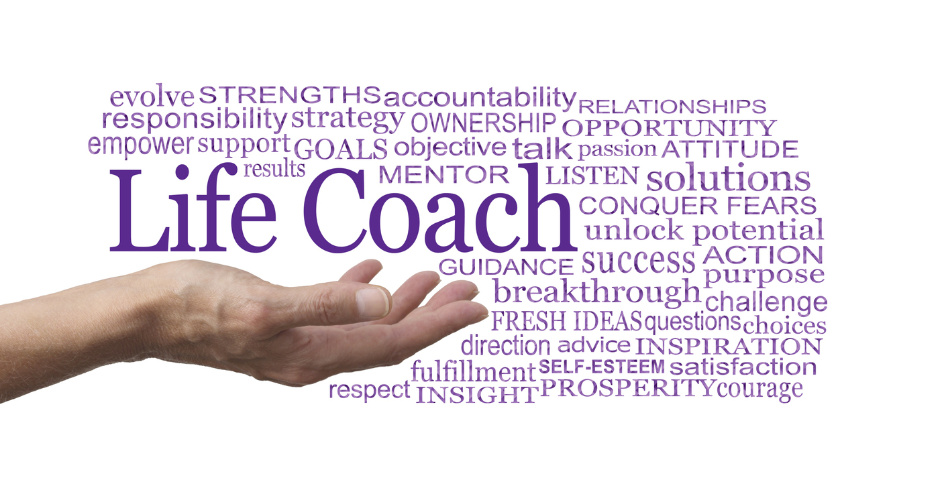
We just need an Agile Mindset

Slide 23

Any Agile Coaches in the Audience?

Slide 24

How many Agile Coaches does it take to change a light bulb?
Is that a sustainable light bulb?

Slide 25
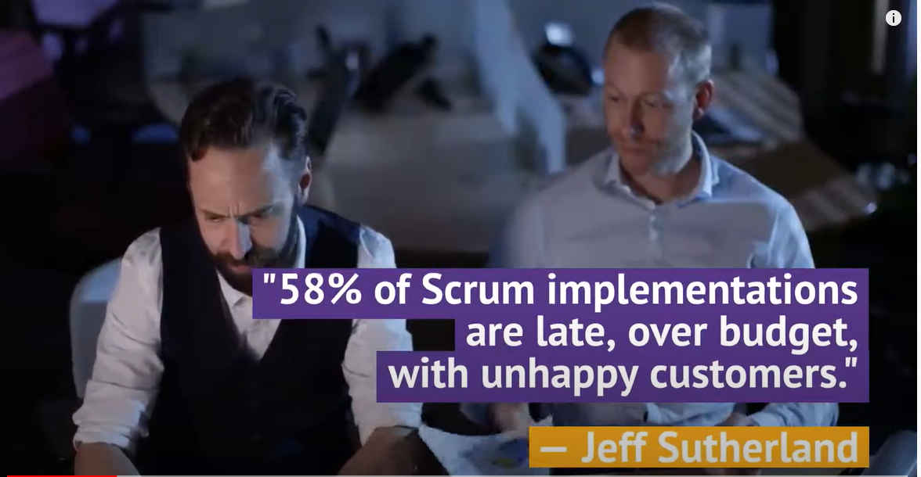

Slide 26

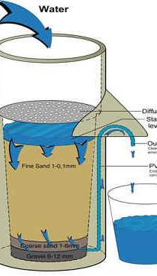

Is your Mindset a Bucket or a Filter?

Slide 27
Declaration of Interdependence for Agile Leadership
We …
  increase return on investment by — making continuous flow of value our focus.
  deliver reliable results by — engaging customers in frequent interactions and shared ownership.
  expect uncertainty and manage for it through — iterations, anticipation and adaptation.
  unleash creativity and innovation by — recognizing that individuals are the ultimate source of value, and creating an environment where they can make a difference.
  boost performance through — group accountability for results and shared responsibility for team effectiveness.
  improve effectiveness and reliability through — situationally specific strategies, processes and practices.”
©2005 David Anderson, Sanjiv Augustine, Christopher Avery, Alistair Cockburn, Mike Cohn, Doug DeCarlo, Donna Fitzgerald, Jim Highsmith, Ole Jepsen, Lowell Lindstrom, Todd Little, Kent McDonald, Pollyanna Pixton, Preston Smith and Robert Wysocki.

Slide 28
Lean Decision Filter
Value trumps flow: Expedite at the expense of flow to maximize value.
Flow trumps waste elimination: Increase WIP if required to maintain flow, even though it will add waste.
Eliminate waste to improve efficiency: Do not pursue economy of scale.

Slide 29

Discovery has Value of Information

Slide 30

Does Kanban go down with the Ship?
SS Agile
Kanban

Slide 31
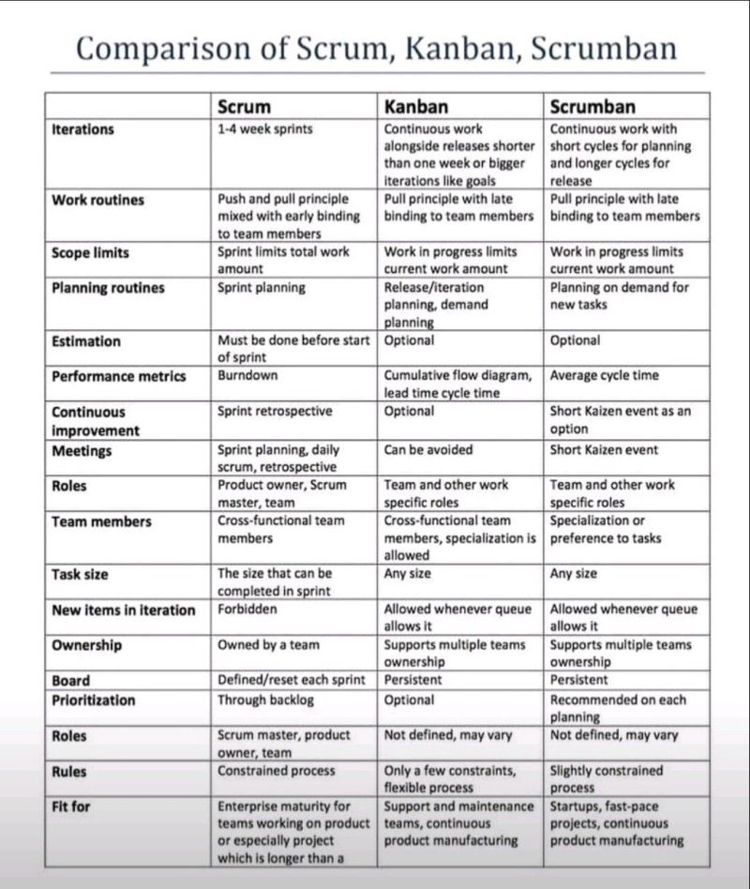
Wrong
Wrong
Wronger
Scrum Lens

Slide 32
Kanban is not a process delivery framework
Kanban is not just a board
Kanban is not something you install
Kanban is not a transformation
Any Kanban vs. Scrum comparison makes no sense
Kanban is a management method for improving the delivery of knowledge work using evolutionary change starting from where you are today
While not a transformation, Kanban can be quite transformational
Kanban is an unframework

Slide 33

Start with what you do now
Add Kanban principles and practices on top of your existing process or framework
Kanban is NOT a Process Framework!
Kanban IS a method for managing and improving knowledge work service delivery through evolutionary change
Existing Process or Framework

Slide 34

Kanban can save your Agile boat!

Slide 35
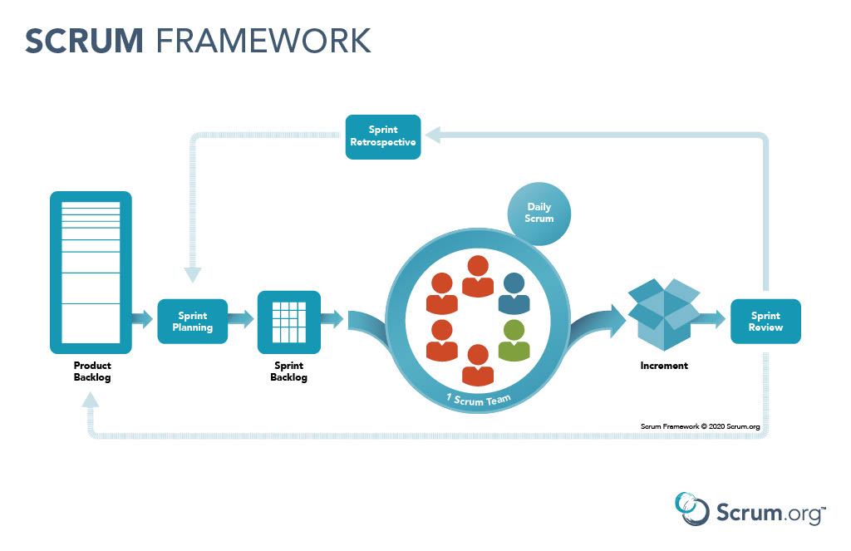
Start with what you do now

Slide 36
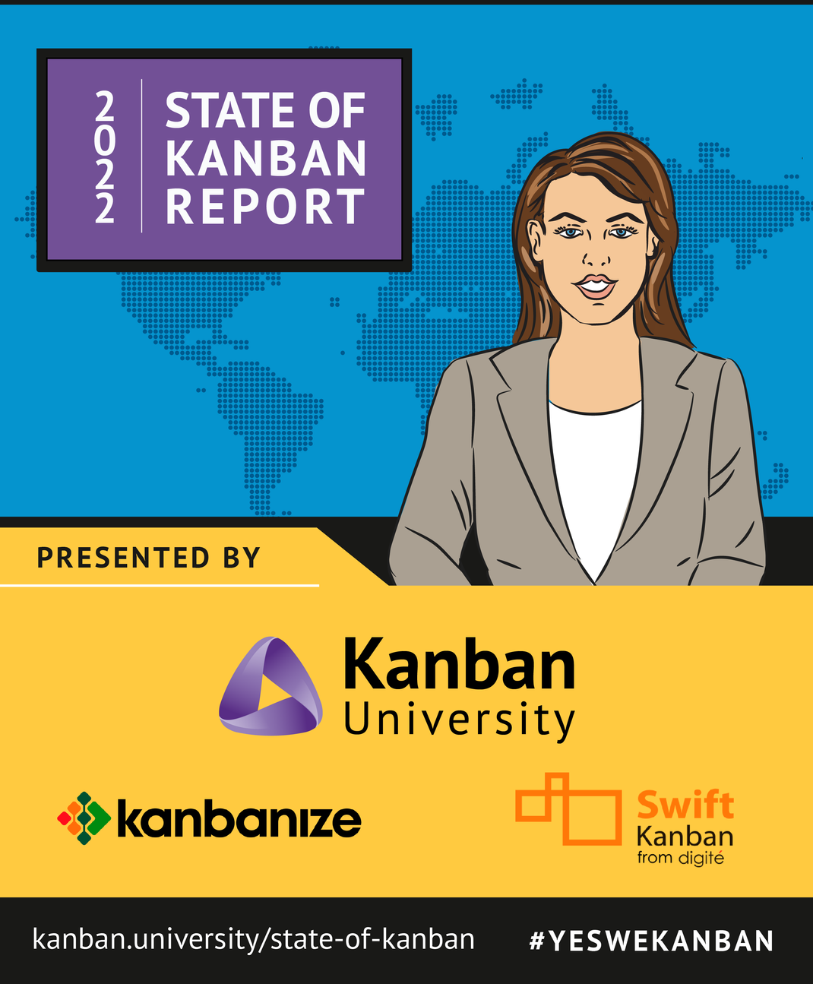

Slide 37
State of Kanban 2022

Slide 38
Kanban Maturity Model at Vanguard
78% improvement (time to deliver) in approximately 90 days!
Scrum Stall

Slide 39
Kanban Maturity Model at Vanguard
78% improvement (time to deliver) in approximately 90 days!

Slide 40
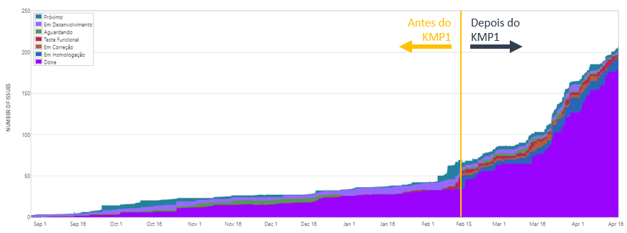
Kanban Impact at Accenture Brazil
What happens when you learn how to properly design and build a Kanban System? You evolve (fast).

Slide 41

KANBAN ON

Slide 42
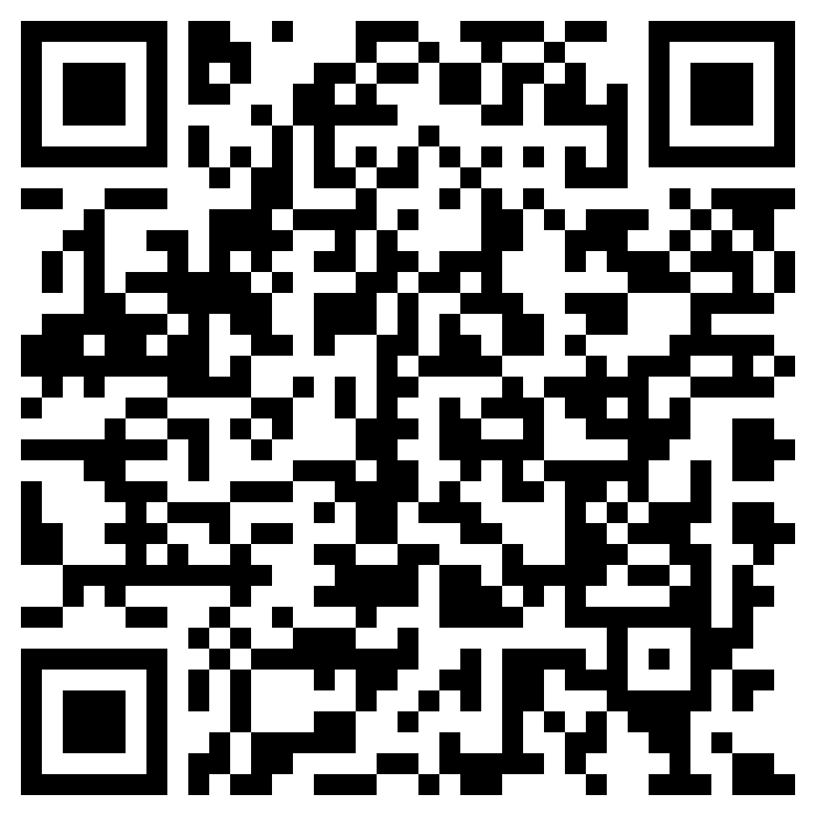
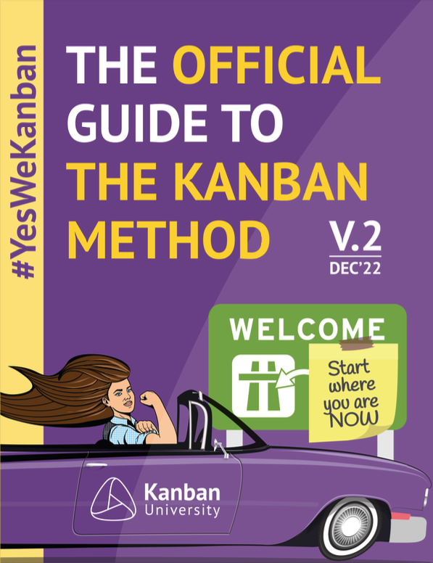
Official Guide To The Kanban Method
Copyright © 2022 Kanban University

Slide 43
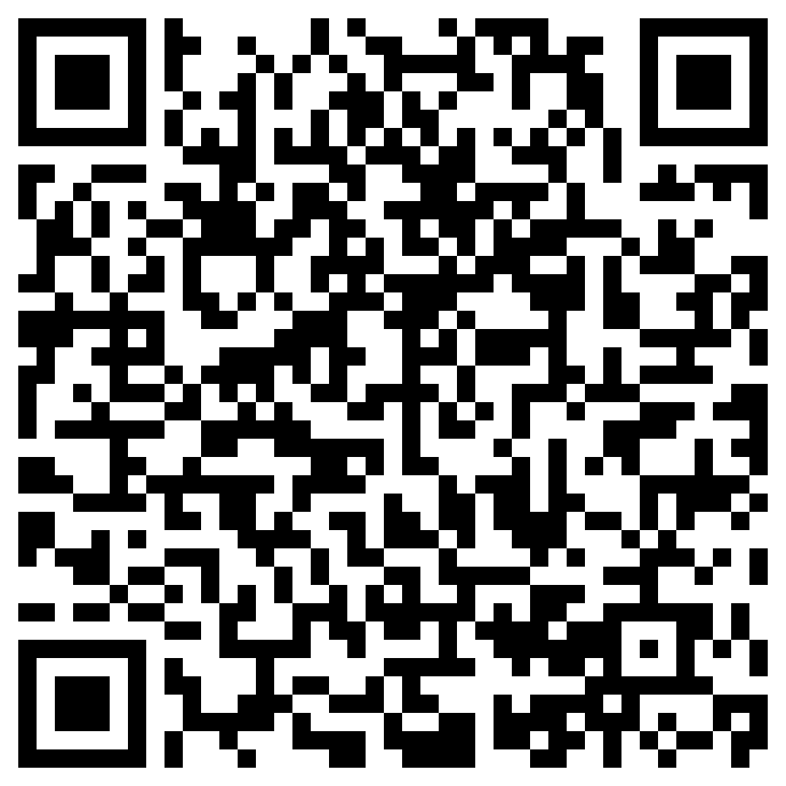
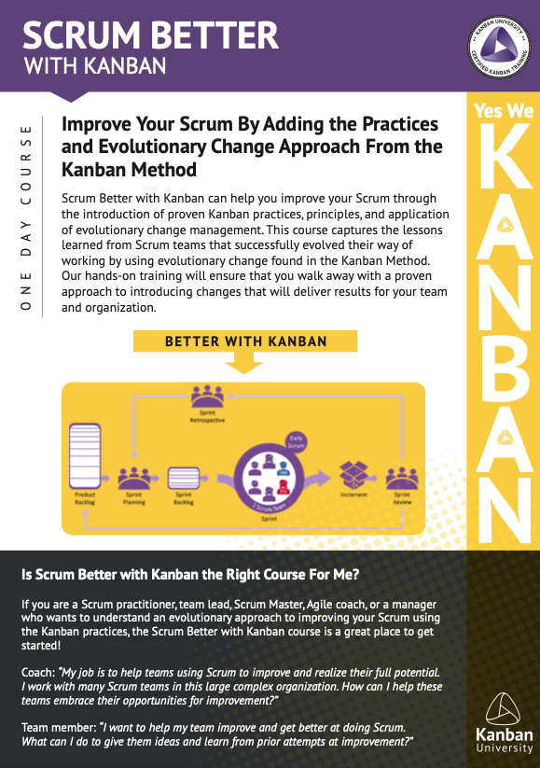
Scrum Better with Kanban Course
Copyright © 2022 Kanban University
Notes:
1 full day or 2 half day training experience
Great for individuals who have used Scrum and some or no Kanban at all
Excellent for new as well as very skilled Scrum practitioners
Individual team members, team leads, Scrum Masters, coaches, and anyone responsible for supporting a team using the Scrum Framework

Slide 44

Is Agile Dead Yet?
Evolutionary Change
Todd Little
Chairman
Kanban University

