Slide 1

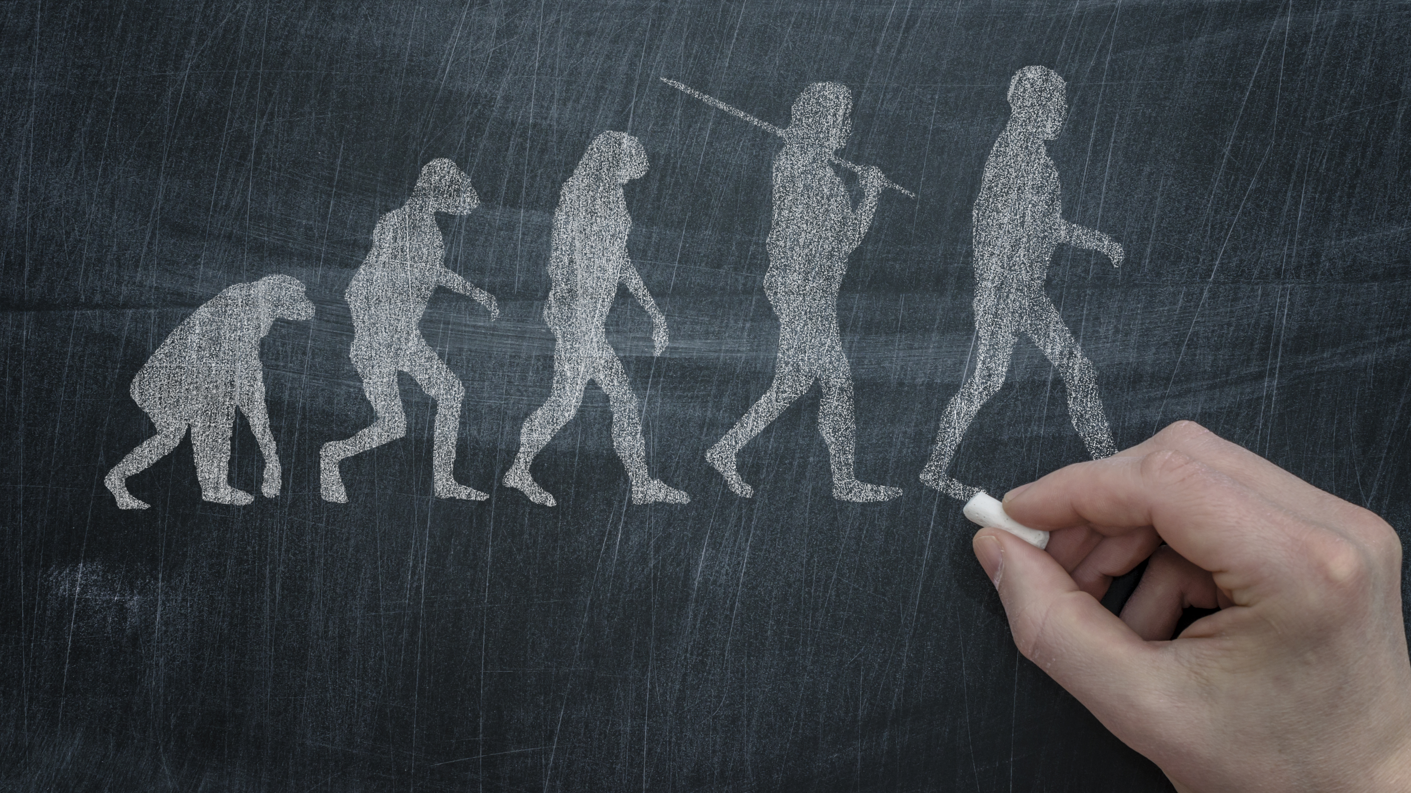
Managed Evolutionary Change
The Foundation of the Kanban Method
Todd Little
Chairman, Kanban University

Slide 2
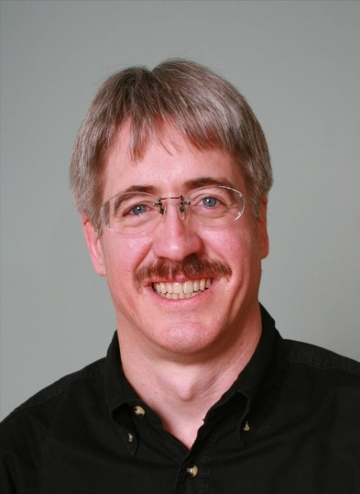
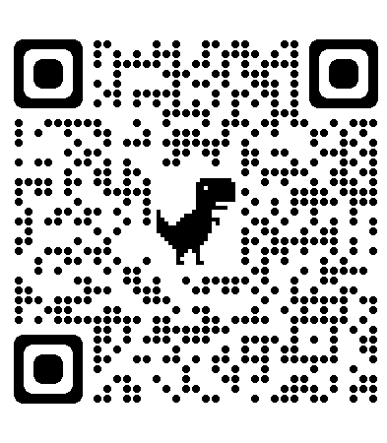
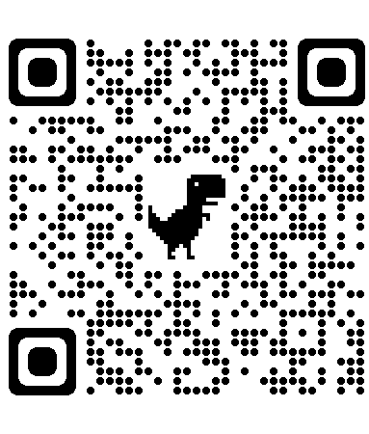
Todd Little
Chairman, Kanban University
linkedin.com/in/toddelittle/

Slide 3

Outcomes from Agile Transformations
Agile worked for us, and we continue to get better. | Agile helped a bit, but we haven’t gotten much better lately.
Agile has been a disaster. | Agile didn’t really help, but didn’t really hurt either.

Slide 4
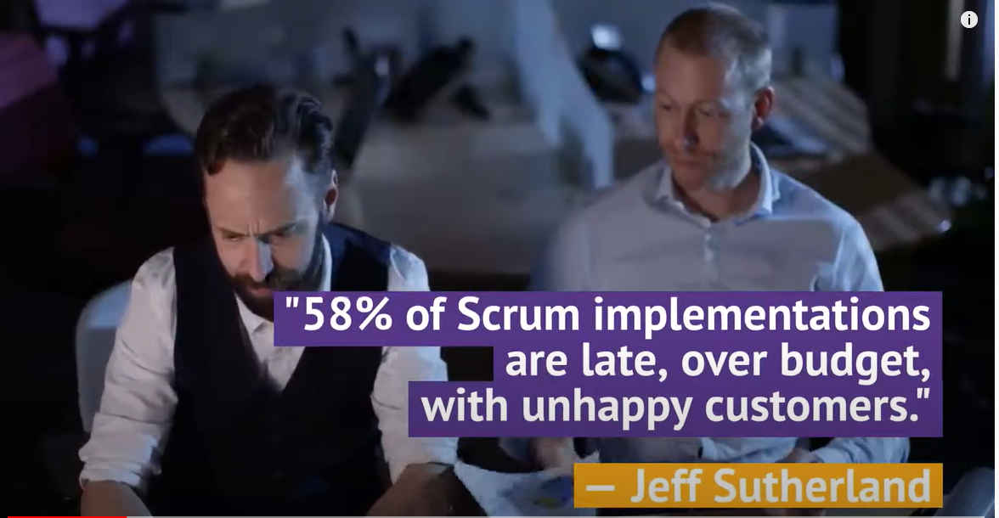

Slide 5

Traditional Transformation is an A to B Process
Future process is defined / designed in advance
Current
Process
Transform
Future
Process
Notes:
Traditional change management assumes you can plan a specific change goal and jump to it
Traditional change is an A to B process. A is where you are now. B is a destination. B is either defined (from a methodology definition) or designed (by tailoring a framework).
To get from A to B, a change agency* will guide a transition initiative to install destination B into the organization.
*either an internal SEPG or external consultants
* Value stream mapping, ** Theory of Constraints Thinking Processes

Slide 6

Start with what you do now
Add Kanban principles and practices on top of your existing process or framework
Kanban is NOT a Process Framework!
Kanban IS a method for managing and improving knowledge work service delivery through evolutionary change
Existing Process or Framework

Slide 7
Evolutionary Change is Humane

Slide 8
Two types of Evolution
Darwinism / Gradualism
Punctuated Equilibrium
Evolution generally occurs uniformly and by the steady and gradual transformation of whole lineages.
This is what most people associate with “evolution.”
In response to rapidly changing environmental conditions there is a rapid burst of evolution – it is changing a whole lot in a very short amount of time.
Notes:
“lineage” : blood lines, ascendents
More about punctuated equilibrium:
https://evolution.berkeley.edu/more-on-punctuated-equilibrium/

Slide 9
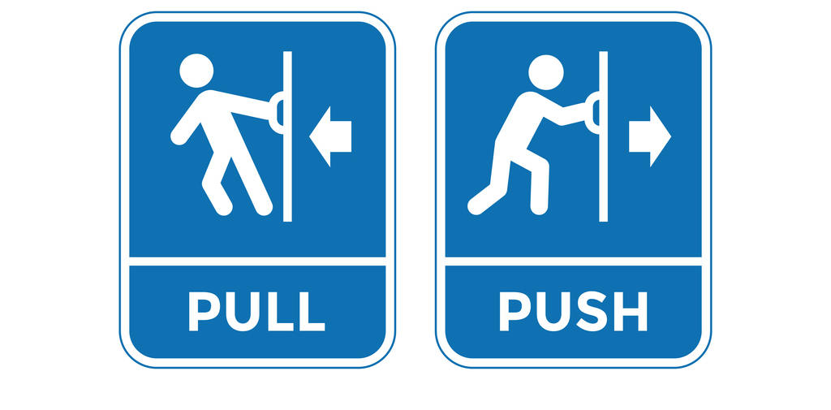
Push vs. Pull

Slide 10

TO CHANGE

Slide 11
“People do not resist change, they resist being changed!”
Peter Senge

Slide 12
Change Management Principles
1
Start where you are!
With Kanban, we start by developing and visualizing a joint understanding of the current way of working.
Then, improvements are identified and implemented.
2
Agree to pursue evolutionary change.
3
Acts of leadership at all levels.
Notes:
Goal: explain the change management principles.
Instructions:
These principles are designed to frame an evolutionary approach to improvement.
Briefly walk through each of these principles.

Slide 13
Change Management Principles
1
Start where you are!
Understanding current processes, as actually practiced. Respecting existing roles, responsibilities, and job titles.
2
Agree to pursue evolutionary change.
Make small changes, only as much as you are comfortable
3
Acts of leadership at all levels.
Get comfortable being a bit uncomfortable
Notes:
Goal: explain the change management principles using a slightly different perspective
Instructions:
Start with what you do now! We mean it. If you are currently doing Scrum, then great. We’re going to start with your Scrum and look to improve it through….
Evolutionary change , which means that you only make small changes that you are comfortable with, but
Acts of leadership might make you or team members uncomfortable, so get used to being just a bit uncomfortable.

Slide 14



Evolutionary change formula
Areas to consider when planning out evolutionary change.
Leadership
lead
3
Reflection Mechanism
reflect
2
Stressor
stress
1
The Change Potion
Notes:
Goal: Explain that these three components are needed to have evolutionary change take place.
A stressor typically presents itself in the form of a problem. Whereby you feel the pain almost on a daily basis.
One initial goal of reflection is to understand and reflect back your understanding of the stressor. Do you see it clearly. Is the stressor you’ve observed the root cause of something or is it a symptom of an underlying “real” stressor?
Leadership is often performed by anyone willing to take action. Here, we’re looking for who or what action is needed.

Slide 15
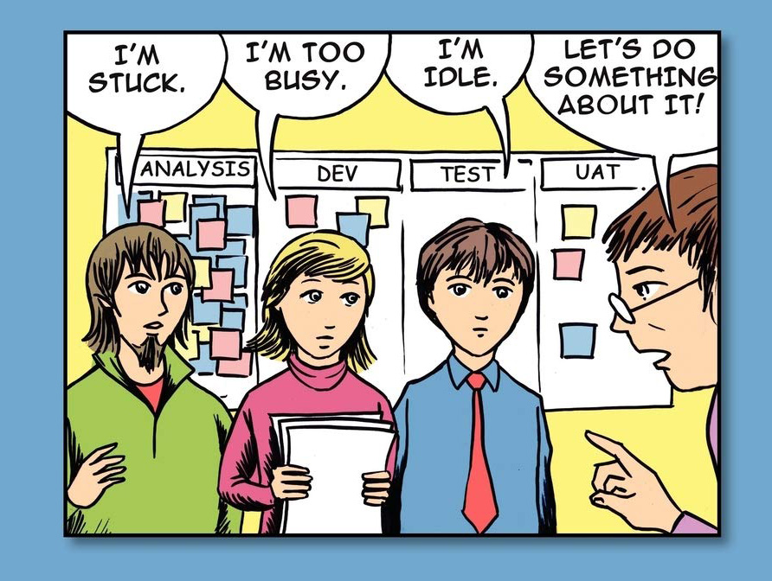

Feedback Loops - Reflection
Feedback
Mechanisms
Feedback
Loop
Communication
Meetings
Board
Acts of
Leadership
Reports and
Metrics
Notes:
Assess this organization – what ML? What problems?

Slide 16
Feedback without action
is not a feedback loop.
Notes:
Goal: to emphasize that one needs to act in order to close a feedback loop.

Slide 17
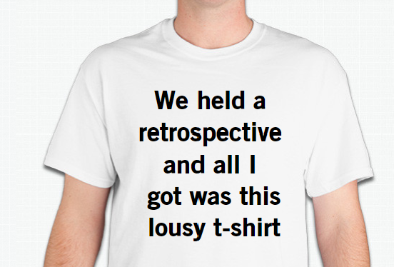
Feedback Loop?

Slide 18

Don’t leave it to chance: MANAGED Evolution
Only mutate that which isn’t working well. Preserve that which is.
Notes:
VERY IMPORTANT closing remark.
Like a crazy scientist, mixing stuff.
See Jurassic world evolution park.
The KCP comes with an agenda!

Slide 19
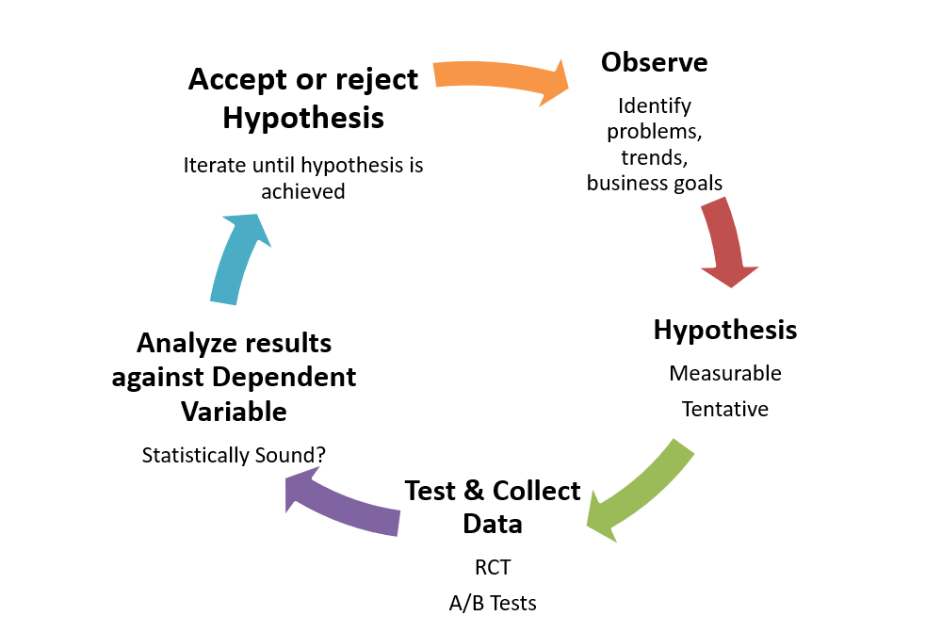
The Scientific Method

Slide 20
Improve collaboratively, evolve experimentally
Reflect on the problem
Explore solutions
Evaluate difficulty and resistance
Design experiment
Evaluate Fitness
Run Experiment
It Hurts
No longer hurts
Notes:
Goal: When reflecting on the problem, you’re digging deeper. Attempting to find the cause of the problem.
Call out that every step has a feedback loop in itself and can take you back one or more steps in this iterative process.

Slide 21

It Hurts
Here is what hurt for my team.
we receive mixed or conflicting messages from different team members
Feeling isolated in our individual tasks without a clear view of the bigger picture
We’re lacking feedback
Environment is "down" too much and too long
sprint scope keeps changing
Voicing concerns are being largely ignored
Software engineers push work onto the testers and expect immediate feedback?
Testing takes way too long!
we're constantly set up for failure with goals that are unrealistic
our sprint goals aren't clear, and it's like we're shooting in the dark
Notes:
Goal: “It Hurts” is stated as an outcome pain. Note how Rosie worked with her team to pull out the painful outcomes they were feeling.
They then selected “using the bolts” which pains were really worth looking into more.

Slide 22
Improve collaboratively, evolve experimentally
Reflect on the problem
Explore solutions
Evaluate difficulty and resistance
Design experiment
Evaluate Fitness
Run Experiment
It Hurts
No longer hurts
Notes:
Goal: When reflecting on the problem, you’re digging deeper. Attempting to find the cause of the problem.
Call out that every step has a feedback loop in itself and can take you back one or more steps in this iterative process.

Slide 23
Reflecting on the problems
we're constantly set up for failure with goals that are unrealistic
Poor goal setting
Inadequate resources
Stakeholders make promises before we see them
Our metrics are misaligned
We dug deeper behind the pains and found the following causes.
Sprint scope keeps changing
Lack of clear vision
Too much unplanned work
Discover things in the middle of the Sprint
Testing takes way too long!
QA is overloaded
Too many defects
Test automation isn’t in place
Weak definition of done
Notes:
Goal: Explain “Reflect on the Problem” is looking a bit deeper into possible cause.
The weak definition of done is why we have too many defects.

Slide 24
Improve collaboratively, evolve experimentally
Reflect on the problem
Explore solutions
Evaluate difficulty and resistance
Design experiment
Evaluate Fitness
Run Experiment
It Hurts
No longer hurts
Notes:
Goal: Explain that once you’ve got a few problems to look at, it’s a great time to start thinking about solutions.
Call out that every step has a feedback loop in itself and can take you back one or more steps in this iterative process.

Slide 25
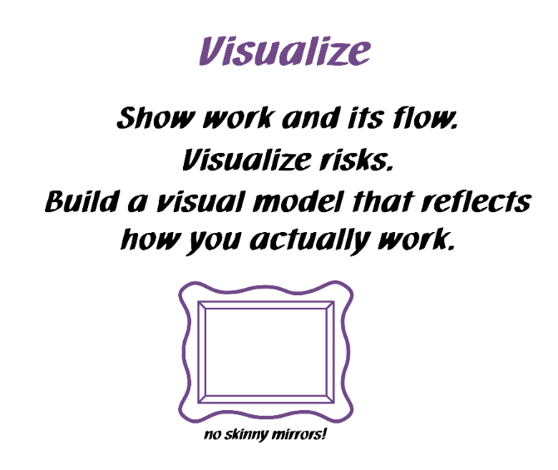
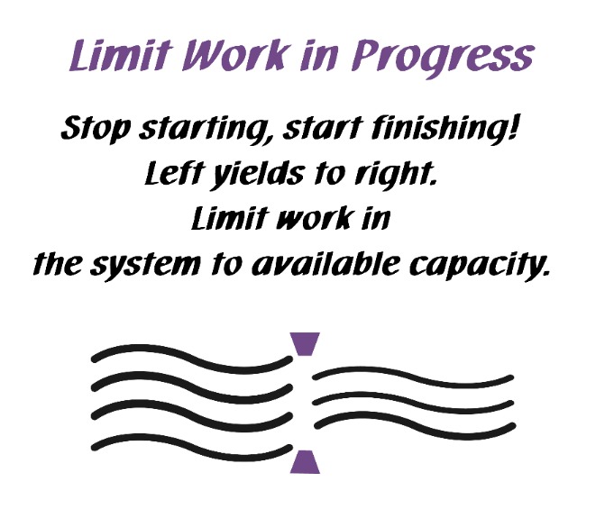
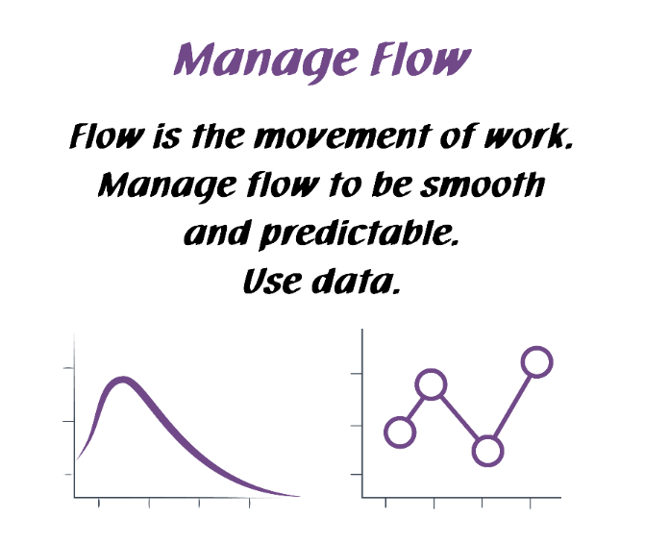
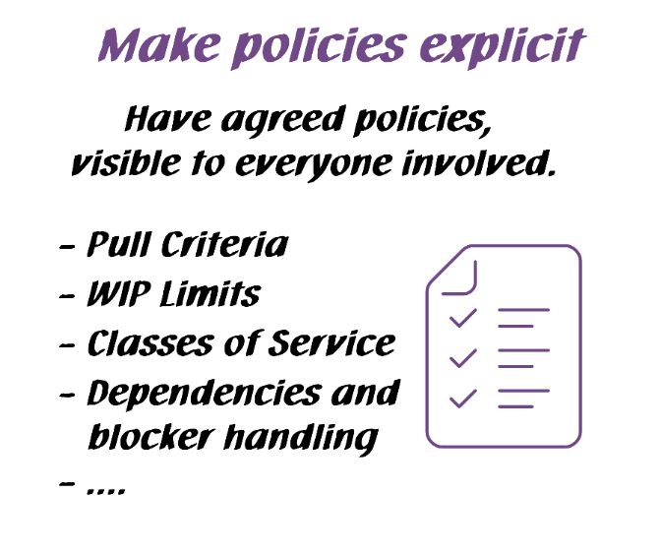
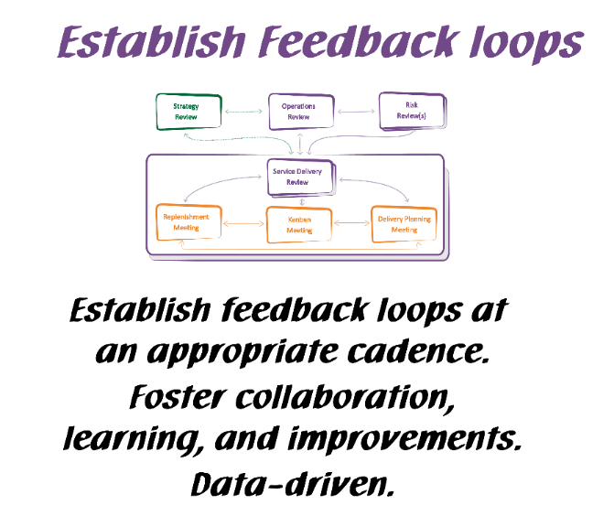
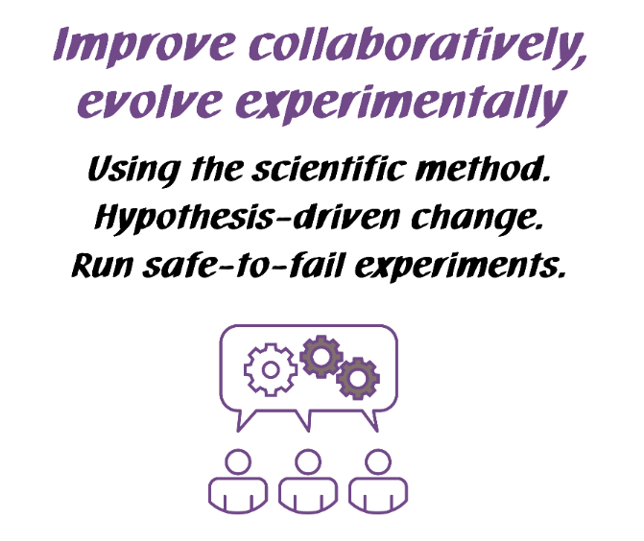
Kanban General Practices
Notes:
Walk the class through the Kanban practices.
There are 6 General Practices in the Kanban Method. [Walk briefly through each of the 6 Practices. See David Anderson’s blog at http://www.djaa.com/principles-general-practices-kanban-method if you want help with how to explain]
Instead of using this slide, you can also create a flipchart with similar info etc.
You might revise this after the simulation.

Slide 26
The Scrum Teams’ ideas
Problem
Cause
Ideas
Sprint scope keeps changing
Too much unplanned work
Use a WIP limit
Agree on a policy for how on handle unplanned work
Visualize the unplanned work in a swim lane
Testing takes way too long!
Weak definition of done
Rewrite definition of done after looking into it more
Enforce definition of done
easy
difficult
Testing takes way too long!
QA is overloaded
Expand the workflow to show visualize what QA is focusing on
Establish a WIP limit of one test per tester
Implement automated testing
Hire more staff
Notes:
Goal: Explain how Rosie’s team started generating ideas. Any idea was a good idea at this time.
She didn’t want to constrain things. She wanted as many crazy and good ideas on the table. She knew she wanted to think through the ideas later but not now.

Slide 27
Improve collaboratively, evolve experimentally
Reflect on the problem
Explore solutions
Evaluate difficulty and resistance
Design experiment
Evaluate Fitness
Run Experiment
It Hurts
No longer hurts
Notes:
Goal: Now that we have some potentially good ideas, we’re going to evaluate them.
Call out that every step has a feedback loop in itself and can take you back one or more steps in this iterative process.

Slide 28

Water flows around the rock
“be like water”
the rock represents resistance
Official Licensed Material, Copyright © 2024 Kanban University
28
Notes:
Goal: Explain the concept in this slide using the information below.
A key teaching in Bruce Lee’s philosophy adapted from Taoism, is "to be like water".
Water flows around the rock.
The rock represents resistance - in fighting, the resistance is from the opponent.
In Kanban, the rock represents resistance to change.

Slide 29

Water becomes the cup
?
We can’t be agile unless we change the culture!
Agile needs to adapt to culture as much as culture needs to adapt to agile.

Slide 30
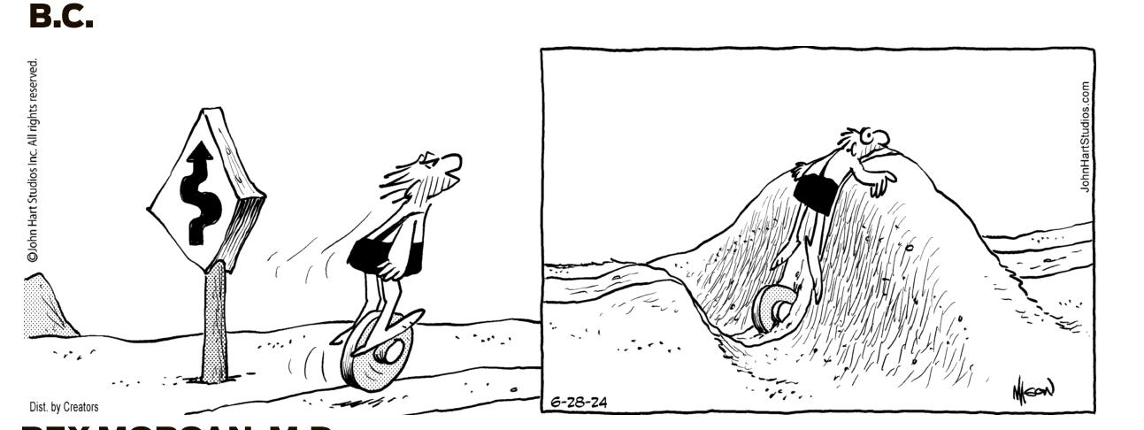
Why Around the Rocks?

Slide 31
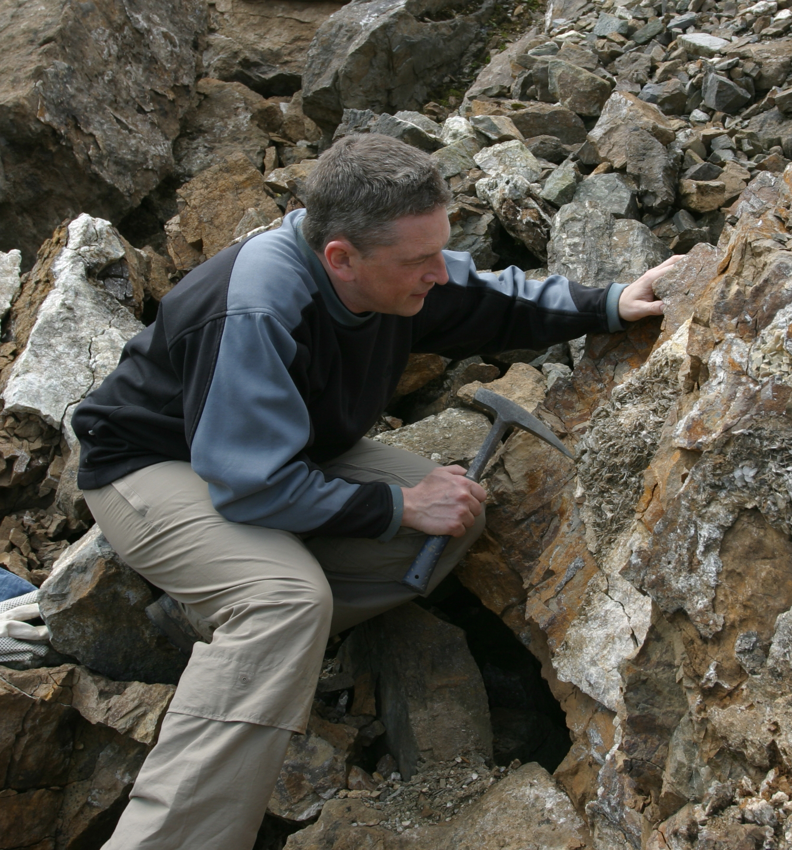

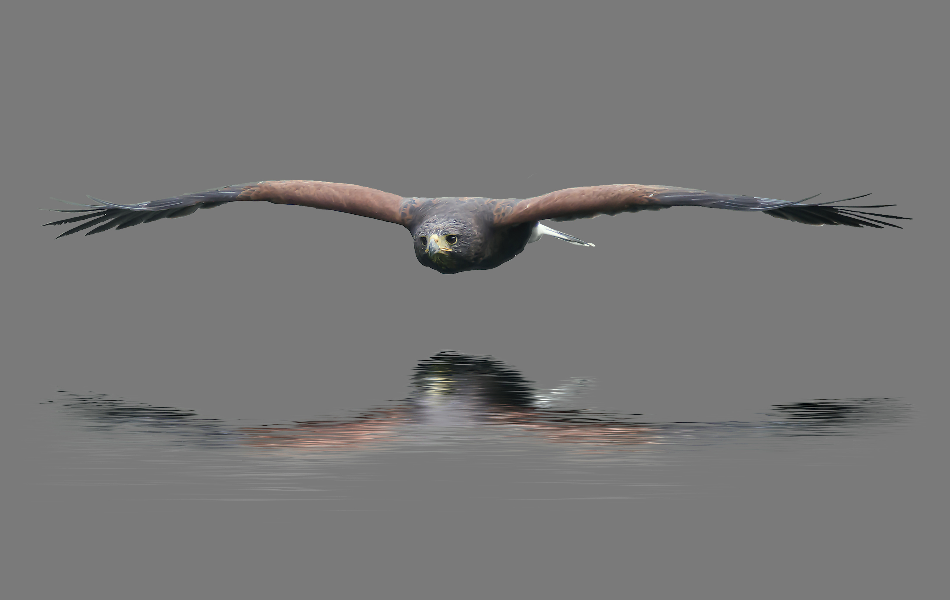
Around the rocks in real life
Under the radar
Break it down
Run experiments

Slide 32
Be like water
Attributes for an idea
Resistance from people
Technical difficulty
Ability to influence
Who will resist your idea? How much? A little or a lot?
How hard is your idea from a technical perspective? Really easy?
Does it require iterations to learn and then put it into place (e.g., hard work)?
How much autonomy do you or your team have to put the idea into place without consulting others?
32
Notes:
Goal: Orient the students to these three attributes for an idea.
These will be used to assess their ideas.

Slide 33
Deeper Dive into Resistance
 | Disagree | Pain
Resistance to the Problem | I don’t agree that is a problem, or don’t think it is important | I actually benefit from the problem
Resistance to the Solution | I don’t agree that the proposed solution will work, or I have a better solution | The solution harms me
Resistance to the Implementation | I don’t agree with how you propose to implement the solution, or I have a better implementation | The implementation harms me

Slide 34
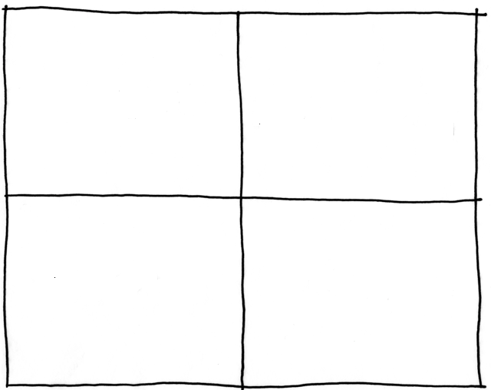
Be like water
Low
Straight
ahead
Assist
Resistance from people
Technical difficulty
Around
the rocks
Defer
High
Low
High
Ability to influence
Notes:
Goal: Orient students to this grid. It should map back to what you’ve previously taught.

Slide 35
Be like water
Rewrite definition of done after looking into it more
Expand the workflow to show visualize what QA is focusing on
Low
Assist
Straight
ahead
Establish a WIP limit of one test per tester
Resistance from people
Technical difficulty
Enforce definition of done
Hire more staff
Around
the rocks
Defer
Implement automated testing
High
Low
High
Ability to influence
35
Notes:
Goal: Describe how Rosie used this grid with her team to assess their ideas.
The green ones indicate they are going to give them a try as an experiment.

Slide 36
Improve collaboratively, evolve experimentally
Reflect on the problem
Explore solutions
Evaluate difficulty and resistance
Design experiment
Evaluate Fitness
Run Experiment
It Hurts
No longer hurts
Notes:
Goal: Now that ideas are in place for one cause, the next step is to put together the design.
Call out that every step has a feedback loop in itself and can take you back one or more steps in this iterative process.

Slide 37
The Scrum Team’s experiment
We believe that if we …
Expand the workflow to show visualize what QA is focusing on
Rewrite definition of done after looking into it more
Establish a WIP limit of one test per tester
Rosie’s team felt they were comfortable taking on all three of these experiments at the same time.
Your team may want to choose one at a time. That’s OK!
We will be able to address …
Testing takes way too long!
Notes:
Goal: Explain that by using a few or more ideas to solve just one problem is effectively the beginning of hypothesis driven change.
It’s worth calling out that Rosie’s team spent some time observing their problems first before coming to these ideas and hypothesis.

Slide 38
Improve collaboratively, evolve experimentally
Reflect on the problem
Explore solutions
Evaluate difficulty and resistance
Design experiment
Evaluate Fitness
Run Experiment
It Hurts
No longer hurts
Notes:
Goal: Now it’s time to sit, wait, watch, and run the experiment.
Call out that every step has a feedback loop in itself and can take you back one or more steps in this iterative process.

Slide 39
Improve collaboratively, evolve experimentally
Options to consider
Do we roll back a change if it’s not fit?
Even if the pain is there, do we want to keep the change and try something new?
If the pain is gone, we want to explore for another pain.
If there doesn’t appear to be an obvious pain, congratulations! But don’t get complacent. Kanban Maturity Model offers approaches for continued improvements.
Reflect on the problem
Explore solutions
Evaluate difficulty and resistance
Design experiment
Evaluate Fitness
Run Experiment
It Hurts
No longer hurts
Notes:
Goal: When you evaluate fitness, your solution either:
Solved the problem, so it no longer hurts, a new hurt arises.
Did not solve the problem, it still hurts.
Call out that every step has a feedback loop in itself and can take you back one or more steps in this iterative process.

Slide 40
Evolutionary Change
Future maturity
is emergent
Evaluate Fitness
Evaluate Fitness
Evaluate Fitness
Evaluate Fitness
Roll forward
Evaluate Fitness
Roll back
Initial Maturity
Evolving Maturity
Notes:
Kanban uses evolutionary change which makes small steps and evaluates the results. Some changes are rolled back.
Traditional change is an A to B process. A is where you are now. B is a destination. B is either defined (from a methodology definition) or designed (by tailoring a framework).
To get from A to B, a change agency* will guide a transition initiative to install destination B into the organization.
*either an internal SEPG or external consultants
Your capability to change is low at the beginning
As you move forward, your capability improves and you can risk more significant change
You change management capability improves as you go
So does your process
Check out the Kanban Maturity Modell if you want to learn more

Slide 41
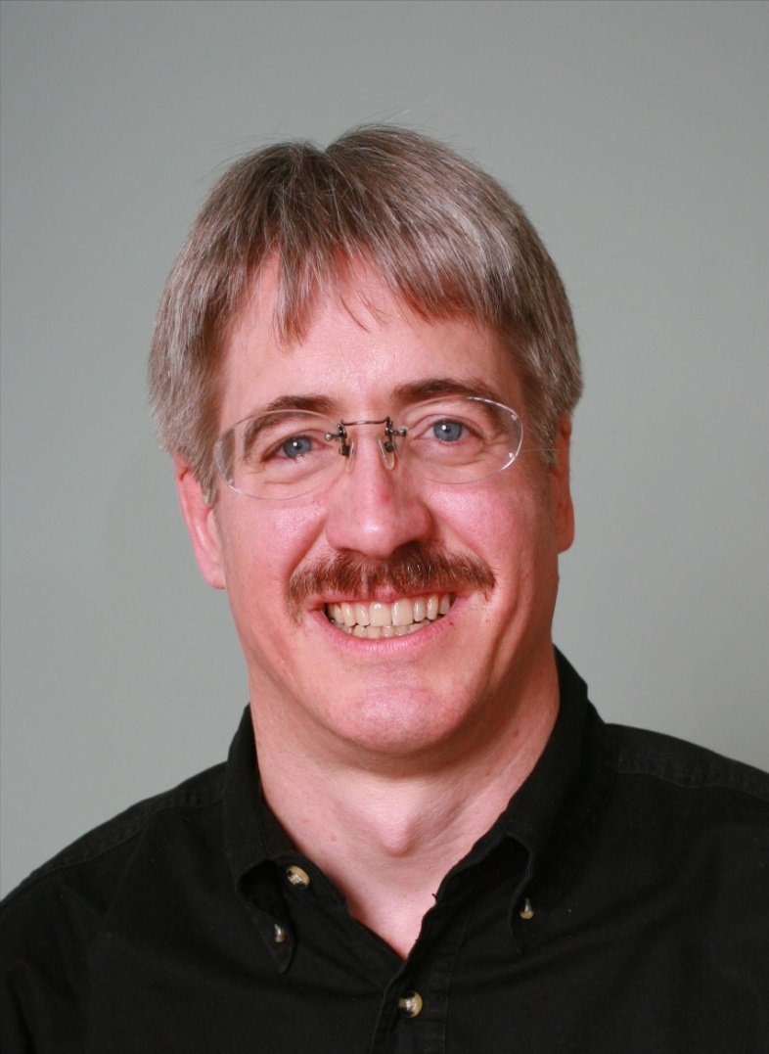
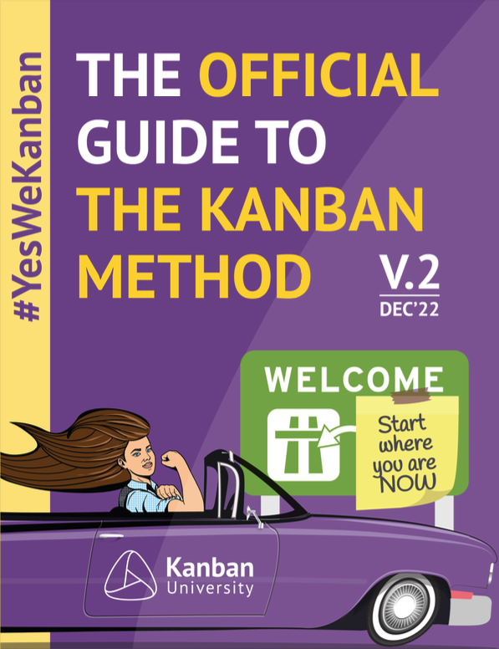
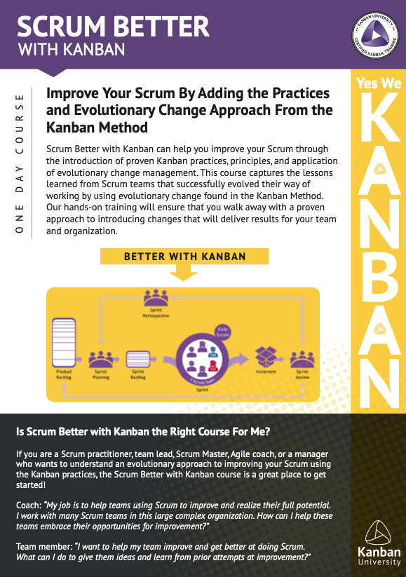
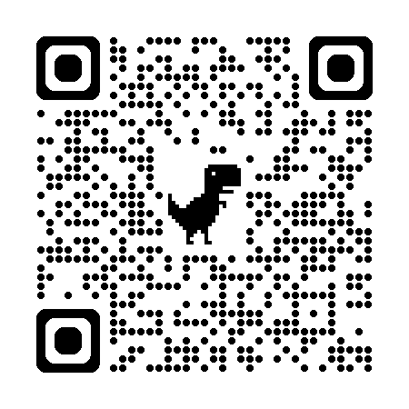
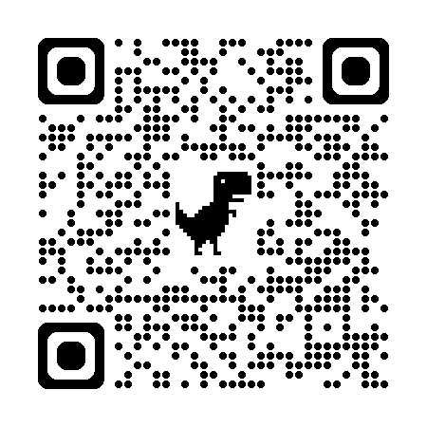
FREE!

