Slide 1

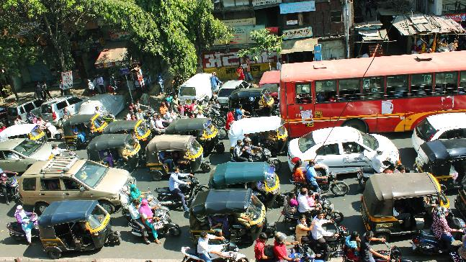
The 8 D’s of Delay
Todd Little
Chairman
Kanban University

Slide 2
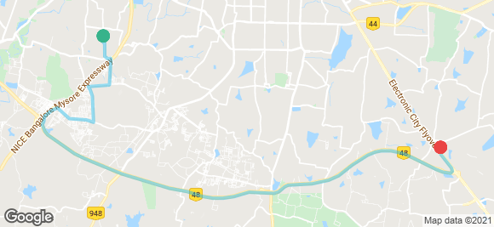

Fun with Uber in Bangalore

Slide 3
Fun with Uber in Bangalore

Slide 4
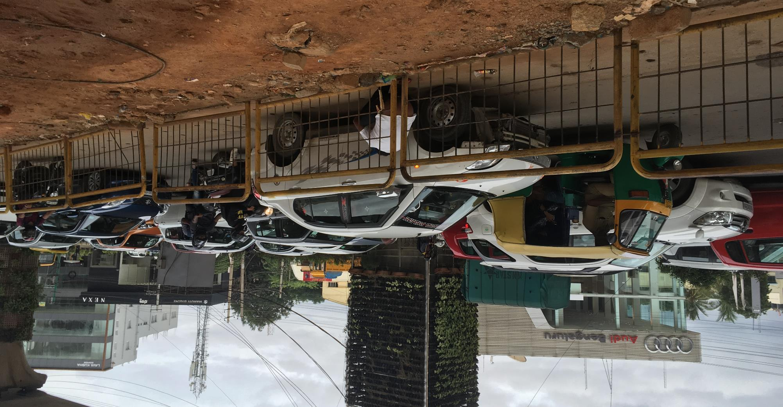

Slide 5
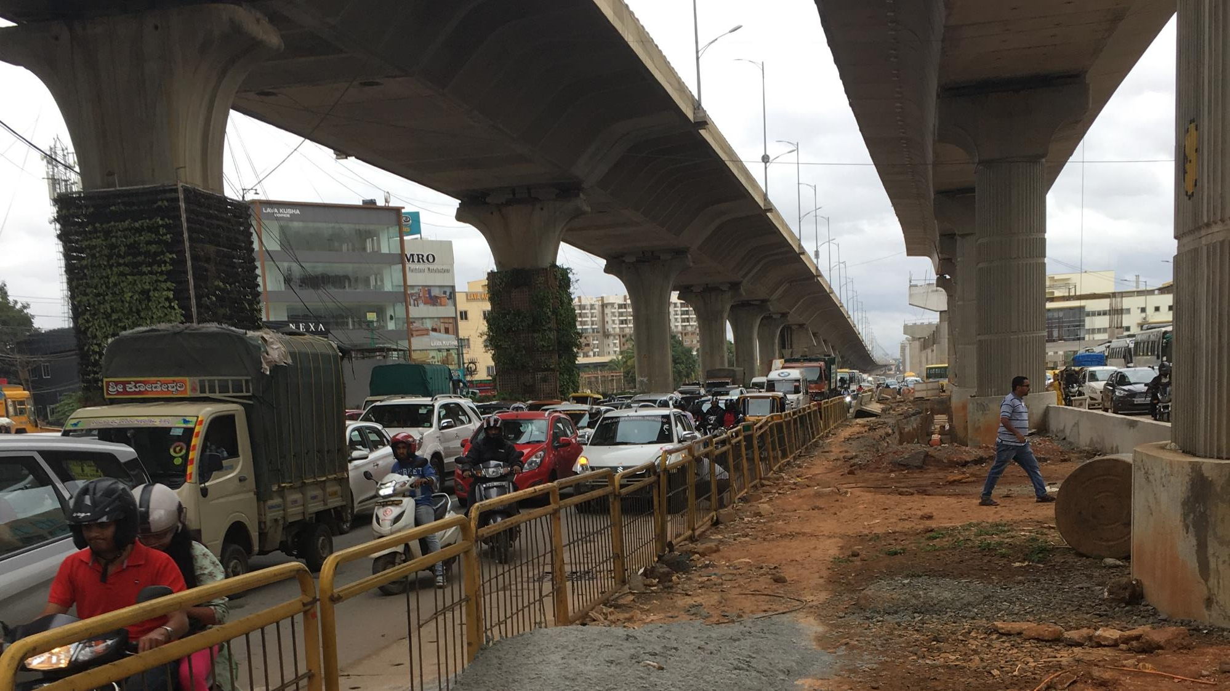

Slide 6
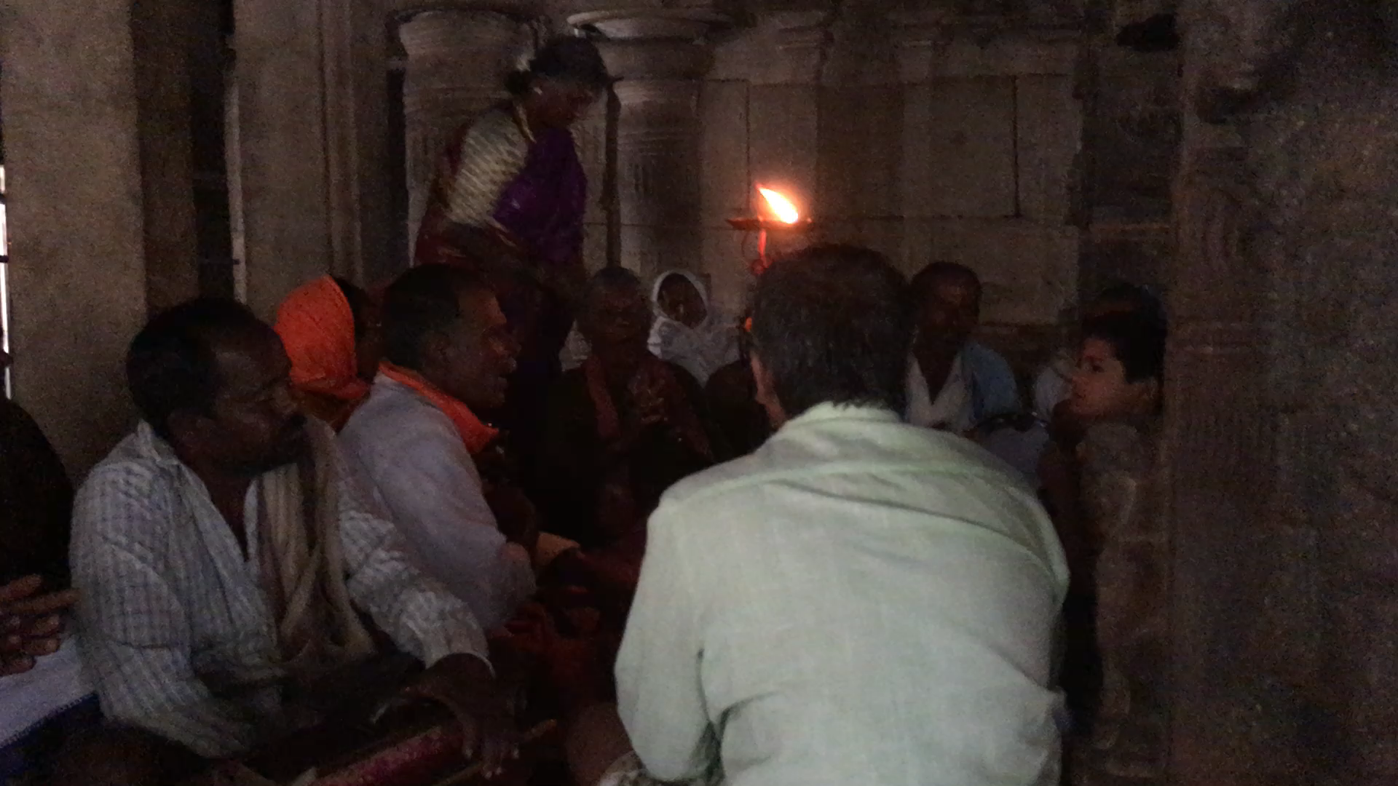

Slide 7
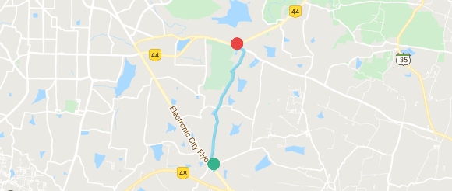
Uber to the rescue

Slide 8
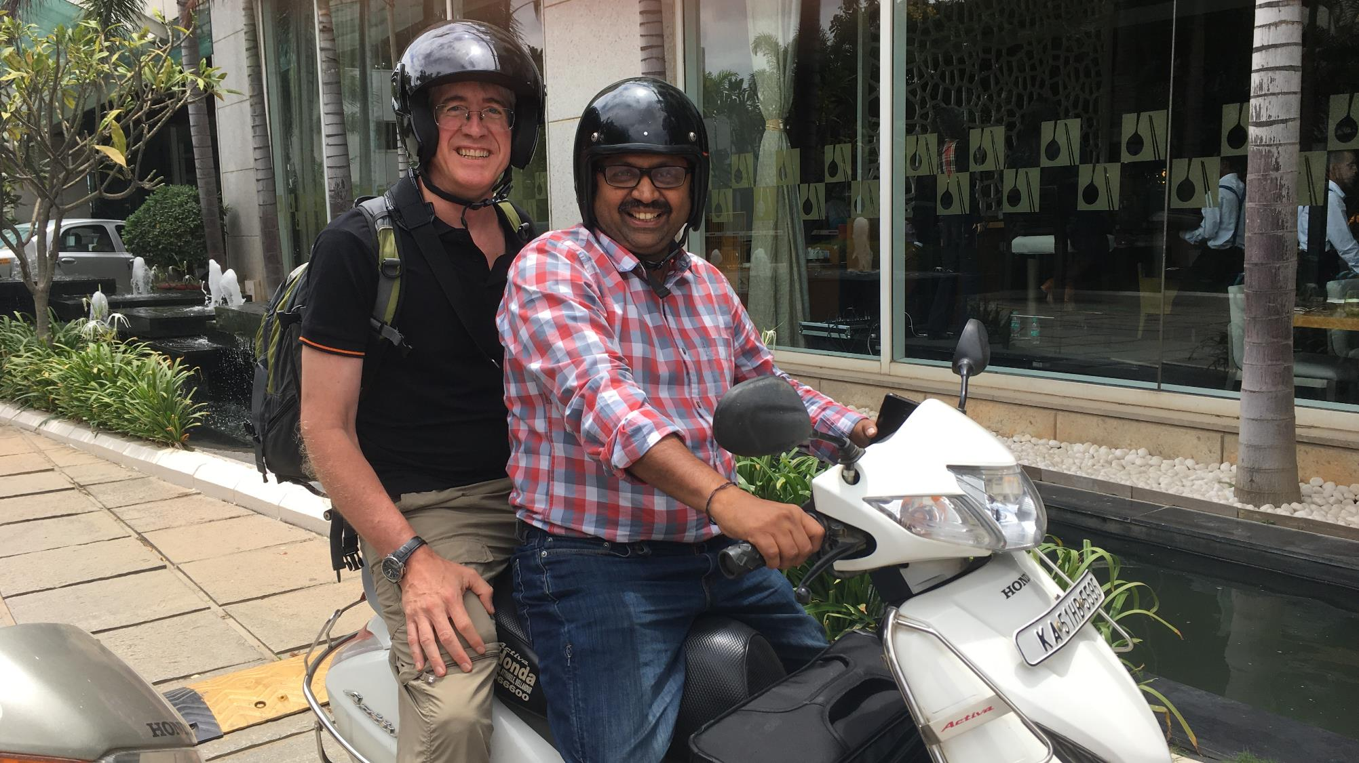

Slide 9
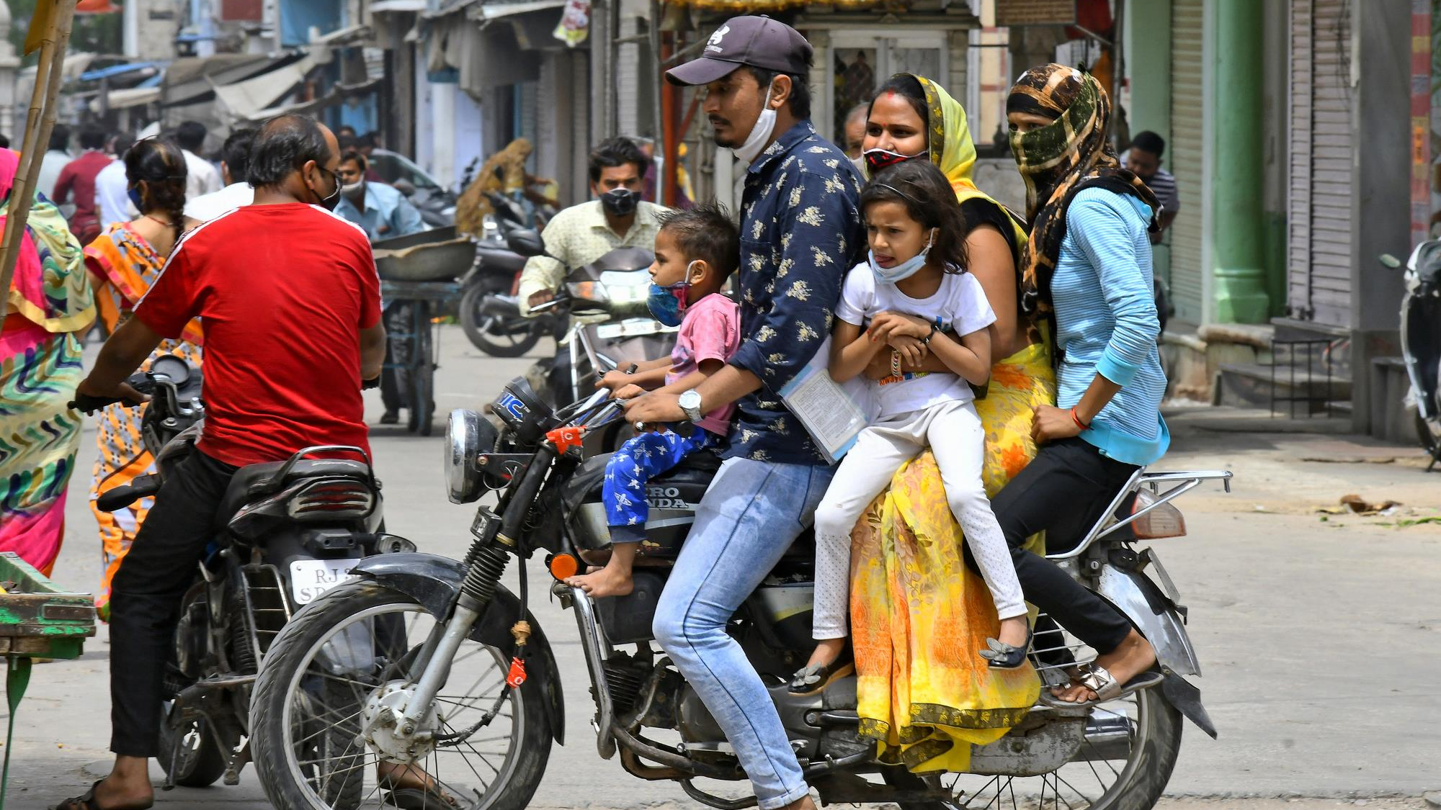

Slide 10
Sources of Delay

Slide 11

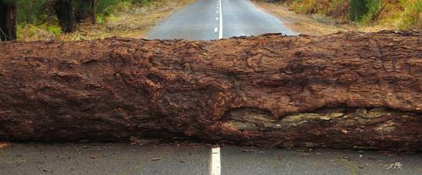
Variation: “Lack of consistency or fixed pattern”
Common Cause (“Chance Cause”)
Special Cause (“Assignable Cause”)
Expected or unsurprising
Inside of typical system parameters, “The noise within the system”
Unexpected and unpredictable
Possible but outside of system control
Notes:
There are different approaches to handling variation. Changing the system to address something that is outside of system control is pointless.
Briefly discuss the example of commuting to work.
We will have a look at the Wimbledon Tennis tournament next where you can apply these categories.
After this, we will have a look at how to deal with these two types of variation.

Slide 12
Sources of delay in Bangalore

Slide 13
8 D’s of Delay

Slide 14





A Service-Oriented Kanban Board
Selected | Develop Concept |  | Drafting |  | Editing |  | Publishing | Done
 | Active | Done | Active | Done | Active | Done
5
5
3
3
$$4$$
$$∞$$
Policies
…
…
…
Policies
…
…
…
Policies
…
…
…
Policies
…
…
…
Notes:
A kanban system has more detailed and useful information to help us organize and manage work.
Specifically in this image: Stages of a Workflow, WIP limits, policies, blocked work, different ticket colors for different types of articles, a limited input queue

Slide 15
#1: Dawdle (wait in queue)
Selected | Develop Concept |  | Drafting |  | Editing |  | Publishing | Done
 | Active | Done | Active | Done | Active | Done
5
5
3
3
$$4$$
$$∞$$
Notes:
A kanban system has more detailed and useful information to help us organize and manage work.
Specifically in this image: Stages of a Workflow, WIP limits, policies, blocked work, different ticket colors for different types of articles, a limited input queue

Slide 16
#2: Defect
Selected | Develop Concept |  | Drafting |  | Editing |  | Publishing | Done
 | Active | Done | Active | Done | Active | Done
5
5
3
3
$$4$$
$$∞$$
Notes:
A kanban system has more detailed and useful information to help us organize and manage work.
Specifically in this image: Stages of a Workflow, WIP limits, policies, blocked work, different ticket colors for different types of articles, a limited input queue

Slide 17
#3: Discovery/Difficulty
(bigger/harder than we thought)
Selected | Develop Concept |  | Drafting |  | Editing |  | Publishing | Done
 | Active | Done | Active | Done | Active | Done
5
5
3
3
$$4$$
$$∞$$
Notes:
A kanban system has more detailed and useful information to help us organize and manage work.
Specifically in this image: Stages of a Workflow, WIP limits, policies, blocked work, different ticket colors for different types of articles, a limited input queue

Slide 18
#4: Distraction (multitasking)
(see also Deprioritization, Dilly-Dally)
Selected | Develop Concept |  | Drafting |  | Editing |  | Publishing | Done
 | Active | Done | Active | Done | Active | Done
5
5
3
3
$$4$$
$$∞$$
Notes:
A kanban system has more detailed and useful information to help us organize and manage work.
Specifically in this image: Stages of a Workflow, WIP limits, policies, blocked work, different ticket colors for different types of articles, a limited input queue

Slide 19
#5: Dependency
Selected | Develop Concept |  | Drafting |  | Editing |  | Publishing | Done
 | Active | Done | Active | Done | Active | Done
5
5
3
3
$$4$$
$$∞$$
Notes:
A kanban system has more detailed and useful information to help us organize and manage work.
Specifically in this image: Stages of a Workflow, WIP limits, policies, blocked work, different ticket colors for different types of articles, a limited input queue

Slide 20
#6: Decisions
Selected | Develop Concept |  | Drafting |  | Editing |  | Publishing | Done
 | Active | Done | Active | Done | Active | Done
5
5
3
3
$$4$$
$$∞$$
A
B
Notes:
A kanban system has more detailed and useful information to help us organize and manage work.
Specifically in this image: Stages of a Workflow, WIP limits, policies, blocked work, different ticket colors for different types of articles, a limited input queue

Slide 21
#7: Departures
Temporary – vacation, sick
Longer term – resign
Selected | Develop Concept |  | Drafting |  | Editing |  | Publishing | Done
 | Active | Done | Active | Done | Active | Done
5
5
3
3
$$4$$
$$∞$$
Notes:
A kanban system has more detailed and useful information to help us organize and manage work.
Specifically in this image: Stages of a Workflow, WIP limits, policies, blocked work, different ticket colors for different types of articles, a limited input queue

Slide 22

#7: Departures
Temporary – vacation, sick
Longer term – resign
Selected | Develop Concept |  | Drafting |  | Editing |  | Publishing | Done
 | Active | Done | Active | Done | Active | Done
5
5
3
3
$$4$$
$$∞$$
Notes:
A kanban system has more detailed and useful information to help us organize and manage work.
Specifically in this image: Stages of a Workflow, WIP limits, policies, blocked work, different ticket colors for different types of articles, a limited input queue

Slide 23
#8: Derailed?
Selected | Develop Concept |  | Drafting |  | Editing |  | Publishing | Done
 | Active | Done | Active | Done | Active | Done
5
5
3
3
$$4$$
$$∞$$
Notes:
A kanban system has more detailed and useful information to help us organize and manage work.
Specifically in this image: Stages of a Workflow, WIP limits, policies, blocked work, different ticket colors for different types of articles, a limited input queue

Slide 24
But Wait – Did anyone notice the 8d”S”

Slide 25
Scope Creep?
Selected | Develop Concept |  | Drafting |  | Editing |  | Publishing | Done
 | Active | Done | Active | Done | Active | Done
5
5
3
3
$$4$$
$$∞$$
Notes:
A kanban system has more detailed and useful information to help us organize and manage work.
Specifically in this image: Stages of a Workflow, WIP limits, policies, blocked work, different ticket colors for different types of articles, a limited input queue

Slide 26
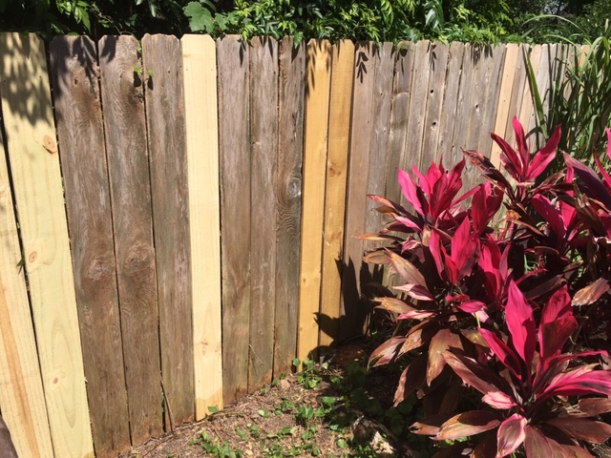
Todd’s Fence Project During COVID

Slide 27
Workflow
Buy lumber | Collect tools | Remove Old Board | Remove nails | Dispose of board | Move boards to saw | Measure board | Saw board | Move Board to Fence | Nail Board

Slide 28
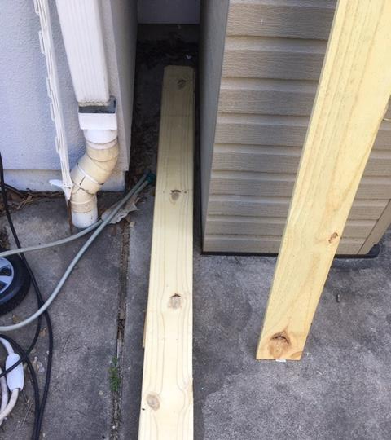
Lumber Storage

Slide 29
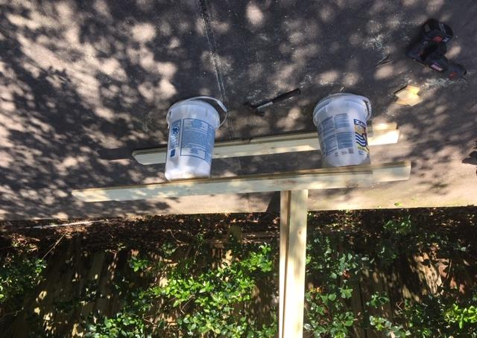
Sawing

Slide 30
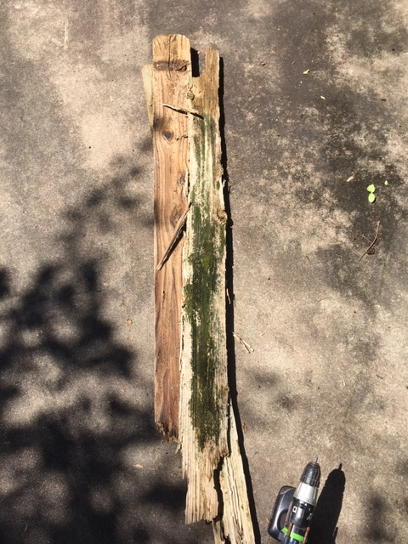
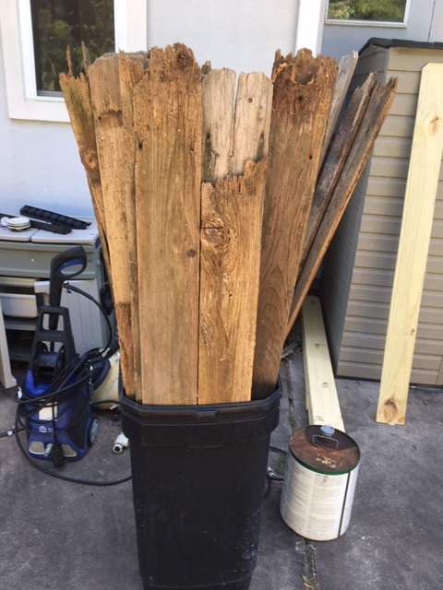
Disposal

Slide 31
Workflow – Batch Sizes
 | Buy lumber | Collect tools | Remove Old Board | Remove nails | Dispose of board | Move boards to saw | Measure board | Saw board | Move Board to Fence | Nail Board
Batch Size | 20 | 1 | 1 | 1 | 1 | 5 | 1 | 2 | 1 | 1
Varies

Slide 32
Workflow – Timings
 | Buy lumber | Collect tools | Remove Old Board | Remove nails | Dispose of board | Move boards to saw | Measure board | Saw board | Move Board to Fence | Nail Board
Batch Size | 20 | 1 | 1 | 1 | 1 | 5 | 1 | 2 | 1 | 1
Time (sec) | 1200 | 300 | 60 | 120 | 60 | 120 | 120 | 30 | 60 | 60
Time for 20 Boards (sec) | 1200 | 300 | 1200 | 2400 | 1200 | 480 | 2400 | 300 | 1200 | 1200
Total time for 20 Boards = 11880 Sec = 3:18 hr

Slide 33
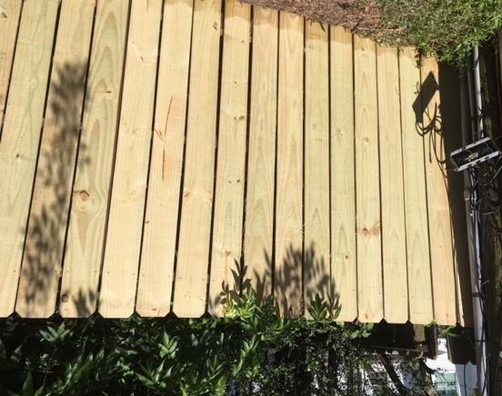
One section completed

Slide 34
But Wait – What about Waits
Actual total time to remove 20 boards and replace just 15 boards was 12600 sec vs. 8985 sec from the calculation. Wait’s going on?

Slide 35
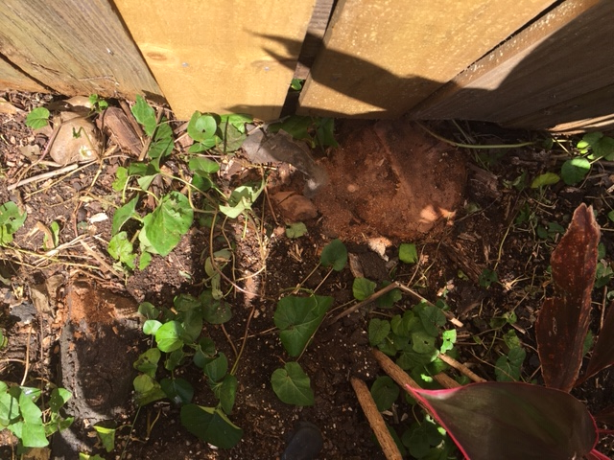
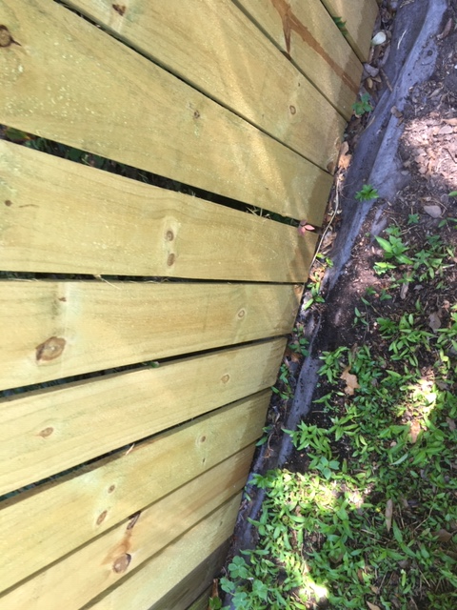
Delay – Need to dig out

Slide 36
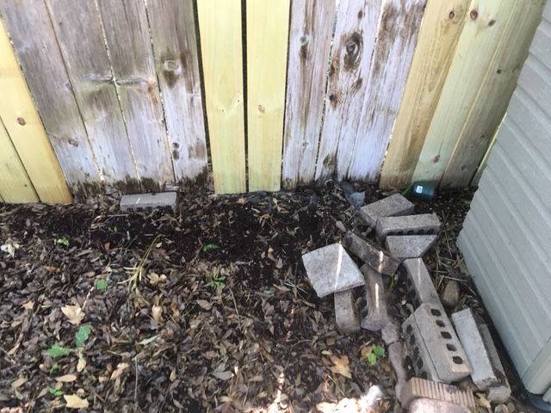
Delay – Dig out with bricks

Slide 37
#3: Discovery/Difficulty
(bigger/harder than we thought)
Selected | Develop Concept |  | Drafting |  | Editing |  | Publishing | Done
 | Active | Done | Active | Done | Active | Done
5
5
3
3
$$4$$
$$∞$$
Notes:
A kanban system has more detailed and useful information to help us organize and manage work.
Specifically in this image: Stages of a Workflow, WIP limits, policies, blocked work, different ticket colors for different types of articles, a limited input queue

Slide 38
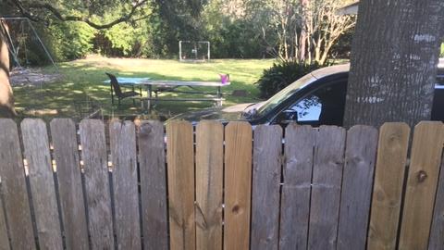
I’m Working on my Fence –
Wait might happen?

Slide 39
#4: Distraction (multitasking)
(see also Deprioritization, Dilly-Dally)
Selected | Develop Concept |  | Drafting |  | Editing |  | Publishing | Done
 | Active | Done | Active | Done | Active | Done
5
5
3
3
$$4$$
$$∞$$
Notes:
A kanban system has more detailed and useful information to help us organize and manage work.
Specifically in this image: Stages of a Workflow, WIP limits, policies, blocked work, different ticket colors for different types of articles, a limited input queue

Slide 40
But Wait – What about Waits
Actual total time to remove 20 boards and replace just 15 boards was 12600 sec vs. 8985 sec from the calculation. Wait’s going on?
Dig dirt away so that I can install new fence properly: 1800 sec
Chat with new neighbor: 1800 sec
Total time = 12585 sec vs. calculated 12600 sec.

Slide 41
Day 2: Replace 5 boards
 | Time
Calculated | 1275
Actual time | 1200

Slide 42
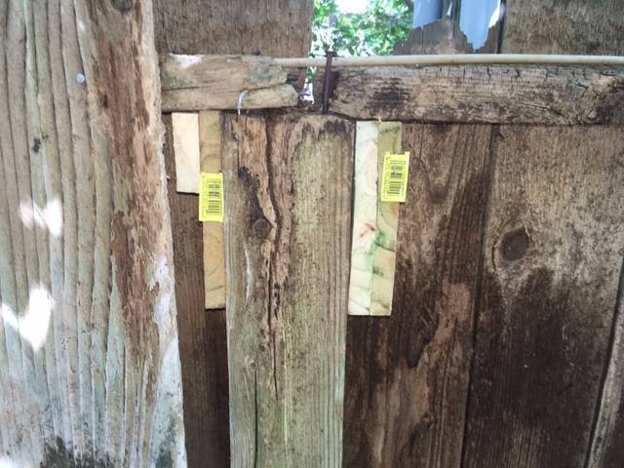
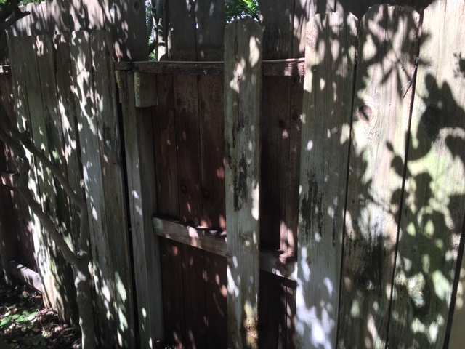
Next Batch: Architecture Issues

Slide 43
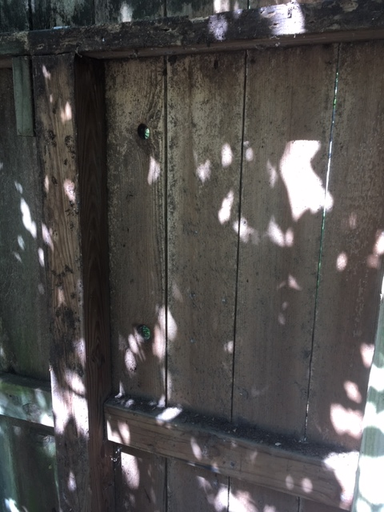
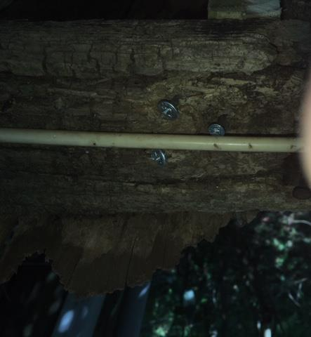
Technical Debt

Slide 44
#3: Discovery/Difficulty
(bigger/harder than we thought)
Selected | Develop Concept |  | Drafting |  | Editing |  | Publishing | Done
 | Active | Done | Active | Done | Active | Done
5
5
3
3
$$4$$
$$∞$$
Notes:
A kanban system has more detailed and useful information to help us organize and manage work.
Specifically in this image: Stages of a Workflow, WIP limits, policies, blocked work, different ticket colors for different types of articles, a limited input queue

Slide 45
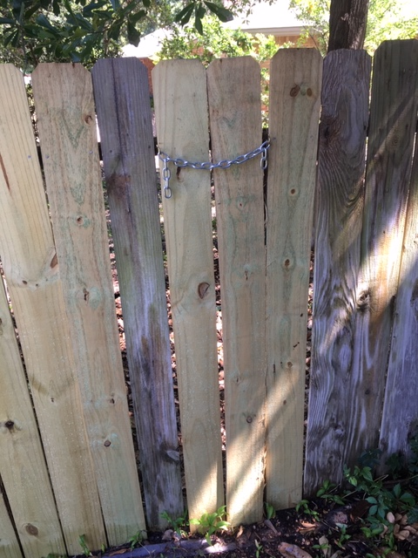
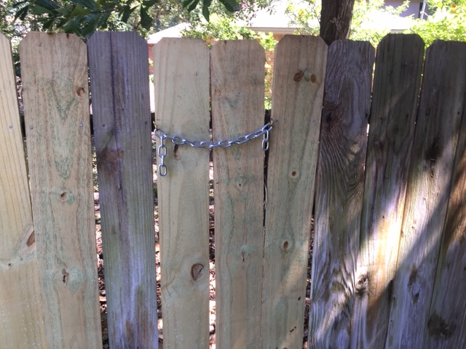
Security Hole

Slide 46
Scope Creep?
Selected | Develop Concept |  | Drafting |  | Editing |  | Publishing | Done
 | Active | Done | Active | Done | Active | Done
5
5
3
3
$$4$$
$$∞$$
Notes:
A kanban system has more detailed and useful information to help us organize and manage work.
Specifically in this image: Stages of a Workflow, WIP limits, policies, blocked work, different ticket colors for different types of articles, a limited input queue

Slide 47
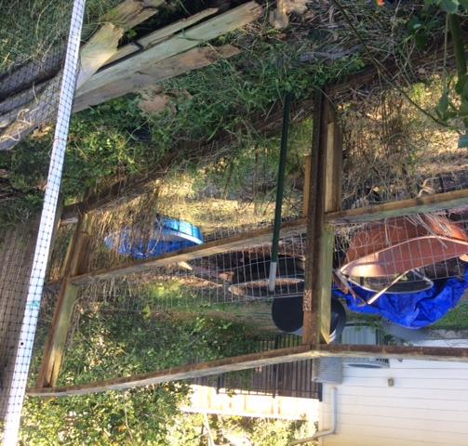
Next phase

Slide 48
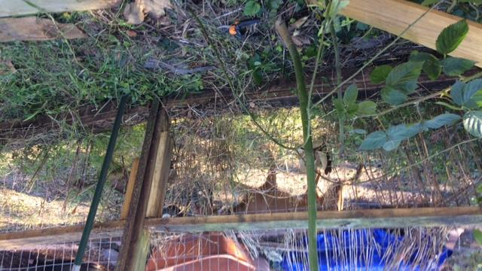
Neighbor

Slide 49
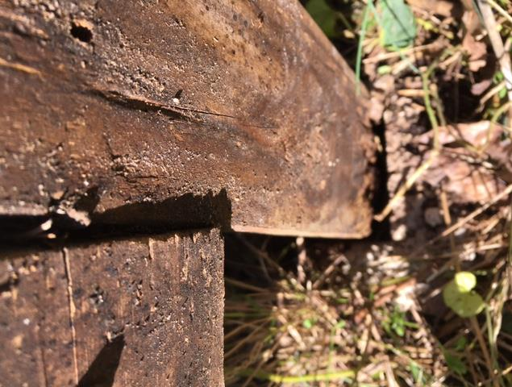
More technical debt

Slide 50
#3: Discovery/Difficulty
(bigger/harder than we thought)
Selected | Develop Concept |  | Drafting |  | Editing |  | Publishing | Done
 | Active | Done | Active | Done | Active | Done
5
5
3
3
$$4$$
$$∞$$
Notes:
A kanban system has more detailed and useful information to help us organize and manage work.
Specifically in this image: Stages of a Workflow, WIP limits, policies, blocked work, different ticket colors for different types of articles, a limited input queue

Slide 51
#6: Decisions
Selected | Develop Concept |  | Drafting |  | Editing |  | Publishing | Done
 | Active | Done | Active | Done | Active | Done
5
5
3
3
$$4$$
$$∞$$
A
B
Notes:
A kanban system has more detailed and useful information to help us organize and manage work.
Specifically in this image: Stages of a Workflow, WIP limits, policies, blocked work, different ticket colors for different types of articles, a limited input queue

Slide 52
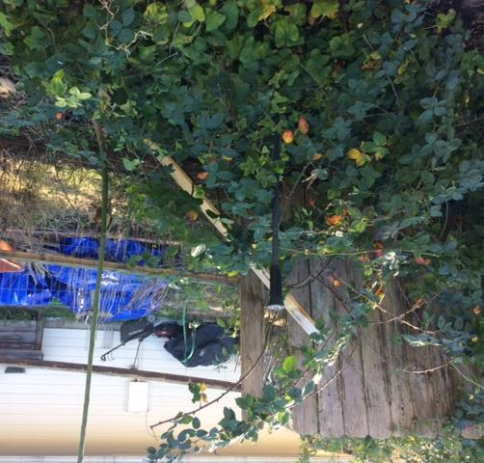
Blackberry Bush

Slide 53
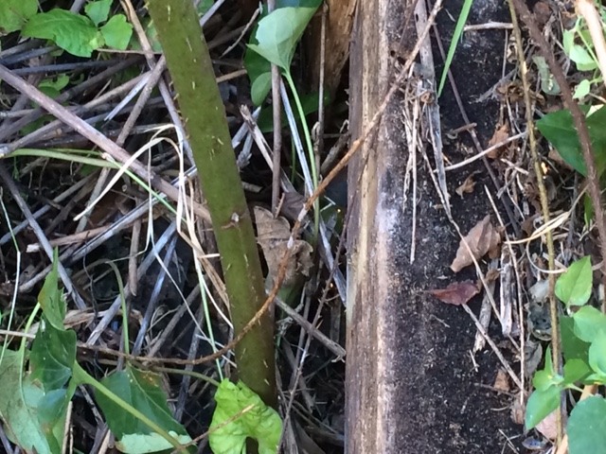
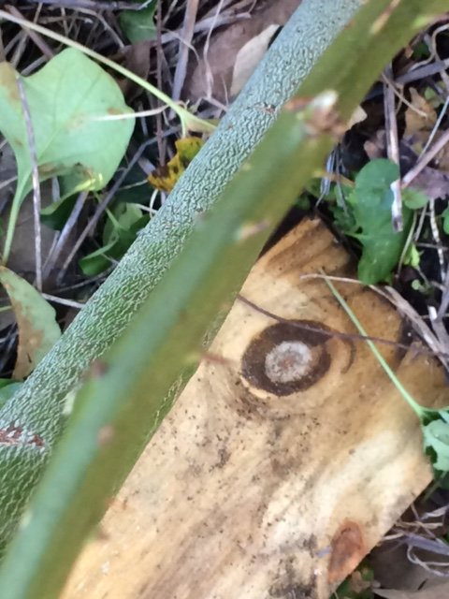
Thorny Issues

Slide 54
#8: Derailed?
Selected | Develop Concept |  | Drafting |  | Editing |  | Publishing | Done
 | Active | Done | Active | Done | Active | Done
5
5
3
3
$$4$$
$$∞$$
Notes:
A kanban system has more detailed and useful information to help us organize and manage work.
Specifically in this image: Stages of a Workflow, WIP limits, policies, blocked work, different ticket colors for different types of articles, a limited input queue

Slide 55
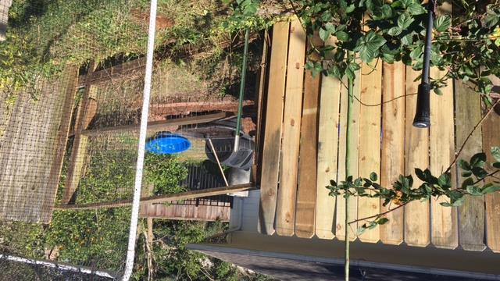
In progress

Slide 56
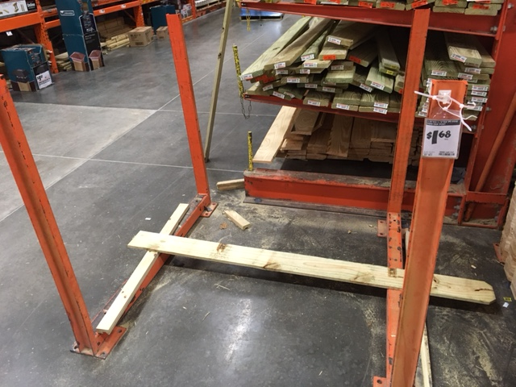
Old Mother Hubbard

Slide 57
#5: Dependency
Selected | Develop Concept |  | Drafting |  | Editing |  | Publishing | Done
 | Active | Done | Active | Done | Active | Done
5
5
3
3
$$4$$
$$∞$$
Notes:
A kanban system has more detailed and useful information to help us organize and manage work.
Specifically in this image: Stages of a Workflow, WIP limits, policies, blocked work, different ticket colors for different types of articles, a limited input queue

Slide 58
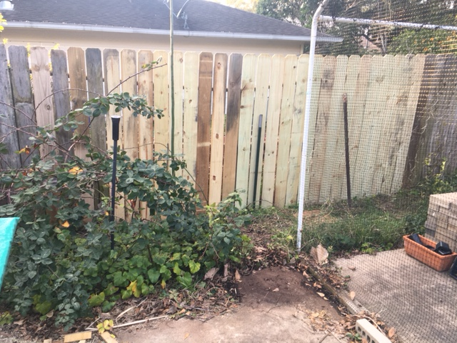
Success!

Slide 59
8 D’s of Delay

Slide 60
#1: Dawdle (wait in queue)
Selected | Develop Concept |  | Drafting |  | Editing |  | Publishing | Done
 | Active | Done | Active | Done | Active | Done
5
5
3
3
$$4$$
$$∞$$
Notes:
A kanban system has more detailed and useful information to help us organize and manage work.
Specifically in this image: Stages of a Workflow, WIP limits, policies, blocked work, different ticket colors for different types of articles, a limited input queue

Slide 61
#2: Defect
Selected | Develop Concept |  | Drafting |  | Editing |  | Publishing | Done
 | Active | Done | Active | Done | Active | Done
5
5
3
3
$$4$$
$$∞$$
Notes:
A kanban system has more detailed and useful information to help us organize and manage work.
Specifically in this image: Stages of a Workflow, WIP limits, policies, blocked work, different ticket colors for different types of articles, a limited input queue

Slide 62
#3: Discovery/Difficulty
(bigger/harder than we thought)
Selected | Develop Concept |  | Drafting |  | Editing |  | Publishing | Done
 | Active | Done | Active | Done | Active | Done
5
5
3
3
$$4$$
$$∞$$
Notes:
A kanban system has more detailed and useful information to help us organize and manage work.
Specifically in this image: Stages of a Workflow, WIP limits, policies, blocked work, different ticket colors for different types of articles, a limited input queue

Slide 63
#4: Distraction (multitasking)
(see also Deprioritization, Dilly-Dally)
Selected | Develop Concept |  | Drafting |  | Editing |  | Publishing | Done
 | Active | Done | Active | Done | Active | Done
5
5
3
3
$$4$$
$$∞$$
Notes:
A kanban system has more detailed and useful information to help us organize and manage work.
Specifically in this image: Stages of a Workflow, WIP limits, policies, blocked work, different ticket colors for different types of articles, a limited input queue

Slide 64
#5: Dependency
Selected | Develop Concept |  | Drafting |  | Editing |  | Publishing | Done
 | Active | Done | Active | Done | Active | Done
5
5
3
3
$$4$$
$$∞$$
Notes:
A kanban system has more detailed and useful information to help us organize and manage work.
Specifically in this image: Stages of a Workflow, WIP limits, policies, blocked work, different ticket colors for different types of articles, a limited input queue

Slide 65
#6: Decisions
Selected | Develop Concept |  | Drafting |  | Editing |  | Publishing | Done
 | Active | Done | Active | Done | Active | Done
5
5
3
3
$$4$$
$$∞$$
A
B
Notes:
A kanban system has more detailed and useful information to help us organize and manage work.
Specifically in this image: Stages of a Workflow, WIP limits, policies, blocked work, different ticket colors for different types of articles, a limited input queue

Slide 66
#7: Departures
Temporary – vacation, sick
Longer term – resign
Selected | Develop Concept |  | Drafting |  | Editing |  | Publishing | Done
 | Active | Done | Active | Done | Active | Done
5
5
3
3
$$4$$
$$∞$$
Notes:
A kanban system has more detailed and useful information to help us organize and manage work.
Specifically in this image: Stages of a Workflow, WIP limits, policies, blocked work, different ticket colors for different types of articles, a limited input queue

Slide 67
#7: Departures
Temporary – vacation, sick
Longer term – resign
Selected | Develop Concept |  | Drafting |  | Editing |  | Publishing | Done
 | Active | Done | Active | Done | Active | Done
5
5
3
3
$$4$$
$$∞$$
Notes:
A kanban system has more detailed and useful information to help us organize and manage work.
Specifically in this image: Stages of a Workflow, WIP limits, policies, blocked work, different ticket colors for different types of articles, a limited input queue

Slide 68
#8: Derailed?
Selected | Develop Concept |  | Drafting |  | Editing |  | Publishing | Done
 | Active | Done | Active | Done | Active | Done
5
5
3
3
$$4$$
$$∞$$
Notes:
A kanban system has more detailed and useful information to help us organize and manage work.
Specifically in this image: Stages of a Workflow, WIP limits, policies, blocked work, different ticket colors for different types of articles, a limited input queue

Slide 69
But Wait – Did anyone notice the 8d”S”

Slide 70
Scope Creep?
Selected | Develop Concept |  | Drafting |  | Editing |  | Publishing | Done
 | Active | Done | Active | Done | Active | Done
5
5
3
3
$$4$$
$$∞$$
Notes:
A kanban system has more detailed and useful information to help us organize and manage work.
Specifically in this image: Stages of a Workflow, WIP limits, policies, blocked work, different ticket colors for different types of articles, a limited input queue

Slide 71
The 8 D’s of Delay
Todd Little
Chairman
Kanban University

