Slide 1
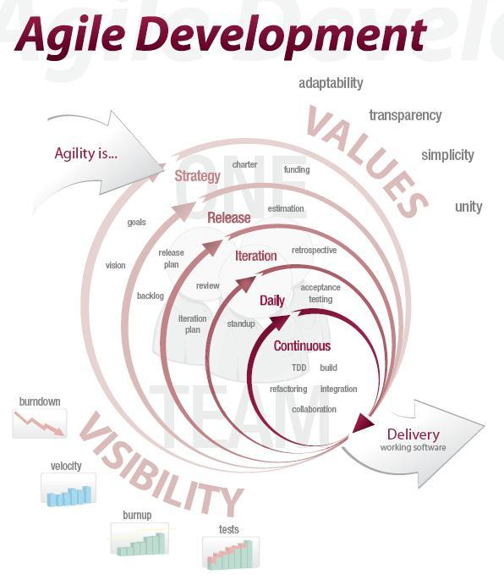
Agile Development @ Landmark
Todd Little

Slide 2

The Idealized Waterfall
Requirements
Design
Develop
Test

Slide 3
Hurricane Rita

Slide 4
Hurricane Rita

Slide 5

The Agile Manifesto–a statement of values
Individuals and interactions
Process and tools
over
Working software
Comprehensive documentation
over
Customer collaboration
Contract negotiation
over
Responding to change
Following a plan
over
Source: www.agilemanifesto.org

Slide 6
Scrum in a Nutshell
24 hours
1-4 weeks
Iteration Backlog
Backlog tasks
Potentially Shippable
Product Increment
Release Backlog

Slide 7
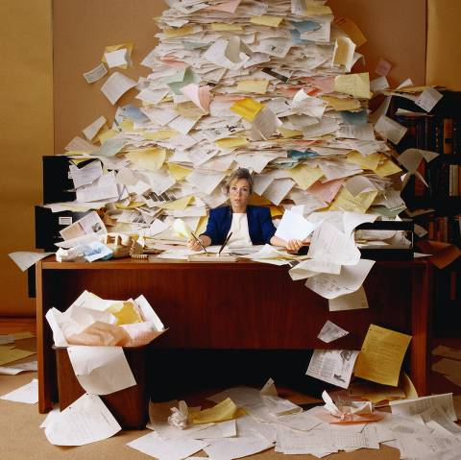

Backlogs and Planning

Slide 8
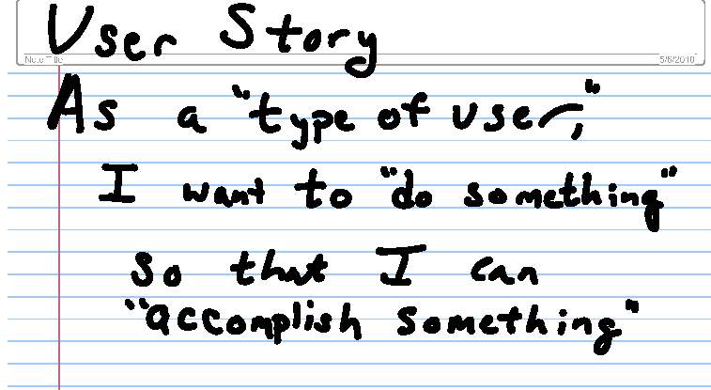
Backlog is a set of “Stories”

Slide 9
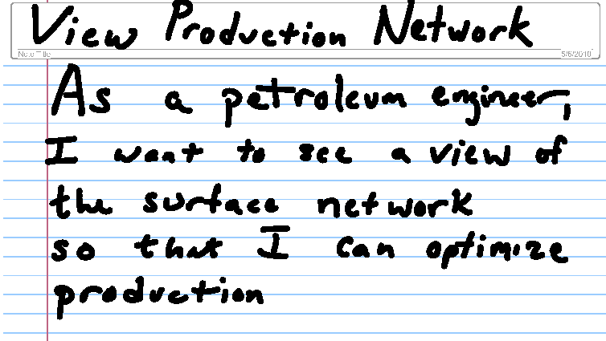
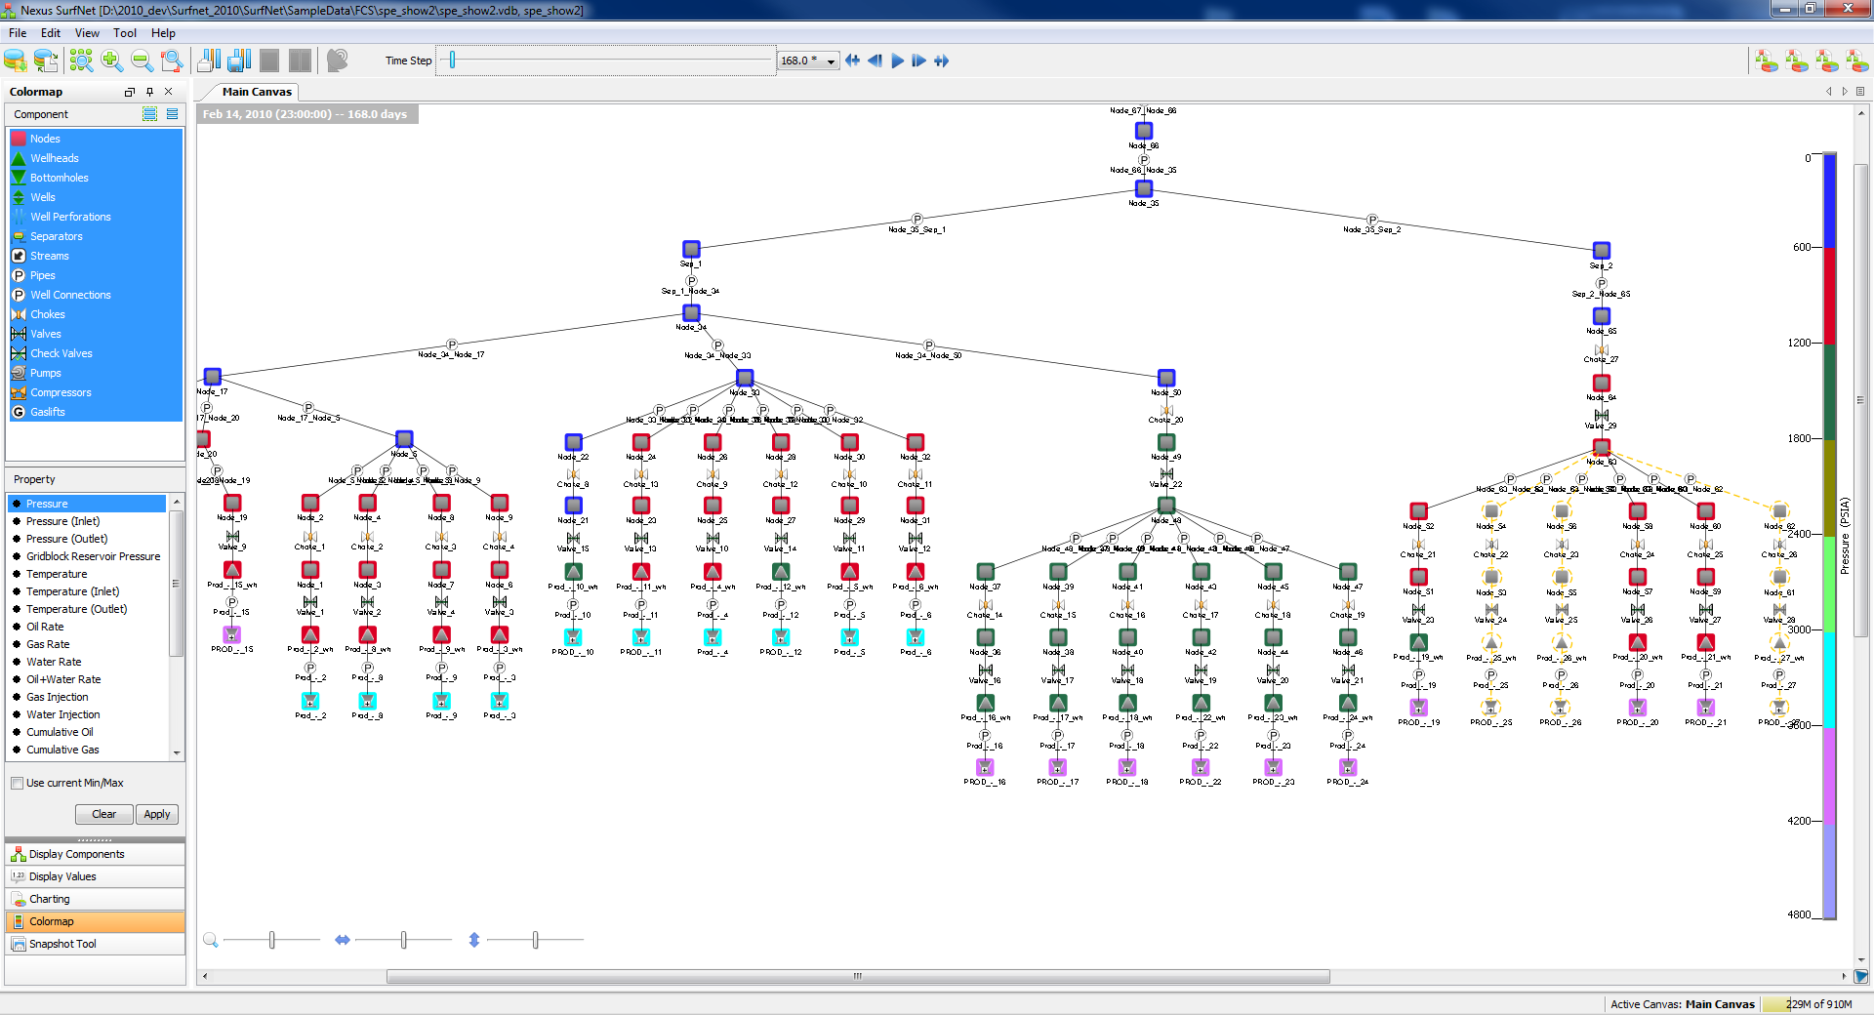
Backlog is a set of “Stories”

Slide 10
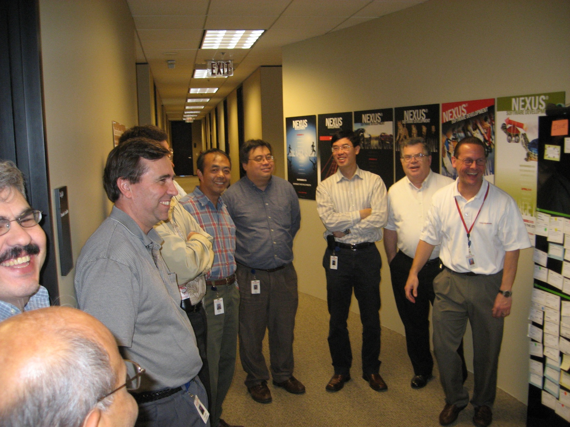
Daily Standup

Slide 11

3 questions for the Daily Standup
1
What did you do yesterday?
2
What will you do today?
3
Is anything in your way?
15-minutes
24 hours

Slide 12
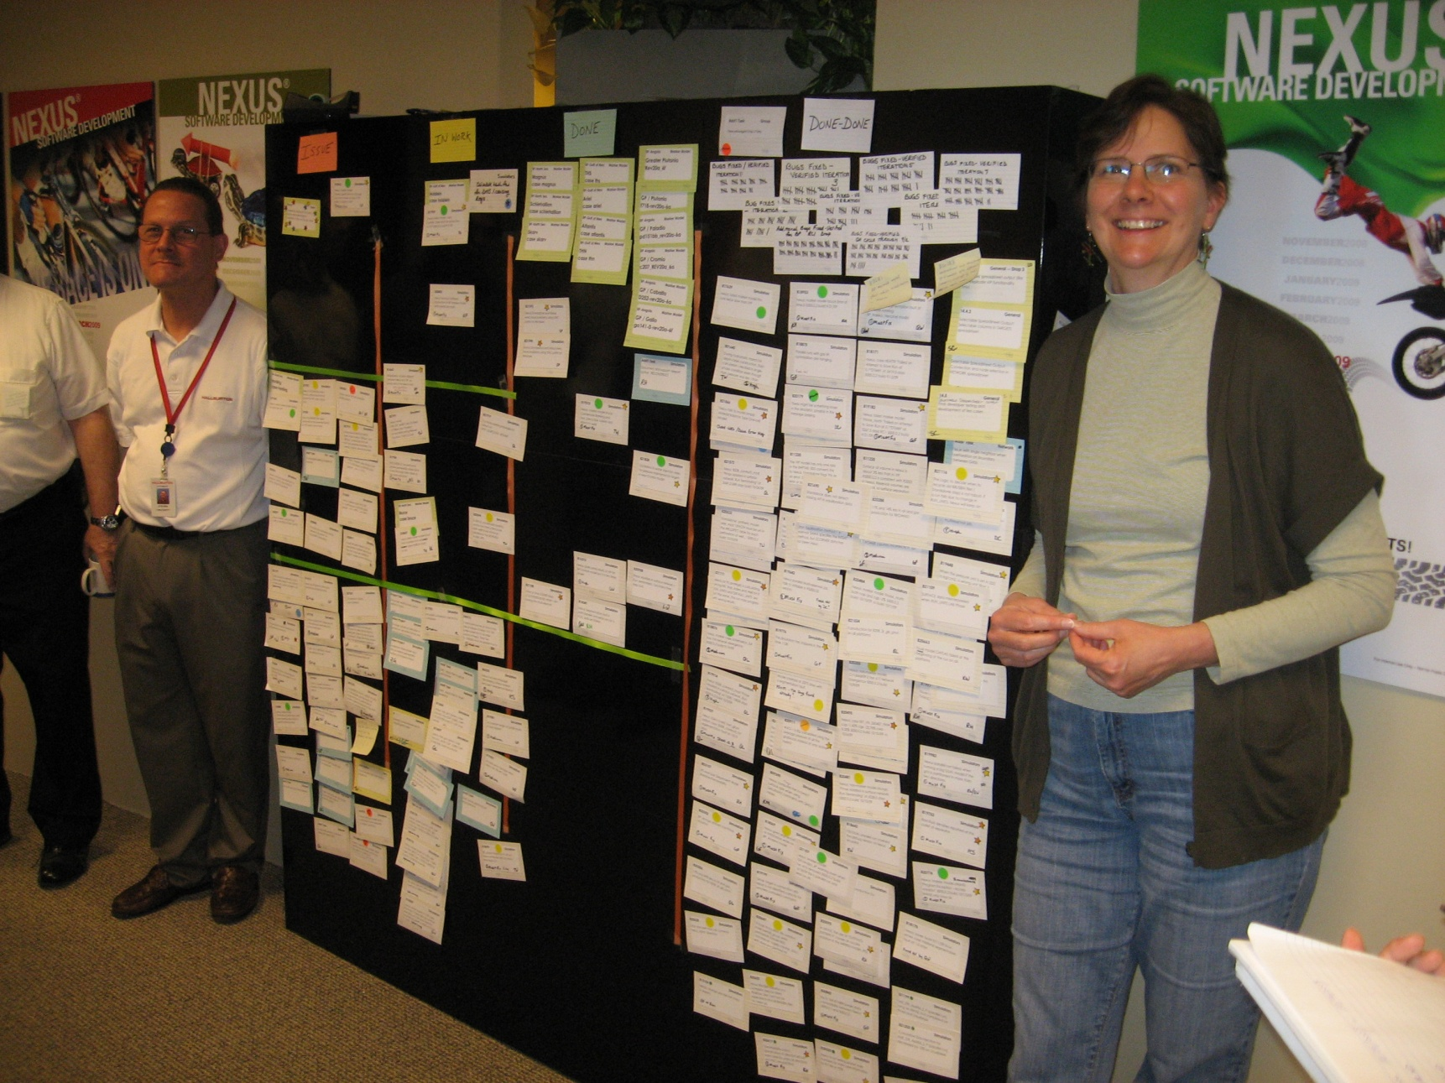
Tracking Progress

Slide 13
Burndown Chart

Slide 14
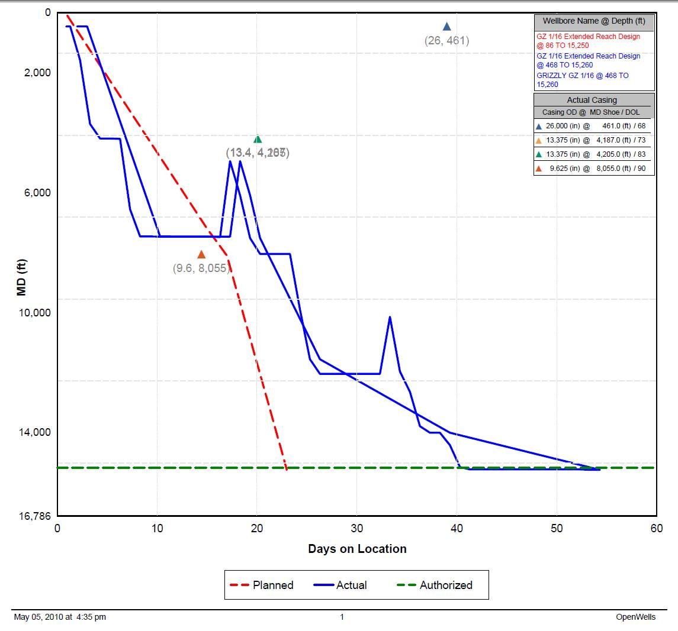
Depth vs. Days

Slide 15
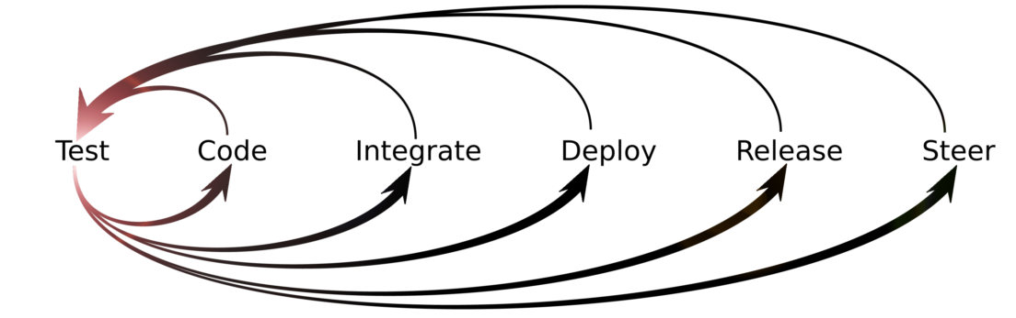
Designing Quality into the Solution
Acceptance
Tests
UI
Unit Tests
Business Layer
Unit Tests
Unit Tests
Unit Tests
Class
Class
Class

Slide 16
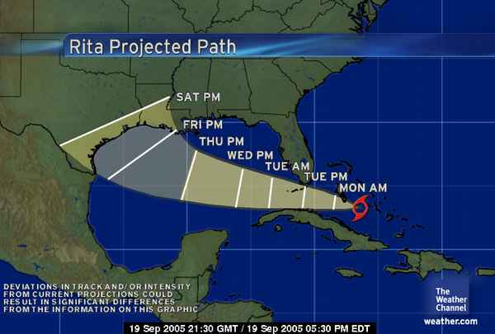
Uncertainty
We expect uncertainty and manage for it through iterations, anticipation and adaptation.

Slide 17
Uncertainty
We expect uncertainty and manage for it through iterations, anticipation and adaptation.

Slide 18
Uncertainty
We expect uncertainty and manage for it through iterations, anticipation and adaptation.

Slide 19
Uncertainty
We expect uncertainty and manage for it through iterations, anticipation and adaptation.

Slide 20
Uncertainty
We expect uncertainty and manage for it through iterations, anticipation and adaptation.

Slide 21
Uncertainty
We expect uncertainty and manage for it through iterations, anticipation and adaptation.

Slide 22
Uncertainty
We expect uncertainty and manage for it through iterations, anticipation and adaptation.

Slide 23
Uncertainty
We expect uncertainty and manage for it through iterations, anticipation and adaptation.

Slide 24
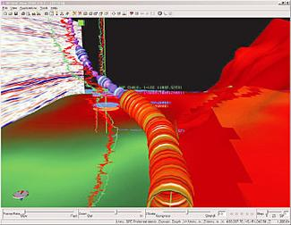
Geosteering

Slide 25

Agile Development
Delivering the software our customers want efficiently and effectively

