Slide 1

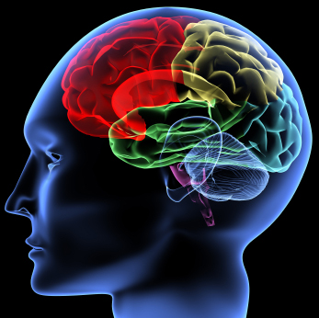
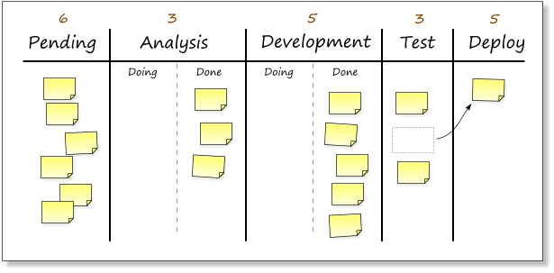
Discovering The Kanban Mindset
Todd Little, Chairman Kanban University

Slide 2
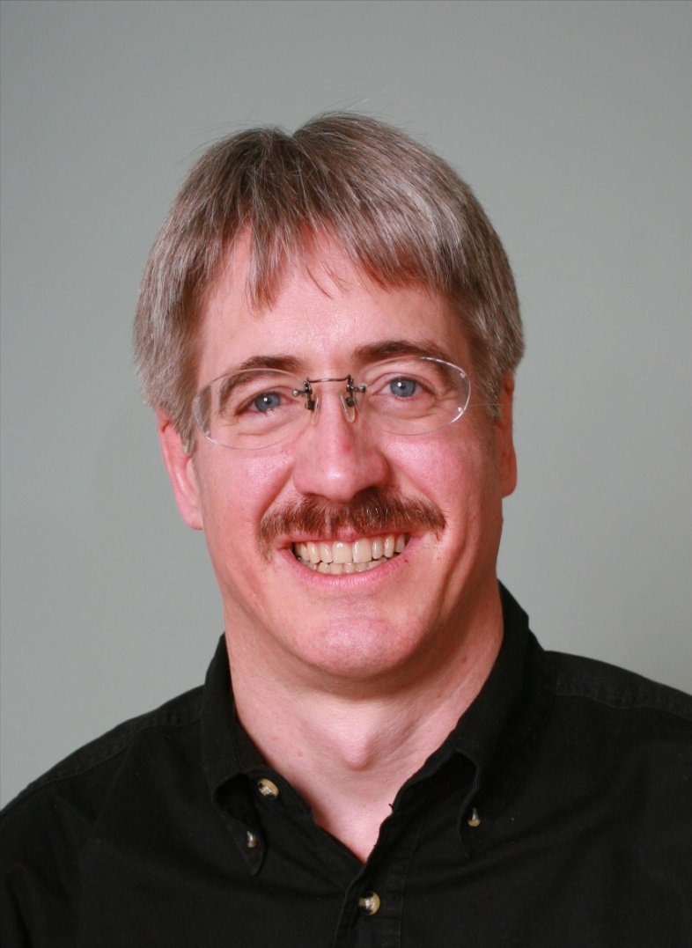



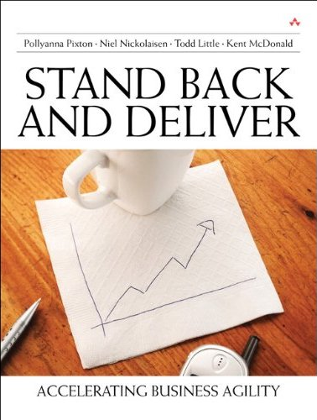



About Todd
Chairman Kanban University
Executive roles as VP Product Development, Director of Software & Technology
@toddelittle

Slide 3


Lean Kanban University is now Kanban University

Slide 4
Why Kanban?

Slide 5
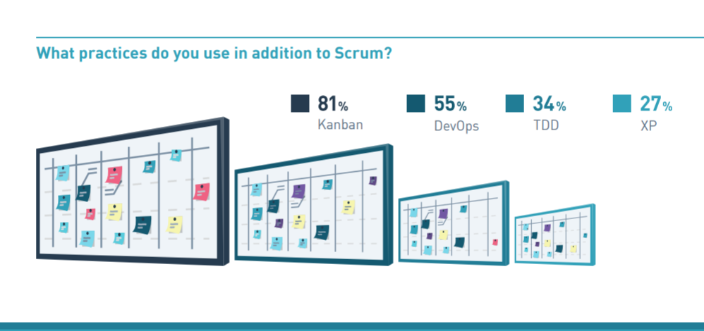
2019 Scrum Master Trends (Scrum.org)

Slide 6
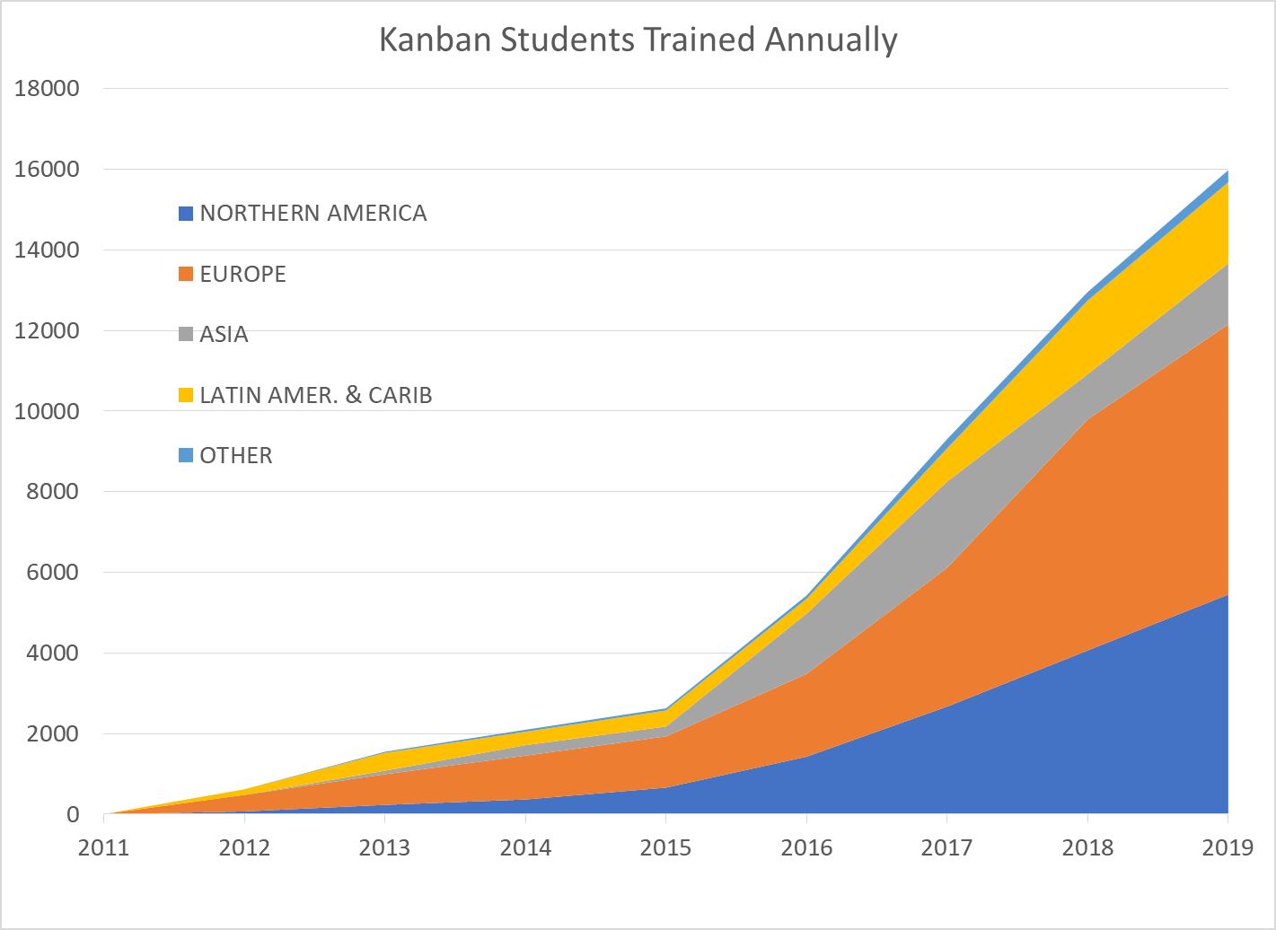
Over 50000 through 2019

Slide 7
But Why Kanban?

Slide 8
Business Problems Persist
Business agility
Predictability
Efficiency
Scale
Continuous Improvement

Slide 9
What is the Kanban Mindset?

Slide 10
What is Kanban?

Slide 11
What people think Kanban is
To Do
In Progress
Done

Slide 12
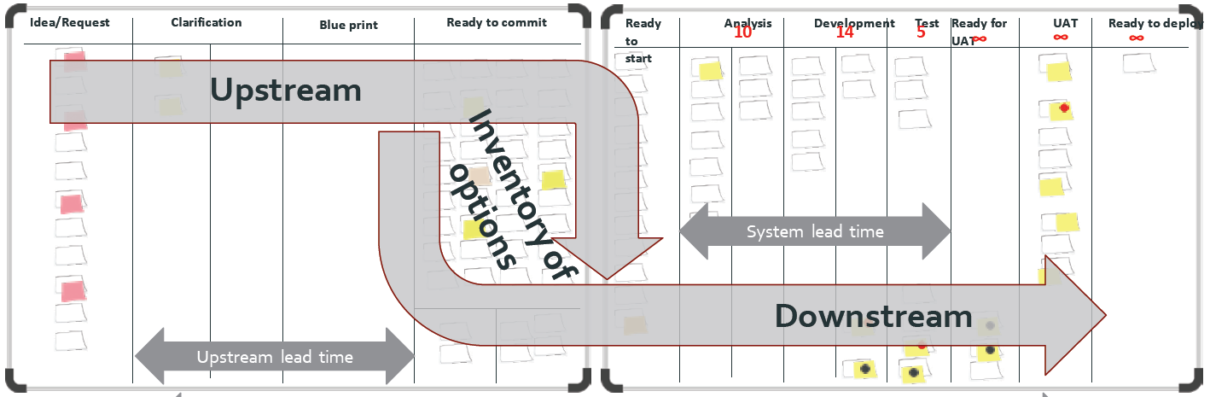
What is Kanban?
The Kanban Method teaches organizations how to understand, visualize and measure systems of work to continually improve and consistently deliver results.
The Kanban Method provides a set of proven practices and approaches that scale from individuals and teams to the enterprise.

Slide 13
How Many People See Kanban
Agile
Scrum
SAFe
Kanban
Scrumban

Slide 14
How Kanban University sees Kanban
Agile
Kanban
Scrum
SAFe
Scrumban

Slide 15
Kanban: The Great Unifier –
Start where you are now
Chaos
Kanban
SAFe
Scrum
Waterfall
CMMi

Slide 16
Foundations of Kanban

Slide 17
Motivation for the Kanban Method (Agendas)
Line-Level, Individual Contributors
Mid-Level Management
Senior-Level
Management
Relief from overburdening
Produce better quality
Take a professional pride in their work & customer satisfaction
Up-managing – answer the hard questions with confidence
Down-managing – make difficult decisions with confidence
Reliable, predictable, faster service delivery
Make promises we can keep
Lead the business (strategy, positioning)
SUSTAINABILITY
SERVICE ORIENTATION
SERVICE ORIENTATION
SURVIVABILITY
Notes:
Briefly explain the three agendas with the motivation for the different groups. Use this slide to position the class at service-level.
Concerns:
SENIOR --Mid-level managers lie to me. There is no transparency. Bad news arrives late. Too late to intervene
Business failure
MID -- Senior leaders over-react. I don’t trust them with information
Line managers & workers can’t be trusted to deliver on their promises
INDIVIDUAL -- Our bosses constantly set us up for failure
Burn out

Slide 18

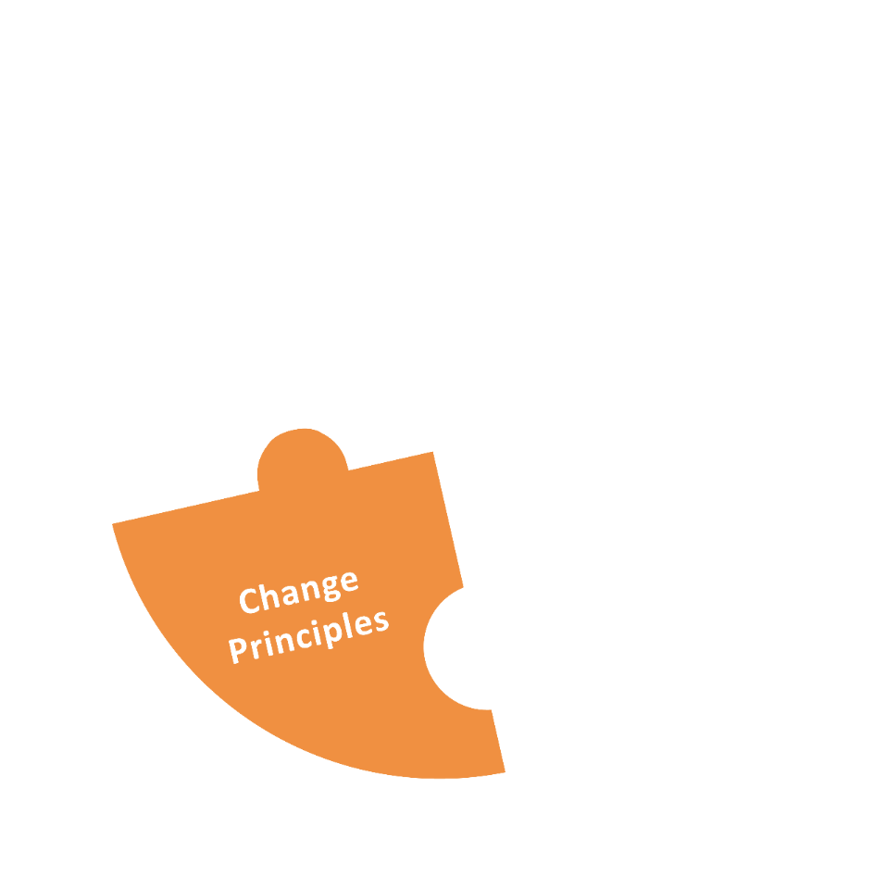
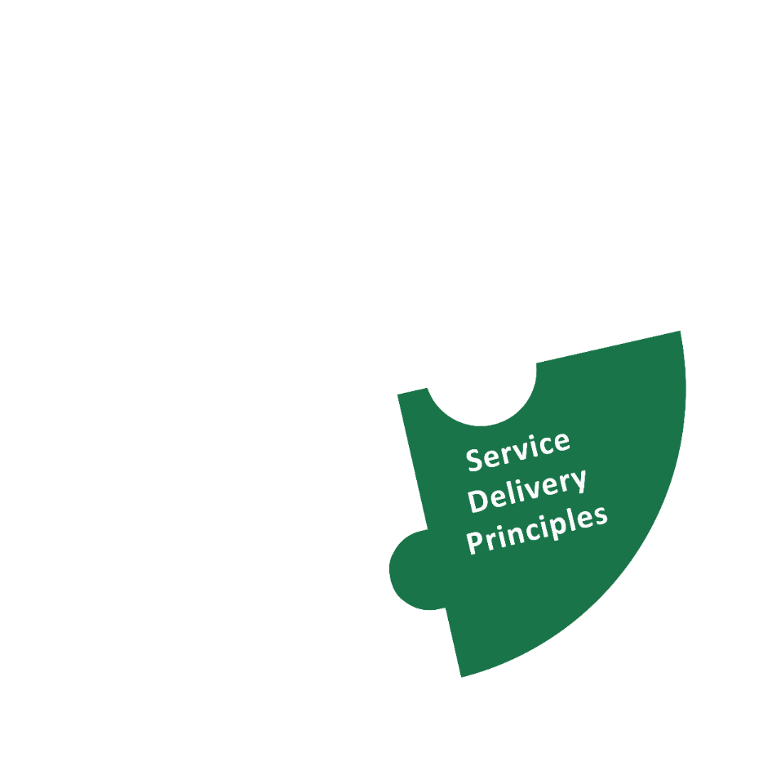

Elements of the Kanban Method
Notes:
What does the Kanban Method consist of?
These are the three building blocks defining the Kanban Method. We are going to cover them in this part of the class.
Technically, the Kanban Values are not part of the definition of the method, rather a different way of expressing it. They are not explicitely covered in this class.

Slide 19

Kanban Method: Change Management Principles
Start with what you do now.
    Understanding current processes, as actually practiced
    Respecting existing roles, responsibilities, and
    job titles
Gain agreement to pursue
improvement through
evolutionary change.
Encourage acts of leadership at all levels.
Notes:
There are 3 Change Management Principles designed to frame an evolutionary approach to improvement. Be aware that the Kanban Method is applied to the way you work now, and it will help you evolve the way you work gradually over time.
[Briefly walk through each of the principles. See David’s blog at http://www.djaa.com/principles-general-practices-kanban-method if you want help with how to explain each.]

Slide 20
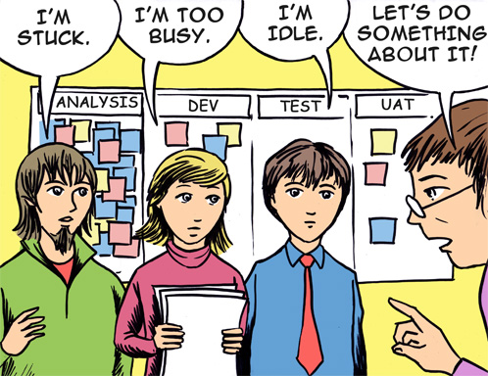
Evolutionary Change in Action

Slide 21
Evolutionary Change in Action
Formula for evolutionary change …
Stressor
Reflection Mechanism
Leadership

Slide 22

Traditional Change is an A to B Process
Future process is defined / designed in advance
Transformation
Current
Process
Future
Process
Notes:
Traditional change management assumes you can plan a specific change goal and jump to it
Traditional change is an A to B process. A is where you are now. B is a destination. B is either defined (from a methodology definition) or designed (by tailoring a framework).
To get from A to B, a change agency* will guide a transition initiative to install destination B into the organization.
*either an internal SEPG or external consultants
* Value stream mapping, ** Theory of Constraints Thinking Processes

Slide 23
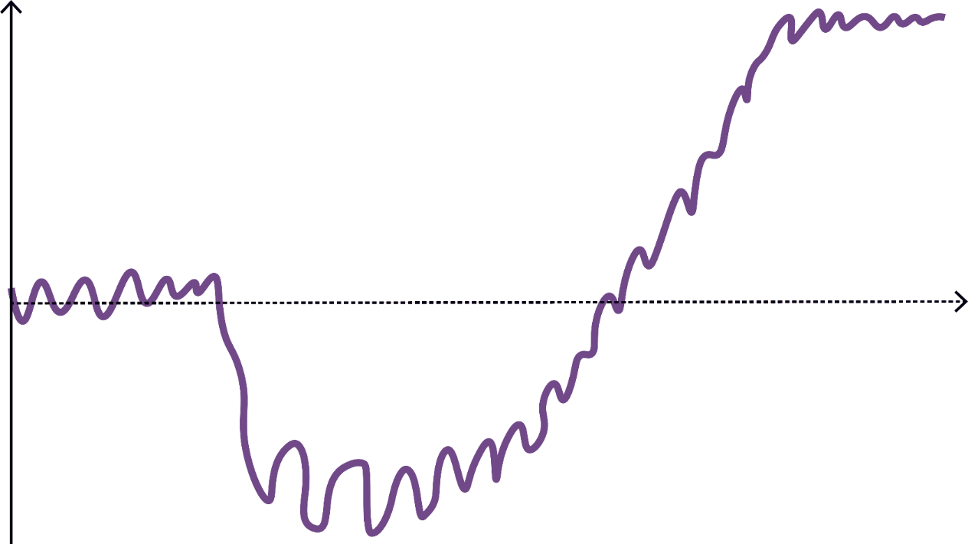
What Change Really Feels Like: The J Curve
performance
time
Safety!
Patience!
Notes:
But change initiatives feel like a lot of jarring ups and downs.
The trauma of a managed change initiative can feel unsafe
…and require a lot of patience

Slide 24
Evolutionary Change
Future process
is emergent
Evaluate Fitness
Evaluate Fitness
Evaluate Fitness
Evaluate Fitness
Roll forward
Evaluate Fitness
Roll back
Initial Process
Evolving Process
Notes:
Kanban uses evolutionary change which makes small steps and evaluates the results. Some changes are rolled back.
Traditional change is an A to B process. A is where you are now. B is a destination. B is either defined (from a methodology definition) or designed (by tailoring a framework).
To get from A to B, a change agency* will guide a transition initiative to install destination B into the organization.
*either an internal SEPG or external consultants
Your capability to change is low at the beginning
As you move forward, your capability improves and you can risk more significant change
You change management capability improves as you go
So does your process
Check out the Kanban Maturity Modell if you want to learn more

Slide 25

Water flows around the rock
“be like water”
the rock represents resistance
Notes:
A key teaching in Bruce Lee’s philosophy adapted from Taoism, is "to be like water". Water flows around the rock. The rock represents resistance - in fighting, the resistance is from the opponent. In Kanban, the rock represents resistance to change.

Slide 26
Evolutionary change with
many small J’s
Fitness
Capability for Change
Time

Slide 27


The Kanban Method
“Kanban is a management method for
  directly improving service delivery,
  catalyzing improvements, and
  evolving a business to be “fit for purpose.”
“Kanban is a project management method.”
“Kanban is a software development lifecycle process.”
Kanban for Ops, Scrum for projects
Notes:
The Kanban Method helps you manage the work you do now, so that you can improve the way you deliver and evolve your business to better suit your customers.
You can easily involve the audience here by asking them to gather correct and wrong statements about Kanban. You might do some myth-busting here ;)
TBR-option: Prepare statements on cards and hand out to groups of students. Let them sort into “true” and “false”, let them discuss. Show the slide as a debrief.

Slide 28

Kanban Method: Service Delivery Principles
Your organization is a network of interdependent services with policies that determine its behavior.
Therefore:
Understand and focus on the customer’s
needs and expectations.
Manage the work;
let workers self-organize around it.
Regularly review the network and its policies to improve outcomes.
Notes:
Service delivery is a focus on providing a service for a customer.
Briefly explain the 3 service delivery principles. Reflect on the values embedded in these statements: customer focus; respect; understanding.
The Kanban Method has 2 sets of principles: the service delivery principles; and the change management principles.
EKC full wording:
Any sizable organization is a network of interdependent services with policies that drive its behavior. Kanban acknowledges this with three service delivery principles, applicable not just to one service but to the whole network:
Understand and focus on your customers’ needs and expectations.
Manage the work; let people self-organize around it. (or "Manage the work; let the workers self-organize around it.")
Regularly review the network and its policies to improve customer and business outcomes. (or "effectiveness")

Slide 29




What is a service?
Customer
Has Need
Requests a
product or service
Service Delivery
Responds to the need
with a series of
activities
Need Fulfilled
Customer accepts or acknowledges delivery
Notes:
A service fulfills the request of a customer
Source: Travis Birch‘s Twitter Feed: https://twitter.com/xroadstree
https://twitter.com/xroadstree/status/971740384626913280
Gather examples here from attendees, both real-life services as well as services from corporate life.

Slide 30

The Kanban Lens
See work as flow
See workflow as knowledge discovery steps
See knowledge work as a service
See organizations as networks of services

Slide 31
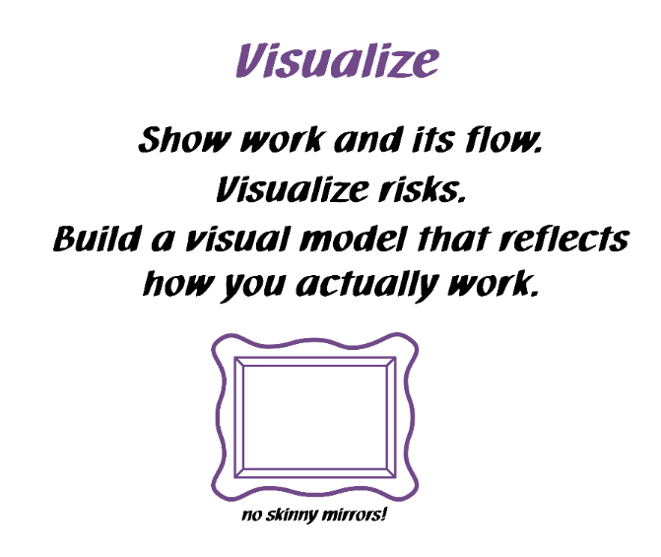
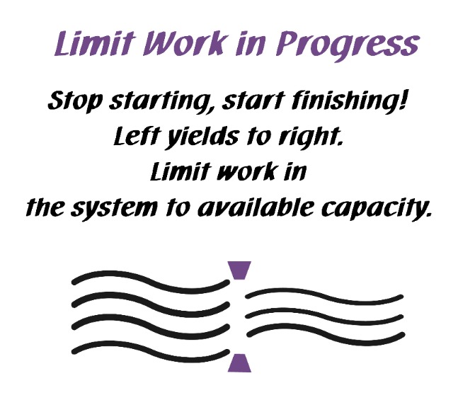
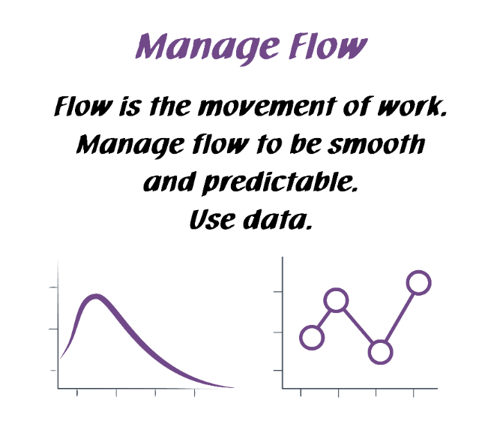
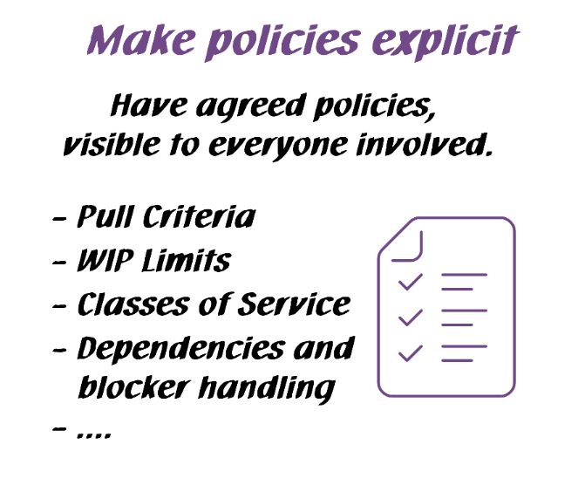
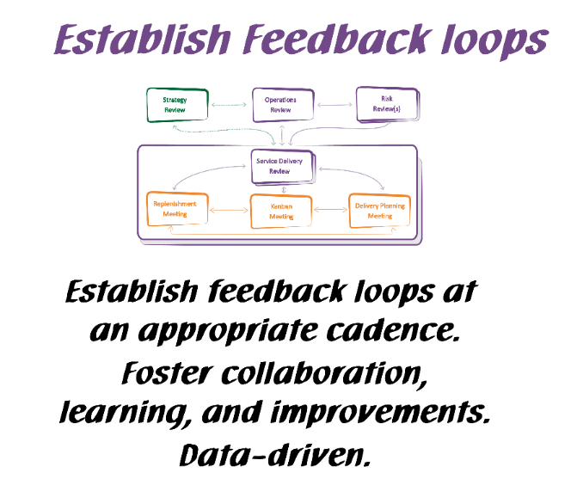
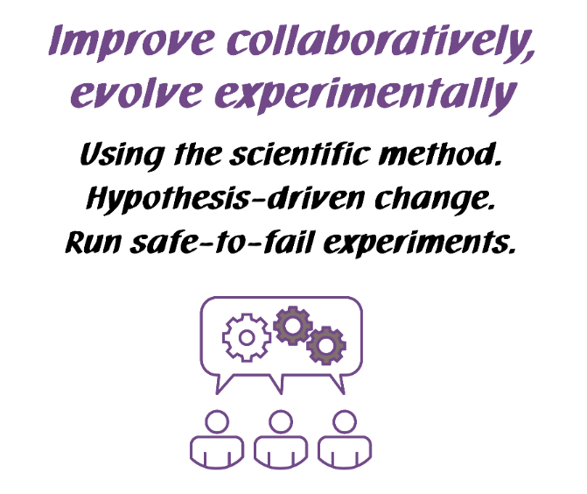
Kanban General Practices
Notes:
Walk the class through the Kanban practices.
There are 6 General Practices in the Kanban Method. [Walk briefly through each of the 6 Practices. See David Anderson’s blog at http://www.djaa.com/principles-general-practices-kanban-method if you want help with how to explain]
Instead of using this slide, you can also create a flipchart with similar info etc.
You might revise this after the simulation.

Slide 32
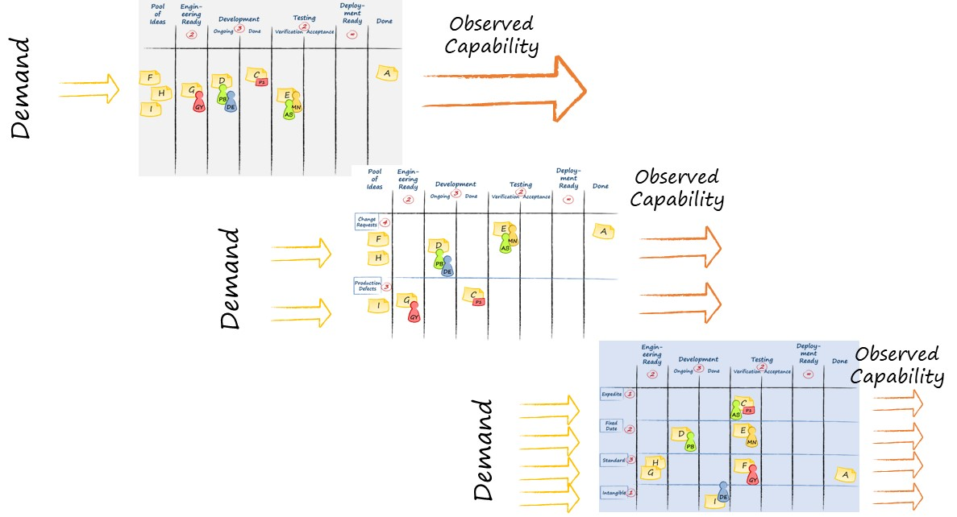

Visualize
Ideas

Slide 33
Visualize
Ideas
Understand the system

Slide 34

Systems Thinking Approach to Introducing Kanban (STATIK)
Identify Services. For each service:
Understand what makes the service “fit for purpose”
Understand sources of dissatisfaction regarding current delivery
Analyze sources of and nature of demand
Analyze current delivery capability
Model the service delivery workflow
Identify & define classes of service
Design the Kanban system
Socialize, design & negotiate implementation
This process tends to be iterative
Notes:
We develop a Kanban system for each service using STATIK.
With STATIK, we consider the unique needs of the customer and our capability to fulfill that need. The Kanban system we design is unique to match that customer demand and our capability.
We have walked through the Systems Thinking Approach to Introducing Kanban (in Kanban System Design class). This process tends to be iterative. Don’t be afraid to go back and adjust your Kanban system as new information emerges or your needs change.
8. Covered in this class as well!

Slide 35
Visualize
Ideas
Understand the system

Slide 36
Visualize
Ideas
Understand the system
FLOW

Slide 37

Visualize
Ideas
Understand the system
FLOW
Balance Demand and Capacity

Slide 38
Visualize
Ideas
Understand the system
FLOW
Balance Demand and Capacity
Limit WIP

Slide 39
Visualize
Ideas
Understand the system
FLOW
Balance Demand and Capacity
Limit WIP
Bottleneck

Slide 40
Visualize
Ideas
Understand the system
Scale
FLOW
Balance Demand and Capacity
Limit WIP
Bottleneck

Slide 41
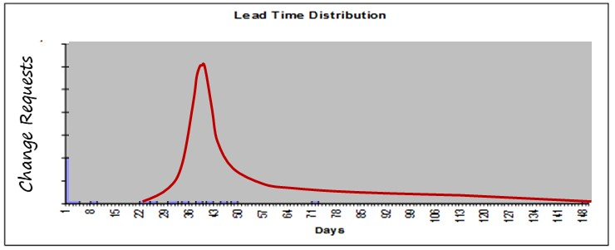
Visualize
Ideas
Incremental process improvement through measurement
Understand the system
Scale
FLOW
Balance Demand and Capacity
Limit WIP
Bottleneck

Slide 42
Visualize
Ideas
Incremental process improvement through measurement
Understand the system
Scale
FLOW
Balance Demand and Capacity
Limit WIP
Bottleneck
Double loop learning

Slide 43
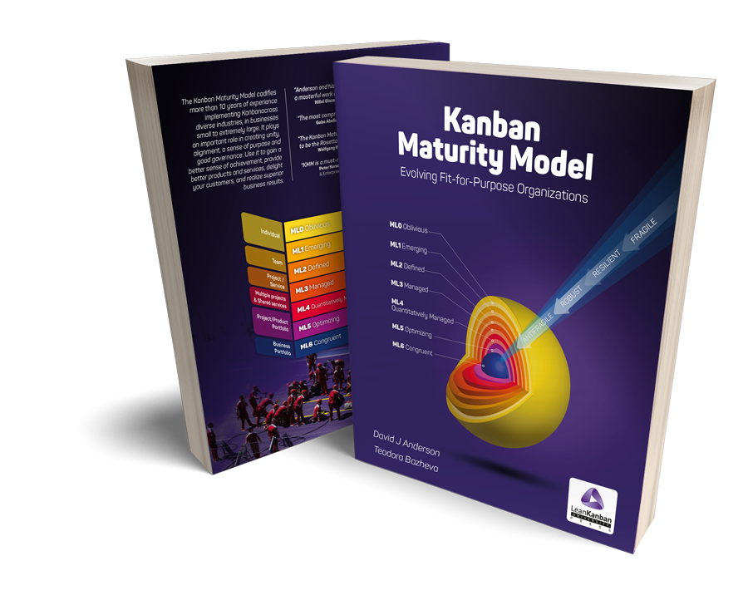
Kanban Maturity Model

Slide 44
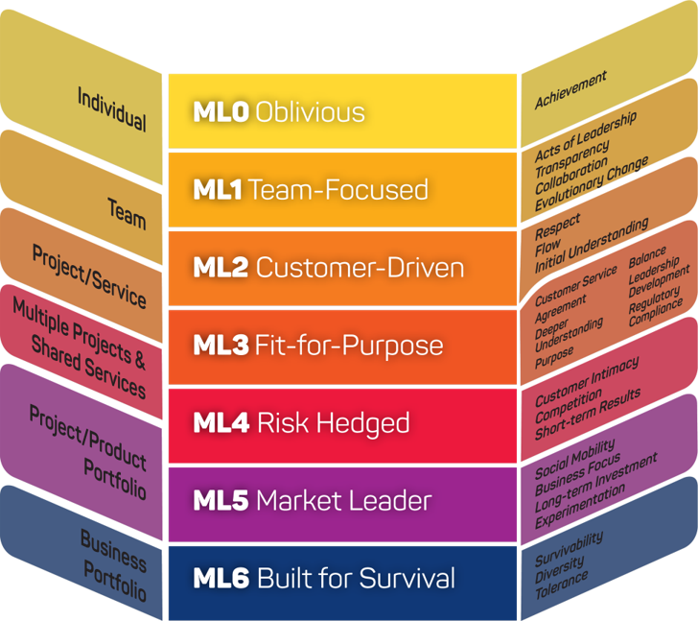
Kanban Maturity Model
The Kanban Maturity Model (KMM) maps ~150 specific Kanban practices to observable business outcomes using seven levels of organizational maturity

Slide 45
Kanban Maturity Model
KMM helps eliminate the two failure modes in Kanban and Agile implementations: overreaching causing an aborted start; false summit plateaus and failure to realize full benefit.

Slide 46
KMM Case Studies

Slide 47
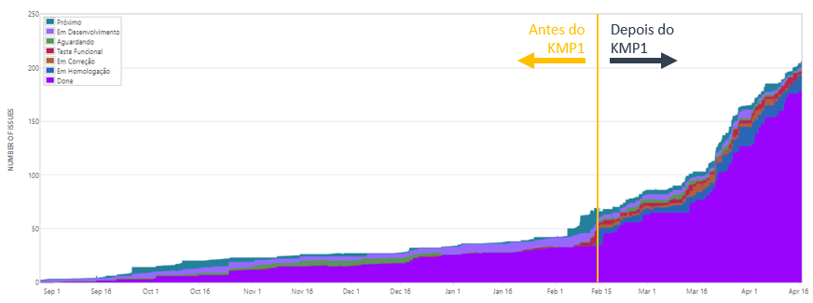
Kanban Impact at Accenture Brazil

Slide 48

BBVA Case Study
At BBVA we seek to improve continuously, focused on our values: “Customer first,” “Think big,” and “We are a team.” Therefore, we decided to look at how KMM could help us achieve our goal. After a few months, we have proof that it gives us valid guidance on how to improve our level of customer service.
—Juan José Gil Bilbao

Slide 49
Kanban Maturity Model at BBVA
“We developed the capability to manage based on data, not on perceptions. This helps us to foresee future needs and resolve blockages due to dependencies on other teams in a fast and simple manner.”
—Nagore Bilbao, Core Data Program Manager

Slide 50
Kanban Maturity Model at BBVA
In only one year, two programs have evolved from team-focused management to service-oriented entities with deep understanding of their real capability and the types of services they are delivering to their customers.
Three more programs have evolved from team-focused to flow-oriented management. The approach taken using the Kanban Maturity Model has proven to be repeatable.

Slide 51
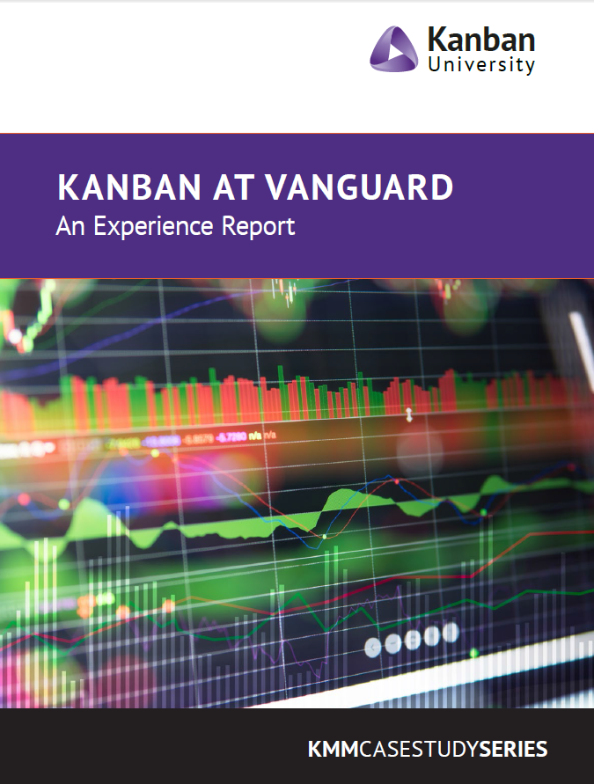
Vanguard Case Study
“Kanban helped Vanguard FinTech operate in a lean model and accelerate delivered value more so than with using just Scrum or traditional project management methods. Our teams are now starting less work before WIP is finished and the productivity and morale of each team has increased."
— Christopher Sicilia, Principal, Head of Technology and Project Management at Vanguard Finance Technology.

Slide 52
Kanban Maturity Model at Vanguard
From April 2018 through March 2019, maturity levels were studied to quantify the effects of twelve years of Agile “transformation” and five years of DevOps. A target population of approximately 240 Agile teams was sampled. The sample set grew to approximately 10 percent of the total population, with good distribution across the enterprise.
The key result was that, of the twenty-four teams in the sample set, all of which started with Scrum, 40 percent “voted with their feet” and switched or were planning to switch to Kanban. A related result was that the Kanban teams who recovered from “Scrum stall” exhibited flow metrics that outperformed all but one of the very best Scrum teams!
Teams are asking for Kanban coaching in four out of five new requests.

Slide 53
Kanban Maturity Model at Vanguard
For “Fast Flow,” Kanban has a richer, simpler, and more effective set of metrics and forecasting tools.
For “Fast Feedback,” Kanban’s visual orientation encourages end-to-end systems thinking. So, the indispensable upstream flow receives a lot of attention.
For “Fast Learning,” Vanguard knows it must continue to evolve its nimble digital infrastructure. Essentially, this is the evolutionary approach of the Kanban Method.

Slide 54
Kanban Maturity Model at Vanguard
Scrum Stall
System lead time improved by 78 percent in approximately ninety days!

Slide 55
Kanban Maturity Model at Vanguard

Slide 56

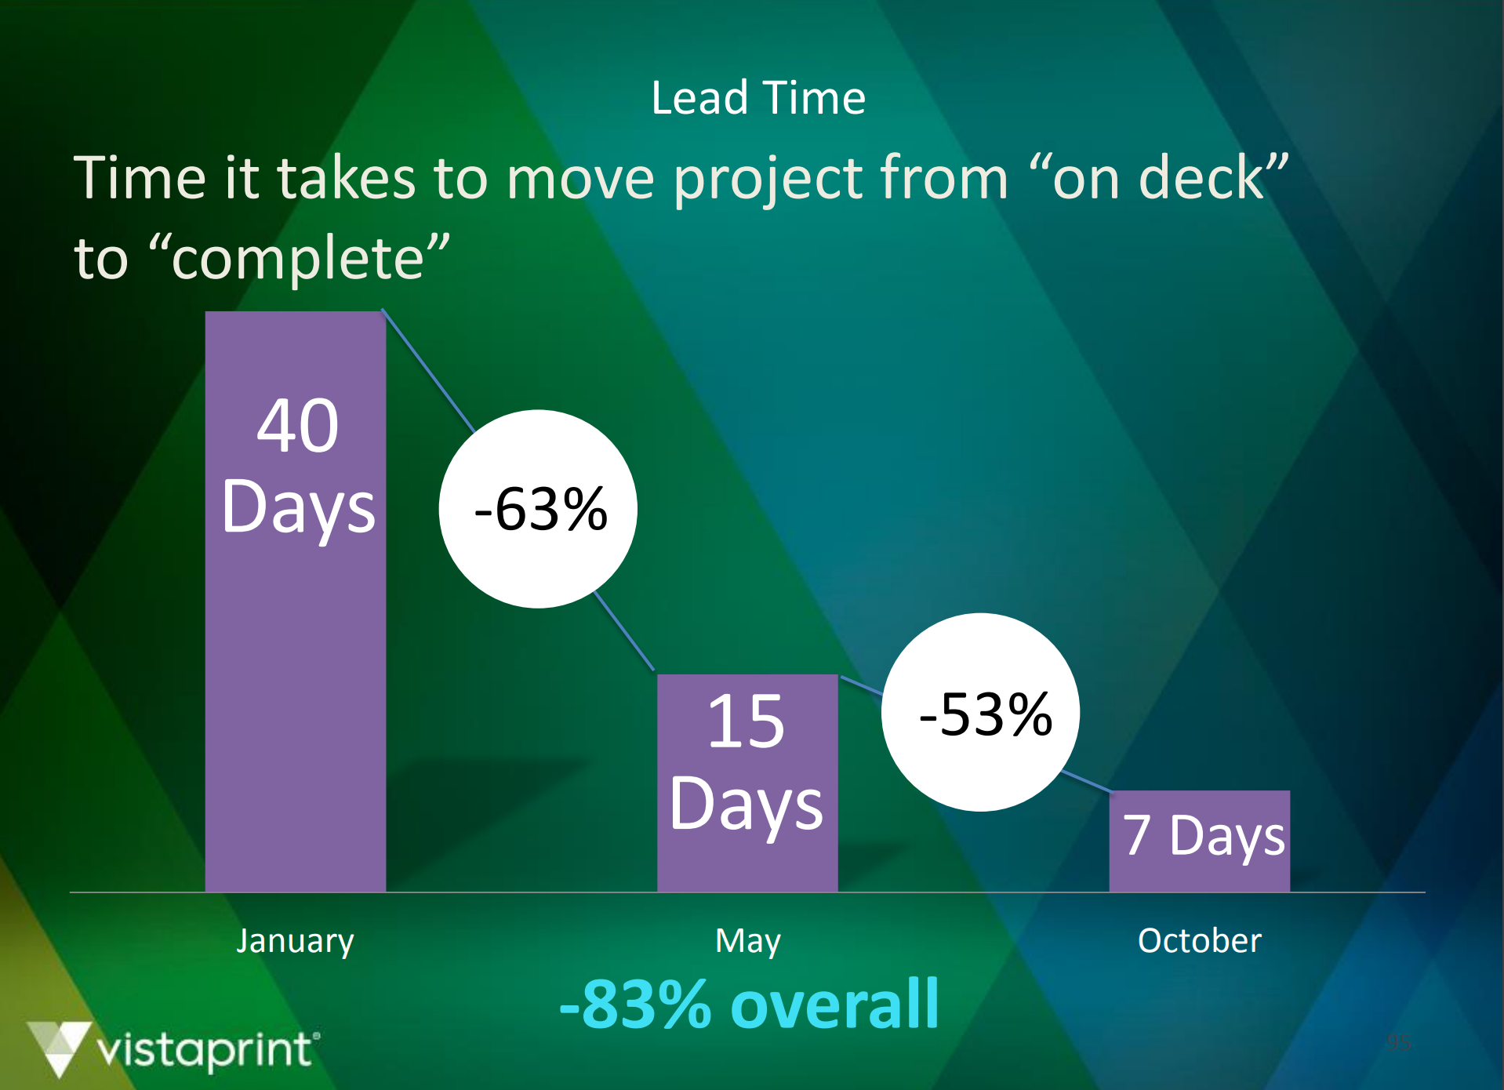
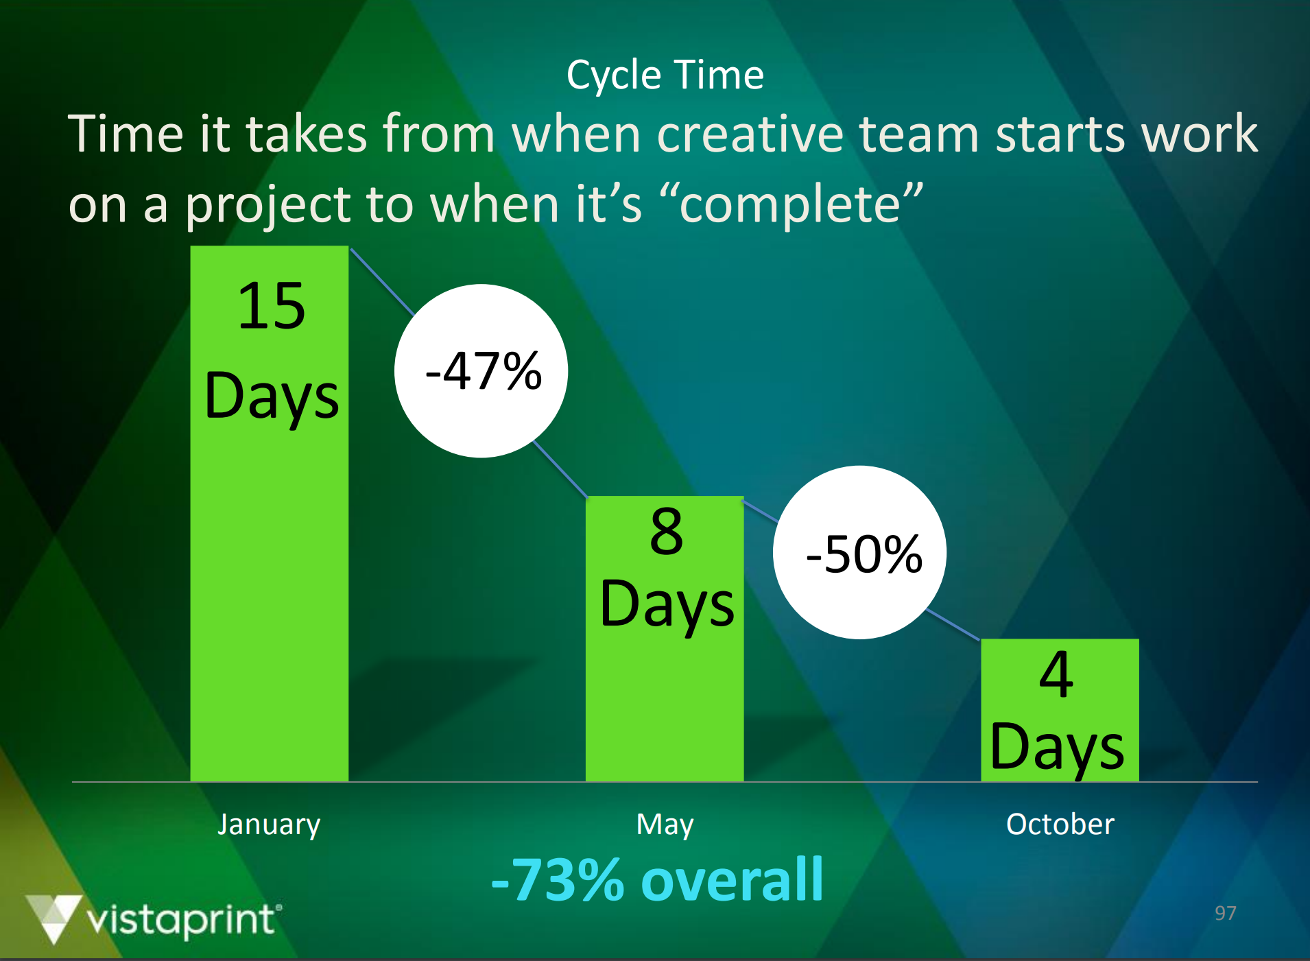
“Vistaprint transformed its software development teams to Scrum and Kanban, reducing release cycles from 18 months to 3 weeks. But Marketing had to move faster to match this pace. The bottlenecks seemed to be in Creative (the in-house advertising agency). Could Kanban work for Creative? Yes it could!”
“We reduced the lead time for the North American email team from 8 weeks to 9 days. The cycle time dropped from 15 days to 4. Late night and weekend work disappeared. The on-time delivery rate soared and quality did not suffer.”

Slide 57
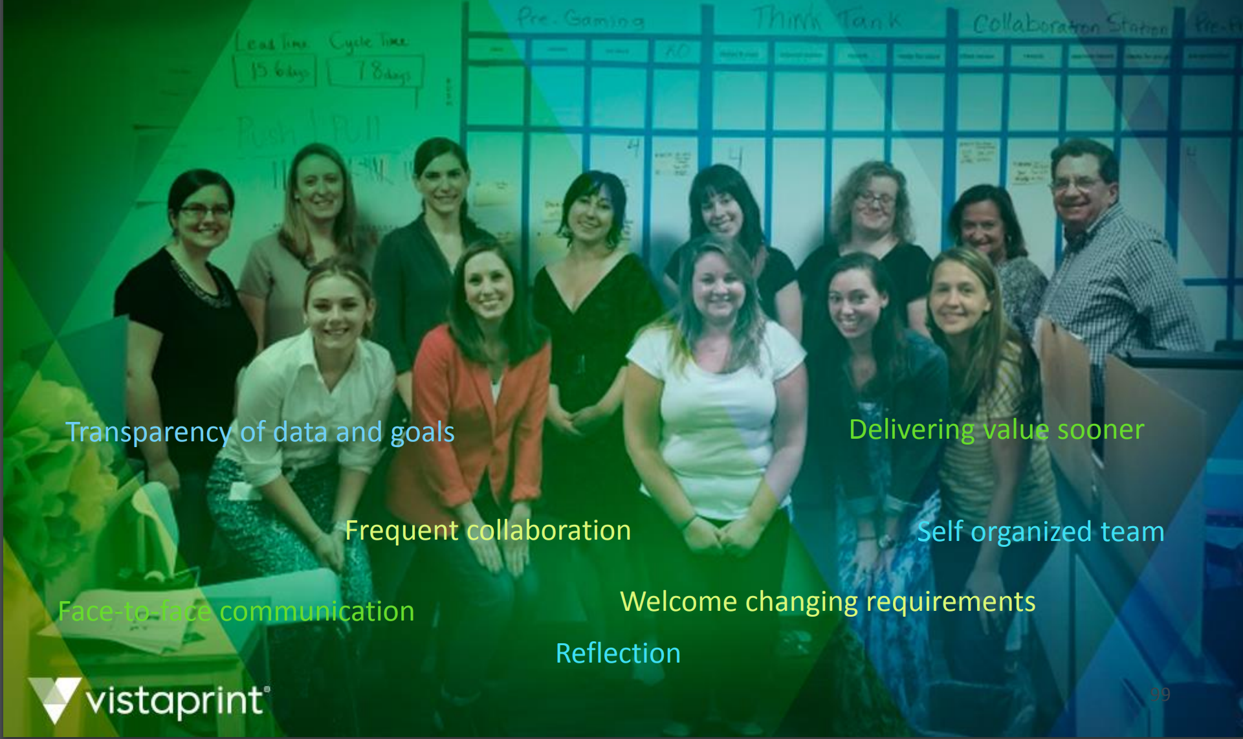
“This approach is now being used to spread Kanban to other teams in the agency in both the US and Europe. We demonstrated that Kanban works well outside of software. Now we have traction for an enterprise-wide transformation.”

Slide 58
Growing the Kanban Mindset
Learning and Evolutionary Change

Slide 59




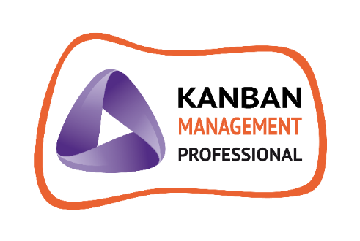

Coaching Proficiency
Training

Slide 60
KMP I – Kanban Systems Design
Todd Little
March 14-15, 2020
Bengaluru
KMP II – Kanban Management Professional
Todd Little
March 21-22, 2020
Bengaluru
AKT – Accredited Kanban Trainer
Todd Little
August 2-6
Bengaluru
KCP – Kanban Coaching Professional
David Anderson
August 9-13
Bengaluru

Slide 61
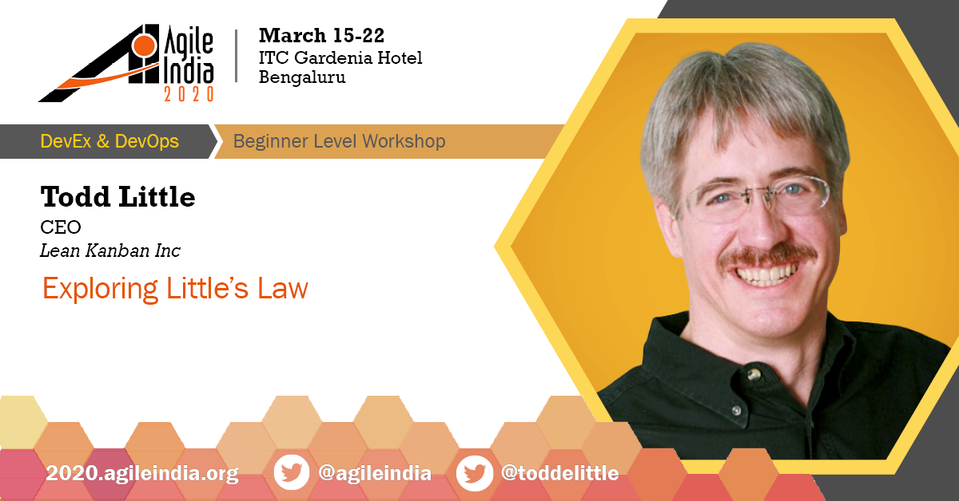

Slide 62
Contact
Todd Little
  todd@kanban.university
  toddelittle@gmail.com
  www.toddlittleweb.com
  www.linkedin.com/in/toddelittle/
  @toddelittle

Slide 63
Questions?

