Slide 1

To Estimate or
#NoEstimates,
that is the question
Alas, Poor Yorick, I knew him well…
Yet another software death march

Slide 2


Slide 3
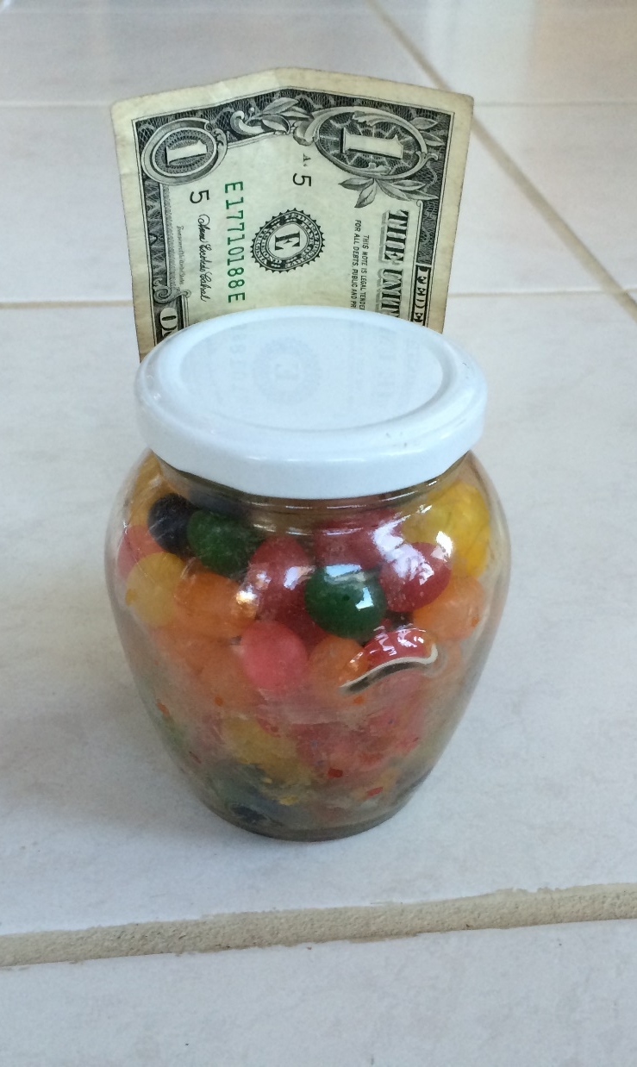
Estimation Exercise
Number of Jellybeans in the jar

Slide 4
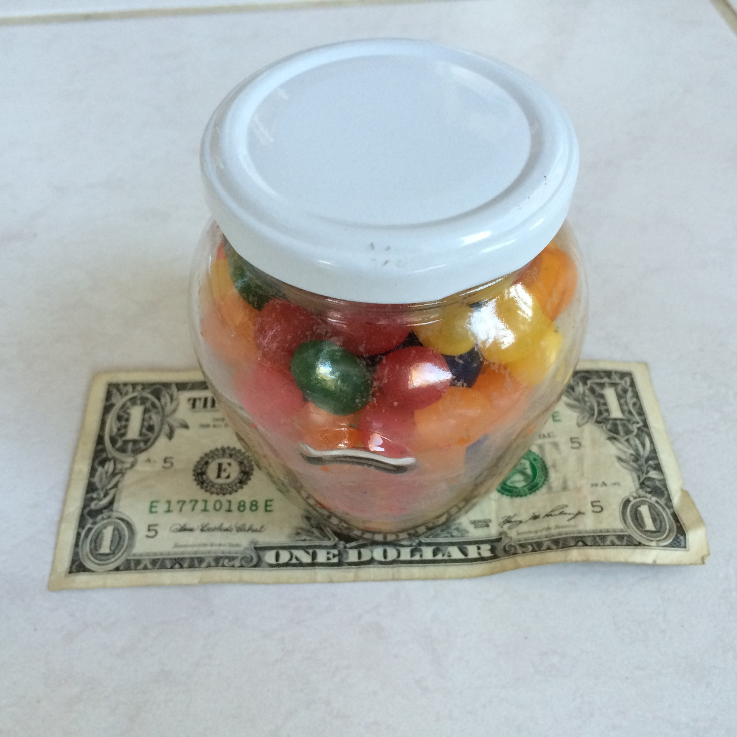
Estimate the # of Jelly Beans

Slide 5
To Estimate or
#NoEstimates,
that is the question
Alas, Poor Yorick, I knew him well…
Yet another software death march

Slide 6
To Estimate, or #NoEstimates, that is the question:
Whether ‘tis nobler in the mind to suffer
The Slings and Arrows of outrageous errors,
Or to take Arms against a Sea of troubles,
And by opposing, end them? #NoEstimates, so easy;
No more; and by #NoEstimates, focus on value and end
The headaches and the thousands of natural unknowns
That estimation is prone to, ‘tis a consumption
Devouring all resources. #NoEstimates; so easy;
So easy; perchance it seems: ay, there’s the rub;
For in #NoEstimates what surprises may come,
When we develop in earnest and begin our toil.
Must give us pause. There’s the respect
That makes calamity of software’s life;

Slide 7

To Estimate or #NoEstimates, That is the Question
Todd Little
Founder, Accelinnova
Chris Verhoef
CS Professor, VU, Amsterdam
  @toddelittle

Slide 8
Quick Survey
Agile?
Story Points?
Relative Estimation?
Story Splitting?
Velocity?
Throughput?
Burn Up / Burn Down Charts?
Cumulative Distribution Functions?
P90/P10 ratio?
#NoEstimates?

Slide 9
How many of you consider it to be a major part of your job to either create estimates or deliver against someone’s estimates?

Slide 10
“
It is difficult to get a man to understand something when his salary depends upon his not understanding it.
”
        Upton Sinclair

Slide 11
Why do we Estimate?
Notes:
Get the crowd to throw out their ideas. Capture on the flipchart

Slide 12
Decisions
Decisions at project sanction | What is the cost, is it worth doing? When is the target delivery? What is the critical scope? Do we have the right investment?
Decisions to steer towards the release | Are we on target to meet our commitments? What are the scope/schedule tradeoffs? Is it worth continuing? Can we do anything to accelerate delivery? What is the cost of delay?
Decisions to help with managing iterations | Can we make our iteration commitment? What is our capacity?

Slide 13
What do we Estimate?
Notes:
Get the crowd to throw out their ideas. Capture on the flipchart

Slide 14
What do we Estimate?
Release – duration, effort, cost
Feature/Epic – story points, T-shirt sizes
Stories – story points
Tasks – hours
#NoEstimates

Slide 15




Managing the Coming Storm
Inside the Cyclone
Project Kickoff
When will we get the requirements?
All in good time, my little pretty, all in good time
But I guess it doesn't matter anyway
Just give me your estimates by this afternoon
Team Unity
Not so fast! Not so fast! ... I'll have to give the matter a little thought. Go away and come back tomorrow
No, we need something today!
Ok then, it will take 2 years.
No, we need it sooner.
Doesn't anybody believe me?
I already promised the customer it will be out in 6 months
You're a very bad man!
Notes:
We look at a typical software project…..

Slide 16


We’re not in Kansas Anymore
Developer Hero
I may not come out alive, but I'm goin' in there!
Reorg
The Great and Powerful Oz has got matters well in hand.
My! People come and go so quickly here!
Testing
"Hee hee hee ha ha! Going so soon? I wouldn't hear of it! Why, my little party's just beginning!

Slide 17



Test First

Slide 18
#1: Story Point Estimates improve predictability

Slide 19
#2: Velocity Improves over Time

Slide 20
#3: Velocity Variation Stabilizes over Time

Slide 21
#4: We’re Good at Estimating Smaller Stories

Slide 22
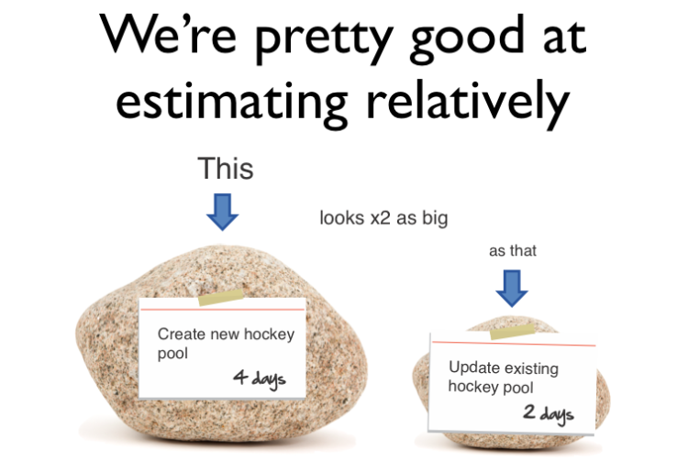
#5: We’re pretty good at estimating things relatively

Slide 23
#6: We’re a bit behind, but we’ll make it up in testing since most of our uncertainty was in the features.

Slide 24
#7: Scope Creep is a major source of estimation error.

Slide 25
#8: Having more estimators, even if they are not experts, improves estimation accuracy

Slide 26
#9: Project success is determined by on-time delivery

Slide 27
#10: Estimation is waste

Slide 28

What is #NoEstimates
“#NoEstimates is a hashtag for the topic of exploring alternatives to estimates [of time, effort, cost] for making decisions in software development. That is, ways to make decisions with ‘No Estimates’.”
Woody Zuill

Slide 29
One Approach Suggested by #NoEstimates
Discontinue estimating story points
Instead simply count number of completed stories per iteration (throughput)
Forecast using a burnup or burndown based on throughput

Slide 30
We collected and analyzed some real data

Slide 31
About the Data
Data collected anonymously by Vasco Duarte
55 Projects from 9 companies
https://bitly.com/NoEstimatesProjectsDB

Slide 32
Definitions
 | Instantaneous | Average
Velocity | Story points delivered in an iteration | Average story points delivered over all iterations
Throughput | Number of stories delivered in an iteration | Average number of stories delivered over all iterations

Slide 33
Question:
If we just use throughput (story count) to forecast completion, is it any more/less accurate than using velocity (story points)?

Slide 34
Basic Burnup

Slide 35
What does the Data show?
Notes:
First thing we note is that there is not a lot of difference between Velocity and Throughput.
The second thing we note is that neither Velocity nor Throughput address the Hardening cycle that we see in 50% of the projects.

Slide 36
What does the Data show?
2-12% Hardening for 50% of projects
Notes:
First thing we note is that there is not a lot of difference between Velocity and Throughput.
The second thing we note is that neither Velocity nor Throughput address the Hardening cycle that we see in 50% of the projects.

Slide 37

Beware … statistics ahead

Slide 38
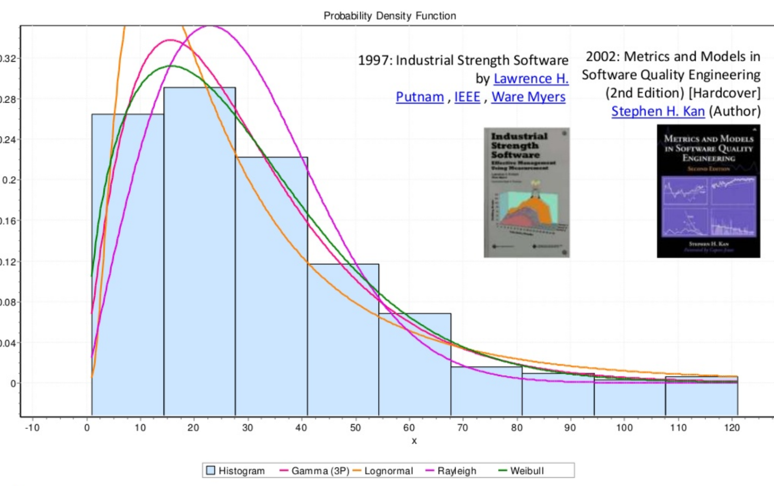
Typical Distributions (From Troy Magennis)

Slide 39


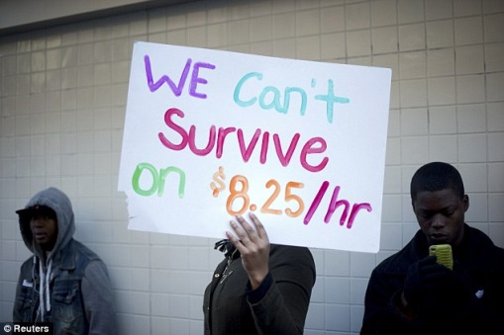

P90 and P10
20
12 | P90
10
8
7
6
5
3
2 | P10
1
P90/P10 = 12/2 = 6

Slide 40
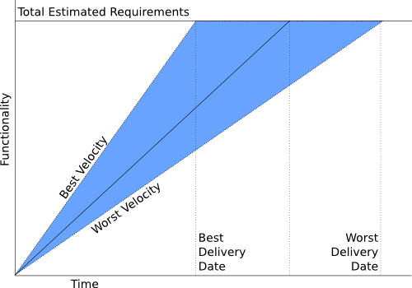
P90/P10 Ratio
P10=10% confidence
P90=90% confidence
Example
P10 = 6 months
P90 =12 months
P90/P10 = 2
P10
P90

Slide 41
Estimate the # of Jelly Beans

Slide 42
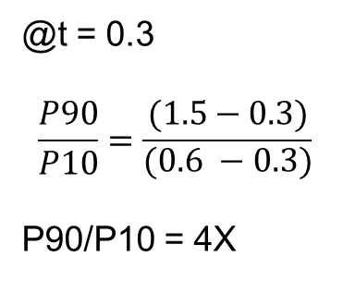
Burnup Projection to P10 and P90
@t = 0.3
P90 = 1.5
P10 = 0.6
@t = 0.3
$$\frac{P90}{P10}=\frac{(1.5−0.3)}{\begin{aligned}(0.6 −0.3) \\ \end{aligned}}$$
P90/P10 = 4X
P10
P90

Slide 43
What do we see in Projections?
Discovery: Velocity and Throughput provide comparable accuracy in forecasting release date
Notes:
Velocity and Throughput projection error bounds are nearly identical. The ratio of P90/p10 is roughly 4 for both. The ratio of the Velocity P90/P10 to the Throughput P90/P10 is basically 1.0.

Slide 44
Question:
Do we get better at estimating the further we go in a project?
(or: does our velocity become more stable over time?)

Slide 45
What do we see in Velocity?
Discovery: Velocity predictability does not get better over time.
Notes:
Velocity predictability does not get better over time. It starts out sucking (P90/P10 of 4.0 and actually gets a bit worse at 6.0+ This is counter to what we have been led to believe by the Cone of Uncertainty.

Slide 46
Conclusions from the Data
Story point estimations did not provide any improvement in predictive power over just counting stories.
Velocity and throughput both showed a high variance and that variance did not decrease (actually increased) over time.
About 50% of the projects required a “hardening” phase of from 2-12%.
While throughput is as good of a predictor as velocity, neither is a great predictor as the P90/P10 ratio is about 3.5.
  if the burnup forecasts 6 months remaining, the P10 to P90 bands are roughly 3.2 to 11.2 months.

Slide 47
How about a Simulation
Simulated 1000 projects with 50 stories per project
  Story Point Distribution
  Estimation Accuracy
  Bucketing Approach
  Hardening Effort
Output
  Distribution of Projections
    Velocity
    Throughput
Monte Carlo Engine
SP Distribution
Estimation Accuracy

Slide 48
How about a Simulation
Discovery: We can run a computer
simulation that produces results similar to the measured data.
Notes:
Main point here is that we were able to come close to matching the raw data with the simulation,. That let’s us explore some of the parameters to see which ones influence the results.

Slide 49
Typical Distributions (From Troy Magennis)

Slide 50
Simulation Results – What If?
What if we look at the observed data?
  Throughput and Velocity give nearly identical results (Throughput slightly better)
What if we have a large distribution in story size?
  Velocity (Story Point Estimates) is better
What if we are really good at estimation?
  Somewhat surprisingly, if Story Point Distribution is not large, improving Estimation Accuracy helps Throughput as much as it helps Velocity
What if we use buckets such at Fibonacci (planning poker) or 2X etc.?
  Using buckets, such as Planning Poker modified Fibonacci, power of 2, or even power of 4 did not significantly impact the difference between velocity and throughput accuracy.

Slide 51
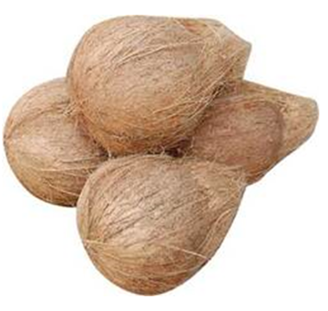
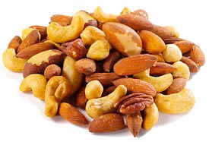
What do the simulations tell us
Estimating Mixed nuts…..

Slide 52
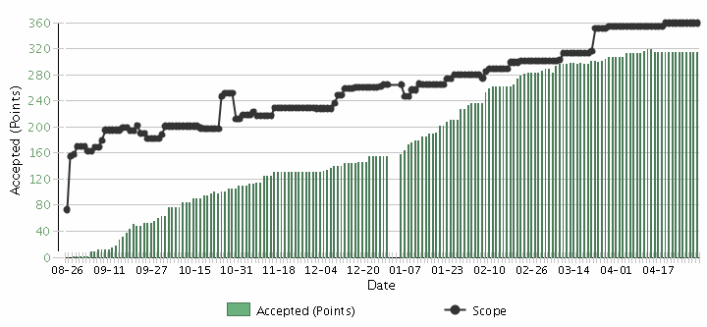
What does this tell us about Estimation?
Decisions to steer towards the release | Velocity and Throughput are equally good AND equally bad predictors, but better than nothing.
Scope Creep
Velocity

Slide 53


Slide 54
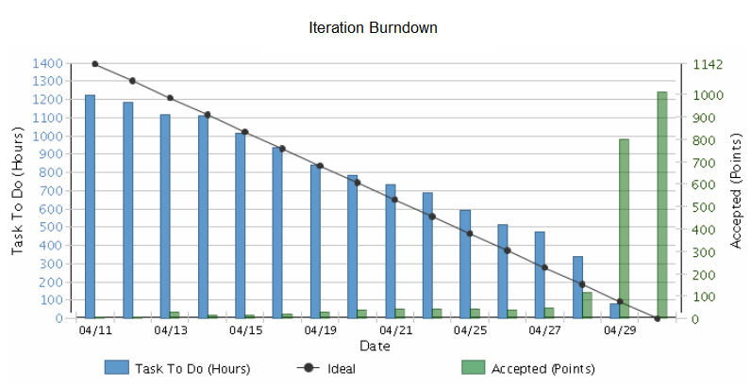
What does this tell us about Estimation?
Decisions to help with managing iterations | Do task estimates add value? What decisions are you making based on what you assume?

Slide 55
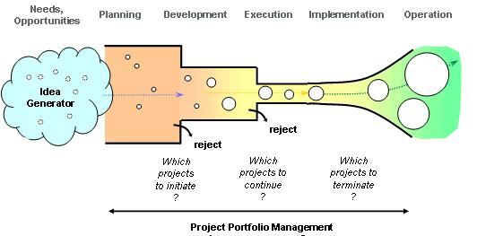

What does this tell us about Estimation?
Decisions at project sanction | Some level of macro-estimation of costs and benefits is likely necessary for business decisions. In general it is waste to spend more time on cost estimation than on benefits.

Slide 56
Comparison to other Research

Slide 57
IEEE Software, May/June 2006
Notes:
This is from an IEEE Software article that I published in May 2006

Slide 58
Accuracy of Initial Estimate

Slide 59
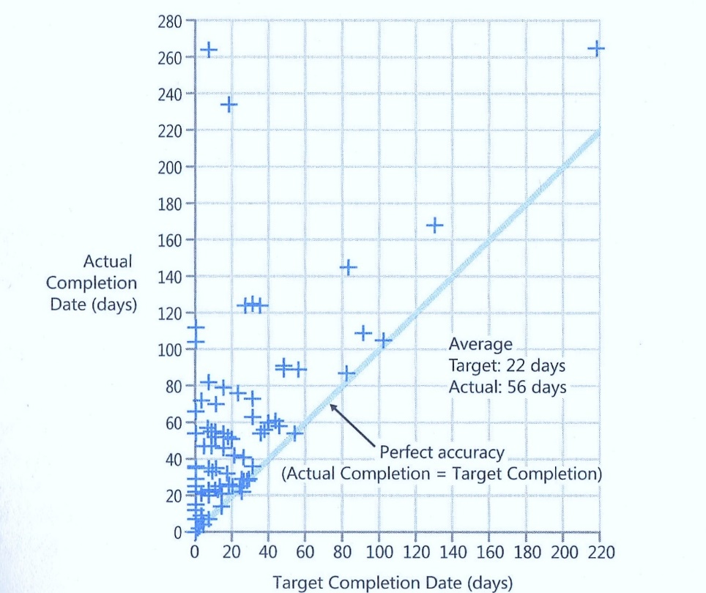
Data From Steve McConnell

Slide 60
Actual vs. Original Estimate
P90/P10 = 4

Slide 61
Jørgensen 2013
Put software development project for bid on online marketplace vWorker.com
Received 16 bids.
Reduced down to 6 bids from vendors that had high (9.5) client satisfaction.
All 6 bidders went ahead and built the software

Slide 62
Jørgensen 2013
Highest Estimate 8x the Lowest
Actual/Estimate Range: 0.7 – 2.9 (4x)
Actual Performance Range: Worst took 18X the effort of the best

Slide 63
#1: Story Point Estimates improve predictability.

Slide 64
#2: Velocity Improves over Time

Slide 65
#3: Velocity Variation Stabilizes over Time

Slide 66
#4: We’re Good at Estimating Smaller Stories

Slide 67
#5: We’re pretty good at estimating things relatively

Slide 68
Relative Sizing - Dimensionality
Low by 4X

Slide 69
#5: We’re pretty good at estimating things relatively

Slide 70
#6: We’re a bit behind, but we’ll make it up in testing since most of our uncertainty was in the features.

Slide 71
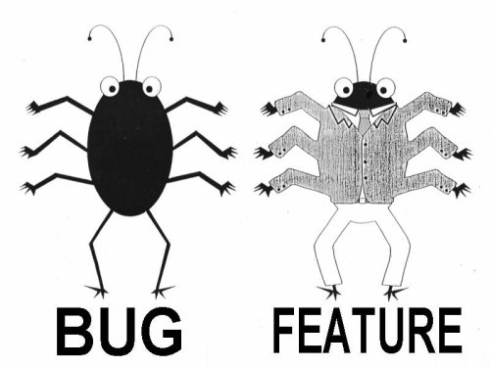
Lan Cao - Estimating Agile Software Project Effort: An Empirical Study
2X
Uncertainty
Notes:
Lessons learned: If uncertainty is high, work on it earlier. Reduce Technical Debt—Get to potentially shippable at each iteration. Finding and fixing the last bugs has high uncertainty – plan on there being uncertainty.

Slide 72
#6: We’re a bit behind, but we’ll make it up in testing since most of our uncertainty was in the features.

Slide 73

#7: Scope Creep is a major source of estimation error.

Slide 74
We want this
Innovation
Revenue
Predictability
Efficiency
CLOUD
Social Networking
Late projects
Mobility
Integration
SOA
Business
Intelligence
BPM
Agile
Notes:
Chris taped one of the investment bankers at his previous job

Slide 75
Scope Creep
Capers Jones
  2% per month
  27% per year
Scope Creep
Velocity

Slide 76
Estimate Velocity Net of Scope Creep

Slide 77
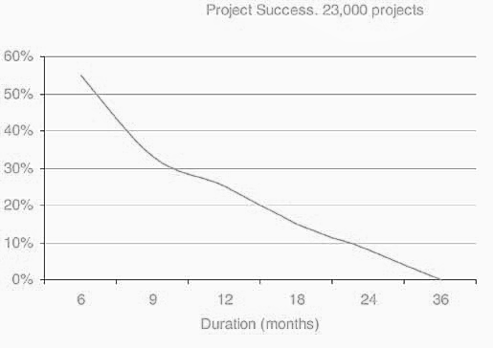
Success vs. Project Duration -- Larman / Standish

Slide 78
#7: Scope Creep is a major source of estimation error.

Slide 79
#8: Having more estimators, even if they are not experts, improves estimation accuracy

Slide 80
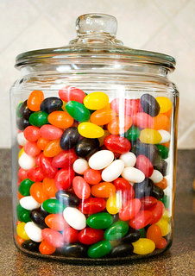
Group Estimation Exercise
Number of Jellybeans in the jar

Slide 81

Jellybean Results
Type of Estimate | Typical Ranges
Individual Estimates | 0.30 – 1.8 (6X)
Groups (of ~6) | 0.75 – 1.50 (2X)
Average of the Individuals | 0.80 – 1.20

Slide 82
Ask the Team

Slide 83
#8: Having more estimators, even if they are not experts, improves estimation accuracy

Slide 84
#9: Project success is determined by on-time delivery

Slide 85
Delivery Challenges/Failures
Standish Group 2006, reported by CEO Jim Johnson, CIO.com, ‘How to Spot a Failing Project’
Notes:
Delivery failures are well documented in the software business.
This is the classic report from Standish showing only 35% of projects delivered on time with expected features. 46% were challenged and 19% were killed. This is from 2006, and is a substantial improvement from the 19% success rate in 1996.

Slide 86

Wrong Priorities
The Cost of Crap
Notes:
The first generation of Ford Taurus turned out to be the best selling car in America in the
late 1980s. Conceived in the 1980's and introduced in 1986, it set the standard for new practices
in project management and product development. It was one of the early projects in the U.S.,
which fully utilized the concept of cross-functional teams and concurrent engineering practices.
It established close ties with vendors and subcontractors, and was characterized by a spirit of
cooperation and strong synergy among teams. The result was a remarkable market and business
success. Its revolutionary design and outstanding quality, created a new trend in the U.S.
automobile industry, and customers simply loved the car. Yet, when the project was completed,
the project manager was fired. His “sin” was that project completion was delayed by six months.
In contrast, the second generation of Ford Taurus was developed in the early 1990s and
2
completed in 1995. With increased competition and the enormous success of Japanese imports,
Ford had hoped to reestablish Taurus, once again, as the best selling car in America. But the new
project manager learned the lesson of his predecessor: He considered project schedule as a “holy
grail,” and made sticking to the completion date the ultimate goal, while sacrificing other things.
Vendor relationships, team spirit, and product integration were just few of the issues that
suffered. The second generation of Taurus turned out to be a disappointing business experience.
It did not recapture the position of the best selling car in America and Ford was not able to repeat
its outstanding success of the first Taurus.

Slide 87

Poker Metric:
Percent of Hands Won

Slide 88
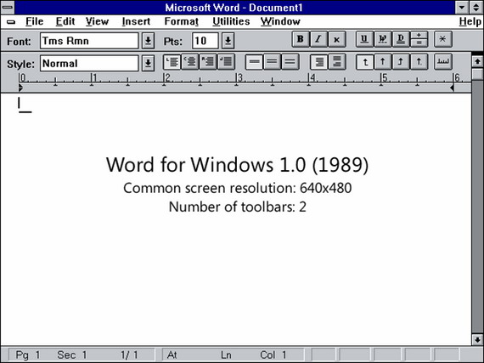
Software Metric – On Time%
Initial Estimate 1 year
Actual Delivery 5 years

Slide 89
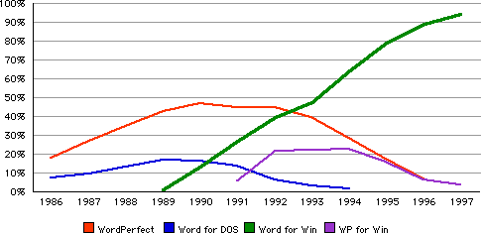
Value Metric

Slide 90

The Measurement Inversion
Lowest
Information Value
Cost & Time
Most Measured
Highest Information Value
Value Delivery
Least Measured

Slide 91

Why do we care about on-time delivery?

Slide 92
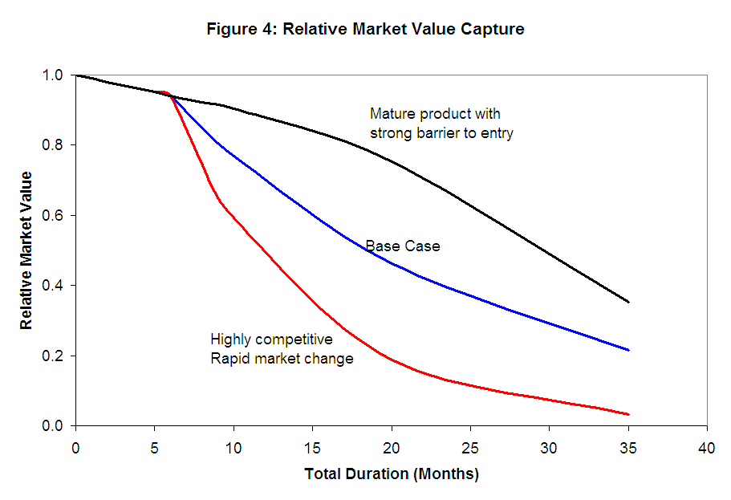
Impact of Delay

Slide 93
#9: Project success is determined by on-time delivery

Slide 94
#10: Estimation is waste

Slide 95
#10: Estimation is waste

Slide 96
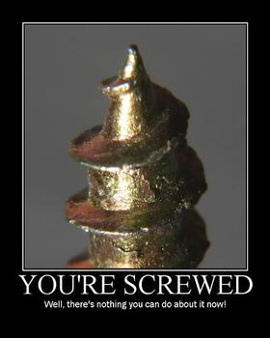
How many of you consider it to be a major part of your job to either create estimates or deliver against someone’s estimates?

Slide 97
Now What?

Slide 98
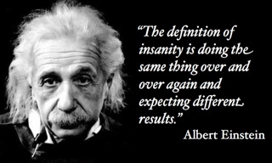
Option 1:
Continue to do the same thing

Slide 99
Option 2:
What about giving a distribution range?

Slide 100




Probability Distribution
Estimate/Actual
TELL ME HOW LONG
IT IS GOING TO TAKE
MEDIAN?
P50
WHAT PEOPLE
EXPECT
Frequency
P10
WHAT PEOPLE
HEAR
MEAN
P90
Actual/Estimated
DeMarco, Little (approximated)

Slide 101

Option 3:
Get Better at Estimating?

Slide 102
Option 4:
Get Better at Story Splitting?

Slide 103
Option 5:
Get Better at Managing Uncertainty?

Slide 104
The A/B/C List sets proper expectations
A | MUST be completed in order to ship the product and the schedule will be slipped if necessary to make this commitment. The Product Owner will take the heat for the schedule slippage.
B | Is WISHED to be completed in order to ship the product, but may be dropped without consequence.
C | Is NOT TARGETED to be completed prior to shipping, but might make it if time allows.
Only “A” features may be committed to customers.
If more than 50% of the planned effort is allocated to “A” items the project is at risk.
Notes:
(MoSCoW for Pre-Schoolers) But actually an improvement on MoSCoW. The English language is loaded. “Should” implies that if I don’t deliver it is a failure. On the other hand, by calling a “B” a “wish” I’m actually happy if it is delivered. The definition of “A” is critical. It is the Product Owner that is taking the heat for a schedule slip. This is a huge change for many teams.

Slide 105
A/B/C List
50%
25%
25%
A
B
C
D
Typical Delivery
C
A
B
Backlog Plan
Target Delivery Date
50%
100%
Notes:
We devise a plan where we look to lock down the “A” features but we create a buffer capacity by only allocating 50%. If our estimates are close then deliver all the “A”s, but we find that some of the “C”s were actually higher priority and that there were a number of “D”s that were discovered during the development. But, what if the “A”s turn out to be harder than we thought?

Slide 106
A/B/C List
A
50%
25%
25%
A
B
C
D
Uncertainty Risk
C
A
B
Backlog Plan
Target Delivery Date
50%
100%
Notes:
We devise a plan where we look to lock down the “A” features but we create a buffer capacity by only allocating 50%. If our estimates are close then deliver all the “A”s, but we find that some of the “C”s were actually higher priority and that there were a number of “D”s that were discovered during the development. But, what if the “A”s turn out to be harder than we thought?

Slide 107
Option 6:
Get Better at Continuous Delivery (DevOps)?

Slide 108
Option 7:
Count Stories?

Slide 109
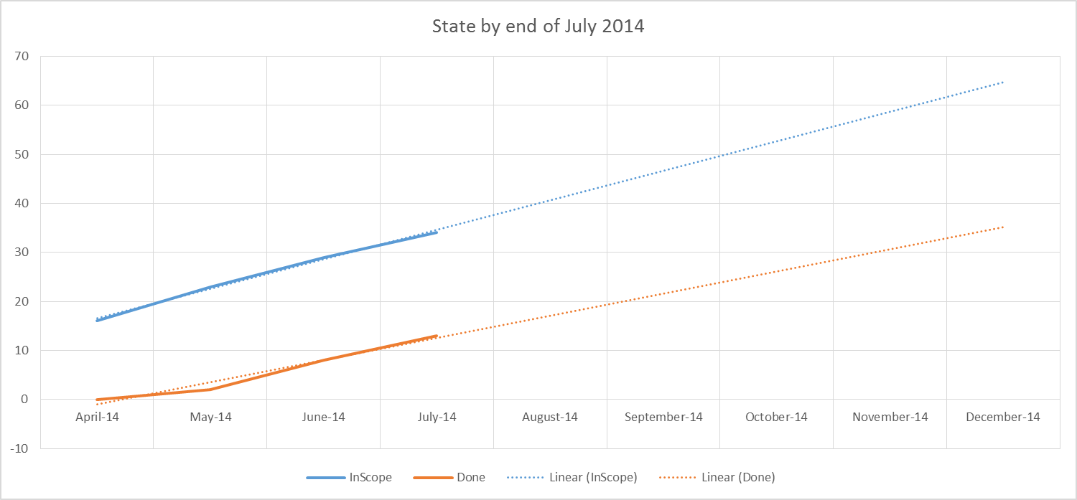
#NoEstimates Example
Count Stories

Slide 110
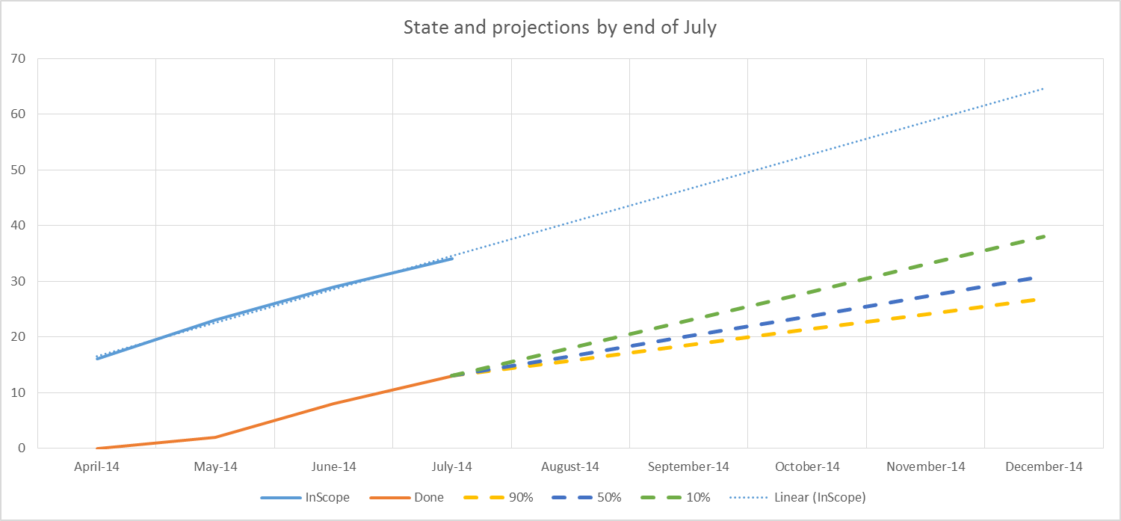
#NoEstimates Example
Count Stories

Slide 111
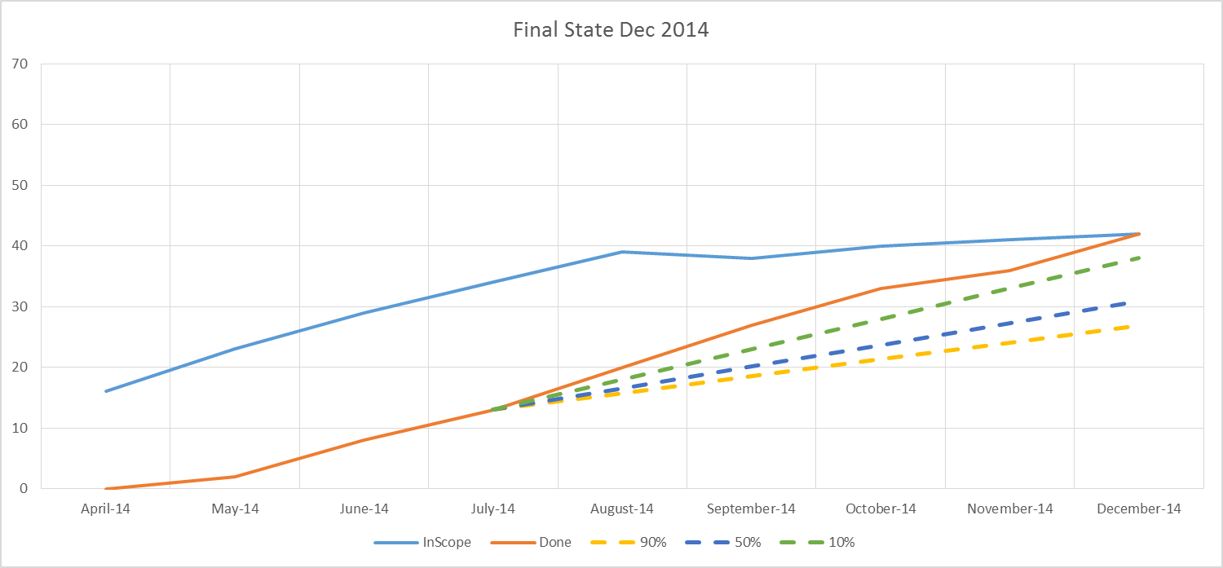
#NoEstimates Example
Count Stories

Slide 112

Estimation Values
Macro-estimates for cost/value tradeoff decisions
  Sometimes useful
Story Point estimates
  Marginal at best
Task estimates
  Probably Waste
Focus on value and use data to make decisions
  Priceless
There are sometimes that estimates are useful, for everything else there's #NoEstimates

Slide 113
What would Polonius Say?
Neither an Estimator nor a #NoEstimation bigot be, for estimation oft implies a false sense of both accuracy and certainty, while NO estimates may make suboptimal decisions. To thine own self (and team) be true.
“
”

Slide 114
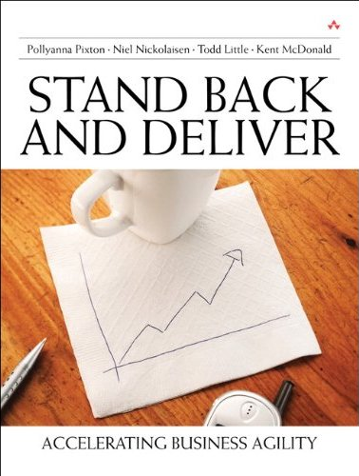

Contact
  toddelittle@gmail.com
  www.toddlittleweb.com
  www.accelinnova.com
  @toddelittle
  www.linkedin.com/in/toddelittle/

