Slide 1

Risky Business: Real Options for Software Development
Todd Little
@toddelittle

Slide 2

Risky Business
Risky Business

Slide 3
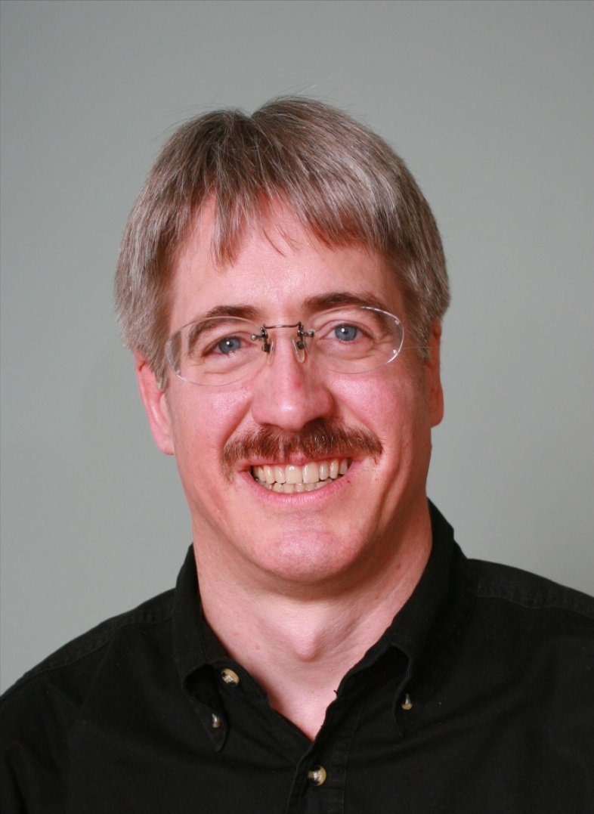


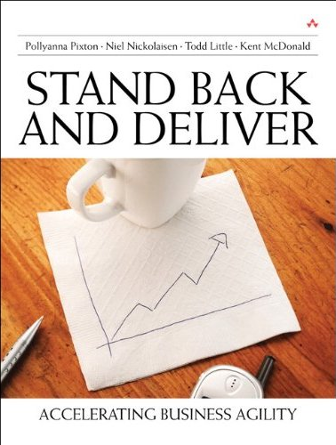



About Todd
Executive roles as VP Product Development, Director of Software & Technology
@toddelittle
Notes:
Director – company called IHS until a few days ago
Just merged – 9,000 – 15,000
Information & analytics company, verticals
Performance reviews 10 years – mistake
Stopped laughing – launch
3 years ago – working off and on

Slide 4
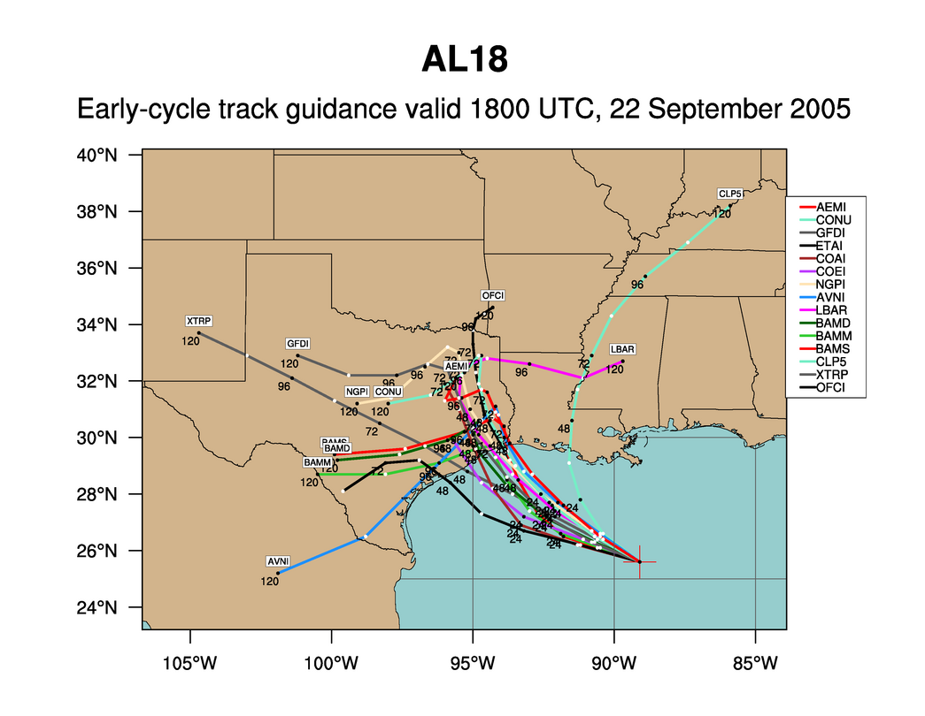
Weather Forecasting:
Hurricane Rita
Notes:
What can we say about every one of these predictions? They are wrong. But the collective set of predictions is quite useful. Which is more important when predicting hurricanes – where it hits or when it hits? Ok, both are important, but where is much more important than when. If you are in Florida you don’t really care when it hits. But once you know it has a chance to hit Houston then it is very important to know when it might hit.

Slide 5
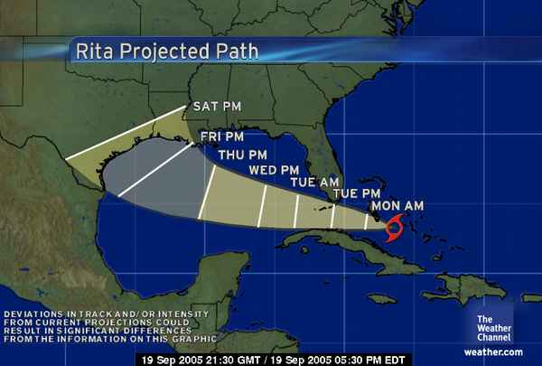
The Cone of Uncertainty
We expect uncertainty and manage for it through iterations, anticipation, and adaptation.
Notes:
Inspection and adaptation is the answer. Iterations help bring in new information

Slide 6



Managing the Coming Storm
Inside the Cyclone
Project Kickoff
When will we get the requirements?
All in good time, my little pretty, all in good time
But I guess it doesn't matter anyway
Just give me your estimates by this afternoon
Team Unity
Not so fast! Not so fast! ... I'll have to give the matter a little thought. Go away and come back tomorrow
No, we need something today!
Ok then, it will take 2 years.
No, we need it sooner.
Doesn't anybody believe me?
I already promised the customer it will be out in 6 months
You're a very bad man!
Notes:
We look at a typical software project…..

Slide 7


We’re not in Kansas Anymore
Developer Hero
I may not come out alive, but I'm goin' in there!
Reorg
The Great and Powerful Oz has got matters well in hand.
My! People come and go so quickly here!
Testing
"Hee hee hee ha ha! Going so soon? I wouldn't hear of it! Why, my little party's just beginning!

Slide 8
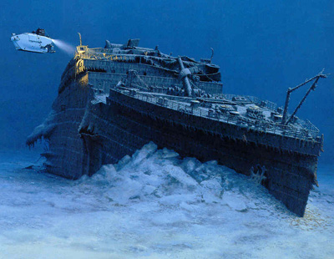

Movies
78% of Films Lose Money
6% of films make 80% of profit
Notes:
Most movies strive to be the next Titanic, the largest grossing film of all time.
The reality is that the vast majority really do end up closer to the real Titanic than to the movie Titanic.

Slide 9
Books
300,000 in 2004,
<25% sold more
Than 100 copies
Notes:
Books. Here is my book. Doesn’t it look like it is chock full of useful stuff?
But only 25% of books sell more than 100 copies. Please do your part so that I am not part of that statistic.

Slide 10

Poker

Slide 11

Poker Metric:
Percent of Hands Won

Slide 12
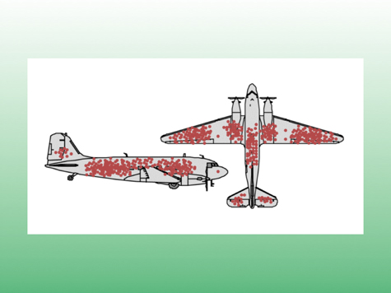
The Context of Feedback

Slide 13
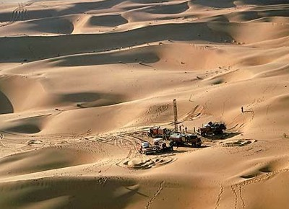
Oil & Gas Exploration
Notes:
Oil exploration is highly risky. It used to be that 10% was a good find rate for wildcat wells. Based on improvements in technology this is closer to 20%. Still risky, but that risk is acceptable because the payout is enormous. The key is having a diversified portfolio to balance the risk exposure.

Slide 14
Oil & Gas Exploration
90-80% Failure
Notes:
Oil exploration is highly risky. It used to be that 10% was a good find rate for wildcat wells. Based on improvements in technology this is closer to 20%. Still risky, but that risk is acceptable because the payout is enormous. The key is having a diversified portfolio to balance the risk exposure.

Slide 15
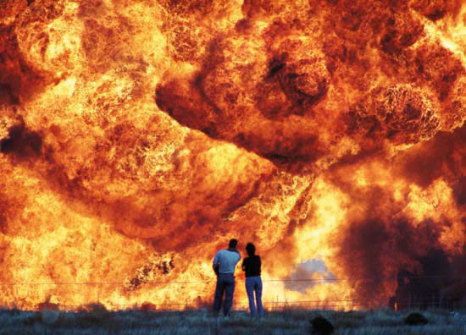
I’m beginning to think it wasn’t such a good idea to turn off those unit tests
Notes:
Safety is not to be messed with.
Test, Test, Test
Test again with real data
Test, Test, Test
Test again with real data

Slide 16

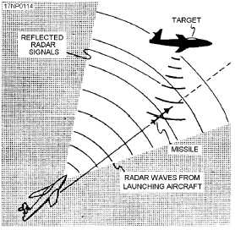
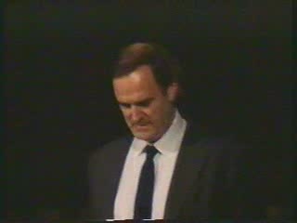
Gordon the Guided Missile

Slide 17
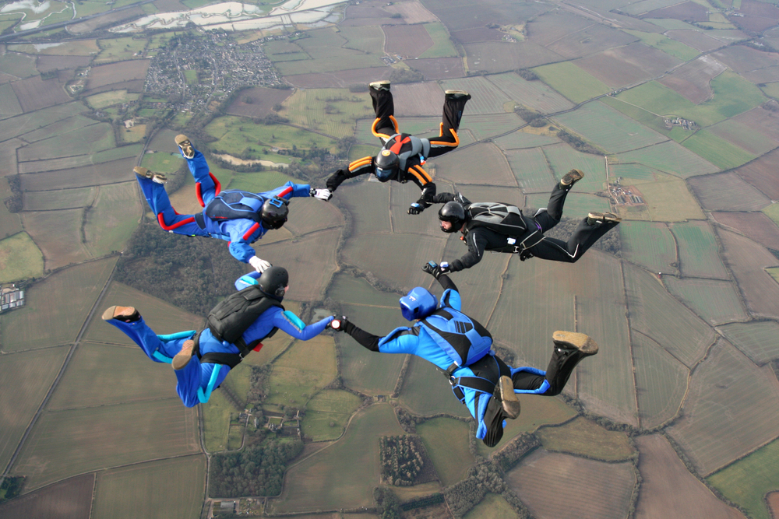
Risk management tools
Risk Management Tools

Slide 18
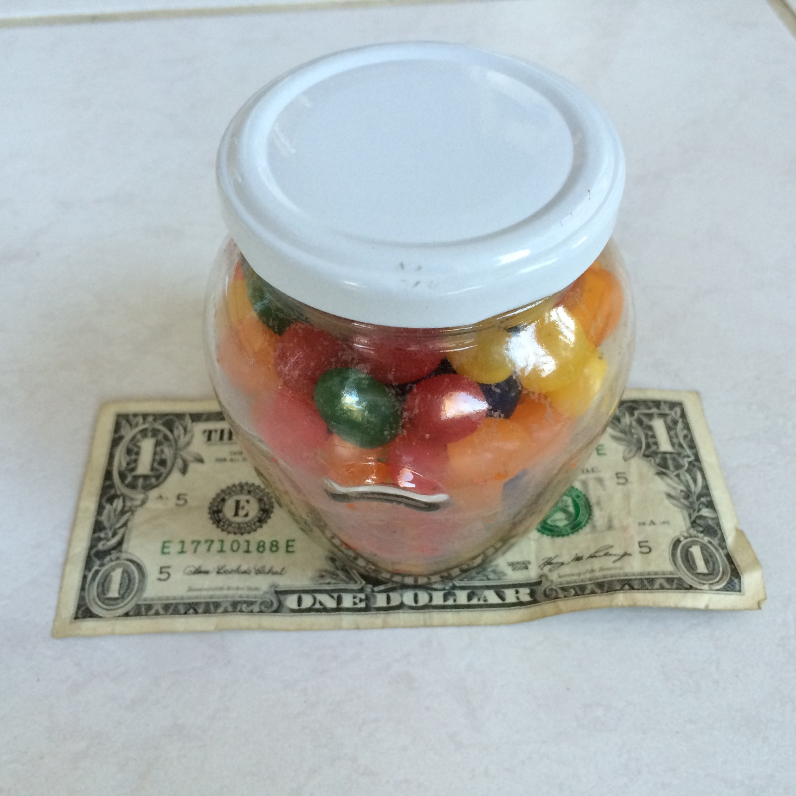
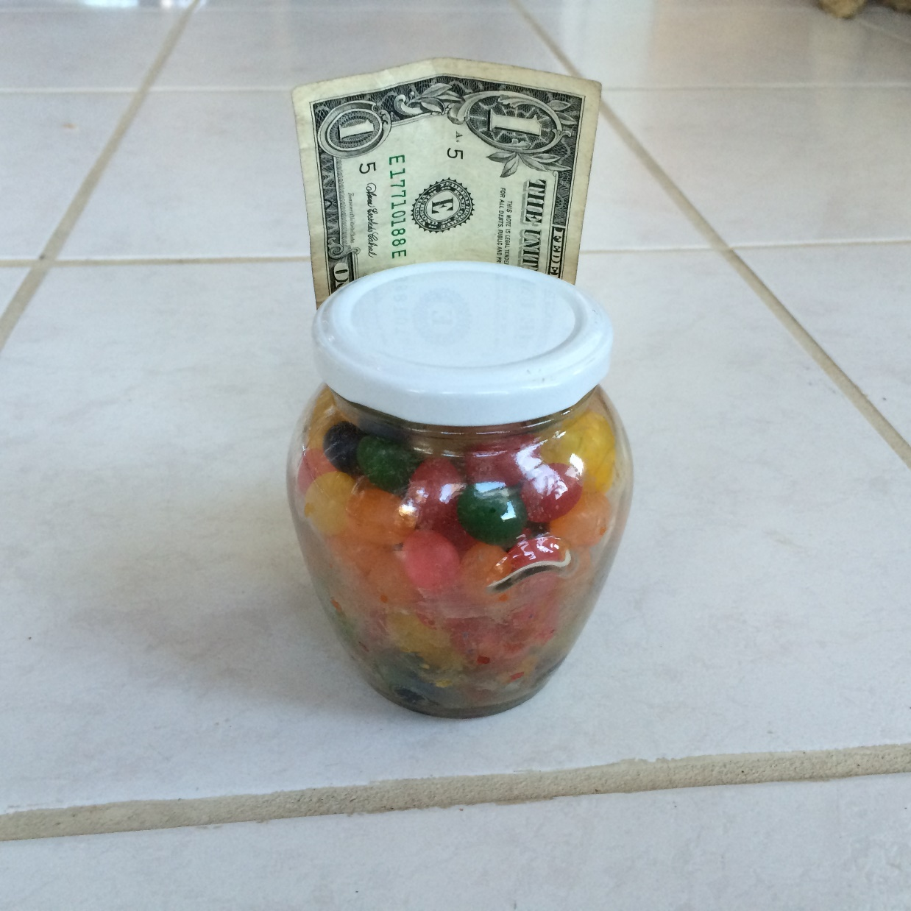
Estimate the # of Jelly Beans

Slide 19
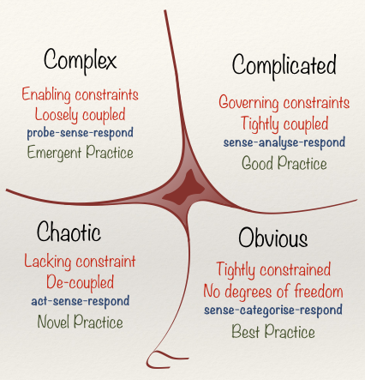
Cynefin Framework
(Snowden)

Slide 20
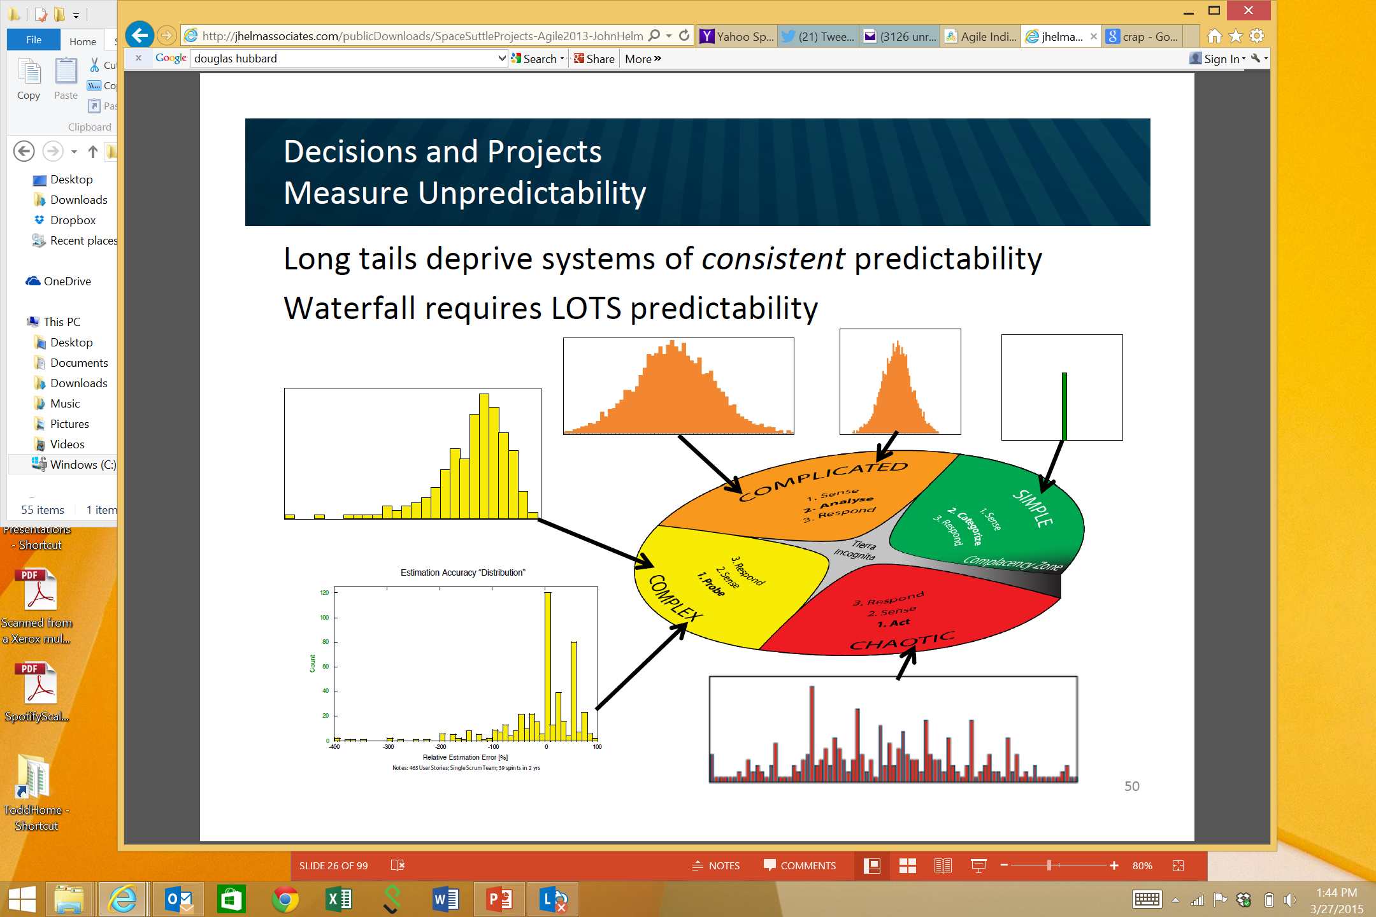
Obvious
Distribution
Input
Output
Cause and Effect Obvious to all
Known - Knowns
Sense - Categorize - Respond
apply best practice
Example: Manufacturing

Slide 21
Complicated
Analysis
Input
Output
Distribution
Cause and Effect Requires Analysis
Known - Unknowns
Sense - Analyze – Respond
apply good practice
Example: Incremental Product Development

Slide 22
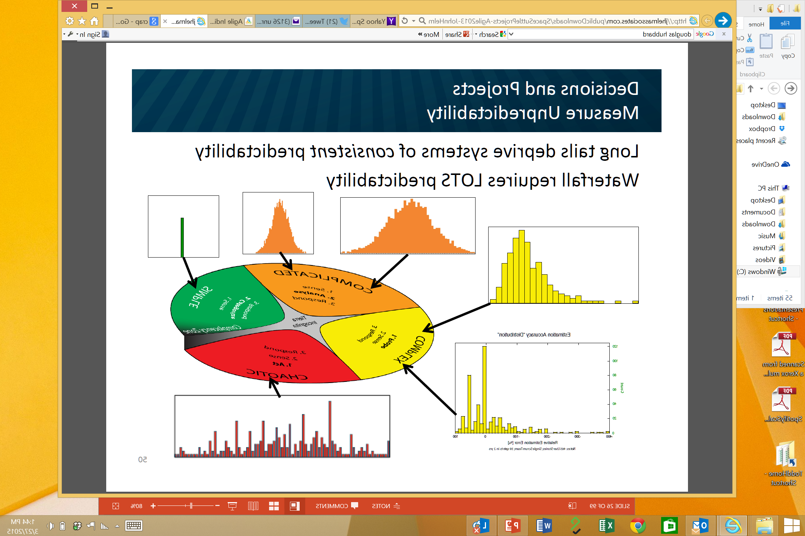
Complex
Distribution
Input
Output
Cause and Effect perceived in retrospect
Unknown - Unknowns
Probe - Sense – Respond
sense emergent practice
Example: New Product Development

Slide 23
Chaotic
Output
Distribution
Input
No Relationship between Cause and Effect
Unknowables
Act - Sense - Respond
discover novel practice.
Example: Medical Emergency

Slide 24
Control Systems
Processes
Inputs
Inputs
Inputs
Command & Control
Processes
Inputs
Inputs
Inputs
Agile Leadership
Outputs

Slide 25
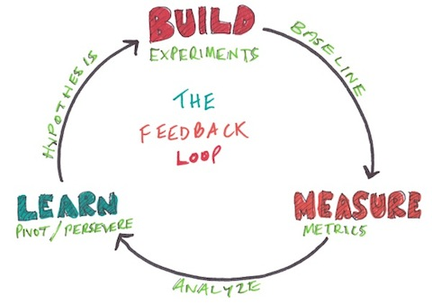
Lean startup

Slide 26
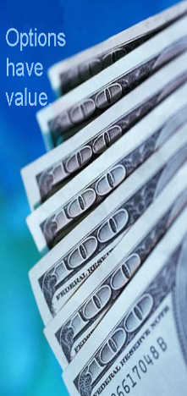


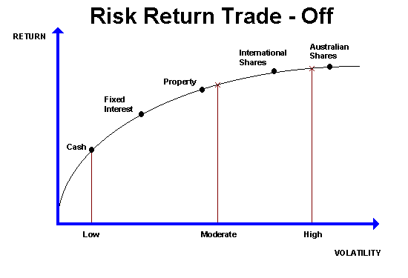

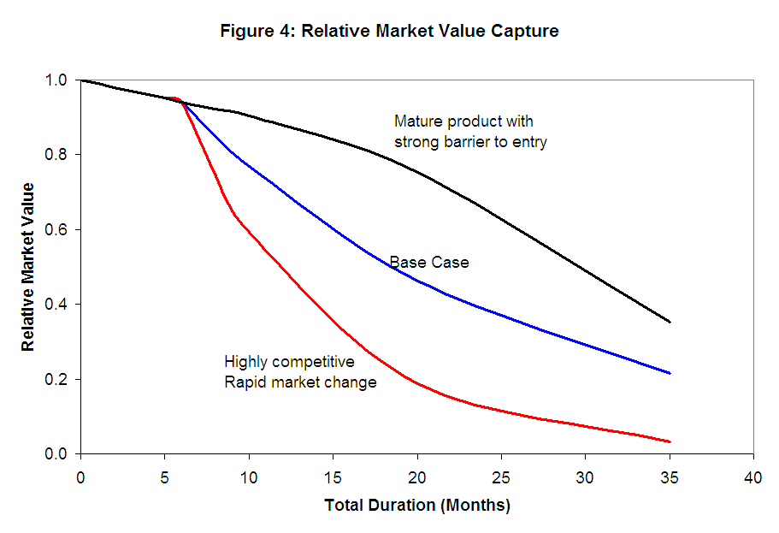

Real Options
Value of Uncertainty
Value of Flexibility
Tornado Chart
Value of Information
Cost of Delay

Slide 27

Real Options
The right — but not the obligation — to undertake certain actions prior to an expiry date

Slide 28
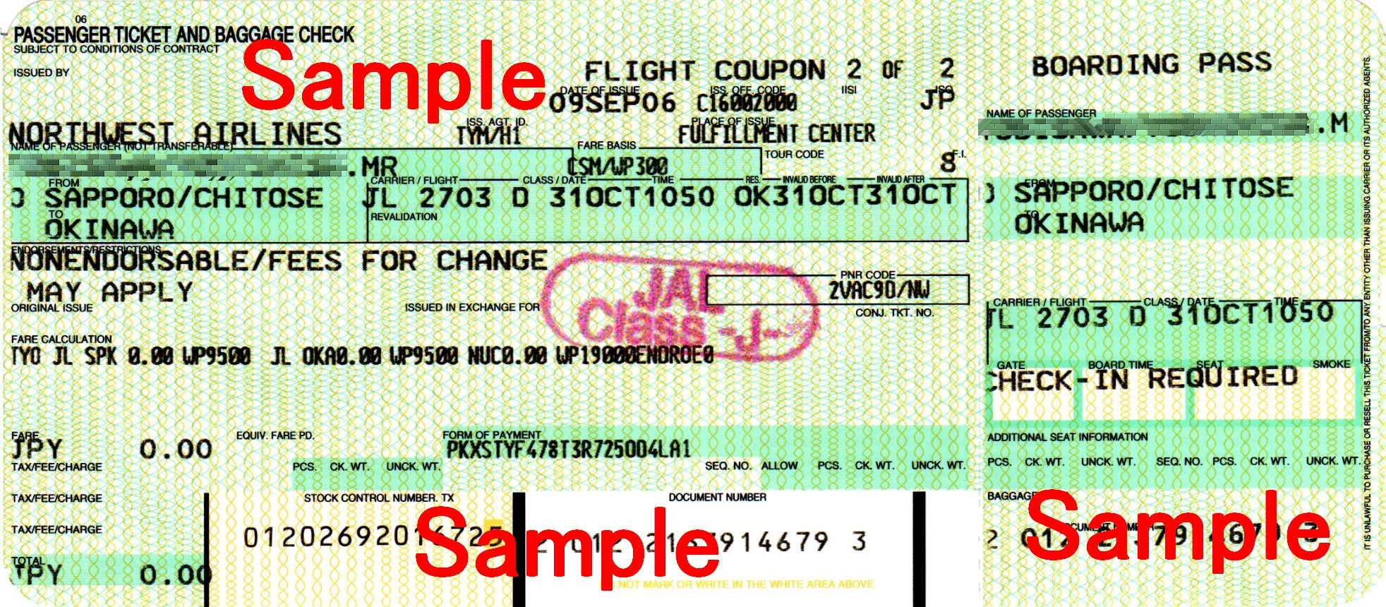
Airline Tickets
The right — but not the obligation — to undertake certain actions prior to an expiry date

Slide 29
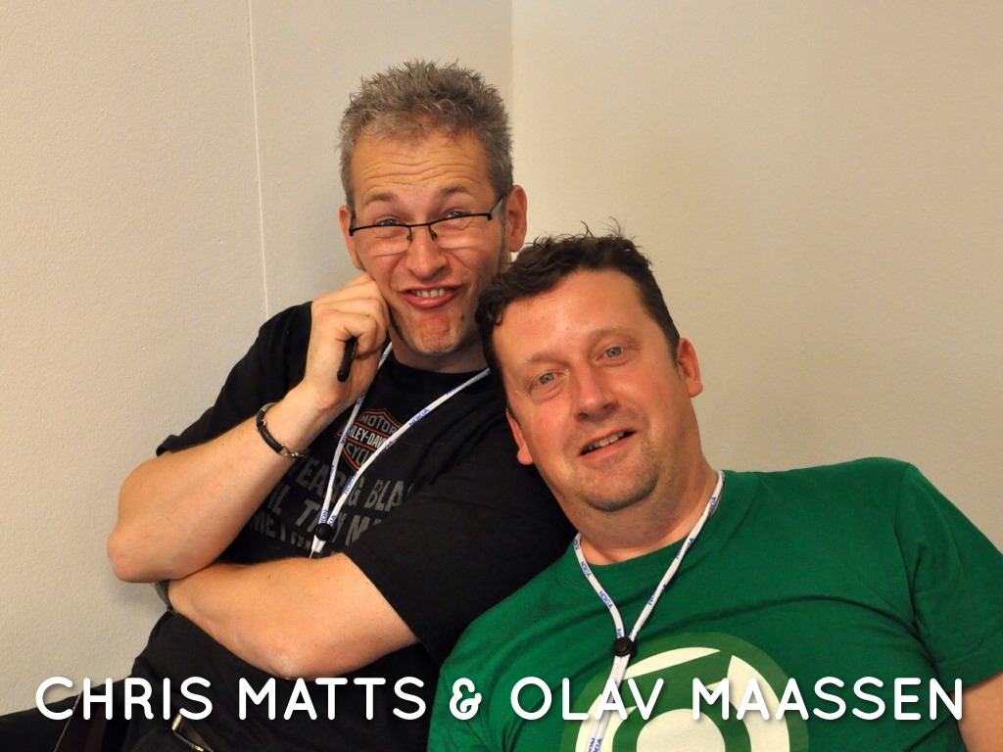
Real Options

Slide 30

Real Options
The right, but not the obligation to take some action prior to an expiry date

Slide 31
Do you have a choice?
Option
Decision
Commitment

Slide 32

Notes:
http://www.flickr.com/photos/nick_anderson/5049751331/sizes/m/in/photostream/

Slide 33
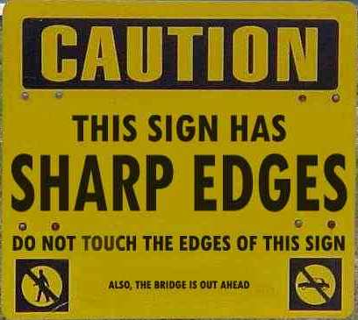
Which risks are important?
Notes:
Which risks are important? The sharp edges of the sign or the fact that the bridge is out ahead?

Slide 34
Tornado Chart: Which Uncertainties Are Important?
Notes:
Oil and gas geologists and engineers build models to help them comprehend the uncertainties. This is a tornado chart, because it looks like a tornado. This chart clearly shows that the largest uncertainty is associated with Reserves, with the next largest uncertainty being oil/gas price. This gives the engineer something to focus on. Perhaps there is additional data that can be collected to help reduce the uncertainty bars. There may not be anything that can be done about Oil/gas price. Perhaps futures contracts could be used to hedge some of the uncertainty. The other uncertainties may not be worth spending too much time since they have limited effect on the total uncertainty.

Slide 35
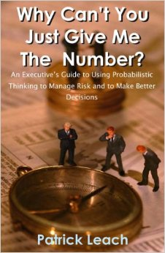
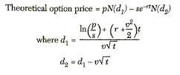
Value of Uncertainty
What is the source of all value?

Slide 36
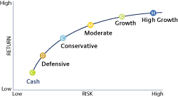
Eliminating Risk/Uncertainty is not the Goal!
Efficient Frontier

Slide 37
Software Tornado Example
Item | -15M |  | 0M |  | 15M |  | 30M |  | 45M
Product Acceptance Uncertainty |  |  | ██ | ███ | ███ | ███ | ███ | ███ | ███
Schedule Uncertainty |  |  | █ | ███ | ███ | ██
General Market Uncertainty |  |  |  |  | ██ | ██
Cost Uncertainty |  |  |  |  | ██ | █

Slide 38
Software Tornado Example
Item | -15M |  | 0M |  | 15M |  | 30M |  | 45M
Product Acceptance Uncertainty |  |  |  | ███ | ███ | ███ | ███ | ███ | ███
Schedule Uncertainty |  |  |  | ███ | ███ | ██
General Market Uncertainty |  |  |  |  | ██ | ██
Cost Uncertainty |  |  |  |  | ██ | █

Slide 39
Software Tornado Example
Item | -15M |  | 0M |  | 15M |  | 30M |  | 45M
Product Acceptance Uncertainty |  |  |  | ███ | ███
Schedule Uncertainty |  |  |  | ███ | ██
General Market Uncertainty |  |  |  | ██ | ██
Cost Uncertainty |  |  |  | ██ | █

Slide 40
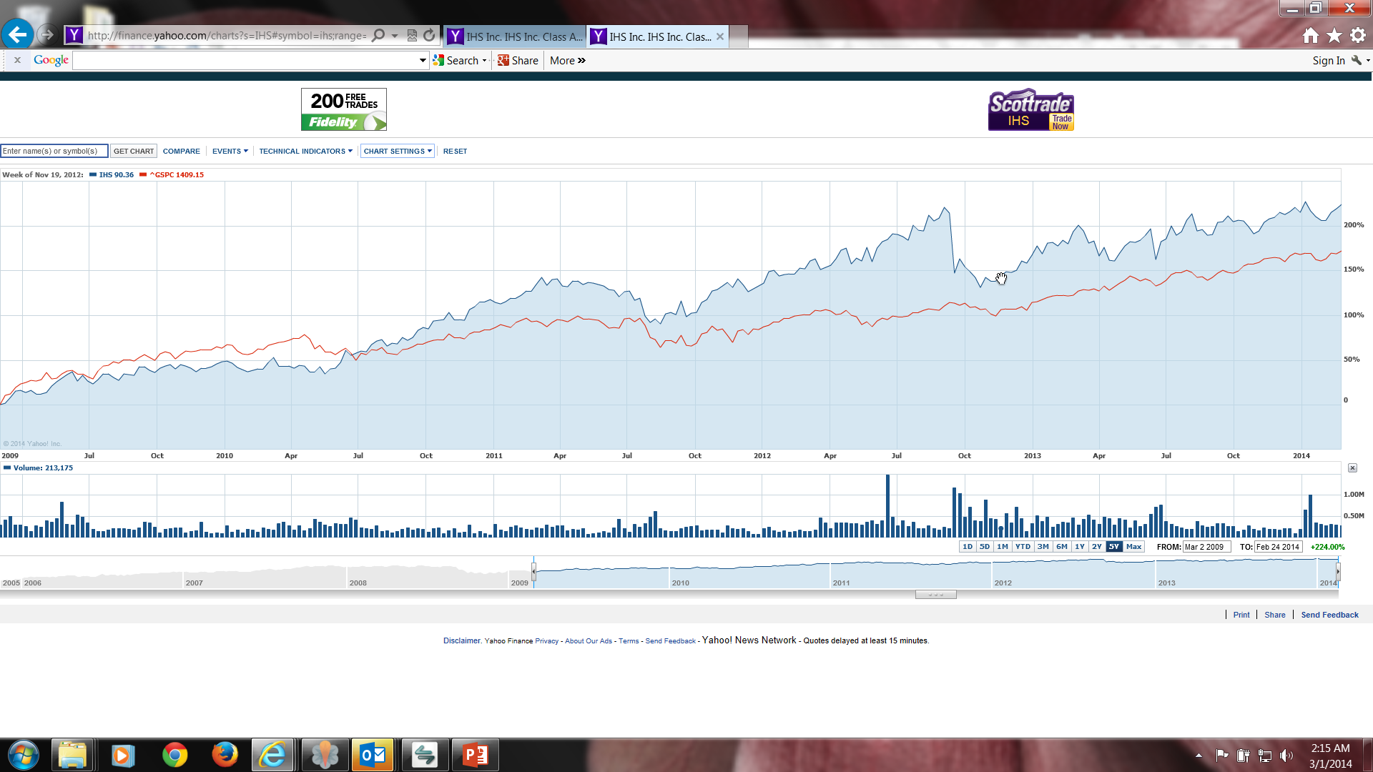
Value of Information

Slide 41
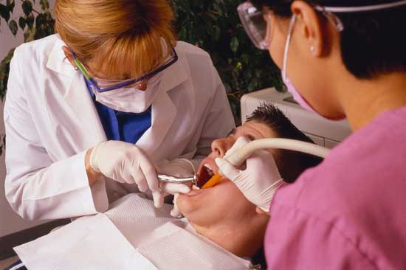
Value of Information

Slide 42
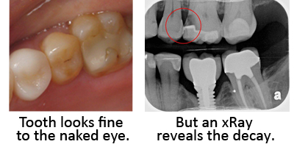
Value of Information

Slide 43
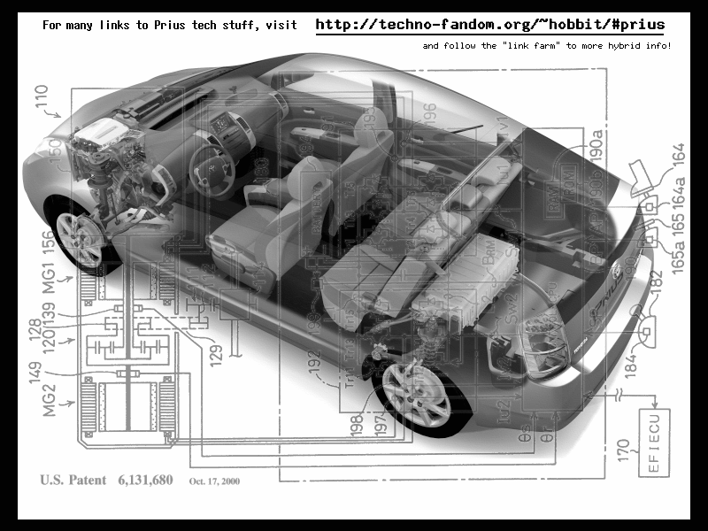
Value of Flexibility
Notes:
9 research projects for drive train
1 chassis – same hole for all 9 drive trains
VOI from 9 research projects, VOF from chassis design
Contrast this with the development of the Prius. Toyota had 9 different research projects running to develop hybrid engine technologies. Normally they would choose a drivetrain first, and build a car around it. Instead Toyota decided to keep its options open, and designed the Prius with a hole in it for the drive train. The 9 research projects continued, and 9+ months after the Prius development project was started, a drive train was chosen. Toyota knew that this car needed a radically new drive train architecture. Instead of guessing and choosing one, they let all 9 research projects continue their work, and as they did, the best option for the car's engine became clear. So was 9 research projects a waste? No because each project was generating factual information about the options for hybrid engine design, information that Toyota engineering management needed to make an informed choice.

Slide 44
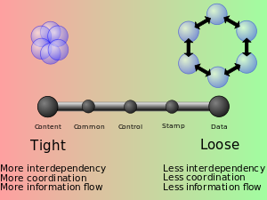
Value of Flexibility from Loose Coupling

Slide 45


Slide 46
Cost of Delay
Value Loss from Delay

Slide 47
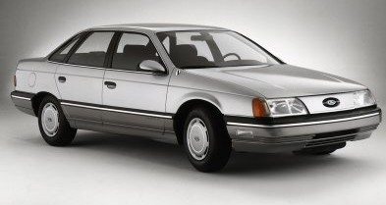
Wrong Priorities?
Notes:
The first generation of Ford Taurus turned out to be the best selling car in America in the
late 1980s. Conceived in the 1980's and introduced in 1986, it set the standard for new practices
in project management and product development. It was one of the early projects in the U.S.,
which fully utilized the concept of cross-functional teams and concurrent engineering practices.
It established close ties with vendors and subcontractors, and was characterized by a spirit of
cooperation and strong synergy among teams. The result was a remarkable market and business
success. Its revolutionary design and outstanding quality, created a new trend in the U.S.
automobile industry, and customers simply loved the car. Yet, when the project was completed,
the project manager was fired. His “sin” was that project completion was delayed by six months.
In contrast, the second generation of Ford Taurus was developed in the early 1990s and
2
completed in 1995. With increased competition and the enormous success of Japanese imports,
Ford had hoped to reestablish Taurus, once again, as the best selling car in America. But the new
project manager learned the lesson of his predecessor: He considered project schedule as a “holy
grail,” and made sticking to the completion date the ultimate goal, while sacrificing other things.
Vendor relationships, team spirit, and product integration were just few of the issues that
suffered. The second generation of Taurus turned out to be a disappointing business experience.
It did not recapture the position of the best selling car in America and Ford was not able to repeat
its outstanding success of the first Taurus.

Slide 48

The Measurement Inversion
Lowest
Information Value
Cost & Time
Most Measured
Highest Information Value
Value Delivery
Least Measured

Slide 49

Risk Management is NOT Risk Aversion

Slide 50
Contact
Todd Little
  toddelittle@gmail.com
  www.linkedin.com/in/toddelittle/
  @toddelittle
  www.toddlittleweb.com
  www.accelinnova.com

Slide 51

Jellybean Results
Type of Estimate | Typical Ranges
Individual Estimates | 0.30 – 1.8 (6X)
Groups (of ~6) | 0.75 – 1.50 (2X)
Average of the Individuals | 0.80 – 1.20

Slide 52
Actual vs. Original Estimate
P90/P10 = 4

