Slide 1
Agile test automation = big challenges

Slide 2
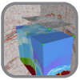
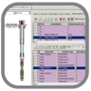
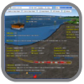
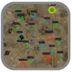
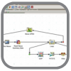
Landmark E&P Ecosystem Collaborative Applications – Data Management – Modern Platform – Expert Services
DecisionSpace Platform
Geosciences
Reservoir
Drilling and Completions
Production
Services and Support
BASIN
GEOPHYSICS
GEOLOGY
EARTH
MODELING
FIELD
PLANNING
SIMULATION
DESIGN
REPORTING
SURVEILLANCE
REAL-TIME
OPTIMIZATION
Data Management

Slide 3
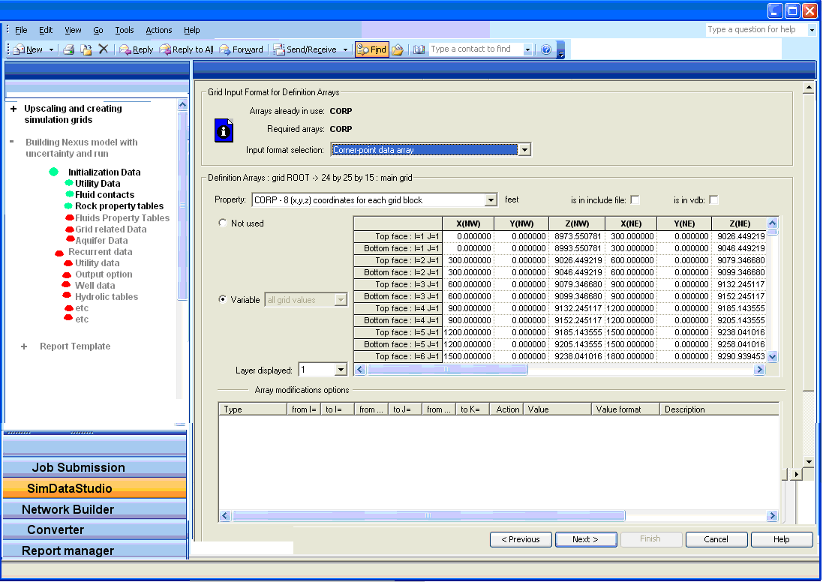
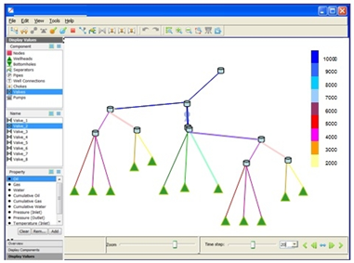
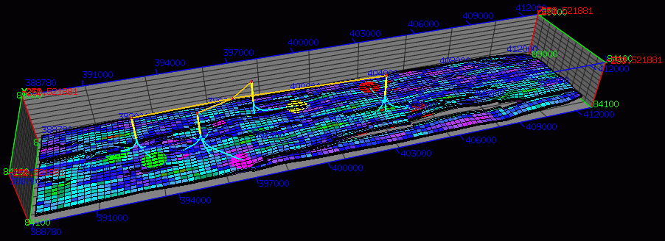
System Workflow
User Interface
Graphical Pre-Processing
Graphical Post-Processing
High Performance Cluster

Slide 4
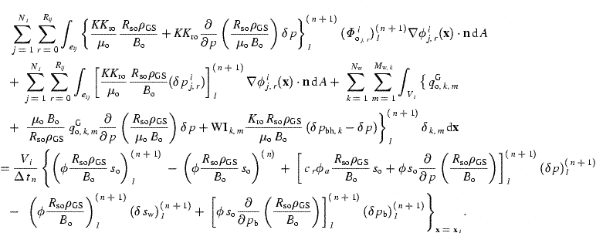
Computing Challenges
Some Simulations can take hours or days, or even …
Our Testers are Petroleum Engineers, not Test Automation Specialists.
Numerical Simulation is an approximation and as such is subject to round-off and/or perturbation differences.

Slide 5
Agile/Scrum in a Nutshell
24 hours
Backlog tasks
1-4 weeks
Iteration Backlog
Potentially Shippable
Product Increment
Release Backlog

Slide 6
Testing and Automation Strategy
Customer Models
Weekly
Complexity of Tests
Smoke Tests (manual)
Nightly
Every Check-in
Developer Tests
Breadth of Coverage

Slide 7
Testing and Automation Strategy
Customer Models
Weekly
Gap
Complexity of Tests
Smoke Tests (manual)
Nightly
Every Check-in
Developer Tests
Breadth of Coverage

Slide 8
Testing and Automation Strategy
Customer Models
Weekly
Complexity of Tests
Nightly
Mid-Tier Tests
GUI Tests (automated)
Smoke Tests (manual)
Nightly
Developer Tests
Every Check-in
Breadth of Coverage

Slide 9
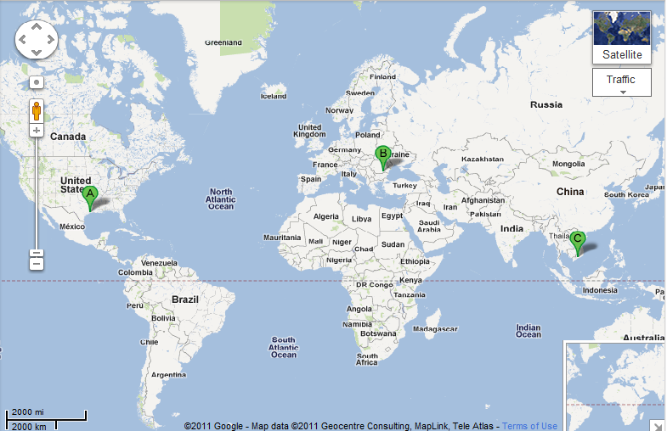
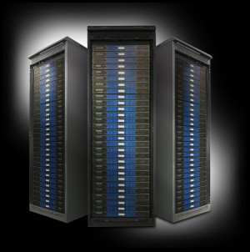
Global Expertise (Houston, Bucharest, Ho Chi Minh City)
3 Dev
3 PE Test
15 Dev
6 PE Test
2 Pgm Mgr
2 Prod Mgr
4 Auto Test

Slide 10
Simulator Regression Tests over time
Customer X
Customer Other

Slide 11
Test Automation Workflow
Input
Actions
Output
Difference Engine
Report
Baseline

Slide 12
Record – Playback Test Automation
Total Cost to Maintain
Cost
Cost to generate
Number of tests automated

Slide 13
Action Based Testing
Total Cost to Maintain
Cost
Cost to generate
Number of tests automated

Slide 14
Agile/Scrum in a Nutshell
24 hours
Backlog tasks
1-4 weeks
Iteration Backlog
Potentially Shippable
Product Increment
Release Backlog

Slide 15
The Bottom Line
97% Reduction

Slide 16
Automation Across Halliburton
# of Projects | 23
# of Test Automation Engineers | 76
# of Test Cases Automated | 11,018
Leveraged Investment
3x

Slide 17
Freeing Testers

Slide 18
Overcoming Outsourcing Challenges

Slide 19
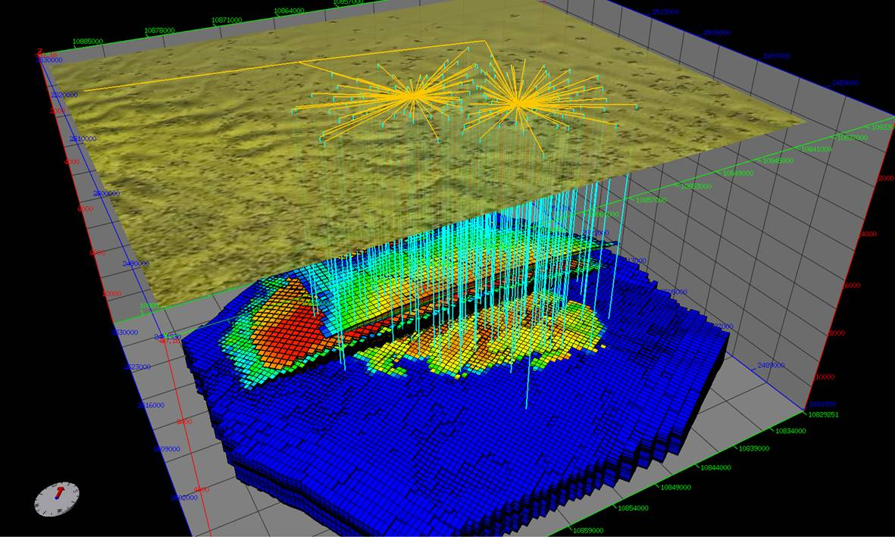
Outsourcing Challenge: Proprietary Data

Slide 20
Outsourcing Challenge: Time Shift
8 hours
12 hours

Slide 21
Outsourcing Challenge: Time Shift
8 hours
12 hours

Slide 22
Key Take Aways
Find and Correct Defects Early to Reduce Uncertainty
A Testing Strategy Helps to Maximize Efficiency
Test Automation Helps to Maintain Velocity
Outsourcing Can Work When Used Judiciously.
Treat Outsourcer as a Partner
Cost Effective Global Talent
Distributed Teams Can be Effective
Test Automation Does not Replace Exploratory Testing
Action Based Testing Reduces Test Brittleness

Slide 23
Achieving large-scale automation

Slide 24
Agile testing challenges
Sprints speed development.
Regression tests increase with each sprint.
Testing must scale with every sprint.
Regression testing requirements
Manual exploratory testing

Slide 25
Agile testing challenges
Large-scale testing typically reaches resource limits.
Options:
Increase resources
Slow release cycles
Limit test coverage
Change the approach
Testing
Deficit
Total Testing Capacity

Slide 26
Efficient modular test development
TestArchitect incorporates the Action Based Testing method into a keyword-driven, module-based test development and automation platform.
Test Modules are the units in which tests are organized efficiently.
Separation of tests, actions & interfaces from the underlying code make tests maintainable.

Slide 27
Action-based modular test design
Actions simplify & reduce test creation.
Low-level actions…can be used to create test cases…
Keyword action: Click.
Action – mouse click.
…and be combined to make higher level actions…
Action(s) -- Select product, click “ok”, Click “checkout”.
Keyword action: Checkout.
that combine to make even higher level actions.
Keyword action: Order Entry.
Actions -- all actions & steps associated with the entire order process.

Slide 28
Action-based modular test design
Test are easily maintained when requirements change.
For example: New functionality requires “click” to be changed to “swipe”.
Action is updated & saved.
Every test & high-level action containing the previous action is automatically updated when tests are executed.

Slide 29
Test design & organization
Test Modules
Action library
Interface definitions

Slide 30
Test creation using actions
Notes:
Talk to the facts that how TA / ABT reduces the need for coding; and efficient test design reduces the number of tests that need to be created.

Slide 31
ABT in Agile
product owner
team
prod owner & team
Product Backlog
Sprint
Products
Test Module
Definitions
Test Module Development
Test re-use
Interface Definition
Automation re-use
Action Automation
Test Execution

Slide 32
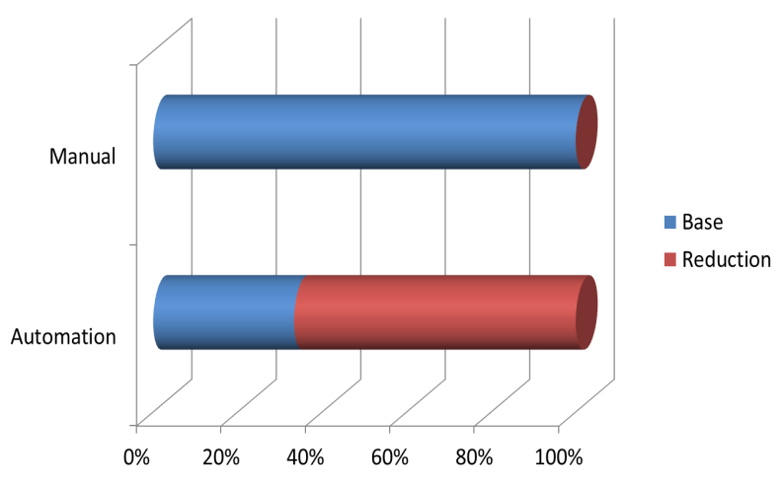
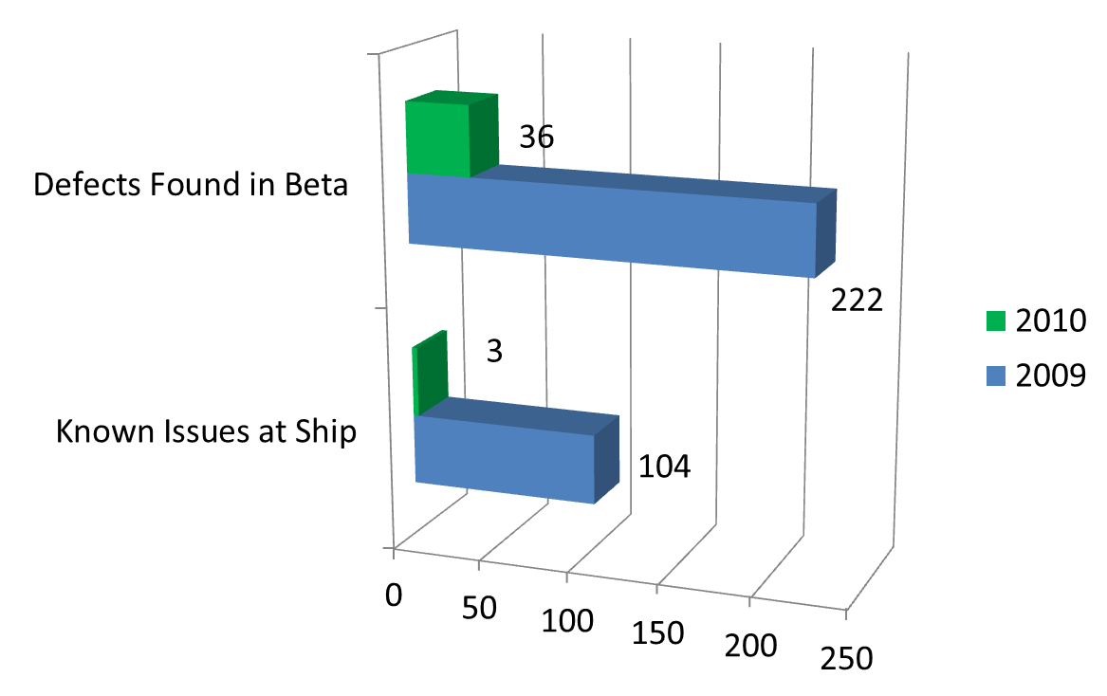
The Bottom Line
Significant reduction in testing resources
Increased test coverage
Improved product quality.
Efficiency increase

Slide 33
Thank You
For more information on TestArchitect go to: www.testarchitect.com
For more about ABT you can contact:
joeh @ logigear.com
Contact LogiGear:
info @ logigear.com

