Slide 1
Leveraging Global Talent for Effective Agility
Todd Little
Sr. Development Manager, Landmark/Halliburton
Joe Hughes
VP
Logigear

Slide 2
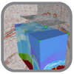
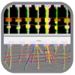
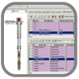
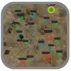
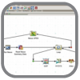
Landmark E&P Ecosystem Collaborative Applications – Data Management – Modern Platform – Expert Services
DecisionSpace Platform
Geosciences
Reservoir
Drilling and Completions
Production
Services and Support
BASIN
GEOPHYSICS
GEOLOGY
EARTH
MODELING
FIELD
PLANNING
SIMULATION
DESIGN
REPORTING
SURVEILLANCE
REAL-TIME
OPTIMIZATION
Data Management

Slide 3
Petroleum Reservoir Simulation

Slide 4
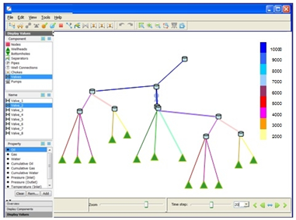
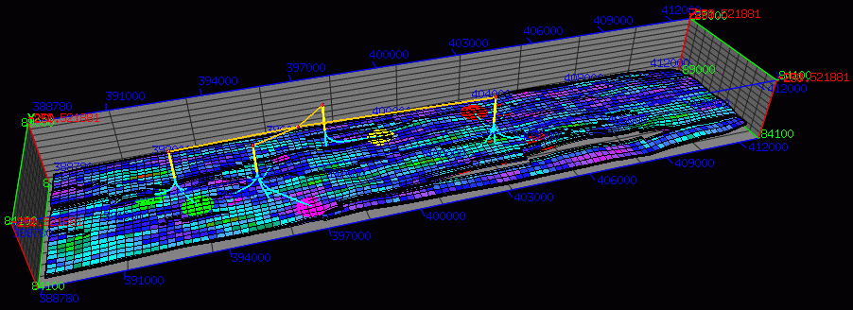
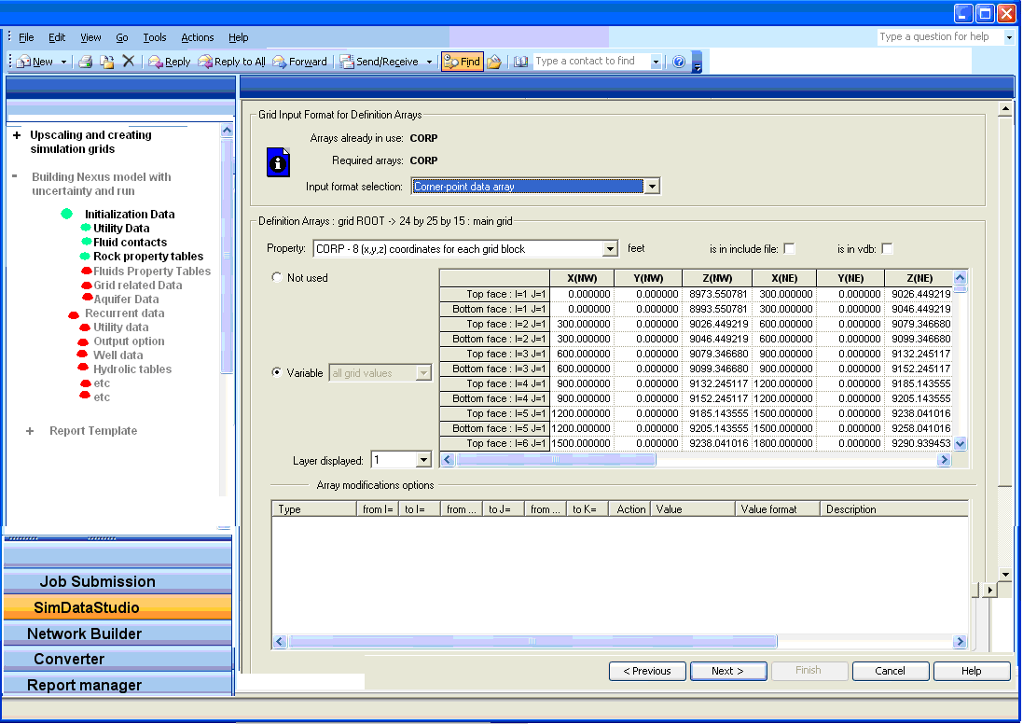
System Workflow
User Interface
Graphical Pre-Processing
Graphical Post-Processing
High Performance Cluster

Slide 5
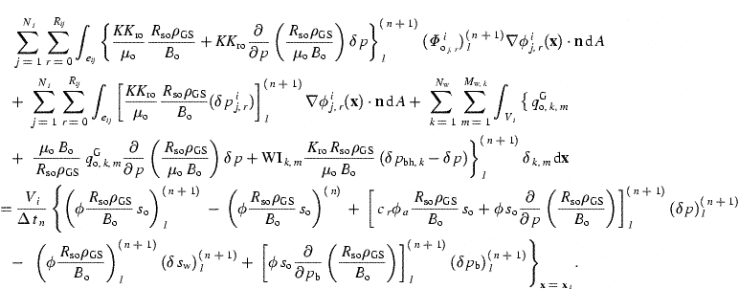
Computing Challenges
Some Simulations take hours or even days, or even …
Our Testers are Petroleum Engineers, not Test Automation Specialists
Numerical Simulation is an approximation and as such is subject to round-off and/or perturbation differences

Slide 6
Managing the Coming Storm Inside the Tornado
Project Kickoff
When will we get the requirements?
All in good time, my little pretty, all in good time
But I guess it doesn't matter anyway
Just give me your estimates by this afternoon
Team Unity
Not so fast! Not so fast! ... I'll have to give the matter a little thought. Go away and come back tomorrow
No, we need something today!
Ok then, it will take 2 years.
No, we need it sooner.
Doesn't anybody believe me?
I already promised the customer it will be out in 6 months
You're a very bad man!
Notes:
We look at a typical software project…..

Slide 7
We’re not in Kansas Anymore
Developer Hero
I may not come out alive, but I'm goin' in there!
Reorg
The Great and Powerful Oz has got matters well in hand.
My! People come and go so quickly here!
Testing
"Hee hee hee ha ha! Going so soon? I wouldn't hear of it! Why, my little party's just beginning!

Slide 8
Agile/Scrum in a Nutshell
24 hours
1-4 weeks
Iteration Backlog
Backlog tasks
Potentially Shippable
Product Increment
Release Backlog

Slide 9
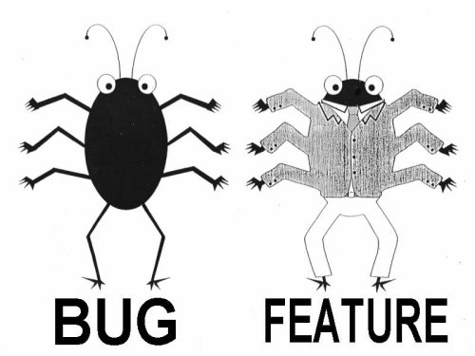
Lan Cao - Estimating Agile Software Project Effort: An Empirical Study
2X
Uncertainty,
Notes:
Lessons learned: If uncertainty is high, work on it earlier. Reduce Technical Debt—Get to potentially shippable at each iteration. Finding and fixing the last bugs has high uncertainty – plan on there being uncertainty.

Slide 10
System Workflow
User Interface
Graphical Pre-Processing
Graphical Post-Processing
High Performance Cluster

Slide 11
Test Automation Workflow
Input
Simulate
Output
Difference Engine
Report
Baseline

Slide 12
Testing and Automation Strategy
Customer Models
Weekly
Complexity of Tests
Nightly
Mid-Tier
GUI Tests (automated)
Smoke Tests (manual)
Nightly
Developer Tests
Every Checkin
Breadth of Coverage

Slide 13
Simulator Regression Tests over time
Customer X
Customer Other

Slide 14
Record – Playback Test Automation
Number of automation programs
Number of tests automated
Test : test program ratio = 1:1
The more tests the greater the maintenance
Reached limit of maintainability
Automation effort vs. number of test

Slide 15
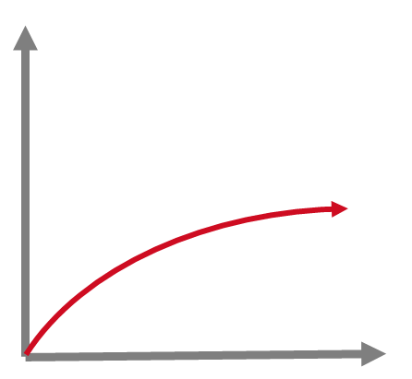
Action Based Testing
Number of automation programs
Test : test program ratio < 1:1
Need for added automation declines.
Long-term maintainable.
Number of tests automated
Automation effort vs. number of test

Slide 16
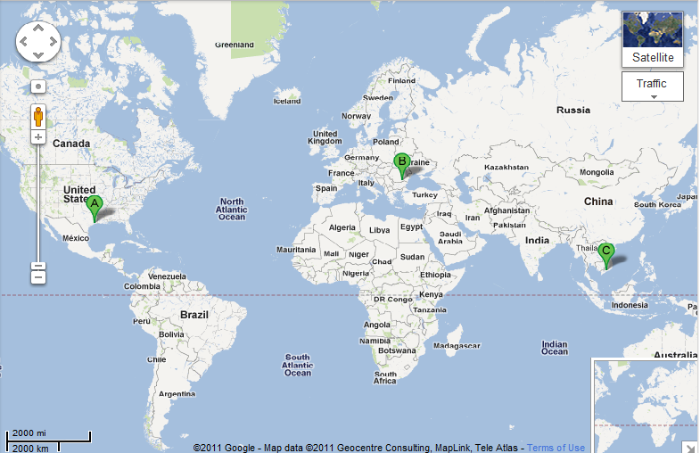
Global Expertise (Houston, Bucharest, Ho Chi Minh City)
3 Dev
3 PE Test
15 Dev
6 PE Test
2 Pgm Mgr
2 Prod Mgr
4 Auto Test

Slide 17
The Bottom Line
97% Reduction

Slide 18
Automation Across Halliburton
# of Projects | 23
# of Test Automation Engineers | 76
# of Test Cases Automated | 11,018
9x
Leveraged Investment

Slide 19
The Bottom Line
85% reduction in testing man-hours per month.
23 projects
76 automation engineers
11,018 test cases automated
105,770
Man-hours/month

Slide 20
Overcoming Outsourcing Challenges

Slide 21
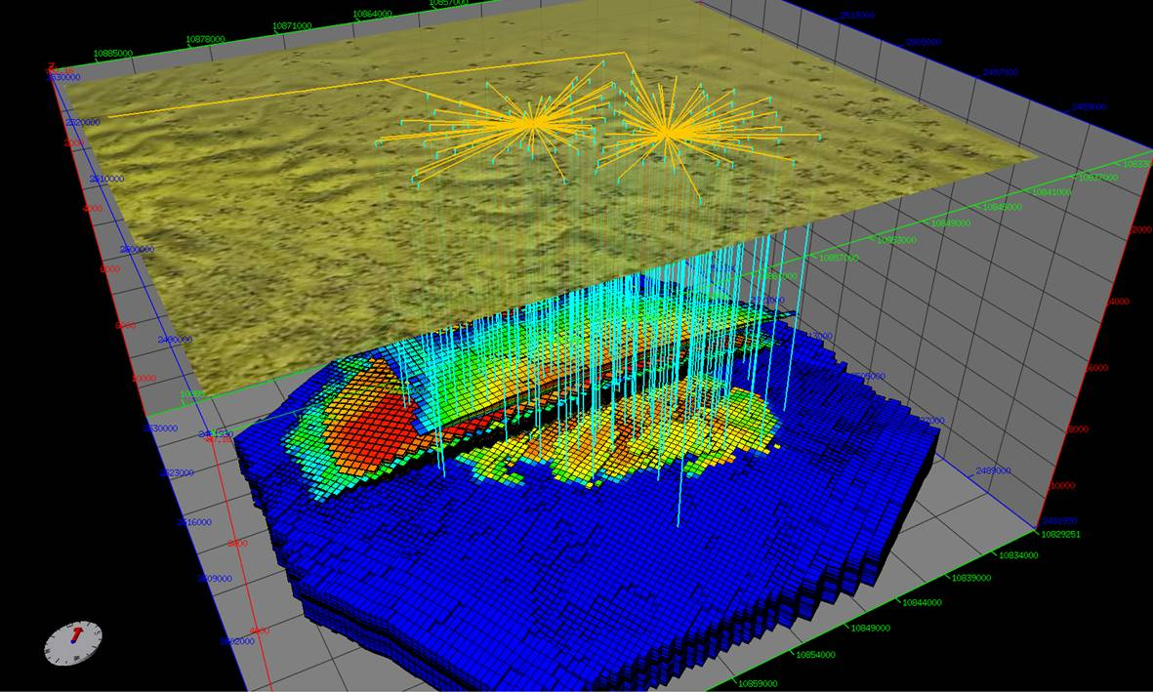
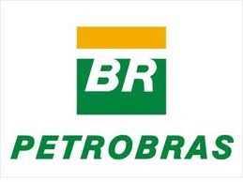
Outsourcing Challenge: Proprietary Data

Slide 22
Outsourcing Challenge: Time Shift
8 hours
12 hours

Slide 23
Outsourcing Challenge: Xenophobia

Slide 24
Key Take Aways
Find and Correct Defects Early to Reduce Uncertainty
A Testing Strategy Helps to Maximize Efficiency
Test Automation Helps to Maintain Velocity
Outsourcing Can Work When Used Judiciously.
Treat Outsourcer as a Partner
Cost Effective Global Talent
Distributed Teams Can be Effective
Test Automation Does not Replace Exploratory Testing

Slide 25
Leverage Global Talent

Slide 26
Think Globally and Optimize the Whole

Slide 27
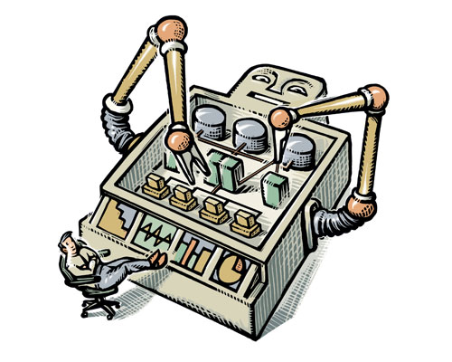
Automate – Automate - Automate

Slide 28
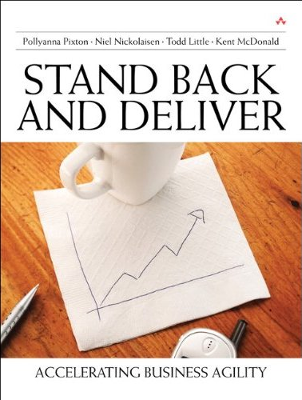
Contact
Todd Little
tlittle@lgc.com
www.toddlittleweb.com
Joe Hughes
joeh@logigear.com
www.logigear.com

