Slide 1
Transforming the World of Work®
A story of Fearless Change Todd Little

Slide 2
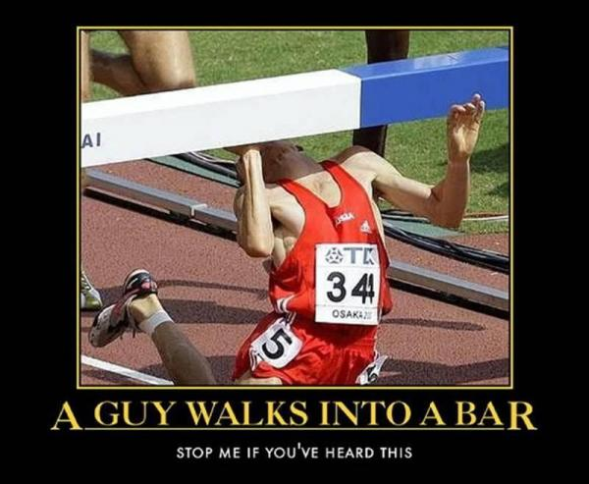

Slide 3
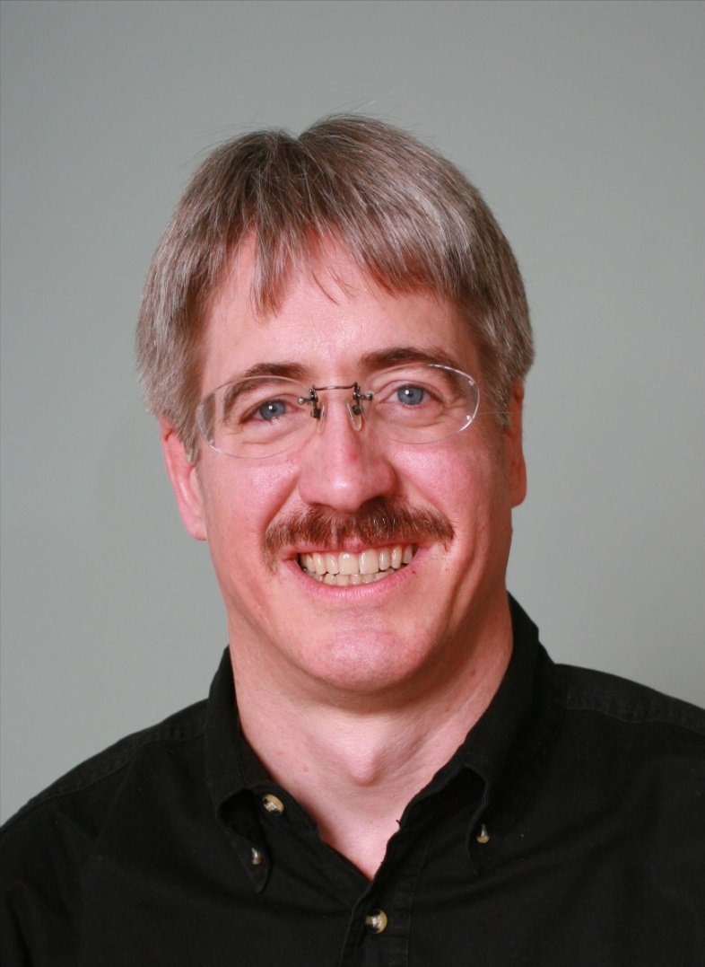

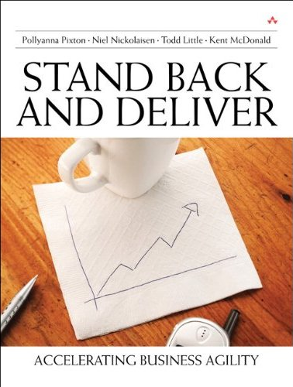





About Todd
Chemical & Petroleum Engineer
30+ Years in Software Development
Founding Consultant at
Executive roles as VP Product Development, Director of Software & Technology
Pioneer and Agile Community Builder

Slide 4
About Todd
Chemical & Petroleum Engineer
30+ Years in Software Development
Founding Consultant at
Executive roles as VP Product Development, Director of Software & Technology
Pioneer and Agile Community Builder

Slide 5
Setting
Cutter Summit April 2002 – Hotel@MIT
Night at the MIT Museum
Miracle of Science Bar & Grill

Slide 6
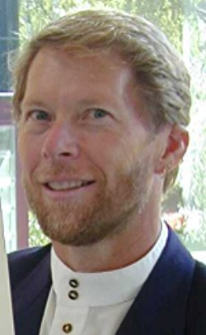

Which Logo do you like?

Slide 7
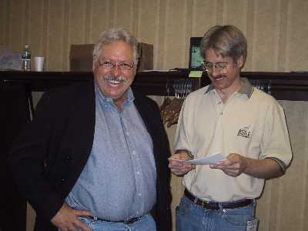
Fish Stories (Dan Reed)

Slide 8
Insert Videos here
Seattle Fish company
Shamu jumping over the Alamo

Slide 9
You’re not just starting a conference, you’re building a community and changing the world of work
You’re Right!
Let’s do it!

Slide 10
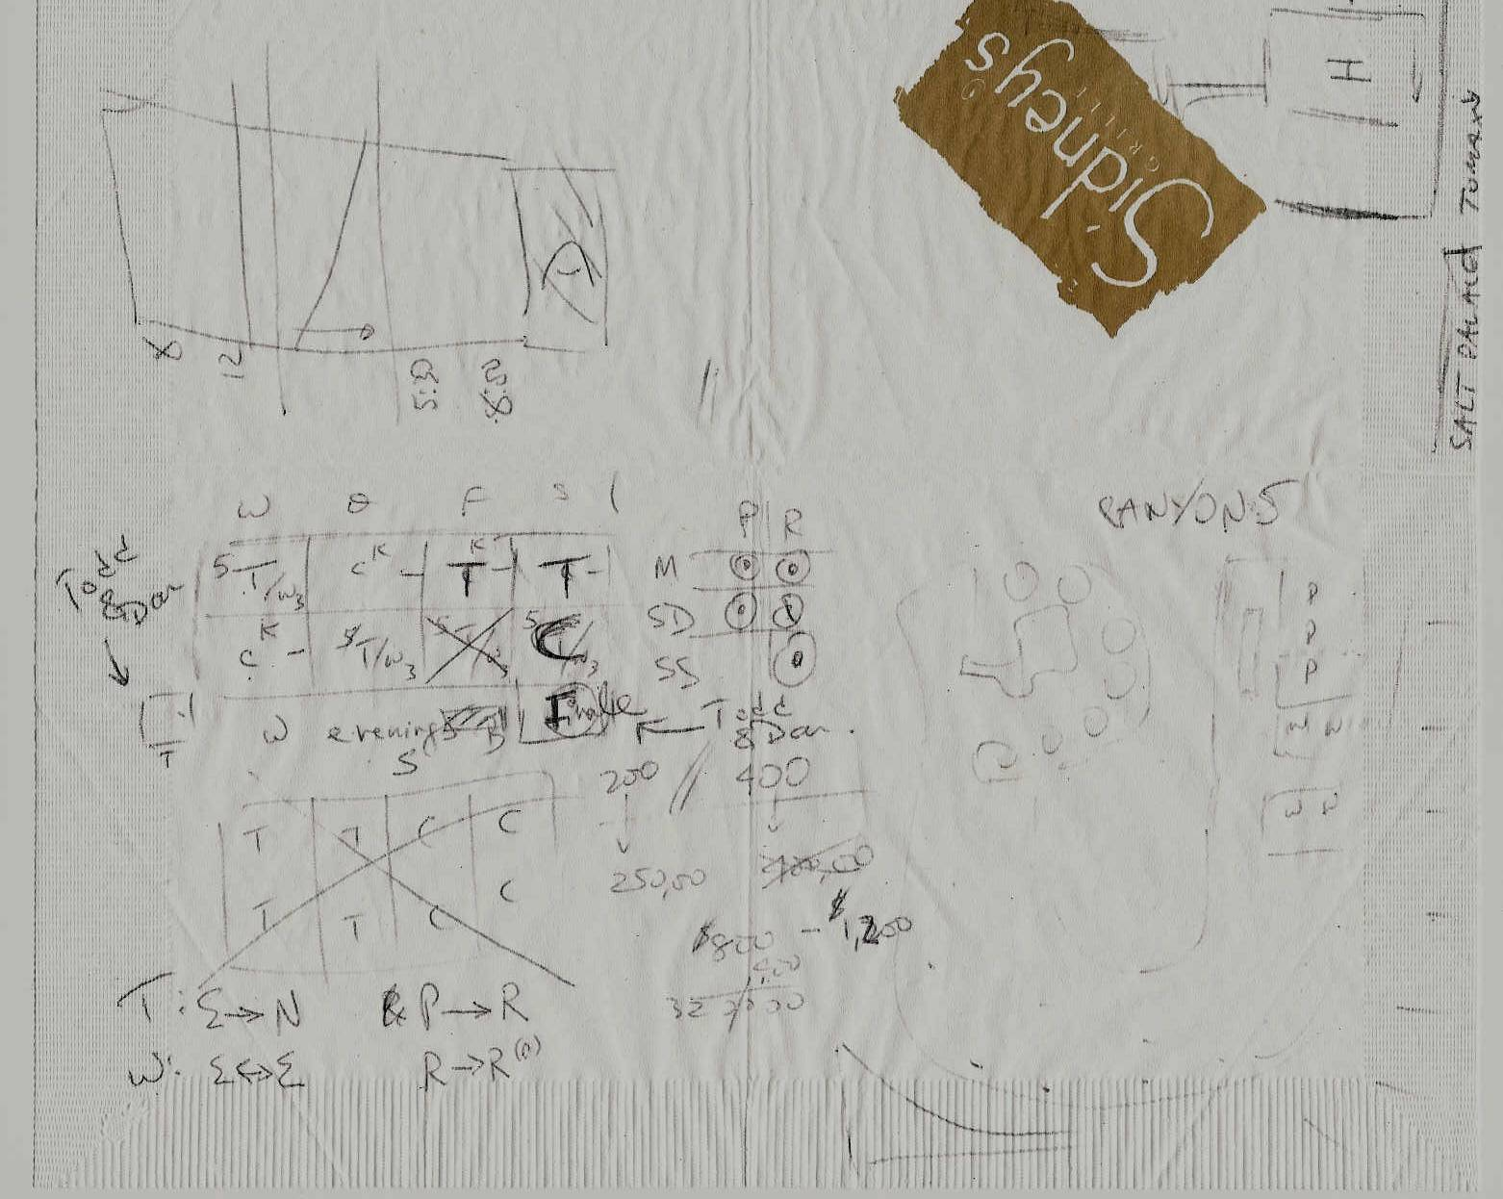
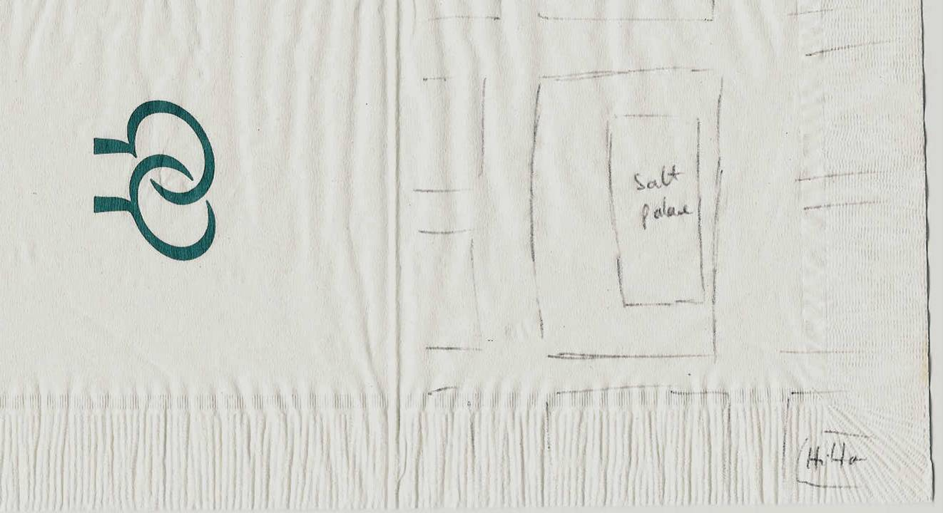
Who says Agilists don’t Document

Slide 11

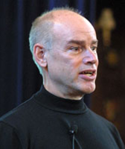
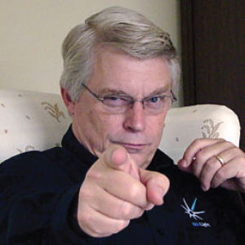
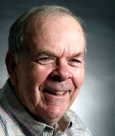

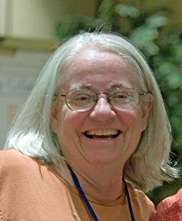
Stakeholders

Slide 12
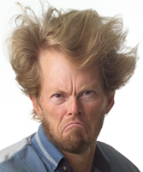
Conflict
This is my conference and I want to do it my way!

Slide 13
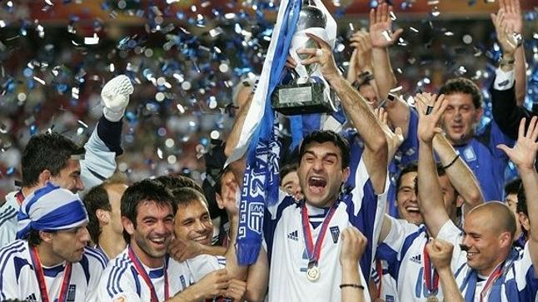
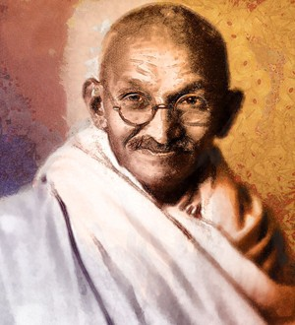

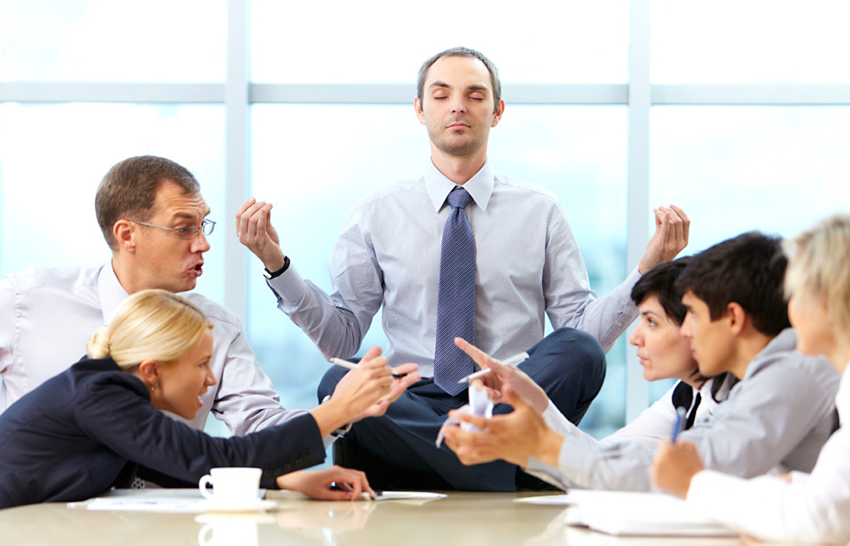
Path to Greatness
+
Integrity
Greatness
=
Passion
Conflict

Slide 14
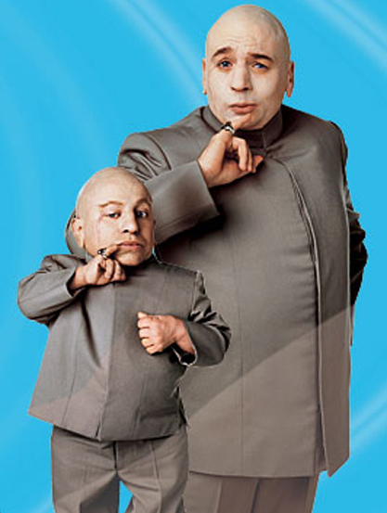
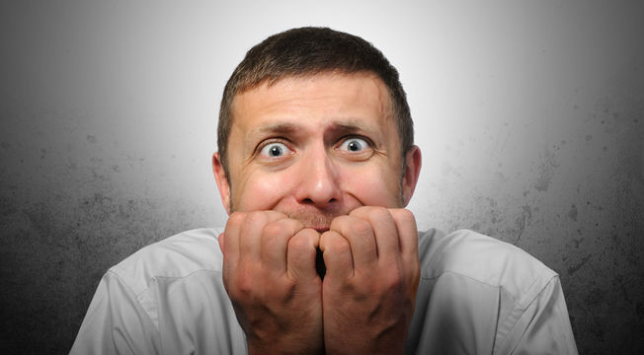
Absence of Conflict

Slide 15
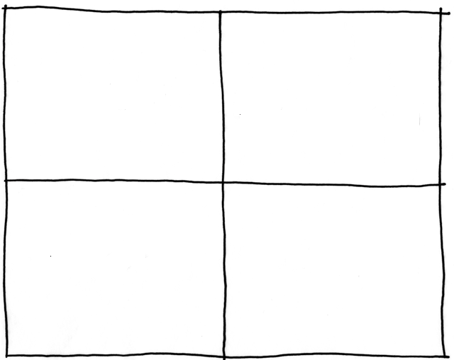
Collaborating with Non-Collaborators
Creative
Tension
Collaborator
Collegial
More useful
Drive to
Purpose
Collaboration
Non-
Collaborator
Compliance
Combative
Common Practice
Agree
Disagree
Agreement

Slide 16
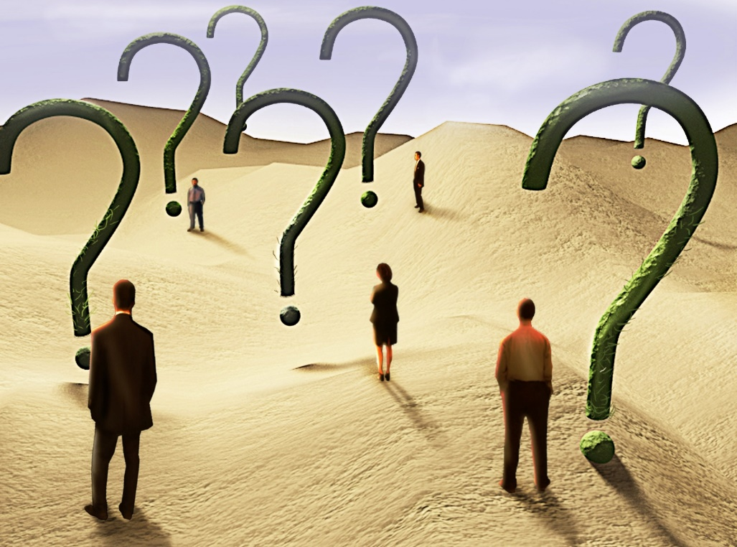
Uncertainty

Slide 17
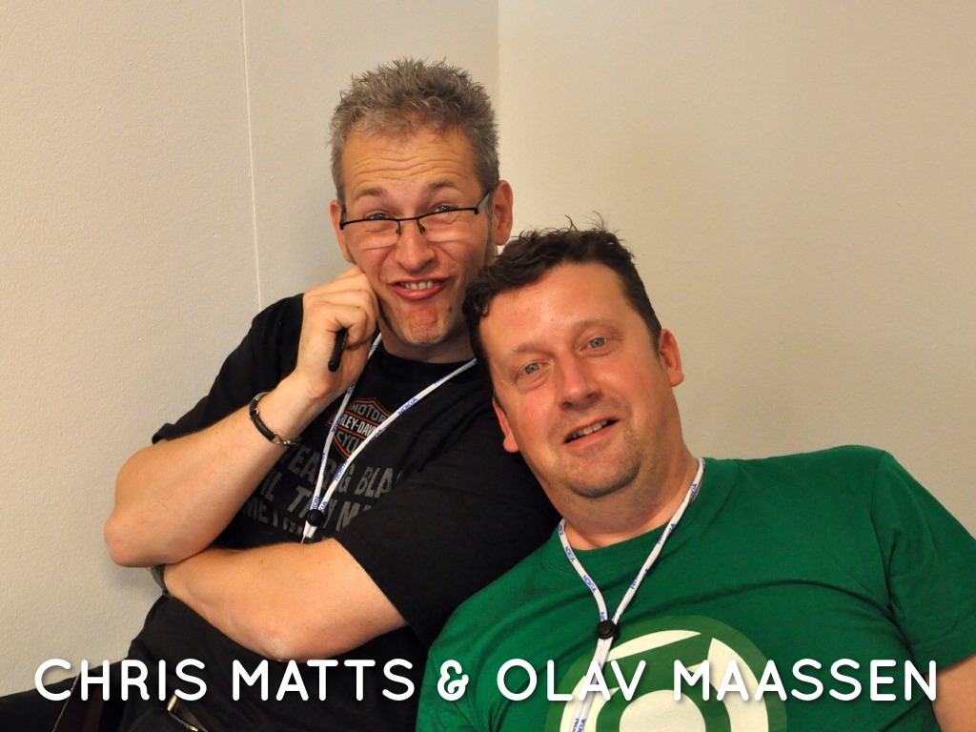
Real Options

Slide 18
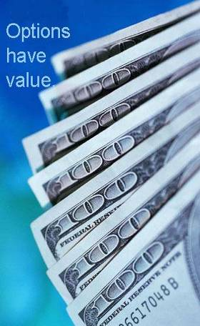
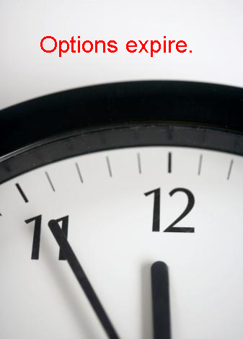
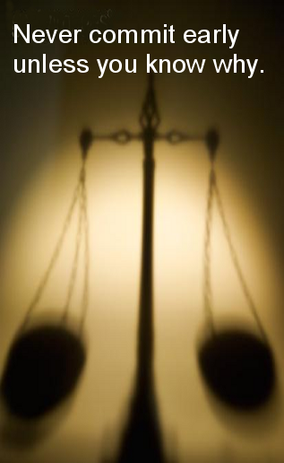
Real Options
A right, but not an obligation to do something
Notes:
18

Slide 19
Beyond Budgeting –
Building a Conference Financial Model

Slide 20
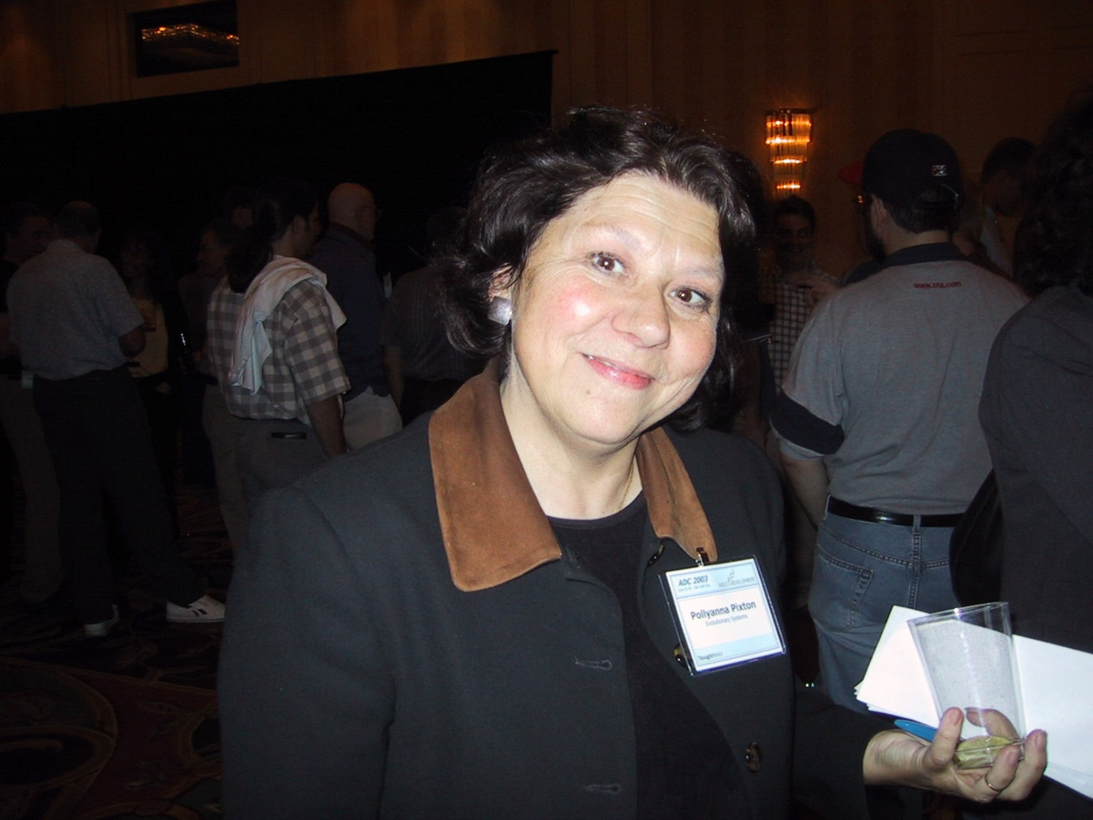
The right people show up
Pollyanna Pixton

Slide 21
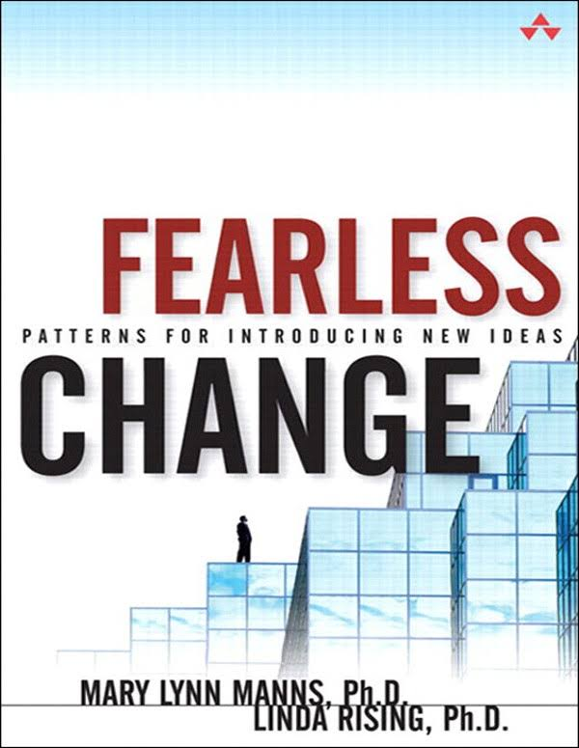
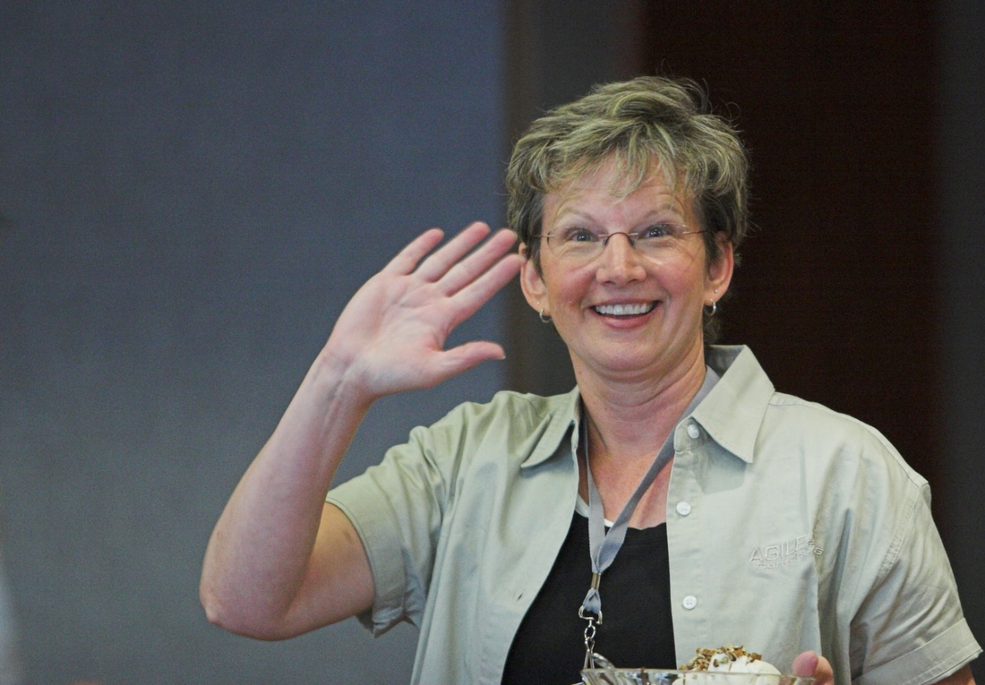
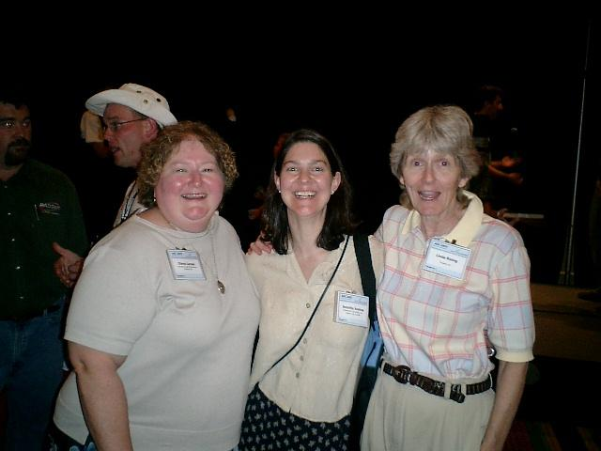

Slide 22
How did it go?
"I was told this conference would be a four-day conversation. That was only partly right. It was the four-day start to an ongoing, and fascinating, conversation with people around the world.“
"… the four folks that attended the conference in Salt Lake City came away very enthusiastic. The general comment was that the conference was the best technical conference that they had attended. "
- Texas Instruments
“I’ve been to many other conferences, but this one has the highest density of people who want to talk about interesting things. So many dissimilar people with common goals.”
- Jeff Patton, Tomax
“This conference exceeded my expectations. I met far more intriguing, insightful and worth keeping in touch with people at this conference than any conference I have been to in a long time.”
- Kevin Tate, Alias Wavefront
“The most valuable and most fun conference I have been to in my 15 years in IT.”
- Michael Spayd, Qwest
“This conference had the highest proportion of people I wanted to talk with of any conference I have been to.”
- Brian Marick

Slide 23
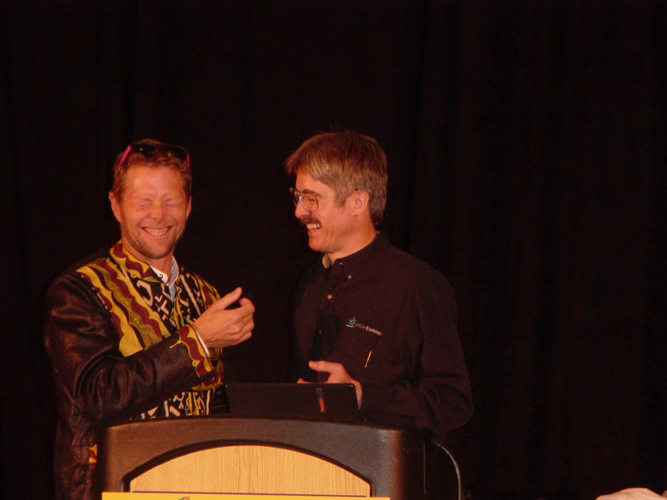
We had a blast!

Slide 24
Fearless Change: Transition to Year 2
This is my conference and I want to do it my way!

Slide 25
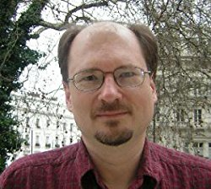
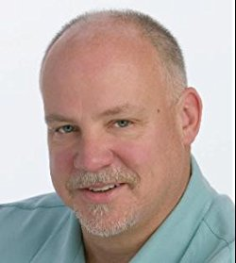
Fearless Change: Year 3 - Merge

Slide 26
How did we do?
10x Growth
Todd hands over to Mary Lynn
10 yr. Manifesto
XPAU Merge

Slide 27
Fearless Change Take Aways
Create and seize opportunities
Articulate and stay focused on purpose
Even brilliant people struggle in new domains
Bound the uncertainty
Resolve conflict by alignment to purpose
Allow the right people to show up
Be Fearless

Slide 28
Contact
Todd Little
  toddelittle@gmail.com
  www.toddlittleweb.com
  www.accelinnova.com
  www.linkedin.com/in/toddelittle/en
  @toddelittle

