Slide 1


TURBOCHARGE YOUR SCRUM
WITH KANBAN
Todd Little
Chairman, Kanban University

Slide 2
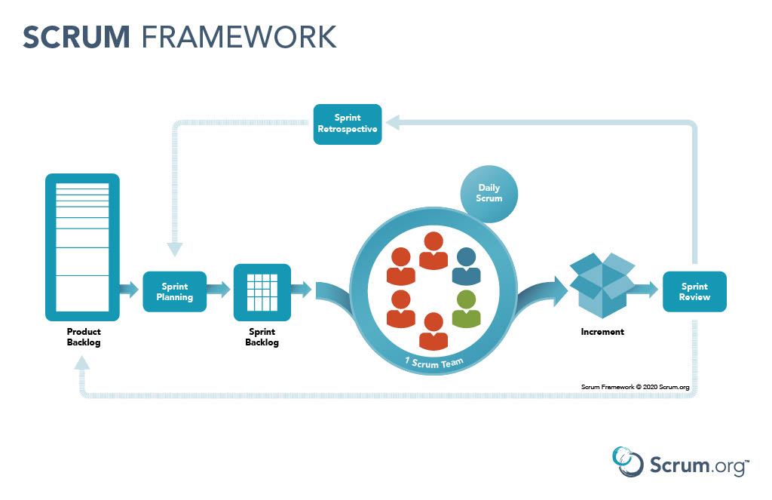


Slide 3
Outcomes from Scrum Transformations
Scrum worked for us, and we continue to get better. | Scrum helped a bit, but we haven’t gotten much better lately.
Scrum has been a disaster. | Scrum didn’t really help, but didn’t really hurt either.

Slide 4
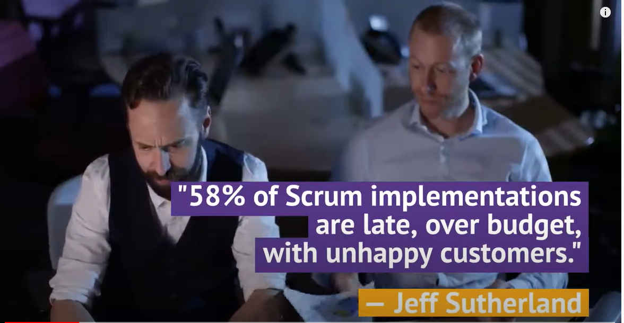

Slide 5
Scrum Challenges
Unplanned work
Estimating and Planning
Lots of meetings
Don’t know how to improve
The transformation and reorganization nearly killed us
We were told we needed lots of agile coaches, but what are they really doing to add value?

Slide 6
Kanban Can Help

Slide 7
Kanban is not a framework
Kanban is not just a board
Kanban is not something you install
Kanban is not a transformation
Any Kanban vs. Scrum comparison makes no sense
Kanban is a management method for improving the delivery of knowledge work using evolutionary change
While not a transformation, Kanban can be quite transformational
Kanban is an unframework

Slide 8
Start with what you do now

Slide 9
Kanban: The Great Unifier
Start with what you do now
Chaos
KANBAN
SAFe
Scrum
Waterfall
CMMi
Notes:
Use different background

Slide 10
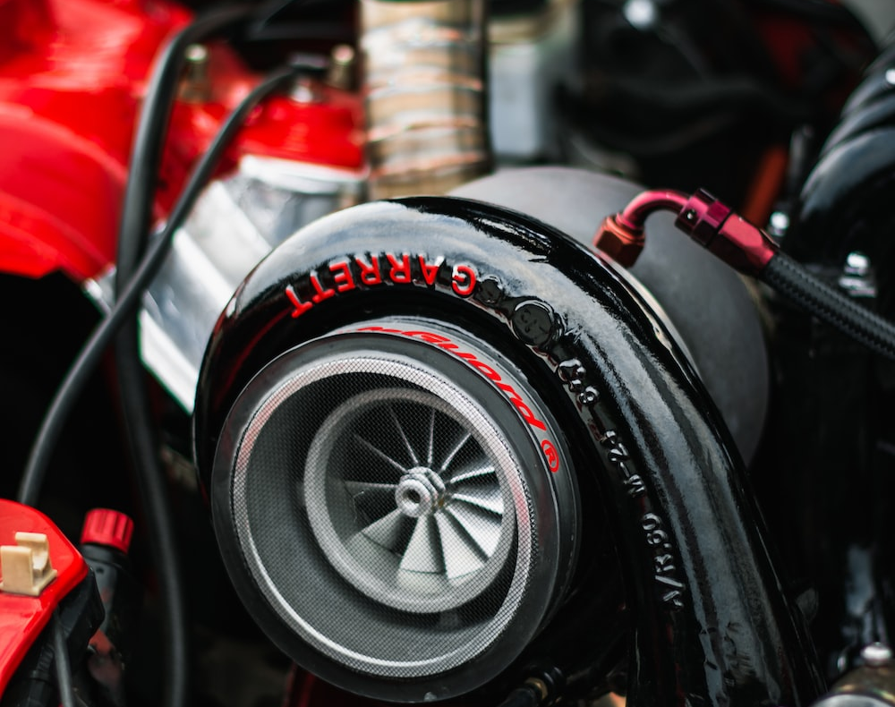
What is a turbocharger?
In addition to the extra power, turbochargers are sometimes referred to as devices that offer “free power” because unlike a supercharger, it does not require the engine’s power to drive it.
Credit: Simone Durelli
https://www.eagleridgegm.com/what-is-a-turbocharger-and-how-does-it-work/

Slide 11
A turbocharger …
Improves your team's performance without costing them a ton of energy to improve and potentially fail

Slide 12
Kanban Change Management Principles

Slide 13

Kanban Method: Change Management Principles
Start with what you do now
  Understanding current processes, as actually practiced
  Respecting existing roles, responsibilities & job titles
Gain agreement to pursue
improvement through
evolutionary change
Encourage acts of leadership at all levels
Notes:
There are 3 Change Management Principles designed to frame an evolutionary approach to improvement. Be aware that the Kanban Method is applied to the way you work now, and it will help you evolve the way you work gradually over time.
[Briefly walk through each of the principles. See David’s blog at https://leankanban.com/principles-general-practices-kanban-method/ if you want help with how to explain each.]

Slide 14

Scrum and Kanban Perspectives
HI, I’M SAL, SHORT FOR SALVADOR AND I’M A LONG TIME SCRUM PRACTITIONER
HI, I’M ROSIE AND #YESWEKANBAN

Slide 15
CMP#1: Start with what you do now
IN OUR TRANSFORMATION WE RE-ORGANIZED INTO CROSS FUNCTIONAL TEAMS WITH THE 3 ROLES OF PRODUCT OWNER, SCRUM MASTER AND TEAM MEMBER.
KANBAN DOES NOT REQUIRE CROSS FUNCTIONAL TEAMS, BUT IF YOU ALREADY HAVE CROSS FUNCTIONAL TEAMS THAT WILL BE YOUR STARTING POINT. IN KANBAN A REORGANIZATION IS GENERALLY A LAST RESORT.

Slide 16
CMP#2: Agree to evolutionary change
SCRUM IS BASED ON EMPIRICISM WHICH DONE WELL CONTINUES TO EVOLVE. UNFORTUNATELY, MANY IMPLEMENTATIONS STALL OUT, OR REVERT. IF YOU’RE DOING SCRUM HOW YOU WERE TAUGHT, YOU LIKELY AREN’T DOING SCRUM WELL.
KANBAN “STARTS WITH WHAT YOU DO NOW.” UNDERSTAND THE CURRENT PROCESS AS PRACTICED. THEN USE GUIDED EXPERIMENTS THAT CAN BE MEASURED TO ESTABLISH A MINDSET OF CONTINUOUS IMPROVEMENT.

Slide 17
CMP#3: Encourage acts of leadership at all levels
SCRUM’S SELF-ORGANIZATION CAN ENCOURAGE ACTS OF LEADERSHIP. BUT SOMETIMES THE PO, THE SM OR THE TEAM MANAGER WILL BE VIEWED AS THE “LEADERS” AND TEAM MEMBERS SIMPLY BECOME FOLLOWERS.
WORK TO CREATE A SAFE ENVIRONMENT TO ENCOURAGE ACTS OF LEADERSHIP AT ALL LEVELS.

Slide 18
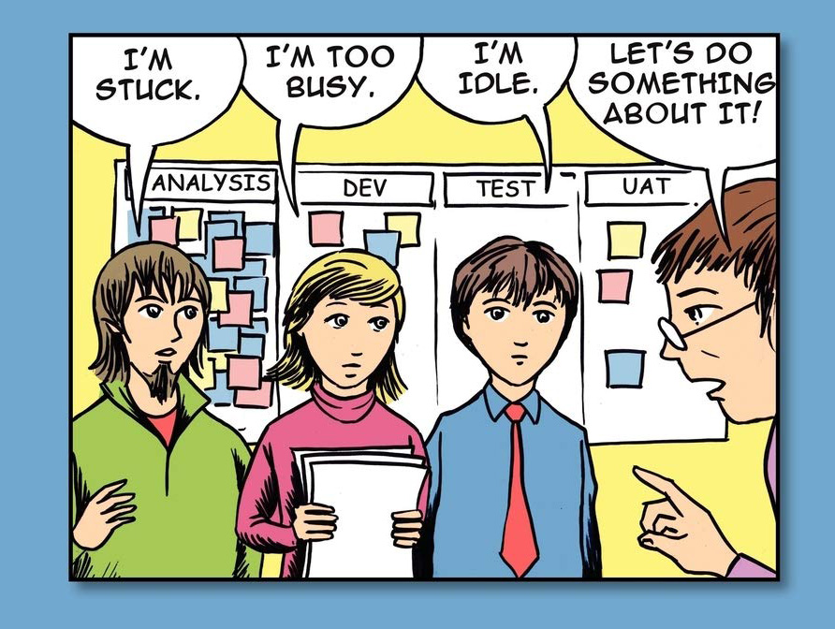
Acts of Leadership
Notes:
Assess this organization – what ML? What problems?

Slide 19
Kanban General Practices

Slide 20
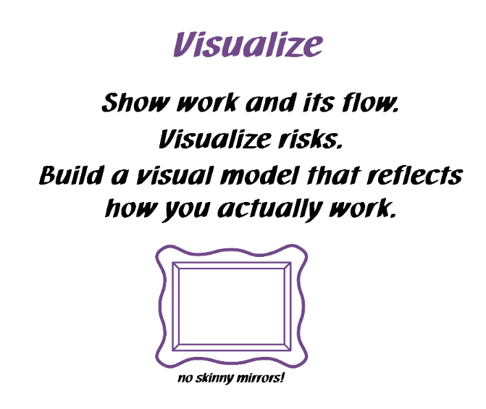
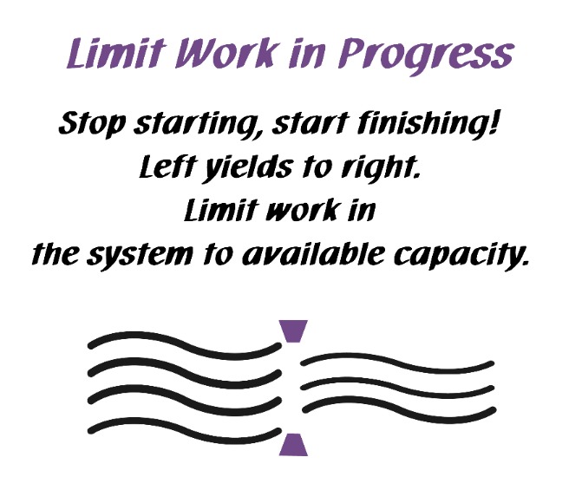
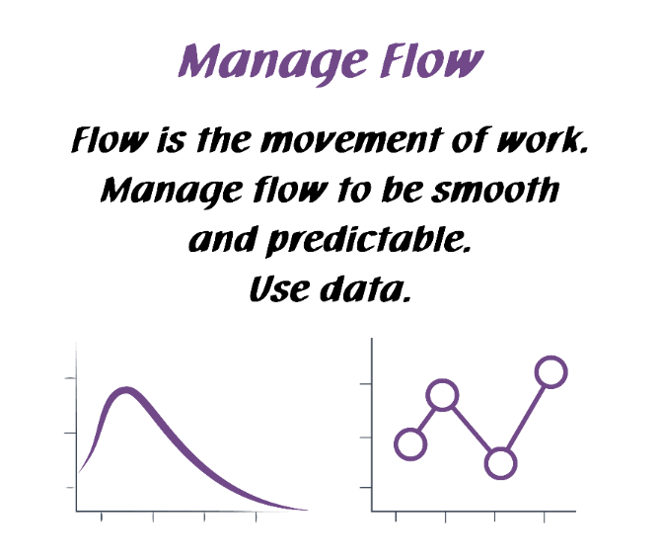
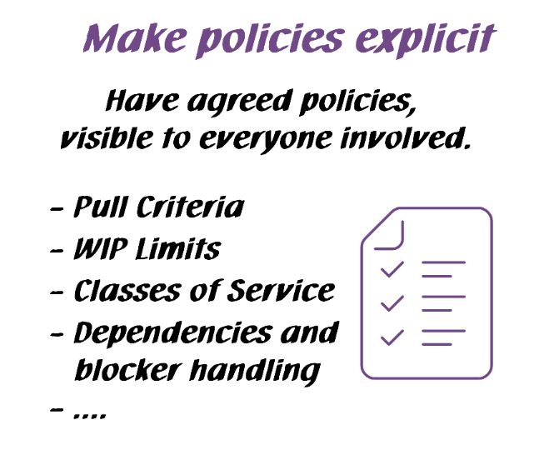
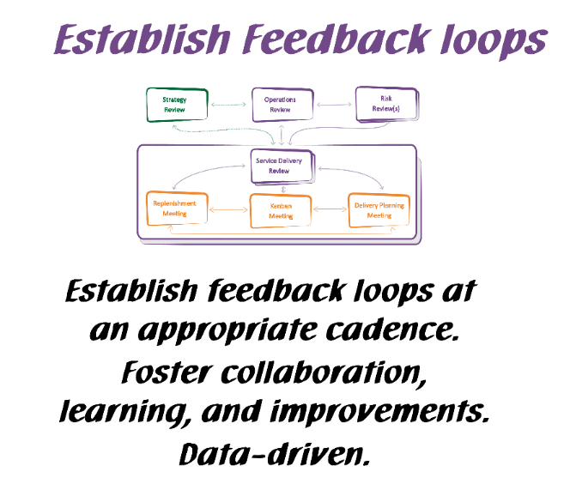
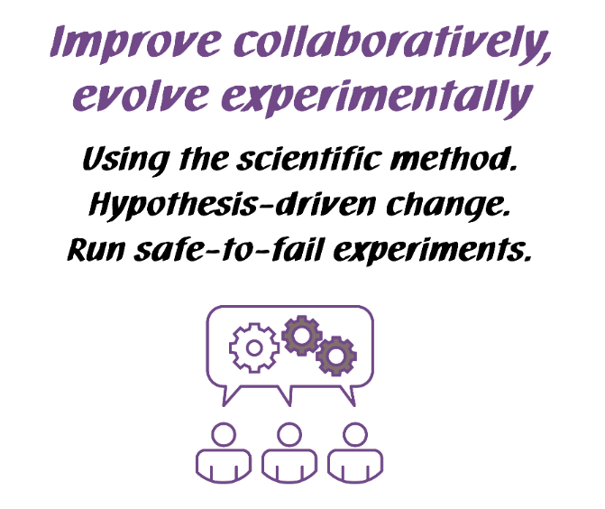
Kanban General Practices
Notes:
Walk the class through the Kanban practices.
There are 6 General Practices in the Kanban Method. [Walk briefly through each of the 6 Practices. See David Anderson’s blog at http://www.djaa.com/principles-general-practices-kanban-method if you want help with how to explain]
Instead of using this slide, you can also create a flipchart with similar info etc.
You might revise this after the simulation.

Slide 21
Visualize
IF YOU HAVE NOT ALREADY DONE SO, LOOK AT MAPPING OUT THE WORKFLOW AS A SERIES OF KNOWLEDGE DISCOVERY STEPS. LOOK AT THE ENTIRE SERVICE DELIVERY, NOT JUST A TEAM.
MANY SCRUM TEAMS MAKE A VISUAL BOARD EITHER PHYSICALLY OR USING AN ELECTRONIC TOOL.

Slide 22
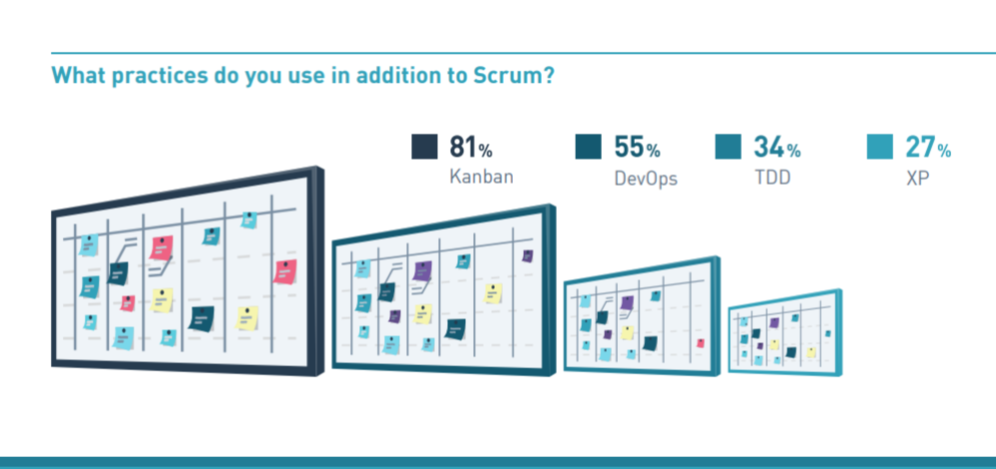
2019 Scrum Master Trends (Scrum.org)

Slide 23
Limit Work in Progress
SET WIP LIMITS FOR EACH STEP IN THE PROCESS TO IMPROVE CONTROL AND PREDICTABILITY.
SCRUM LIMITS WIP TO SOME EXTENT BY SMALL BATCHES

Slide 24
Manage Flow
SCRUM REQUIRES SELF-ORGANIZATION, BUT SADLY MANY IMPLEMENTATIONS OF SCRUM ARE NOT. IF THE DAILY SCRUM SOUNDS LIKE A STATUS REPORT, THERE IS ROOM FOR IMPROVEMENT. A COMMON SCRUM METRIC IS VELOCITY. IT CAN BE USEFUL OR MISUSED.
FOCUS ON THE WORK AND LET THE WORKERS SELF-ORGANIZE. WALK THE BOARD ASKING WHAT IS PREVENTING ITEMS FROM FLOWING. COLLECT AND DISPLAY METRICS SUCH AS LEAD TIME, RUN CHART, AND CUMULATIVE FLOW DIAGRAMS.

Slide 25
Make Policies Explicit
MANY SCRUM TEAMS HAVE MADE A FEW POLICIES EXPLICIT LIKE DEFINITION OF DONE, DEFINITION OF READY. THESE CAN BE GOOD POLICIES.
START LOOKING AT OTHER POLICIES WHICH COULD BE MADE EXPLICIT, E.G. PULL CRITERIA, CLASSES OF SERVICE, SERVICE LEVEL AGREEMENTS.

Slide 26
Feedback and Feedback Loops
Feedback
Loop
Feedback
Notes:
Assess this organization – what ML? What problems?

Slide 27
Feedback Loops
SCRUM HAS THE 5 “EVENTS” FOR FEEDBACK, UNFORTUNATELY, WHILE MANY RELIGIOUSLY DO THE CEREMONIES, MANY FAIL TO “DO SOMETHING ABOUT IT.” THE SCRUM GUIDE STATES THAT IMPROVEMENTS MAY EVEN BE ADDED TO THE SPRINT BACKLOG FOR THE NEXT SPRINT.
KANBAN HAS CADENCES WHICH CAN START WITH THE SCRUM EVENTS. BUT THE KEY IS UTILIZING THE FEEDBACK AND TAKING ACTS OF LEADERSHIP TO DO SOMETHING ABOUT IT TO CLOSE THE FEEDBACK LOOP.

Slide 28
Scrum Events and Kanban Cadences
Scrum Event | Kanban Cadence
Sprint | The Sprint is not required in Kanban. If you like Sprints, it is ok to keep them.
Sprint Planning | Replenishment Meeting The main difference is that the Replenishment Meeting does not generally involve “planning.”
Daily Scrum | Kanban Meeting Main shift may be to focus on flow.
Sprint Review | Service Delivery Review
Sprint Retrospective | Can be kept or dropped. Many Kanban implementations drop the formality of a retrospective and handle improvement through the reviews.

Slide 29
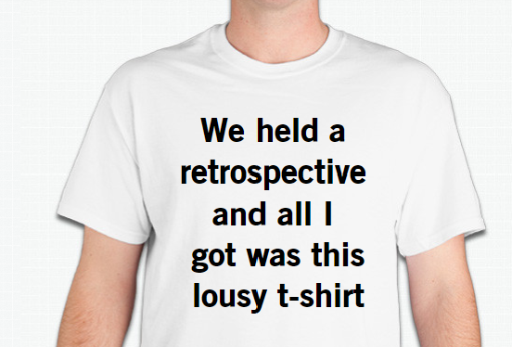
Feedback Loop?

Slide 30
Improve Collaboratively, Evolve Experimentally
SCRUM AIMS TO BE BASED ON EMPIRICISM AND WHEN DONE WELL CONTINUES TO EVOLVE. IF YOU’RE DOING SCRUM HOW YOU WERE TAUGHT, YOU LIKELY AREN’T DOING SCRUM WELL.
EXPERIMENTS MIGHT BE A MISNOMER, AS WE NOW HAVE A LOT OF PRAGMATIC GUIDANCE FROM MANY YEARS OF KANBAN. THE KANBAN MATURITY MODEL IS A GREAT GUIDE FOR WHAT MIGHT BE APPROPRIATE NEXT STEPS.

Slide 31

Evolutionary Change, not Revolutionary

Slide 32
Evolutionary Change at Posit Science
(A Case Study)

Slide 33


Posit Science Background
Posit Science was started by one of the world’s most pre-eminent neuroscientists to apply new discoveries in brain plasticity
Mike Merzenich
Not Brain Surgery
Not Rocket Science
But it is Brain Science!
Dr. Michael Merzenich
Notes:
Posit Science makes games to improve brain plasticity. Scientist Dr. Mike Merzenich is a founder.

Slide 34
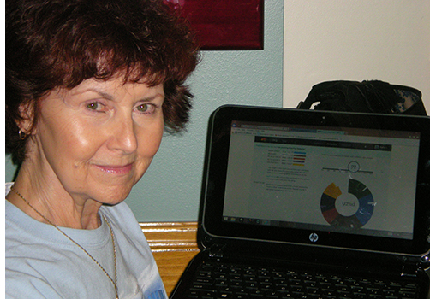
Posit Science Background
Scrum was adopted as the development process.
Everything worked very well initially. Scrum really helped the firm deliver its early product
Notes:
Scrum worked okay! The product was launched.

Slide 35
Posit Science Background
Problems started to develop using Scrum. The team was not very happy
Agile coaches insisted that the problem was with Posit Science and that they simply weren’t doing Scrum properly
Notes:
Even though the product was developed fine with Scrum, after release Scrum is not satisfactory
The developers became unhappy with the rules of Scrum and started to show resistance to it. The project manager looked for a solution but received no satisfactory answer from the Agile community.

Slide 36
Sources of Dissatisfaction - Motivation for Change
Customer Dissatisfaction (External)
Stories are not being finished
Deadlines are being missed
Team Frustration (Internal)
“Fragmentation” – pulled in many directions, priorities always changing
Task-based estimates – inaccurate, too much effort to produce
Notes:
Internal and external dissatisfaction.

Slide 37
Initial “Kanban” adoption
 | BEFORE | AFTER
Iterations | ✓ | ✓
Scrum Master, PO | ✓ | ✓
Sprint planning | ✓ | ✓
Daily Standup Meeting | ✓ | ✓
Product Owner accepts | ✓ | ✓
Demo | ✓ | ✓
Retrospective | ✓ | ✓
Estimation | ✓ By TASK | ✓ By User Story (T-shirt sized)
Other |  | Per Person WIP LIMIT
Notes:
Key changes when moving from Scrum to Proto-kanban
Hourly task estimation was dropped in favor of t-shirt sizes (S,M,L)
A per-person WIP limit was added, limiting each developer to 3 stories at a time

Slide 38
Initial Kanban Board
Backlog
User Stories
Sprint
Backlog
Dev/Build/
Test/Deploy
Pending
Specify
Done
M
P
E
DE
H
G
GY
MN
GY
A
L
R
K
B
PB
DE
D
O
MN
3 items per person WIP limit was adopted. Collaboration on items is encouraged
PB
C
J
N
MN
GY
AB
Bench
I
F
DE
A Kanban board was developed based on the existing Scrum board
AB
PB
AB
Notes:
This is what the board looked like. It was derived from the Scrum board.
Instructors can point out that the “per person” WIP limit in the Posit Science case study is another sign of proto-Kanban
The main focus of proto-Kanban is reduction of multitasking and individual relief from overburdening, but the system can still be overburdened, slow and unpredictable

Slide 39

After 6 Months of Kanban…
Six to Nine months of Kanban engaged people emotionally and motivated them for the next level of change
Kanban provided some relief from overburdening and gave the team a rich language for expressing their frustrations
Notes:
After 6 months of living with proto-Kanban, the group and stakeholders were surveyed again. They still had great dissatisfactions but could express the problems more clearly and specifically.

Slide 40
Continued Frustration & Dissatisfaction
Customer Dissatisfaction (External)
Too Busy to discuss new work
Stories are not being finished
Deadlines are being missed
Team Frustration (Internal)
Too much context switching!
Too much work in progress!
Planning is disruptive and cumbersome
Uneven workflow for Clinical Testing
Massive workload at start of each sprint for developers
Priorities from stakeholders are unclear and shifting
Product Owner isn’t accepting completed stories
Notes:
The new list of dissatisfactions. Note the more specific complaints about workflow and too much work in progress.

Slide 41
Goals of new “flow” system
Goals
Reduce context switching
Reduce work in progress
Steadier workflow for QA & Deploy
Reduce massive workload at start of each sprint (achieve balance)
Clearer priorities from stakeholders
Notes:
A new system was proposed which expanded the current proto-Kanban system. Improvements were designed to address the specific complaints.

Slide 42
Transition to “flow”
 | BEFORE | AFTER
Iterations | ✓ | ✕ Flow & SLA
Scrum Master, PO | ✓ | ✓
Sprint planning | ✓ | ✕ Triggered, per feature
Daily Standup Meeting | ✓ | ✓
Product Owner accepts | ✓ | ✓
Demo | ✓ | ✓ Calendar
Retrospective | ✓ | ✓ Calendar
Estimation | ✓ By Story | ✓ By Feature per SLA
Other |  | More detailed workflow
Other |  | Per Person WIP LIMIT
Notes:
Calendar iterations were dropped; Only feature-level work was planned; SLA was established
Hourly task estimation was dropped in favor of t-shirt sizes (S,M,L)
A per-person WIP limit was added, limiting each developer to 3 stories at a time

Slide 43
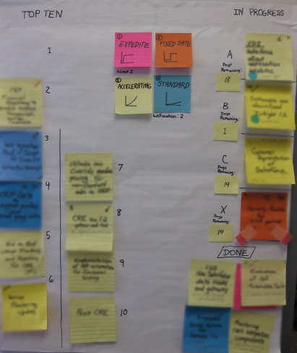
Replenishment Meeting Board
Feature per team
Notes:
[detail on slide] The input queue for the kanban board was the Top 10 List, shown here with Top 10 slots on left, 3 features in progress on right, 1 expedite in progress, and completed features.
Blue “Intangible” class of service features got a capacity allocation of 2 allowed on the Top 10. This was to satisfy the developers who usually created these features and were concerned that they would never be prioritized onto the Top 10.
Dots showed dependencies on a Design team.
SLA Clock Ticking shows how many days remaining to finish the in-progress feature.
Checkmark means a rough estimate confirmed that it could be finished in 21 days or less.

Slide 44

Design/
Specify
(features into stories)
Limit 3 features
In Progress
(stories and features)
Limit 3 features
Accept
(stories & features)
Limit 5
Top 10 (features) Limit 10
Test
(stories)
Limit 3
Done
(stories & features)
Deploy Limit 2
PO must review
1
Backlog
(features)
No limit
2
3
EX
21-day SLA for completing feature starts now!
Notes:
The kanban system design
This is the new kanban board design. When a slot opened in any of the 3 Feature lanes, a feature was pulled from the Top 10 input queue, then a planning meeting would be called in which the feature was decomposed into user stories. The SLA clock starts when the feature is pulled onto the board. Note workflow WIP limits as well as limits implied in the board design.

Slide 45
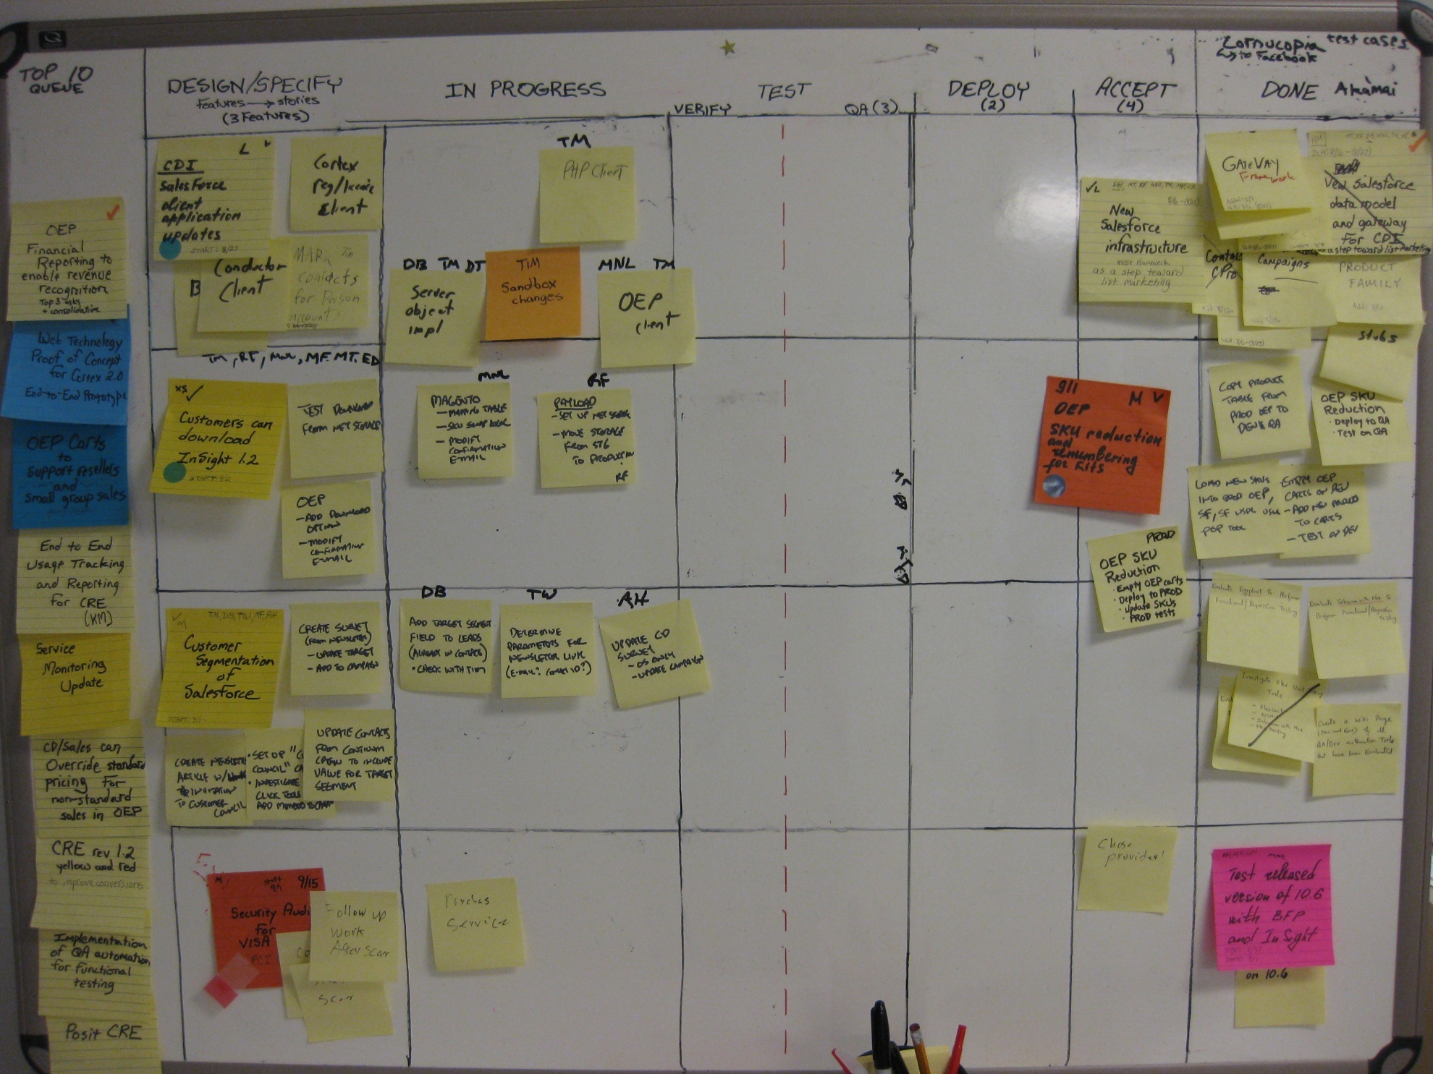
Notes:
This is a photograph of the actual kanban board. Note some elements such as WIP limits and colors were updated over time.

Slide 46
WIP limit to smooth flow through clinical testing
WIP limit to protect deployment bottleneck
WIP limit to hold the Product Owner accountable
Physical lane for expedite. Color shows “fixed date” item that wasn’t started early enough. Provides learning in retrospective
Notes:
Note elements to address previous complaints.
The expedite is now orange instead of white. The team decided to keep it orange to remember that a fixed date feature had to be expedited and learn from this.

Slide 47
Kanban @ Vanguard
An Experience Report
The Lean Kanban Global Summit
Alexandria, VA USA, 2019
David Hughes, AKC
Notes:
Good afternoon. This is an experience report about Kanban at Vanguard. I’m Dave Hughes, the Senior Lean-Agile Enterprise Coach at Vanguard’s main campus located in Malvern, Pennsylvania.

Slide 48
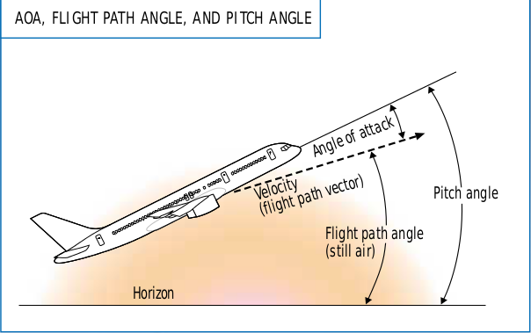
Team P: Pre-Kanban State, One Year
Average delivery lead time 38 to 57 days.
Low work item volume “elevated” to production.
Who is the customer? For what service?
Quick-fix manual process flow.
Scrum
Stall
Notes:
Average delivery lead time was high due to:
Uneven flow = mura.
Over-burdening = muri.
Technical debt, rework, backward flow = muda.
[Click] This team flew into a Scrum stall condition.

Slide 49
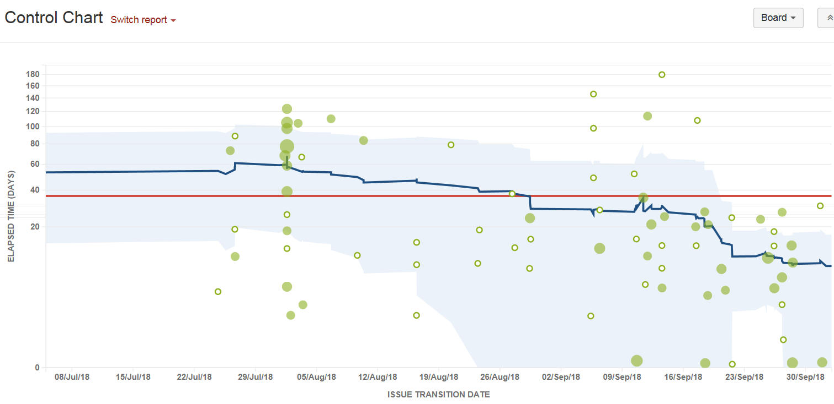
Team P: Flow Metrics
78% improvement (time to deliver) in approximately 90 days!
Nothing Here!
1yr Scrum
90d Kanban
Notes:
Oct 2: 7.5d, 9.3d
Sep 25: 10.0d, 8.2d
Sep 11: 27.4d, 38.8d
Aug 29: 35.9d, 38.8d
Jun 31: 38d to 57d (old measures)
System lead time improved 78% in approximately 90 days! Note the eradication of upper control limit violations. Standard deviation still too high a percentage of sample mean in relative terms. In absolute terms, however, Team P became much more predictable with a bias toward “better than expected.” Team P could commit to service levels.
All system variables were kept constant, except improvements in workflow modeling with an end-to-end WiP limit, and classes of service with new, explicit pull policies and upstream work filters driving better decision making.

Slide 50
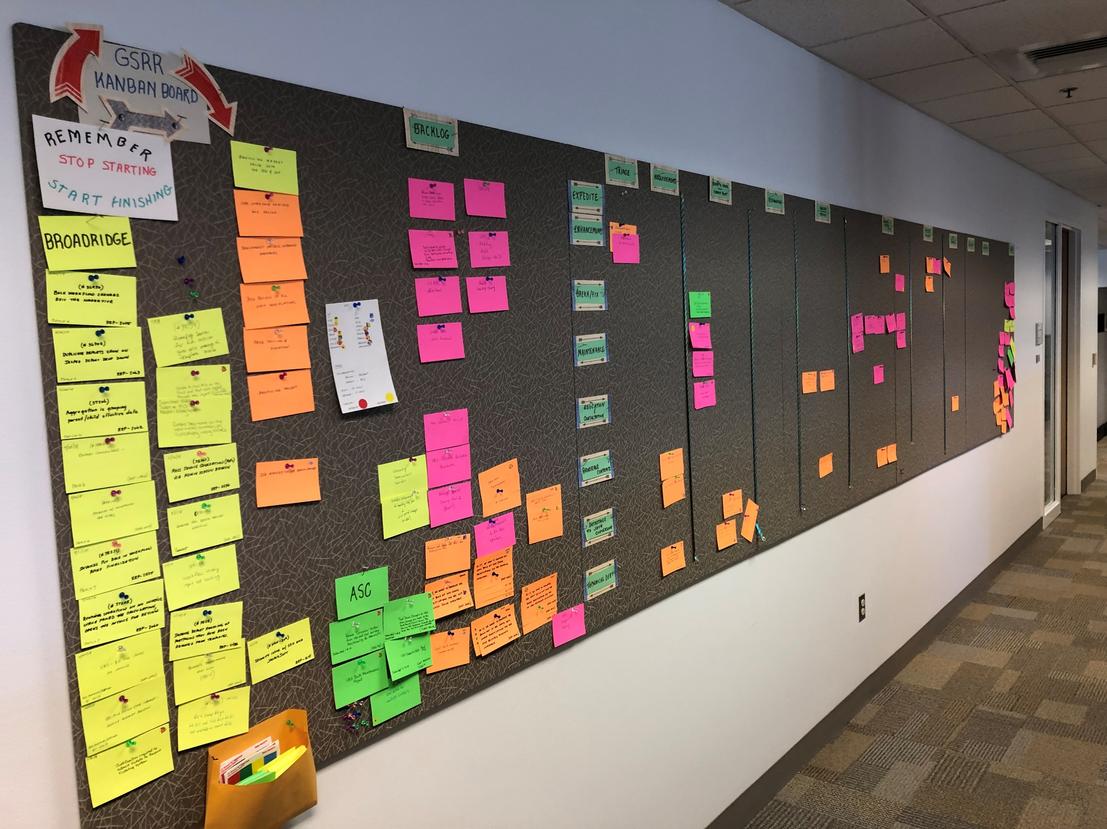
Team Q: Visualizing the Work
Notes:
The power of an end-to-end physical board with policies for workflow states, classes of service, and upstream filtering has been enormous and positive. This picture shows the initial attempt at a physical board correlated to a JIRA virtual board.

Slide 51
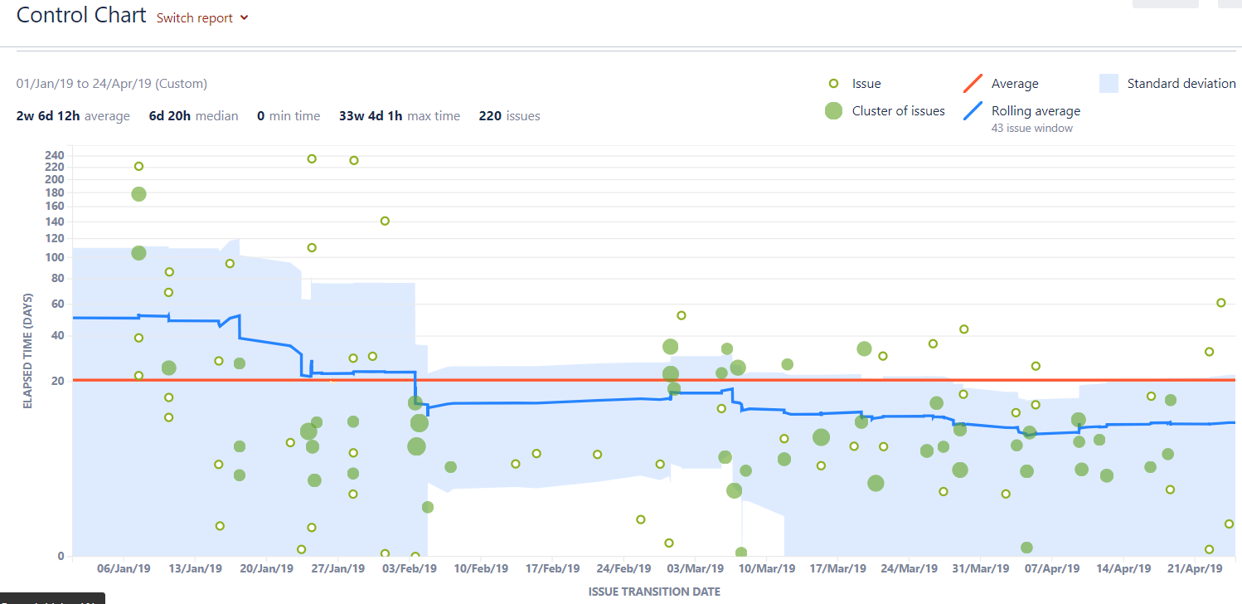
Team Q: Flow Metrics – Success with STATIK!
77% improvement (time to deliver) in approximately 90 days!
Little Here!
1yr Scrum
90d Kanban
Notes:
Vanguard has proved that scatter plots do not always improve in lockstep with cumulative flow diagrams. In this case, system lead time improvement lagged about a month.
System lead time dropped from an average of 65 days to 15 days, a 77% improvement! Note that upper control limit violations have been reduced to nearly zero. Team Q repeated Team P’s experimental results to within one percentage point for system lead time improvement and with nearly the same reduction of upper limit lead time violations to near zero.

Slide 52
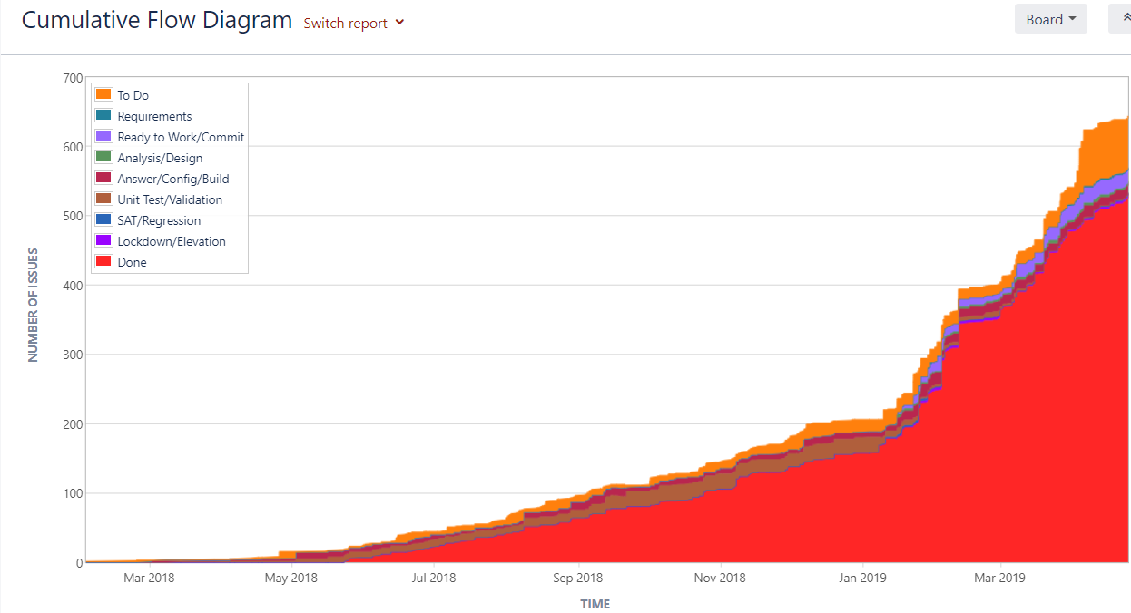
Team Q: Flow Metrics – Spectacular Acceleration!
KMM Level 3
KMM Level 1 to 2
Notes:
Team Q’s flow improvement was spectacular after they hit [click] an inflection point in Jan 2019. We concluded that:
merging multiple separate boards into one large board promoted simplicity and effectiveness, and enabled …
a robust focus on upstream work classification and filtering, which …
motivated the team to focus on WiP limits. Simultaneously, …
a set of service classes renewed the focus on the customer, vendors, and production release frequency.
In retrospect, we discovered that team Q’s inflection point [Click] occurred when they achieved maturity level 3. You really never know when this will happen but, if the right environment is nurtured and the right behaviors are cultivated, it happens. Vanguard’s six critical success factors were used all together and it took about 90 days to observe the effects. You are looking at an average delivery rate increase of 325% and this really got the attention of management. As a matter of fact, this is being written up in a company newsletter as an example of success!

Slide 53
Team Q: Critical Success Factors
4X throughput and ¼ lead time
Big, visible physical Kanban board
Upstream filtering
Focus on bottlenecks
Kanban Maturity Model
Notes:
These factors were focused on early and all together. The Kanban Maturity Model was (and still is) used as a “map back to actual practice.” The KMM is not used as a “map forward to next steps.”

Slide 54
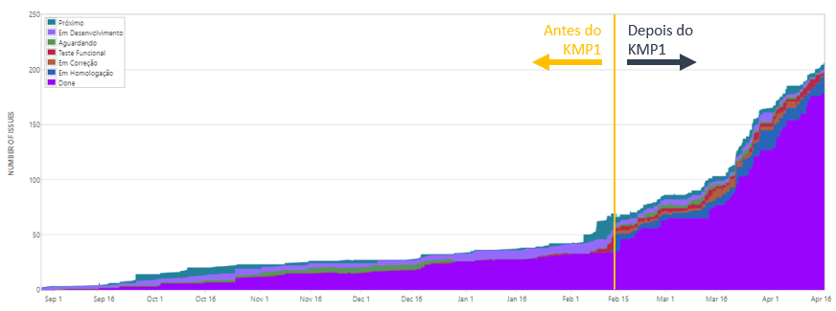
Kanban Impact at Accenture Brazil
What happens when you learn how to properly design and build a Kanban System? You evolve (fast).

Slide 55

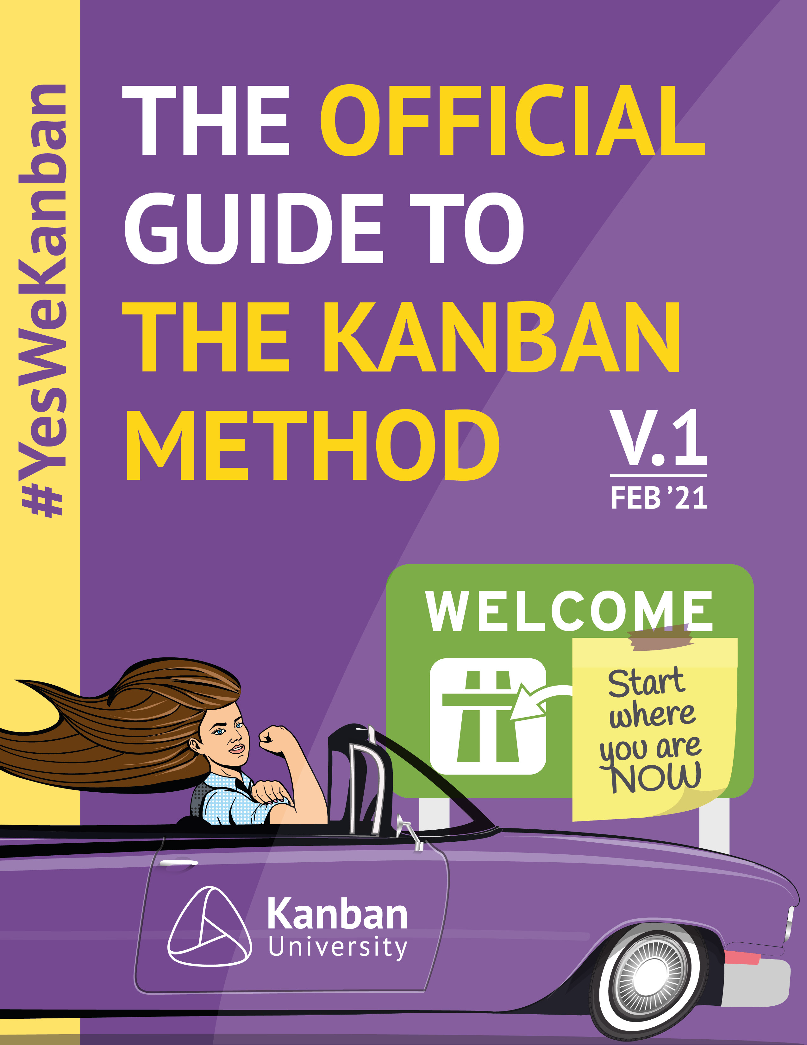



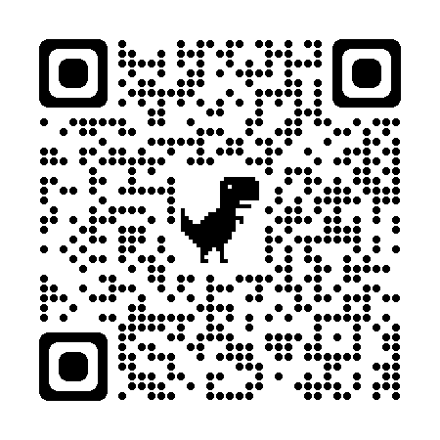
How to get started with Kanban
Kanban Guide | Case Studies | Blue Book
Essential Kanban Condensed | State of Kanban Survey | www.kanban.university

Slide 56

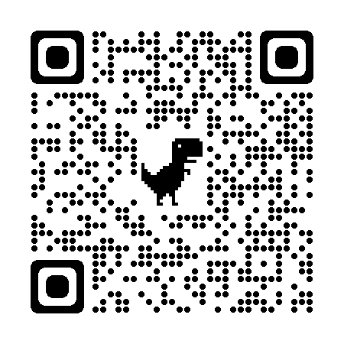
Todd Little Chairman,
LinkedIn Kanban University

Slide 57

Scrum Better With Kanban
Todd Little Chairman,
LinkedIn Kanban University

