Slide 1

Resilience and Agility Through Evolutionary Change and the Kanban Maturity Model
Todd Little
Chairman Kanban University

Slide 2
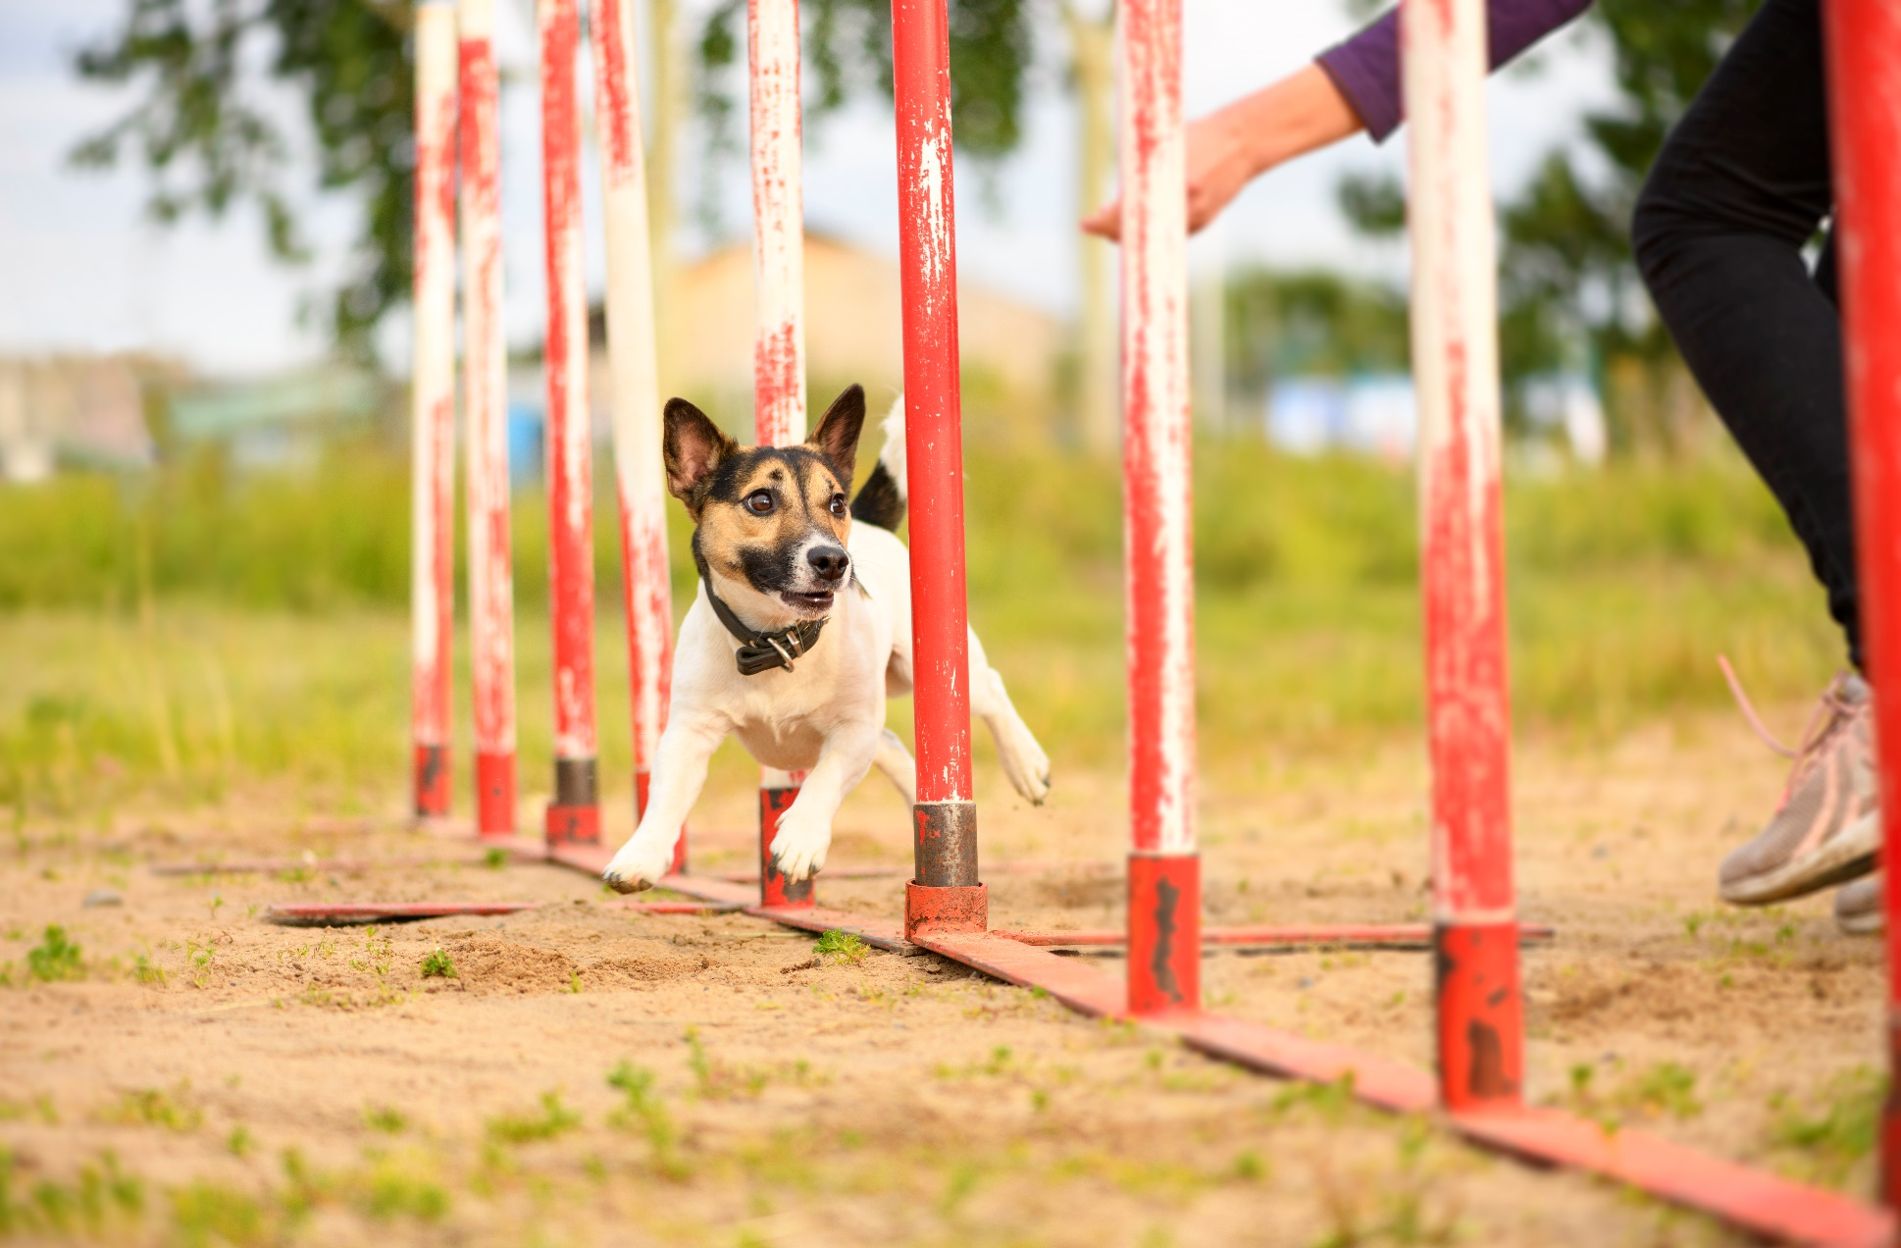
Agility
Ability to change direction

Slide 3
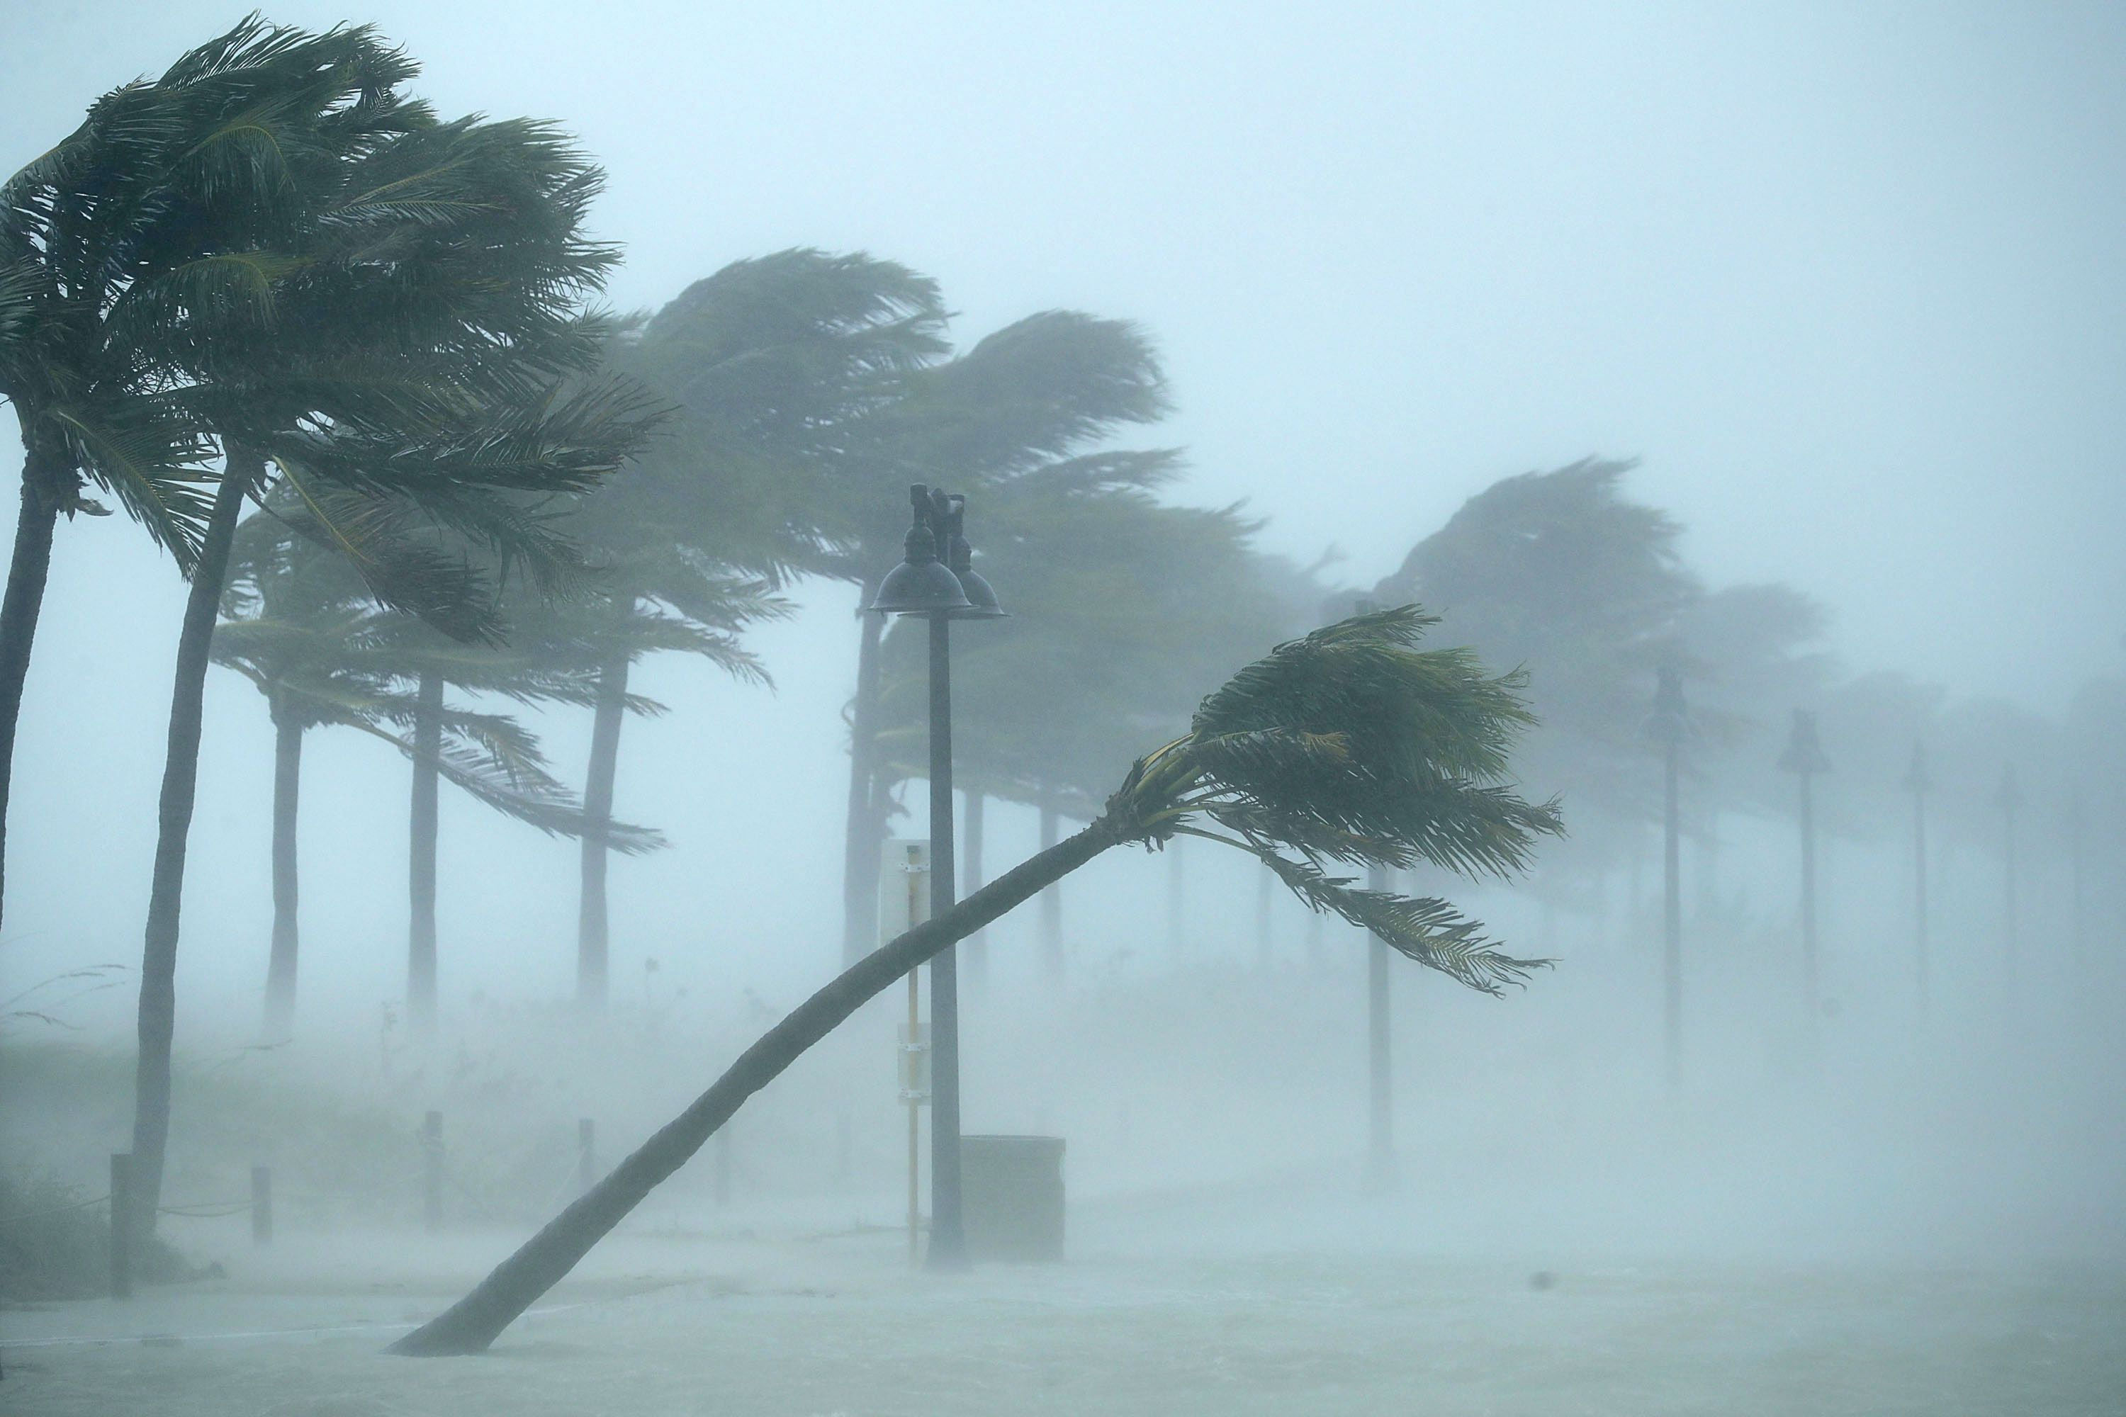
Resilience
Ability to recover from adversity

Slide 4
What is Kanban?

Slide 5
This is what people think Kanban is
To Do
In progress
Done

Slide 6
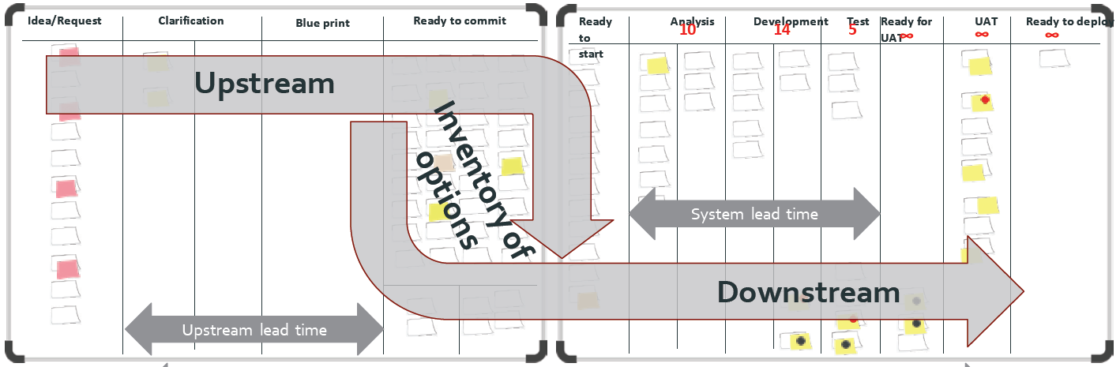
What is Kanban?
The Kanban Method is a tool for evolutionary change in managing knowledge work. It teaches organizations how to understand, visualize and measure systems of work to continually improve and consistently deliver effective results.
The Kanban Method provides a set of proven practices and approaches that scale from individuals and teams to the enterprise.

Slide 7
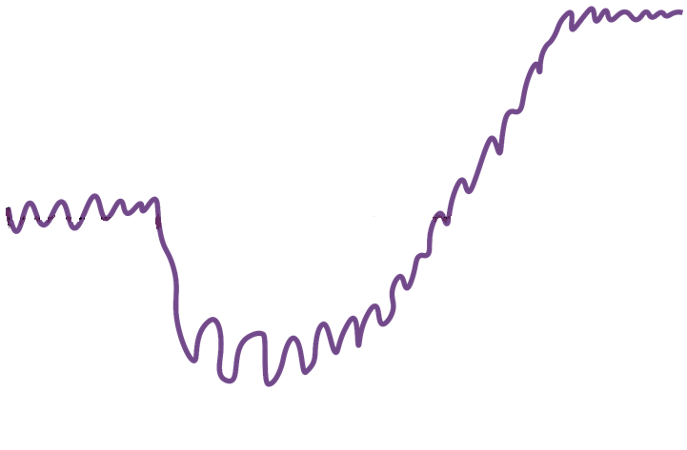
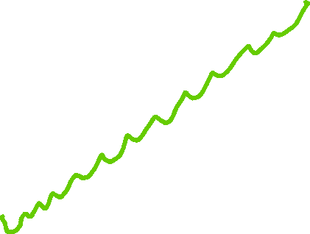
Evolutionary Change
Future State
Capability
Kanban in action!
Avoid the failure mode
of large scale, designed &
managed transformations
18% success*
64% moderately effective
Current State
time
Safety!
Lower maturity organizations panic under stress
Patience!
Failure!
18% failure
* https://www.pmi.org/-/media/pmi/documents/public/pdf/learning/thought-leadership/pulse/organizational-change-management.pdf
Notes:
But change initiatives feel like a lot of jarring ups and downs.
The trauma of a managed change initiative can feel unsafe
…and require a lot of patience

Slide 8
Kanban: The Great Unifier
Start with what you do now
Chaos
Kanban
SAFe
Scrum
Waterfall
CMMi

Slide 9
Why do we need YAMM?

Slide 10
How the Kanban Maturity Model is Different
Conformance to Practices
Processes
Inputs
Inputs
Inputs
Traditional Maturity Models
Outcomes and Results
Processes
Inputs
Inputs
Inputs
Kanban Maturity Model
Outcomes and Results

Slide 11
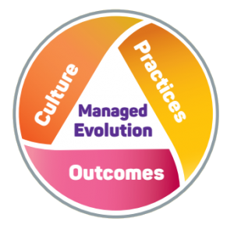

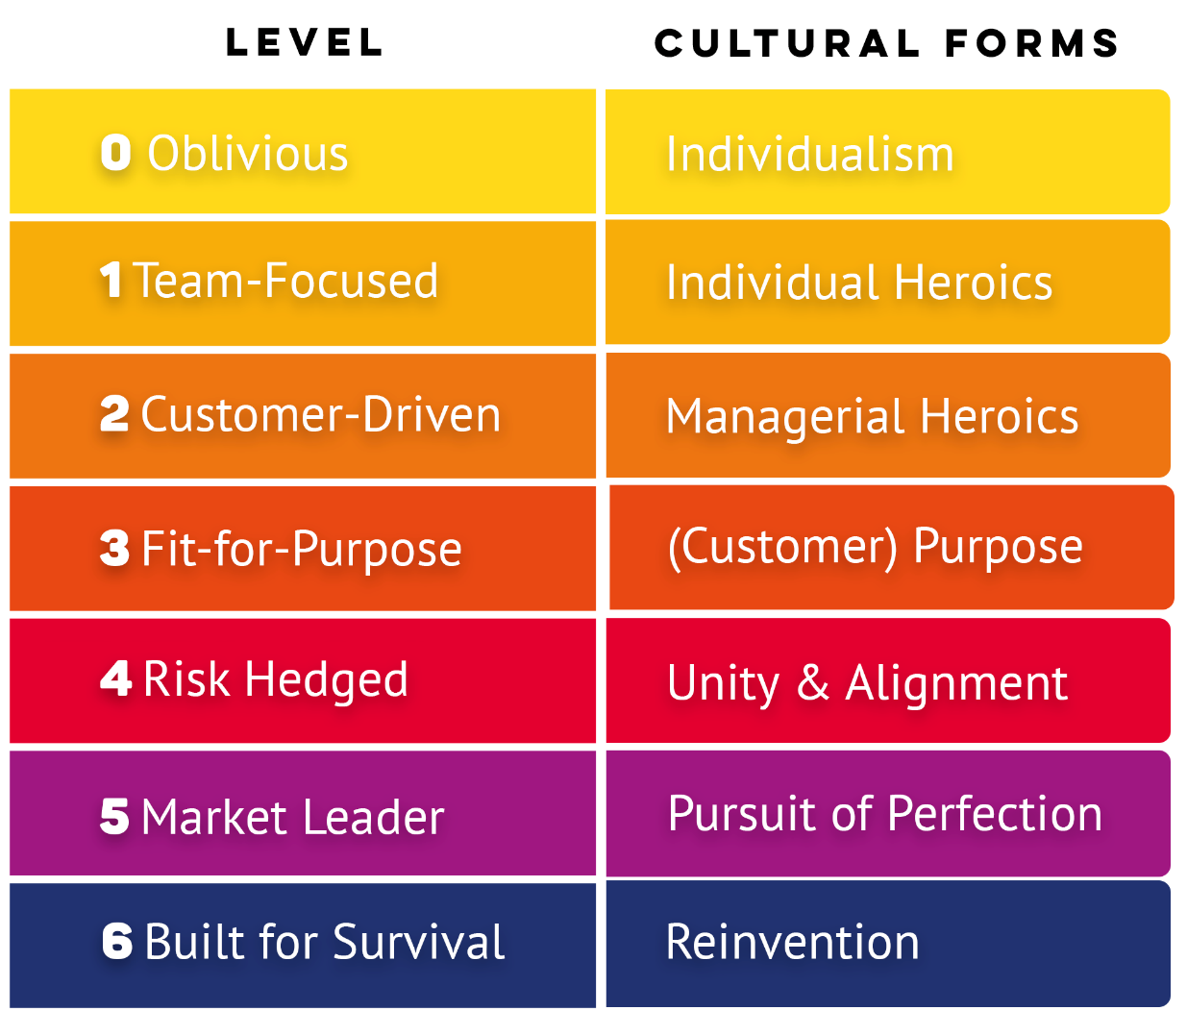
The Kanban Maturity Model (KMM) maps ~150 specific Kanban practices to observable business outcomes using seven levels of organizational maturity
Notes:
*Every customer has their pet!

Slide 12
KMM helps eliminate the two failure modes in Kanban and Agile implementations:
  overreaching causing an aborted start;
  false summit plateaus that fail to realize full benefit.
Notes:
*Every customer has their pet!

Slide 13
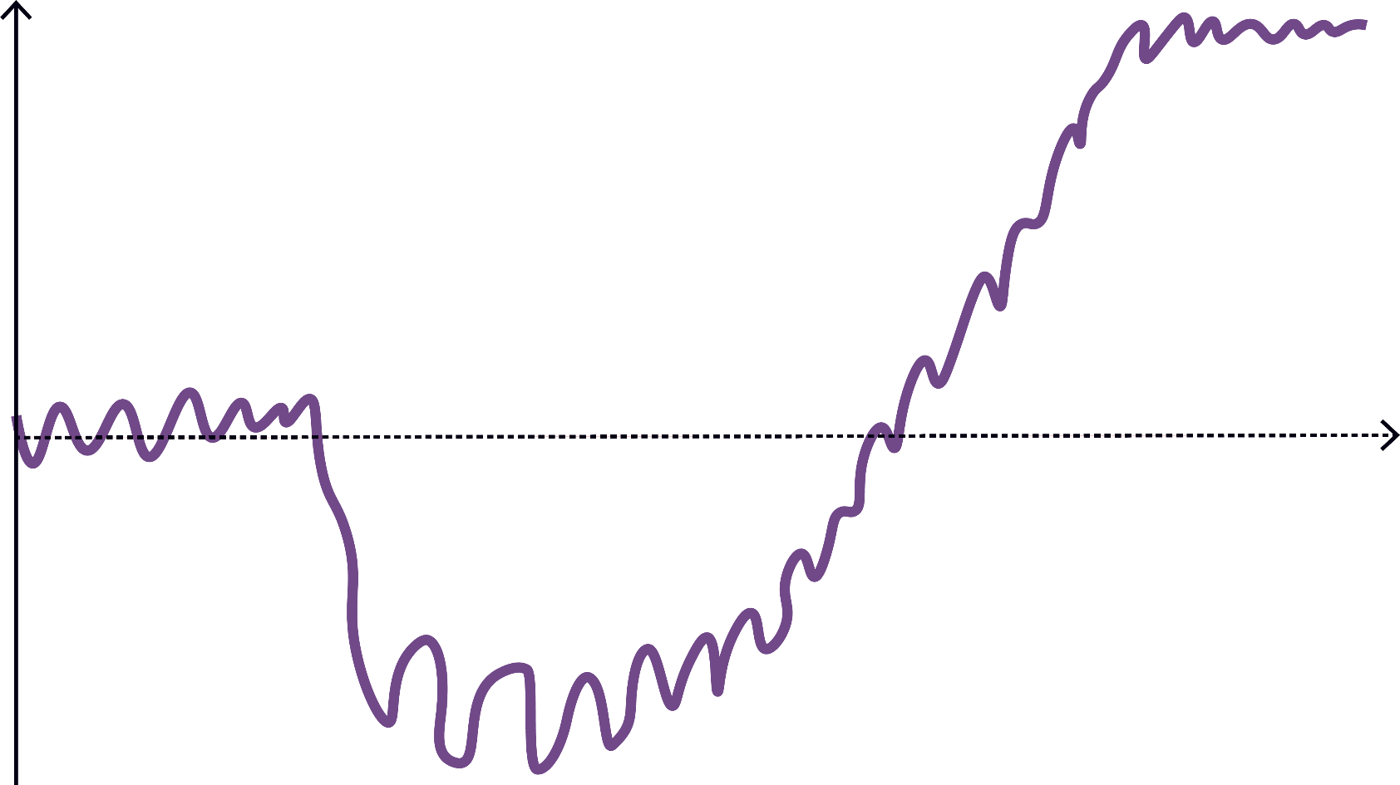
Overreaching and Plateauing
Capability
Missed
Benefit
False Summit Plateau
time
Overreaching
Notes:
But change initiatives feel like a lot of jarring ups and downs.
The trauma of a managed change initiative can feel unsafe
…and require a lot of patience

Slide 14
ML0: Oblivious
“My Way”
Every customer has their pet
Notes:
*Every customer has their pet!

Slide 15

Individualism
Unpredictable and unreliable service
Overburdened people
Unhappy customers Unhappy managers Unhappy people

Slide 16
Recommendations
Implement:
Visualize Work at Team Level
Limit Work In Progress (WIP)
Define Initial Policies
Feedback Loops – Kanban Meeting

Slide 17
ML1: Team-Focused
“Never the same way twice”
individual heroics
unconnected teams
Notes:
If you see evidence of reliance on ‘the hero’ it’s ML1
If you hear that people is talking all the time about teams and nothing about aligning and coordinating different teams, it is ML1.
If team members complain that the managers change priorities frequently, this is ML1 (or less) – the management does not care about how priority changes affect team’s work.

Slide 18
Problem Statement
“Every team reports that they deliver on their commitments, but I know that customers are waiting longer than 6 months for delivery”
agile coach,
internet equipment manufacturer

Slide 19
Maturity Level 1 - Team Kanban Boards
Backlog
Next
In-progress
Done
∞
₃
₃
∞
D
C
A
H
PB
_{I}
E
_{J}
DE
G
F
GY

Slide 20
Diagnosis
Lack of service-orientation
Localized metrics & objectives
No customer recognizable work items
Lack of collaboration across service-delivery workflow

Slide 21
Recommendations
Implement:
STATIK (Systems Thinking Approach to Introducing Kanban)
Customer recognizable work item types
Service-oriented workflow board
Flow Review

Slide 22
Maturity Level 2 – Aggregated Team Kanban Board
Pool
of
Ideas
Next
Platform Enhancement
API Development
Mobile UI Dev
Ready for Customer
₅
Ongoing
Done
Ongoing
Done
₃
∞
₃
∞
₃
∞
C
C
P1
J
A
F
D
B
H
G
PB
M
GY
DE
K
E
MN
I
O
AB
N
P
L
Team 1 Kanban
Team 3 Kanban
Team 2 Kanban

Slide 23
ML2: Customer-Driven
“Never the same result twice”
managerial heroics
delays and last-minute tension despite coordinated team effort
Notes:
*If you see managers stepping in to solve problems before a disaster, or draconian policies put in place to avoid future disasters – it’s ML2
If managers and people complain that they cannot meet deadlines or meet them at the cost of extra hours and tension in spite of all their intents to coordinate the teams, it is ML2.
If teams complain that work within their dept goes smoothly but there are frequent conflict of priorities among departments, this is ML2T, services are managed within the departments, but the alignment around a common purpose is still missing and this creates friction and tension in the end-to-end flow management.

Slide 24
Problem Statement
“I haven’t looked at the lead time chart in months”
software development manager,
telecom equipment manufacturer

Slide 25
Diagnosis
Is a “service delivery manager” role present?
Are customer expectations understood & communicated?
Is there service delivery review happening?

Slide 26
Additional questions
Is there any blocker management?
Is blocker likelihood and impact being reported?
Is there a risk review?
Is the lead time distribution thin or fat-tailed?

Slide 27
Recommendations
Implement:
Instrument & Report Lead time
Service Delivery Manager Role
Service Delivery Review
Blocker Metrics
Risk Review
Customer Expectation (fitness criteria)

Slide 28
Maturity Level 3 Kanban Board (and pull system)
Engin-
eering
Ready
Deploy-ment
Ready
Test
Ready
Ideas
Development
Testing
UAT
₃
₅
₃
∞
∞
₅
Ongoing
Done
H
B
Pull
_{J}
E
F
G
F
Pull
C
F
F
F
I
F
F
D
A
*
I
Notes:
Slides in the section are for discussion of review material, as needed.
----
Numbers written at the top of the columns can also express available slots (capacity) for new work.

Slide 29
ML3: Fit-for-Purpose
“Predictable Delivery”
“no more heroes anymore”
processes under control
Notes:
*when the system keeps customers happy – you don’t have to work all night – it’s ML3
* When people say that they go home on time, not worrying or thinking how to manage to do everything the next day because the entire process is under control, it is ML3.

Slide 30
Problem Statement
“We just put out a release on time, met our commitments, but our product management team, reacted with WTF is this?”
software development manager,
mobile application, Berlin

Slide 31
Diagnosis
Work items weren’t meaningful and understood by customers
Asynchronous commitment
Pull from partially committed “buffer”, no replenishment meeting

Slide 32
Recommendations
Implement:
2-tiered Kanban Board
New coarse-grained work item type
Synchronous commitment
Full replenishment meeting with customers present, & synchronous commitment
Customers commit to coarse-grained work items

Slide 33
ML4: Risk Hedged
“Everyone is happy”
no more surprises
Notes:
*When the system anticipates problems and adjusts actions to avoid them, it’s ML4

Slide 34
ML5: Market Leader
“Simply the best”
marginal gains
attention to every detail
Notes:
*When teams re-paint the floor, and individuals rinse their cottage cheese, to squeeze effectiveness and profit out of good economics – it’s ML5

Slide 35
ML6: Built for Survival
“Reinvention”
Continually challenging
new identity; new purpose
Notes:
*When the leaders challenge existing identity and purpose and redefine who, what, how, and why – successfully – it’s ML6

Slide 36
Kanban Maturity Model at Vanguard
Scrum Stall
System lead time improved by 78 percent in approximately ninety days!

Slide 37
Kanban Maturity Model at Vanguard

Slide 38
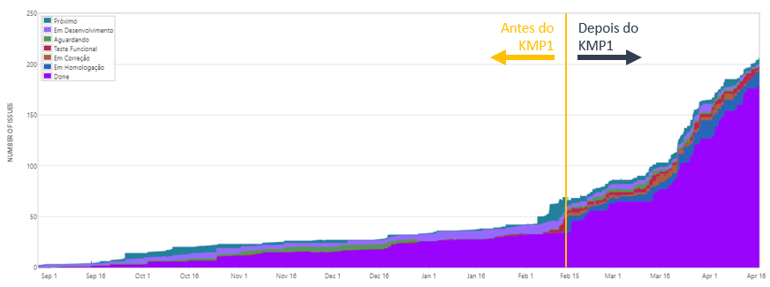
Kanban Impact at Accenture Brazil

Slide 39
It is the organization that matures, not the Kanban that matures

Slide 40
Resilience and Agility Through Evolutionary Change and the Kanban Maturity Model
Todd Little
Chairman Kanban University

