Slide 1
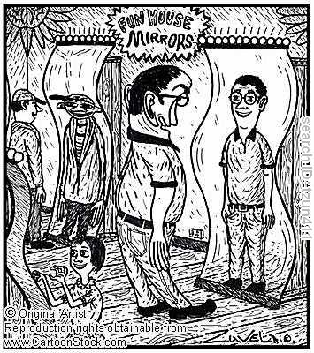
Reflections on 10 Years of Agility

Slide 2
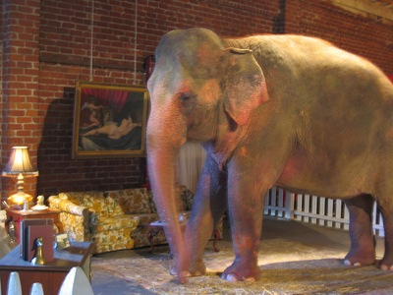
The Elephant in the Room

Slide 3
The selling of Agile is a business
Commercial interests censoring failures
Failure to dampen negative behaviors
Dogma sells
Hypocrisy

Slide 4
Anarchism

Slide 5
Elitism

Slide 6
One size does not fit all - Context

Slide 7
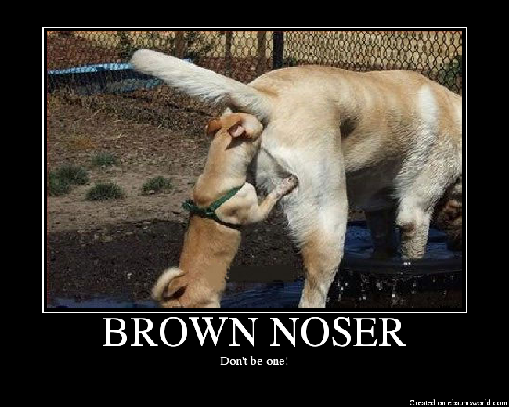
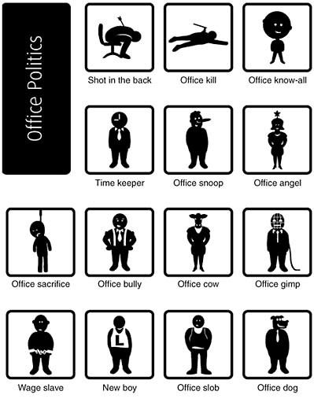
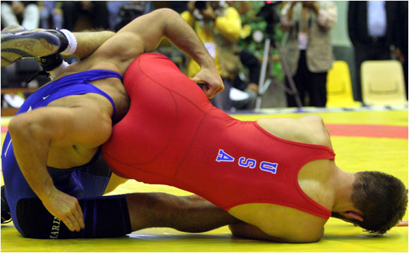
Politics are a huge cultural issue

Slide 8
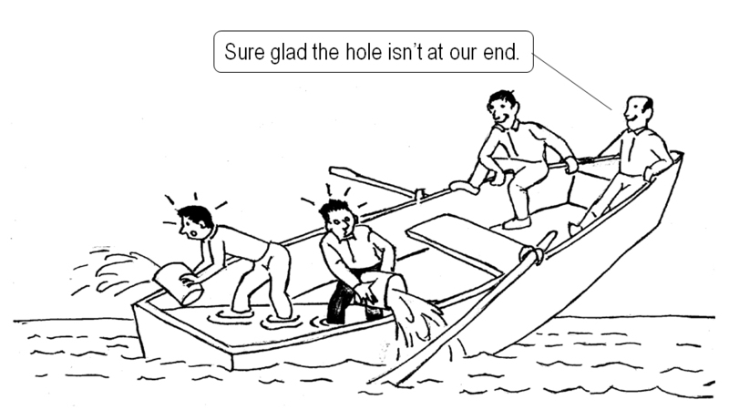
Agile needs to adopt to culture as much or more than culture needs to adopt to agility

Slide 9
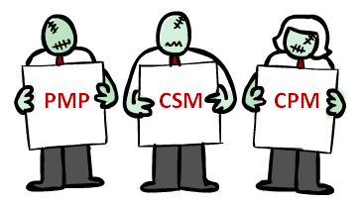
Certification (the “zombie elephant”)

Slide 10
Agile Successes!

Slide 11
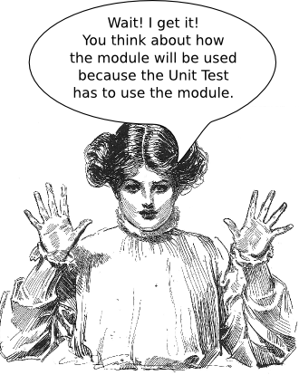
Heightened Focus on Unit Testing and Automation

Slide 12
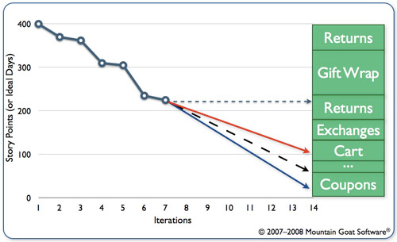
Transparency, Reporting and Tracking

Slide 13
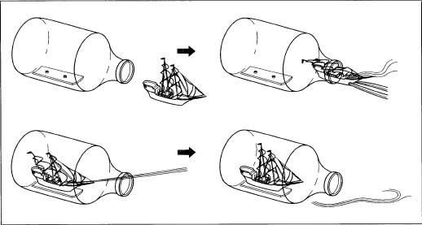
Emphasis on Shipping and Feedback

Slide 14
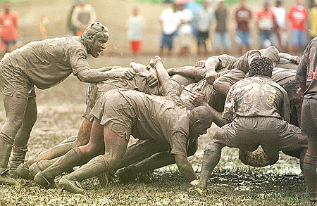
Software Development is a Team Sport

Slide 15
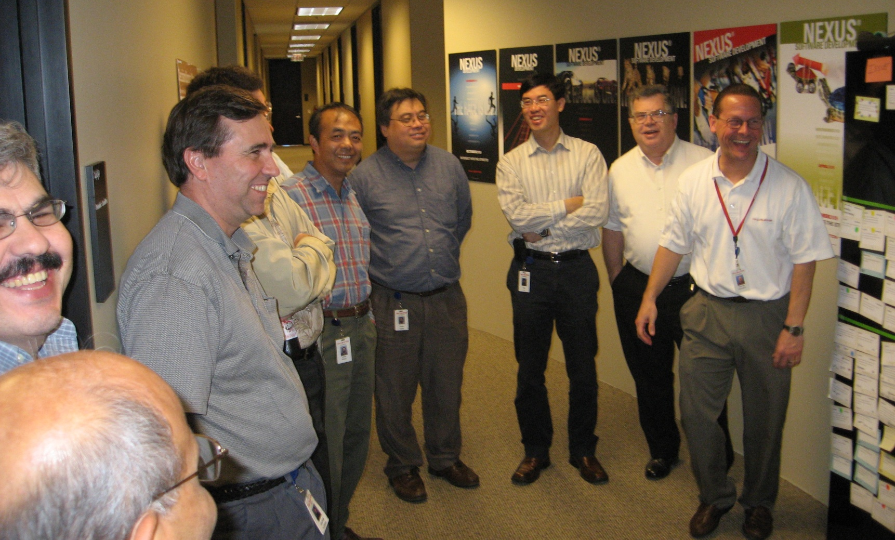
Teams are Enjoying Developing Software

Slide 16
Global Spread – 91 Countries

Slide 17
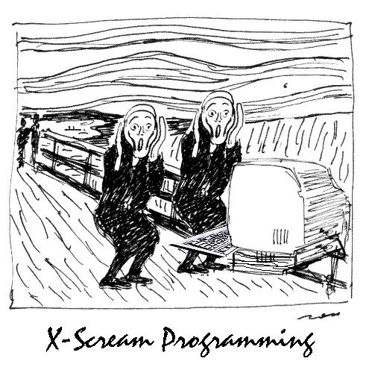
It’s OK to be Agile

Slide 18
To Agility and Beyond Four Value Propositions
Demand Technical Excellence
Promote Individual Change and Lead Organizational Change
Organize Knowledge and Improve Education
Maximize Value Creation Across the Entire Process

