Slide 1
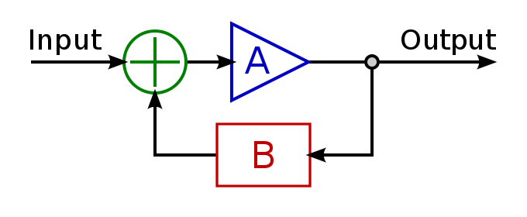
Closed Loop Feedback is the Key to Manage Today’s Risk
Todd Little

Slide 2
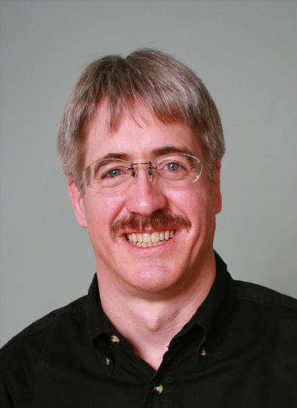
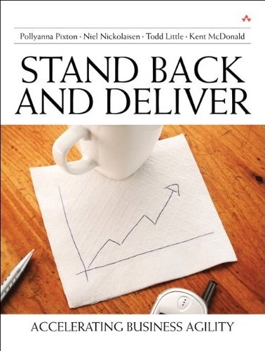
About Todd
Chairman, Kanban University
Chemical and Petroleum Engineer
Executive roles as VP Product Development, Director of Software & Technology
@toddelittle

Slide 3
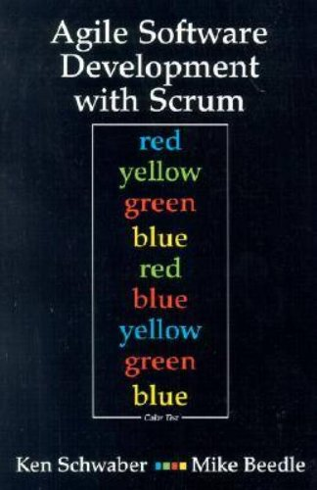
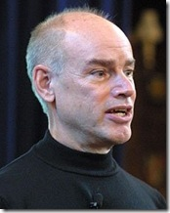
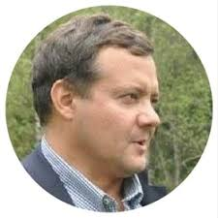
Empirical Process Control

Slide 4
Control Systems
Processes
Inputs
Inputs
Inputs
Open
Loop
Processes
Inputs
Inputs
Inputs
Closed
Loop
Outputs

Slide 5
Open Loop Control
Desired Output Response
Controller
Process
Output

Slide 6
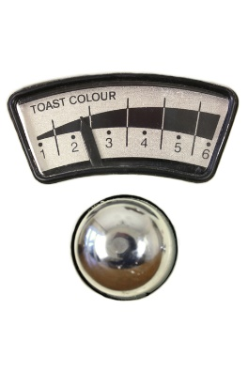
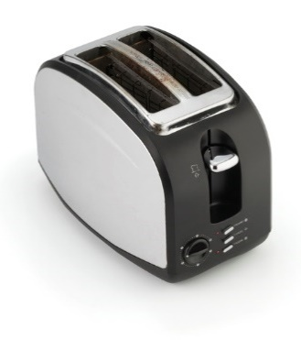
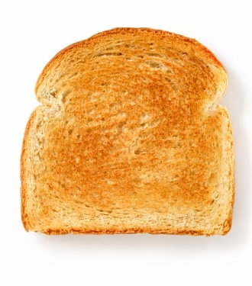
Open Loop Control
Desired Output Response

Slide 7
Closed Loop Control (Balancing Feedback loop)
Deviation from desired state
Assessment
Actual Output
+
+
Corrective Action
Process
-
Sensor
Feedback Signal

Slide 8
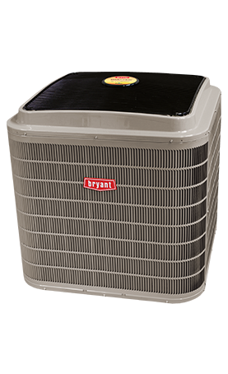
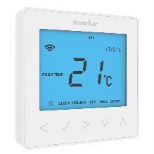
Closed Loop Control Example
Deviation from desired state
Assessment
Actual Output
+
+
Turn on or off
-
Temperature
Feedback Signal

Slide 9
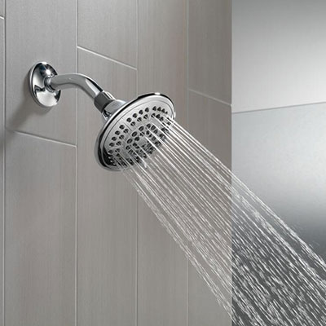
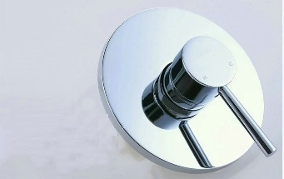
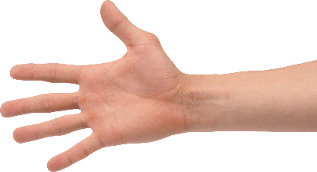
Shower Control System
Deviation from desired state
Adjust
Assessment
Actual Output
+
+
-
Feedback Signal
Temperature

Slide 10
Shower Control System
Deviation from desired state
Adjust
Assessment
Actual Output
+
+
-
Feedback Signals
Temperature
Flow Rate

Slide 11
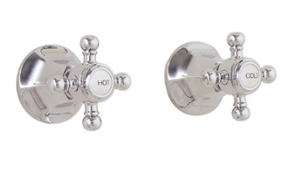
Shower Control System
Deviation from desired state
Adjust
Assessment
Actual Output
+
+
-
Feedback Signals
Temperature
Flow Rate

Slide 12
Shower Control System
Deviation from desired state
Adjust
Assessment
Delay
Actual Output
+
+
-
Feedback Signal
Temperature

Slide 13
Cynefin Framework(Snowden)

Slide 14
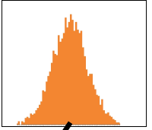
Obvious
Distribution
Input
Output
Cause and Effect Obvious to all
Known - Knowns

Slide 15
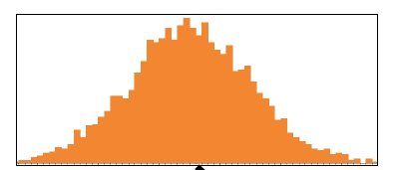
Complicated
Analysis
Input
Output
Distribution
Cause and Effect Requires Analysis
Known - Unknowns

Slide 16
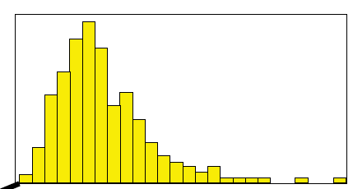
Complex
Distribution
Input
Output
Cause and Effect perceived in retrospect
Unknown - Unknowns

Slide 17
Shower Control System
Deviation from desired state
Adjust
Assessment
Actual Output
+
+
-
Feedback Signals
Temperature
Flow Rate

Slide 18
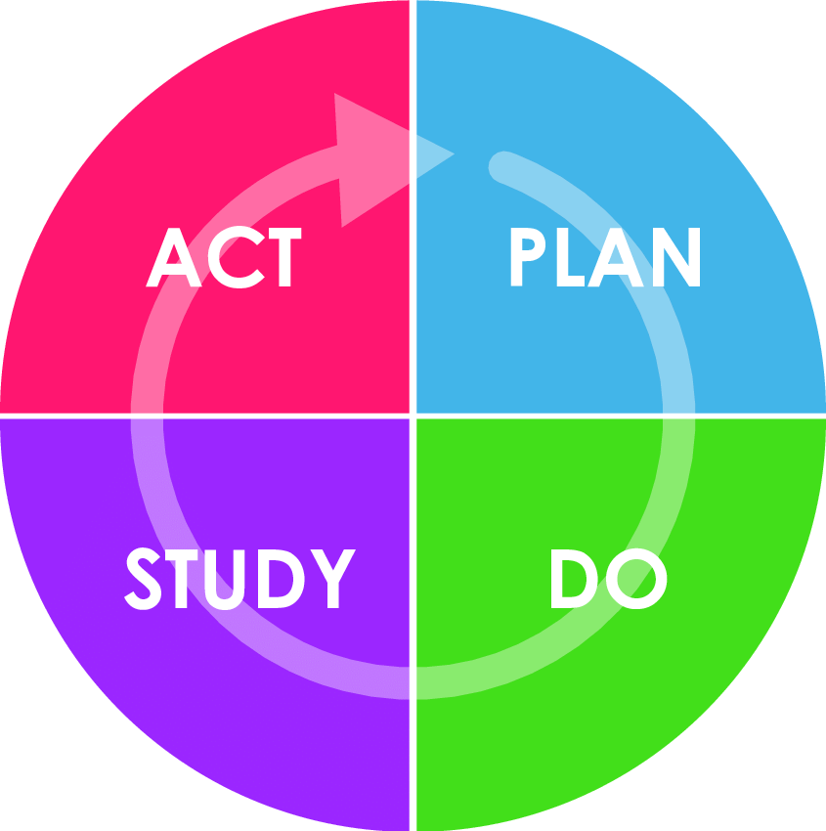
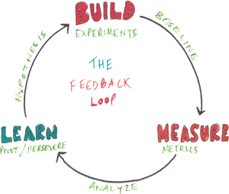
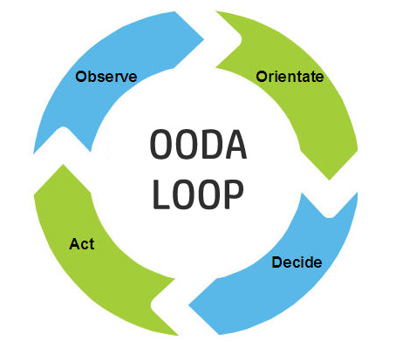
Feedback Loops
Desired
Value
S
Discrepancy
O
S
Actual
Value
Adjustment
S

Slide 19
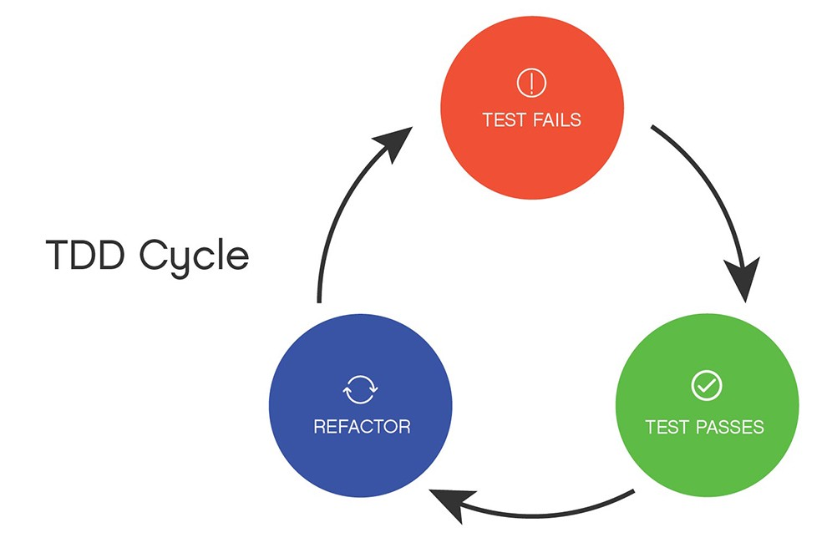
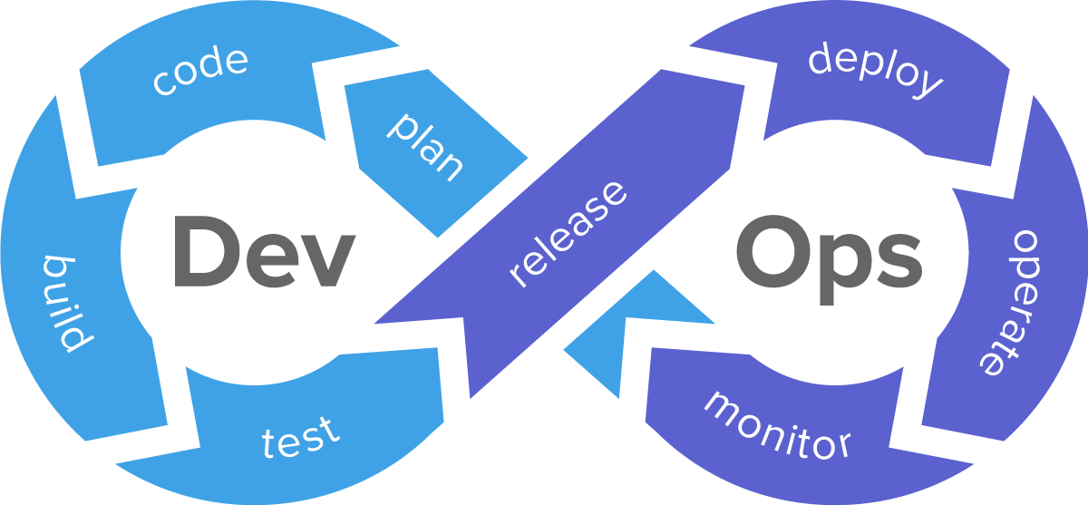
Enhancing Feedback

Slide 20
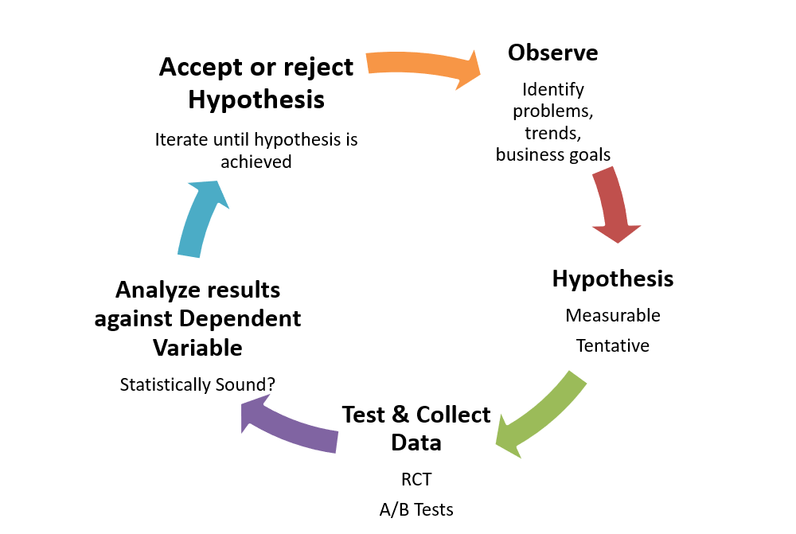
The Scientific Method

Slide 21
Observe-Orient-Decide-Act (John Boyd)

Slide 22
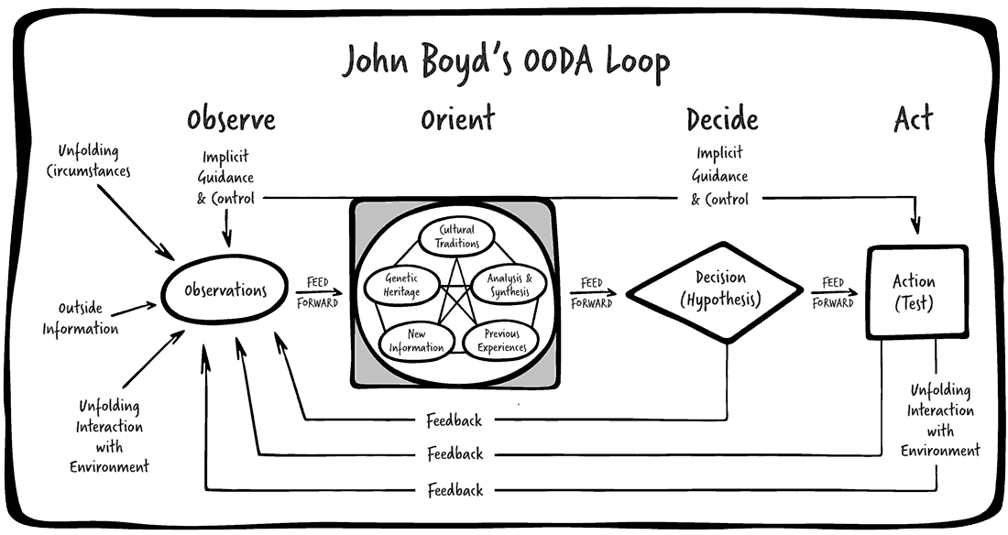
Reality of Feedback Loops

Slide 23
Complex Control System
Desired Output Response
Controller
Process
Output Variables
Measurement
Multi Input Multi Output (MIMO) System

Slide 24
Complex Control
Adjust Scope
Adjust Date
Adjust Team
Adjust Quality
Adjust Process
Desired Output Response
Controller
Process
Output Variables
Value
Schedule
Cost
Quality
Measurement
Multi Input Multi Output (MIMO) System

Slide 25
Lockdown
Desired Output Response
Controller
Process
Output Variables
Value
Schedule
Cost
Quality
Measurement
Multi Input Multi Output (MIMO) System

Slide 26
Delivery Goals

Slide 27
Calendar of Innovation

Slide 28
Extreme Closed Loop Creates Open Loops?
Desired Output Response
Controller
Process
Output Variables
Value
Schedule
Cost
Quality
Measurement
Multi Input Multi Output (MIMO) System

Slide 29
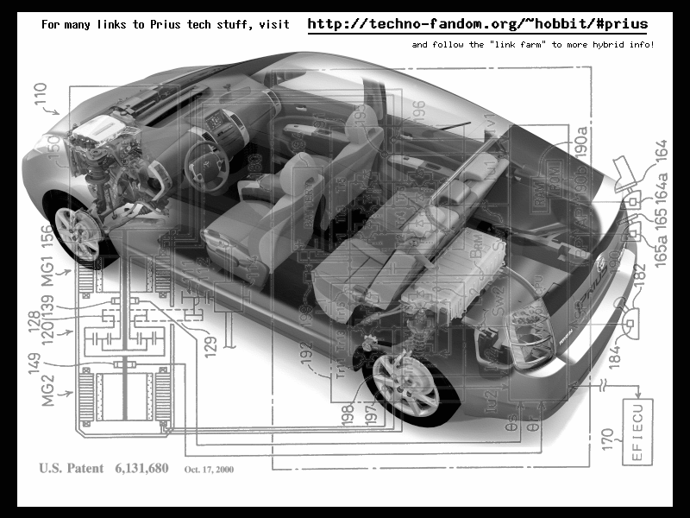
Value of Flexibility
Notes:
9 research projects for drive train
1 chassis – same hole for all 9 drive trains
VOI from 9 research projects, VOF from chassis design
Contrast this with the development of the Prius. Toyota had 9 different research projects running to develop hybrid engine technologies. Normally they would choose a drivetrain first, and build a car around it. Instead Toyota decided to keep its options open, and designed the Prius with a hole in it for the drive train. The 9 research projects continued, and 9+ months after the Prius development project was started, a drive train was chosen. Toyota knew that this car needed a radically new drive train architecture. Instead of guessing and choosing one, they let all 9 research projects continue their work, and as they did, the best option for the car's engine became clear. So was 9 research projects a waste? No because each project was generating factual information about the options for hybrid engine design, information that Toyota engineering management needed to make an informed choice.

Slide 30
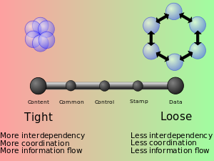
Value of Flexibility from Loose Coupling

Slide 31
Ongoing Feedback

Slide 32
Business Process Value Chain
Market
Product
Development
Sales
Product Company
Business Need
Development
Delivery
Internal IT
Specifications
Development
Delivery
Contract Model

Slide 33
How does Kanban work with feedback?

Slide 34
Kanban and Feedback Loops
What people think Kanban is
To Do
In Progress
Done

Slide 35
What is Kanban?
The Kanban Method teaches organizations how to understand, visualize and measure systems of work to continually improve and consistently deliver results.
The Kanban Method provides a set of proven practices and approaches that scale from individuals and teams to the enterprise.

Slide 36
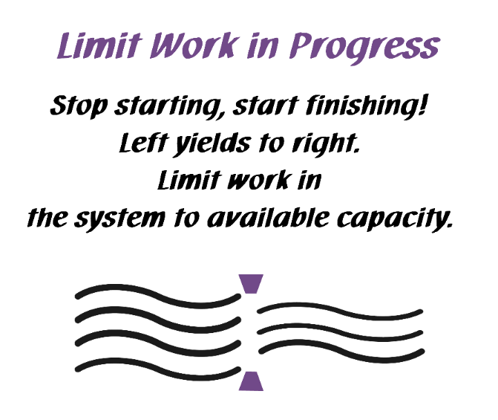
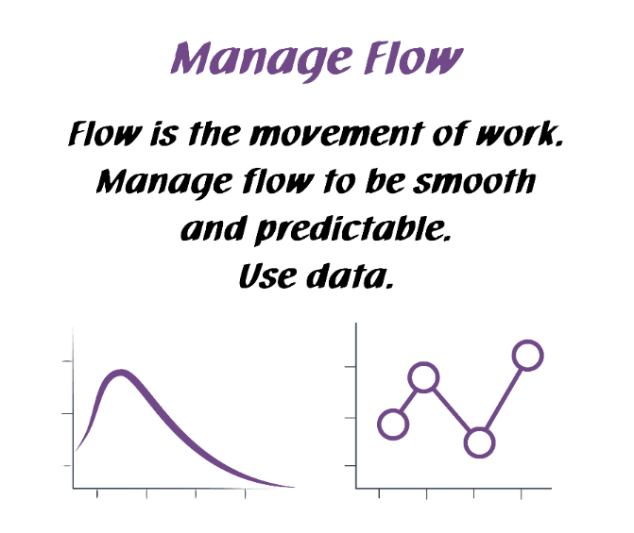
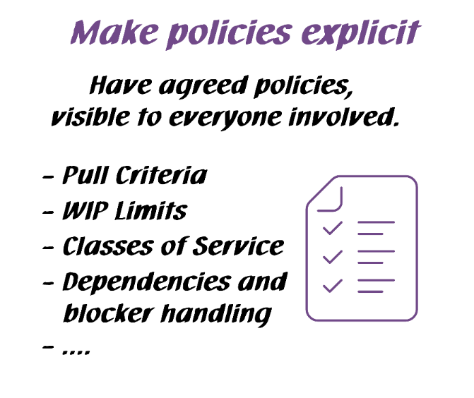
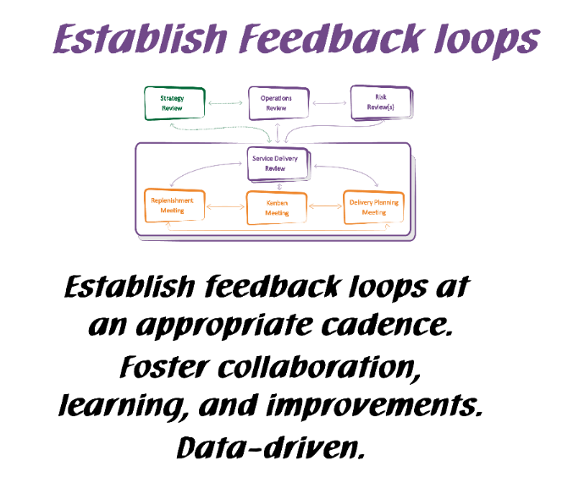
Kanban General Practices
Kanban General Practices
Notes:
Walk the class through the Kanban practices.
There are 6 General Practices in the Kanban Method. [Walk briefly through each of the 6 Practices. See David Anderson’s blog at http://www.djaa.com/principles-general-practices-kanban-method if you want help with how to explain]
Instead of using this slide, you can also create a flipchart with similar info etc.
You might revise this after the simulation.

Slide 37
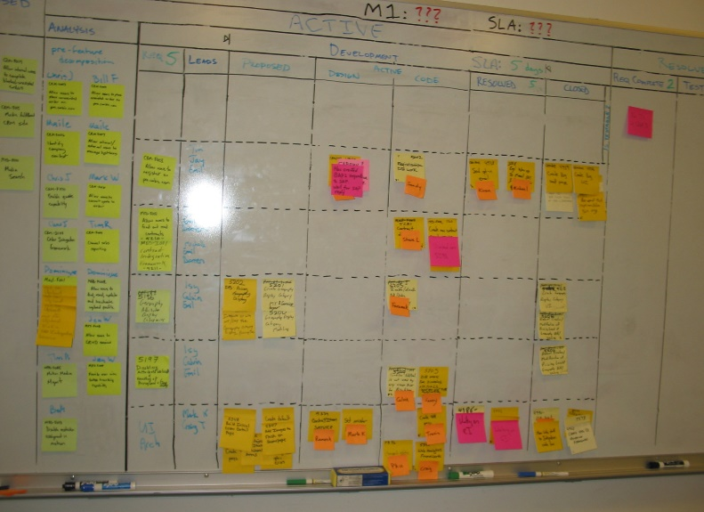
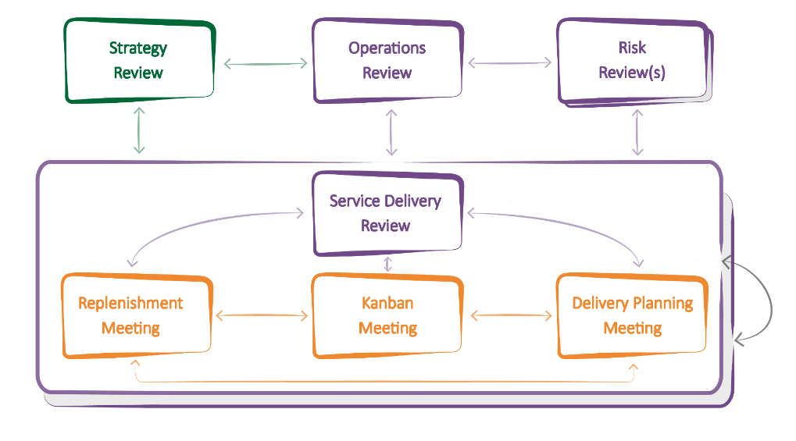
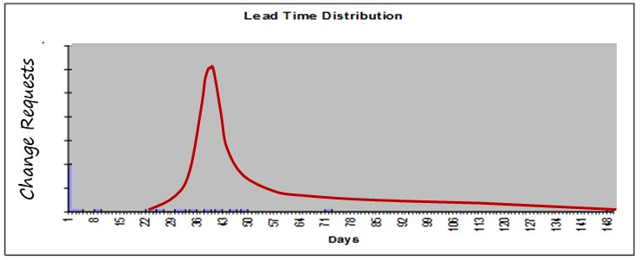
Feedback in Kanban
Boards
Meetings/Cadences
Metrics

Slide 38
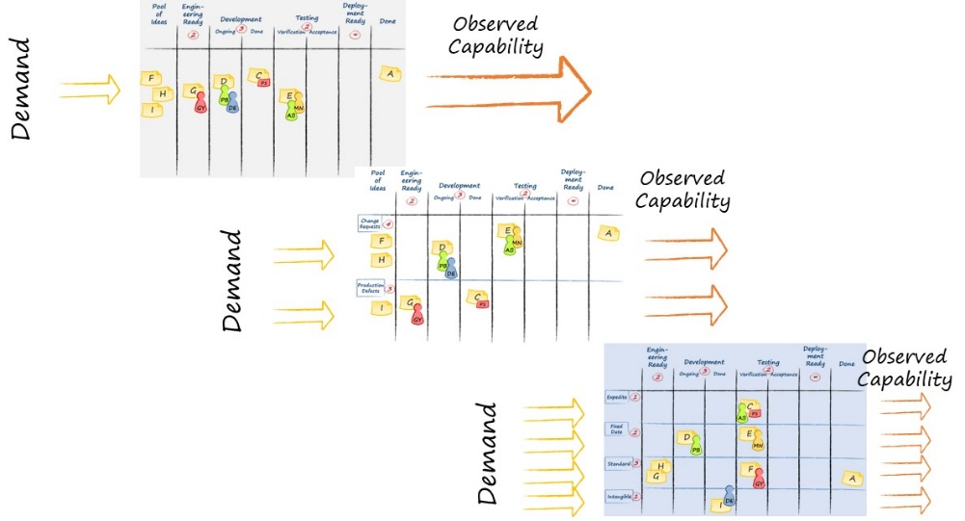
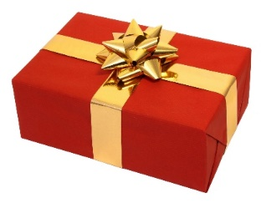
Visualize
Ideas

Slide 39
Visualize
Ideas
Understand the system

Slide 40
Visualize
Ideas
Understand the system
FLOW

Slide 41
Visualize
Ideas
Understand the system
FLOW
Balance Demand and Capacity

Slide 42
Visualize
Ideas
Understand the system
FLOW
Balance Demand and Capacity
Limit WIP

Slide 43
Visualize
Ideas
Understand the system
FLOW
Balance Demand and Capacity
Limit WIP
Bottleneck

Slide 44
Kanban and Feedback Loops
Visualize
Ideas
Understand the system
Scale
FLOW
Balance Demand and Capacity
Limit WIP
Bottleneck

Slide 45
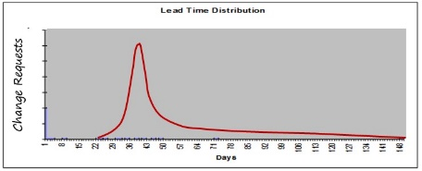
Kanban and Feedback Loops
Visualize
Ideas
Incremental process improvement through measurement
Understand the system
Scale
FLOW
Balance Demand and Capacity
Limit WIP
Bottleneck

Slide 46
Kanban and Feedback Loops
Visualize
Ideas
Process monitoring & improvement through measurement
Understand the system
Scale
FLOW
Balance Demand and Capacity
Limit WIP
Bottleneck
Service or Product Improvement

Slide 47
The Kanban Cadences: The Full Set
Notes:
Kanban gives you a PATTERN of 7 meetings / reviews and their interactions that helps you properly implement your feedback loops.
You will not need to understand or memorize all of them at this point. We will explore them step by step, so that you will have the full picture at the end of the class.
WHAT DO THE ARROWS MEAN? THEY SUGGEST FLOW OF COMMUNICATION THAT YOU MIGHT EXPECT TO SEE
Highlight the general type of information that is schematically represented by the arrows in the diagram.
Information delivered from one feedback mechanism to another. The information is considered for possible decisions.
Actions and Decisions made at one meeting that will have a direct effect on data reviewed, capability observed and discussions held in other meetings.

Slide 48
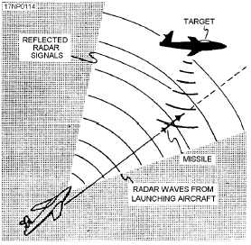
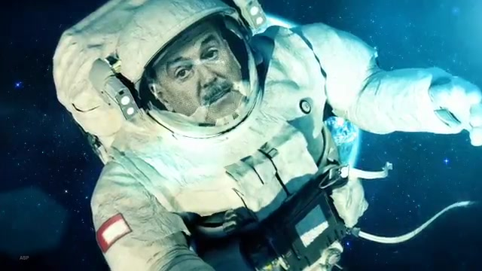
Gordon the Guided Missile

Slide 49
Contact
Todd Little
todd@kanban.university
toddelittle@gmail.com
www.toddlittleweb.com
www.linkedin.com/in/toddelittle/
@toddelittle

