Slide 1
Six Key Lessons Learned from Agile and Lean Principles to Incorporate into a Stage-Gate® Idea-to-Launch Process
Todd Little

Slide 2



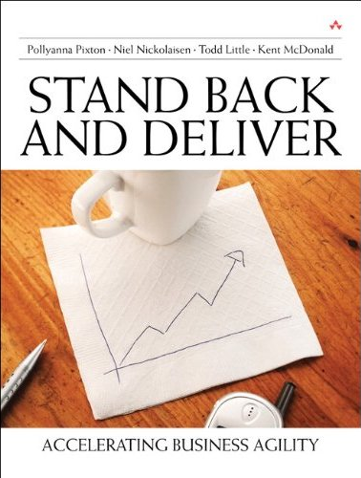



About Todd
Executive roles as VP Product Development, Director of Software & Technology
@toddelittle
Notes:
Director – company called IHS until a few days ago
Just merged – 9,000 – 15,000
Information & analytics company, verticals
Performance reviews 10 years – mistake
Stopped laughing – launch
3 years ago – working off and on

Slide 3
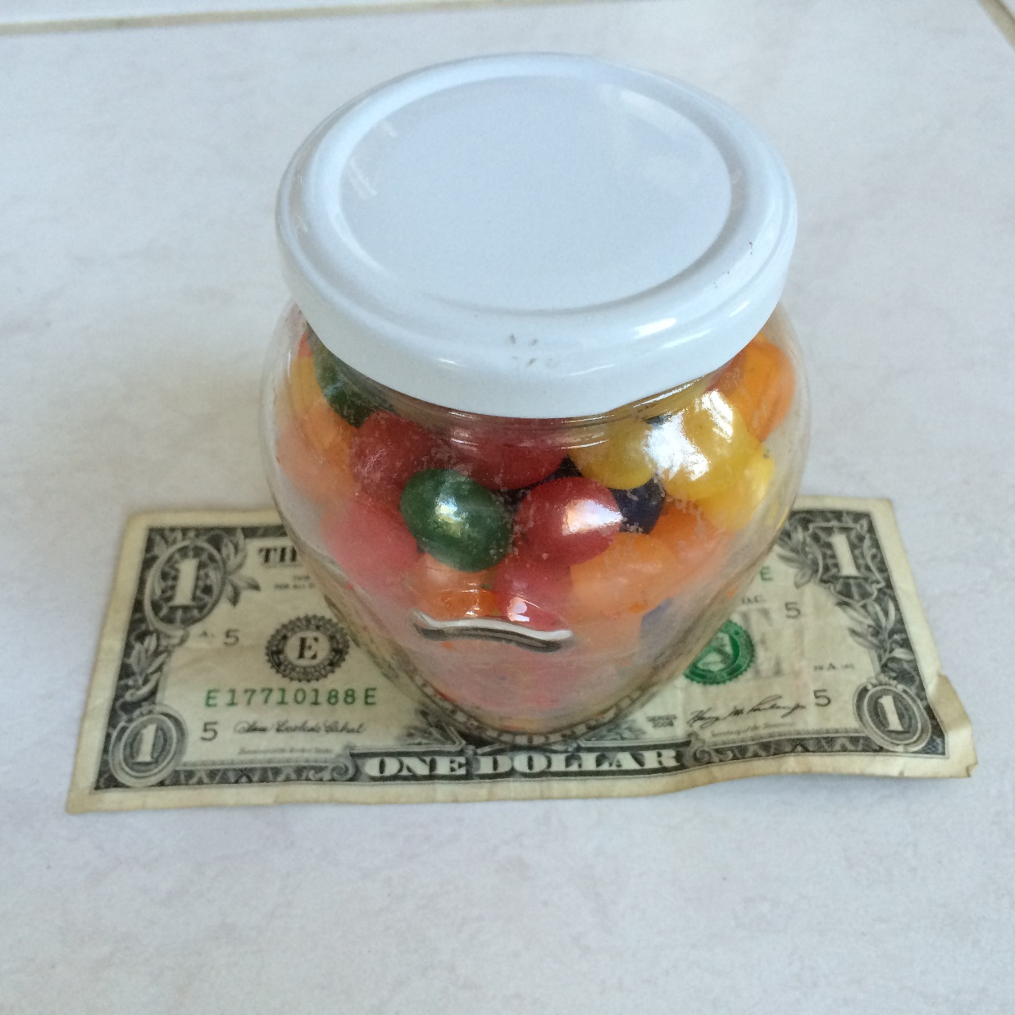
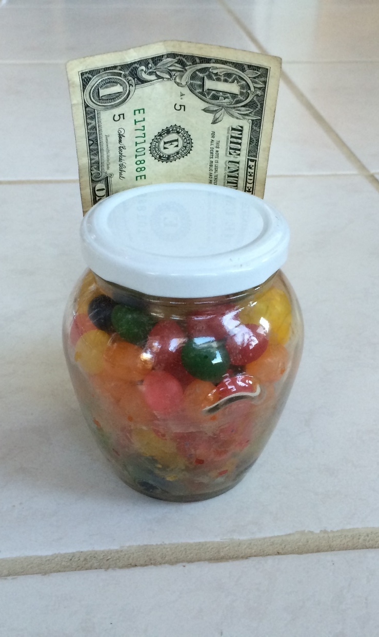
Estimate the # of Jelly Beans

Slide 4
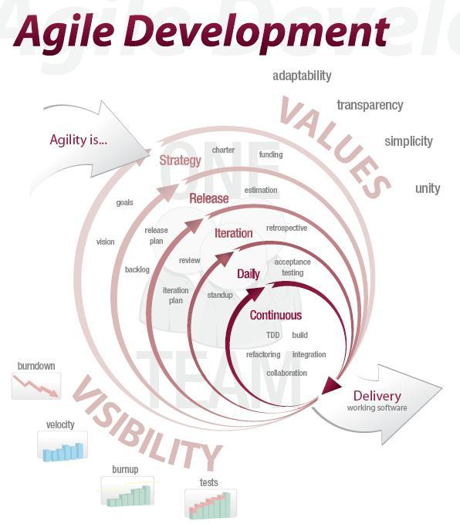
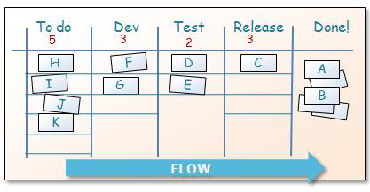
What is Agile and Lean Development?

Slide 5
Agile Manifesto
We are uncovering better ways of developing software by doing it and helping others do it. Through this work we have come to value:
Individuals and interactions | over | processes and tools
Working software | over | comprehensive documentation
Customer collaboration | over | contract negotiation
Responding to change | over | following a plan
That is, while there is value in the items on the right, we value the items on the left more.

Slide 6




What Happens in a Typical Project
Inside the Tornado
Project Kickoff
When will we get the requirements?
All in good time, my little pretty, all in good time
But I guess it doesn't matter anyway
Just give me your estimates by this afternoon
Team Unity
Not so fast! Not so fast! ... I'll have to give the matter a little thought. Go away and come back tomorrow
No, we need something today!
Ok then, it will take 2 years.
No, we need it sooner.
Doesn't anybody believe me?
I already promised the customer it will be out in 6 months
You're a very bad man!
Notes:
We look at a typical software project…..

Slide 7


We’re not in Kansas Anymore
Developer Hero
I may not come out alive, but I'm goin' in there!
Reorg
The Great and Powerful Oz has got matters well in hand.
My! People come and go so quickly here!
Testing
"Hee hee hee ha ha! Going so soon? I wouldn't hear of it! Why, my little party's just beginning!

Slide 8

The Idealized Waterfall
Envisioning
Plan/Design
Develop
Test
Release
Notes:
In the early days of software engineering, engineers wanted to look at software development as an assembly line. Winston Royce wrote a famous paper where in the beginning of the paper he wrote about the ideal waterfall development process.

Slide 9
Uncertainty
Know that
we know
Know that
we don’t know
Don’t know that
we know
Knowable
Unknowable
Don’t know that
we don’t know
Notes:
This slide works best in animation mode. There are some things that we know that we know. This is essentially the spec. If everything goes well, this is the best we could do. There are some things that we know that we don’t know. These are typical project risks. There is another category of things that we don’t know that we don’t know. Some of these might be knowable if we put more effort into planning, but some of these are fundamentally unknowable in advance. (I ignore the Don’t know that we know. Some people refer to this quadrant as intuition or reflexes.). The unknowable section is what Fred Brooks refers to as the Werewolf.

Slide 10
The Realized Waterfall
Envisioning
Plan/Design
Develop
Test
Release
Notes:
But Royce went on to say that the idealized waterfall was impossible. Many people ignored the second half of the paper because it was much more complicated.

Slide 11

Foundation and Pillars of Agile
Lean Product Management Strategy
Learning (Inspect and Adapt)
24 hrs
Build Quality In
Deliver Often
1-4 wks
Potentially Shippable
Product Increment
Iteration
Backlog
Release
Backlog
Backlog
tasks
Context
Servant Leadership & Sustaining Culture

Slide 12
Foundation and Pillars of Agile
Lean Product Management Strategy
Learning (Inspect and Adapt)
24 hrs
Build Quality In
Deliver Often
1-4 wks
Potentially Shippable
Product Increment
Iteration
Backlog
Release
Backlog
Backlog
tasks
Context
Servant Leadership & Sustaining Culture

Slide 13

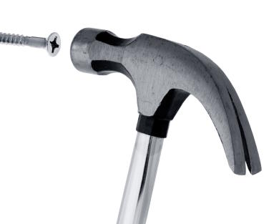
Context
One size does not fit all

Slide 14
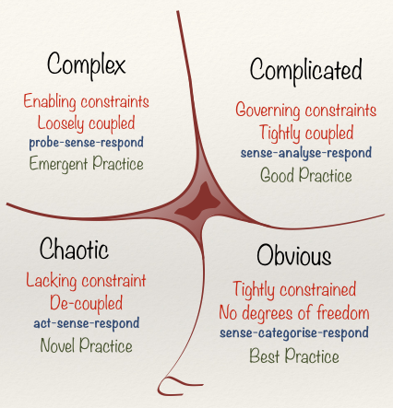
Cynefin Framework
(Snowden)

Slide 15
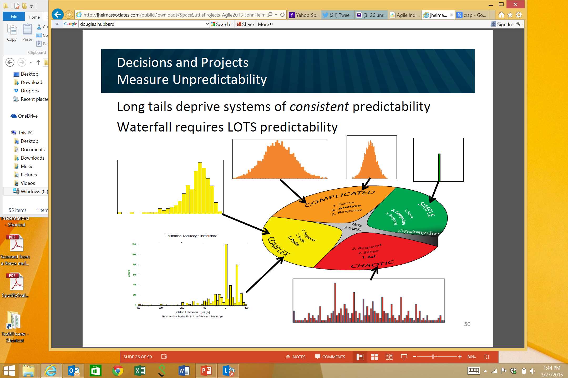
Obvious
Distribution
Input
Output
Cause and Effect Obvious to all
Known - Knowns
Sense - Categorize - Respond
apply best practice
Example: Manufacturing

Slide 16
Complicated
Analysis
Input
Output
Distribution
Cause and Effect Requires Analysis
Known - Unknowns
Sense - Analyze – Respond
apply good practice
Example: Incremental Product Development

Slide 17
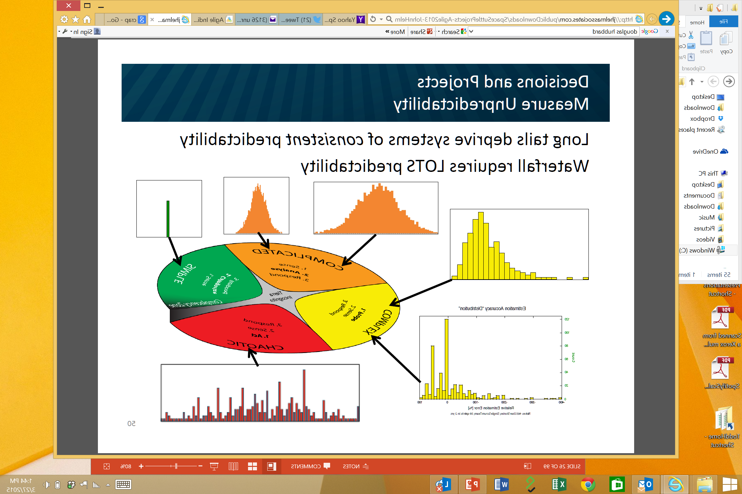
Complex
Distribution
Input
Output
Cause and Effect perceived in retrospect
Unknown - Unknowns
Probe - Sense – Respond
sense emergent practice
Example: New Product Development

Slide 18
Chaotic
Output
Distribution
Input
No Relationship between Cause and Effect
Unknowables
Act - Sense - Respond
discover novel practice.
Example: Medical Emergency

Slide 19
John Helm
Agile 2013

Slide 20
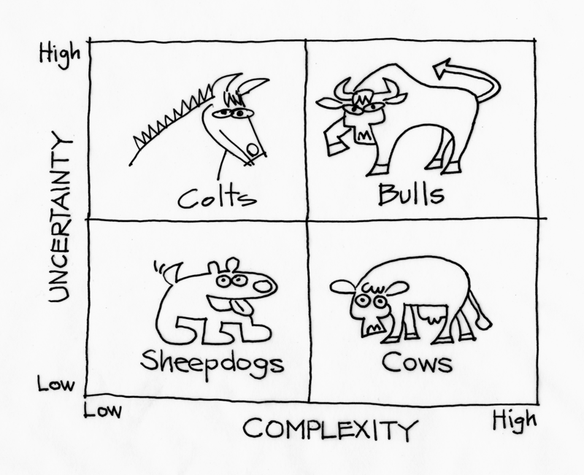
Managing Complexity and Uncertainty
Context Leadership Model

Slide 21
Reduce Uncertainty or Complexity
Uncertainty | Complexity
Opportunities to Reduce Uncertainty: Use proven technologies Reduce project duration | Opportunities to Reduce Complexity: Collocate the team Break project into sub-projects
Attribute | Score
Market | ███
Technical | ███
# Customers | █████████
Duration | █████████
Change | ███
Attribute | Score
Team Size | █████████
Mission Critical | █████████
Team Location | █████████
Team Maturity | ███
Domain Gaps | ███
Dependencies | █████████

Slide 22
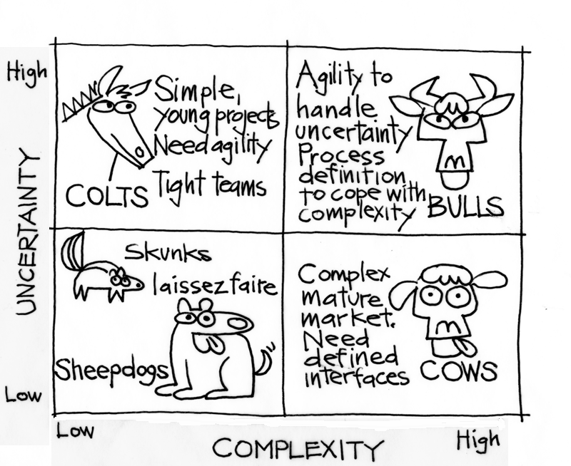
Managing Complexity and Uncertainty

Slide 23
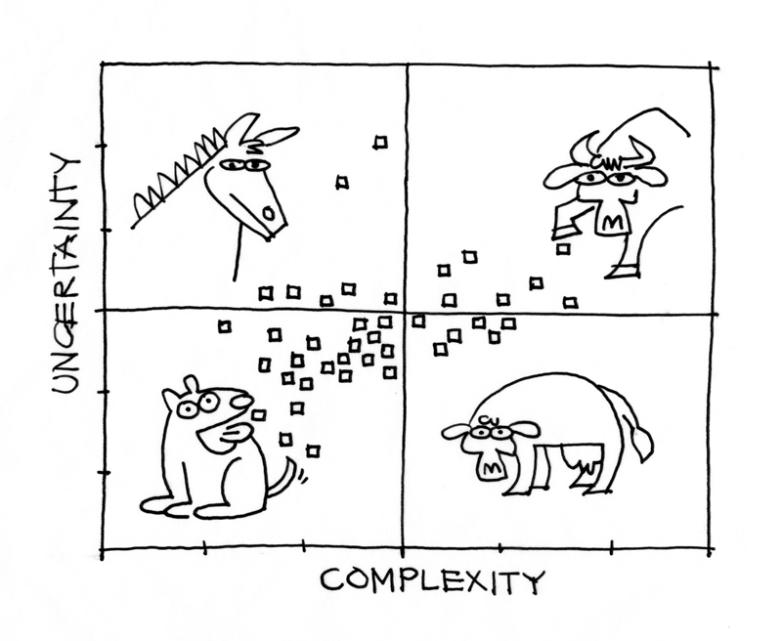
Portfolio Distribution

Slide 24
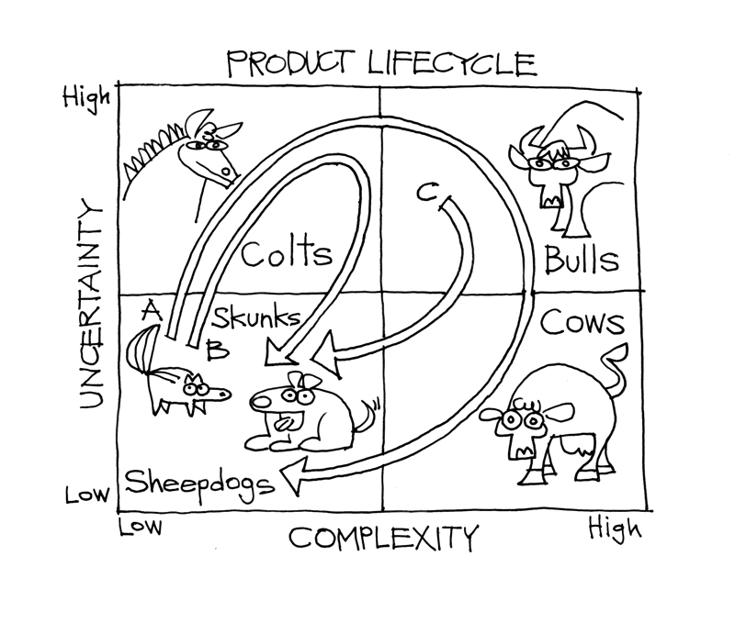
Product Lifecycle

Slide 25

Not all dogs are the same

Slide 26
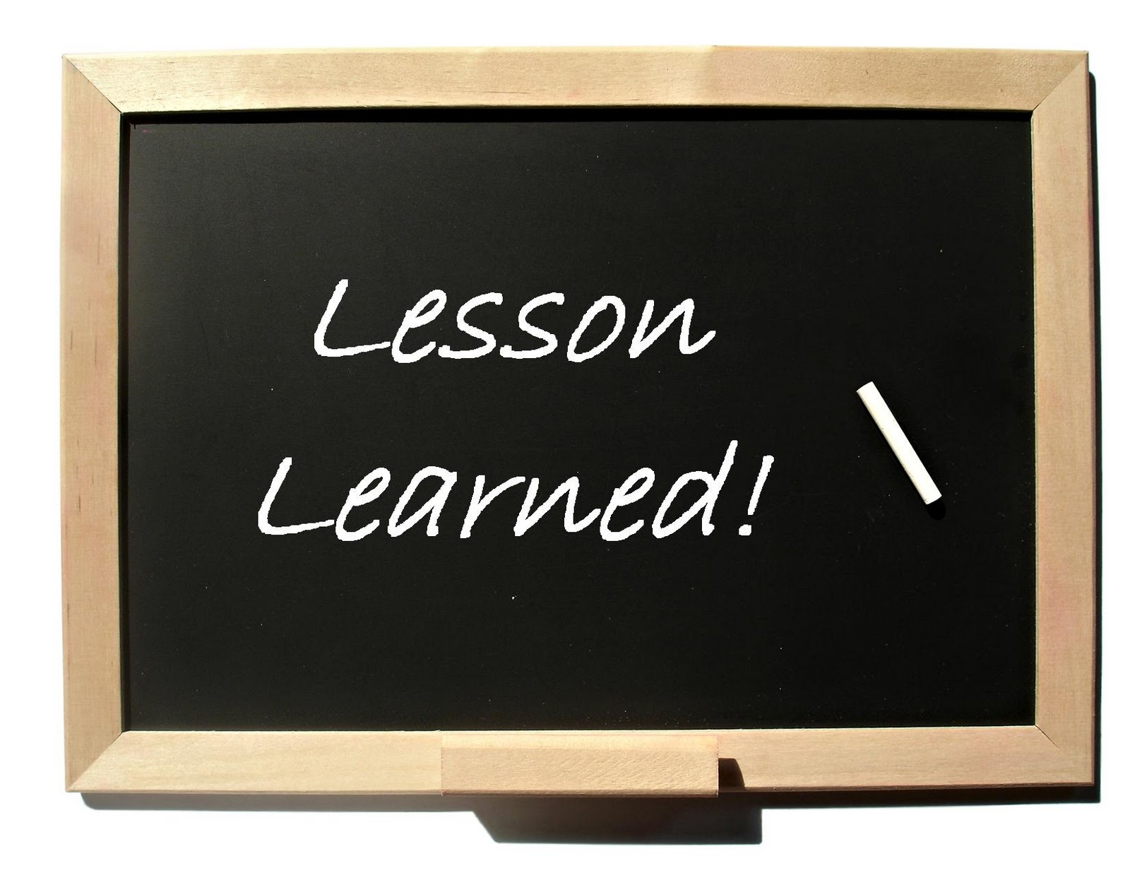
#1
Pay Attention to Context!

Slide 27
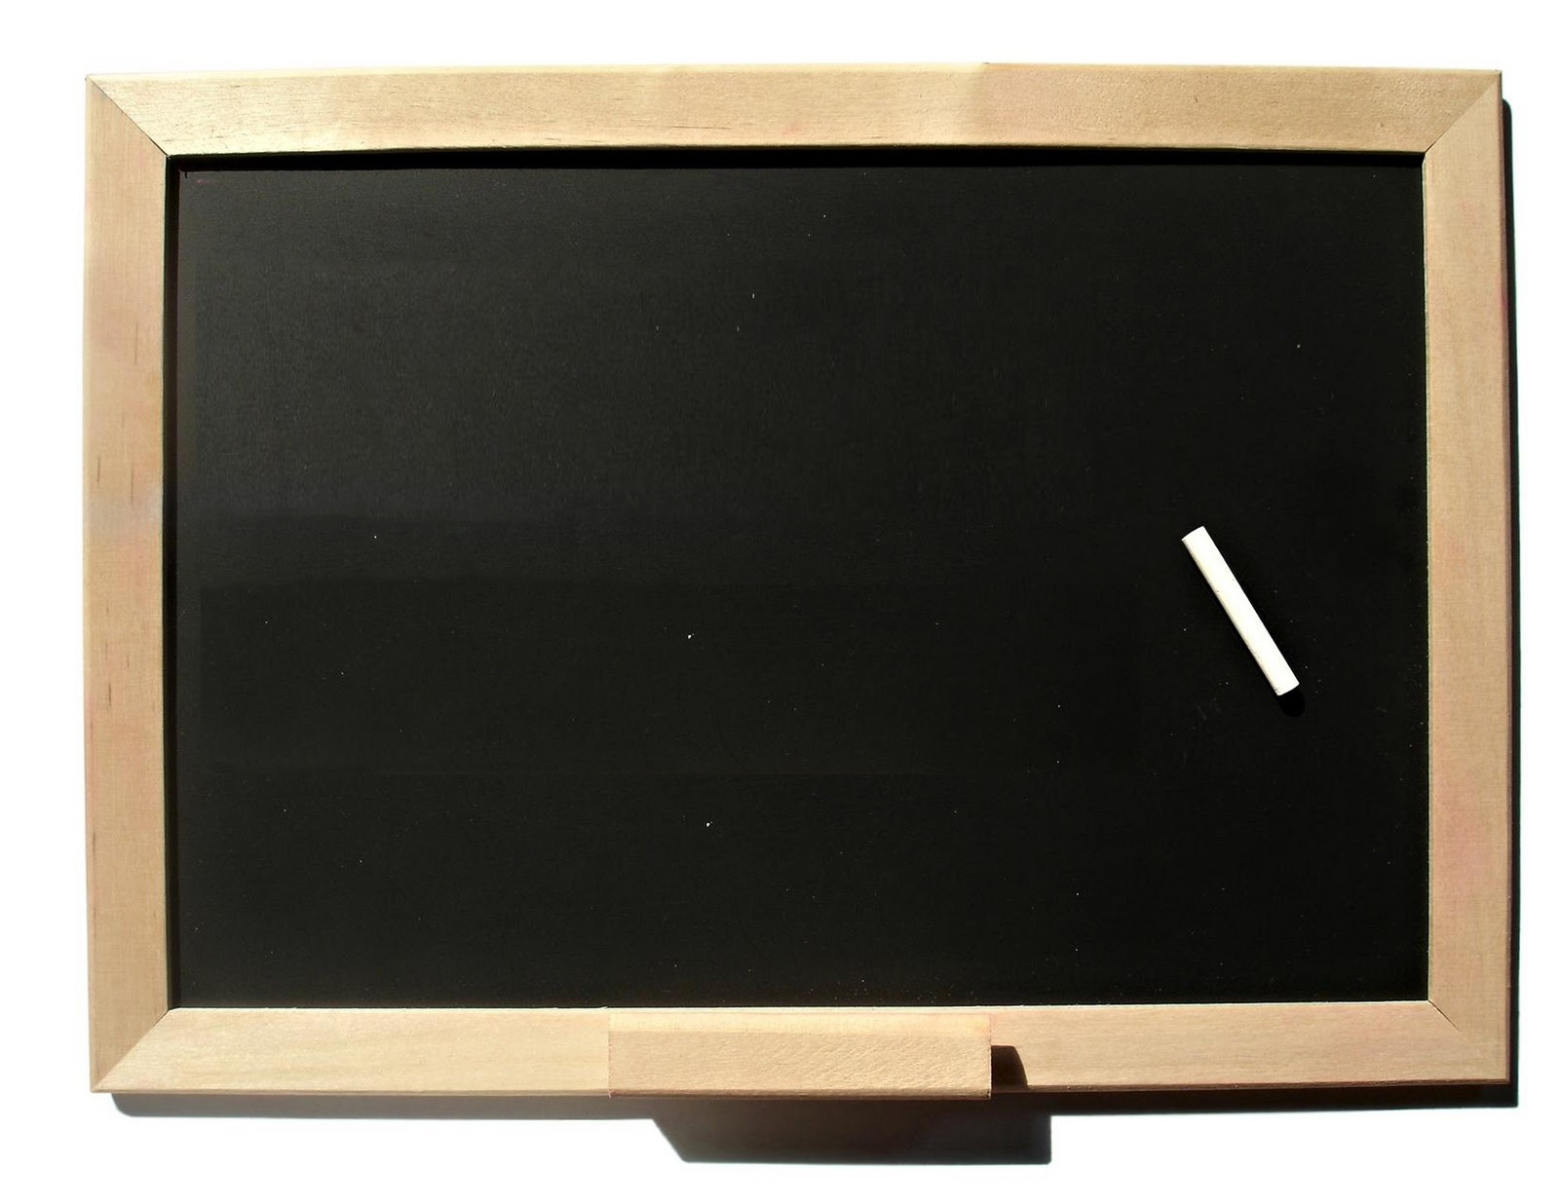
Exercise:
Cynefin Framework
Context Leadership Model

Slide 28
Estimate the # of Jelly Beans

Slide 30
Foundation and Pillars of Agile
Lean Product Management Strategy
Learning (Inspect and Adapt)
24 hrs
Build Quality In
Deliver Often
1-4 wks
Potentially Shippable
Product Increment
Iteration
Backlog
Release
Backlog
Backlog
tasks
Context
Servant Leadership & Sustaining Culture

Slide 31

Build Quality In
Functional Acceptance Tests
Build Test
Build Feature
Refactor
Build Test
Build Feature
Refactor
Build Test
Build Feature
Refactor

Slide 32
#2
Build Quality In!

Slide 33
Foundation and Pillars of Agile
Lean Product Management Strategy
Learning (Inspect and Adapt)
24 hrs
Build Quality In
Deliver Often
1-4 wks
Potentially Shippable
Product Increment
Iteration
Backlog
Release
Backlog
Backlog
tasks
Context
Servant Leadership & Sustaining Culture

Slide 34
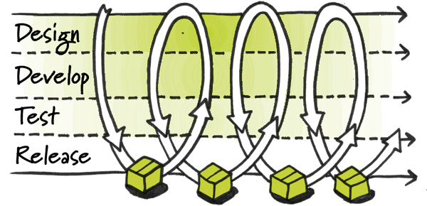
Deliver Frequently

Slide 35
#3
Deliver Frequently!

Slide 36
Foundation and Pillars of Agile
Lean Product Management Strategy
Learning (Inspect and Adapt)
24 hrs
Build Quality In
Deliver Often
1-4 wks
Potentially Shippable
Product Increment
Iteration
Backlog
Release
Backlog
Backlog
tasks
Context
Servant Leadership & Sustaining Culture

Slide 37

Learning
Feedback Loop

Slide 38
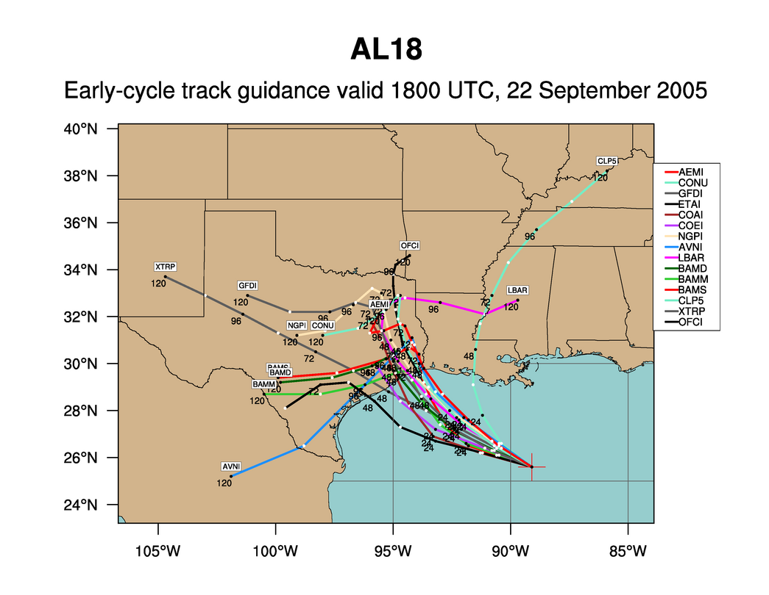
Hurricane Rita
Notes:
We like to use forecasting a hurricane track as an analogy to software development. This is an example of the various news agencies early forecast of hurricane’s Rita track. One thing we know is that all of these tracks are wrong.

Slide 39
Hurricane Rita
Notes:
The actual path of Rita is shown in yellow. Planning of software is much like this. Almost everything we do is “new” and when we followed a more waterfall model, we took lots of time designing and gathering estimates of tasks before starting. From that initial Plan, the one thing we really knew, was that the project would not turnout looking like the plan and it would change. We know that as we gain more knowledge during development the plan would be refined many times. So, with Agile, we don’t spend a lot of time in upfront planning.

Slide 40

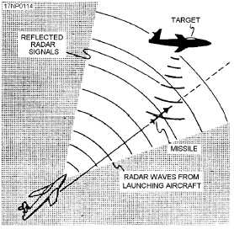
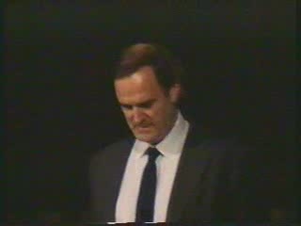
Gordon the Guided Missile

Slide 41
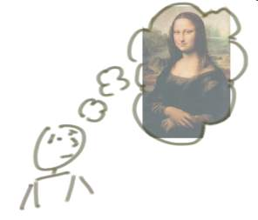



“Incrementing” Builds a Bit at a Time
But, incrementing calls for a fully formed idea
1
2
3

Slide 42
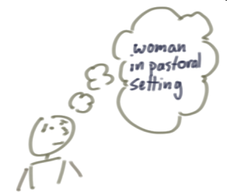
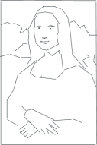


“Iterating” Builds a Rough Version, Validates it, Then Slowly Builds Up Quality
Iterating allows you to move from vague idea to realization
1
2
3

Slide 43
Learning
The objective is to get it right at the end
1
2
3

Slide 44
#4
Learn through Inspect & Adapt!

Slide 45
Foundation and Pillars of Agile
Lean Product Management Strategy
Learning (Inspect and Adapt)
24 hrs
Build Quality In
Deliver Often
1-4 wks
Potentially Shippable
Product Increment
Iteration
Backlog
Release
Backlog
Backlog
tasks
Context
Servant Leadership & Sustaining Culture

Slide 46
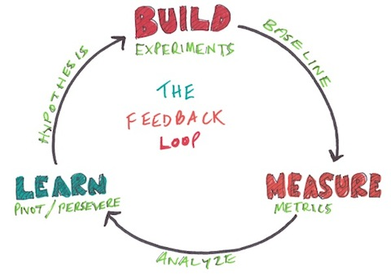
Lean Product Management Strategy

Slide 47


Slide 48


Slide 49

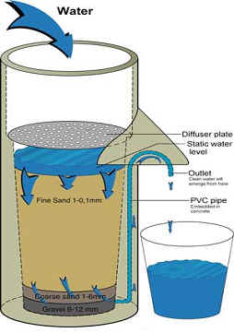
Is your Strategy a Bucket or a Filter?

Slide 50
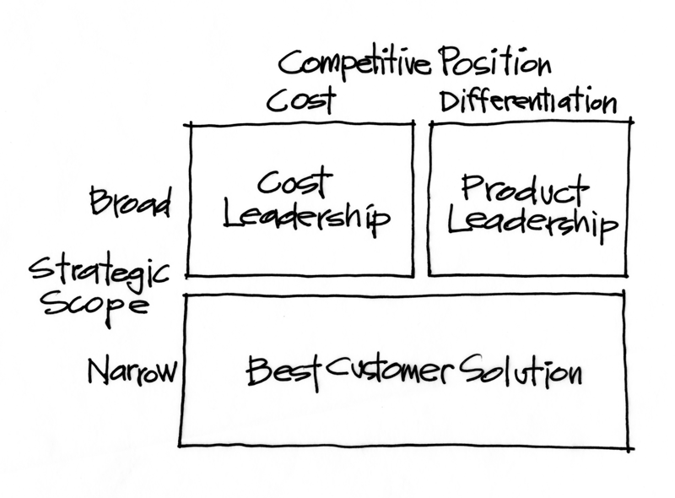
Start with Market Positioning

Slide 51
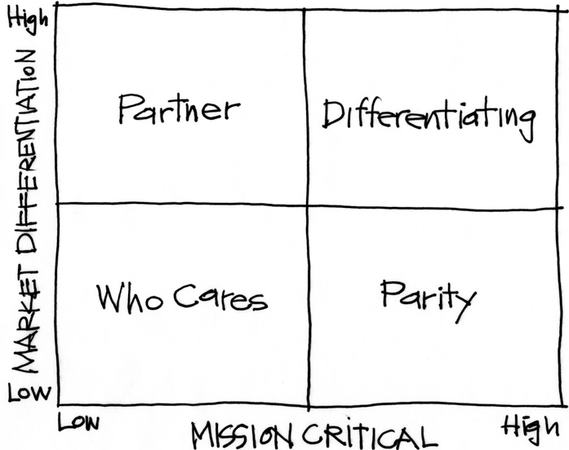
Purpose Alignment Model
Notes:
[Purpose of slide] [#]
[Information]

Slide 52
Purpose Alignment Model
CAN WE
CREATE A
DIFFERENTIATED
PARTNERSHIP?
INNOVATE,
CREATE
ACHIEVE AND
MAINTAIN PARITY, MIMIC, SIMPLIFY
MINIMIZE /
ELIMINATE
Notes:
[Purpose of slide] [#]
[Information]

Slide 53

Applicable at all Levels
Corporate Strategy
Product Strategy
Feature

Slide 54
A View of Strategy - Apple
54
NEW PRODUCT DESIGN
USER EXPERIENCE
CONTENT DISTRIBUTION
ATT
MS OFFICE
INTEL HARDWARE
OTHER SOFTWARE
PERIPHERALS
Notes:
54
[Purpose of slide] [#]
[Information]
© International Institute of Business Analysis®

Slide 55
Purpose Filter
Idea
Idea
Partner | Invest
Who Cares | Parity
Critical
Items
Roughly
Estimate
Values and
Costs
Prioritize
By
Value/Cost
Idea
Prioritize
Idea
Strategic
Fit
Other
Release
Backlog
Idea
Idea
Non-
Economic
Non-
Strategic

Slide 56
#5
Lean Product Mgt Strategy!

Slide 57
Exercise:
Good and Bad Examples of Strategy (Buckets & Filters)
Purpose Alignment Model

Slide 59
Foundation and Pillars of Agile
Lean Product Management Strategy
Learning (Inspect and Adapt)
24 hrs
Build Quality In
Deliver Often
1-4 wks
Potentially Shippable
Product Increment
Iteration
Backlog
Release
Backlog
Backlog
tasks
Context
Servant Leadership & Sustaining Culture

Slide 60

Servant Leadership and Sustaining Culture

Slide 61
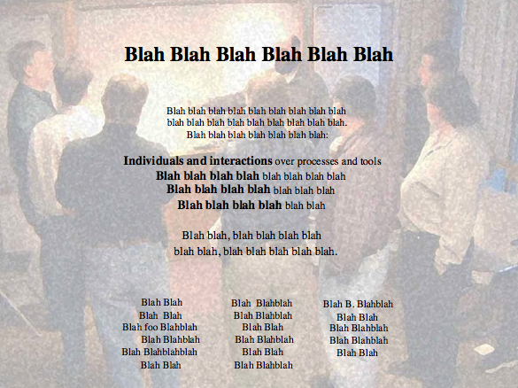
Alexey Krivitsky

Slide 62
Trust/Ownership Model
Trust
Abdication
Energy & Innovation
How do we
get here?
Command & Control
Conflict
Control
Low
Team Ownership
High

Slide 63
Control Systems
Processes
Inputs
Inputs
Inputs
Command & Control
Processes
Inputs
Inputs
Inputs
Agile Leadership
Outputs

Slide 64
Trust/Ownership Model
Trust
Abdication
Energy & Innovation
How do we
get here?
Zone of
Stable Control
Command & Control
Conflict
Control
Low
Team Ownership
High

Slide 65
#6
Servant Leadership & Culture!

Slide 66
Foundation and Pillars of Agile
Lean Product Management Strategy
Learning (Inspect and Adapt)
24 hrs
Build Quality In
Deliver Often
1-4 wks
Potentially Shippable
Product Increment
Iteration
Backlog
Release
Backlog
Backlog
tasks
Context
Servant Leadership & Sustaining Culture

Slide 67

Case Study: Integrating Agile Principles into a Stage-Gate® Process

Slide 68
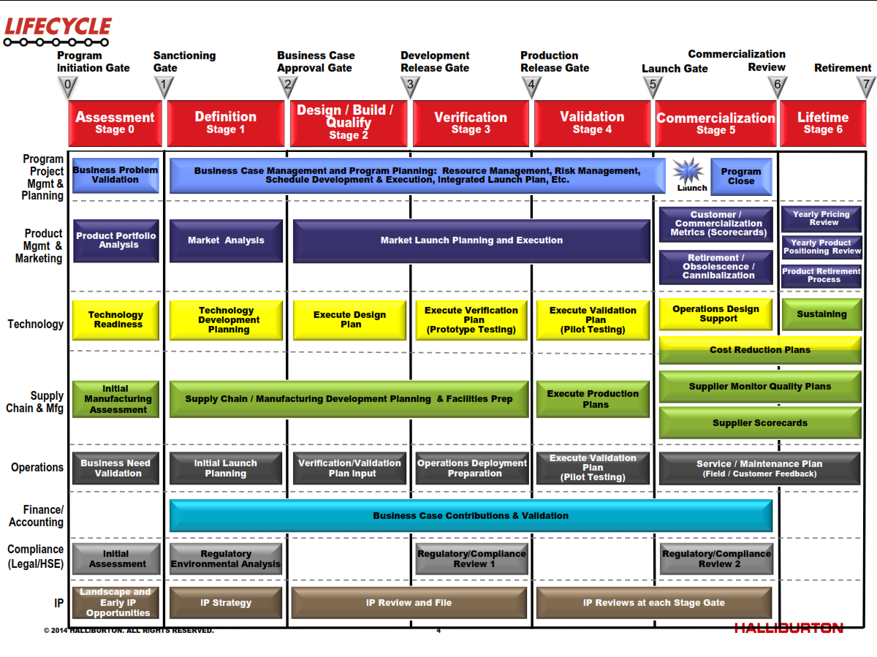
Case Study: Integrating Agile Practices in a Stage Gate Process

Slide 69
Lifecycle for Software
Executive Mandate
‘Produce a process based on LIFECYCLE that works for software, as much like LIFECYCLE as you can make it. And you have to keep the same stages and gates.’

Slide 70
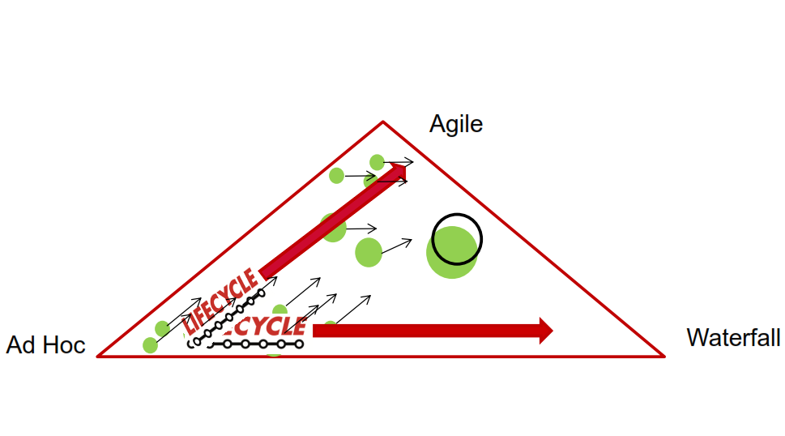
Moving towards Agility

Slide 71
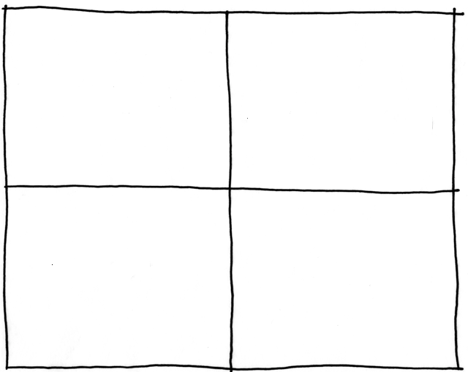
Flexibility vs. Discipline
High
Ad-Hoc
Agile
Flexible
Bureaucracy
Waterfall
Low
Low
High
Discipline

Slide 74
Halliburton Case Study
Agile can fit in Stage-Gate®

Slide 75

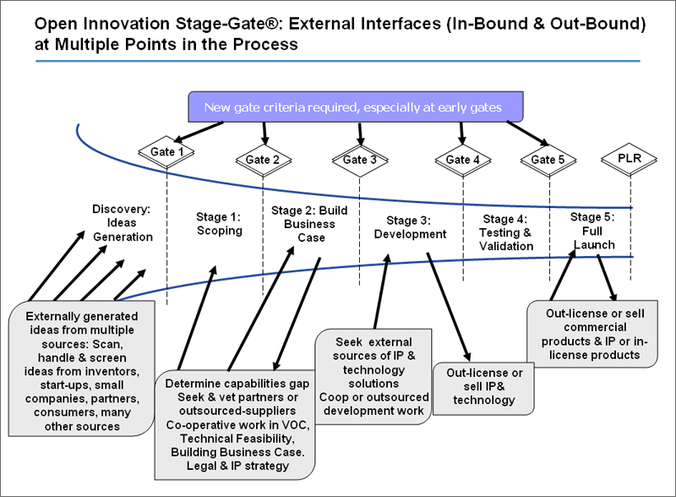
Case Study: Add Stage-Gates® to Agility
24 hrs
1-4 wks
Potentially Shippable
Product Increment
Iteration
Backlog
Release
Backlog
Backlog
tasks

Slide 76
Collaborating with Non-Collaborators
Creative
Tension
Collegial
Collaborator
More useful
Drive to
Purpose
Collaboration
Non-Collaborator
Compliance
Combative
Common Practice
Agree
Disagree
Agreement

Slide 77
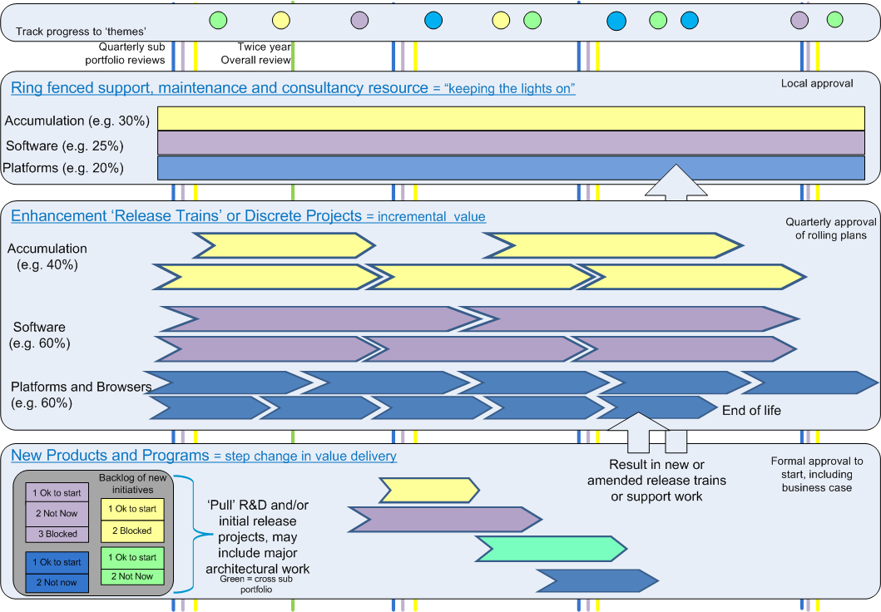
The Complete Picture

Slide 78
Project | Stack Rank | $ | FTE
Lights On Bucket
Special Projects Bucket
Maintenance and Enhancements Bucket
Project 1
Project 2
Investment Bucket
Project 1 | 1
Project 2 | 2
Project 3 | 3
Project 4 | 4
Project 5 | 5

Slide 79
Mindset Shift
From | To
Project Approval | Portfolio Prioritization
All projects follow the same process | Fitting the process to the context
Annual budget | Continuous portfolio review
Status Reporting | Managing the Business

Slide 80
Portfolio to Sub-Portfolio to Team
Company Portfolio
 |  |  |  |  |  |  |  |  |  |  |  |  |  |  |  |  |  | Biz Line Portfolio
 |  |  |  |  |  |  |  |  |  |  |  |  |  |  |  |  |  | Sub-portfolio |  |  |  |  |  | Sub-portfolio |  |  |  |  |  | Sub-portfolio
Yearly
Quarterly
Monthly
Daily

Slide 81
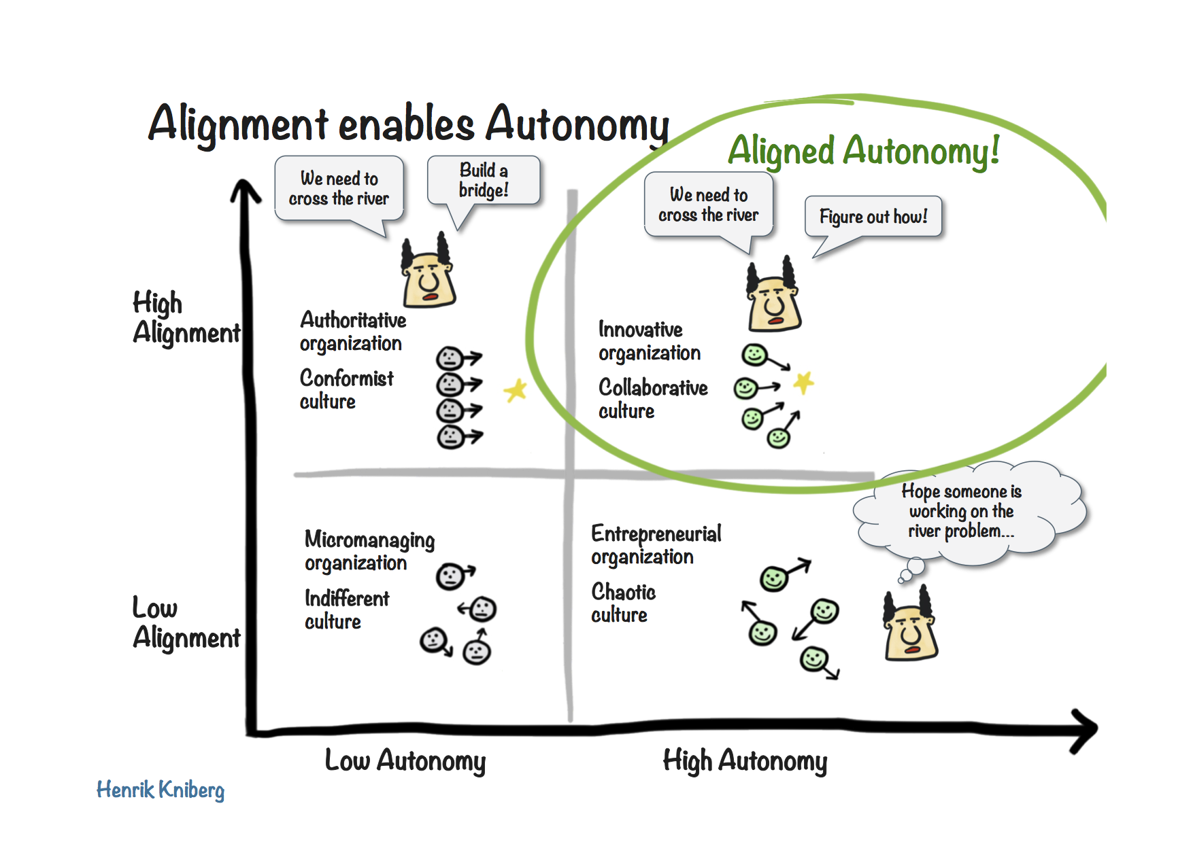
Autonomy is Good, but Aligned Autonomy is Great

Slide 82
IHS Case Study
Stage-Gate® + Agile = Better

Slide 83
Summary
Lean Product Management Strategy
Learning (Inspect and Adapt)
24 hrs
Build Quality In
Deliver Often
1-4 wks
Potentially Shippable
Product Increment
Iteration
Backlog
Release
Backlog
Backlog
tasks
Context
Servant Leadership & Sustaining Culture

Slide 84
Why does Agile Work in Software?
We respect context
We build quality frameworks in
We deliver frequently
We value feedback as learning
We value value
We collaborate and share ownership
Software has an incremental funding model
Software has variable scope

Slide 85
Summary
We respect context
We build quality frameworks in
We deliver frequently
We value feedback as learning
We value value
We collaborate and share ownership
Software has an incremental funding model
Software has variable scope

Slide 86
Cynefin Framework (Snowden)

Slide 87
Managing Complexity and Uncertainty

Slide 88
Build Quality In
Functional Acceptance Tests
Build Test
Build Feature
Refactor
Build Test
Build Feature
Refactor
Build Test
Build Feature
Refactor

Slide 89
Deliver Frequently

Slide 90
Learning
The objective is to get it right at the end
1
2
3

Slide 91
Is your Strategy a Bucket or a Filter?

Slide 92
Purpose Filter
Idea
Idea
Partner | Invest
Who Cares | Parity
Critical
Items
Roughly
Estimate
Values and
Costs
Prioritize
By
Value/Cost
Idea
Prioritize
Idea
Strategic
Fit
Other
Release
Backlog
Idea
Idea
Non-
Economic
Non-
Strategic

Slide 93


Overall Process Flow
  Iterations
Adaptive Activities
Inputs
Pre-conditions
Outputs
Post-conditions
Released Software
CORE Activities
Project Sanction
RTM

Slide 94
Continuous Product Innovation Flow
Flexible Scope
Backlog
Hot Items
Idea Filter
Iteration
Backlog
Product
Backlog
Newly Discovered
Items
Project Sanction
RTM
Sales
Services
Customer
Support
B & C
Release
Backlog
Adaptive Activities
A
Items
CORE Activities
Most Items for consideration in next release

Slide 95
Alexey Krivitsky

Slide 96
Take Aways
Agile and Lean principles are aligned with Stage-Gate® principles
  Add agility to a Stage-Gate process
  Add Stage-Gate concepts to an Agile model
  Drive towards Continuous Stage-Gate

Slide 97
Contact
  toddelittle@gmail.com
  www.toddlittleweb.com
  www.accelinnova.com
  @toddelittle
  www.linkedin.com/in/toddelittle/

Slide 98
Exercise:
How is your NPD like or unlike Software?
  Which Agile/Lean practices do you think would be worth trying?
  Which do you think would be unsuccessful?

Slide 99
Comparison
 | Oil and Gas Exploration | Software
Investment Decision | Large capital investment | Incremental investment
Uncertainty | Where is the oil? | Where is the market?
Learning | Probing (Seismic, etc.) | Beta test
Quality | Safety / Environment | Test automation
Collaboration | Asset teams | Product Teams

