Slide 1
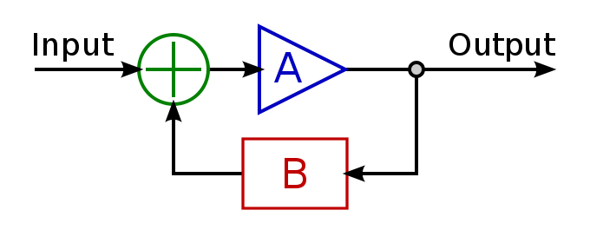
Feedback Loops: The Foundation of Business Agility
Todd Little
Chairman Kanban University

Slide 2
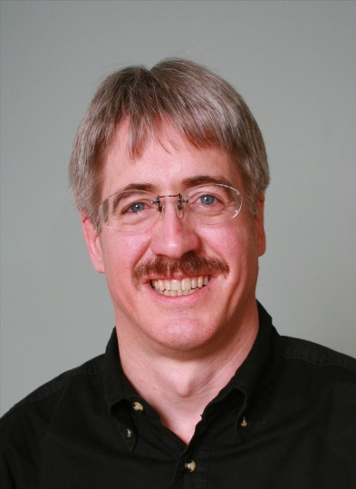




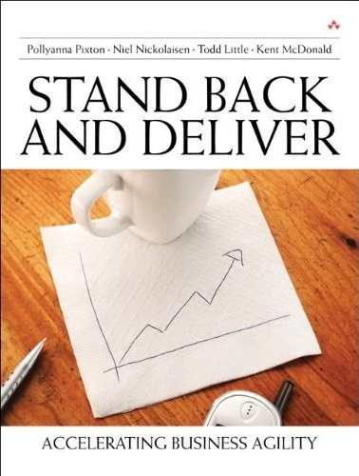



About Todd
Chairman, Kanban University
Chemical and Petroleum Engineer
Executive roles as VP Product Development, Director of Software & Technology
@toddelittle

Slide 3

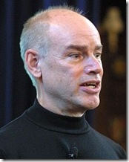
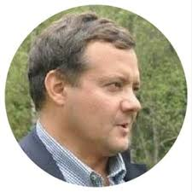
Empirical Process Control

Slide 4

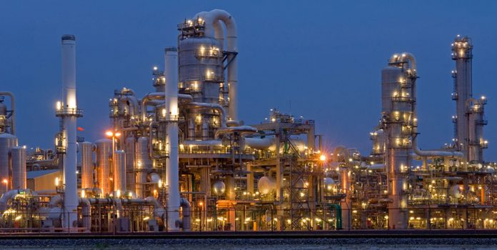

Slide 5
Control Systems
Processes
Inputs
Inputs
Inputs
Open
Loop
Processes
Inputs
Inputs
Inputs
Closed
Loop
Outputs

Slide 6
Open Loop Control
Desired Output Response
Controller
Process
Output

Slide 7
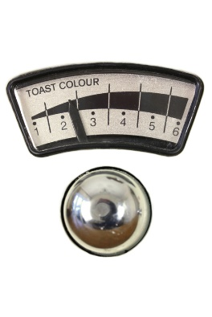
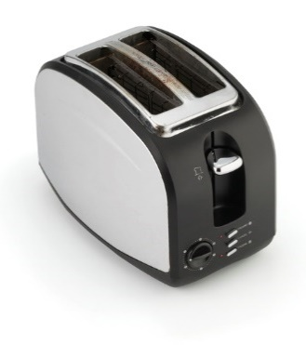
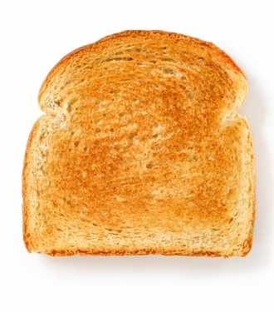
Open Loop Control
Desired Output Response

Slide 8
Closed Loop Control (Balancing Feedback loop)
Deviation from desired state
Assessment
Actual Output
+
+
Corrective Action
Process
-
Sensor
Feedback Signal

Slide 9
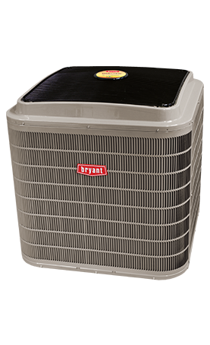
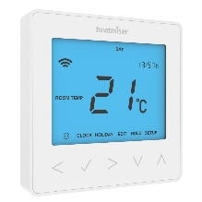
Closed Loop Control Example
Deviation from desired state
Assessment
Actual Output
+
+
Turn on or off
-
Temperature
Feedback Signal

Slide 10
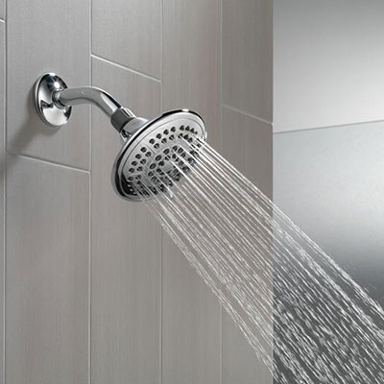
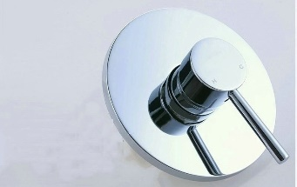
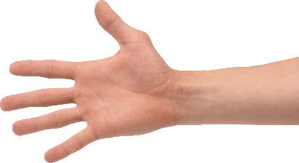
Shower Control System
Deviation from desired state
Adjust
Assessment
Actual Output
+
+
-
Feedback Signal
Temperature

Slide 11
Shower Control System
Deviation from desired state
Adjust
Assessment
Actual Output
+
+
-
Feedback Signals
Temperature
Flow Rate

Slide 12
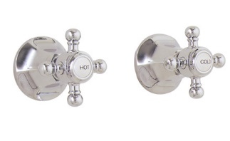
Shower Control System
Deviation from desired state
Adjust
Assessment
Actual Output
+
+
-
Feedback Signals
Temperature
Flow Rate

Slide 13
Shower Control System
Deviation from desired state
Adjust
Assessment
Delay
Actual Output
+
+
-
Feedback Signal
Temperature

Slide 14
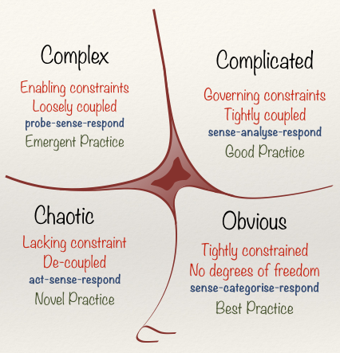
Cynefin Framework(Snowden)

Slide 15
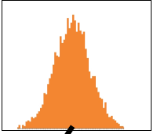
Obvious
Distribution
Input
Output
Cause and Effect Obvious to all
Known - Knowns

Slide 16
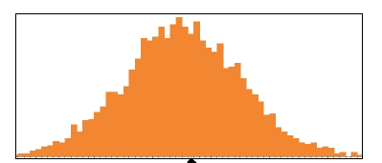
Complicated
Analysis
Input
Output
Distribution
Cause and Effect Requires Analysis
Known - Unknowns

Slide 17
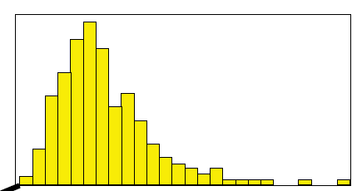
Complex
Distribution
Input
Output
Cause and Effect perceived in retrospect
Unknown - Unknowns

Slide 18
Shower Control System
Deviation from desired state
Adjust
Assessment
Actual Output
+
+
-
Feedback Signals
Temperature
Flow Rate

Slide 19
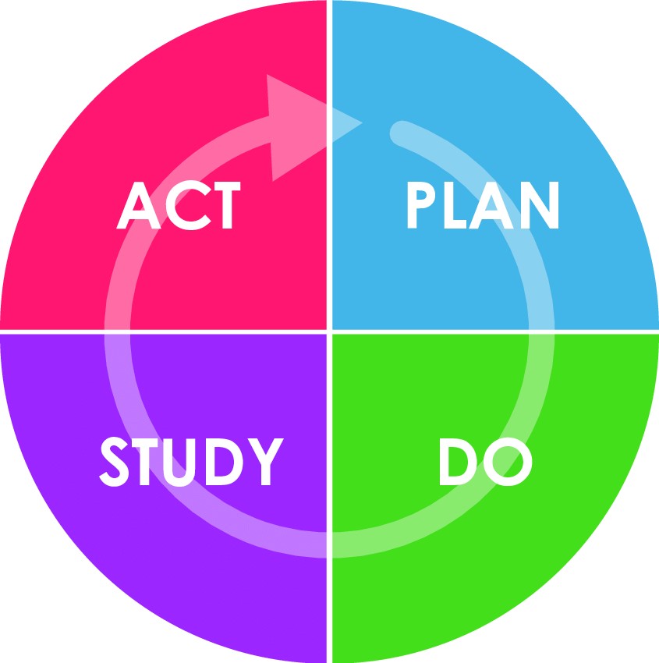
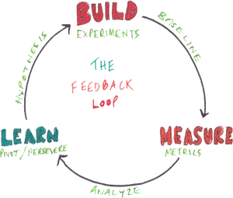
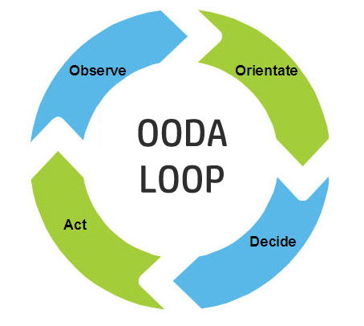
Feedback Loops
Desired
Value
S
Discrepancy
O
S
Actual
Value
Adjustment
S

Slide 20
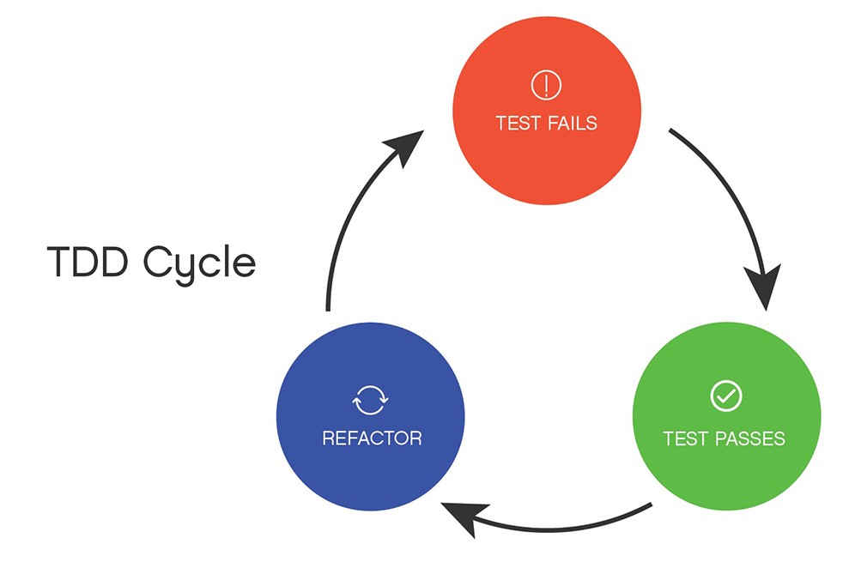
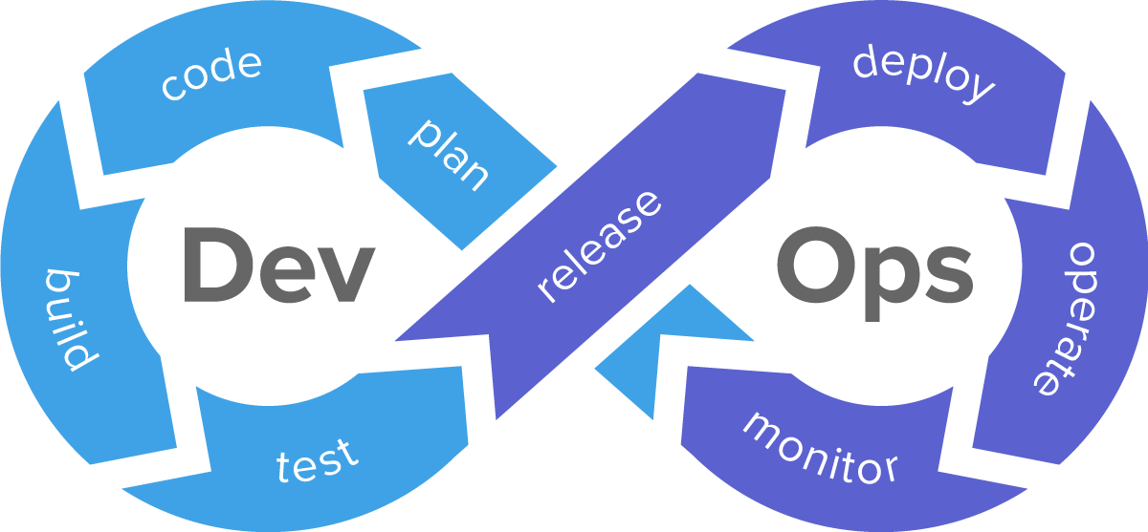
Enhancing Feedback

Slide 21
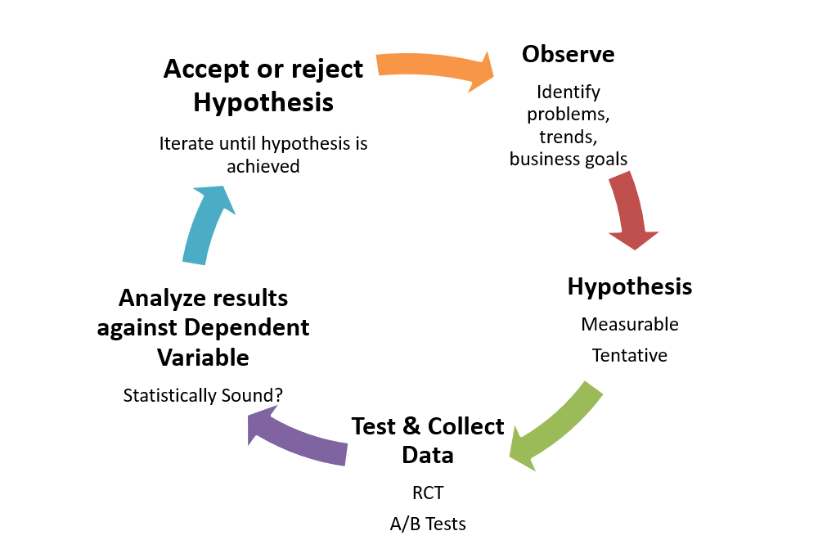
The Scientific Method

Slide 22
Observe-Orient-Decide-Act (John Boyd)

Slide 23
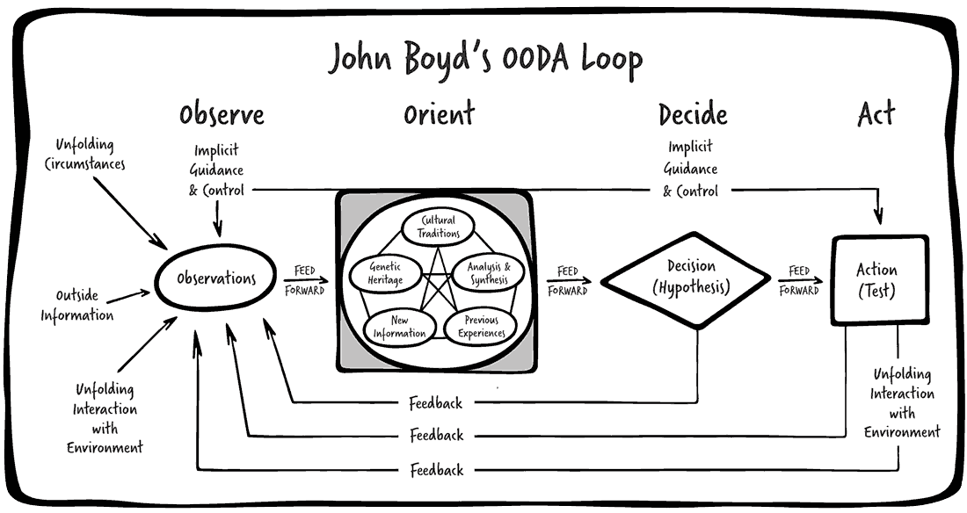
Reality of Feedback Loops

Slide 24
Complex Control System
Desired Output Response
Controller
Process
Output Variables
Measurement
Multi Input Multi Output (MIMO) System

Slide 25
Complex Control
Adjust Scope
Adjust Date
Adjust Team
Adjust Quality
Adjust Process
Desired Output Response
Controller
Process
Output Variables
Value
Schedule
Cost
Quality
Measurement
Multi Input Multi Output (MIMO) System

Slide 26
Lockdown
Desired Output Response
Controller
Process
Output Variables
Value
Schedule
Cost
Quality
Measurement
Multi Input Multi Output (MIMO) System

Slide 27
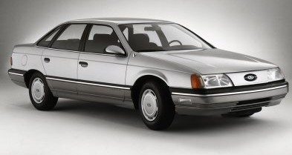
Delivery Goals

Slide 28

Calendar of Innovation

Slide 29
Extreme Closed Loop Creates Open Loops?
Desired Output Response
Controller
Process
Output Variables
Value
Schedule
Cost
Quality
Measurement
Multi Input Multi Output (MIMO) System

Slide 30
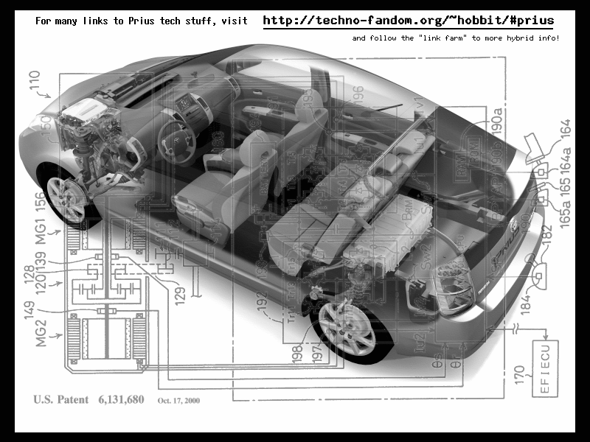
Value of Flexibility
Notes:
9 research projects for drive train
1 chassis – same hole for all 9 drive trains
VOI from 9 research projects, VOF from chassis design
Contrast this with the development of the Prius. Toyota had 9 different research projects running to develop hybrid engine technologies. Normally they would choose a drivetrain first, and build a car around it. Instead Toyota decided to keep its options open, and designed the Prius with a hole in it for the drive train. The 9 research projects continued, and 9+ months after the Prius development project was started, a drive train was chosen. Toyota knew that this car needed a radically new drive train architecture. Instead of guessing and choosing one, they let all 9 research projects continue their work, and as they did, the best option for the car's engine became clear. So was 9 research projects a waste? No because each project was generating factual information about the options for hybrid engine design, information that Toyota engineering management needed to make an informed choice.

Slide 31
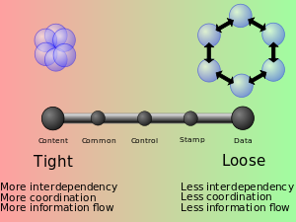
Value of Flexibility from Loose Coupling

Slide 32
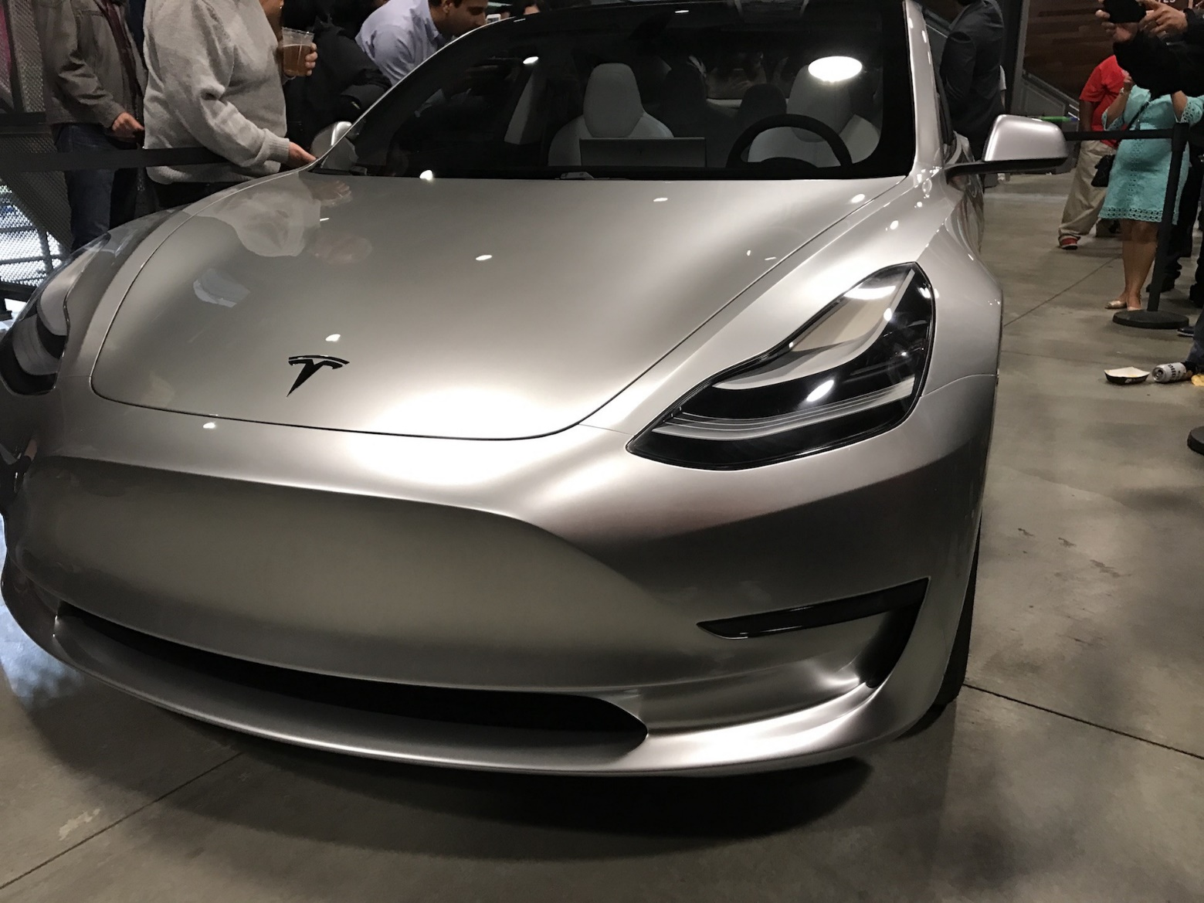
Ongoing Feedback

Slide 33
Business Process Value Chain
Market
Product
Development
Sales
Product Company
Business Need
Development
Delivery
Internal IT
Specifications
Development
Delivery
Contract Model

Slide 34
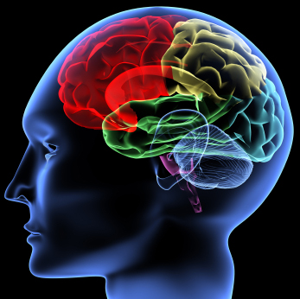
Learning
Feedback Loop

Slide 35
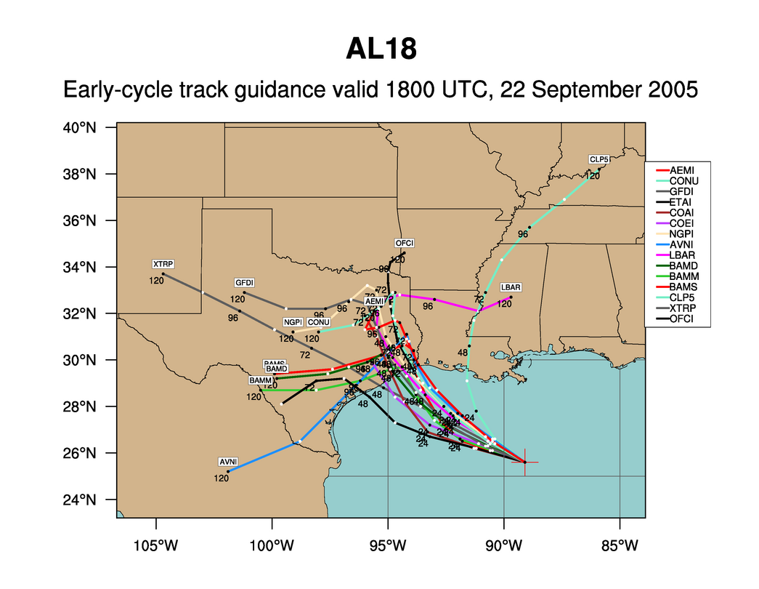
Hurricane Rita
Notes:
We like to use forecasting a hurricane track as an analogy to software development. This is an example of the various news agencies early forecast of hurricane’s Rita track. One thing we know is that all of these tracks are wrong.

Slide 36
Hurricane Rita
Notes:
The actual path of Rita is shown in yellow. Planning of software is much like this. Almost everything we do is “new” and when we followed a more waterfall model, we took lots of time designing and gathering estimates of tasks before starting. From that initial Plan, the one thing we really knew, was that the project would not turnout looking like the plan and it would change. We know that as we gain more knowledge during development the plan would be refined many times. So, with Agile, we don’t spend a lot of time in upfront planning.

Slide 37
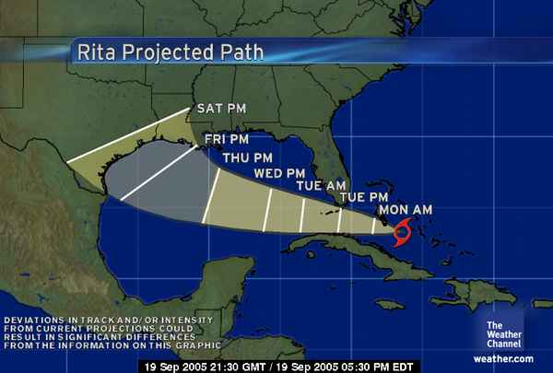

Slide 45
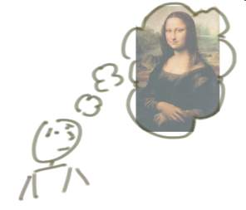


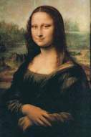
“Incrementing” Builds a Bit at a Time
But, incrementing calls for a fully formed idea
1
2
3
Jeff Patton

Slide 46
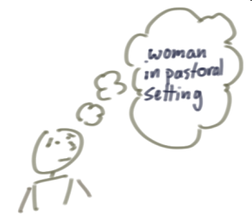
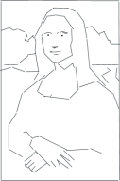
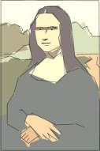

“Iterating” Builds a Rough Version, Validates it, Then Slowly Builds Up Quality
Iterating allows you to move from vague idea to realization
1
2
3

Slide 47
Learning
The objective is to get it right at the end
1
2
3

Slide 48
How does Kanban work with feedback?

Slide 49
Kanban and Feedback Loops
What people think Kanban is
To Do
In Progress
Done

Slide 50
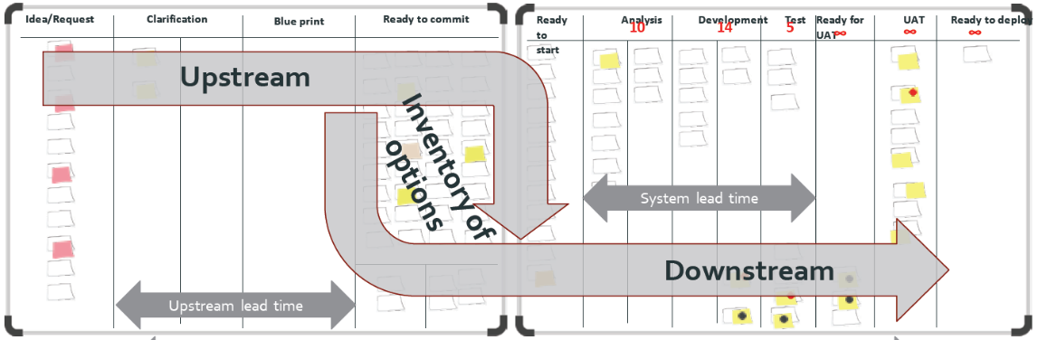
What is Kanban?
The Kanban Method teaches organizations how to understand, visualize and measure systems of work to continually improve and consistently deliver results.
The Kanban Method provides a set of proven practices and approaches that scale from individuals and teams to the enterprise.

Slide 51
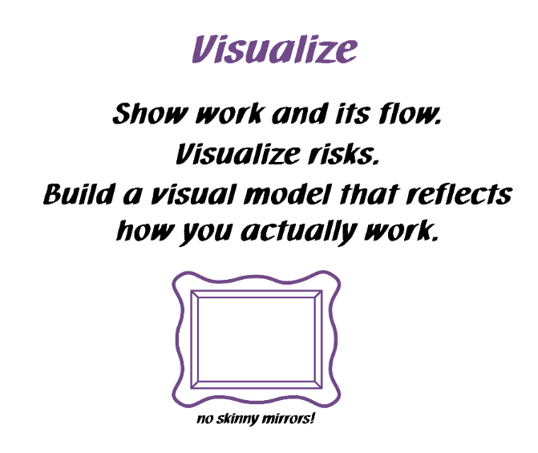
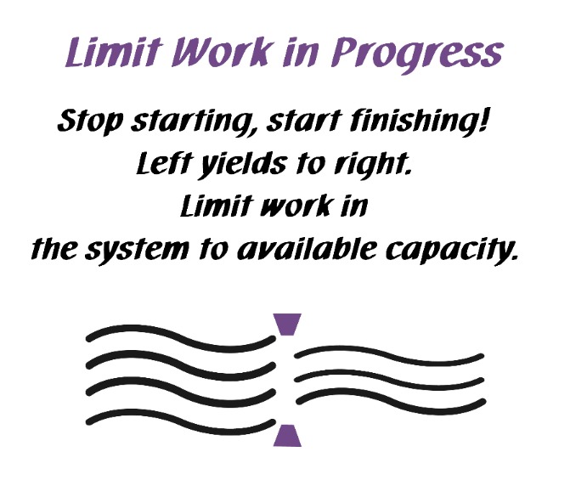
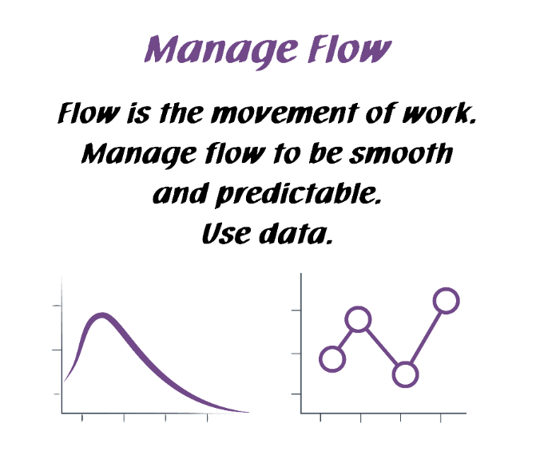
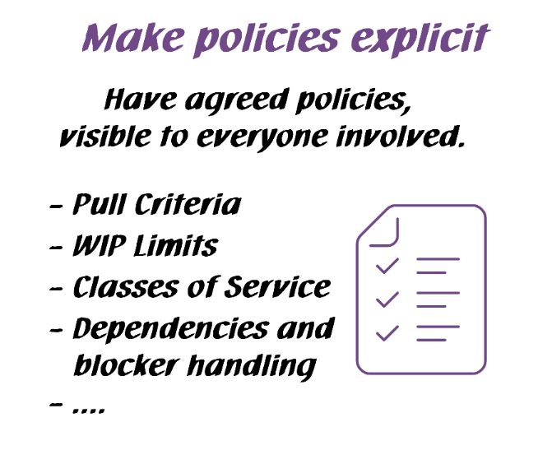
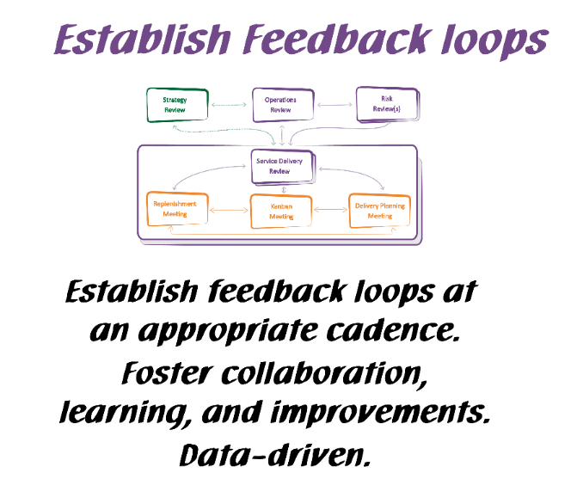
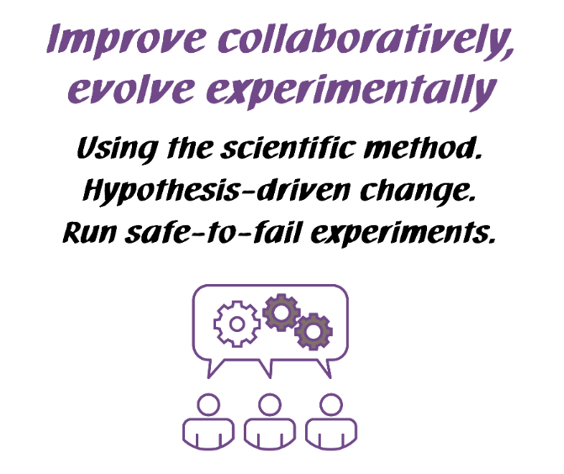
Kanban General Practices
Kanban General Practices
Notes:
Walk the class through the Kanban practices.
There are 6 General Practices in the Kanban Method. [Walk briefly through each of the 6 Practices. See David Anderson’s blog at http://www.djaa.com/principles-general-practices-kanban-method if you want help with how to explain]
Instead of using this slide, you can also create a flipchart with similar info etc.
You might revise this after the simulation.

Slide 52
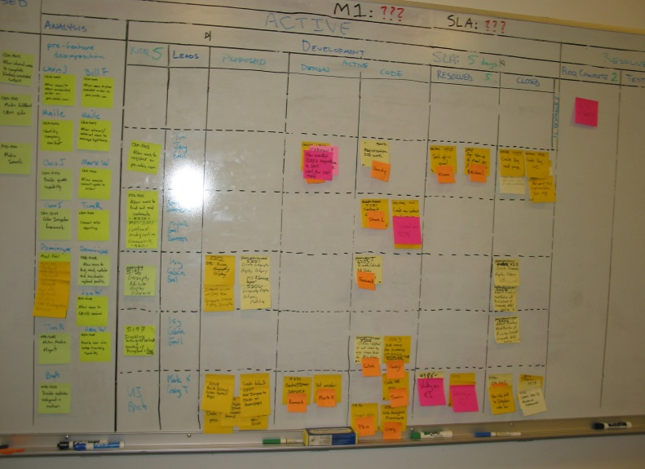
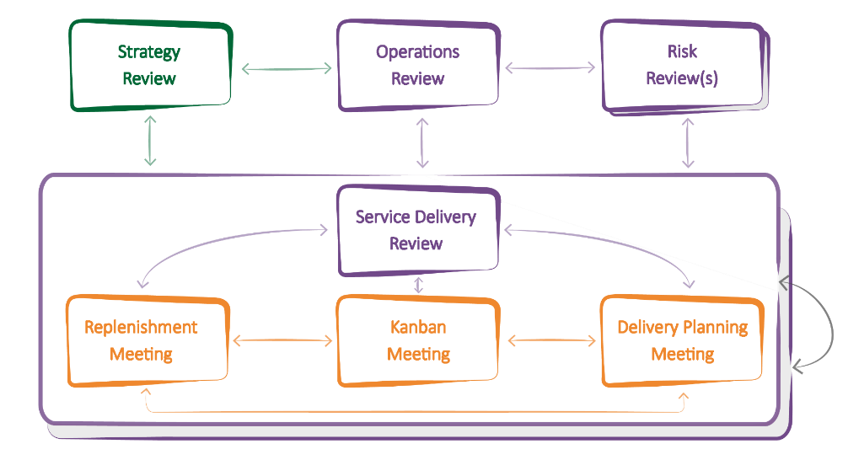
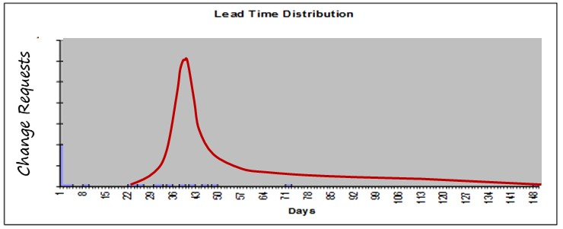
Feedback in Kanban
Boards
Meetings/Cadences
Metrics

Slide 53
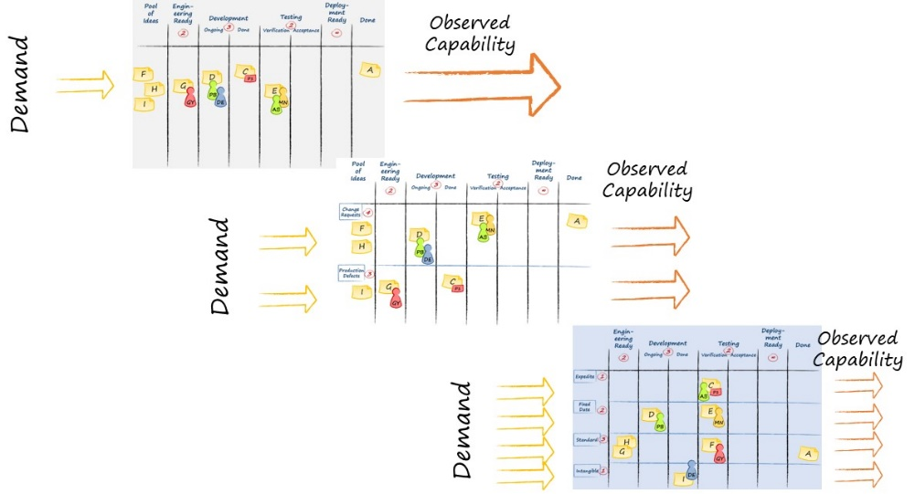

Visualize
Ideas

Slide 54
Visualize
Ideas
Understand the system

Slide 55
Visualize
Ideas
Understand the system
FLOW

Slide 56

Visualize
Ideas
Understand the system
FLOW
Balance Demand and Capacity

Slide 57
Visualize
Ideas
Understand the system
FLOW
Balance Demand and Capacity
Limit WIP

Slide 58
Visualize
Ideas
Understand the system
FLOW
Balance Demand and Capacity
Limit WIP
Bottleneck

Slide 59
Kanban and Feedback Loops
Visualize
Ideas
Understand the system
Scale
FLOW
Balance Demand and Capacity
Limit WIP
Bottleneck

Slide 60
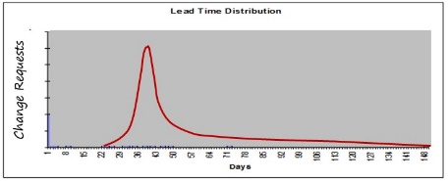
Kanban and Feedback Loops
Visualize
Ideas
Incremental process improvement through measurement
Understand the system
Scale
FLOW
Balance Demand and Capacity
Limit WIP
Bottleneck

Slide 61
Kanban and Feedback Loops
Visualize
Ideas
Process monitoring & improvement through measurement
Understand the system
Scale
FLOW
Balance Demand and Capacity
Limit WIP
Bottleneck
Service or Product Improvement

Slide 62

The Kanban Cadences: The Full Set
Notes:
Kanban gives you a PATTERN of 7 meetings / reviews and their interactions that helps you properly implement your feedback loops.
You will not need to understand or memorize all of them at this point. We will explore them step by step, so that you will have the full picture at the end of the class.
WHAT DO THE ARROWS MEAN? THEY SUGGEST FLOW OF COMMUNICATION THAT YOU MIGHT EXPECT TO SEE
Highlight the general type of information that is schematically represented by the arrows in the diagram.
Information delivered from one feedback mechanism to another. The information is considered for possible decisions.
Actions and Decisions made at one meeting that will have a direct effect on data reviewed, capability observed and discussions held in other meetings.

Slide 63



Gordon the Guided Missile

Slide 64
Contact
Todd Little
  todd@kanban.university
  toddelittle@gmail.com
  www.toddlittleweb.com
  www.linkedin.com/in/toddelittle/
  @toddelittle

