Slide 1
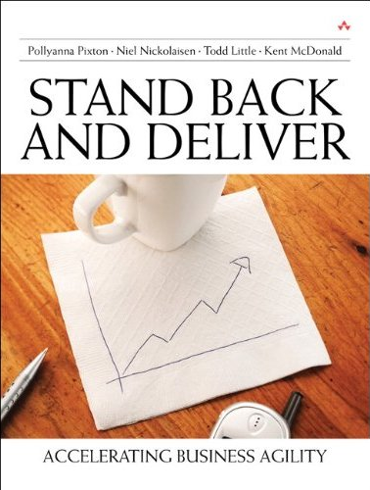
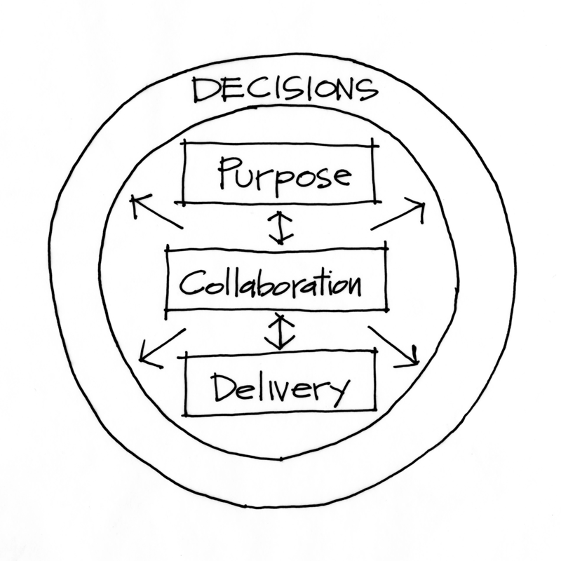

Stand Back and Deliver
A Leader’s Guide to Accelerating Business Agility
Todd Little

Slide 2
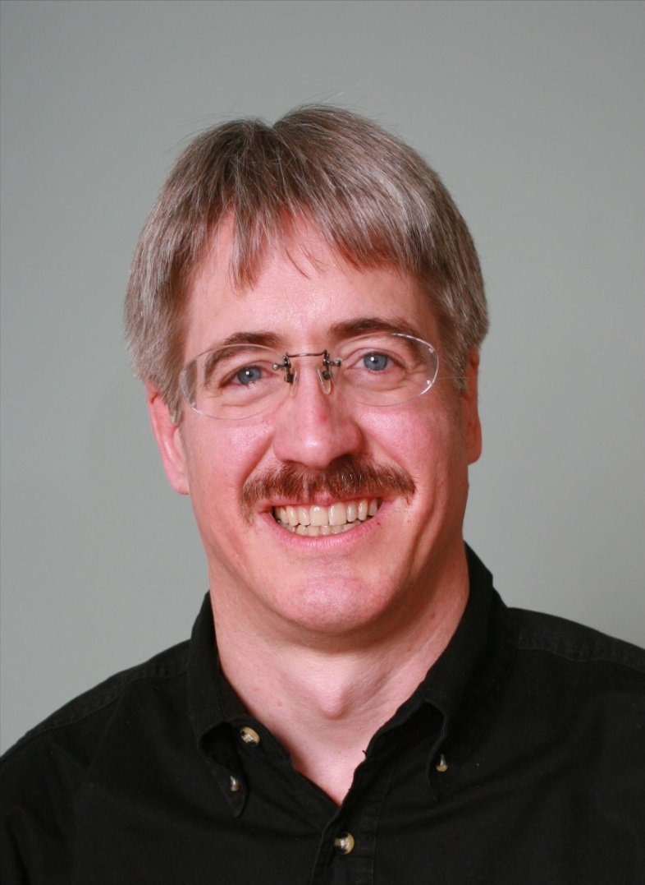






About Todd
CEO Lean Kanban Inc.
Executive roles as VP Product Development, Director of Software & Technology
@toddelittle

Slide 3
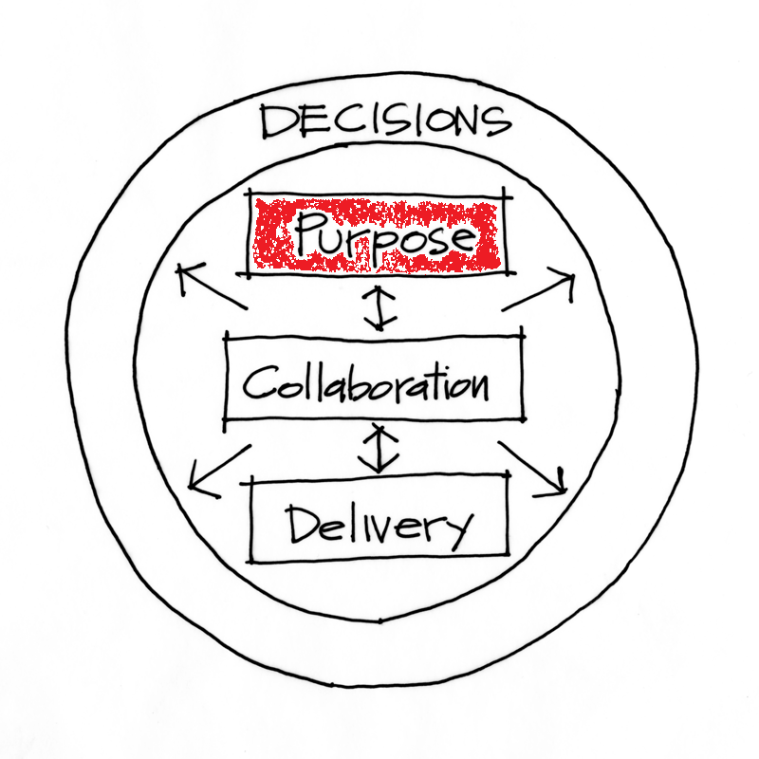

Slide 4
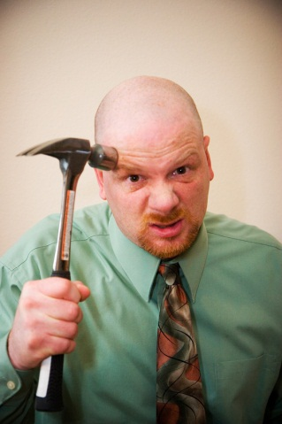
Get Alignment on the Purpose
Powerful Questions are:
What are we building?
What Business are we in?
What Building are we in?

Slide 5
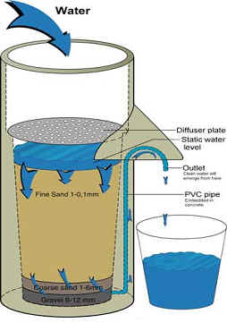

Is your Strategy a Bucket or a Filter?

Slide 6
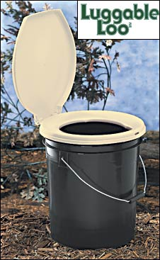
Bad Strategies (Rumelt)
Fluff
Failure to face the problem
Mistaking goals for strategy
Fuzzy or overly complex strategic objectives
  “increase market share”
  "our fundamental strategy is one of customer-centric intermediation."
  “reaching for the impossible to do the impossible"
  47 strategies and 178 action items.
  Action item number 122 was 'create a strategic plan.’

Slide 7
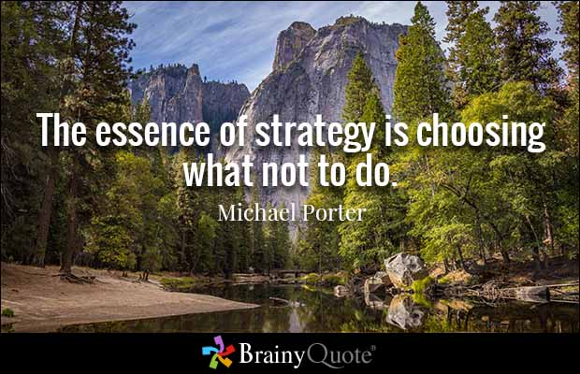

Slide 8
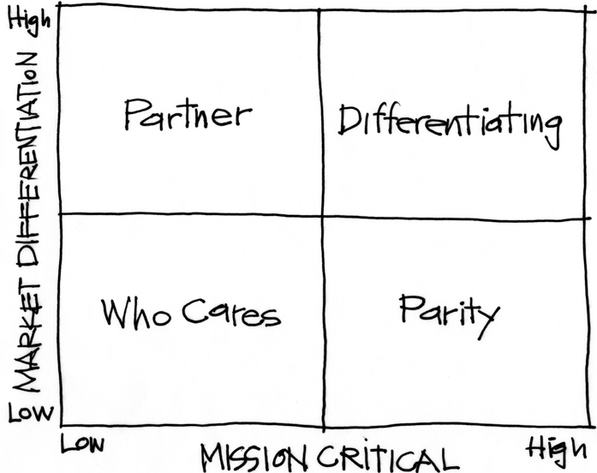
Purpose Alignment Model (Nickoliasen)
Notes:
[Purpose of slide] [#]
[Information]

Slide 9
Purpose Alignment Model (Nickoliasen)
CAN WE
CREATE A
DIFFERENTIATED
PARTNERSHIP?
INNOVATE,
CREATE
ACHIEVE AND
MAINTAIN PARITY, MIMIC, SIMPLIFY
MINIMIZE /
ELIMINATE
Notes:
[Purpose of slide] [#]
[Information]

Slide 10
A View of Strategy - Apple
10
NEW PRODUCT DESIGN
USER EXPERIENCE
CONTENT DISTRIBUTION
ATT
MS OFFICE
INTEL HARDWARE
OTHER SOFTWARE
PERIPHERALS
Notes:
10
[Purpose of slide] [#]
[Information]
© International Institute of Business Analysis®

Slide 11

Applicable at all Levels
Corporate Strategy
Product Strategy
Feature

Slide 12
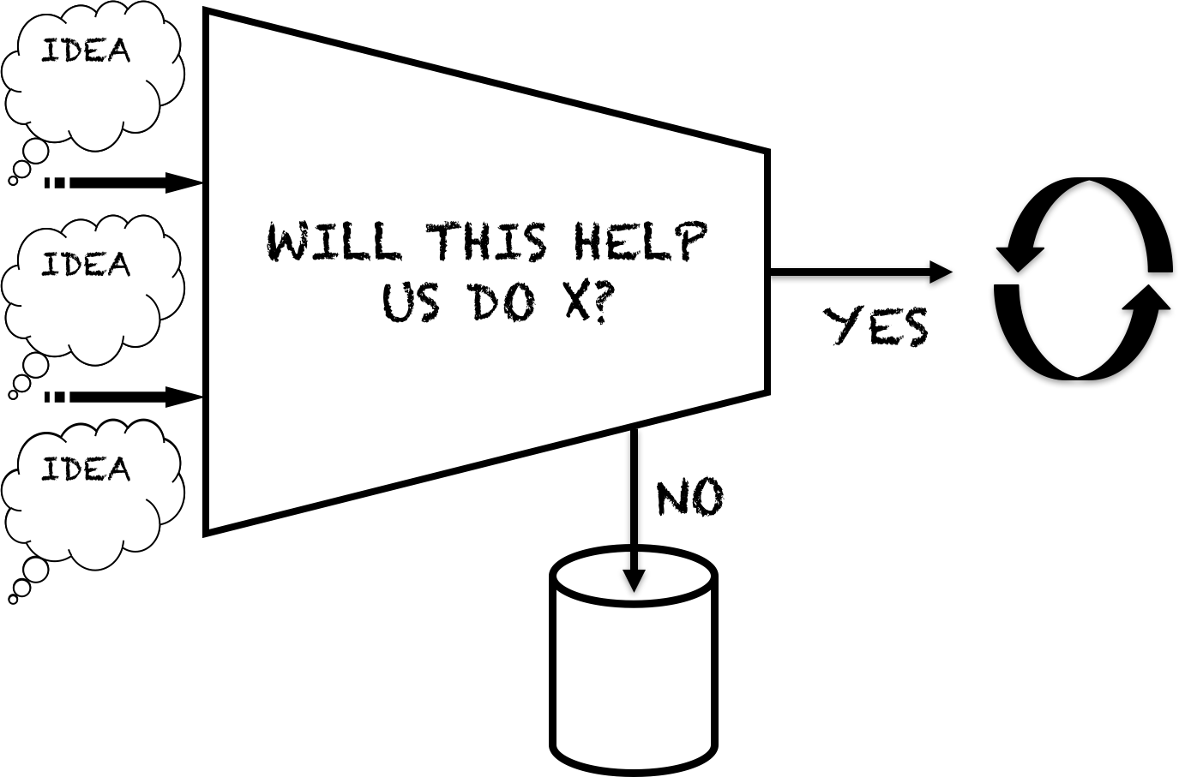
Decision Filters

Slide 13
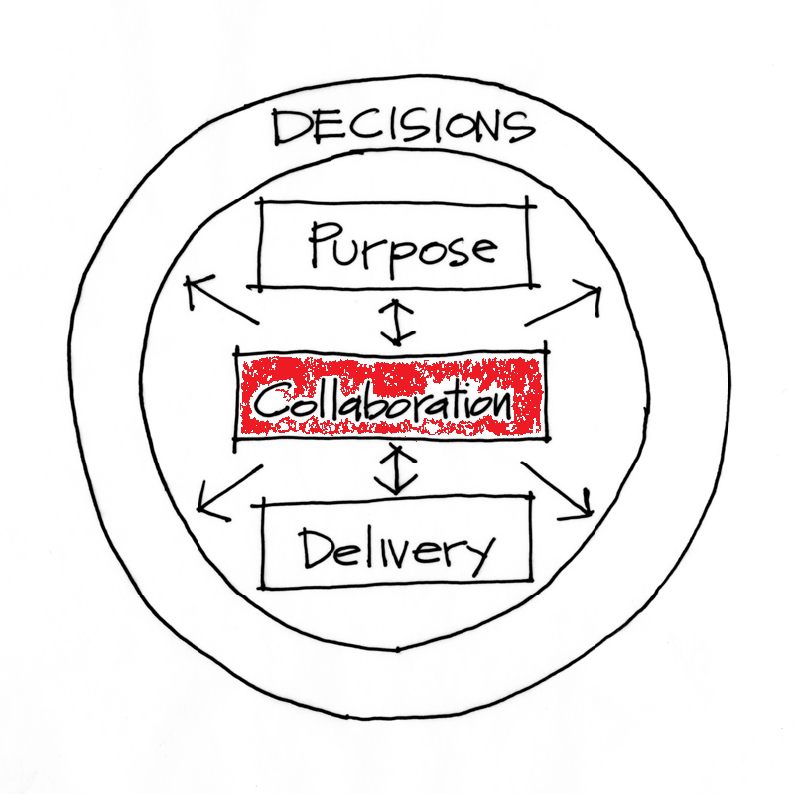

Slide 14
Trust/Ownership Model
Trust
Abdication
Energy & Innovation
How do we
get here?
Command & Control
Conflict
Control
Low
Team Ownership
High

Slide 15
Trust/Ownership Model
Trust
Stand Back and watch them fail
Stand Back and Deliver
Abdication
Energy & Innovation
How do we
get here?
Command & Control
Stand on top and rein them in
Stand on top and control
Conflict
Control
Low
Team Ownership
High

Slide 16
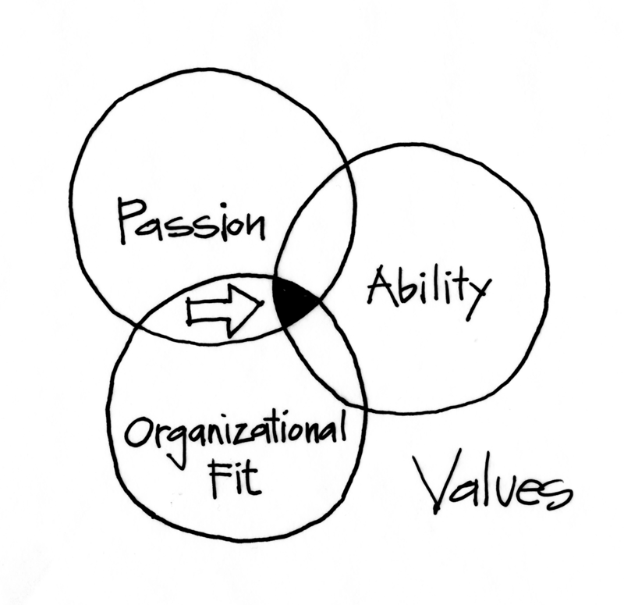
Get the Right People

Slide 17
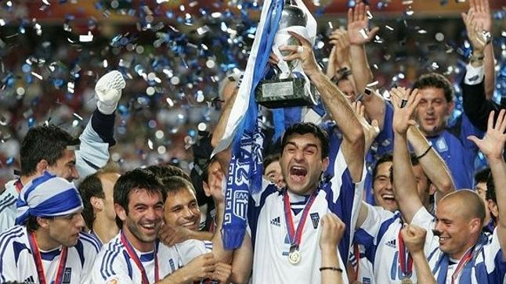
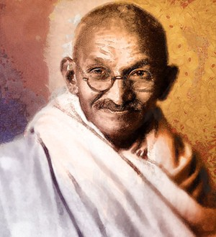


Path to Greatness
+
Integrity
Greatness
=
Passion
Conflict

Slide 18
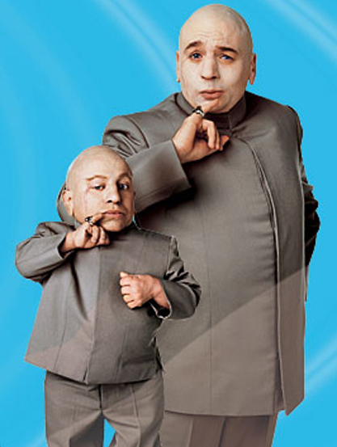

Absence of Conflict

Slide 19
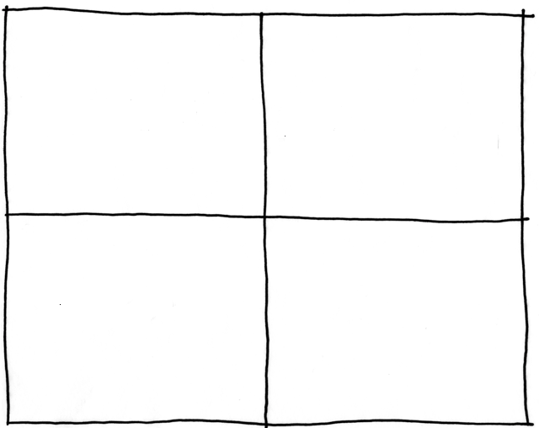
Collaborating with Non-Collaborators
Collegial
Creative
Tension
Collaborator
More useful
Drive to
Purpose
Collaboration
Non-
Collaborator
Compliance
Combative
Common Practice
Agree
Disagree
Agreement

Slide 20
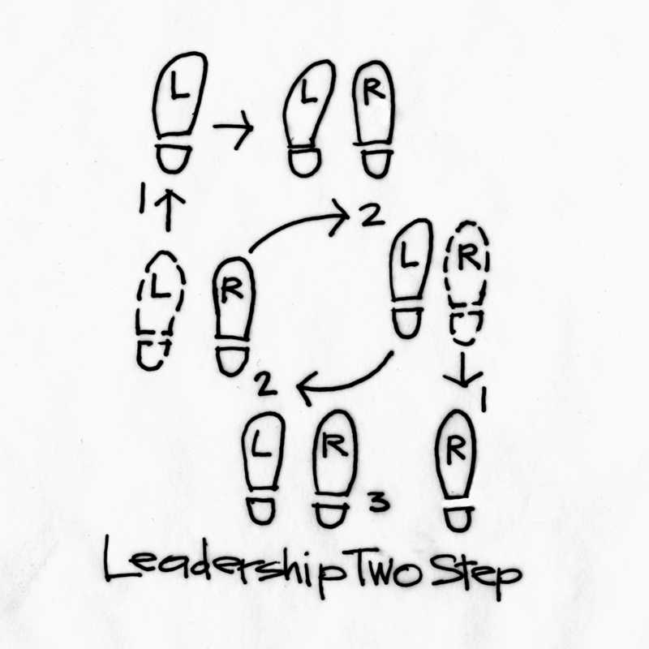
Stepping Up and Standing Back
Purpose and Strategic Intent
Shared Ownership
Stand Back and Deliver

Slide 21
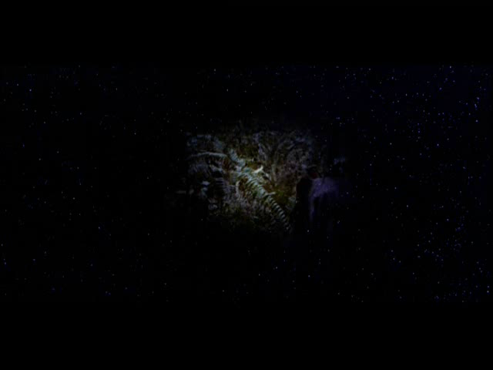
Agile Leadership

Slide 22
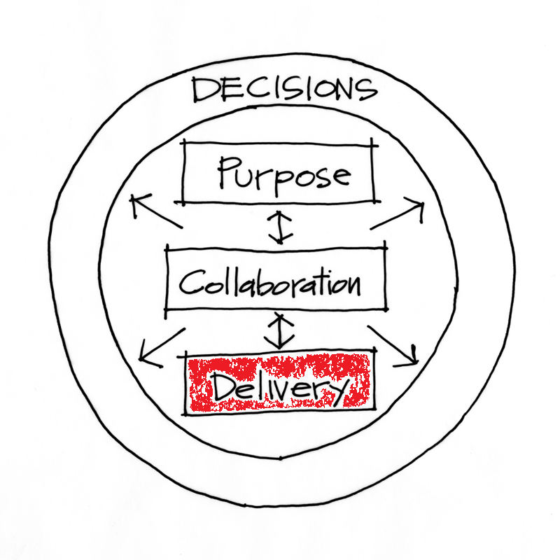

Slide 23




Managing the Coming Storm
Inside the Tornado
Project Kickoff
When will we get the requirements?
All in good time, my little pretty, all in good time
But I guess it doesn't matter anyway
Just give me your estimates by this afternoon
Team Unity
Not so fast! Not so fast! ... I'll have to give the matter a little thought. Go away and come back tomorrow
No, we need something today!
Ok then, it will take 2 years.
No, we need it sooner.
Doesn't anybody believe me?
I already promised the customer it will be out in 6 months
You're a very bad man!
Notes:
We look at a typical software project…..

Slide 24


We’re not in Kansas Anymore
Developer Hero
I may not come out alive, but I'm goin' in there!
Reorg
The Great and Powerful Oz has got matters well in hand.
My! People come and go so quickly here!
Testing
"Hee hee hee ha ha! Going so soon? I wouldn't hear of it! Why, my little party's just beginning!

Slide 25

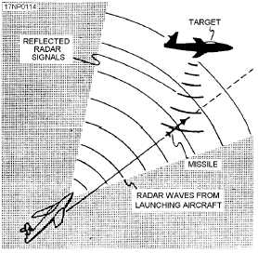
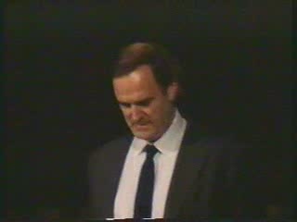
Gordon the Guided Missile

Slide 26
Control Systems
Processes
Inputs
Inputs
Inputs
Command & Control
Processes
Inputs
Inputs
Inputs
Agile Leadership
Outputs and Outcomes

Slide 27
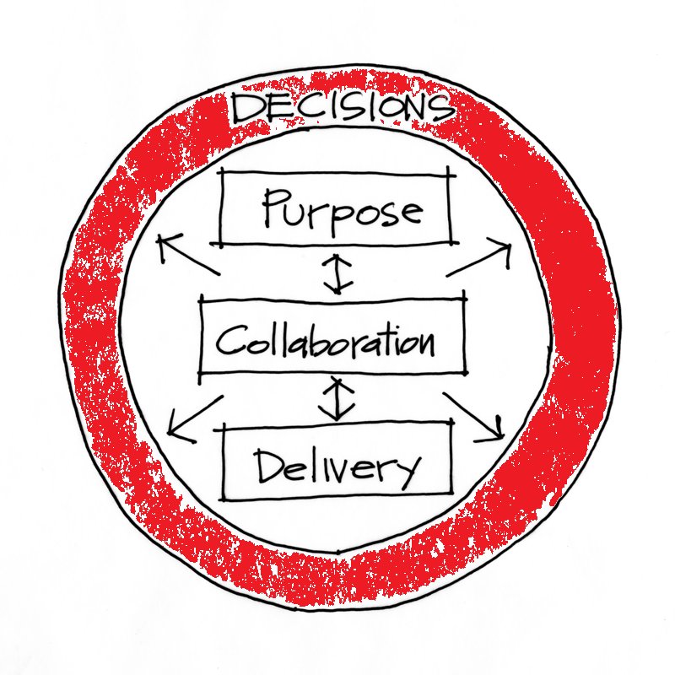

Slide 28
Decision Filters

Slide 29
Contact
Todd Little
  todd@leankanban.com
  toddelittle@gmail.com
  www.toddlittleweb.com
  www.accelinnova.com
  www.linkedin.com/in/toddelittle/en

Slide 30
Great leaders find a way to succeed in a bad system
(but they will likely move on rather than put up with the crap)
Bad leaders find a way to f-up a great system
Great leaders will seek out great systems and work to make them even better.

Slide 31
Purpose

Slide 32
Collaboration

Slide 33
Delivery

Slide 34
Decisions

Slide 35


