Slide 1

Transformational Leadership

Slide 2
Introduction
Your name
Your organization
What it does
Your role

Slide 3

Start Up
Exercise
Exercise: Pick a project.
Why are you here?
What is the one area you need to change in how you lead your team and your organization’s digital transformation?
Notes:
3

Slide 4


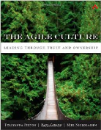
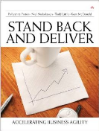
Who Is This Guy?
The Accidental CIO
Author of two books and numerous articles
Spent last 17 years doing IT turnarounds

Slide 5

How do we solve the Leadership Paradox?
Deliver operational excellence while . . .
Driving innovation
  Technology
  Business model
  Business rule
  Product and service

Slide 6

So what is different today?
?

Slide 7

The currency is now speed
Collaboration Model
Everything is moving fast.
We need to move fast too.

Slide 8

We are swimming in oceans of uncertainty and ambiguity
We must move fast but move where?

Slide 9

We are buried in data and so need to be really good at personalizing the filters

Slide 10

the individual is the device and there is no difference between organizational and personal computing
Notes:
Emphasize again that Parity activities are important and necessary.
10

Slide 11

Unleashing Innovation
Collaboration Process
think BIG
technology trends towards perfection

Slide 12
We need to be in the experience business

Slide 13

Trustworthiness
It really is
different today.
How so?

Slide 15
And This Is Before
Cognitive systems / deep learning
Internet of Things (sensors on everything) / ubiquitous compute (microprocessors everywhere)
Ubiquitous wireless and wired broadband
Real, “living” nanotechnology
What does a supply chain manager do when every item can report its location and age? Use a spreadsheet? A clip board?

Slide 16
What Worries Me
My IT is not agile enough (and, by extension, neither am I)
I am not setting up my team or my organization for success
We are not spending our time on the right things
We are not doing things the right way

Slide 17

“The biggest change to the enterprise since
Al Gore invented the internet.”

Slide 18

Let’s be honest:
Collaboration Model
We might not be prepared for this new world

Slide 19

Leadership Challenges
Get More Done by Doing Less
Lead Change
Deliver the Right Product
Meet Customer’s Changing Needs
Meet Market Windows
How can we survive in this world?
How can we thrive in this world?

Slide 20
Change everything!
Transform my role
Then Transform my organization
Then Transform my organization some more

Slide 21

?
But how? Some tools that work.

Slide 22
Tools of Transformational Leaders
Models:
Business Value Model
Purpose Alignment
Design for Information
Pro-active Risk Management
Trust / Ownership
Collaborative Leadership
Delivery Practices:
Agile / Beyond Agile
Agile Project Management
Production Change
Proactive Service Improvement
Meaningful Metrics

Slide 23


Business Value Model
Purpose
Considerations
Costs and Benefits

Slide 24
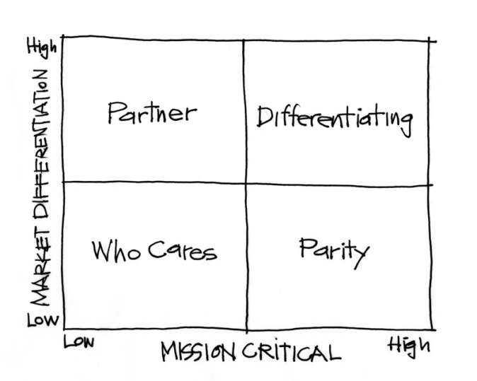
Purpose Alignment
This line
is a big
deal

Slide 25
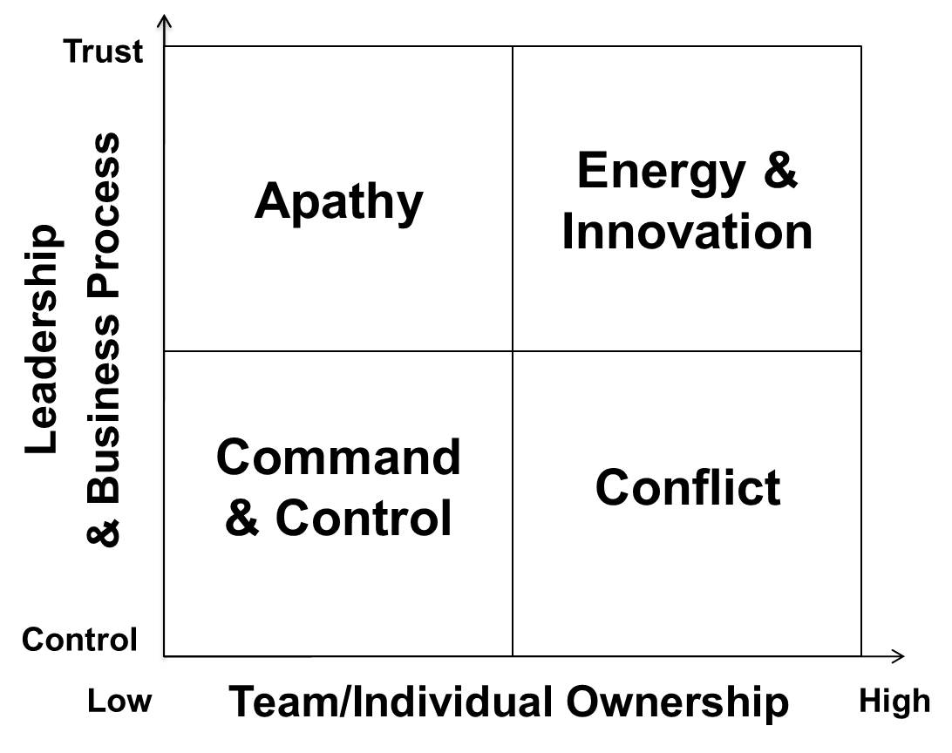
Trust Ownership Model – Rethinking our Role
If we operate here, we are the speed, operational excellence,
and innovation bottleneck

Slide 26

Make great decisions
!
What if it all comes down to better decision-making?

Slide 27

What does it take to win at decision-making?

Slide 28

All types of decisions:
what do we do?
when do we do it?
when do we decide?

Slide 29
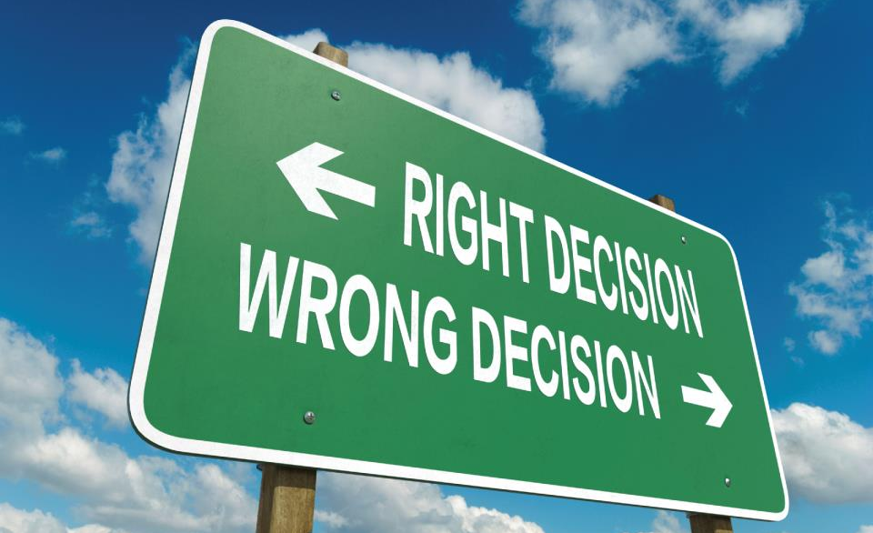
and, how we decide to decide?

Slide 30

Why This Matters
Our Credibility Is On The Line
Never or Rarely Used: 64%
Rarely
19%
Sometimes
16%
Never
45%
Often
13%
Always
7%
Always or Often Used: 20%
Notes:
Does this help us realize that we often over-engineer our designs?
The Never and Rarely used not only represent our over-investing in some features and functions, that work might have kept us from developing features and functions that would help us win in the marketplace.
Google Docs are competing with MS by only implementing the elements of MS Office that people actually use.

Slide 31

My Favorite Personal Example
Legacy System
Replacement System
Name:
Phone:
Address:
Name:
Address:
Phone:
what’s the value of
this required
change?
Notes:
Online book company – taking orders over the phone
Legacy data entry sequence = Name, Telephone, Address.
Replacement data entry sequence = Name, Address, Telephone.
The requirement is to customize the replacement. Cost is $100,000.
How much “value” did this customization generate? Was it worth $100,000? How about $1000? $1?

Slide 32

Ideally, we decide based on
value
But,
what’s that?

Slide 33
Defining Value
calculation
Costs
Value Calculation
Benefits
Business Value

Slide 34
Valuing the Inputs
calculation
Estimate
Value Calculation
Guess
Business Value
Notes:
Using this cost / benefit calculation approach to business value is not only incomplete, it can be gamed. In many cases, we start with the number that will guarantee project approval and then work backwards to determine what costs and benefits will generate this number.
If your cost estimate is +/-25% and your value estimate is +-50% (These are not uncommon numbers) then your E/R is +-85% = essentially a random number and not a good basis for decision making.

Slide 35
we need some help !

Slide 36

Business Value Model
Purpose
Considerations
Costs and Benefits
Notes:
36
This gives an overview of the value model and the following slides describe each element of the model starting with Purpose

Slide 37

where
do
we
start?

Slide 38
Business Value Model
Purpose
Notes:
38

Slide 39
My Operating System: Purpose Alignment Model
High
Partner
(very rare)
Differentiating
(Better Than)
Market
Differentiating
Who cares
(hopefully rare)
Parity
(As Well As)
Low
Low
High
Mission Critical
Notes:
Differentiate is how to gain market share. Parity is how to hold market share.

Slide 40
In Practice
High
Do we take this on?
Innovate,
Create
Market
Differentiating
Achieve and
Maintain
Parity
Minimize or Eliminate
Low
Low
High
Mission Critical
Notes:
While there are many examples of Parity activities, it is helpful to point out some of the Differentiating activities of the team or group you are training.
It is also important to emphasize that the Parity activities are important. They are as important as the Differentiating activities. However, their importance does not come from their uniqueness.
It is important to emphasize that Purpose not only helps us stop over-engineering or over-investing in Parity activities, features, and functions, it also helps us focus our creativity and innovation on the Differentiating activities, features and functions.

Slide 41
The Differentiating Rules
Rules | How?
Always Be the Market Leader | Innovate now and forever
Focus | Have 1-3 specific things you do better than anyone else
Own Differentiating | You cannot outsource your innovation

Slide 42
The Parity Rules
Rules | How?
Fill Any Gaps Because Gaps Kill | Adopt Best Practices – adopt the innovation of market leaders
Eliminate Risks Because Risks Kill | Simplify – complexity increases risks and reduces agility
Create Capacity To Focus Resources on Innovation | Standardize – there is only downside to exception handling of Parity activities

Slide 43
My Current Example – OC Tanner
High
Employee
recognition that
drives
engagement
Market
Differentiating
Everything else
Acctg, Lean, Pricing, CRM, Network, eCommerce
Low
Low
High
Mission Critical

Slide 44
OC Tanner IT
High
Engagement analytics,
Natural recognition
Market
Differentiating
Everything Else:
Network, CRM, platform, cloud, architecture, reporting
Low
Low
High
Mission Critical

Slide 45
Rationalizing The Portfolio And The Projects
System | Purpose | What To Do
Order processing, catalog and item management | Parity | A gentle but complete re-do of ERP
CRM | Parity | Replace highly-customized system with something we configure to best practices
Accounting | Parity | Replace wackiness and 3rd party AR with standard COA and ERP
Natural recognition | Differentiating | Mine Slack, Chatter, Jabber, et cetera for recognition suggestions

Slide 46
The To-Date Results
ERP Re-do in 12 months and at a fraction of the previous budget
Re-defined business architecture (what do we do better than anyone else?)
5 Year Strategic Plan includes 5 initiatives – 4 of them from IT
Hope for the hopeless

Slide 47
Another Example - WGU
High
Self-paced,
Competency-
Based Higher Ed
Market
Differentiating
Everything Else
Fin Aid, Registration, Student Support, Faculty, Etc
Low
Low
High
Mission Critical

Slide 48
WGU IT
High
Student Analytics
(for competency-based, self-paced)
Market
Differentiating
Everything Else:
Network, SRM, Portal, ERP, Etc
Low
Low
High
Mission Critical

Slide 49
Rationalizing The Portfolio And The Projects
Project | Purpose | What To Do
Student Profile | Parity | Kill current custom project, configure in CRM
CRM | Parity | Replace seven different systems / approaches with one
Enrollment | Parity | Configure (not customize) and free up 4 engineers
Analytics For Student Engagement | Differentiating | Pilot “Edge” technologies to capture and analyze data

Slide 50
Want To Give This A Try?

Slide 51
The Challenge?
Strategy
High
Partner?
Differentiating
Market
Differentiating
Who cares?
Parity
Low
Low
High
Mission Critical
Notes:
The primary challenge in using the Purpose model is to identify what belongs in the Differentiating category. As a rule of thumb, what belongs in Differentiating should be directly linked to the organization’s strategy.

Slide 52
strategy = sustainable competitive advantage
Notes:
And, strategy is equivalent with what generates our strategic competitive advantage. As a result, what belong in the Differentiating category are those things that directly generate sustainable competitive advantage.

Slide 53
4 important questions:
Who do we serve?
What do they need and want most?
What do we do – better than anyone else – to meet these needs and wants?
What is the best way to provide this?
Notes:
These 5 Questions are a useful tool to help us identify the sustainable competitive advantage activities – those that belong in the Differentiating category.

Slide 54

the “billboard” test…
Notes:
A basic human need is to want to be needed. Often, we translate this to mean that we want what we do to be Differentiating. One way to filter what is truly differentiating is the idea that, since the Differentiating activities, features, and functions help us gain market share and win new customers, we should be willing to advertise these to the world.
If there are questions about whether or not an activity, feature, or function is differentiating, we can ask whether or not we would ever post it on a billboard to win new customers.
54

Slide 55

For OC Tanner
Employee recognition? Who cares?
You Should See Our Custom Invoices!
Notes:
CTO was arguing for significant investments in their financial system but trying to create a billboard makes is clear that this can only be a parity – not a differentiating investment

Slide 56
Or . . .
Want a faster recovery? Want lower risks? Want to reduce time in surgery?
Our implants give that and more
Notes:
CTO was arguing for significant investments in their financial system but trying to create a billboard makes is clear that this can only be a parity – not a differentiating investment

Slide 57
For OC Tanner
Engagement? Who cares. Did you know that all of
our revenue drops into an account titled
Diamond Sales!
Notes:
CTO was arguing for significant investments in their financial system but trying to create a billboard makes is clear that this can only be a parity – not a differentiating investment

Slide 58

strategy
creates
decision filters
a HUGE idea!
Notes:
Because we want to improve decision making and push it out to our teams, we can assess our Differentiating activities, features, and functions and define a simple, effective decision filter (just like Southwest Airlines’) that our teams can use for the thousands of decisions they make.
58

Slide 59

decision filters
make daily
decisions
schedule projects
what
to develop

Slide 60
cascade
decision
filters
throughout
organization

Slide 61
caveats

Slide 62

treat exceptions as exceptions
Notes:
Much of the complexity is our Parity process is due to exception handling. We need to assess the value created by standardizing our treatment of exceptions. If the value is low, treat the exception in a one-off manner.

Slide 63

Managing Risks
common sense
not common practice
List Three Professional Options

Slide 64
parity is
mission critical
Notes:
Emphasize again that Parity activities are important and necessary.
64

Slide 65

purpose is not priority
Notes:
This is a reminder that when we prioritize our projects and tasks, it could be that we should complete work on a Parity activity, product, feature, or function before we complete work on something that is Differentiating. Getting up to Parity might be the most important thing to do today.

Slide 66

Differentiating changes over
time
Notes:
As soon as we release Differentiating features and functions, our competitors can mimic them. So, we need to be thinking several iterations ahead and constantly innovate our Differentiating products, features, and functions.
66

Slide 67

innovate!
Leadership Influence

Slide 68
Start Up
Exercise
For your organization . . .
Exercise: Pick a project.
Notes:
68

Slide 69
What is differentiating?
High
Partner?
Differentiating
Market
Differentiating
Who cares?
Parity
Low
Low
High
Mission Critical
Notes:
69
For this exercise, have the group (or sub groups) select something they are actually working on. The exercise is much more effective if the participants can use the exercise to make real decisions.
For the exercise, use the handout to manage the flow.

Slide 70
your
decision
filter?
Notes:
70
Just like the previous exercise tasks, ideally the groups define a decision filter.

Slide 71
Pick a project. Where does it fit?
High
Partner?
Differentiating
Market
Differentiating
Who cares?
Parity
Low
Low
High
Mission Critical
Notes:
71
For this exercise, have the group (or sub groups) select something they are actually working on. The exercise is much more effective if the participants can use the exercise to make real decisions.
For the exercise, use the handout to manage the flow.

Slide 72

other
considerations
Notes:
The next piece of the decision making model is Considerations.
Considerations are the inputs to the decision that we cannot quantify using a number.

Slide 73
Business Value Model
Purpose
Considerations
Notes:
73
One point you can make is how Purpose affects Considerations. For example, if the project is a Parity project and you have technical uncertainty, you might treat this uncertainty very differently than if it is a Differentiating project.

Slide 74
Collaboration Model
flexibility

Slide 75

dependencies
Collaboration Model

Slide 76
Time to
Benefit

Slide 77

time
to
market

Slide 78
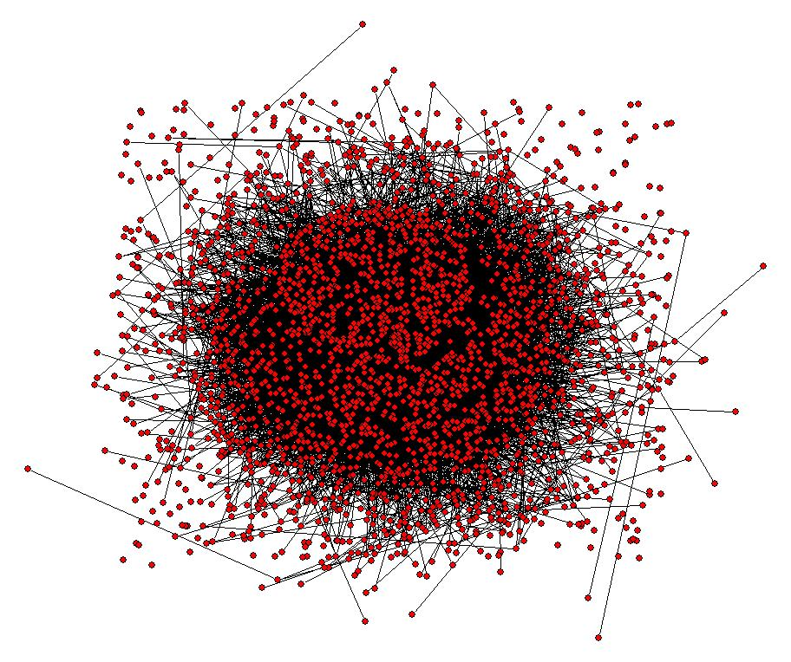
Complexity risks
team size
mission criticality
team location
team capacity
domain
knowledge gaps
dependencies
technical complexity
Notes:
78
This is a representative, not exhaustive list

Slide 79

uncertainty risks
market
uncertainty
technical uncertainty
project duration
dependents
Notes:
This is a representative, not exhaustive list

Slide 80
Considerations . . .
Exercise: Pick a project.
Vary by project, time, competitive landscape, and pretty much everything else
Brainstorm and prioritize your considerations and then repeat
Notes:
80

Slide 81
your considerations?
Notes:
81
This continues the exercise we started after the Purpose training. For this portion of the exercise, we want to continue the same projects the teams selected for Purpose.

Slide 82

prioritize
Notes:
If the groups have been trained in the collaboration process, they can use it to prioritize their considerations. Otherwise, they can use some method to identify the most critical decisions.
82

Slide 83
Business Value Model
Purpose
Considerations
Costs and Benefits
Notes:
83
Now that we have framed our decision model, we start to make decisions.

Slide 84

costs
and
benefits?
Notes:
While costs and benefit are not the only inputs to a decision, they might still be critical or the most important inputs.
84

Slide 85

Business Value Model
Purpose
Considerations
Costs and Benefits
Notes:
85
Now that we have framed our decision model, we start to make decisions.

Slide 86

it’s
a
conversation
Notes:
86
Make sure the team includes EVERYONE who would have input into the conversation

Slide 87

resolve differences
Notes:
It is likely that, in a collaborative environment, there will be differences of opinions about the specific inputs to the decision model and the resulting decisions. One tool is to use the collaboration process to resolve the differences.

Slide 88

group chunks
high – medium - low
Notes:
88
Once there is general agreement as to the decision, it is useful to create iterative chunks of how you will implement the decision. This is similar to iterative release in agile but can be applied to a broad range of decisions.
88

Slide 89

What are your largest value chunks?
Notes:
Continuing the exercise, what are the most important (and therefore highest value) chunks to deliver?

Slide 90

What do we need to add in order to
make a better, future decision?
Notes:
One thing to consider in making deferral decisions is to identify chunks that we can deliver early that will help us make better future decisions. Can we gather important information in the first chunk that we can use to refine and improve our decision model?

Slide 91
Business Value Model
Purpose
Considerations
Costs and Benefits
Notes:
91
Now that we have framed our decision model, we start to make decisions.

Slide 92
Business Value Example – Replace MS Office
Purpose
Considerations
Save $350,000 per year
Notes:
92
Now that we have framed our decision model, we start to make decisions.

Slide 93
Balancing Considerations
Office Suite = Parity
Replace Excel = Dead CIO
Or, = Split Support Model
Save $350,000 per year
Notes:
93
Now that we have framed our decision model, we start to make decisions.

Slide 94
An Example: SAP Re-Do at OCT
P = Differentiating
CA = Parity
P = Low risk, Lower client Impact
CA = Not sure it will even work, High client impact
Assume equal costs, CA = Massive benefits, P = Decent benefits
Notes:
94
Now that we have framed our decision model, we start to make decisions.

Slide 95
WGU: Student Analytics
Parity and Differentiating
High Technical Complexity
Just might be our only chance
Benefits?
Could be pricy
Notes:
95
Now that we have framed our decision model, we start to make decisions.

Slide 96
Your Next Steps
Get some help on this – the models are simple but implementation can be a challenge. This is common sense but not common practice
Use it in leading up, sideways and down – done properly it will change your life (for the better) as well as the life of your organization (for the better)

Slide 97

Analytics Can Create Competitive Advantage

Slide 98

If great decisions matter, how can IT lead in better decision-making?
What analysis will make the biggest, fastest difference?
Customers?
Products?
Operations?

Slide 99
Three Questions to Ask:
  What decisions would you like to be able to make?
  What information do you need in order to make these decisions
  What transactions are required to gather this information?

Slide 100
Student Analytics at WGU.
The Three Questions to Ask:
  What decisions would you like to be able to make? Right now, know which students need help
  What information do you need in order to make these decisions? Profile, historical performance, course engagement, staff feedback, et cetera data
  What transactions are required to gather this information? Gather what we have. Invent a way to get course engagement

Slide 101
What Was The Result?
Increased student retention 10 percentage points (this is huge)
The one time my IT innovation changed the way the entire organization operated

Slide 102
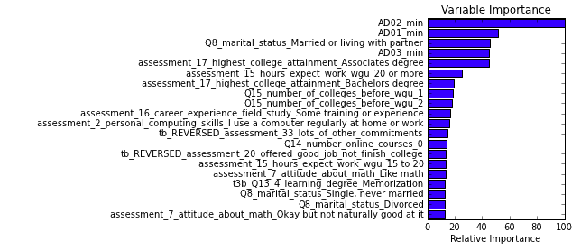
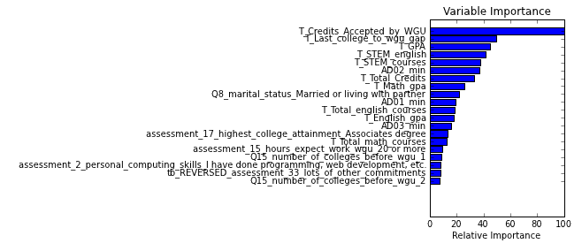
Analytics Example - Admissions
Admissions Model 1
We thought AD02_min was the most
important factor. It turned out to be
the 6th most important
After using advanced analytics, Admissions Model 2
We thought AD01_min was the 2nd most
important factor. It turned out to be
the 9th most important

Slide 103
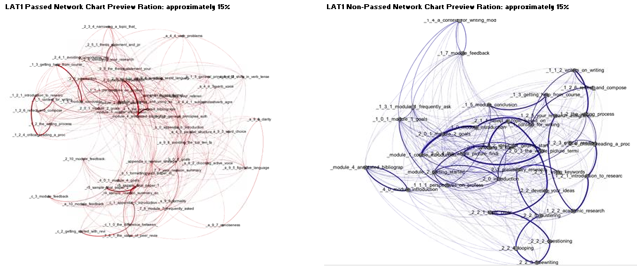
Example: Course Navigation Predicts Success
Machine Learning algorithm can predict pass or fail with 77% accuracy after a student’s first session

Slide 104
Leading Through Influence
Protect Team Boundaries

Slide 105
How Does Influential Authority Differ From Positional Authority?

Slide 106
The Central (Crazy) Idea:
Influential Leaders are those who gain Followers (without positional authority)

Slide 107
What does that mean to you?
How does someone “gain followers?”

Slide 108
Another One Of My Claims:
Influential Authority Is More Important Than Positional Authority
How So?

Slide 109
The framework for this our conversation
Trust / Ownership Model

Slide 110
Trust Ownership Model

Slide 111
How Does Trust / Ownership Apply to Influential Leadership?

Slide 112
But First Some Context
Remember the three drivers of motivation:
https://www.youtube.com/watch?v=u6XAPnuFjJc

Slide 113
Influential Leadership
To be long-term successful as a leader, I need to:
Be in the What and Why business and GET OUT of the How business
Create a culture of trust.

Slide 114
How can we create a culture of trust?

Slide 115
Describe the characteristics of a culture of trust
One idea per sticky note
Read each sticky to the group
Group the sticky notes in silence
Vote to prioritize (divide number of groups by 3 and round up to the nearest whole number = number of votes)

Slide 116

‘Old school’
manages change
knows the answers
bureaucratic
leader decides
authoritarian

Slide 117

‘New school’
embraces change
fosters new ideas
collaborates
gives ownership
influences
Believes that . . .

Slide 118
Leadership Challenges
the answers are in my organization
Get More Done by Doing Less
Lead Change
Deliver the Right Product
Meet Customer’s Changing Needs
Meet Market Windows

Slide 119

Project Management
None of us are as smart as all of us.
- Japanese Proverb
How Do We Deliver?

Slide 120

Methods to build a Culture of Trust

Slide 121

Trust First

Slide 122

Leading Agile
Team-based measurements
Collaboration Model
Collaboration Process

Slide 123

build confidence

Slide 124
short iterations … early wins
Collaboration Model

Slide 125
Blame and fix processes, not people

Slide 126
Authentic

Slide 127

purpose over personal agenda

Slide 128
Project Management
Trustworthy
How Do We Deliver?

Slide 129
protect team Boundaries
Protect Team Boundaries

Slide 130

Project Management
Be transparent and over-communicate
Focus, Communication, and Expectation Management

Slide 131

bring solutions
not just problems

Slide 132

Communicate everything:
The good
The bad
The ugly
Notes:
132

Slide 133

If it is bad news, the earlier you communicate it, the better

Slide 134

Teams know HOW! Let them do it!
Let them make mistakes.
Build safety net
“In the absence of communication, everyone assumes the worst”
Niel Nickolaisen

Slide 135
What is one specific thing you will do differently to build your influential leadership by creating a culture of trust?
Write it down
Share it (to create joint accountability)

Slide 136
How can we grow ownership?

Slide 137
How about giving away decision making?
What are the risks?

Slide 138
Grow Ownership?
Focus on Why and What – never How
Others own all How decisions
Link all work to Why
Communicate Why
Expose team to user’s lives and goals

Slide 139
Start With Why
Simon Sinek
https://www.youtube.com/watch?v=Wb8KpHqU5tg

Slide 140
Never Problem Solve
Notes:
Much of the complexity is our Parity process is due to exception handling. We need to assess the value created by standardizing our treatment of exceptions. If the value is low, treat the exception in a one-off manner.

Slide 141

OK Smart Guy, how do we then solve problems and make plans?
through
collaboration

Slide 142

Project Management
Quality Management
create an open
environment

Slide 143

fosters creativity and innovation,
team commitment and ownership
encourages ideas
Notes:
143

Slide 144

bring the right people together from the entire enterprise
customers
marketing
sales
finance
technology
manufacturing
stakeholders

Slide 145
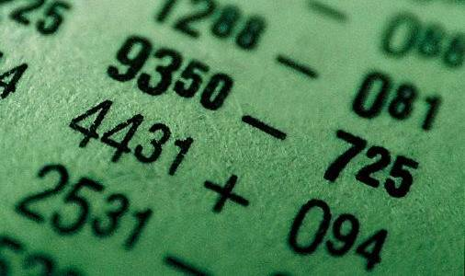
agree to goals and objectives

Slide 146

brainstorm

Slide 147

group
in
silence

Slide 148

prioritize based on
business value
Notes:
No rainbow. Something that reps BV.

Slide 149
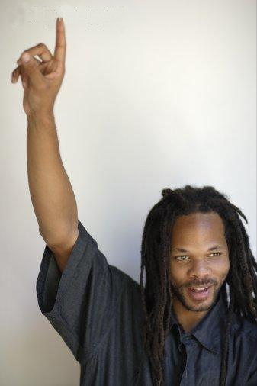
Individuals volunteer
for what
and by when

Slide 150

and let them work

Slide 151
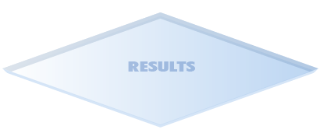




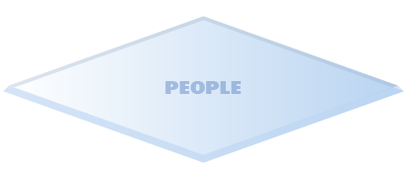
Macro Leadership
Keeping Myself on Track
Notes:
151

Slide 152

Stand Back
Notes:
152

Slide 153

remove barriers

Slide 154

help teams grow?
Using the cube concept, how do you recognize when you need to step back and step up?
How do you use this to help teams grow?

Slide 155
Larger Boundaries
Notes:
155

Slide 156

stand
back
even
further

Slide 157


Step Up
Notes:
157

Slide 158
Use It To Influence Upwards?
Notes:
158

Slide 159
A way to keep track of the
Why and What

Slide 161
What is one specific thing you will do differently to build your influential leadership by creating a culture of ownership?
Write it down
Share it (to create joint accountability)

Slide 162

Focus On Relationships
We need to build relationships of trust with multiple groups:
Our bosses
Our peers
Our staff
Our internal customers
Our external customers
Our service providers

Slide 163

What Does It Take To Build
Relationships of Trust?
Days in the Life
Get out of the office
Build credibility through Operational Excellence
Understand the engine that drives the organization so that you can Enable Strategy

Slide 164
A Final Thought On Trust - Ownership
Establish two decision filters:
Will this improve team / individual ownership?
Will this improve trust?

Slide 165
Leadership Is Not For The Faint Of Heart
What you need to do varies by team, individual, and situation.
Be trustworthy, be honest, be self-aware, and expect to fail, reflect, and change.
Ask if you have influence or positional authority. If your authority is positional, think of how to use trust and ownership to change.

Slide 166
Exercise For you . . .
What are some specific changes you will make in your approach to leadership?
What is your transformation
action plan?
What help do you need?
Exercise: Pick a project.
Notes:
166

Slide 167
Your Next Steps
Experiment with this approach but trust first
Find and utilize an internal or external mentor – and then be prepared to do lots of personal reflection and change

Slide 168
My Offer
I will:
Teach this and / or the extended class (agile, lean, et cetera) to you and your team.
Take your leadership team through Purpose Alignment
Take you and your team (or your leadership team) through a strategic planning exercise
All I ask is that you pay my travel expenses

Slide 169
Questions?
nnick@octanner.com

