Slide 1
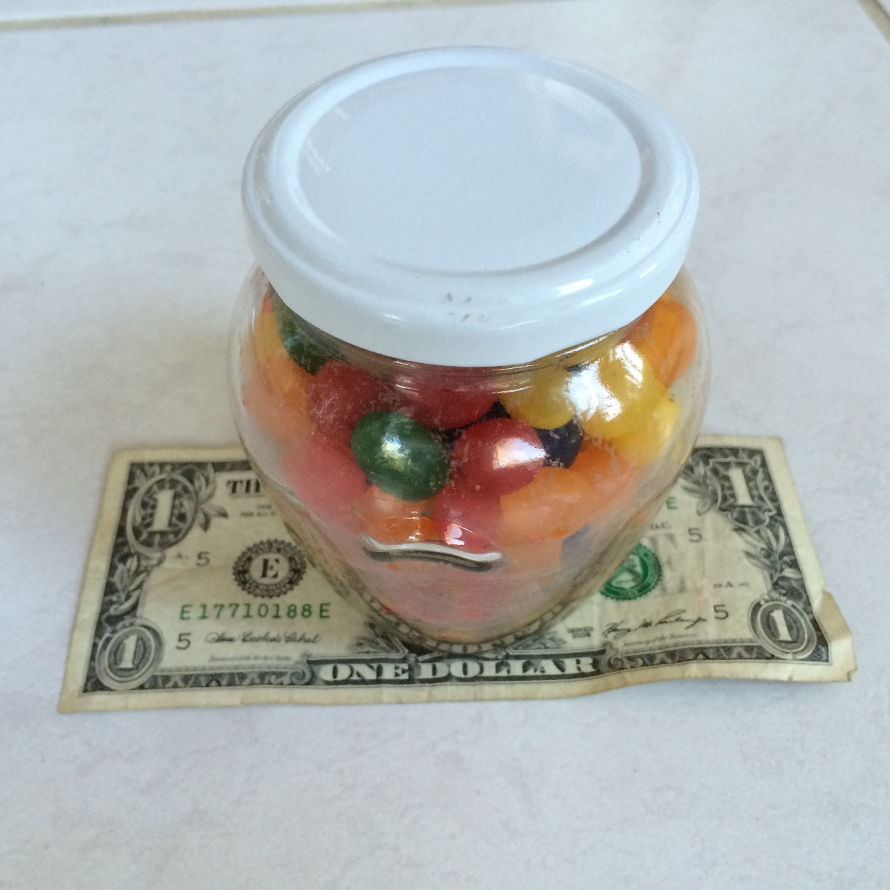
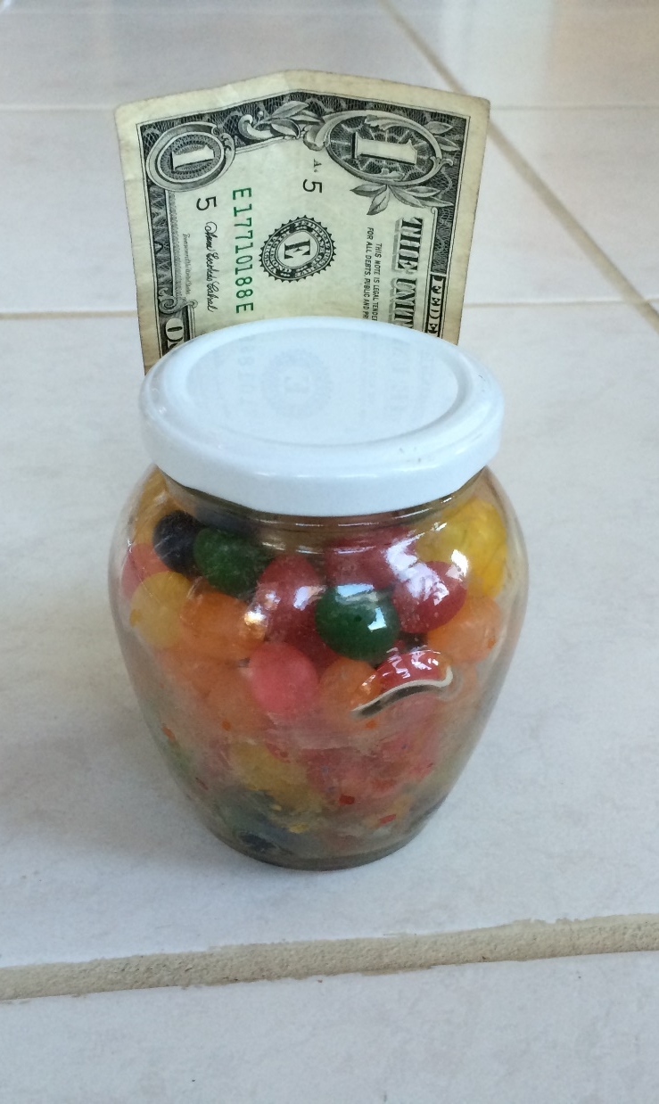
Estimate the # of Jelly Beans

Slide 2
Cynefin Framework (Snowden)

Slide 3
Obvious
Distribution
Input
Output
Cause and Effect Obvious to all
Known - Knowns
Sense - Categorize - Respond
apply best practice
Example: Manufacturing

Slide 4
Complicated
Analysis
Input
Output
Distribution
Cause and Effect Requires Analysis
Known - Unknowns
Sense - Analyze – Respond
apply good practice
Example: Incremental Product Development

Slide 5
Complex
Distribution
Input
Output
Cause and Effect perceived in retrospect
Unknown - Unknowns
Probe - Sense – Respond
sense emergent practice
Example: New Product Development

Slide 6
Chaotic
Output
Distribution
Input
No Relationship between Cause and Effect
Unknowables
Act - Sense - Respond
discover novel practice.
Example: Medical Emergency

Slide 7
John Helm
Agile 2013

Slide 8
Jellybean Results
Type of Estimate | Typical Ranges
Individual Estimates | 0.30 – 1.8 (6X)
Groups (of ~6) | 0.75 – 1.50 (2X)
Average of the Individuals | 0.80 – 1.20

