Slide 1
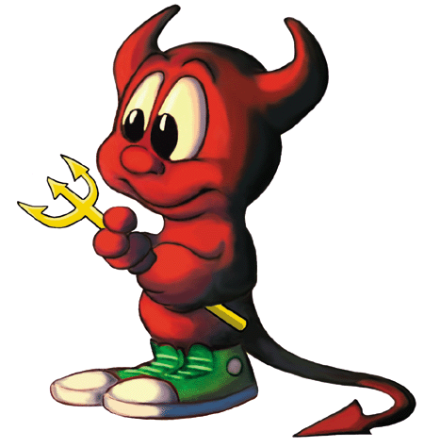
7 Sins of Scaling and other Agile Anti-Patterns
Todd Little
March 2017
@toddelittle

Slide 2


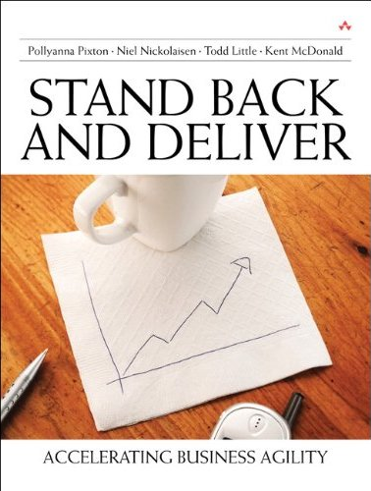





About Todd
Chemical & Petroleum Engineer
30+ Years in Software Development
Founding Consultant at
Executive roles as VP Product Development, Director of Software & Technology
Pioneer and Agile Community Builder

Slide 3

Disclaimer
!7
!Sins
!Scaling

Slide 4
Agile Manifesto
We are uncovering better ways of developing software by doing it and helping others do it. Through this work we have come to value:
Individuals and interactions | over | processes and tools
Working software | over | comprehensive documentation
Customer collaboration | over | contract negotiation
Responding to change | over | following a plan
That is, while there is value in the items on the right, we value the items on the left more.

Slide 5
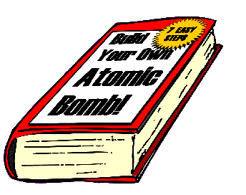
Antipatterns
Jim Coplien: “An anti-pattern is something that looks like a good idea, but which backfires badly when applied.”

Slide 6
Auditor Manifesto
We are uncovering better ways of auditing software development by forcing others do it how we tell them. Through this work we have come to value:
Processes and tools | over | individuals and interactions
Comprehensive documentation | over | working software
Contract negotiation | over | customer collaboration
Following a plan | over | responding to change
That is, while there may be value in the items on the right, we have chosen to ignore them as they are difficult to audit. We only care about the items on the left and we will make sure that you do too!
Notes:
Sean

Slide 7
Sinner’s Manifesto
We think we know what we are doing. It looks like a good idea or someone told us that is the best way to do it so we’ll do more of it. Through this we may have accidentally come to value:
Potential Sin | Over | Virtue
The sin is not always a bad idea. There may be significant value in moderation, but in excess it can be an anti-pattern. The path the redemption is to look to the virtue.

Slide 8


Sample Sin
Potential Sin |  | Virtue
 | Over

Slide 9
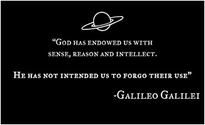

Heresy

Slide 10


Potential Sin #1
Potential Sin |  | Virtue
Scaling Tools & Processes | Over | Scaling the Mindset

Slide 11
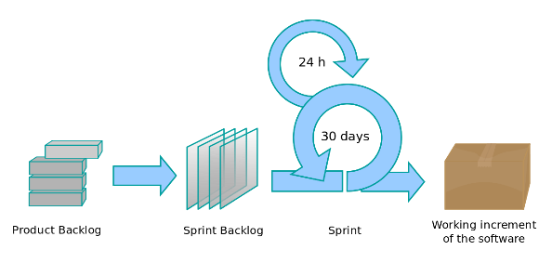

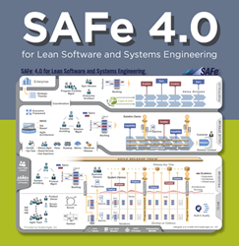
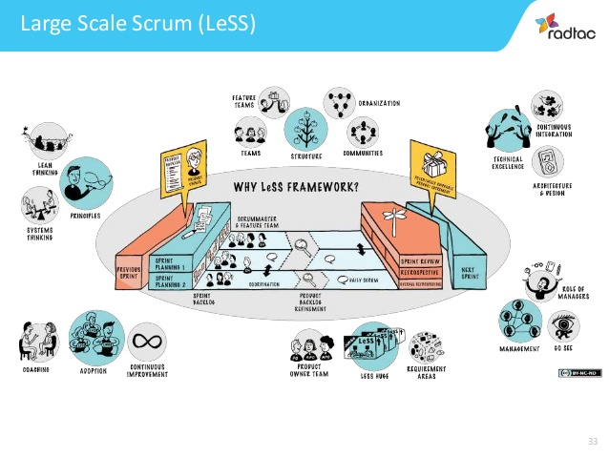
Potential Sin #1:
Scaling Processes and Tools Over Scaling Mindset
Potential Sin |  | Virtue
Agile is a process | Over | Agility is a mindset

Slide 12
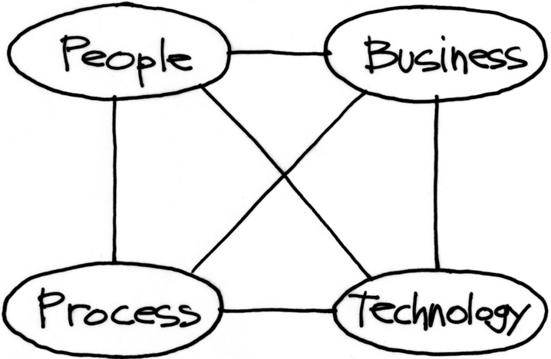
Potential Sin #1:
Scaling Processes and Tools Over Scaling Mindset
Where the mindset leverage is
Where many agile transformations focus

Slide 13
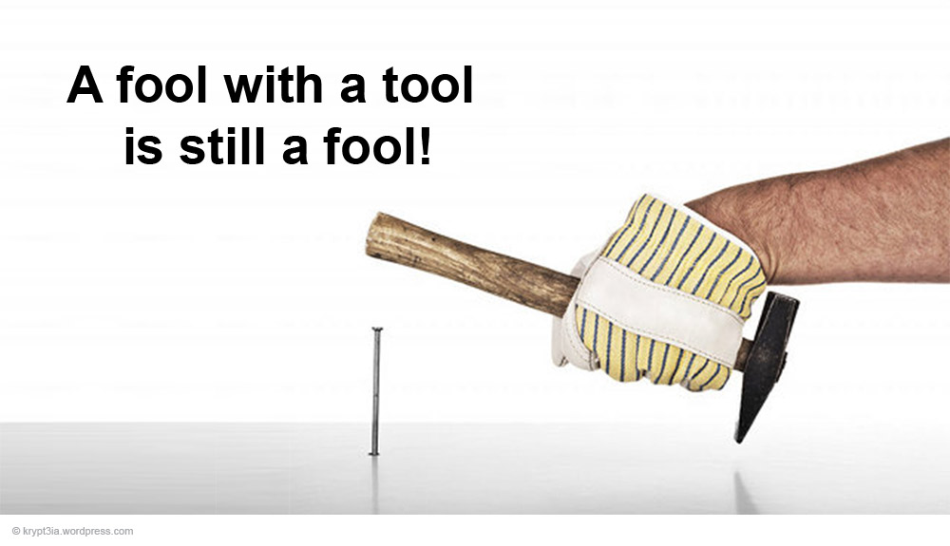
Potential Sin #1:
Scaling Processes and Tools Over Scaling Mindset
Potential Sin |  | Virtue
Agile is the Tool | Over | The tools support agility

Slide 14

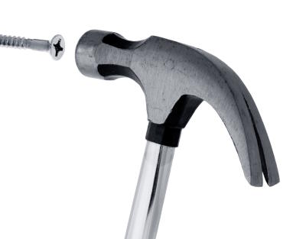
Potential Sin #1:
Scaling Processes and Tools Over Scaling Mindset
Potential Sin |  | Virtue
One size fits all | Over | Context

Slide 15
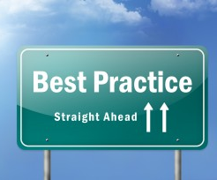
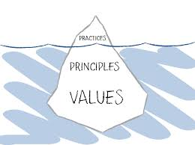
Potential Sin #1:
Scaling Processes and Tools Over Scaling Mindset
Potential Sin |  | Virtue
Best Practices | Over | Principles and Values

Slide 16


Potential Sin #1:
Scaling Processes and Tools Over Scaling Mindset
Potential Sin |  | Virtue
Collaboration | Over | Shared Ownership

Slide 17


Potential Sin #2
Potential Sin |  | Virtue
Status | Over | Flow of Value

Slide 18

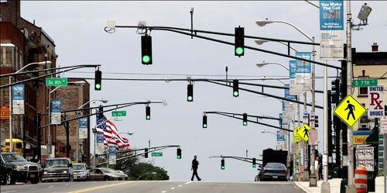
Potential Sin #2:
Status over Flow of Value
Potential Sin |  | Virtue
Showing Progress | Over | Delivering Value

Slide 19


Potential Sin #2:
Status over Flow of Value
Potential Sin |  | Virtue
Checking Boxes | Over | Learning and Adapting
Feedback Loop

Slide 20


Potential Sin #2:
Status over Flow of Value
Potential Sin |  | Virtue
Starting | Over | Finishing

Slide 21
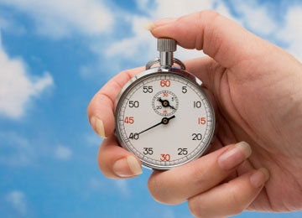
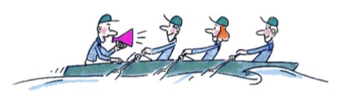
Potential Sin #2:
Status over Flow of Value
Potential Sin |  | Virtue
Individual Utilization | Over | Team Throughput

Slide 22

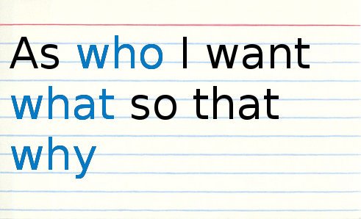
Potential Sin #3
Potential Sin |  | Virtue
Stories | Over | Strategy

Slide 23

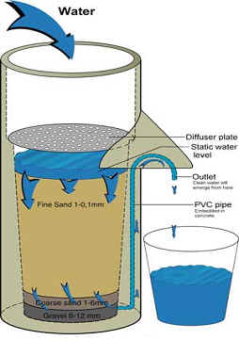
Potential Sin #3:
Stories over Strategy
Potential Sin |  | Virtue
Buckets | Over | Filters

Slide 24
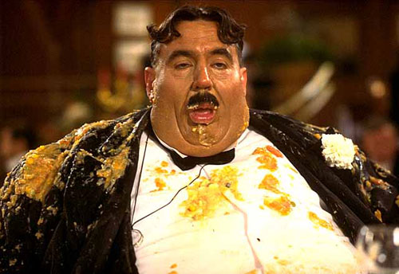
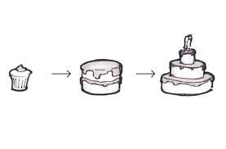
Potential Sin #3:
Stories over Strategy
Potential Sin |  | Virtue
I want it all (Gluttony) | Over | Incremental Delivery

Slide 25
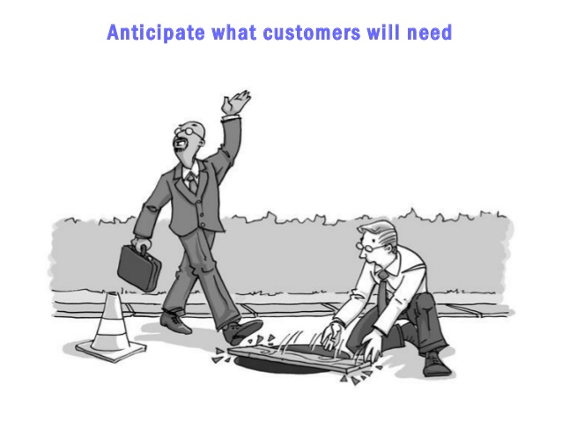

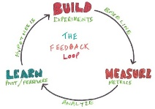
Potential Sin #3:
Stories over Strategy
Potential Sin |  | Virtue
Listening to Customers | Over | Learning what they really need

Slide 26

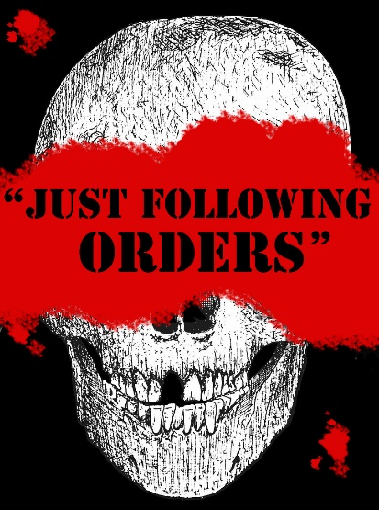
Potential Sin #3:
Stories over Strategy
Potential Sin |  | Virtue
Following orders | Over | Understanding Why

Slide 27
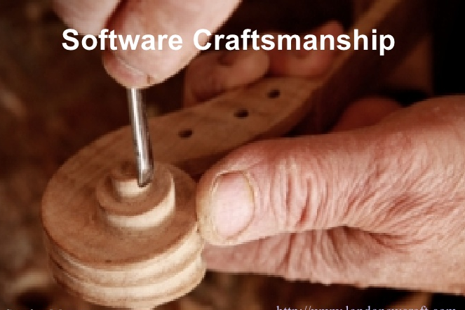

Potential Sin #4
Potential Sin |  | Virtue
Crap | Over | Craftsmanship

Slide 28
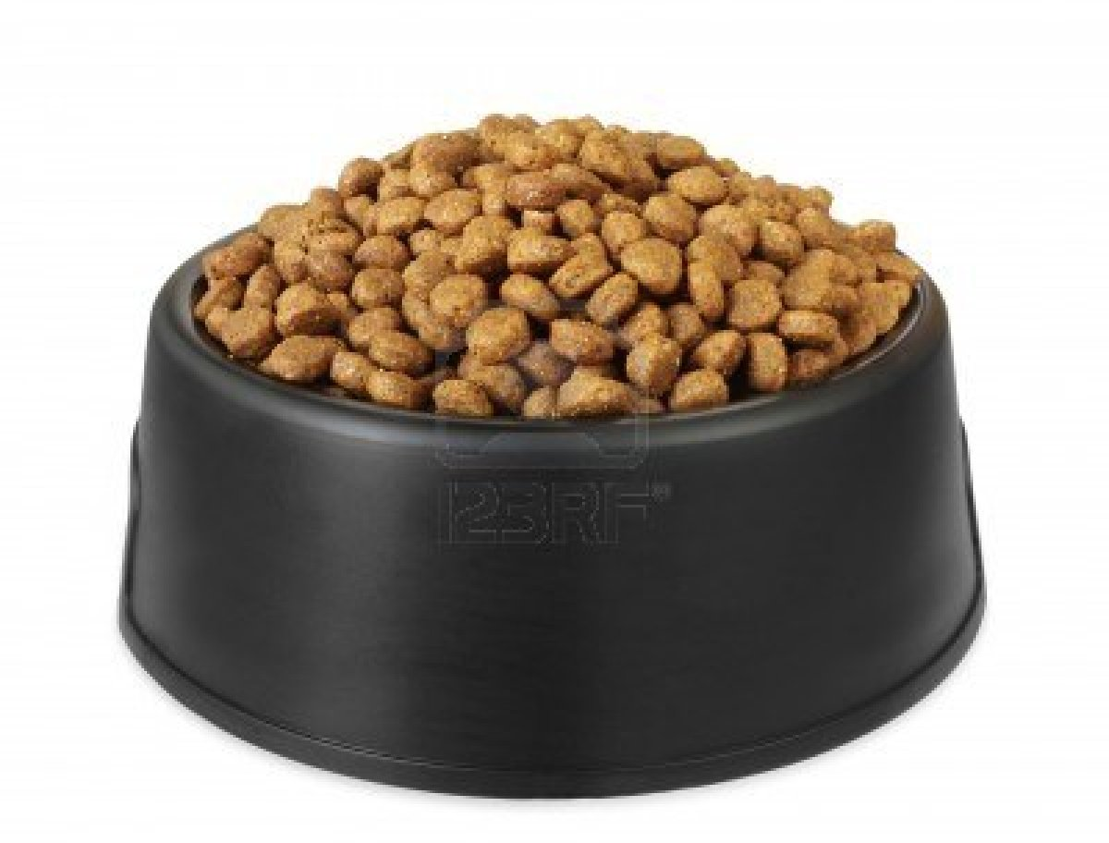
Potential Sin #4:
Crap over Craftsmanship
Potential Sin |  | Virtue
Velocity | Over | Quality

Slide 29
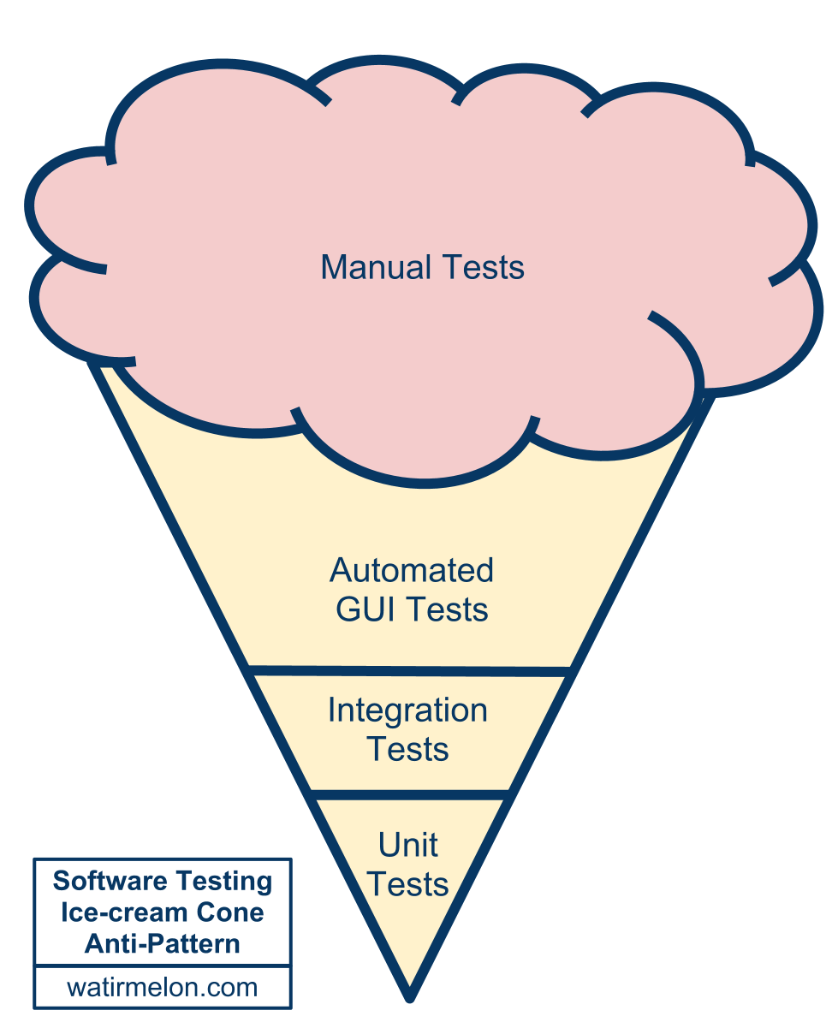
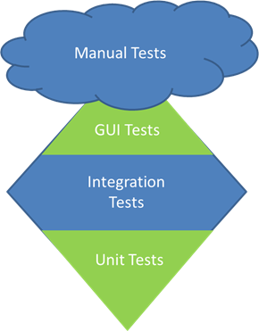
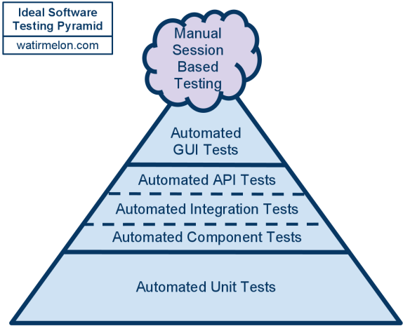
Potential Sin #4:
Crap over Craftsmanship
Potential Sin |  | Virtue
Testing quality in | Over | Building quality in

Slide 30
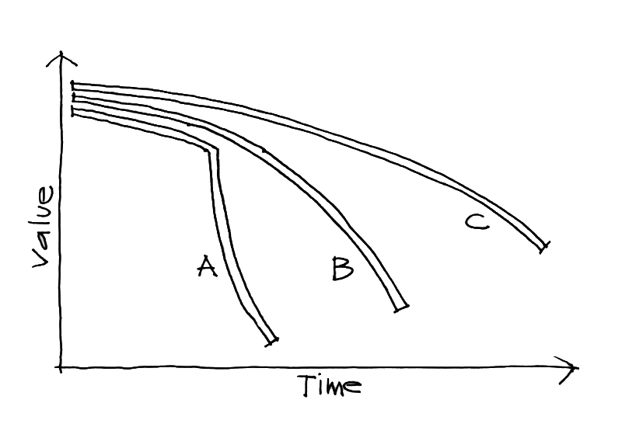
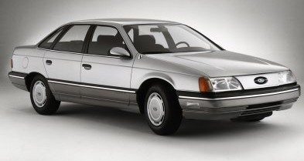
Potential Sin #4:
Crap over Craftsmanship
Potential Sin |  | Virtue
Crap on Time | Over | Impact of Delay

Slide 31
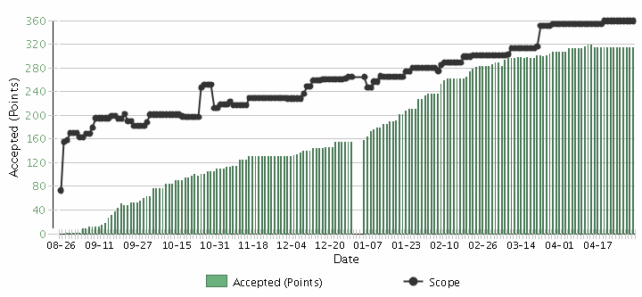
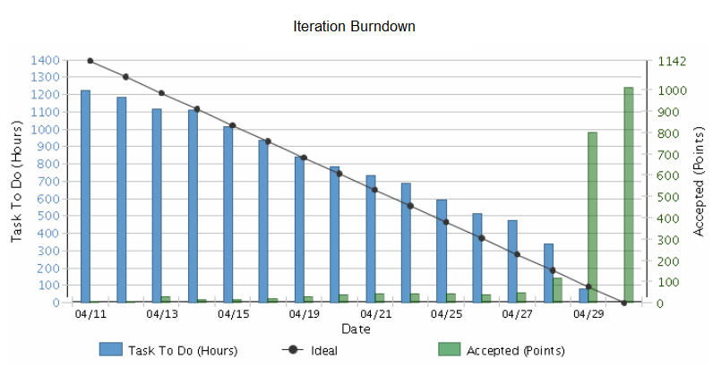
Potential Sin #5
Potential Sin |  | Virtue
Iterations | Over | Releases

Slide 32


Potential Sin #5:
Iterations over Releases
Potential Sin |  | Virtue
Commitment | Over | Focus on Value

Slide 33
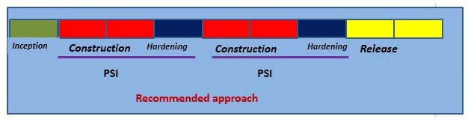
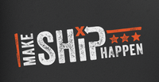
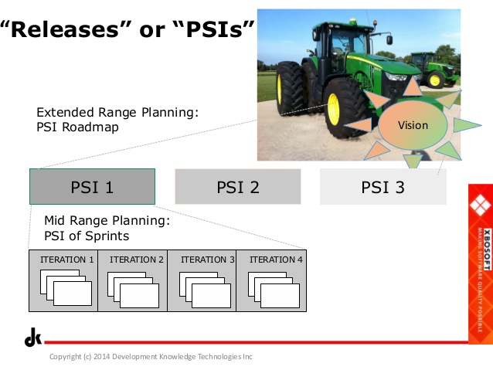
Potential Sin #5:
Iterations over Releases
Potential Sin |  | Virtue
Potentially Shippable Increments (PSIs) | Over | Releases

Slide 34
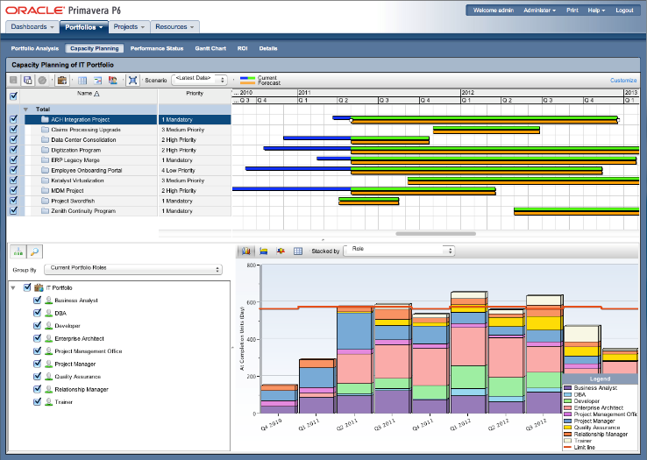
Potential Sin #5:
Iterations over Releases
Potential Sin |  | Virtue
Capacity planning | Over | Velocity/Throughput planning

Slide 35

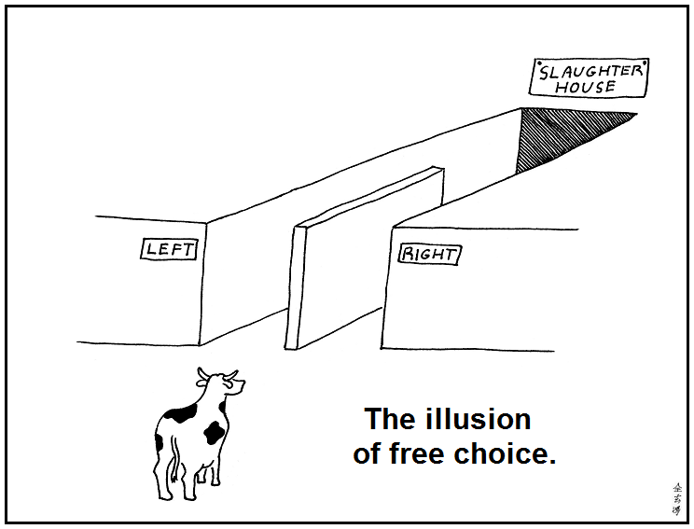
Potential Sin #6
Potential Sin |  | Virtue
Illusion | Over | Reality

Slide 36
Potential Sin #6:
Illusion over Reality
Potential Sin |  | Virtue
Gross velocity | Over | Net velocity
Scope Creep
Velocity
Velocity

Slide 37
Potential Sin #6:
Illusion over Reality
Potential Sin |  | Virtue
Velocity | Over | Quality

Slide 38

Potential Sin #6:
Illusion over Reality
Potential Sin |  | Virtue
Estimation | Over | Forecasting
Scope Creep
Velocity

Slide 39
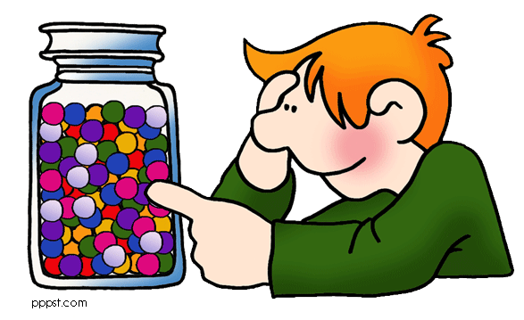
Potential Sin #6:
Illusion over Reality
Potential Sin |  | Virtue
Microestimation | Over | Macroestimation

Slide 40
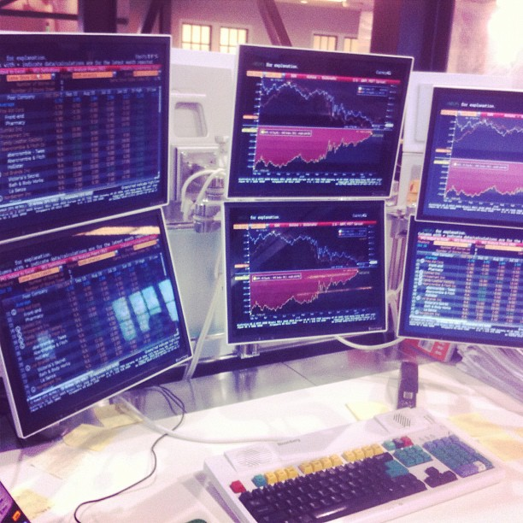
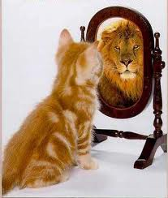
Potential Sin #6:
Illusion over Reality
Potential Sin |  | Virtue
Vanity metrics | Over | Decision metrics

Slide 41

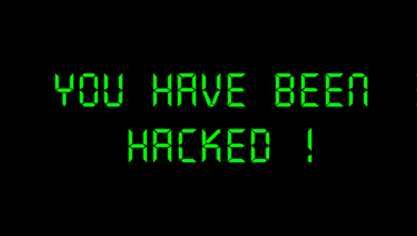
Potential Sin #7
Potential Sin |  | Virtue
Organizational Hacks | Over | Leadership

Slide 42
Potential Sin #7:
Organizational Hacks over Leadership
Potential Sin |  | Virtue
Controlling inputs | Over | Controlling outputs/outcomes
Processes
Inputs
Inputs
Inputs
Processes
Inputs
Inputs
Inputs
Outputs
Outcomes
Micromanagement
Agile Leadership

Slide 43

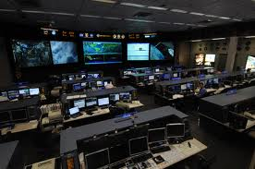
Potential Sin #7:
Organizational Hacks over Leadership
Potential Sin |  | Virtue
Micromanagement | Over | Macromanagement

Slide 44
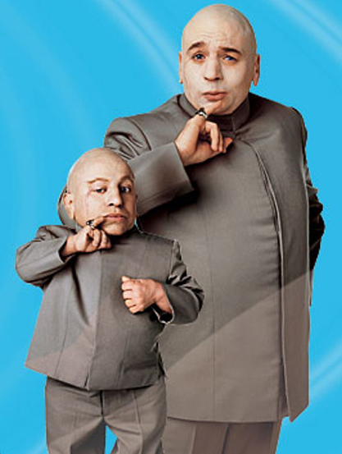

Potential Sin #7:
Organizational Hacks over Leadership
Potential Sin |  | Virtue
Mini-Me | Over | Diversity

Slide 45
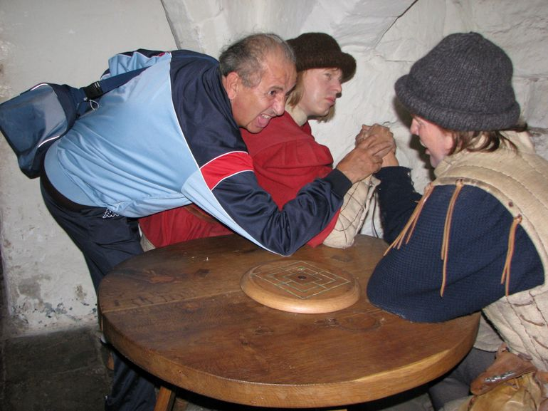
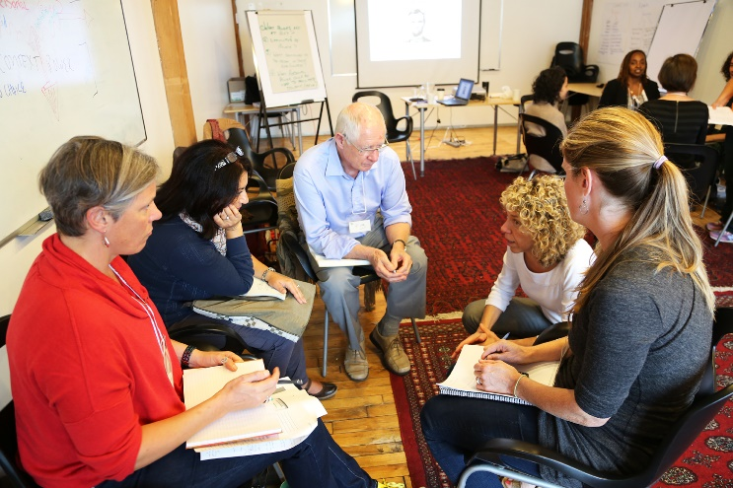
Potential Sin #7:
Organizational Hacks over Leadership
Potential Sin |  | Virtue
Taking sides | Over | Serving the whole team

Slide 46


Potential Sin #7:
Organizational Hacks over Leadership
Potential Sin |  | Virtue
Meetings and Ceremonies | Over | Actions & Resolutions

Slide 47

Potential Sin #7:
Organizational Hacks over Leadership
Potential Sin |  | Virtue
Certification | Over | Qualification

Slide 48
The Sinner Summary
Scaling Processes and Tools | Over | Scaling Mindset
Status | Over | Flow of Value
Stories | Over | Strategy
Crap | Over | Craftsmanship
Iterations | Over | Releases
Illusion | Over | Reality
Organizational Hacks | Over | Leadership

Slide 49
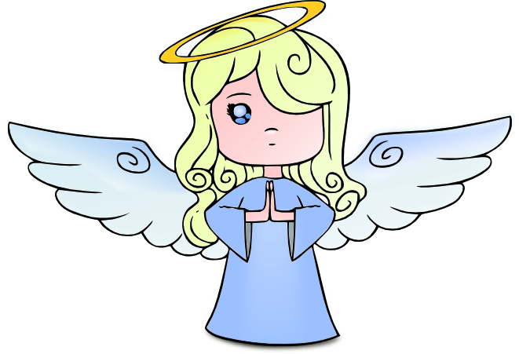
The Virtuous Path
Use Retrospectives
Improve Incrementally
1-2 Items
Get Coaching as needed

Slide 50
Contact
Todd Little
  toddelittle@gmail.com
  www.toddlittleweb.com
  www.accelinnova.com
  www.linkedin.com/in/toddelittle/en
  @toddelittle

Slide 51
Thank you!
Questions?

