Slide 1
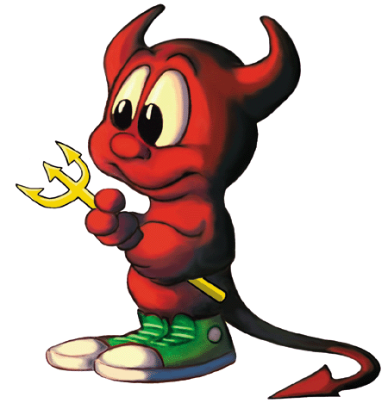
7 Sins of Scrum and other Agile Anti-Patterns
Todd Little
VP Product Development
September 2015
September 2015

Slide 2
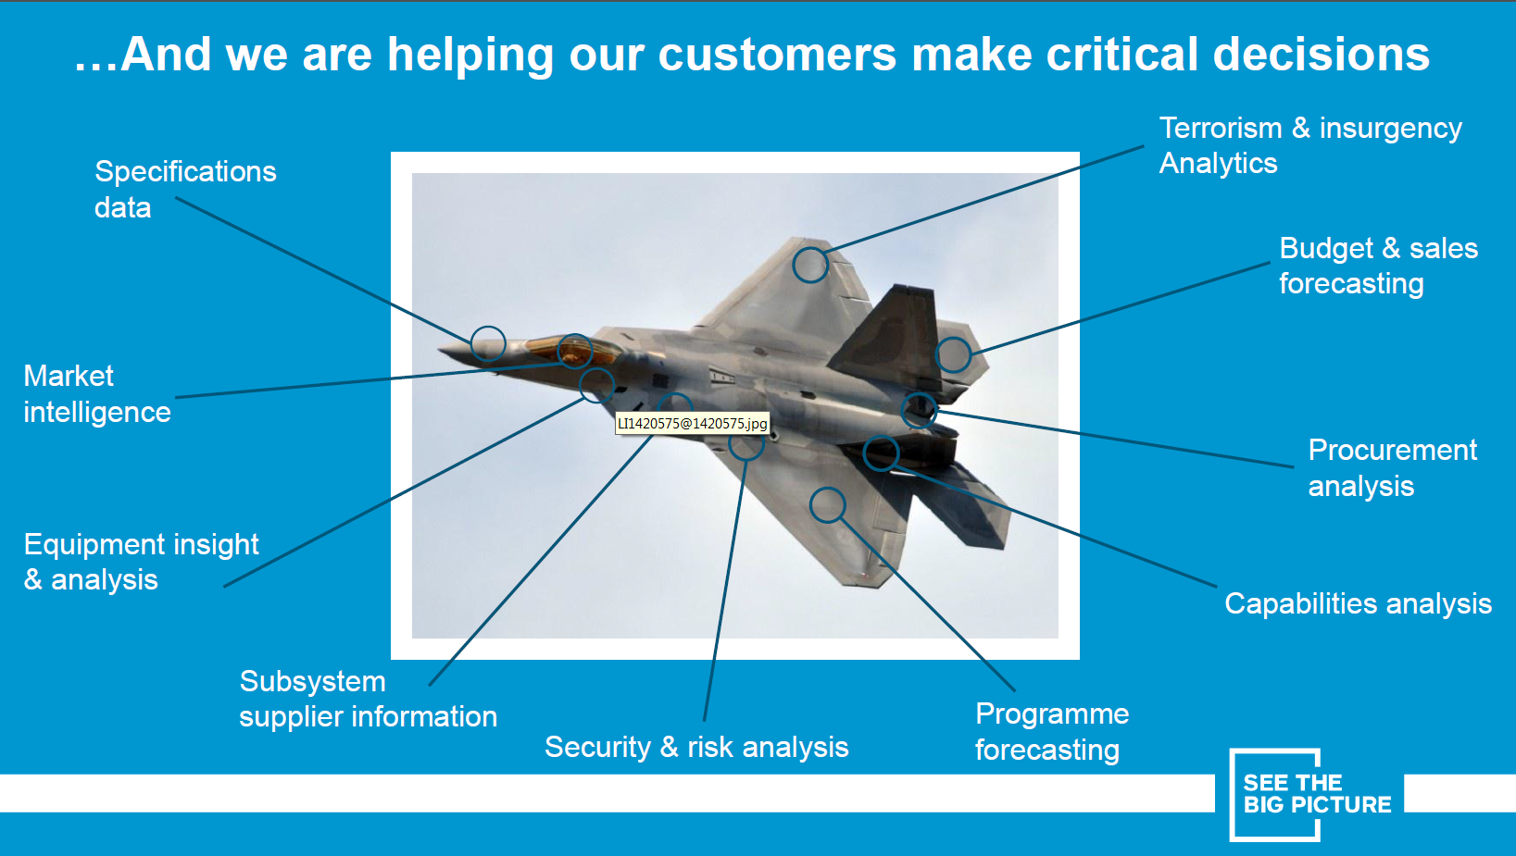
About IHS

Slide 3

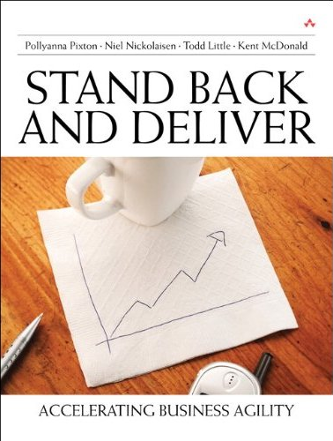
About Todd
Chemical & Petroleum Engineer
30+ Years in Software Development
Co-founder of Agile Development Conference 2003 (Salt Lake City)
Conference Chair
  2004 (Salt Lake City)
  2005 (Denver)
  2006 (Minneapolis)
  2011 (Salt Lake City)
Agile Alliance Board
Co-founder and past President of Agile Leadership Network

Slide 4

Disclaimer
!7
!Sins
!Scrum

Slide 5
Agile Manifesto
We are uncovering better ways of developing software by doing it and helping others do it. Through this work we have come to value:
Individuals and interactions | over | processes and tools
Working software | over | comprehensive documentation
Customer collaboration | over | contract negotiation
Responding to change | over | following a plan
That is, while there is value in the items on the right, we value the items on the left more.

Slide 6
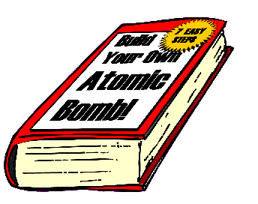
Antipatterns
Jim Coplien: “An anti-pattern is something that looks like a good idea, but which backfires badly when applied.”

Slide 7
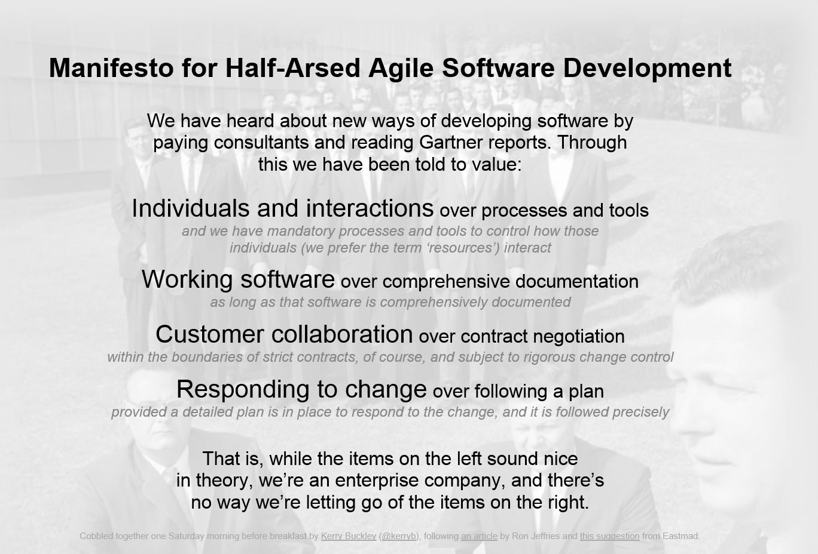

Slide 8
Auditor Manifesto
We are uncovering better ways of auditing software development by forcing others do it how we tell them. Through this work we have come to value:
Processes and tools | over | individuals and interactions
Comprehensive documentation | over | working software
Contract negotiation | over | customer collaboration
Following a plan | over | responding to change
That is, while there may be value in the items on the right, we have chosen to ignore them as they are difficult to audit. We only care about the items on the left and we will make sure that you do too!

Slide 9
Sinner’s Manifesto
We think we know what we are doing. It looks like a good idea or someone told us that is the best way to do it so we’ll do more of it. Through this we may have accidentally come to value:
Potential Sin | Over | Virtue
The sin is not always a bad idea. There may be significant value in moderation, but in excess it can be an anti-pattern. The path the redemption is to look to the virtue.

Slide 10


Sample Sin
Potential Sin |  | Virtue
 | Over

Slide 11
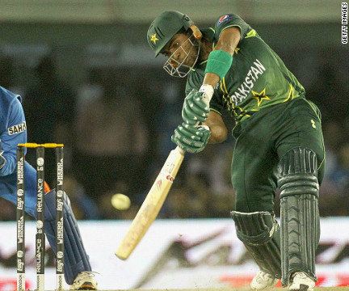
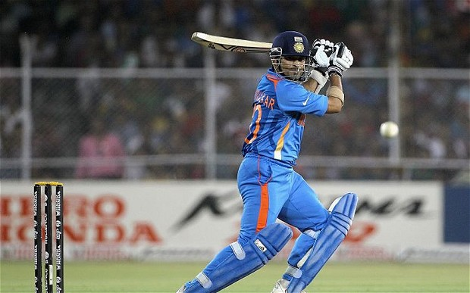
Sample Sin
Potential Sin |  | Virtue
 | Over

Slide 12
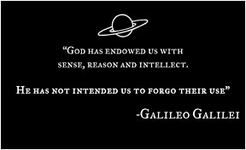

Heresy

Slide 13


Potential Sin #1
Potential Sin |  | Virtue
Processes and Tools | Over | Individuals and Interactions

Slide 14
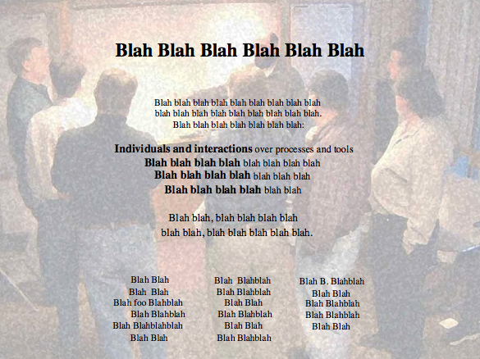
Alexey Krivitsky

Slide 15
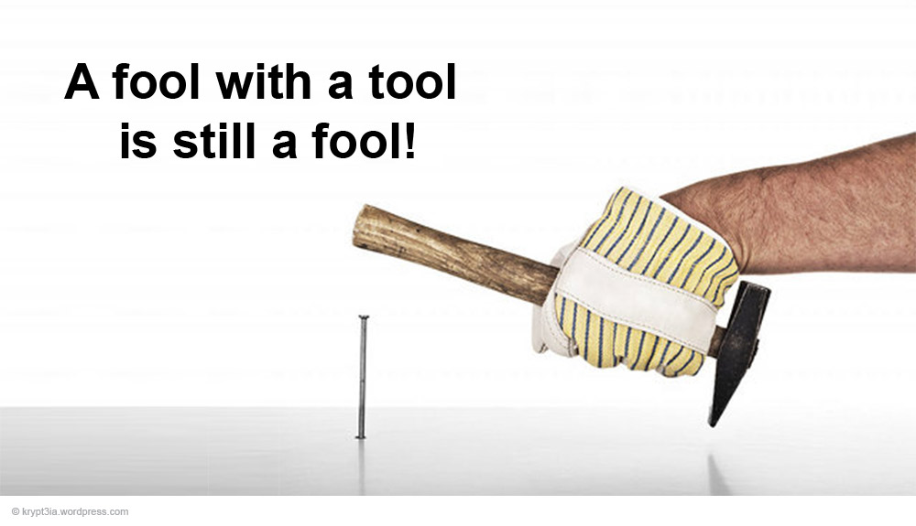
Potential Sin #1:
Processes and Tools Over Individuals and Interactions
Potential Sin |  | Virtue
Agile is the Tool | Over | The tools support agility

Slide 16

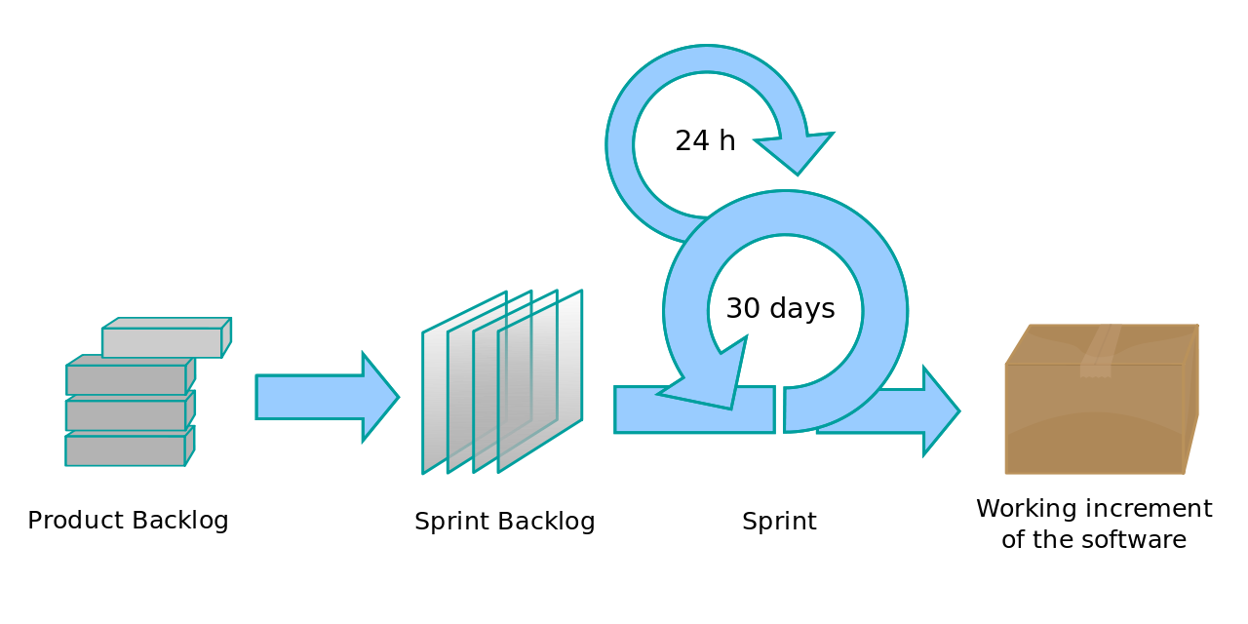
Potential Sin #1:
Processes and Tools Over Individuals and Interactions
Potential Sin |  | Virtue
Agile is a process | Over | Agility is a mindset

Slide 17
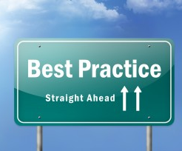
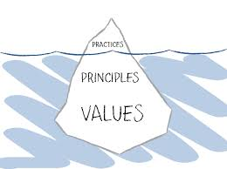
Potential Sin #1:
Processes and Tools Over Individuals and Interactions
Potential Sin |  | Virtue
Best Practices | Over | Principles and Values

Slide 18

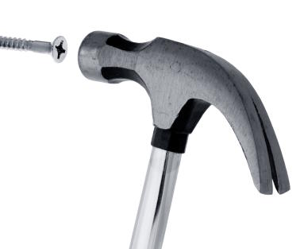
Potential Sin #1:
Processes and Tools Over Individuals and Interactions
Potential Sin |  | Virtue
One size fits all | Over | Context

Slide 19


Potential Sin #1:
Processes and Tools Over Individuals and Interactions
Potential Sin |  | Virtue
Collaboration | Over | Shared Ownership

Slide 20


Potential Sin #2
Potential Sin |  | Virtue
Status | Over | Flow of Value

Slide 21

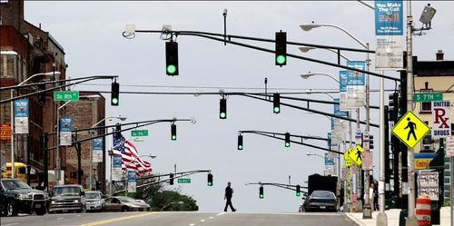
Potential Sin #2:
Status over Flow of Value
Potential Sin |  | Virtue
Showing Progress | Over | Delivering Value

Slide 22


Potential Sin #2:
Status over Flow of Value
Potential Sin |  | Virtue
Checking Boxes | Over | Learning and Adapting
Feedback Loop

Slide 23
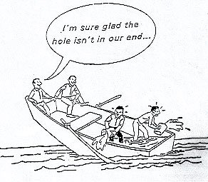

Potential Sin #2:
Status over Flow of Value
Potential Sin |  | Virtue
My part is done | Over | Team is done

Slide 24


Potential Sin #2:
Status over Flow of Value
Potential Sin |  | Virtue
Starting | Over | Finishing

Slide 25

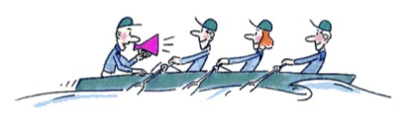
Potential Sin #2:
Status over Flow of Value
Potential Sin |  | Virtue
Individual Utilization | Over | Team Throughput

Slide 26

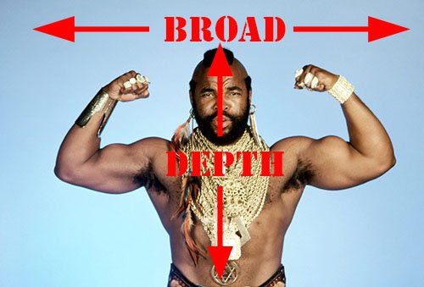
Potential Sin #2:
Status over Flow of Value
Potential Sin |  | Virtue
Specialization | Over | Generalization

Slide 27

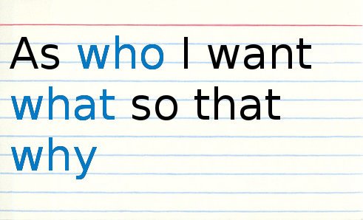
Potential Sin #3
Potential Sin |  | Virtue
Stories | Over | Strategy

Slide 28

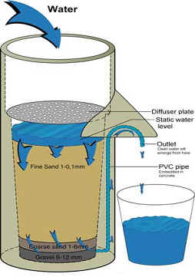
Potential Sin #3:
Stories over Strategy
Potential Sin |  | Virtue
Buckets | Over | Filters

Slide 29
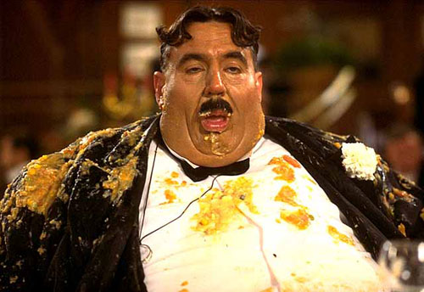
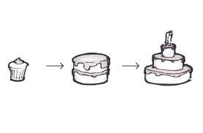
Potential Sin #3:
Stories over Strategy
Potential Sin |  | Virtue
I want it all (Gluttony) | Over | Minimum Viable Product

Slide 30
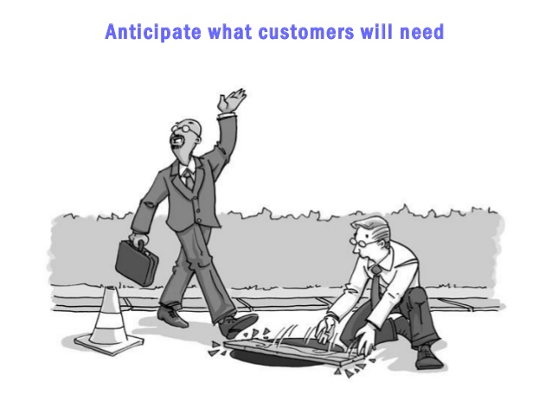

Potential Sin #3:
Stories over Strategy
Potential Sin |  | Virtue
Listening to Customers | Over | Learning what they really need

Slide 31
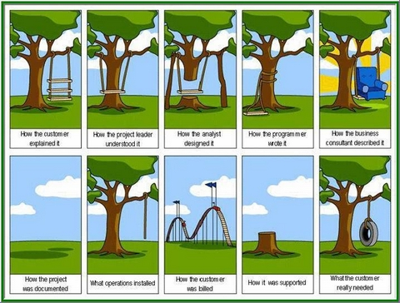
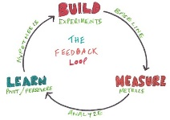
Potential Sin #3:
Stories over Strategy
Potential Sin |  | Virtue
I know what they need | Over | Validating hypothesis

Slide 32

Potential Sin #3:
Stories over Strategy
Potential Sin |  | Virtue
Tasks | Over | Stories

Slide 33

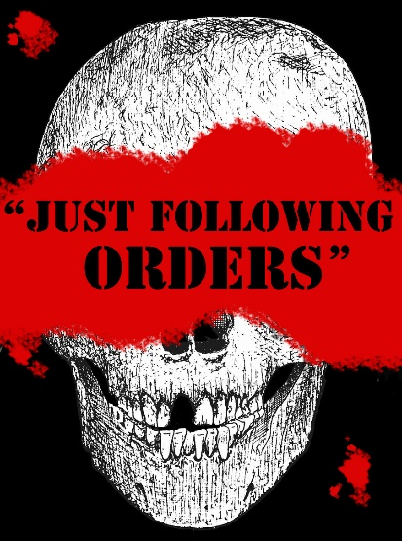
Potential Sin #3:
Stories over Strategy
Potential Sin |  | Virtue
Following orders | Over | Understanding Why

Slide 34
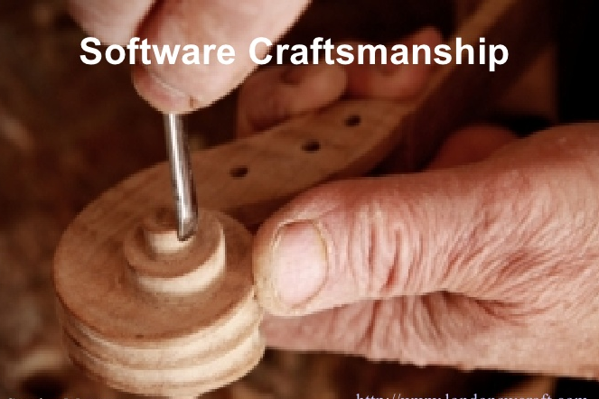

Potential Sin #4
Potential Sin |  | Virtue
Crap | Over | Craftsmanship

Slide 35
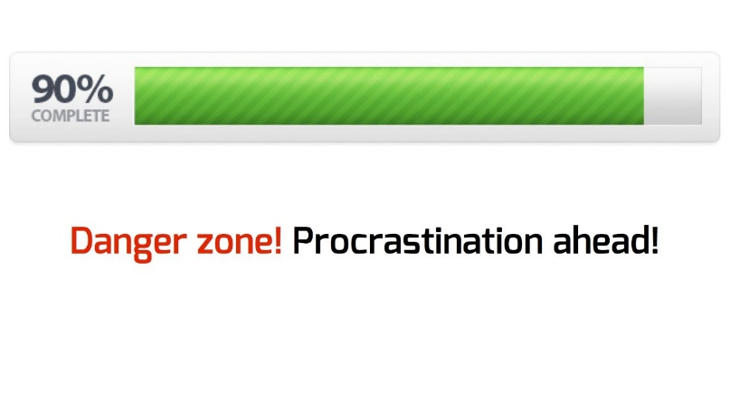
Potential Sin #4:
Crap over Craftsmanship
Potential Sin |  | Virtue
Almost done | Over | Really done

Slide 36
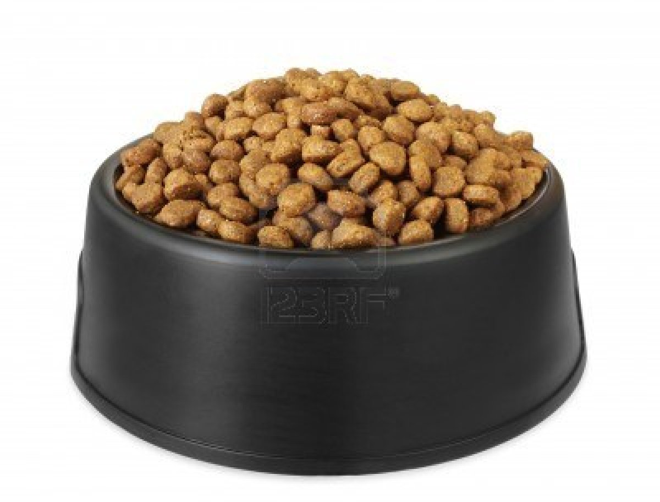
Potential Sin #4:
Crap over Craftsmanship
Potential Sin |  | Virtue
Velocity | Over | Quality

Slide 37
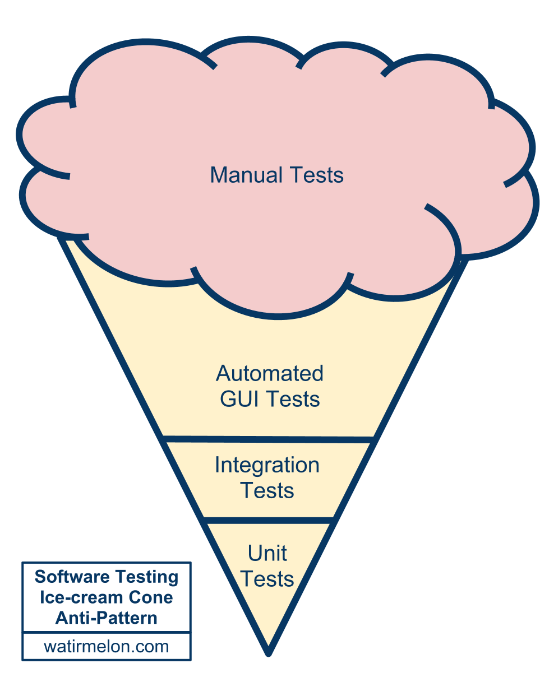
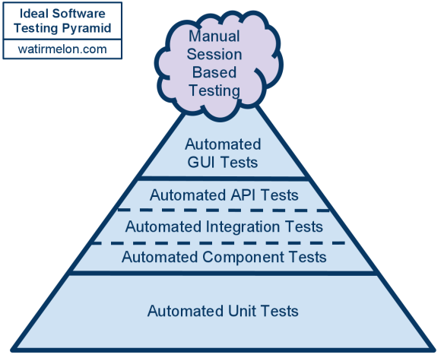
Potential Sin #4:
Crap over Craftsmanship
Potential Sin |  | Virtue
Testing quality in | Over | Building quality in

Slide 38
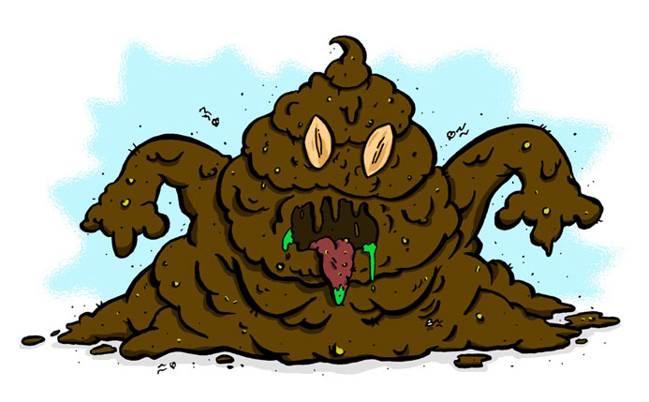
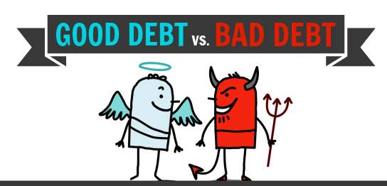
Potential Sin #4:
Crap over Craftsmanship
Potential Sin |  | Virtue
Technical debt is evil | Over | Technical debt is debt

Slide 39
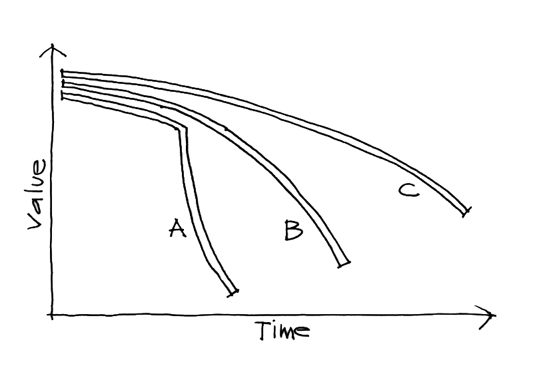
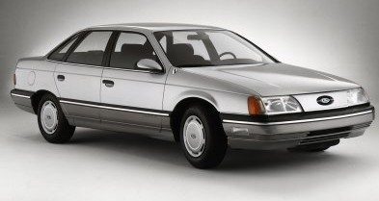
Potential Sin #4:
Crap over Craftsmanship
Potential Sin |  | Virtue
Cost of Crap | Over | Cost of Delay

Slide 40
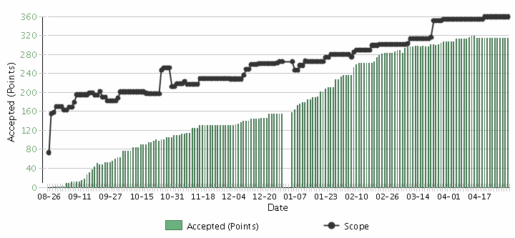
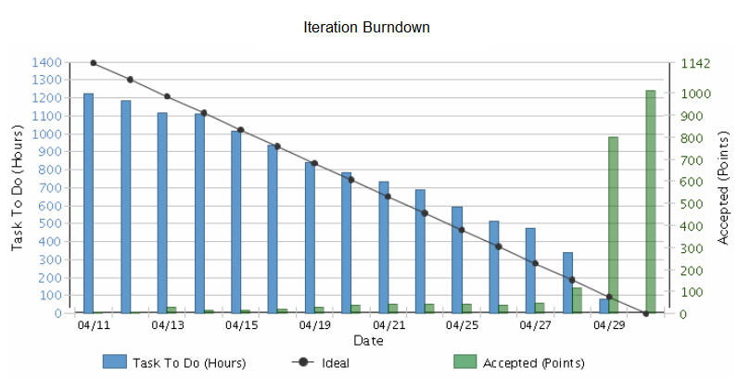
Potential Sin #5
Potential Sin |  | Virtue
Iterations | Over | Releases

Slide 41
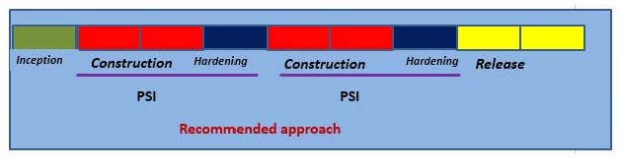
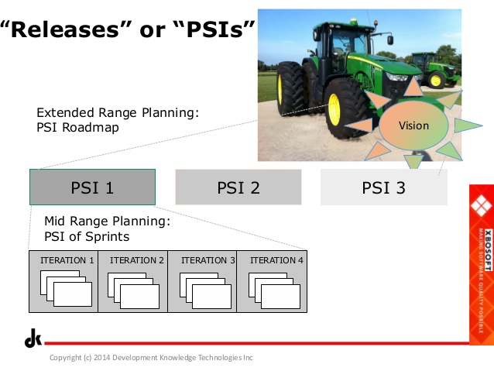
Potential Sin #5:
Iterations over Releases
Potential Sin |  | Virtue
Potentially Shippable Increments (PSIs) | Over | Releases

Slide 42


Potential Sin #5:
Iterations over Releases
Potential Sin |  | Virtue
Commitment | Over | Focus on Value

Slide 43
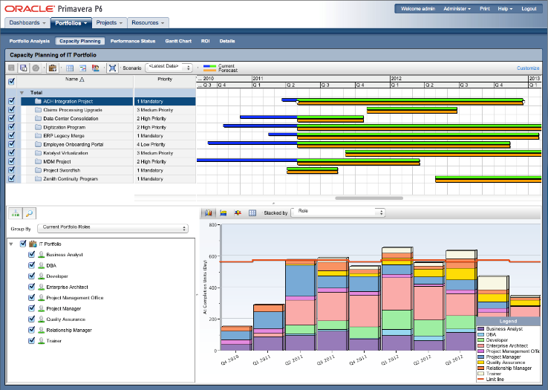
Potential Sin #5:
Iterations over Releases
Potential Sin |  | Virtue
Capacity planning | Over | Velocity planning

Slide 44

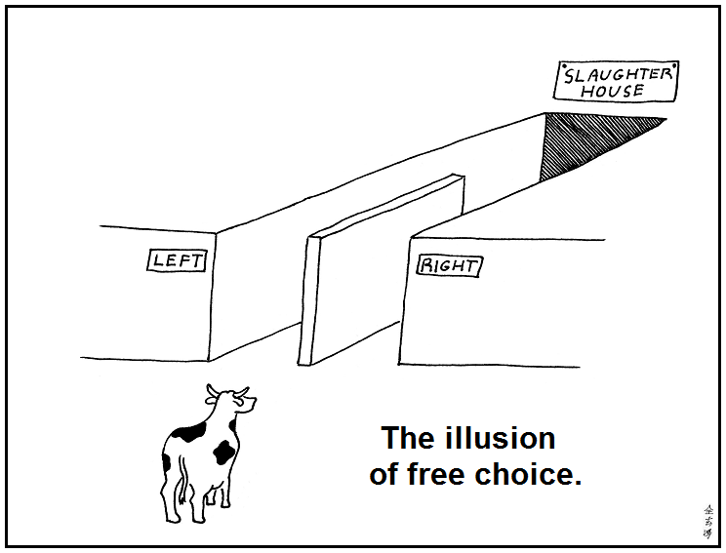
Potential Sin #6
Potential Sin |  | Virtue
Illusion | Over | Reality

Slide 45
Potential Sin #6:
Illusion over Reality
Potential Sin |  | Virtue
Gross velocity | Over | Net velocity
Scope Creep
Velocity
Velocity

Slide 46
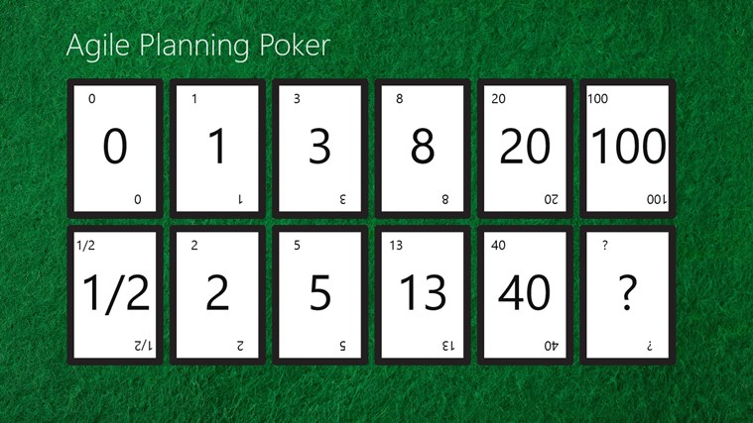
Potential Sin #6:
Illusion over Reality
Potential Sin |  | Virtue
Unpointed stories | Over | Best estimate

Slide 47
Potential Sin #6:
Illusion over Reality
Potential Sin |  | Virtue
Velocity | Over | Quality

Slide 48

Potential Sin #6:
Illusion over Reality
Potential Sin |  | Virtue
Estimation | Over | Forecasting
Scope Creep
Velocity

Slide 49
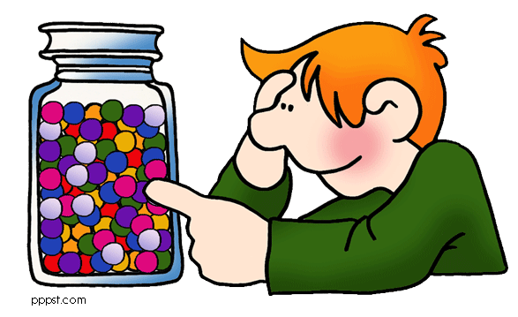
Potential Sin #6:
Illusion over Reality
Potential Sin |  | Virtue
Microestimation | Over | Macroestimation

Slide 50
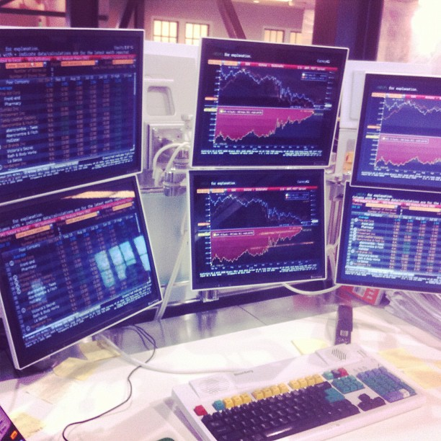
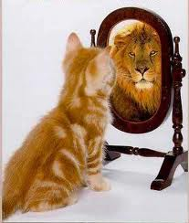
Potential Sin #6:
Illusion over Reality
Potential Sin |  | Virtue
Vanity metrics | Over | Decision metrics

Slide 51

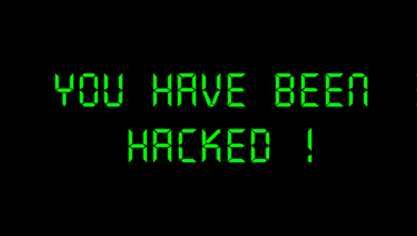
Potential Sin #7
Potential Sin |  | Virtue
Organizational Hacks | Over | Leadership

Slide 52
Potential Sin #7:
Organizational Hacks over Leadership
Potential Sin |  | Virtue
Controlling inputs | Over | Controlling outputs/outcomes
Processes
Inputs
Inputs
Inputs
Processes
Inputs
Inputs
Inputs
Outputs
Micromanagement
Agile Leadership

Slide 53

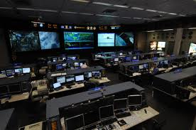
Potential Sin #7:
Organizational Hacks over Leadership
Potential Sin |  | Virtue
Micromanagement | Over | Macromanagement

Slide 54
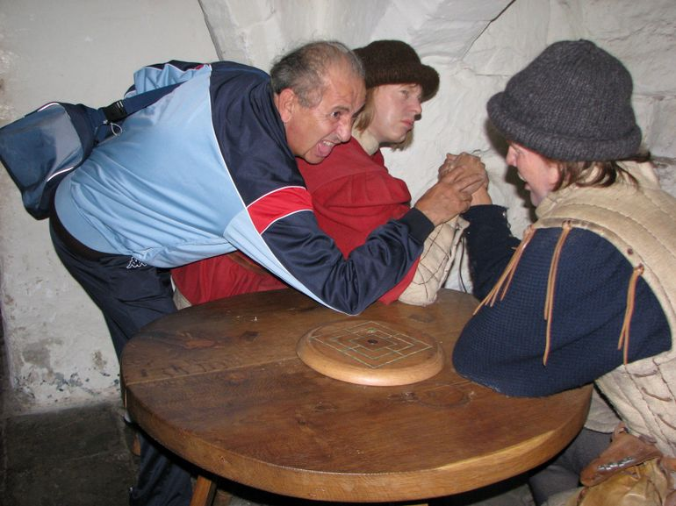
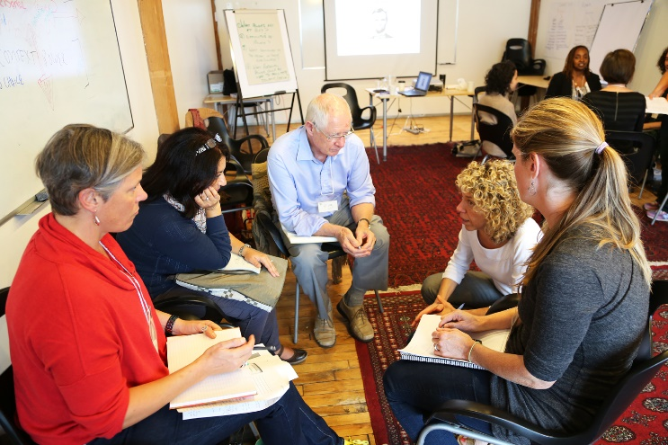
Potential Sin #7:
Organizational Hacks over Leadership
Potential Sin |  | Virtue
Taking sides | Over | Serving the whole team

Slide 55


Potential Sin #7:
Organizational Hacks over Leadership
Potential Sin |  | Virtue
Meetings | Over | Actions & Resolutions

Slide 56

Potential Sin #7:
Organizational Hacks over Leadership
Potential Sin |  | Virtue
Certification | Over | Qualification

Slide 57
The Sinner Summary
Processes and Tools | Over | Individuals and Interactions
Status | Over | Flow of Value
Stories | Over | Strategy
Crap | Over | Craftsmanship
Iterations | Over | Releases
Illusion | Over | Reality
Organizational Hacks | Over | Leadership

Slide 58

The Virtuous Path
Use Retrospectives
Improve Incrementally
1-2 Items
Get Coaching as needed

Slide 59
Contact
Todd Little
  todd.little@ihs.com
  toddelittle@gmail.com
  www.toddlittleweb.com
  www.accelinnova.com
  www.linkedin.com/in/toddelittle/en

Slide 60
Thank you!
Questions?

