Slide 1



Mythbusting Software Estimation
Todd Little
VP Product Development
IHS
Notes:
Todd comes from Oil and Gas exploration, a business that deals with risk in many facets. Chris comes from investment banking, another area that has made it important to understand and comprehend issues associated with risk. Both Todd and Chris have spent their careers developing software in these industries.

Slide 2



Test First

Slide 3
#1: Estimation challenges are well understood by General Management, Project Management, and Teams and it is normal to be able to estimate projects within 25% accuracy.

Slide 4
#2: Estimation accuracy significantly improves as the project progresses

Slide 5
#3: Estimations are frequently impacted by biases and these biases can be significant.

Slide 6
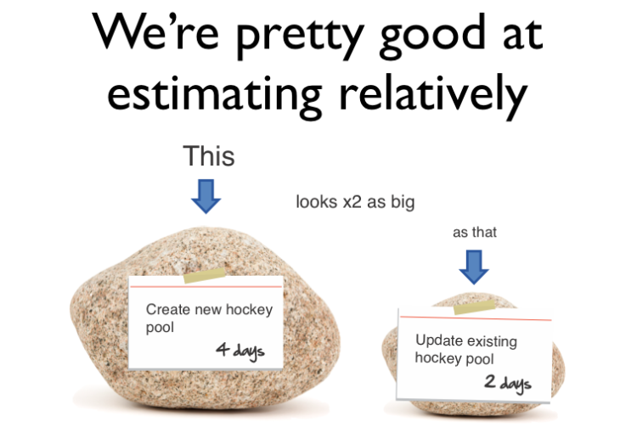
#4: We’re pretty good at estimating things relatively

Slide 7
#5: Velocity/Throughput is a good tool for adjusting estimates.

Slide 8
#6: We’re a bit behind, but we’ll make it up in testing since most of our uncertainty was in the features.

Slide 9
#7: Scope Creep is a major source of estimation error.

Slide 10
#8: Having more estimators, even if they are not experts, improves estimation accuracy

Slide 11
#9: Project success is determined by on-time delivery

Slide 12
#10: Estimation is waste

Slide 13
#1: Estimation challenges are well understood by General Management, Project Management, and Teams and it is normal to be able to estimate projects within 25% accuracy.

Slide 14




Managing the Coming Storm
Inside the Cyclone
Project Kickoff
When will we get the requirements?
All in good time, my little pretty, all in good time
But I guess it doesn't matter anyway
Just give me your estimates by this afternoon
Team Unity
Not so fast! Not so fast! ... I'll have to give the matter a little thought. Go away and come back tomorrow
No, we need something today!
Ok then, it will take 2 years.
No, we need it sooner.
Doesn't anybody believe me?
I already promised the customer it will be out in 6 months
You're a very bad man!
Notes:
We look at a typical software project…..

Slide 15


We’re not in Kansas Anymore
Developer Hero
I may not come out alive, but I'm goin' in there!
Reorg
The Great and Powerful Oz has got matters well in hand.
My! People come and go so quickly here!
Testing
"Hee hee hee ha ha! Going so soon? I wouldn't hear of it! Why, my little party's just beginning!

Slide 16
Why is Software Late?
Genuchten 1991 IEEE
General Manager | Project Manager | Item
1 | 10 | Insufficient front end planning
2 | 3 | Unrealistic project plan
3 | 8 | Project scope underestimated
4 | 1 | Customer/management changes
5 | 14 | Insufficient contingency planning
6 | 13 | Inability to track progress
7 | 5 | Inability to track problems early
8 | 9 | Insufficient Number of checkpoints
9 | 4 | Staffing problems
10 | 2 | Technical complexity
11 | 6 | Priority Shifts
12 | 11 | No commitment by personnel to plan
13 | 12 | Uncooperative support groups
14 | 7 | Sinking team spirit
15 | 15 | Unqualified project personnel

Slide 17

The Context of Feedback

Slide 18
Why is Software Late?
Genuchten 1991 IEEE
General Manager | Project Manager | Item
H | H | Customer/management changes
H | H | Unrealistic project plan
M | H | Staffing problems
L | H | Overall complexity
H | L | Insufficient front end planning
Notes:
The project manager is much closer to the actual work being done and so I tend to think their response is closer to reality. What is of particular interest is where there is a discrepancy between the General Manager and the Project Manager.
1 4 Customer/management changes
PM: They were constantly changing their minds GM:OK, so we changed a few things once in a while
2 10 Technical complexity
PM: We were using new technology and had to discover all the limitations GM: I just to them to make it look like that cool demo I saw
3 2 Unrealistic project plan
PM: We told them it would take longer GM: I had to push them so that they would be serious
4 9 Staffing problems
PM: We couldn’t get the people we needed GM: I gave them everyone I had available
5 7 Inability to track problems early
PM/GM: agree --- We didn’t know what we didn’t know
6 11 Priority Shifts
PM: They were constantly changing their minds GM: We didn’t change that much
7 14 Sinking team spirit
PM: The team felt overworked and underappreciated GM: We’ve got a great team. What spirit they have
8 3 Project scope underestimated
PM: I didn’t really feel that we underestimated it. We told them it would be hard GM: We really didn’t think it was such a big project
9 8 Insufficient Number of checkpoints
PM/GM agree – it would have been good to have better visibility into what was going on
10 1 Insufficient front end planning
PM: We had a plan, but they didn’t like the answer and kept changing their mind GM: It all would have been fine if we could have just planned better
11 12 No commitment by personnel to plan
PM/GM agree – team was willing to commit
12 13 Uncooperative support groups
PM/GM agree – support groups were willing to help
13 6 Inability to track progress
PM: We had pretty good tracking GM: I wish I had better visibility into what was going on so I could have done something
14 5 Insufficient contingency planning
PM: We had decent contingency planning, we just weren’t able to do anything GM: We just needed better planning
15 15 Unqualified project personnel
PM/GM agree – people are our most important assets

Slide 19
Negotiation Bias
"It is difficult to get a man to understand something when his salary depends upon his not understanding it.“
        Upton Sinclair:

Slide 20
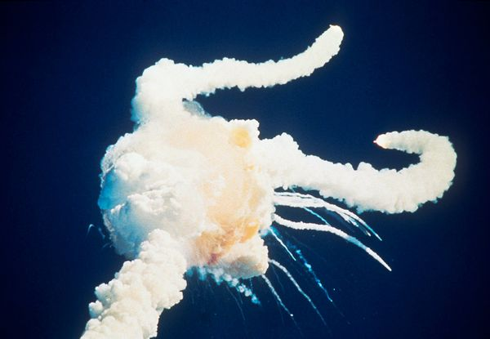
Space Shuttle Challenger
 | Engineers | Management
Probability of loss of life | 1 in 100 | 1 in 100,000
135 Flights
2 Disasters
14 Deaths

Slide 21
IEEE Software, May/June 2006
Notes:
This is from an IEEE Software article that I published in May 2006

Slide 22
Accuracy of Initial Estimate

Slide 23
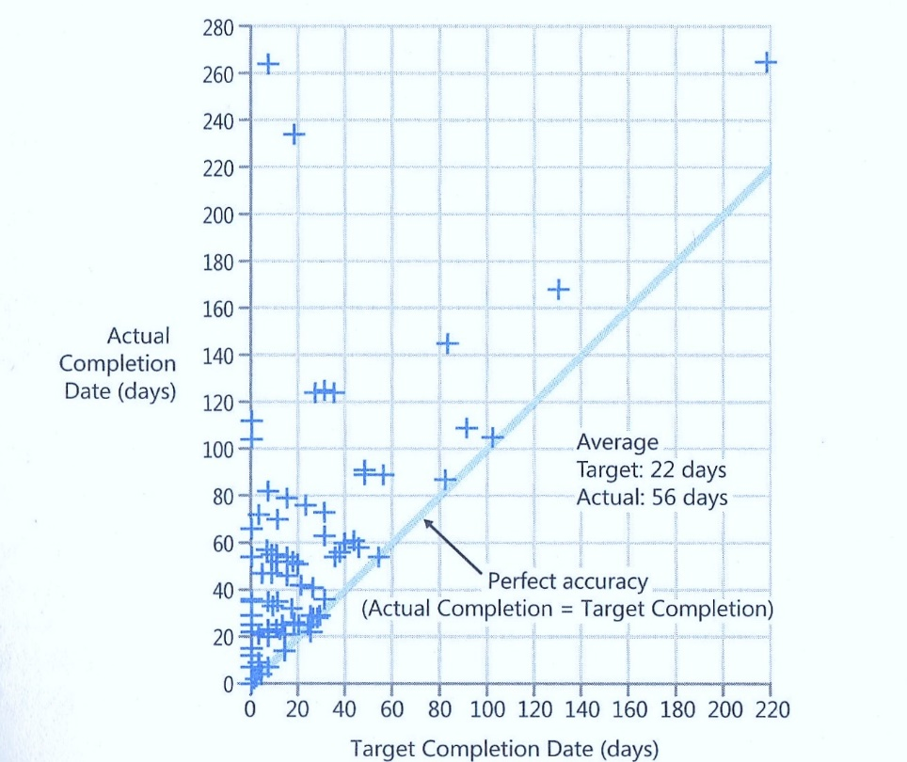
Data From Steve McConnell

Slide 24
Uncertainty
Percentage of Projects
10-20% | Less than or equal to original estimate
50% | Less than 2X original estimate
80-90% | Less than 4X original estimate

Slide 25
Actual vs. Original Estimate

Slide 26
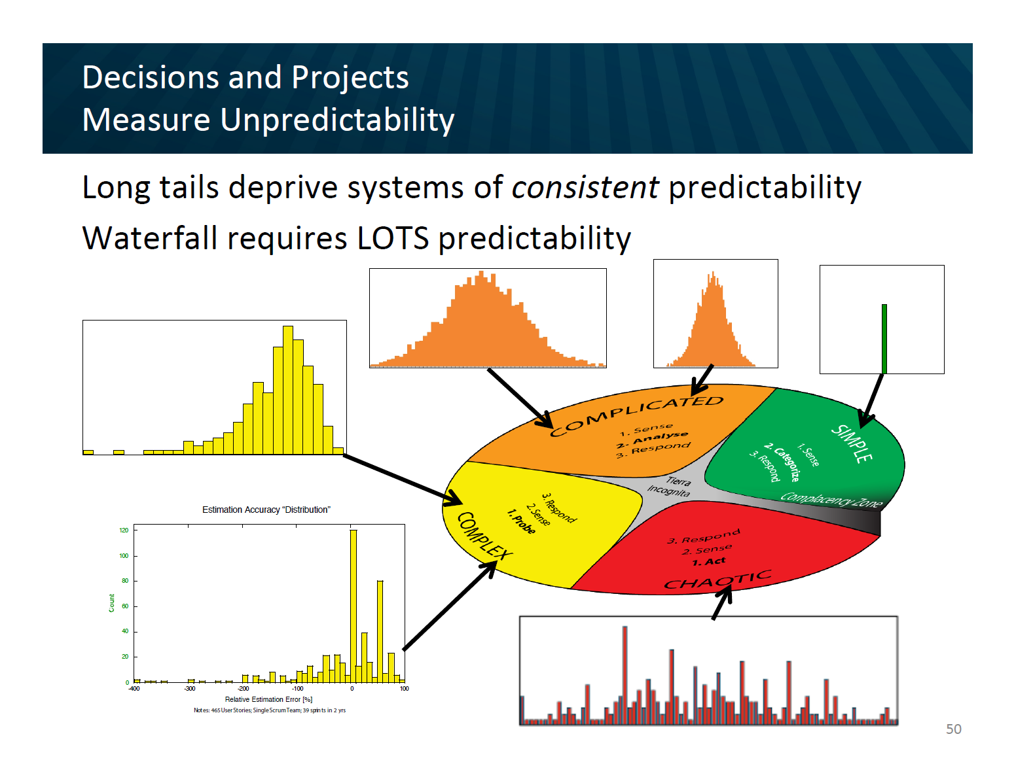
5
John Helm
Agile 2013

Slide 27
Jørgensen 2013
Put software development project for bid on online marketplace vWorker.com
Received 16 bids.
Reduced down to 6 bids from vendors that had high (9.5) client satisfaction.
All 6 bidders went ahead and built the software

Slide 28
Jørgensen 2013
Highest Estimate 8x the Lowest
Actual/Estimate Range: 0.7 – 2.9 (4x)
Actual Performance Range: Worst took 18X the effort of the best

Slide 29
#1: Estimation challenges are well understood by General Management, Project Management, and Teams and it is normal to be able to estimate projects within 25% accuracy.

Slide 30
#2: Estimation accuracy significantly improves as the project progresses

Slide 31
How does Estimation Accuracy Improve Over Time?
4x
Notes:
The conventional wisdom is that estimation gets better as the project progresses. This was first stated by Barry Boehm in COCOMO II, and stated by many authors subsequently, most notably Steve McConnell. At the Feasibility state the uncertainty band is 16X, while at Concept it has narrowed to 4X and by the Requirements it has reduced to 2.25X. This makes a lot of sense.

Slide 32
Landmark Cone of Uncertainty

Slide 33
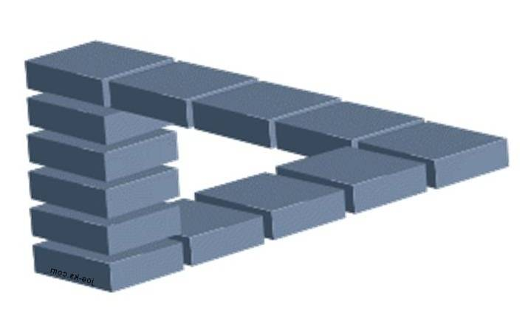
But is Uncertainty Really Reduced?
“Take away an ordinary person’s illusions and you take away happiness at the same time.”
Henrik Ibsen--Villanden

Slide 34

The Real Business Question
How much work do we have left to do and when will we ship?

Slide 35
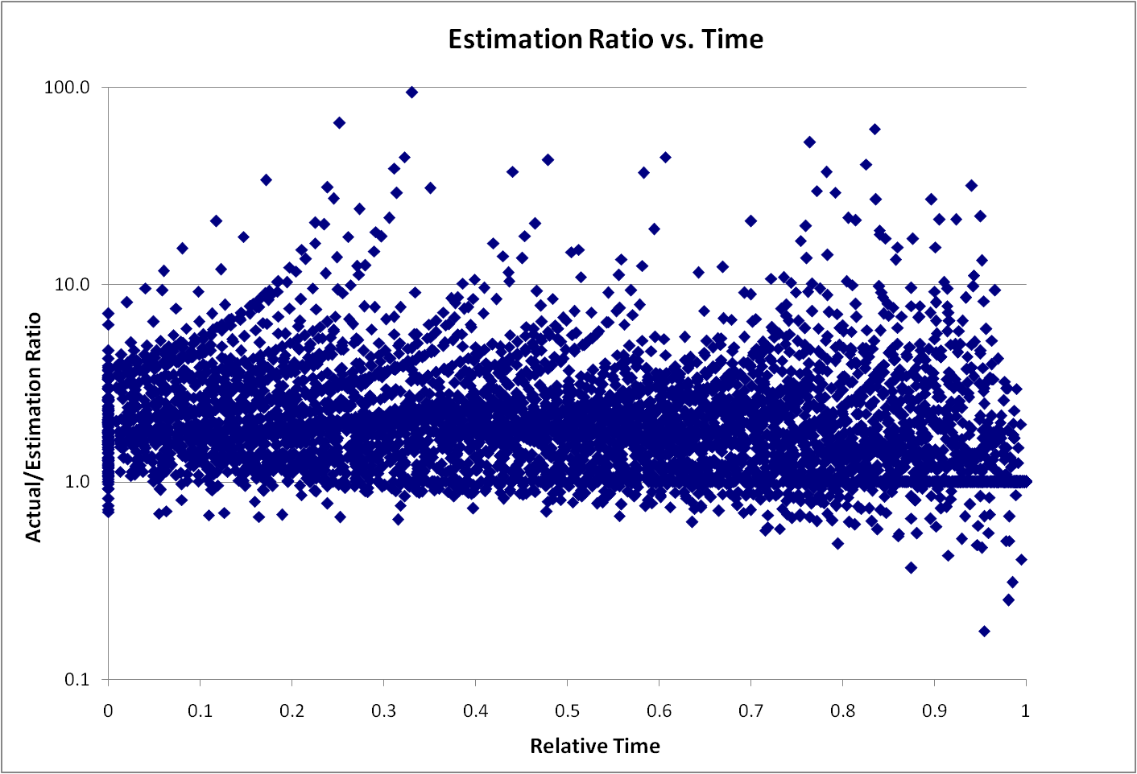
Remaining Uncertainty
4x

Slide 36
Remaining Uncertainty
Story Estimate

Slide 37
#2: Estimation accuracy significantly improves as the project progresses

Slide 38
#3: Estimations are frequently impacted by biases and these biases can be significant.

Slide 39
Optimism Bias

Slide 40
Test 1 (Jørgensen IEEE Software 2008)
Group | Guidance | Result
A | 800
B | 40
C | 4
D | None | 160

Slide 41
Test 1
Group | Guidance | Result
A | 800 | 300
B | 40 | 100
C | 4 | 60
D | None | 160

Slide 42
Test 2
Group | Guidance | Result
A | Minor Extension
B | New Functionality
C | Extension | 50

Slide 43
Test 2
Group | Guidance | Result
A | Minor Extension | 40
B | New Functionality | 80
C | Extension | 50

Slide 44
Test 3
Group | Guidance | Result
A | Future work at stake, efficiency will be measured
B | Control | 100

Slide 45
Test 3
Group | Guidance | Result
A | Future work at stake, efficiency will be measured | 40
B | Control | 100

Slide 46
Understand Bias
"What gets us into trouble is not what we don't know. It's what we know for sure that just ain't so.“
        Mark Twain

Slide 47
#3: Estimations are frequently impacted by biases and these biases can be significant.

Slide 48
#4: We’re pretty good at estimating things relatively

Slide 49

Anchoring

Slide 50
Relative Anchoring
“A” relative to “B” is not symmetric with “B” relative to “A”
Jørgensen IEEE Software March 2013
  Austria’s population is 70% of Hungary’s (Austria relative to Hungary), while Hungary’s population is 80% of Austria’s (Hungary relative to Austria).

Slide 51
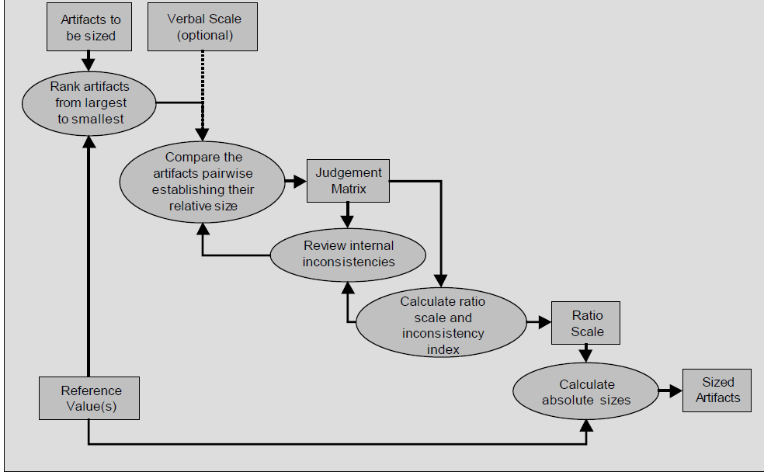
Relative Estimation Studies?
An evaluation of the paired comparisons method for
software sizing
Eduardo Miranda

Slide 52
Relative Sizing - Dimensionality
Low by 4X

Slide 53
#4: We’re pretty good at estimating things relatively

Slide 54
#5: Velocity/Throughput is a good tool for adjusting estimates.

Slide 55
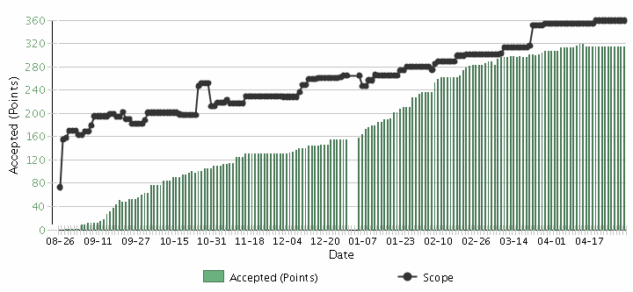
Burnup Chart
Scope Creep
Velocity

Slide 56
Velocity Helps Remove Bias
$\frac{Story Points}{Net Velocity= \frac{Story Points}{Iteration}}=Iterations$

Slide 57
But Velocity is not a Silver Bullet
Story Estimate

Slide 58
#5: Velocity is a good tool for adjusting estimates.

Slide 59
#6: We’re a bit behind, but we’ll make it up in testing since most of our uncertainty was in the features.

Slide 60
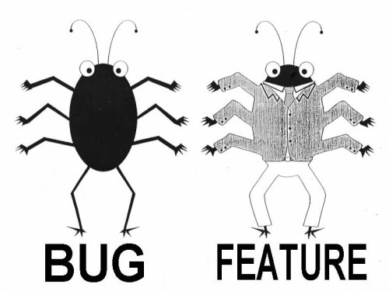
Lan Cao - Estimating Agile Software Project Effort: An Empirical Study
2X
Uncertainty
Notes:
Lessons learned: If uncertainty is high, work on it earlier. Reduce Technical Debt—Get to potentially shippable at each iteration. Finding and fixing the last bugs has high uncertainty – plan on there being uncertainty.

Slide 61
#6: We’re a bit behind, but we’ll make it up in testing since most of our uncertainty was in the features.

Slide 62

#7: Scope Creep is a major source of estimation error.

Slide 63
We want this
Innovation
Revenue
Predictability
Efficiency
CLOUD
Social Networking
Late projects
Mobility
Integration
SOA
Business
Intelligence
BPM
Agile
Notes:
Chris taped one of the investment bankers at his previous job

Slide 64
Scope Creep
Capers Jones
  2% per month
  27% per year
Scope Creep
Velocity

Slide 65
Estimate Velocity Net of Scope Creep

Slide 66
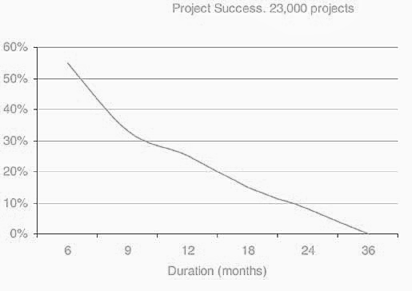
Success vs. Project Duration -- Larman / Standish

Slide 67
#7: Scope Creep is a major source of estimation error.

Slide 68
#8: Having more estimators, even if they are not experts, improves estimation accuracy

Slide 69
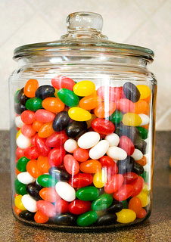
Group Estimation Exercise
Number of Jellybeans in the jar

Slide 70
Actual vs. Original Estimate Range (p90/p10)

Slide 71



Wisdom of Crowds
Dutch Tulip Mania 1637
Jelly Beans
“Who Wants To Be a Millionaire?” audience correct 91%

Slide 72
Ask the Team

Slide 73
#8: Having more estimators, even if they are not experts, improves estimation accuracy

Slide 74
#9: Project success is determined by on-time delivery

Slide 75
Delivery Challenges/Failures
Standish Group 2006, reported by CEO Jim Johnson, CIO.com, ‘How to Spot a Failing Project’
Notes:
Delivery failures are well documented in the software business.
This is the classic report from Standish showing only 35% of projects delivered on time with expected features. 46% were challenged and 19% were killed. This is from 2006, and is a substantial improvement from the 19% success rate in 1996.

Slide 76
Why do we care about on-time delivery?

Slide 77
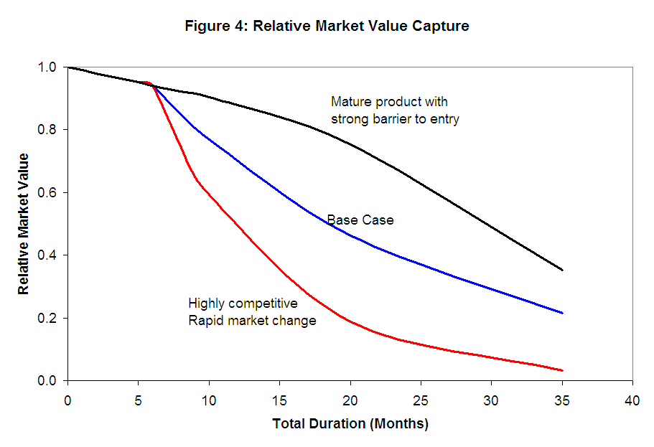
Cost of Delay

Slide 78

Wrong Priorities
Notes:
The first generation of Ford Taurus turned out to be the best selling car in America in the
late 1980s. Conceived in the 1980's and introduced in 1986, it set the standard for new practices
in project management and product development. It was one of the early projects in the U.S.,
which fully utilized the concept of cross-functional teams and concurrent engineering practices.
It established close ties with vendors and subcontractors, and was characterized by a spirit of
cooperation and strong synergy among teams. The result was a remarkable market and business
success. Its revolutionary design and outstanding quality, created a new trend in the U.S.
automobile industry, and customers simply loved the car. Yet, when the project was completed,
the project manager was fired. His “sin” was that project completion was delayed by six months.
In contrast, the second generation of Ford Taurus was developed in the early 1990s and
2
completed in 1995. With increased competition and the enormous success of Japanese imports,
Ford had hoped to reestablish Taurus, once again, as the best selling car in America. But the new
project manager learned the lesson of his predecessor: He considered project schedule as a “holy
grail,” and made sticking to the completion date the ultimate goal, while sacrificing other things.
Vendor relationships, team spirit, and product integration were just few of the issues that
suffered. The second generation of Taurus turned out to be a disappointing business experience.
It did not recapture the position of the best selling car in America and Ford was not able to repeat
its outstanding success of the first Taurus.

Slide 79

Poker Metric:
Percent of Hands Won

Slide 80
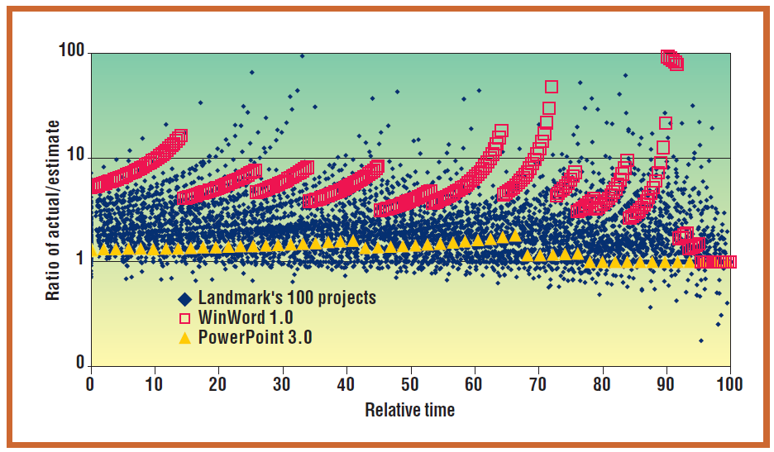
Software Metric – On Time%

Slide 81
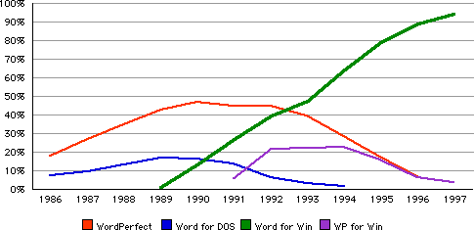
Value Metric
Word Processing Market Share

Slide 82

The Measurement Inversion
Lowest
Information Value
Cost & Time
Most Measured
Highest Information Value
Value Delivery
Least Measured

Slide 83

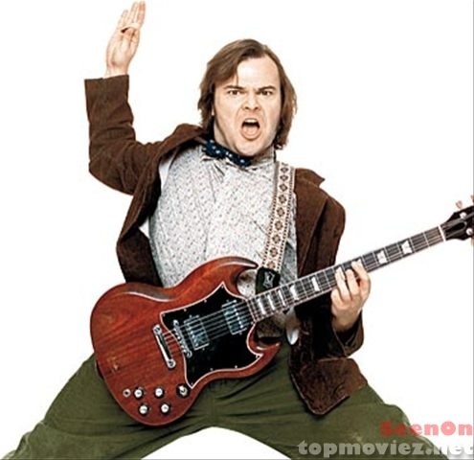
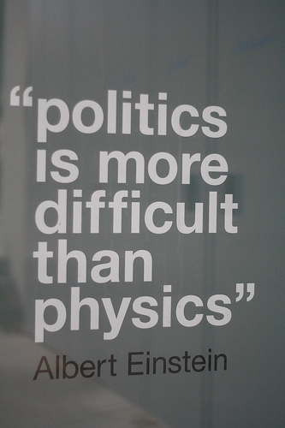
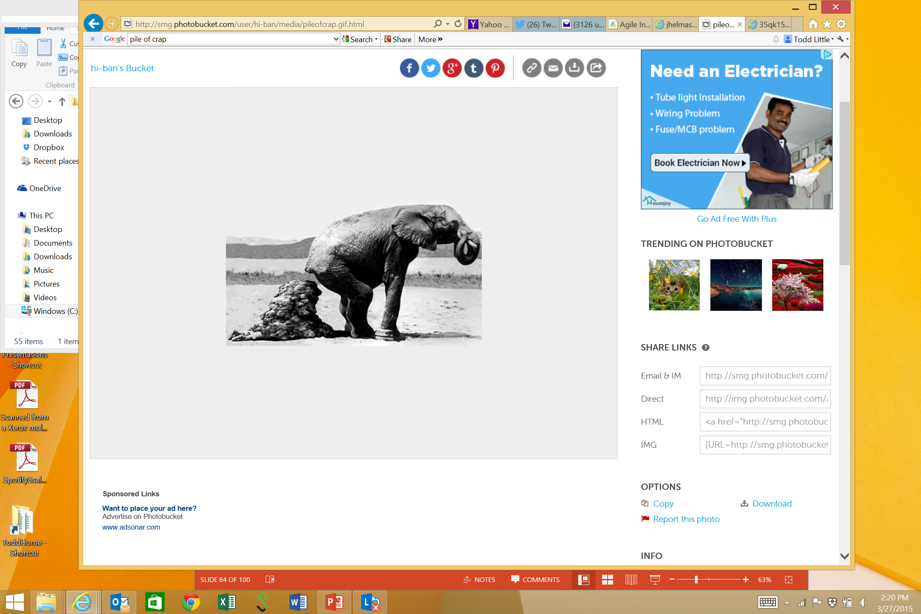

Outputs and Outcomes
Ontime | No | Yes | No | Yes
Outcome | Bad | Good | Good | Bad

Slide 84
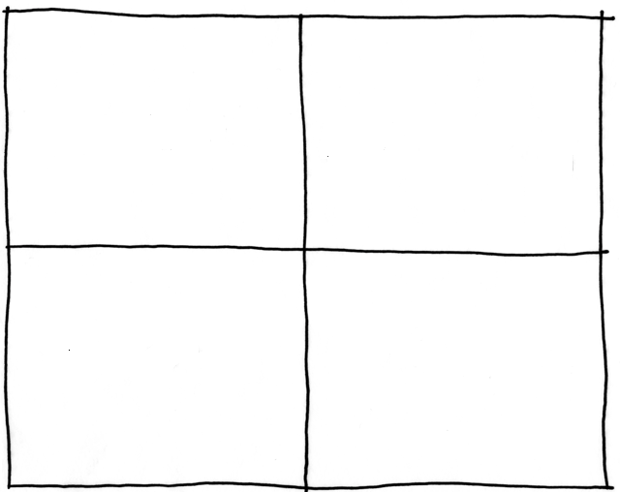
Outputs and Outcomes
Ontime
Output
Late
Bad
Good
Outcome

Slide 85
#9: Project success is determined by on-time delivery

Slide 86
#10: Estimation is waste

Slide 87
The Real Business Questions
Is it worth doing?
What is the priority?
When is the target time to ship?
What is the critical scope?
Do we have the right investment?
What is the cost of delay?

Slide 88
#10: Estimation is waste

Slide 89
Now What?

Slide 90
Estimation and Prioritization
XL
L
M
S
 | S | M | L | XL
Priority
Value
Cost

Slide 91
The A/B/C List sets proper expectations (similar to MoSCoW)
A | MUST be completed in order to ship the product and the schedule will be slipped if necessary to make this commitment.
B | Is WISHED to be completed in order to ship the product, but may be dropped without consequence.
C | Is NOT TARGETED to be completed prior to shipping, but might make it if time allows.
Only “A” features may be committed to customers.
If more than 50% of the planned effort is allocated to “A” items the project is at risk.

Slide 92
Sizing for Scope Creep
500 Point release backlog
Velocity of 25 points per 2 week iteration
2%/mo = 1% scope creep per iteration = 5 pts.
Net Planned Velocity = 20 pts/iteration

Slide 93
A/B/C List
50%
25%
25%
A
B
C
D
Typical Delivery
C
A
B
Backlog Plan
Target Delivery Date
50%
100%

Slide 94
A/B/C List
A
50%
25%
25%
B
C
D
Uncertainty Risk
C
A
B
Backlog Plan
Target Delivery Date
50%
100%
Notes:
Need some explanation to go along with this slide and the previous one.
--The idea is that there is uncertainty in the estimation process. A factor of 2X is a generally sufficient buffer if the team has gotten basic estimation down. Thus is it possible that what is actually delivered is only the “A” items. That is ok and actually expected.

Slide 95

Metrics to Track

Slide 96
Burnup Chart
Scope Creep
Velocity
Monitor Quality

Slide 97
Ask the Team

Slide 98
Cost of Delay

Slide 99
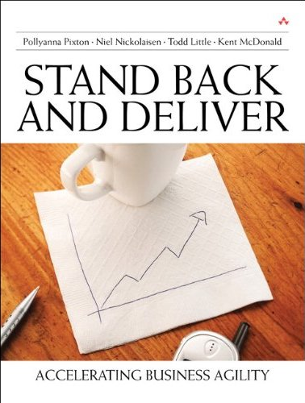
Contact
Todd Little
  todd.little@ihs.com
  toddelittle@gmail.com
  www.toddlittleweb.com
  www.accelinnova.com
  www.linkedin.com/in/toddelittle/

Slide 100
Overconfidence of Success
Matthew G. Miller, Ray J. Dawson, Kieran B. Miller, Malcolm Bradley (2008). New Insights into IT Project Failure & How to Avoid It. Presented at 22nd IPMA World Congress -­‐ Rome (Italy) November 9-­‐11, 2008, in Stream 6. As of May 2013, self published at http://www.mgmiller.co.uk/files/paper.pdf

