Slide 1
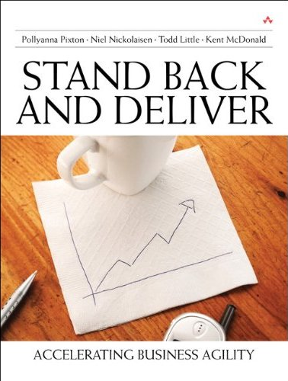
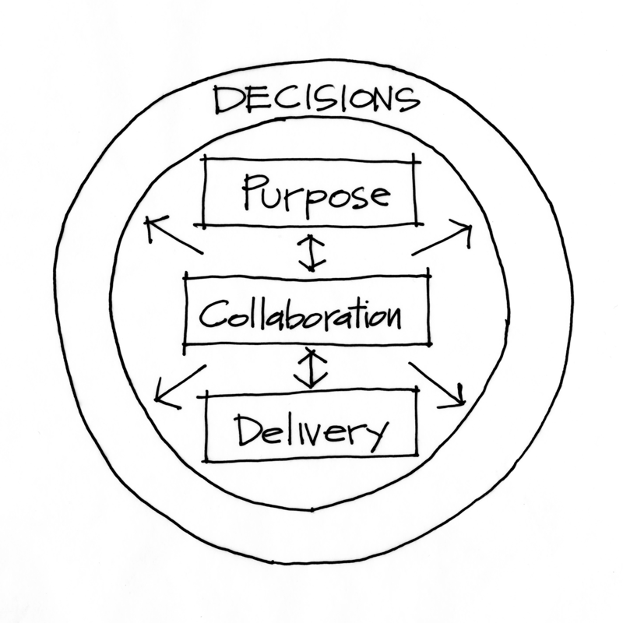
Stand Back and Deliver
A Leader’s Guide to Accelerating Agility
Todd Little, VP Product Development at IHS
Notes:
Over the past 3 years Landmark has been incorporating Agile methodologies in our development processes.

Slide 2
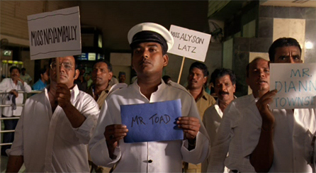
Welcome to India

Slide 3
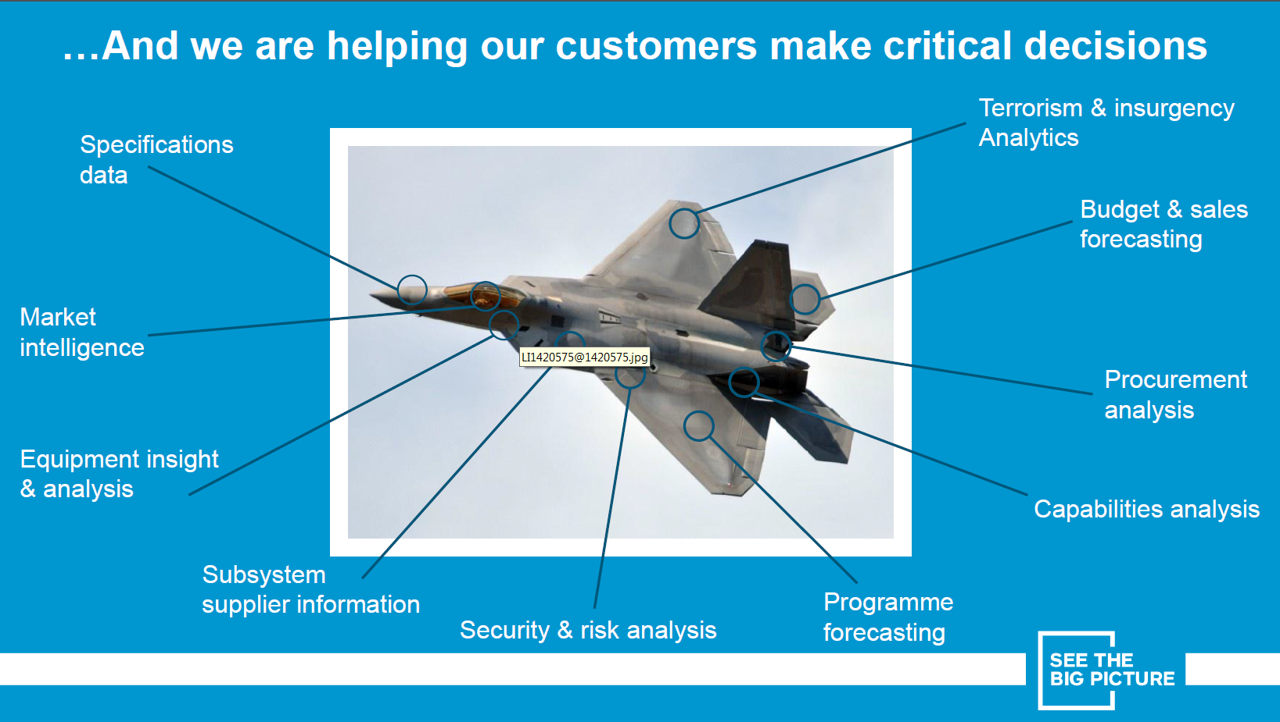
About IHS

Slide 4
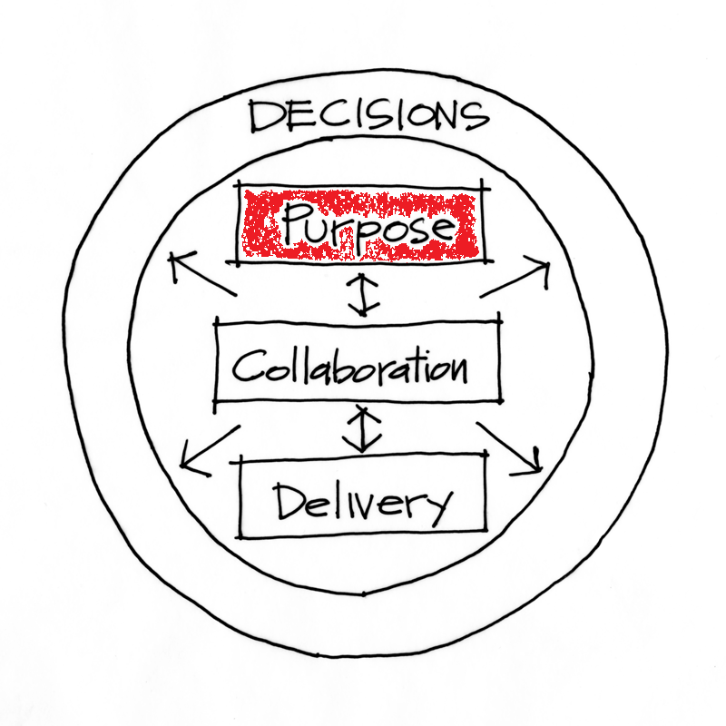
Purpose

Slide 5
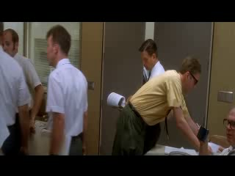
Apollo 13

Slide 6
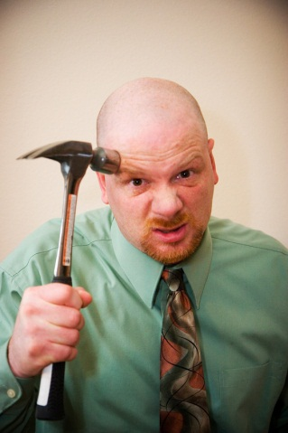
Get Alignment on the Purpose
Powerful Questions are:
What are we building?
What Business are we in?
What Building are we in?

Slide 7
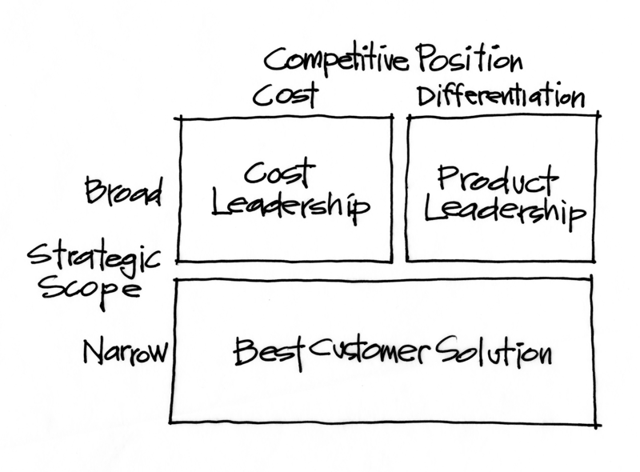
Start with Market Positioning

Slide 8
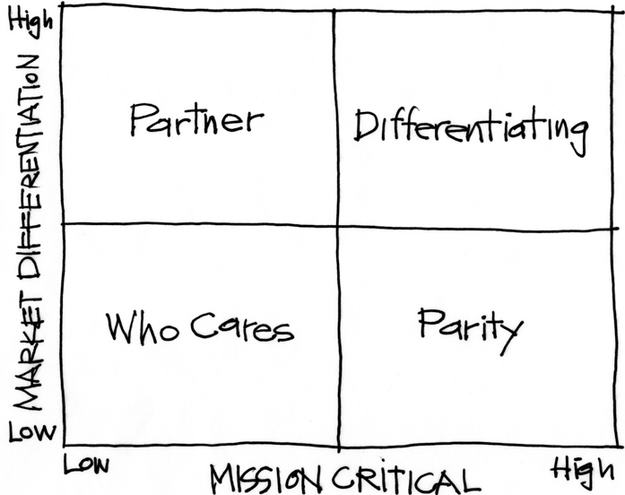
Purpose Alignment Model
Notes:
[Purpose of slide] [#]
[Information]

Slide 9
Purpose Alignment Model
CAN WE
CREATE A
DIFFERENTIATED
PARTNERSHIP?
INNOVATE,
CREATE
ACHIEVE AND
MAINTAIN PARITY, MIMIC, SIMPLIFY
MINIMIZE /
ELIMINATE
Notes:
[Purpose of slide] [#]
[Information]

Slide 10

Applicable at all Levels
Corporate Strategy
Product Strategy
Feature

Slide 11
A View of Strategy - Apple
11
NEW PRODUCT DESIGN
USER EXPERIENCE
CONTENT DISTRIBUTION
ATT
MS OFFICE
INTEL HARDWARE
OTHER SOFTWARE
PERIPHERALS
Notes:
11
[Purpose of slide] [#]
[Information]
© International Institute of Business Analysis®

Slide 12
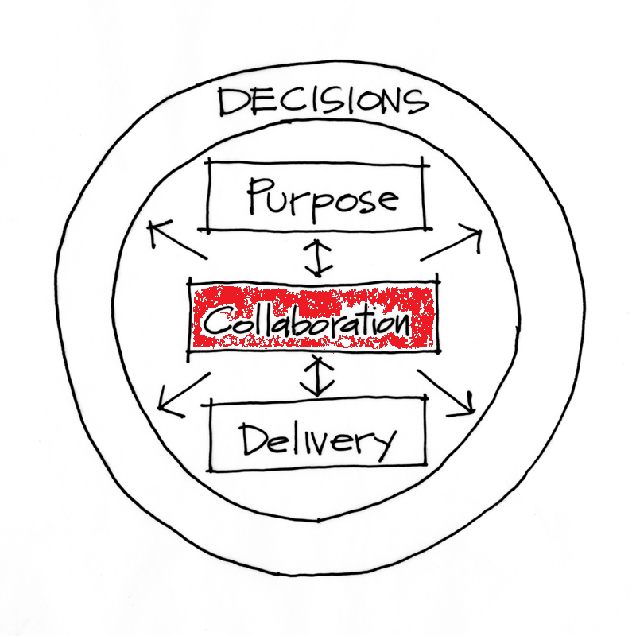
Collaboration

Slide 13
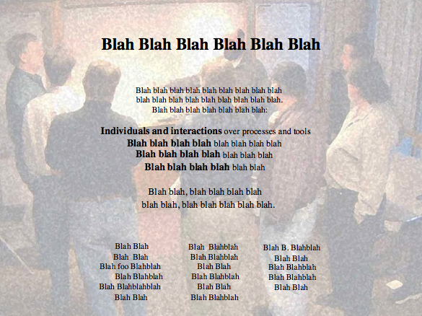
Alexey Krivitsky

Slide 14

Leadership Model
Now:
Embrace Change
Foster New Ideas
Collaborate
Gives Ownership
Influential
‘Old School’
Responds to Change
Knows the Answers
Bureaucratic
Leader Decides
Authoritarian

Slide 15
Long Ago and Far, Far Away…

Slide 16
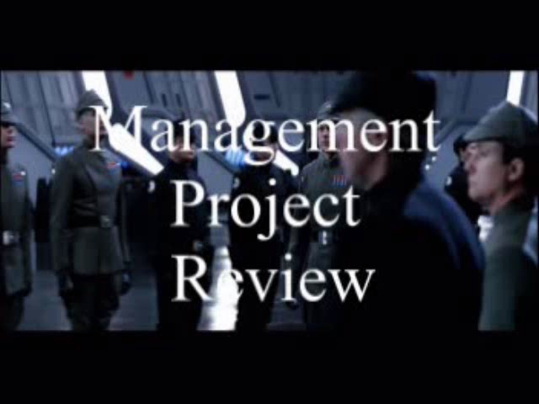

Slide 17
Trust/Ownership Model
Trust
Abdication
Energy & Innovation
How do we
get here?
Command & Control
Conflict
Control
Low
Team Ownership
High

Slide 18
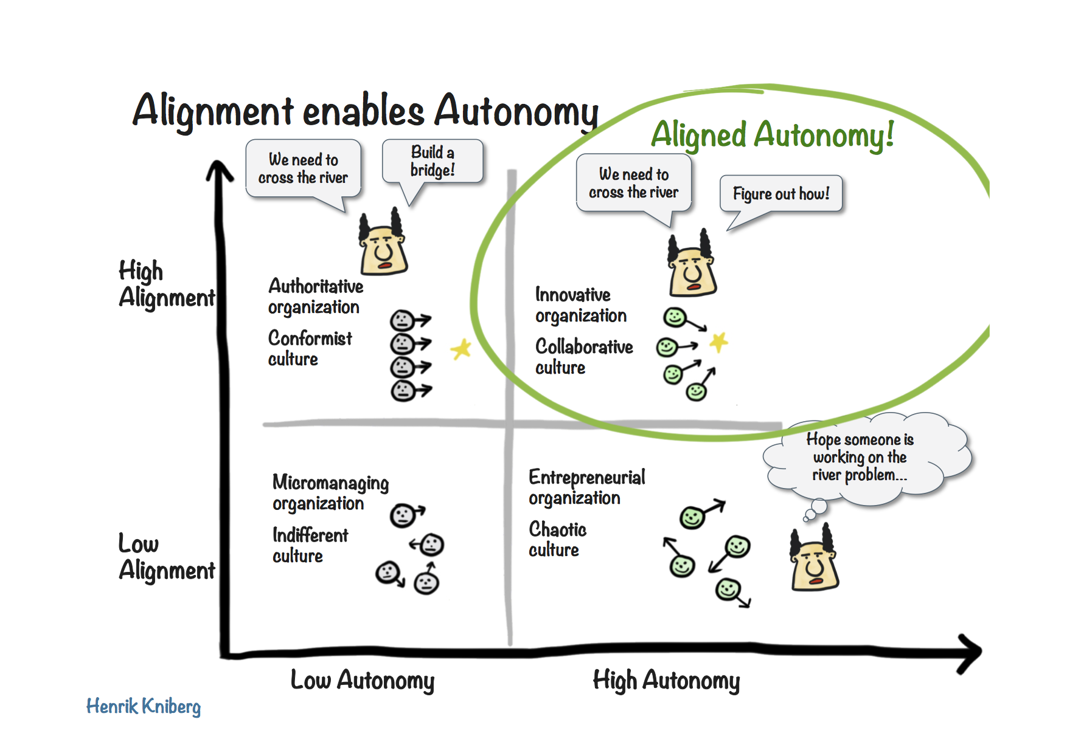

Slide 19

Leadership Model
Today
Embrace Change
Foster New Ideas
Collaborate
Gives Ownership
Influential

Slide 20
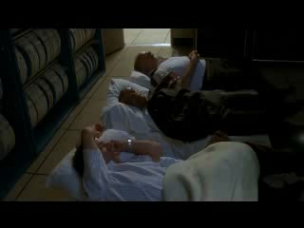
Square peg in a round hole

Slide 21

Collaborative Leadership
The Right People

Slide 22
Hire and promote:
  first on the basis of integrity
  second, motivation
  third, capacity
  fourth, understanding
  fifth, knowledge
  last and least, experience.
- Dee Hock, CEO Emeritus VISA International

Slide 23
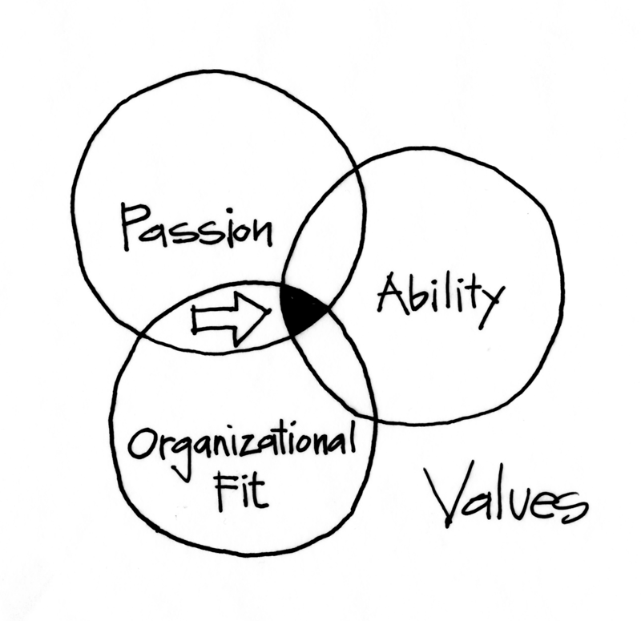
Get the Right People

Slide 24
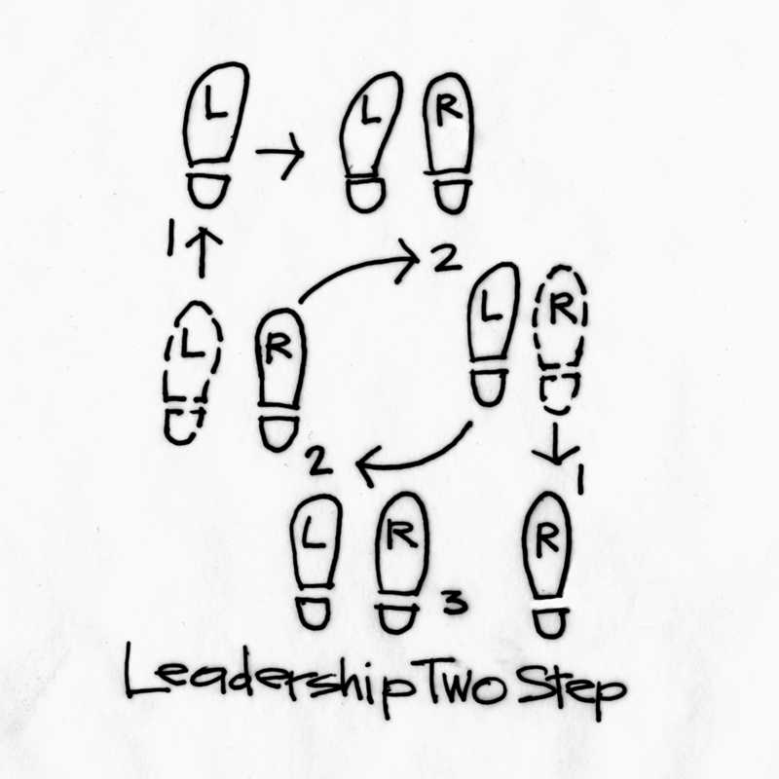
Stepping Up and Standing Back

Slide 25
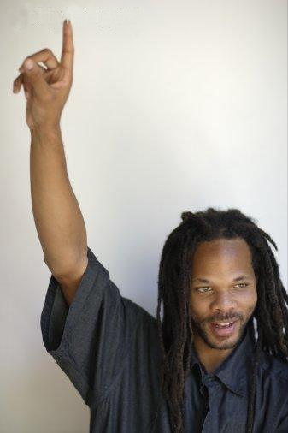
Collaboration
Individuals step up to Volunteer
For What
And
By When

Slide 26

Agile Leadership

Slide 27
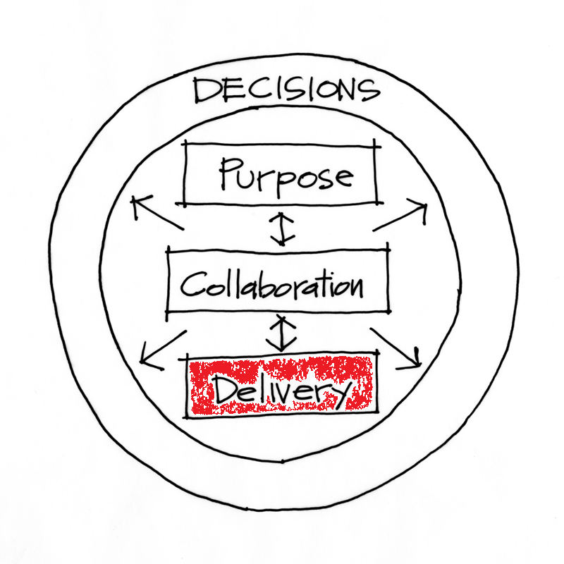
Delivery

Slide 28




Managing the Coming Storm
Inside the Tornado
Project Kickoff
When will we get the requirements?
All in good time, my little pretty, all in good time
But I guess it doesn't matter anyway
Just give me your estimates by this afternoon
Team Unity
Not so fast! Not so fast! ... I'll have to give the matter a little thought. Go away and come back tomorrow
No, we need something today!
Ok then, it will take 2 years.
No, we need it sooner.
Doesn't anybody believe me?
I already promised the customer it will be out in 6 months
You're a very bad man!
Notes:
We look at a typical software project…..

Slide 29


We’re not in Kansas Anymore
Developer Hero
I may not come out alive, but I'm goin' in there!
Reorg
The Great and Powerful Oz has got matters well in hand.
My! People come and go so quickly here!
Testing
"Hee hee hee ha ha! Going so soon? I wouldn't hear of it! Why, my little party's just beginning!

Slide 30
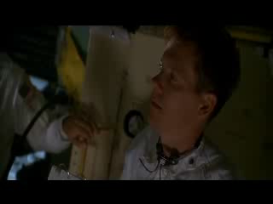
Creative Solutions

Slide 31

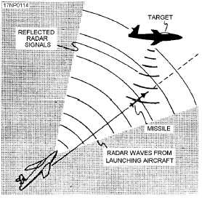
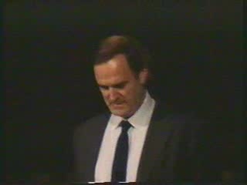
Gordon the Guided Missile

Slide 32
Control Systems
Processes
Inputs
Inputs
Inputs
Command & Control
Processes
Inputs
Inputs
Inputs
Agile Leadership
Outputs

Slide 33
Trust/Ownership Model
Trust
Abdication
Energy & Innovation
How do we
get here?
Zone of
Stable Control
Command & Control
Conflict
Control
Low
Team Ownership
High

Slide 34
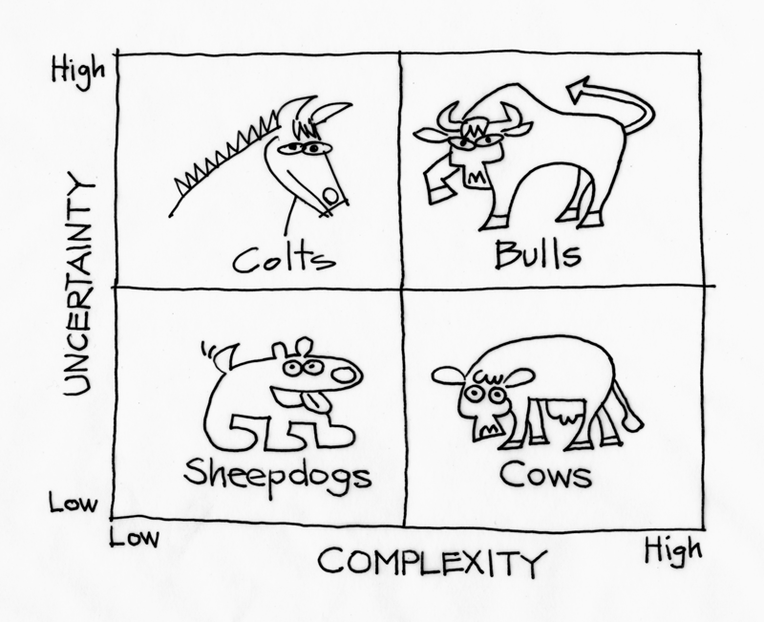
Managing Complexity and Uncertainty
Context Leadership Model

Slide 35
Reduce Uncertainty or Complexity
Uncertainty | Complexity
Opportunities to Reduce Uncertainty: Use proven technologies Reduce project duration | Opportunities to Reduce Complexity: Collocate the team Break project into sub-projects
Attribute | Score
Market | ███
Technical | ███
# Customers | █████████
Duration | █████████
Change | ███
Attribute | Score
Team Size | █████████
Mission Critical | █████████
Team Location | █████████
Team Maturity | ███
Domain Gaps | ███
Dependencies | █████████

Slide 36
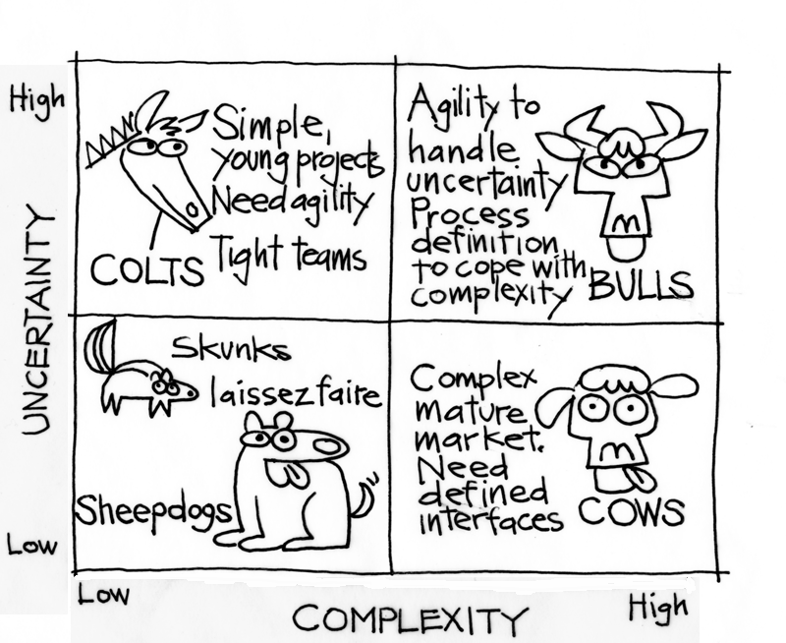
Managing Complexity and Uncertainty

Slide 37
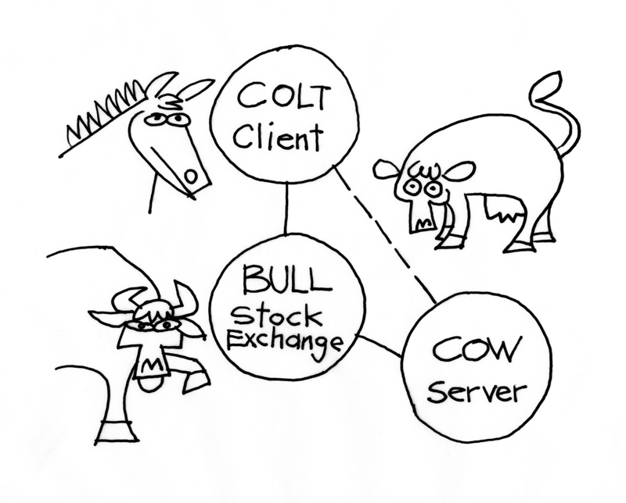
The Swiss Stock Exchange
Remember: Loose Coupling and Strong Cohesion

Slide 38
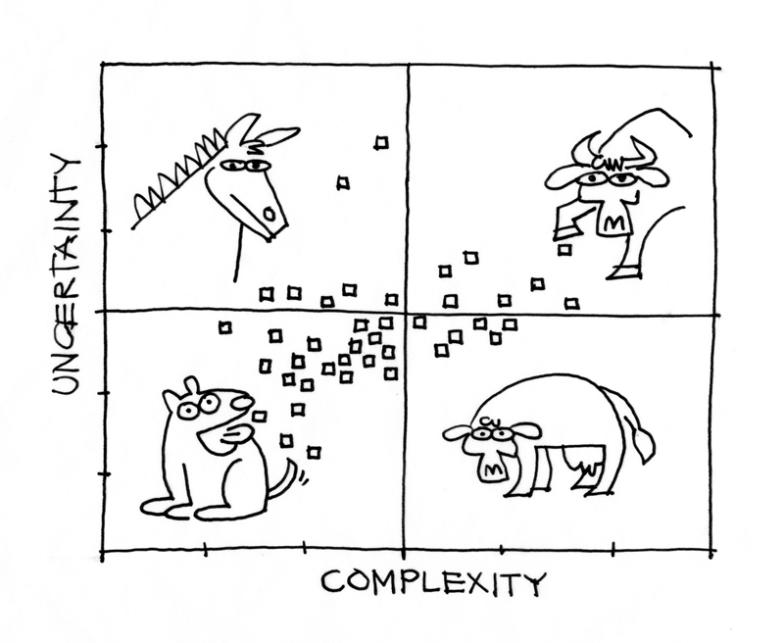
Portfolio Distribution

Slide 39
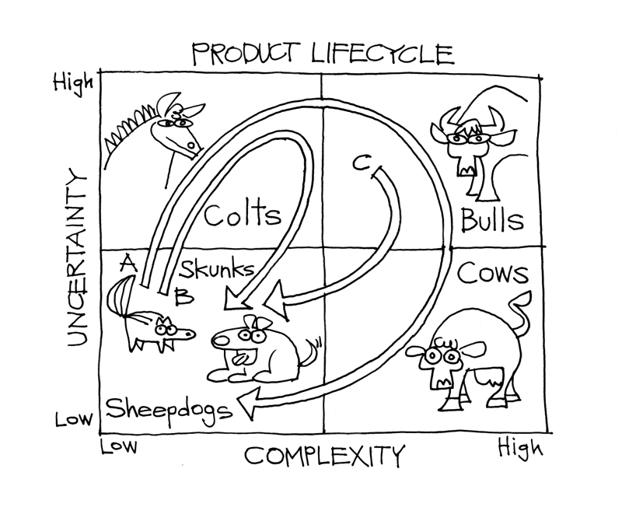
Product Lifecycle

Slide 40
Project Leadership Guide
Create
Change
Embrace
Change
High
Invent
Deploy
Market
Differentiating
Ad Hoc
Agile
Eliminate
Change
Control Change
Manage
Offload
Low
Outsource
Structured
Low
Mission Critical
High

Slide 41
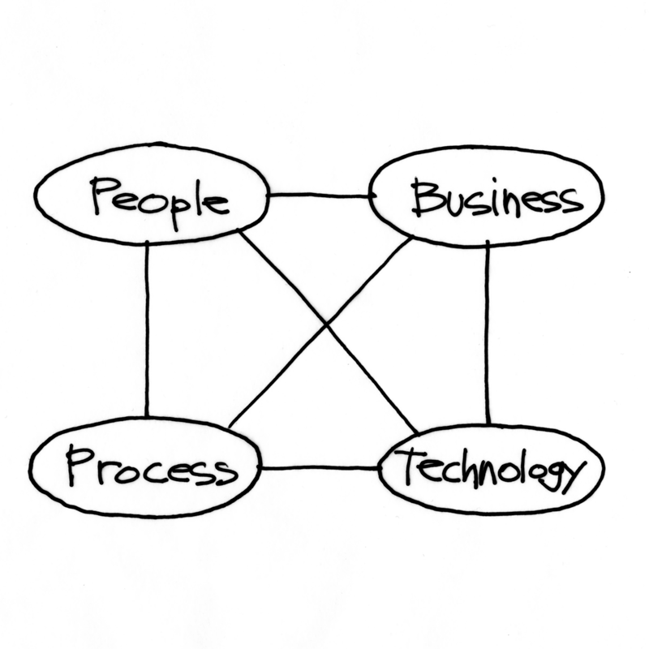
Leadership Development

Slide 42
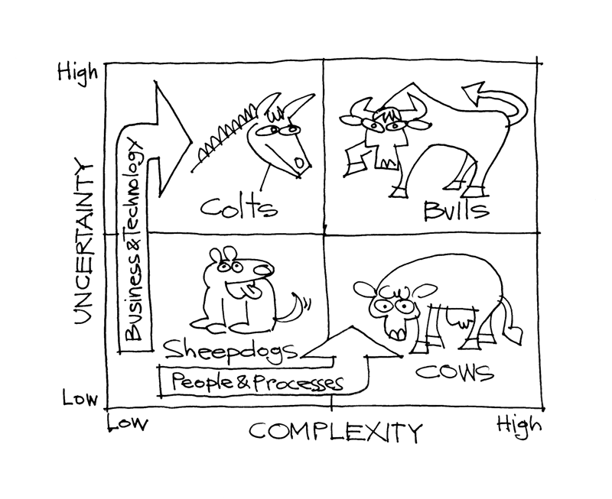
Leadership Development

Slide 43

Not all dogs are the same

Slide 44
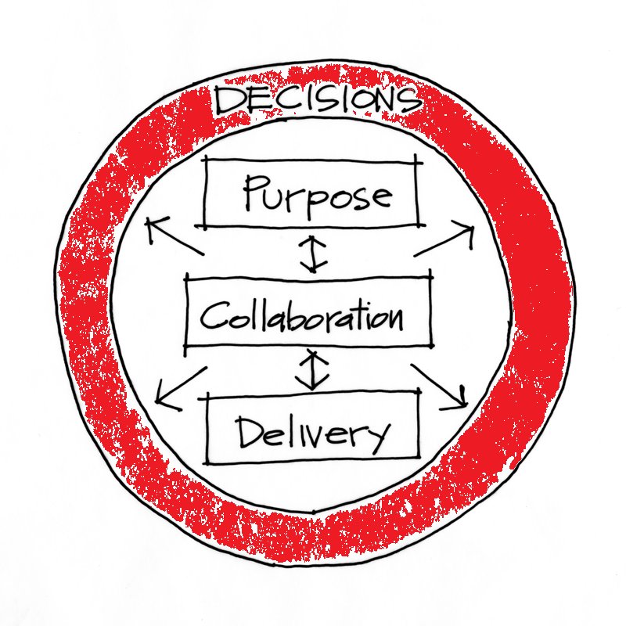
Decisions

Slide 45


Business Value Calculation
calculation
Costs
Value Calculation
Benefits
Business Value

Slide 46
Business Value Guess
calculation
Estimate
Value Calculation
Fabrication
Business Value

Slide 47
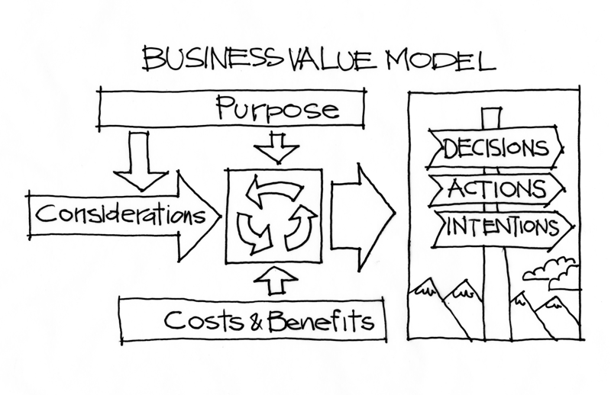
Decisions and Business Value

Slide 48
Purpose Filter
Idea
Idea
Partner | Invest
Who Cares | Parity
Critical
Items
Roughly
Estimate
Values and
Costs
Prioritize
By
Value/Cost
Idea
Prioritize
Idea
Strategic
Fit
Other
Release
Backlog
Idea
Idea
Non-
Economic
Non-
Strategic

Slide 49

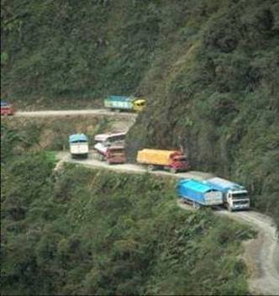
Considerations
Risks | Assumptions | Constraints
Notes:
49

Slide 50
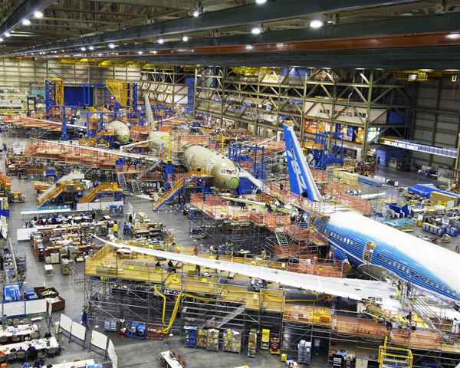
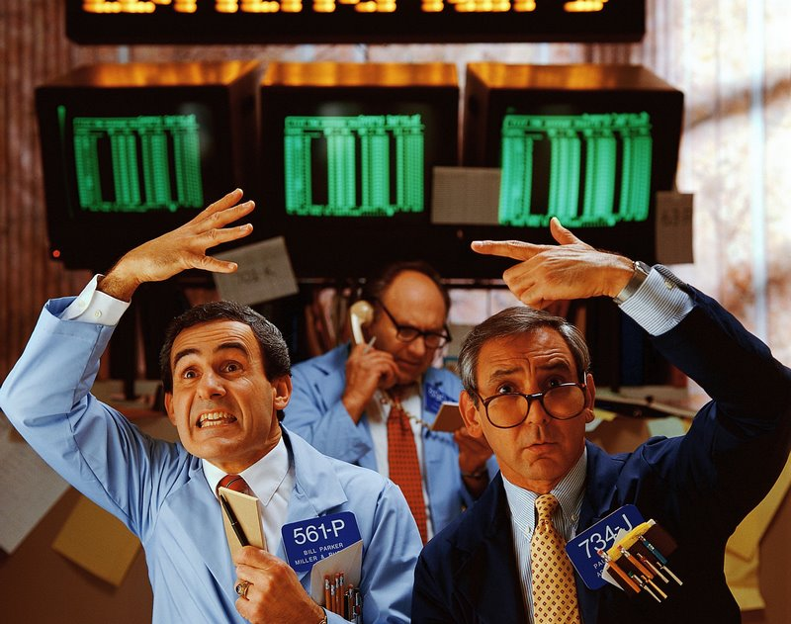

Risks – Types of Uncertainty
Cost Uncertainty
General Market Uncertainty
Feature Acceptance Uncertainty

Slide 51
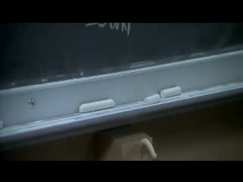
Constraints -- Failure is not an option

Slide 52



Decisions, Decisions, Decisions
What do we do?
When do we do it?
When do we decide?

Slide 53
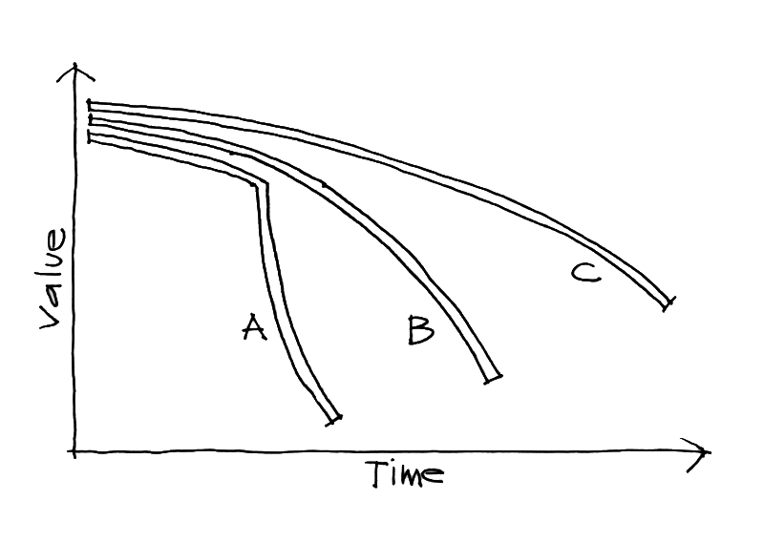
Cost of Delay

Slide 54
Decisions and Business Value

Slide 55
Purpose

Slide 56
Collaboration

Slide 57
Delivery

Slide 58
Decisions

Slide 59
Contact
Todd Little
  todd.little@ihs.com
  toddelittle@gmail.com
  www.toddlittleweb.com
  www.accelinnova.com
  www.linkedin.com/in/toddelittle/en

Slide 60

Collaborating with Non-Collaborators
Collaborator
Creative
Tension
Collegial
More useful
Drive to
Purpose
Collaboration
Non-
Collaborator
Compliance
Combative
Common Practice
Agree
Disagree
Agreement

Slide 61

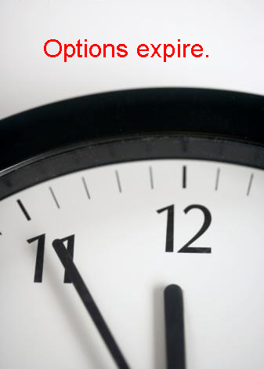

Real Options

