Slide 1


Risky Business: Real Options for Software Development
Todd Little
VP Product Development, IHS
Notes:
Todd comes from Oil and Gas exploration, a business that deals with risk in many facets. Chris comes from investment banking, another area that has made it important to understand and comprehend issues associated with risk. Both Todd and Chris have spent their careers developing software in these industries.

Slide 2

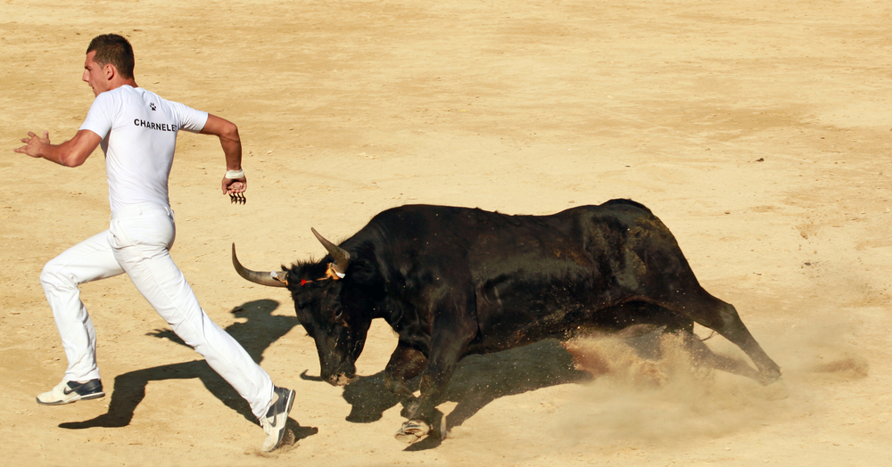
Risk and Uncertainty
 | Risk | Uncertainty
Frank Knight | Immeasurable | Quantifiable
PMI | Risk can be positive or negative | ???
English | A situation involving exposure to danger | The state of being uncertain Not known or established; questionable

Slide 3

Risky Business

Slide 4
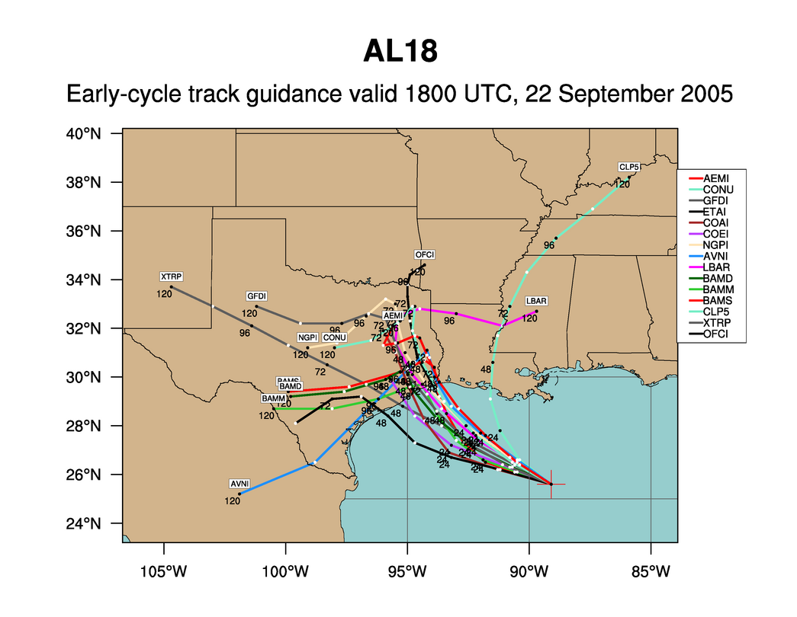
Hurricane Rita
Notes:
What can we say about every one of these predictions? They are wrong. But the collective set of predictions is quite useful. Which is more important when predicting hurricanes – where it hits or when it hits? Ok, both are important, but where is much more important than when. If you are in Florida you don’t really care when it hits. But once you know it has a chance to hit Houston then it is very important to know when it might hit.

Slide 5
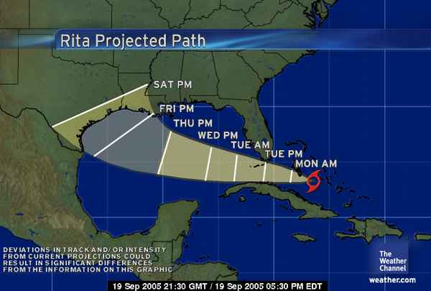
The Cone of Uncertainty
We expect uncertainty and manage for it through iterations, anticipation, and adaptation.
Notes:
Inspection and adaptation is the answer. Iterations help bring in new information

Slide 6
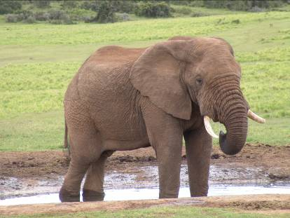
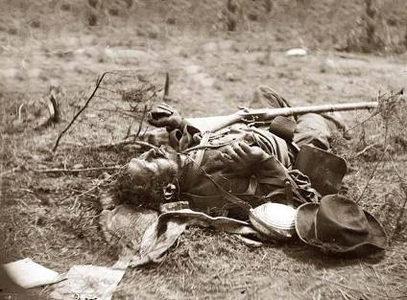
War
They couldn't hit an elephant at this dist…
Last words of General John B. Sedgwick, Union Army Civil War officer, uttered during the Battle of Spotsylvania, 1864
Notes:
War – now that’s an area with lots of risk. I guess he didn’t do too well in his prediction.

Slide 7

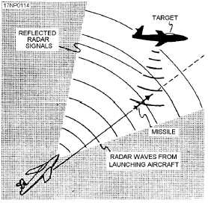
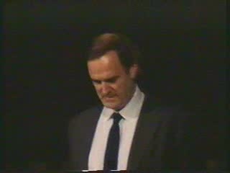
Gordon the Guided Missile

Slide 8
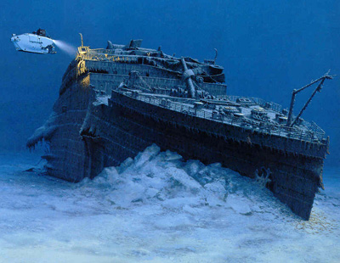

Movies
78% of Films Lose Money
6% of films make 80% of profit
Notes:
Most movies strive to be the next Titanic, the largest grossing film of all time.
The reality is that the vast majority really do end up closer to the real Titanic than to the movie Titanic.

Slide 9
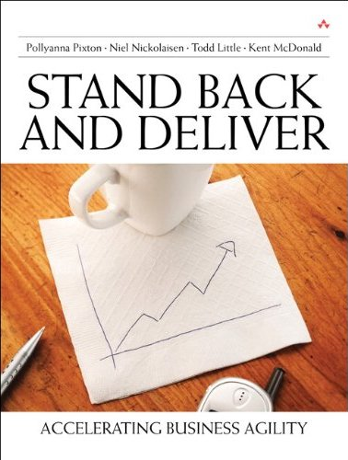
Books
300,000 in 2004,
<25% sold more
Than 100 copies
Notes:
Books. Here is my book. Doesn’t it look like it is chock full of useful stuff?
But only 25% of books sell more than 100 copies. Please do your part so that I am not part of that statistic.

Slide 10

Poker

Slide 11
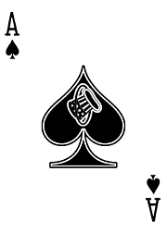
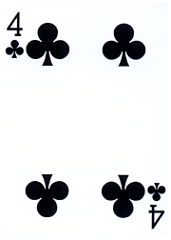
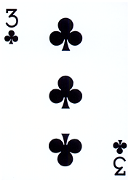

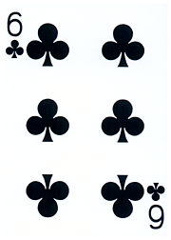

Texas Hold’em:
Which is the best hole hand?
A
B
C

Slide 12
Texas Hold’em:
Which is the best hole hand?
A
B
C
33.5%
29.6%
36.5%

Slide 13

Poker Metric:
Percent of Hands Won

Slide 14
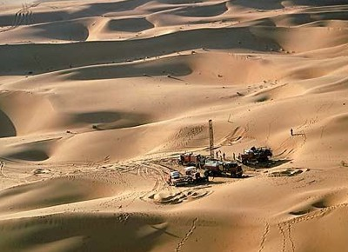
Oil & Gas Exploration
Notes:
Oil exploration is highly risky. It used to be that 10% was a good find rate for wildcat wells. Based on improvements in technology this is closer to 20%. Still risky, but that risk is acceptable because the payout is enormous. The key is having a diversified portfolio to balance the risk exposure.

Slide 15
Oil & Gas Exploration
90-80% Failure
Notes:
Oil exploration is highly risky. It used to be that 10% was a good find rate for wildcat wells. Based on improvements in technology this is closer to 20%. Still risky, but that risk is acceptable because the payout is enormous. The key is having a diversified portfolio to balance the risk exposure.

Slide 16
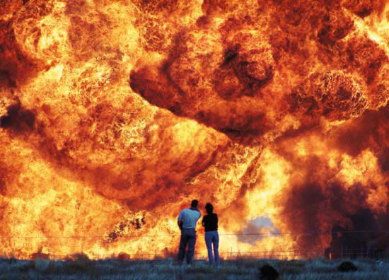
I’m beginning to think it wasn’t such a good idea to turn off those unit tests
Notes:
Safety is not to be messed with.
Test, Test, Test
Test again with real data
Test, Test, Test
Test again with real data

Slide 17
Which Uncertainties Are Important?
Notes:
Oil and gas geologists and engineers build models to help them comprehend the uncertainties. This is a tornado chart, because it looks like a tornado. This chart clearly shows that the largest uncertainty is associated with Reserves, with the next largest uncertainty being oil/gas price. This gives the engineer something to focus on. Perhaps there is additional data that can be collected to help reduce the uncertainty bars. There may not be anything that can be done about Oil/gas price. Perhaps futures contracts could be used to hedge some of the uncertainty. The other uncertainties may not be worth spending too much time since they have limited effect on the total uncertainty.

Slide 18
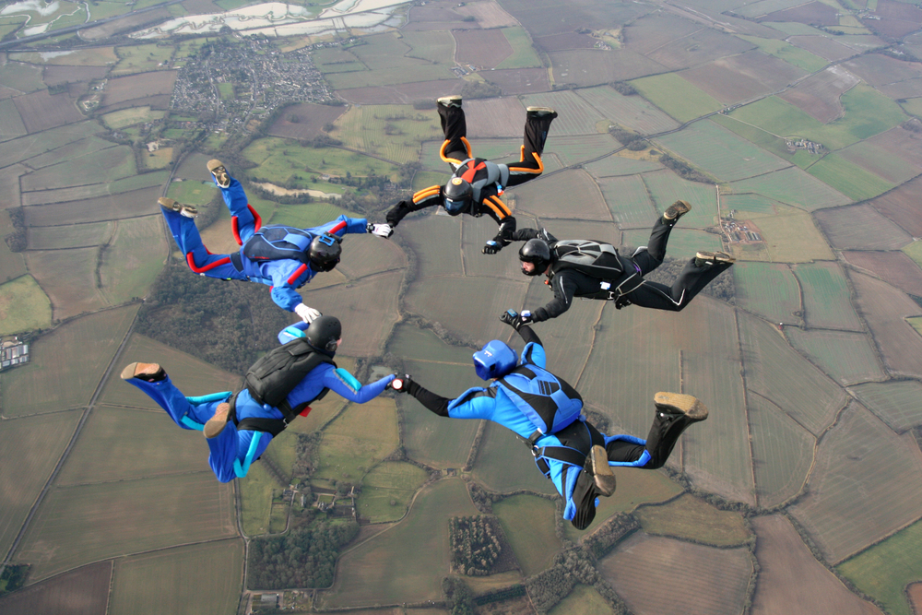
Risk management tools

Slide 19

Real Options
The right — but not the obligation — to undertake certain actions prior to an expiry date

Slide 20

Airline Tickets
The right — but not the obligation — to undertake certain actions prior to an expiry date

Slide 21



Real Options
The right, but not the obligation to take some action prior to an expiry date

Slide 22
Do you have a choice?
Option
Decision
Commitment

Slide 23

Notes:
http://www.flickr.com/photos/nick_anderson/5049751331/sizes/m/in/photostream/

Slide 24
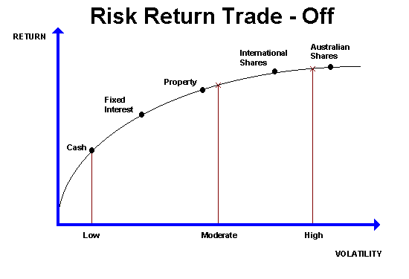


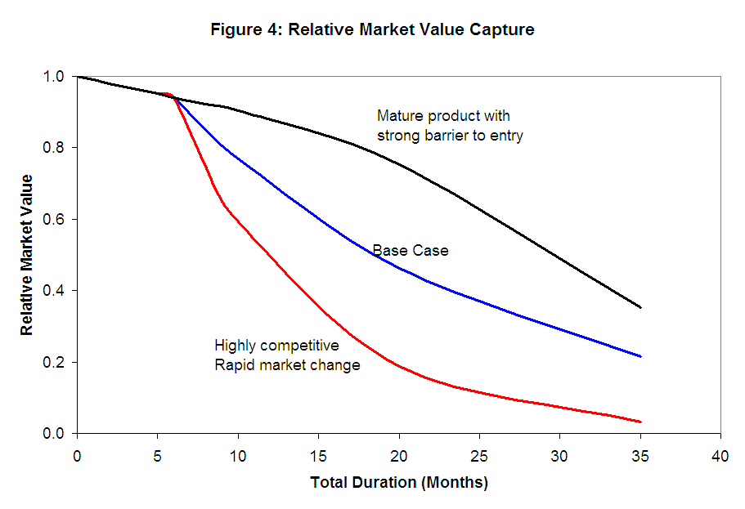
Value of Uncertainty
Value of Information
Value of Flexibility
Cost of Delay

Slide 25
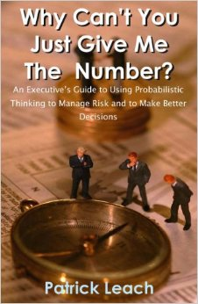
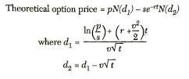
Value of Uncertainty
What is the source of all value?

Slide 26
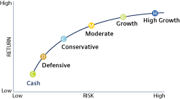
Value of Uncertainty
Efficient Frontier

Slide 27
Software Tornado Example
Item | -15M |  | 0M |  | 15M |  | 30M |  | 45M
Product Acceptance Uncertainty |  |  | ██ | ███ | ███ | ███ | ███ | ███ | ███
Schedule Uncertainty |  |  | █ | ███ | ███ | ██
General Market Uncertainty |  |  |  |  | ██ | ██
Cost Uncertainty |  |  |  |  | ██ | █

Slide 28
Software Tornado Example
Item | -15M |  | 0M |  | 15M |  | 30M |  | 45M
Product Acceptance Uncertainty |  |  |  | ███ | ███ | ███ | ███ | ███ | ███
Schedule Uncertainty |  |  |  | ███ | ███ | ██
General Market Uncertainty |  |  |  |  | ██ | ██
Cost Uncertainty |  |  |  |  | ██ | █

Slide 29
Software Tornado Example
Item | -15M |  | 0M |  | 15M |  | 30M |  | 45M
Product Acceptance Uncertainty |  |  |  | ███ | ███
Schedule Uncertainty |  |  |  | ███ | ██
General Market Uncertainty |  |  |  | ██ | ██
Cost Uncertainty |  |  |  | ██ | █

Slide 30
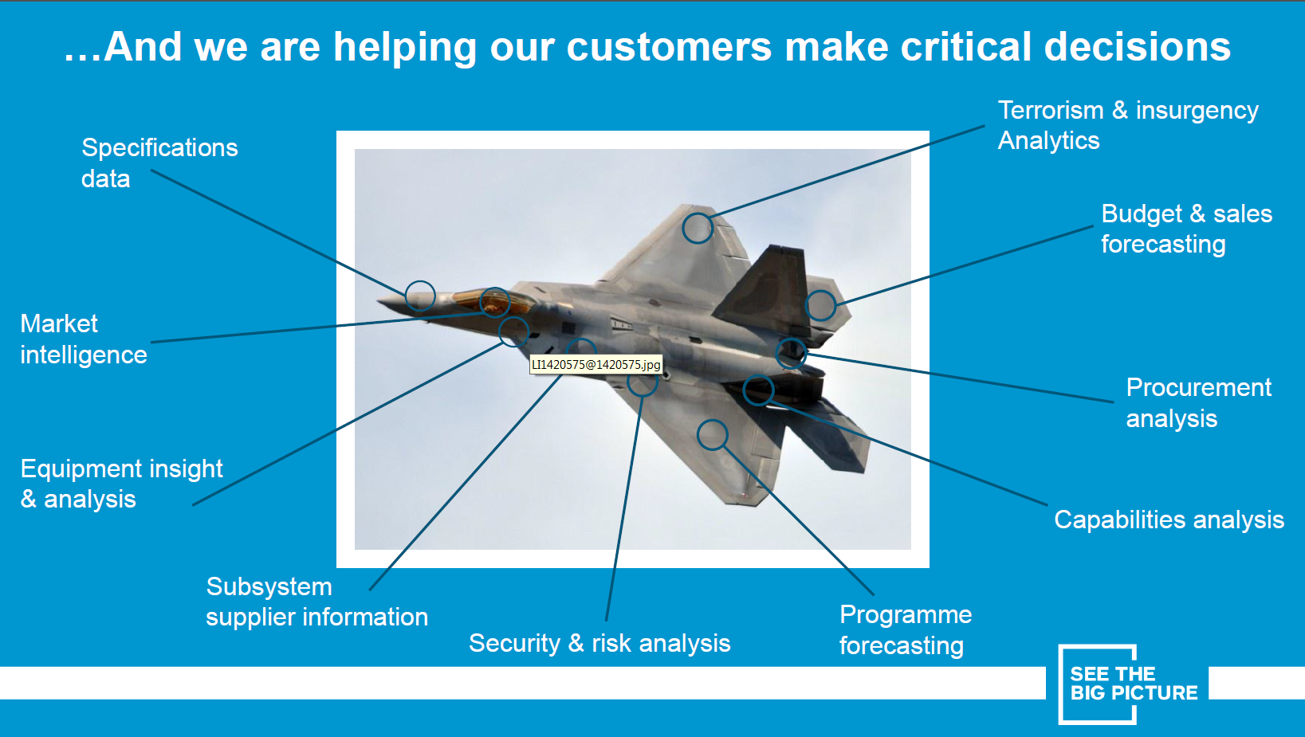
Value of Information

Slide 31
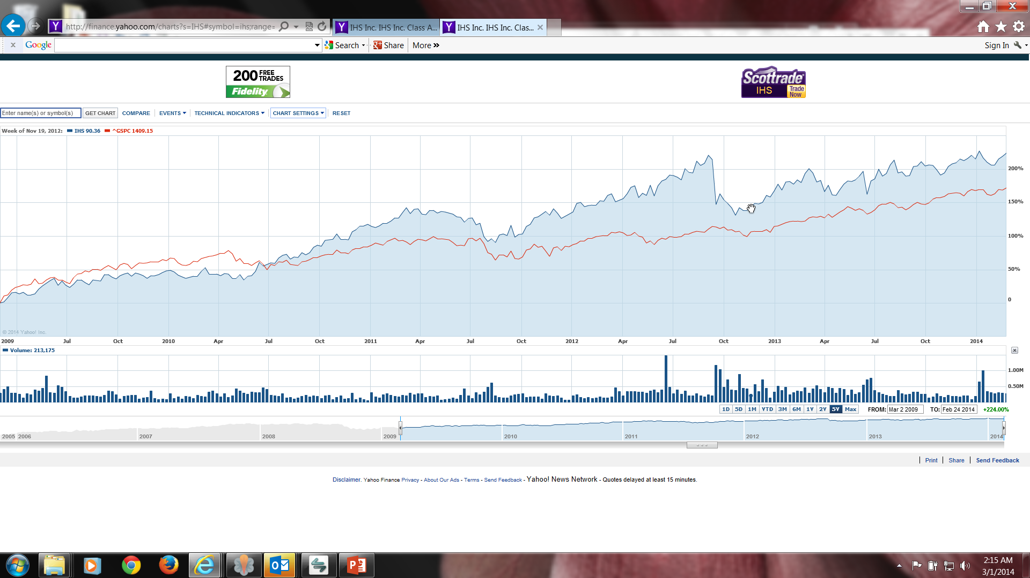
Value of Information

Slide 32

Value of Information

Slide 33
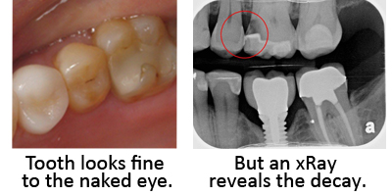
Value of Information

Slide 34

Increasing Value & Cost of Info.
Aim for this range
$$$
EVPI
Value or Cost
Value of Information
Cost
$0
Perfect Information
Low certainty
High certainty

Slide 35
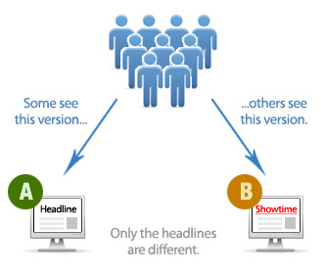
Software Development
Examples of Value of Information

Slide 36
POC can increase risk
POC is intended to show if something is possible
With software almost anything is possible
Therefore, the answer to almost every POC is YES
At that point expectations are set high
What risk is actually reduced?
Instead design POC to expose the biggest risks that we need to understand

Slide 37
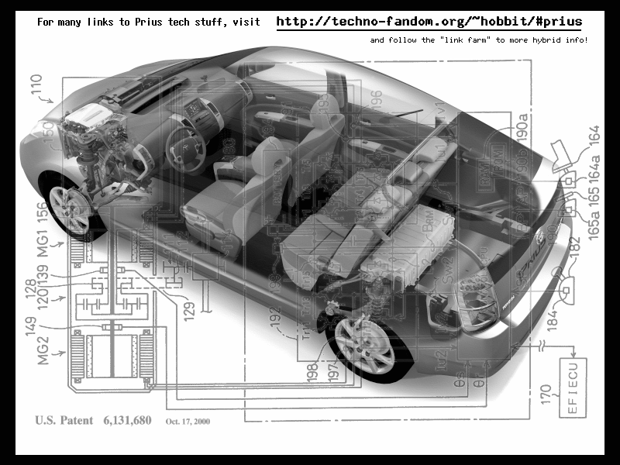
Value of Flexibility
Notes:
9 research projects for drive train
1 chassis – same hole for all 9 drive trains
VOI from 9 research projects, VOF from chassis design
Contrast this with the development of the Prius. Toyota had 9 different research projects running to develop hybrid engine technologies. Normally they would choose a drivetrain first, and build a car around it. Instead Toyota decided to keep its options open, and designed the Prius with a hole in it for the drive train. The 9 research projects continued, and 9+ months after the Prius development project was started, a drive train was chosen. Toyota knew that this car needed a radically new drive train architecture. Instead of guessing and choosing one, they let all 9 research projects continue their work, and as they did, the best option for the car's engine became clear. So was 9 research projects a waste? No because each project was generating factual information about the options for hybrid engine design, information that Toyota engineering management needed to make an informed choice.

Slide 38
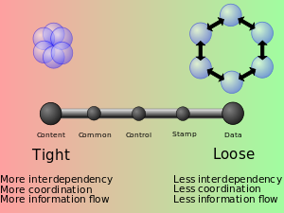
Software Development
Value of Flexibility from Loose Coupling

Slide 39


Slide 40
Cost of Delay
Value Loss from Delay

Slide 41
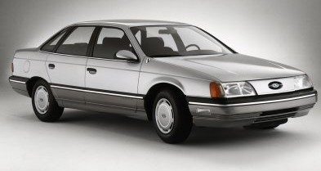
Wrong Priorities
Notes:
The first generation of Ford Taurus turned out to be the best selling car in America in the
late 1980s. Conceived in the 1980's and introduced in 1986, it set the standard for new practices
in project management and product development. It was one of the early projects in the U.S.,
which fully utilized the concept of cross-functional teams and concurrent engineering practices.
It established close ties with vendors and subcontractors, and was characterized by a spirit of
cooperation and strong synergy among teams. The result was a remarkable market and business
success. Its revolutionary design and outstanding quality, created a new trend in the U.S.
automobile industry, and customers simply loved the car. Yet, when the project was completed,
the project manager was fired. His “sin” was that project completion was delayed by six months.
In contrast, the second generation of Ford Taurus was developed in the early 1990s and
2
completed in 1995. With increased competition and the enormous success of Japanese imports,
Ford had hoped to reestablish Taurus, once again, as the best selling car in America. But the new
project manager learned the lesson of his predecessor: He considered project schedule as a “holy
grail,” and made sticking to the completion date the ultimate goal, while sacrificing other things.
Vendor relationships, team spirit, and product integration were just few of the issues that
suffered. The second generation of Taurus turned out to be a disappointing business experience.
It did not recapture the position of the best selling car in America and Ford was not able to repeat
its outstanding success of the first Taurus.

Slide 42

Risk Management is not Risk Aversion

Slide 43
Contact
Todd Little
  todd.little@ihs.com
  toddelittle@gmail.com
  www.linkedin.com/in/ toddelittle/
  www.toddlittleweb.com
  www.accelinnova.com

Slide 44
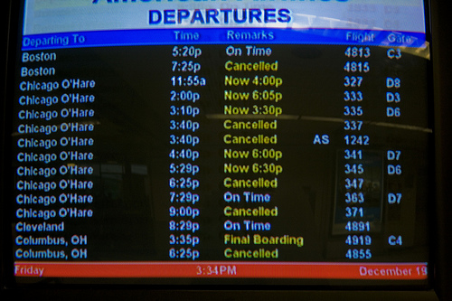
Real Options
Value of Information
Value of Flexibility

Slide 45
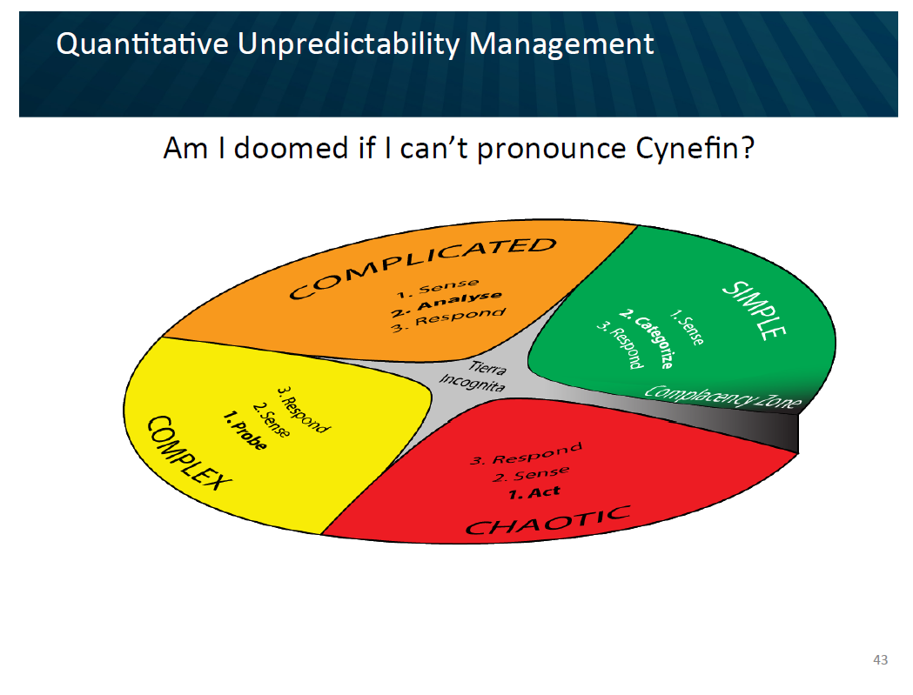

Slide 46
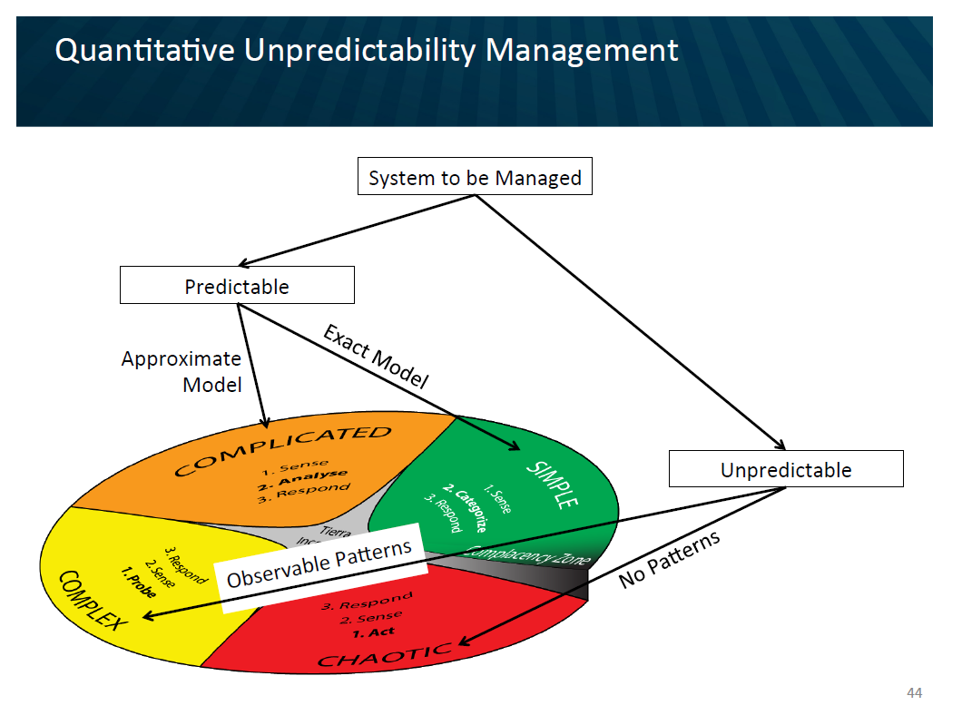

Slide 47
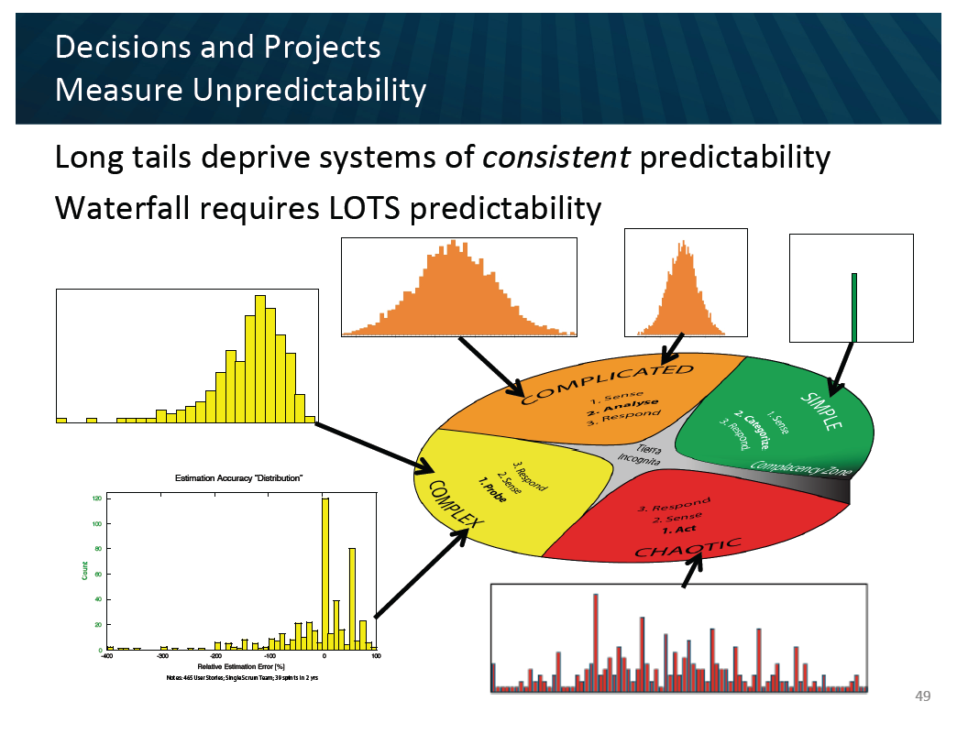

Slide 48
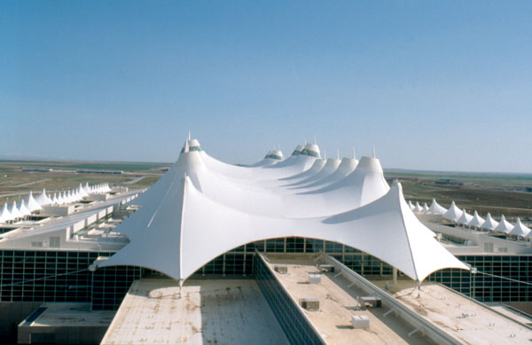
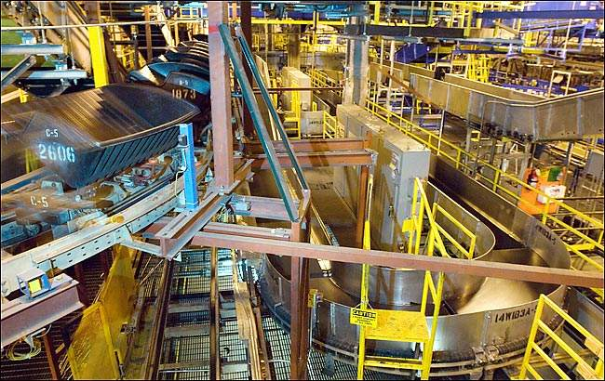
Delivery Failure results in Collateral Damage
Notes:
When the Denver Airport baggage handling system was designed, for example, no one asked what would happen if the fully automated system failed. How would baggage be handed? No one thought about it and there we no accommodations made in the airport plan. So when the system did fail there were no other alternatives to move baggage around the airport. There were no underground roadways on which to manually move luggage using tugs.

Slide 49
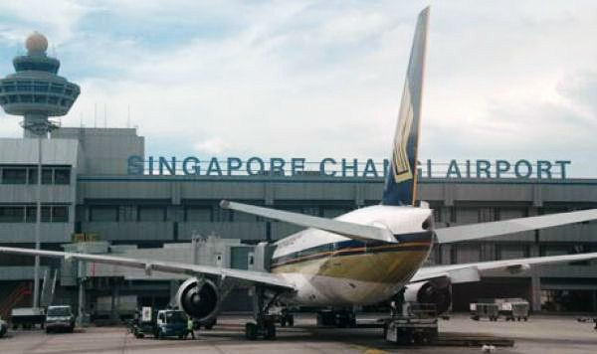

Risk Management and Real Options
Automated Baggage
Airport
Traditional Baggage

Slide 50
Making An Agile Conference Agile
5 Extra weeks to review sessions

Slide 52
Uncertainty Bounds
10% exceed 3-4x
Median project 1.7x
10-20% on time

Slide 53
The A/B/C List sets proper expectations
A | MUST be completed in order to ship the product and the schedule will be slipped if necessary to make this commitment.
B | Is TARGETED to be completed in order to ship the product, but may be dropped without consequence.
C | Is NOT TARGETED to be completed prior to shipping, but might make it if time allows.
Only “A” features may be committed to customers.
If more than 50% of the planned effort is allocated to “A” items the project is at risk.

Slide 54
A/B/C List
50%
25%
25%
A
B
C
D
Typical Delivery
C
A
B
Backlog Plan
Target Delivery Date
50%
100%

Slide 55
A/B/C List
A
50%
25%
25%
B
C
D
Uncertainty Risk
C
A
B
Backlog Plan
Target Delivery Date
50%
100%
Notes:
Need some explanation to go along with this slide and the previous one.
--The idea is that there is uncertainty in the estimation process. A factor of 2X is a generally sufficient buffer if the team has gotten basic estimation down. Thus is it possible that what is actually delivered is only the “A” items. That is ok and actually expected.

Slide 56
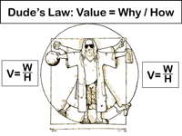

Slide 57
Estimating Story Difficulty
Estimation
XL
L
M
S
 | S | M | L | XL
Value
Cost

