Slide 1



Mythbusting Software Estimation
Todd Little
VP Product Development
IHS
Notes:
Todd comes from Oil and Gas exploration, a business that deals with risk in many facets. Chris comes from investment banking, another area that has made it important to understand and comprehend issues associated with risk. Both Todd and Chris have spent their careers developing software in these industries.

Slide 2
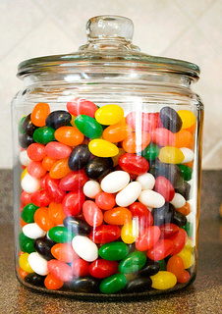

Estimation Exercise
On a 3x5 card
  Name
  Number of Jellybeans in the jar
  Score of Cy-Hawk Game

Slide 3
#1: Estimation challenges are well understood by General Management, Project Management, and Teams and it is normal to be able to estimate projects within 25% accuracy.

Slide 4
#2: Estimation accuracy significantly improves as the project progresses

Slide 5
#3: Estimations are frequently impacted by biases and these biases can be significant.

Slide 6
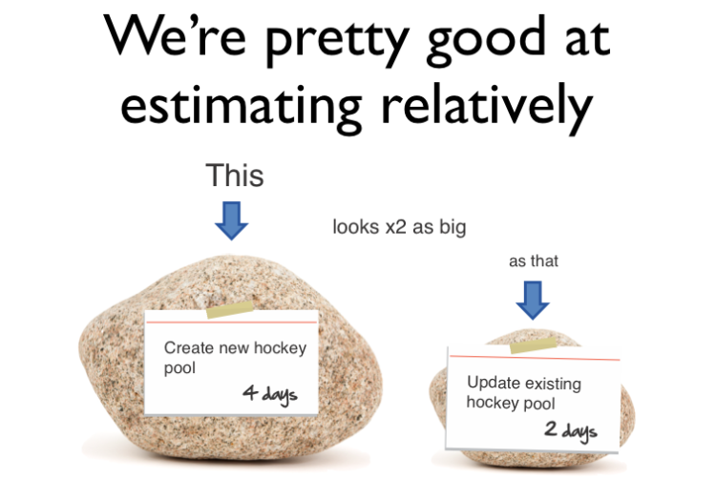
#4: We’re pretty good at estimating things relatively

Slide 7
#5: Velocity/Throughput is a good tool for adjusting estimates.

Slide 8
#6: We’re a bit behind, but we’ll make it up in testing since most of our uncertainty was in the features.

Slide 9
#7: Scope Creep is a major source of estimation error.

Slide 10
#8: Having more estimators, even if they are not experts, improves estimation accuracy

Slide 11
#9: Project success is determined by on-time delivery

Slide 12
#10: Estimation is waste

Slide 13
#1: Estimation challenges are well understood by General Management, Project Management, and Teams and it is normal to be able to estimate projects within 25% accuracy.

Slide 14
Delivery Challenges/Failures
Standish Group 2006, reported by CEO Jim Johnson, CIO.com, ‘How to Spot a Failing Project’
Notes:
Delivery failures are well documented in the software business.
This is the classic report from Standish showing only 35% of projects delivered on time with expected features. 46% were challenged and 19% were killed. This is from 2006, and is a substantial improvement from the 19% success rate in 1996.

Slide 15




Managing the Coming Storm
Inside the Cyclone
Project Kickoff
When will we get the requirements?
All in good time, my little pretty, all in good time
But I guess it doesn't matter anyway
Just give me your estimates by this afternoon
Team Unity
Not so fast! Not so fast! ... I'll have to give the matter a little thought. Go away and come back tomorrow
No, we need something today!
Ok then, it will take 2 years.
No, we need it sooner.
Doesn't anybody believe me?
I already promised the customer it will be out in 6 months
You're a very bad man!
Notes:
We look at a typical software project…..

Slide 16


We’re not in Kansas Anymore
Developer Hero
I may not come out alive, but I'm goin' in there!
Reorg
The Great and Powerful Oz has got matters well in hand.
My! People come and go so quickly here!
Testing
"Hee hee hee ha ha! Going so soon? I wouldn't hear of it! Why, my little party's just beginning!

Slide 17
Why is Software Late?
Genuchten 1991 IEEE
General Manager | Project Manager | Item
1 | 10 | Insufficient front end planning
2 | 3 | Unrealistic project plan
3 | 8 | Project scope underestimated
4 | 1 | Customer/management changes
5 | 14 | Insufficient contingency planning
6 | 13 | Inability to track progress
7 | 5 | Inability to track problems early
8 | 9 | Insufficient Number of checkpoints
9 | 4 | Staffing problems
10 | 2 | Technical complexity
11 | 6 | Priority Shifts
12 | 11 | No commitment by personnel to plan
13 | 12 | Uncooperative support groups
14 | 7 | Sinking team spirit
15 | 15 | Unqualified project personnel

Slide 18

The Context of Feedback

Slide 19
Why is Software Late?
Genuchten 1991 IEEE
General Manager | Project Manager | Item
4 | 1 | Customer/management changes
10 | 2 | Technical complexity
2 | 3 | Unrealistic project plan
9 | 4 | Staffing problems
7 | 5 | Inability to track problems early
11 | 6 | Priority Shifts
14 | 7 | Sinking team spirit
3 | 8 | Project scope underestimated
8 | 9 | Insufficient Number of checkpoints
1 | 10 | Insufficient front end planning
12 | 11 | No commitment by personnel to plan
13 | 12 | Uncooperative support groups
6 | 13 | Inability to track progress
5 | 14 | Insufficient contingency planning
15 | 15 | Unqualified project personnel
Notes:
The project manager is much closer to the actual work being done and so I tend to think their response is closer to reality. What is of particular interest is where there is a discrepancy between the General Manager and the Project Manager.
1 4 Customer/management changes
PM: They were constantly changing their minds GM:OK, so we changed a few things once in a while
2 10 Technical complexity
PM: We were using new technology and had to discover all the limitations GM: I just to them to make it look like that cool demo I saw
3 2 Unrealistic project plan
PM: We told them it would take longer GM: I had to push them so that they would be serious
4 9 Staffing problems
PM: We couldn’t get the people we needed GM: I gave them everyone I had available
5 7 Inability to track problems early
PM/GM: agree --- We didn’t know what we didn’t know
6 11 Priority Shifts
PM: They were constantly changing their minds GM: We didn’t change that much
7 14 Sinking team spirit
PM: The team felt overworked and underappreciated GM: We’ve got a great team. What spirit they have
8 3 Project scope underestimated
PM: I didn’t really feel that we underestimated it. We told them it would be hard GM: We really didn’t think it was such a big project
9 8 Insufficient Number of checkpoints
PM/GM agree – it would have been good to have better visibility into what was going on
10 1 Insufficient front end planning
PM: We had a plan, but they didn’t like the answer and kept changing their mind GM: It all would have been fine if we could have just planned better
11 12 No commitment by personnel to plan
PM/GM agree – team was willing to commit
12 13 Uncooperative support groups
PM/GM agree – support groups were willing to help
13 6 Inability to track progress
PM: We had pretty good tracking GM: I wish I had better visibility into what was going on so I could have done something
14 5 Insufficient contingency planning
PM: We had decent contingency planning, we just weren’t able to do anything GM: We just needed better planning
15 15 Unqualified project personnel
PM/GM agree – people are our most important assets

Slide 20
Why is Software Late?
Genuchten 1991 IEEE
General Manager | Project Manager | Item
H | H | Customer/management changes
L | H | Overall complexity
H | H | Unrealistic project plan
M | H | Staffing problems
H | L | Insufficient front end planning
Notes:
The project manager is much closer to the actual work being done and so I tend to think their response is closer to reality. What is of particular interest is where there is a discrepancy between the General Manager and the Project Manager.
1 4 Customer/management changes
PM: They were constantly changing their minds GM:OK, so we changed a few things once in a while
2 10 Technical complexity
PM: We were using new technology and had to discover all the limitations GM: I just to them to make it look like that cool demo I saw
3 2 Unrealistic project plan
PM: We told them it would take longer GM: I had to push them so that they would be serious
4 9 Staffing problems
PM: We couldn’t get the people we needed GM: I gave them everyone I had available
5 7 Inability to track problems early
PM/GM: agree --- We didn’t know what we didn’t know
6 11 Priority Shifts
PM: They were constantly changing their minds GM: We didn’t change that much
7 14 Sinking team spirit
PM: The team felt overworked and underappreciated GM: We’ve got a great team. What spirit they have
8 3 Project scope underestimated
PM: I didn’t really feel that we underestimated it. We told them it would be hard GM: We really didn’t think it was such a big project
9 8 Insufficient Number of checkpoints
PM/GM agree – it would have been good to have better visibility into what was going on
10 1 Insufficient front end planning
PM: We had a plan, but they didn’t like the answer and kept changing their mind GM: It all would have been fine if we could have just planned better
11 12 No commitment by personnel to plan
PM/GM agree – team was willing to commit
12 13 Uncooperative support groups
PM/GM agree – support groups were willing to help
13 6 Inability to track progress
PM: We had pretty good tracking GM: I wish I had better visibility into what was going on so I could have done something
14 5 Insufficient contingency planning
PM: We had decent contingency planning, we just weren’t able to do anything GM: We just needed better planning
15 15 Unqualified project personnel
PM/GM agree – people are our most important assets

Slide 21
Negotiation Bias
"It is difficult to get a man to understand something when his salary depends upon his not understanding it.“
        Upton Sinclair:

Slide 22
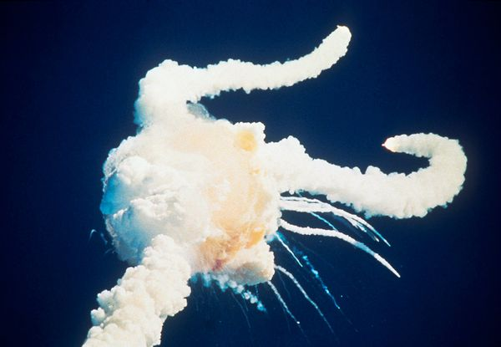
Space Shuttle Challenger
 | Engineers | Management
Probability of loss of life | 1 in 100 | 1 in 100,000
135 Flights
2 Disasters
14 Deaths

Slide 23

Overconfidence in Ranges
Most people are significantly overconfident about their estimates, especially educated professionals
90% Confidence Interval

Slide 24
Overconfidence of Success
Matthew G. Miller, Ray J. Dawson, Kieran B. Miller, Malcolm Bradley (2008). New Insights into IT Project Failure & How to Avoid It. Presented at 22nd IPMA World Congress -­‐ Rome (Italy) November 9-­‐11, 2008, in Stream 6. As of May 2013, self published at http://www.mgmiller.co.uk/files/paper.pdf

Slide 25
IEEE Software, May/June 2006
Notes:
This is from an IEEE Software article that I published in May 2006

Slide 26
Accuracy of Initial Estimate

Slide 27
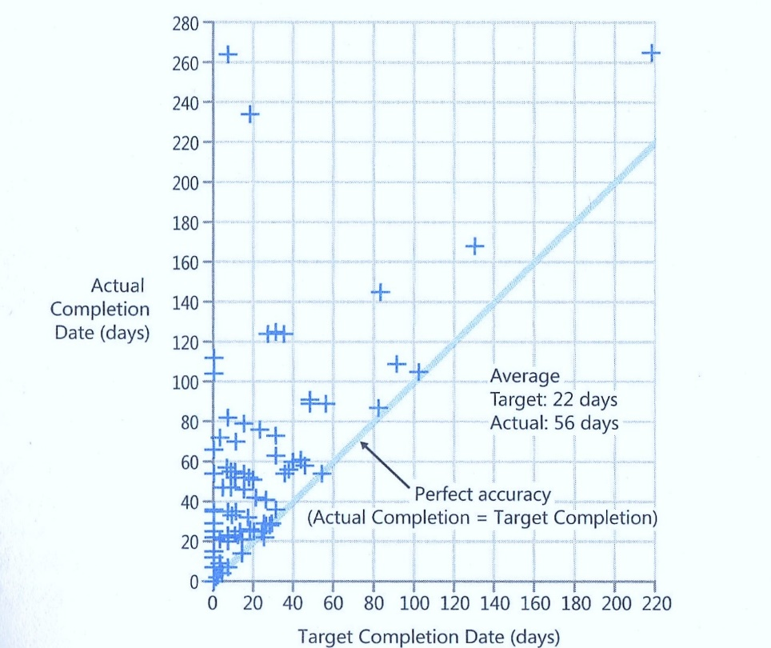
Data From Steve McConnell

Slide 28
Probability Distribution Curve
Notes:
Here is the probability distribution for DeMarco’s data and the LGC data together. Our medians are nearly identical, but our standard deviation is lower, hence the tighter curve.
See the log normal curve shape, as this is plotted on a Cartesian axis. While there are the number of points on either side of the median, there is more area to the right of the median. Thus, the mean of the distribution is higher than the median.

Slide 29
Log Normal Distribution
Estimation Accuracy follows a Log Normal distribution
Median
Mean
Notes:
Log Normal distribution works against us, because the curve is skewed to the right. The average or mean is greater than the p(50).

Slide 30
Uncertainty Bounds
10% exceed 3-4x
Median project 1.7x
10-20% on time

Slide 31
Jørgensen 2013
Put software development project for bid on online marketplace vWorker.com
Received 16 bids.
Reduced down to 6 bids from vendors that had high (9.5) client satisfaction.
All 6 bidders went ahead and built the software

Slide 32
Jørgensen 2013
Estimation Range: 8x
Actual/Estimate Range: 0.7 – 2.9 (4x)
Actual Performance Range: 18X

Slide 33

#1: Estimation challenges are well understood by General Management, Project Management, and Teams and it is normal to be able to estimate projects within 25% accuracy.

Slide 34
#2: Estimation accuracy significantly improves as the project progresses

Slide 35
How does Estimation Accuracy Improve Over Time?
Notes:
The conventional wisdom is that estimation gets better as the project progresses. This was first stated by Barry Boehm in COCOMO II, and stated by many authors subsequently, most notably Steve McConnell. At the Feasibility state the uncertainty band is 16X, while at Concept it has narrowed to 4X and by the Requirements it has reduced to 2.25X. This makes a lot of sense.

Slide 36
Landmark Cone of Uncertainty

Slide 37
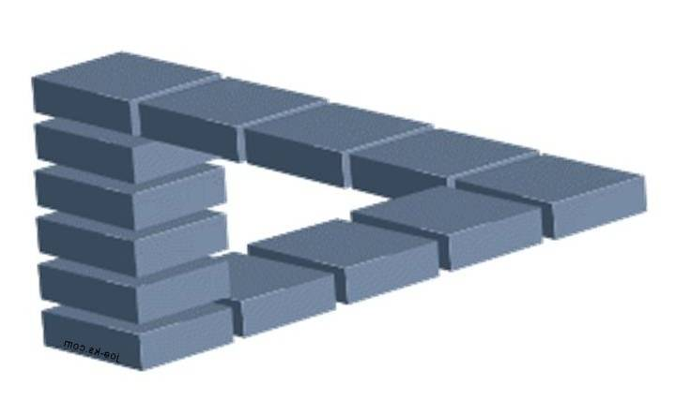
But is Uncertainty Really Reduced?
“Take away an ordinary person’s illusions and you take away happiness at the same time.”
Henrik Ibsen--Villanden

Slide 38

The Real Business Question
How much work do we have left to do and when will we ship?

Slide 39
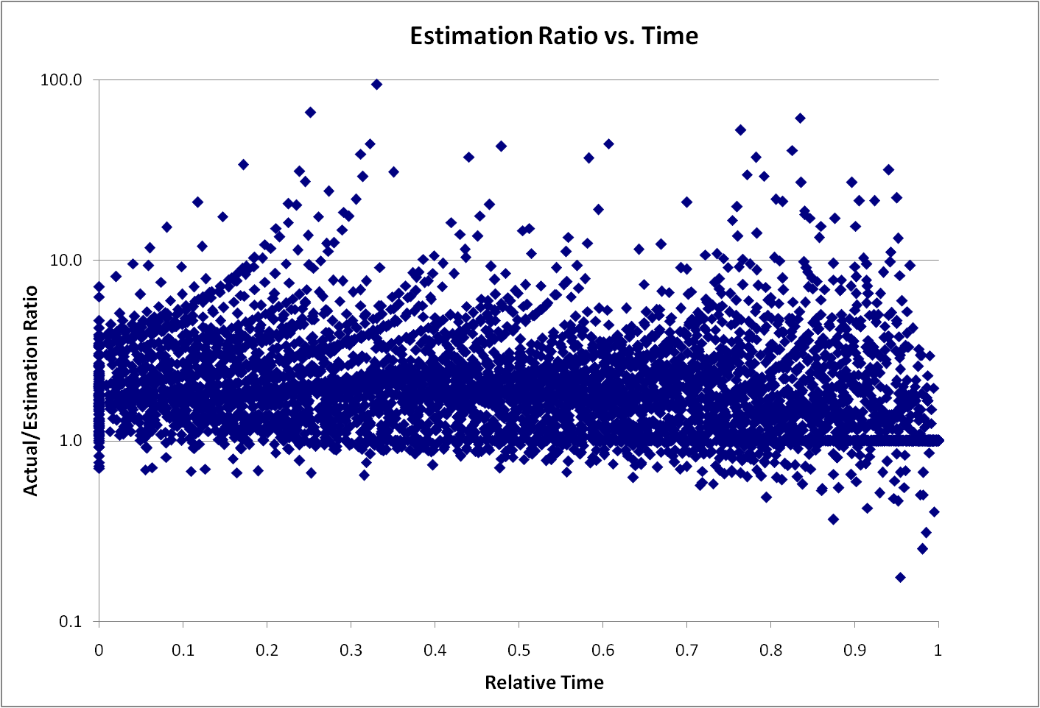
Remaining Uncertainty

Slide 40
Remaining Uncertainty
Story Estimate

Slide 41
#2: Estimation accuracy significantly improves as the project progresses

Slide 42
#3: Estimations are frequently impacted by biases and these biases can be significant.

Slide 43
Test 1 (Jørgensen IEEE Software 2008)
Group | Guidance | Result
A | 800
B | 40
C | 4
D | None | 160

Slide 44
Test 1
Group | Guidance | Result
A | 800 | 300
B | 40 | 100
C | 4 | 60
D | None | 160

Slide 45
Test 2
Group | Guidance | Result
A | Minor Extension
B | New Functionality
C | Extension | 50

Slide 46
Test 2
Group | Guidance | Result
A | Minor Extension | 40
B | New Functionality | 80
C | Extension | 50

Slide 47
Test 3
Group | Guidance | Result
A | Future work at stake, efficiency will be measured
B | Control | 100

Slide 48
Test 3
Group | Guidance | Result
A | Future work at stake, efficiency will be measured | 40
B | Control | 100

Slide 49
Understand Bias
"What gets us into trouble is not what we don't know. It's what we know for sure that just ain't so.“
        Mark Twain

Slide 50

#3: Estimations are frequently impacted by biases and these biases can be significant.

Slide 51
#4: We’re pretty good at estimating things relatively

Slide 52
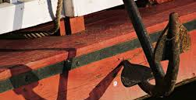
Anchoring

Slide 53
Did you know? (Jørgensen IEEE Software March 2013)
The US has 155 million more inhabitants than Mexico, but Mexico only has 100 million fewer inhabitants than the US.
Poland has 10 million more inhabitants than Romania, but Romania has about the same number of inhabitants as Poland.
Austria’s population is 70% of Hungary’s, while Hungary’s population is 80% of Austria’s.

Slide 54
Relative Sizing
Low by 4X

Slide 55
Uncertainty
Know that
we know
Know that
we don’t know
Don’t know that
we know
Knowable
Unknowable
Don’t know that
we don’t know
Notes:
This slide works best in animation mode. There are some things that we know that we know. This is essentially the spec. If everything goes well, this is the best we could do. There are some things that we know that we don’t know. These are typical project risks. There is another category of things that we don’t know that we don’t know. Some of these might be knowable if we put more effort into planning, but some of these are fundamentally unknowable in advance. (I ignore the Don’t know that we know. Some people refer to this quadrant as intuition or reflexes.). The unknowable section is what Fred Brooks refers to as the Werewolf.

Slide 56
Uncertainty
Know that
we know
Wishful Thinking
1x
Know that
we don’t know
Known Risks
2x
Don’t know that
we know
Knowable
Unknowable
Don’t know that
we don’t know
Uncertainty
Management
4x
Notes:
This slide works best in animation mode. We plan around that which we know. Traditional risk management focuses on risk identification and mitigation strategies, but can only manage risks that are known. Good risk management will result in good p50 estimates, or perhaps better. It is the unknowable that creates chaos. Shit happens. Market direction changes, reorganizations, new project priorities, customer commitments, attrition or RIF, etc. This is the importance of agility and flexibility in setting up project success criteria.

Slide 57
#4: We’re pretty good at estimating things relatively

Slide 58
#5: Velocity/Throughput is a good tool for adjusting estimates.

Slide 59
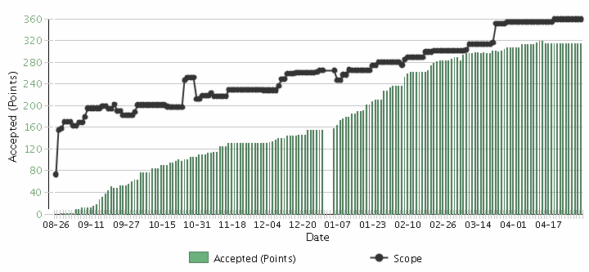
Burnup Chart
Scope Creep
Velocity

Slide 60

Velocity Helps Remove Bias
$\frac{Story Points}{Net Velocity= \frac{Story Points}{Iteration}}=Iterations$

Slide 61
But Velocity is not a Silver Bullet
Story Estimate

Slide 62
#5: Velocity is a good tool for adjusting estimates.

Slide 63
#6: We’re a bit behind, but we’ll make it up in testing since most of our uncertainty was in the features.

Slide 64
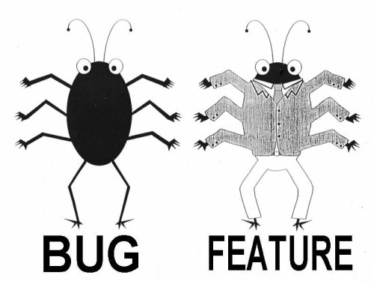
Lan Cao - Estimating Agile Software Project Effort: An Empirical Study
2X
Uncertainty,
Notes:
Lessons learned: If uncertainty is high, work on it earlier. Reduce Technical Debt—Get to potentially shippable at each iteration. Finding and fixing the last bugs has high uncertainty – plan on there being uncertainty.

Slide 65
#6: We’re a bit behind, but we’ll make it up in testing since most of our uncertainty was in the features.

Slide 66

#7: Scope Creep is a major source of estimation error.

Slide 67
We want this
Innovation
Revenue
Predictability
Efficiency
CLOUD
Social Networking
Late projects
Mobility
Integration
SOA
Business
Intelligence
BPM
Agile
Notes:
Chris taped one of the investment bankers at his previous job

Slide 68


Slide 69
Scope Creep
Capers Jones
  2% per month
  27% per year
Scope Creep
Velocity

Slide 70
Estimate Velocity Net of Scope Creep

Slide 71
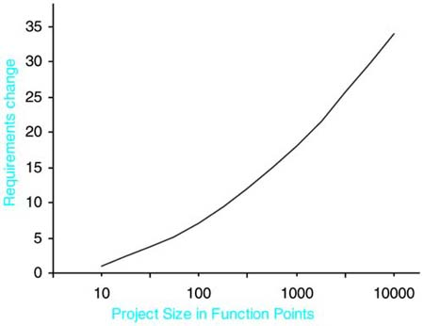
Scope Creep vs. Project Size

Slide 72
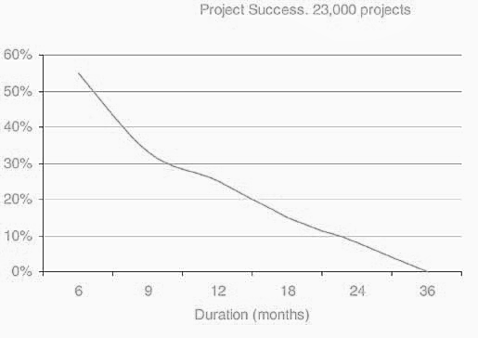
Success vs. Project Duration
Larman / Standish

Slide 73
#7: Scope Creep is a major source of estimation error.

Slide 74
#8: Having more estimators, even if they are not experts, improves estimation accuracy

Slide 75
Group Estimation Exercise
Number of Jellybeans in the jar

Slide 76
Jelly Bean Estimation

Slide 77



Wisdom of Crowds
Jelly Beans
“Who Wants To Be a Millionaire?” audience correct 91%
Dutch Tulips

Slide 78
Ask the Team

Slide 79
#8: Having more estimators, even if they are not experts, improves estimation accuracy

Slide 80
#9: Project success is determined by on-time delivery

Slide 81
Delivery Challenges/Failures
Standish Group 2006, reported by CEO Jim Johnson, CIO.com, ‘How to Spot a Failing Project’
Notes:
Delivery failures are well documented in the software business.
This is the classic report from Standish showing only 35% of projects delivered on time with expected features. 46% were challenged and 19% were killed. This is from 2006, and is a substantial improvement from the 19% success rate in 1996.

Slide 82
Why do we care about on-time delivery?

Slide 83
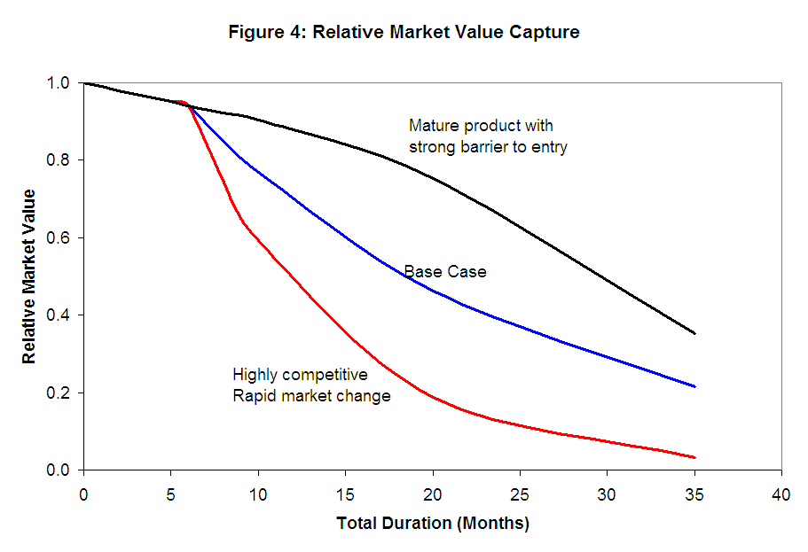
Cost of Delay

Slide 84

Notes:
Which risks are important? The sharp edges of the sign or the fact that the bridge is out ahead?

Slide 85

The Cost of Crap
Notes:
The first generation of Ford Taurus turned out to be the best selling car in America in the
late 1980s. Conceived in the 1980's and introduced in 1986, it set the standard for new practices
in project management and product development. It was one of the early projects in the U.S.,
which fully utilized the concept of cross-functional teams and concurrent engineering practices.
It established close ties with vendors and subcontractors, and was characterized by a spirit of
cooperation and strong synergy among teams. The result was a remarkable market and business
success. Its revolutionary design and outstanding quality, created a new trend in the U.S.
automobile industry, and customers simply loved the car. Yet, when the project was completed,
the project manager was fired. His “sin” was that project completion was delayed by six months.
In contrast, the second generation of Ford Taurus was developed in the early 1990s and
2
completed in 1995. With increased competition and the enormous success of Japanese imports,
Ford had hoped to reestablish Taurus, once again, as the best selling car in America. But the new
project manager learned the lesson of his predecessor: He considered project schedule as a “holy
grail,” and made sticking to the completion date the ultimate goal, while sacrificing other things.
Vendor relationships, team spirit, and product integration were just few of the issues that
suffered. The second generation of Taurus turned out to be a disappointing business experience.
It did not recapture the position of the best selling car in America and Ford was not able to repeat
its outstanding success of the first Taurus.

Slide 86
Compute This
"I recently asked a colleague [CIO] whether he would prefer to deliver a project somewhat late and over-budget but rich with business benefits or one that is on-time and underbudget but of scant value to the business. He thought it was a tough call, and then went for the on-time scenario. Delivering on-time and within budget is part of his IT department's performance metrics. Chasing after the elusive business value, over which he thought he had little control anyway, is not."
Cutter Sr. Consultant Helen Pukszta

Slide 87

Poker Metric:
Percent of Hands Won

Slide 88
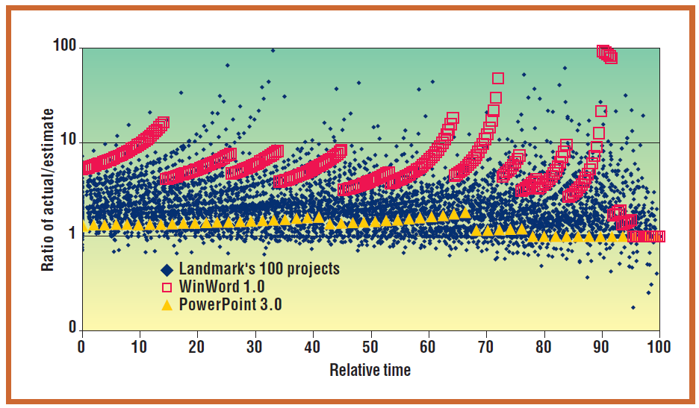
Software Metric – On Time%

Slide 89
The Measurement Inversion
In a business case, the economic value of measuring a variable is usually inversely proportional to the measurement attention it typically gets.
Lowest
Information Value
Most Measured
Initial cost
Long-term costs
Cost saving benefit other than labor productivity
Labor productivity
Revenue enhancement
Technology adoption rate
Project value
Highest Information Value
Least Measured

Slide 90
The Measurement Inversion
Lowest
Information Value
Cost & Time
Most Measured
Highest Information Value
Value Delivery
Least Measured

Slide 91
#9: Project success is determined by on-time delivery

Slide 92
#10: Estimation is waste

Slide 93
The Real Business Questions
Is it worth doing?
What is the priority?
When is the target time to ship?
What is the critical scope?
Do we have the right investment?
What is the cost of delay?

Slide 94

#10: Estimation is waste

Slide 95
Now What?

Slide 96
Increasing Value & Cost of Info.
Aim for this range
$$$
EVPI
EVPI – Expected Value of Perfect Information
ECI – Expected Cost of Information
EVI – Expected Value of Information
Value or Cost
EVI
ECI
$0
Perfect Information
Low certainty
High certainty

Slide 97
Increasing Value & Cost of Infomation
Aim for this range
$$$
Perfect Information
Value or Cost
Value of Information
Cost of Information
$0
Low certainty
High certainty

Slide 98
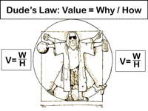

Slide 99
Estimation and Prioritization
XL
L
M
S
 | S | M | L | XL
Priority
Value
Cost

Slide 100
The A/B/C List sets proper expectations
A | MUST be completed in order to ship the product and the schedule will be slipped if necessary to make this commitment.
B | Is WISHED to be completed in order to ship the product, but may be dropped without consequence.
C | Is NOT TARGETED to be completed prior to shipping, but might make it if time allows.
Only “A” features may be committed to customers.
If more than 50% of the planned effort is allocated to “A” items the project is at risk.

Slide 101
Sizing for Scope Creep
500 Point release backlog
Velocity of 25 points per 2 week iteration
2%/mo = 1% scope creep per iteration = 5 pts.
Net Planned Velocity = 20 pts/iteration

Slide 102
A/B/C List
50%
25%
25%
A
B
C
D
Typical Delivery
C
A
B
Backlog Plan
Target Delivery Date
50%
100%

Slide 103
A/B/C List
A
50%
25%
25%
B
C
D
Uncertainty Risk
C
A
B
Backlog Plan
Target Delivery Date
50%
100%
Notes:
Need some explanation to go along with this slide and the previous one.
--The idea is that there is uncertainty in the estimation process. A factor of 2X is a generally sufficient buffer if the team has gotten basic estimation down. Thus is it possible that what is actually delivered is only the “A” items. That is ok and actually expected.

Slide 104

Metrics to Track

Slide 105
Burnup Chart
Scope Creep
Velocity

Slide 106
ABC or MoSCoW Burnup Chart

Slide 107
Defect Burndown

Slide 108
Potential Shippable Test Status

Slide 109
Ask the Team

Slide 110
Cost of Delay

Slide 111
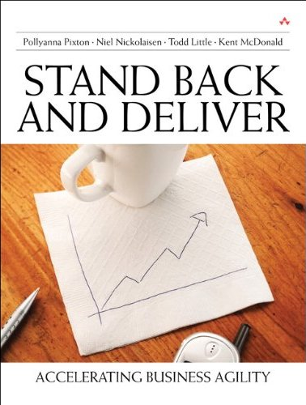
Contact
Todd Little
  todd.little@ihs.com
  toddelittle@gmail.com
  www.toddlittleweb.com
  www.accelinnova.com
  www.linkedin.com/in/toddelittle/

Slide 112

Top Ten reasons why we are late
Top 10 List
Top 10 List

Slide 113
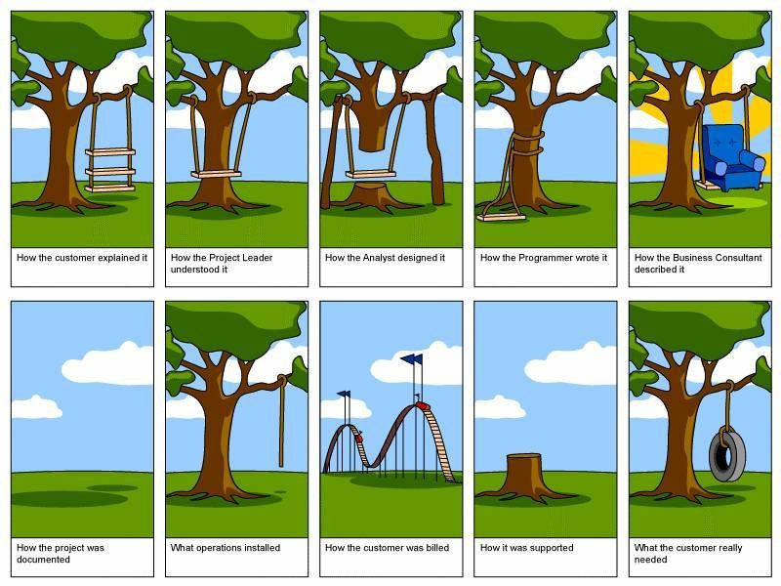
Top Ten reasons why we are late
10: Requirements, what Requirements?
What you want, baby I got it
R-E-Q-U-I-R-E
Find out what it means to me

Slide 114
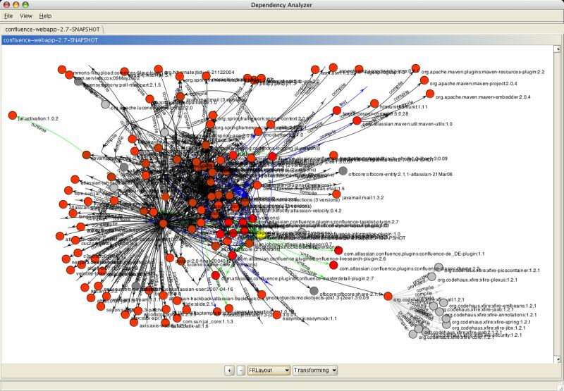
Top Ten reasons why we are late
9: Dependencies on other groups that were late

Slide 115

Top Ten reasons why we are late
8: Over-optimistic Schedule Estimation
Always look on the bright side of code
. . . . . . .
Always look on the bright side of code
. . . . . . .
The code’s a piece of $#!^,
when we look at it
We can always overlook a minor kink . . . .
It probably compiles, it might even link . . .
Surely that must mean it doesn’t stink
LIFE
OF
SOFTWARE

Slide 116
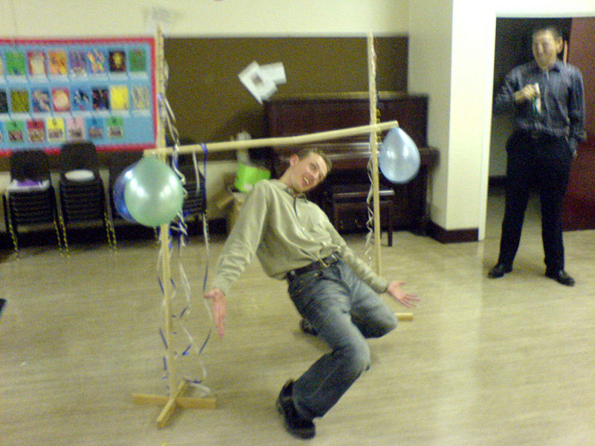
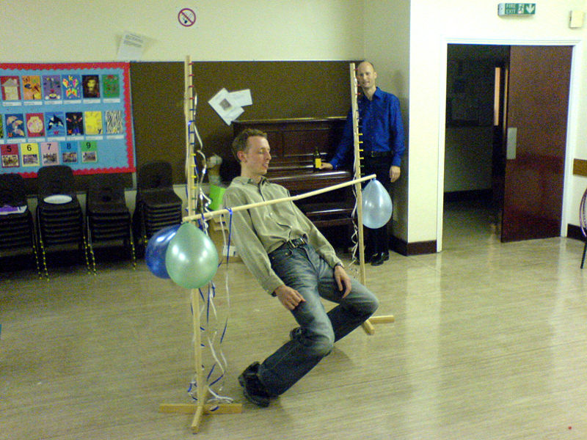
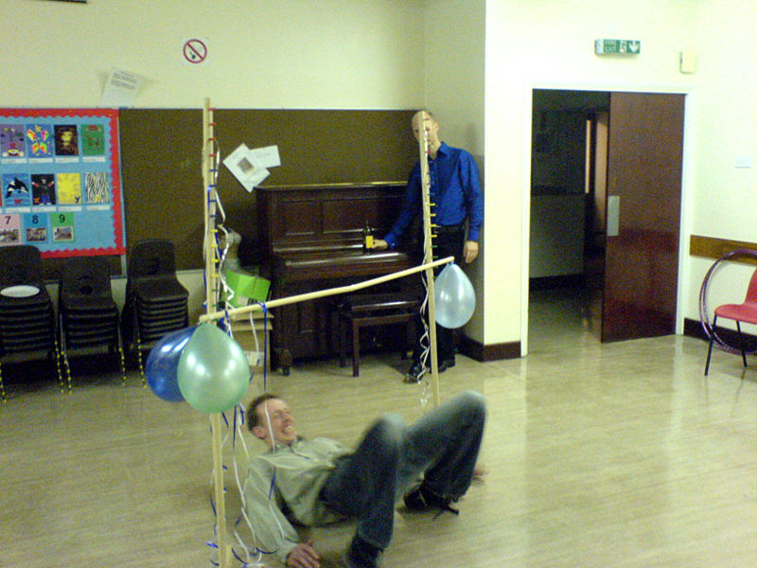
Top Ten reasons why we are late
7: Those weren’t MY estimates
Scheduling Ritual
How low can you go!

Slide 117

Top Ten reasons why we are late
6: Not enough testers or documentation resources.
Who needs them anyway? We put those bugs--I mean features--in there on purpose. Besides, it was difficult to program, it should be difficult to use.

Slide 118
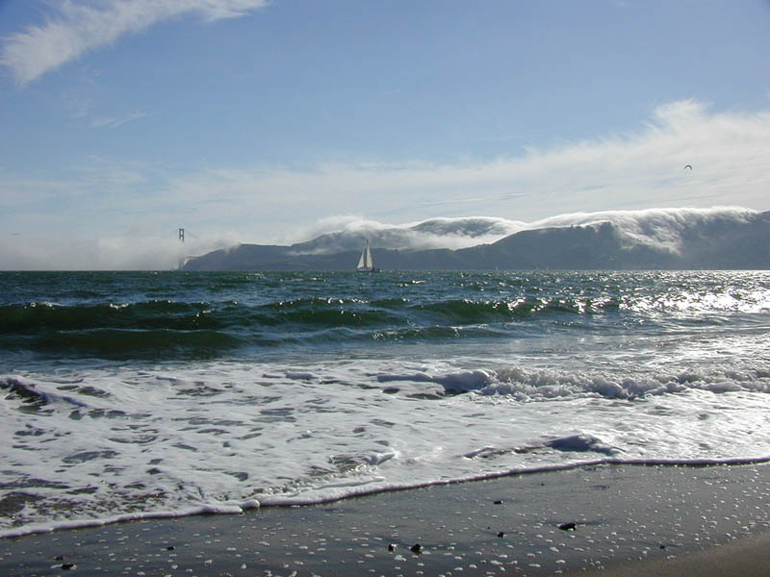
Top Ten reasons why we are late in 2008
5: Offshore and Outsourcing issues
My source code lies over the ocean,
My source code lies over the sea .
My source code lies over the ocean,
Oh bring back my source code to me
. . . . .
Bring Back, Bring Back,
oh bring back my source code to me, to me
Bring Back, Bring Back,
oh bring back my source code to me

Slide 119


Top Ten reasons why we are late
4: One word, Ch-ch-ch-changes

Slide 120

Top Ten reasons why we are late
3: I can’t get no, System Admin
  I can’t get no, CM action
  ‘cause I try,
  ..and I try,
  ….and I try,
  ……and I try….

Slide 121
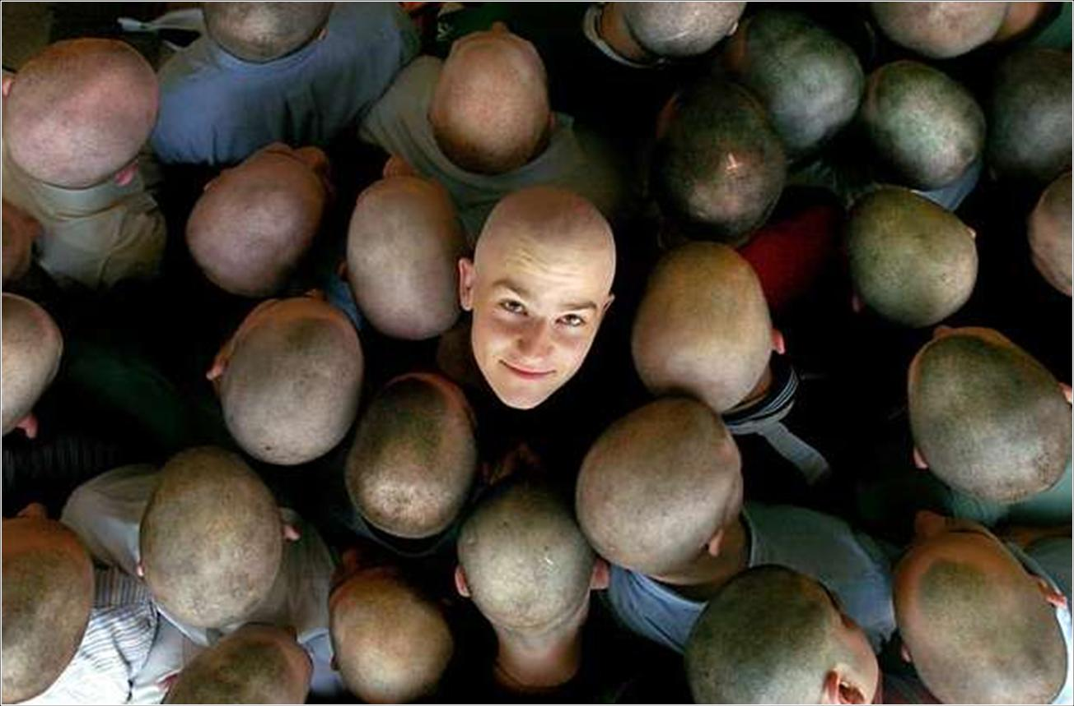
Top Ten reasons why we are late
2: You didn’t give me the headcount that you promised

Slide 122
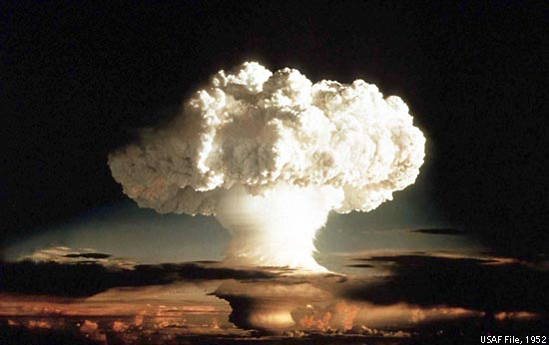
Top Ten reasons why we are late
1: Weren’t you doing the backups!?

Slide 123
Contact
Todd Little
  todd.little@ihs.com
  toddelittle@gmail.com
  www.toddlittleweb.com
  www.accelinnova.com
  www.linkedin.com/in/toddelittle/

