Slide 1

Resilience and Agility Through Evolutionary Change and the Kanban Maturity Model
Todd Little
Chairman Kanban University
www.kanban.university

Slide 2

Agility
Ability to change direction

Slide 3

Resilience
Ability to recover from adversity

Slide 4
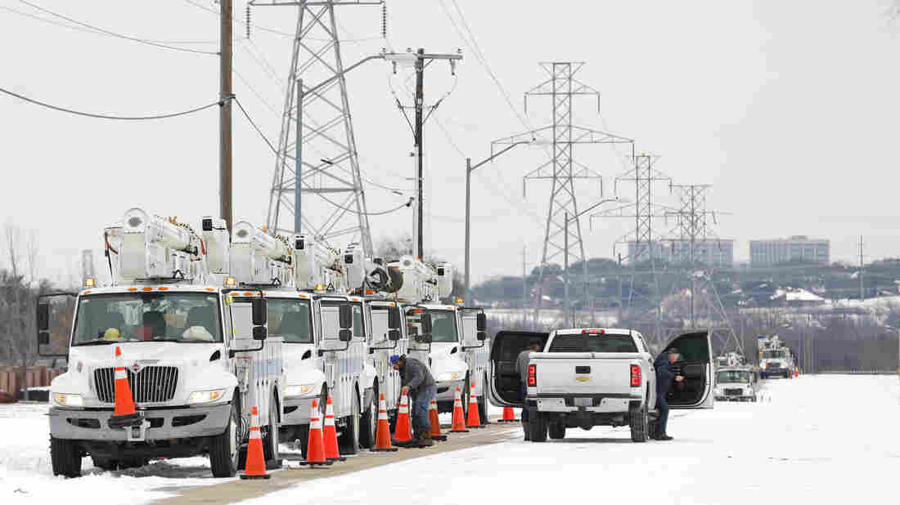

Slide 5


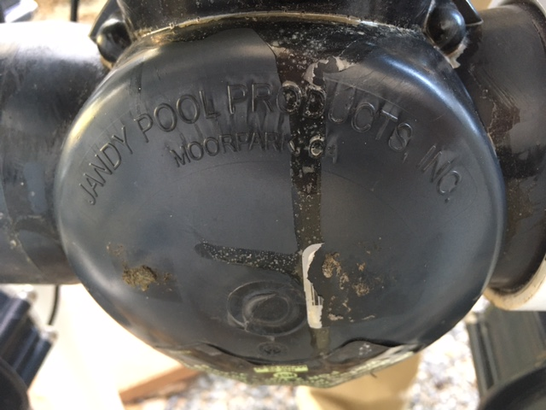
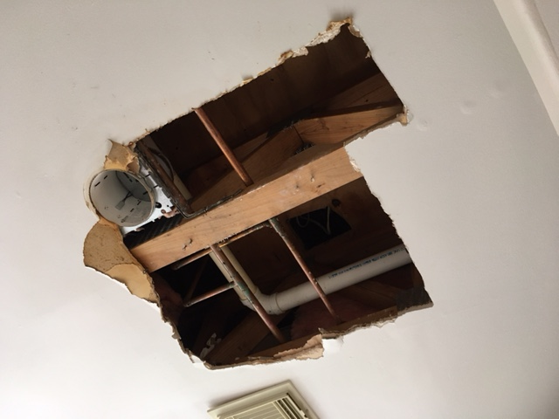
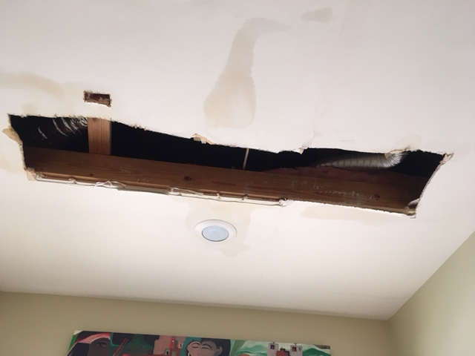
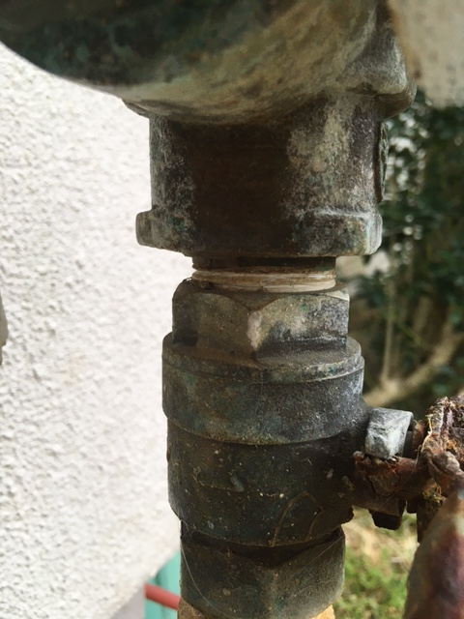

Slide 6
Why Kanban?

Slide 7
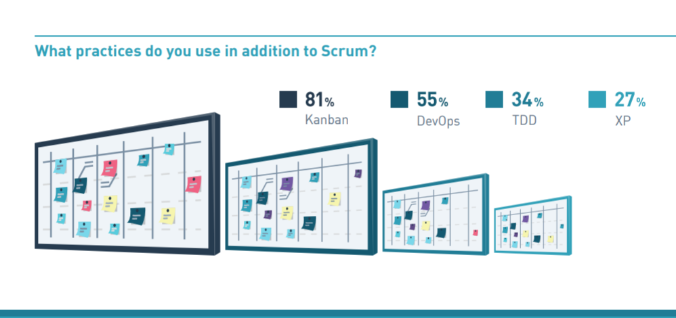
2019 Scrum Master Trends (Scrum.org)

Slide 8
What is Kanban?

Slide 9
This is what many people think Kanban is
To Do
In progress
Done

Slide 10
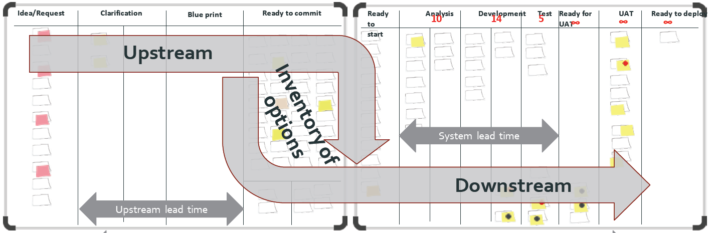
What is Kanban?
The Kanban Method is a tool for evolutionary change in managing knowledge work. It teaches organizations how to understand, visualize and measure systems of work to continually improve and consistently deliver effective results.
The Kanban Method provides a set of proven practices and approaches that scale from individuals and teams to the enterprise.

Slide 11

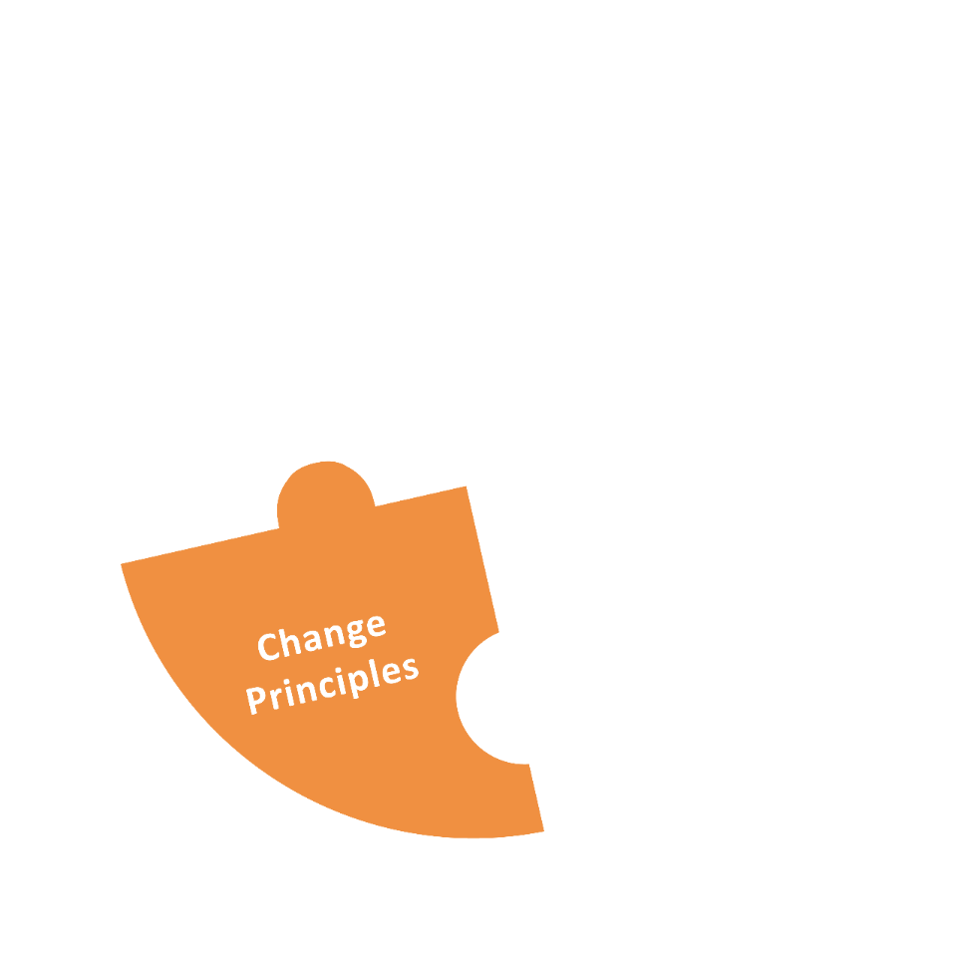
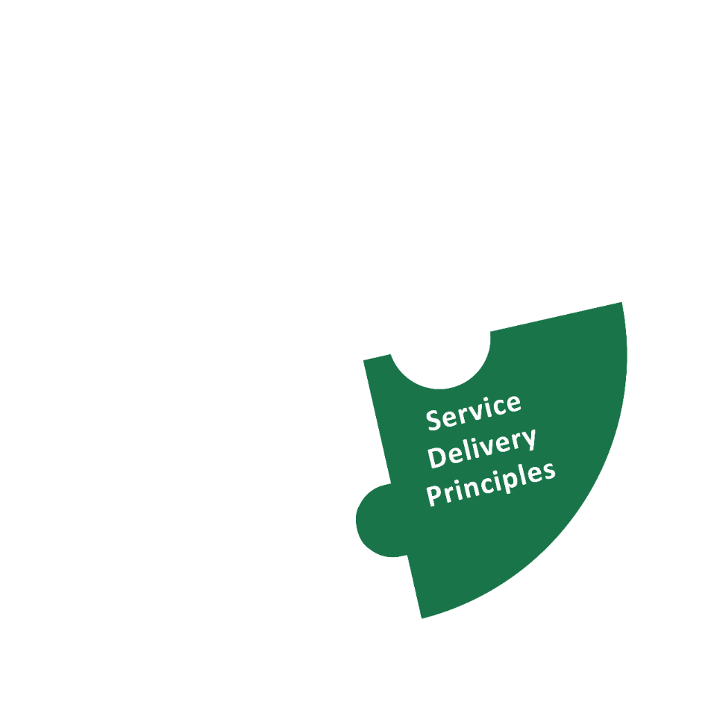

Elements of the Kanban Method
Notes:
What does the Kanban Method consist of?
These are the three building blocks defining the Kanban Method. We are going to cover them in this part of the class.
Technically, the Kanban Values are not part of the definition of the method, rather a different way of expressing it. They are not explicitely covered in this class.

Slide 12

Kanban Method: Change Management Principles
Start with what you do now.
    Understanding current processes, as actually practiced
    Respecting existing roles, responsibilities, and
    job titles
Gain agreement to pursue
improvement through
evolutionary change.
Encourage acts of leadership at all levels.
Notes:
There are 3 Change Management Principles designed to frame an evolutionary approach to improvement. Be aware that the Kanban Method is applied to the way you work now, and it will help you evolve the way you work gradually over time.
[Briefly walk through each of the principles. See David’s blog at http://www.djaa.com/principles-general-practices-kanban-method if you want help with how to explain each.]

Slide 13

Traditional Change is an A to B Process
Future process is defined / designed in advance
Transformation
Current
Process
Future
Process
Notes:
Traditional change management assumes you can plan a specific change goal and jump to it
Traditional change is an A to B process. A is where you are now. B is a destination. B is either defined (from a methodology definition) or designed (by tailoring a framework).
To get from A to B, a change agency* will guide a transition initiative to install destination B into the organization.
*either an internal SEPG or external consultants
* Value stream mapping, ** Theory of Constraints Thinking Processes

Slide 14
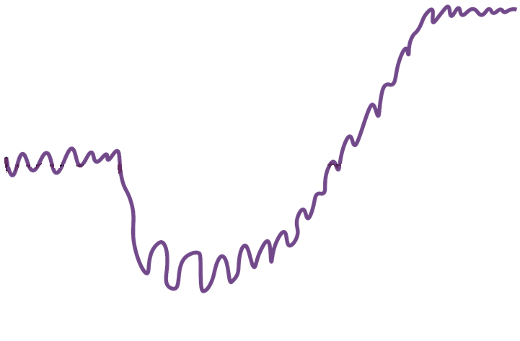

Evolutionary Change
Future State
Capability
Kanban in action!
Avoid the failure mode
of large scale, designed &
managed transformations
18% success*
64% moderately effective
Current State
time
Safety!
Lower maturity organizations panic under stress
Patience!
Failure!
18% failure
* https://www.pmi.org/-/media/pmi/documents/public/pdf/learning/thought-leadership/pulse/organizational-change-management.pdf
Notes:
But change initiatives feel like a lot of jarring ups and downs.
The trauma of a managed change initiative can feel unsafe
…and require a lot of patience

Slide 15
Evolutionary Change
Future process
is emergent
Evaluate Fitness
Evaluate Fitness
Evaluate Fitness
Evaluate Fitness
Roll forward
Evaluate Fitness
Roll back
Initial Process
Evolving Process
Notes:
Kanban uses evolutionary change which makes small steps and evaluates the results. Some changes are rolled back.
Traditional change is an A to B process. A is where you are now. B is a destination. B is either defined (from a methodology definition) or designed (by tailoring a framework).
To get from A to B, a change agency* will guide a transition initiative to install destination B into the organization.
*either an internal SEPG or external consultants
Your capability to change is low at the beginning
As you move forward, your capability improves and you can risk more significant change
You change management capability improves as you go
So does your process
Check out the Kanban Maturity Modell if you want to learn more

Slide 16

Water flows around the rock
“be like water”
the rock represents resistance
Notes:
A key teaching in Bruce Lee’s philosophy adapted from Taoism, is "to be like water". Water flows around the rock. The rock represents resistance - in fighting, the resistance is from the opponent. In Kanban, the rock represents resistance to change.

Slide 17
Kanban: The Great Unifier
Start with what you do now
Chaos
Kanban
SAFe
Scrum
Waterfall
CMMi

Slide 18
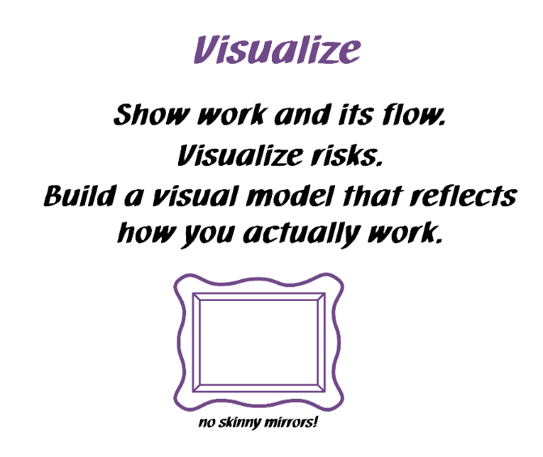
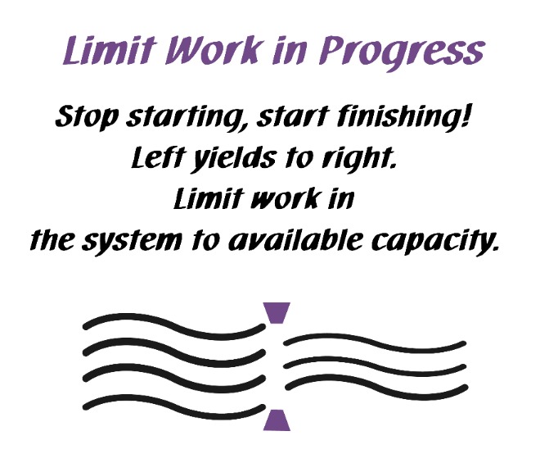
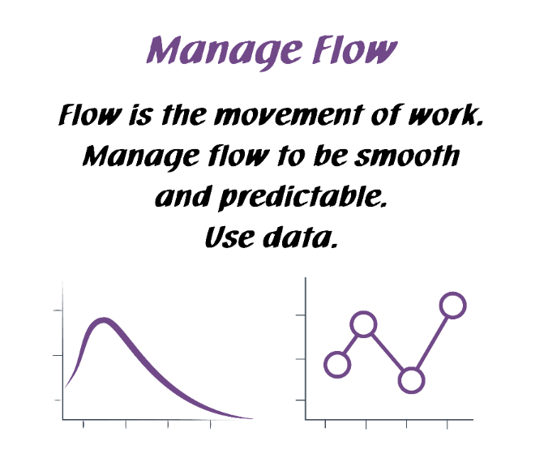
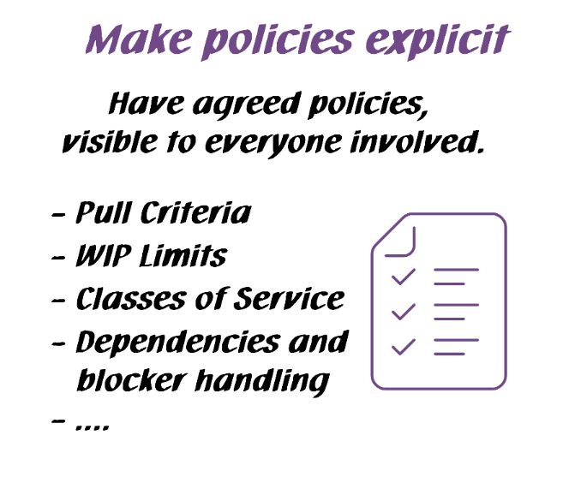
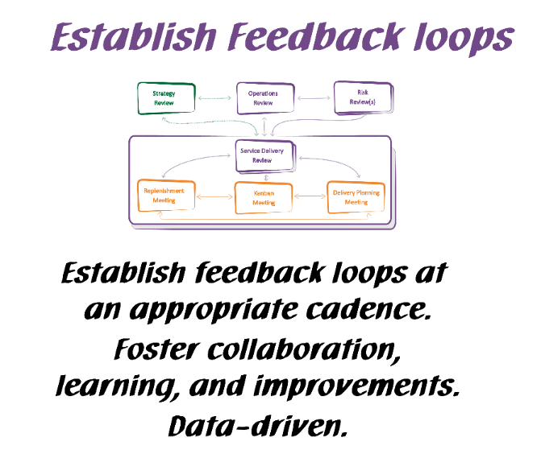
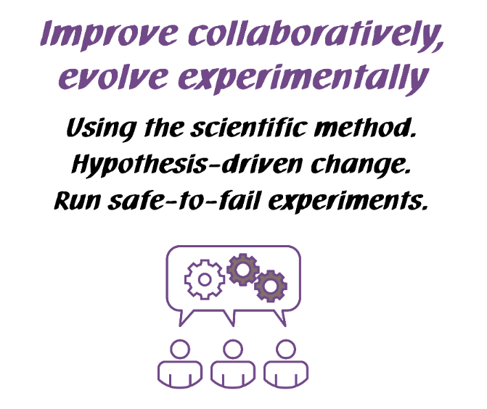
Kanban General Practices
Notes:
Walk the class through the Kanban practices.
There are 6 General Practices in the Kanban Method. [Walk briefly through each of the 6 Practices. See David Anderson’s blog at http://www.djaa.com/principles-general-practices-kanban-method if you want help with how to explain]
Instead of using this slide, you can also create a flipchart with similar info etc.
You might revise this after the simulation.

Slide 19
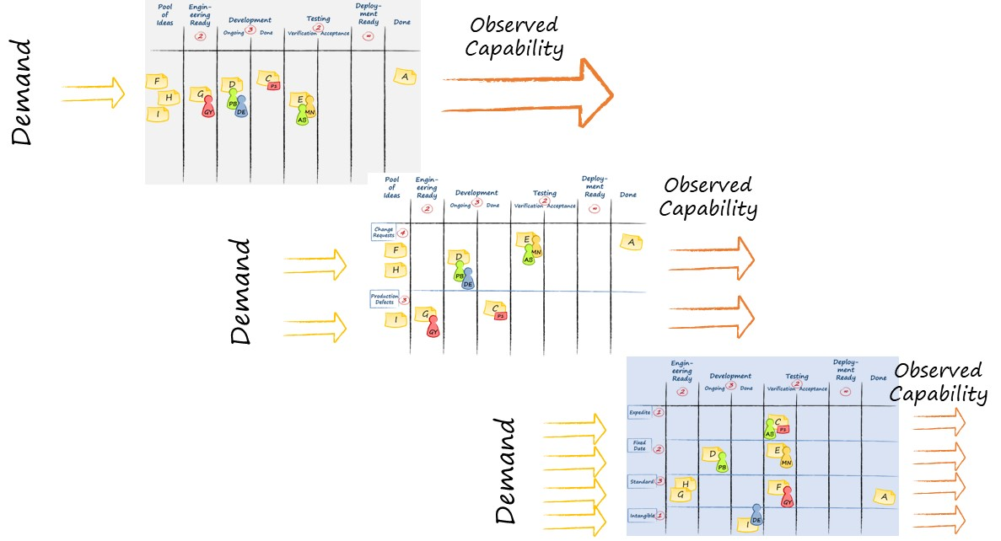

Visualize
Ideas

Slide 20
Visualize
Ideas
Understand the system

Slide 21
Visualize
Ideas
Understand the system
FLOW

Slide 22

Visualize
Ideas
Understand the system
FLOW
Balance Demand and Capacity

Slide 23
Visualize
Ideas
Understand the system
FLOW
Balance Demand and Capacity
Limit WIP

Slide 24
Visualize
Ideas
Understand the system
FLOW
Balance Demand and Capacity
Limit WIP
Bottleneck

Slide 25
Visualize
Ideas
Understand the system
Scale
FLOW
Balance Demand and Capacity
Limit WIP
Bottleneck

Slide 26
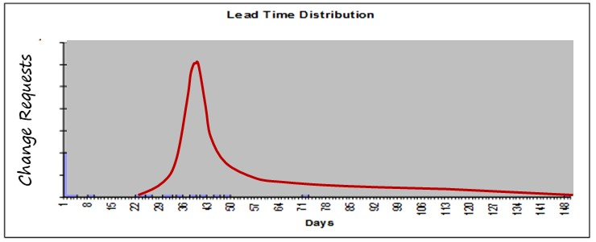
Visualize
Ideas
Incremental process improvement through measurement
Understand the system
Scale
FLOW
Balance Demand and Capacity
Limit WIP
Bottleneck

Slide 27
Visualize
Ideas
Incremental process improvement through measurement
Understand the system
Scale
FLOW
Balance Demand and Capacity
Limit WIP
Bottleneck
Fitness improvement through feedback

Slide 28
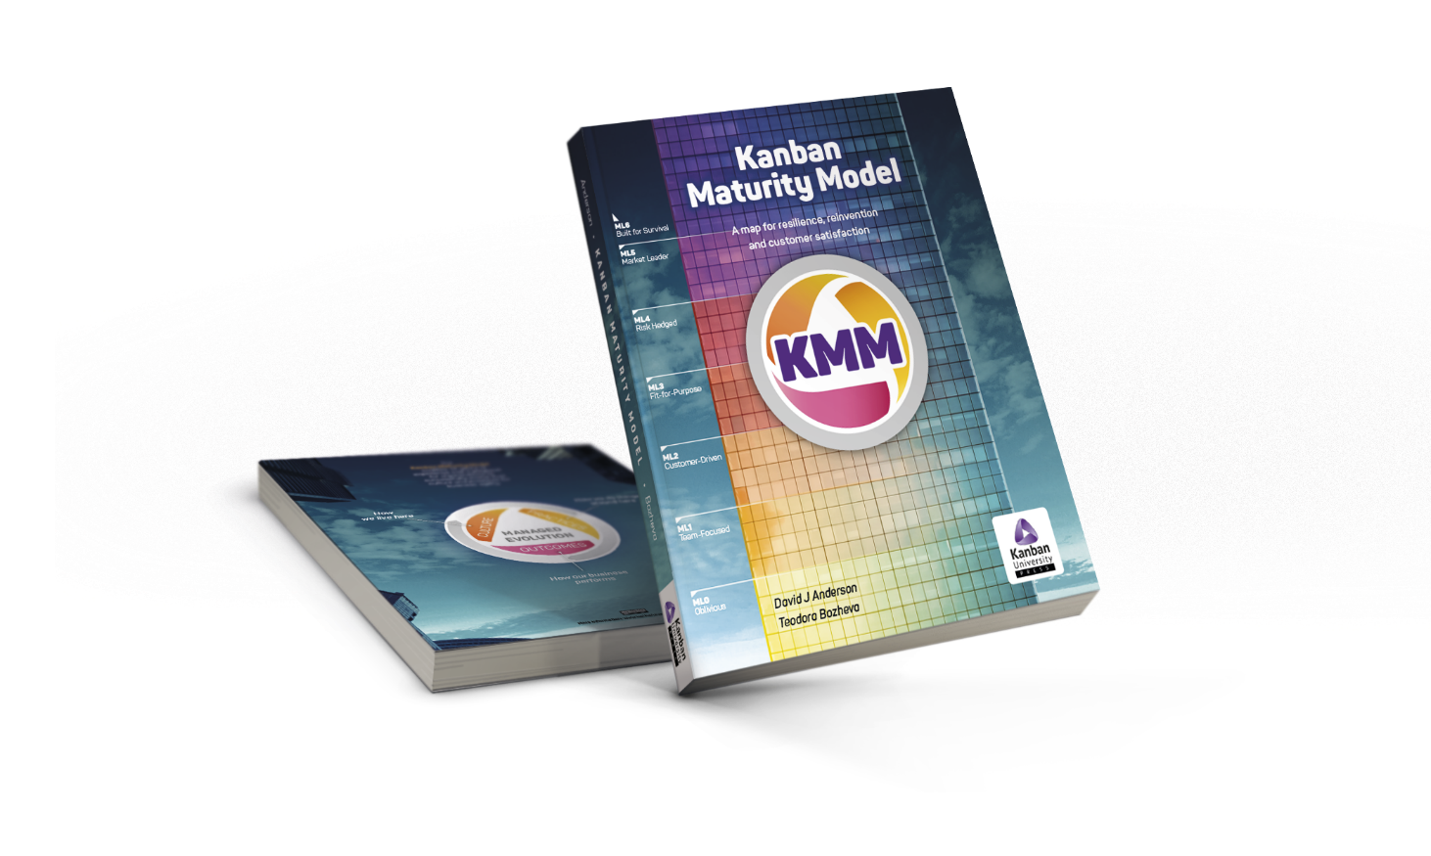
Kanban Maturity Model

Slide 29
Why do we need YAMM?

Slide 30
How the Kanban Maturity Model is Different
Conformance to Practices
Processes
Inputs
Inputs
Inputs
Traditional Maturity Models
Outcomes and Results
Processes
Inputs
Inputs
Inputs
Kanban Maturity Model
Outcomes and Results

Slide 31
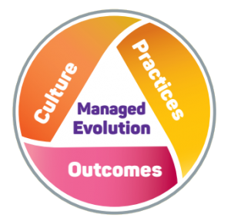

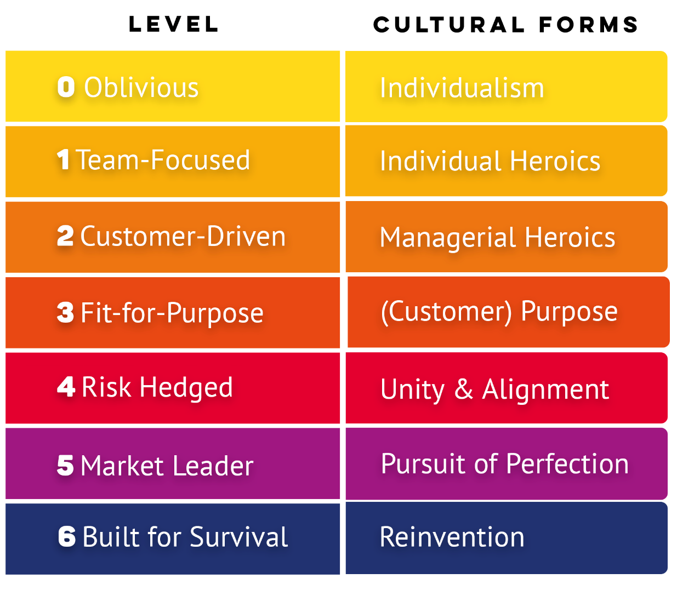
The Kanban Maturity Model (KMM) maps ~150 specific Kanban practices to observable business outcomes using seven levels of organizational maturity
Notes:
*Every customer has their pet!

Slide 32
KMM helps eliminate the two failure modes in Kanban and Agile implementations:
  overreaching causing an aborted start;
  false summit plateaus that fail to realize full benefit.
Notes:
*Every customer has their pet!

Slide 33
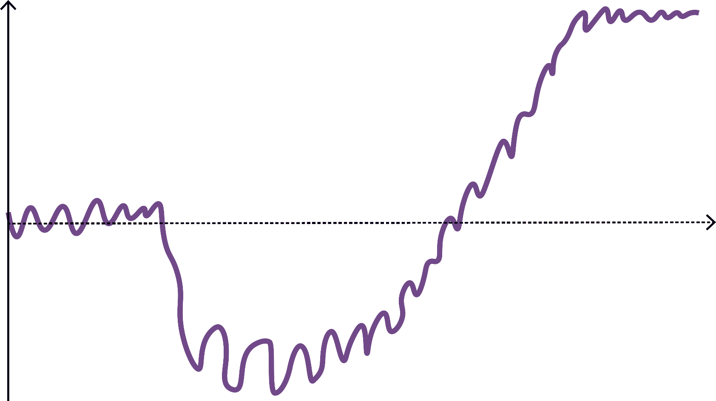
Overreaching and Plateauing
Capability
Missed
Benefit
False Summit Plateau
time
Overreaching
Notes:
But change initiatives feel like a lot of jarring ups and downs.
The trauma of a managed change initiative can feel unsafe
…and require a lot of patience

Slide 34
ML0: Oblivious
“My Way”
Everyone is busy, but what are they producing?
Notes:
*Every customer has their pet!

Slide 35

Individualism
Unpredictable and unreliable service
Overburdened people
Unhappy customers Unhappy managers Unhappy people

Slide 36
Recommendations
Implement:
Visualize Work at Team Level
Limit Work In Progress (WIP)
Define Initial Policies
Feedback Loops – Kanban Meeting

Slide 37
ML1: Team-Focused
“Never the same way twice”
individual heroics
unconnected teams
Notes:
If you see evidence of reliance on ‘the hero’ it’s ML1
If you hear that people is talking all the time about teams and nothing about aligning and coordinating different teams, it is ML1.
If team members complain that the managers change priorities frequently, this is ML1 (or less) – the management does not care about how priority changes affect team’s work.

Slide 38
Problem Statement
“Every team reports that they deliver on their commitments, but I know that customers are waiting longer than 6 months for delivery”
agile coach,
internet equipment manufacturer

Slide 39
Maturity Level 1 - Team Kanban Boards
Backlog
Next
In-progress
Done
∞
₃
₃
∞
D
C
A
H
PB
_{I}
E
_{J}
DE
G
F
GY

Slide 40
Diagnosis
Lack of service-orientation
Localized metrics & objectives
No customer recognizable work items
Lack of collaboration across service-delivery workflow

Slide 41
Recommendations
Implement:
STATIK (Systems Thinking Approach to Introducing Kanban)
Customer recognizable work item types
Service-oriented workflow board
Flow Review

Slide 42
Maturity Level 2 – Aggregated Team Kanban Board
Pool
of
Ideas
Next
Platform Enhancement
API Development
Mobile UI Dev
Ready for Customer
₅
Ongoing
Done
Ongoing
Done
₃
∞
₃
∞
₃
∞
C
C
P1
J
A
F
D
B
H
G
PB
M
GY
DE
K
E
MN
I
O
AB
N
P
L
Team 1 Kanban
Team 3 Kanban
Team 2 Kanban

Slide 43
ML2: Customer-Driven
“Never the same result twice”
managerial heroics
delays and last-minute tension despite coordinated team effort
Notes:
*If you see managers stepping in to solve problems before a disaster, or draconian policies put in place to avoid future disasters – it’s ML2
If managers and people complain that they cannot meet deadlines or meet them at the cost of extra hours and tension in spite of all their intents to coordinate the teams, it is ML2.
If teams complain that work within their dept goes smoothly but there are frequent conflict of priorities among departments, this is ML2T, services are managed within the departments, but the alignment around a common purpose is still missing and this creates friction and tension in the end-to-end flow management.

Slide 44
Problem Statement
“I haven’t looked at the lead time chart in months”
software development manager,
telecom equipment manufacturer

Slide 45
Diagnosis
Is a “service delivery manager” role present?
Are customer expectations understood & communicated?
Is there service delivery review happening?

Slide 46
Additional questions
Is there any blocker management?
Is blocker likelihood and impact being reported?
Is there a risk review?
Is the lead time distribution thin or fat-tailed?

Slide 47
Recommendations
Implement:
Instrument & Report Lead time
Service Delivery Manager Role
Service Delivery Review
Blocker Metrics
Risk Review
Customer Expectation (fitness criteria)

Slide 48
Maturity Level 3 Kanban Board (and pull system)
Engin-
eering
Ready
Deploy-ment
Ready
Test
Ready
Ideas
Development
Testing
UAT
₃
₅
₃
∞
∞
₅
Ongoing
Done
H
B
Pull
_{J}
E
F
G
F
Pull
C
F
F
F
I
F
F
D
A
*
I
Notes:
Slides in the section are for discussion of review material, as needed.
----
Numbers written at the top of the columns can also express available slots (capacity) for new work.

Slide 49
ML3: Fit-for-Purpose
“Predictable Delivery”
“no more heroes anymore”
processes under control
Notes:
*when the system keeps customers happy – you don’t have to work all night – it’s ML3
* When people say that they go home on time, not worrying or thinking how to manage to do everything the next day because the entire process is under control, it is ML3.

Slide 50
Problem Statement
“We just put out a release on time, met our commitments, but our product management team, reacted with WTF is this?”
software development manager,
mobile application, Berlin

Slide 51
Diagnosis
Work items weren’t meaningful and understood by customers
Asynchronous commitment
Pull from partially committed “buffer”, no replenishment meeting

Slide 52
Recommendations
Implement:
2-tiered Kanban Board
New coarse-grained work item type
Synchronous commitment
Full replenishment meeting with customers present, & synchronous commitment
Customers commit to coarse-grained work items

Slide 53
ML4: Risk Hedged
“Everyone is happy”
no more surprises
Notes:
*When the system anticipates problems and adjusts actions to avoid them, it’s ML4

Slide 54
ML5: Market Leader
“Simply the best”
marginal gains
attention to every detail
Notes:
*When teams re-paint the floor, and individuals rinse their cottage cheese, to squeeze effectiveness and profit out of good economics – it’s ML5

Slide 55
ML6: Built for Survival
“Reinvention”
Continually challenging
new identity; new purpose
Notes:
*When the leaders challenge existing identity and purpose and redefine who, what, how, and why – successfully – it’s ML6

Slide 56
Kanban Maturity Model at Vanguard
Scrum Stall
System lead time improved by 78 percent in approximately ninety days!

Slide 57
Kanban Maturity Model at Vanguard

Slide 58
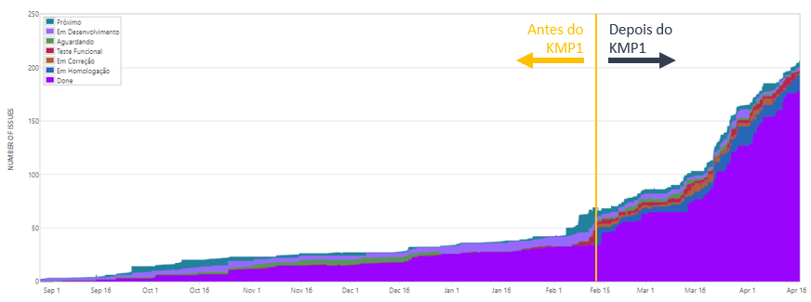
Kanban Impact at Accenture Brazil

Slide 59
It is the organization that matures, not the Kanban that matures

Slide 60
Resilience and Agility Through Evolutionary Change and the Kanban Maturity Model
Todd Little
Chairman Kanban University
www.kanban.university

