Slide 1
Performance Reviews that don’t Suck
Todd Little, CEO Lean Kanban

Slide 2
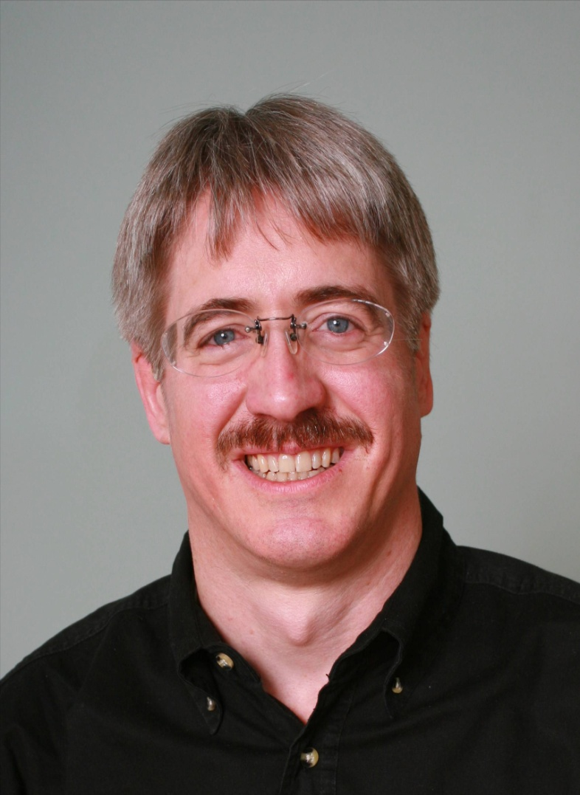
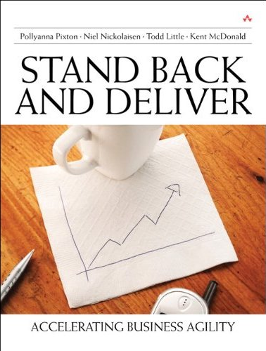
About Todd and Andrew Tuttle
CEO at Lean Kanban
Executive roles as VP Product Development, Director of Software & Technology
@toddelittle
Executive Director of Product Development
10 years of people management experience
Notes:
Director – company called IHS until a few days ago
Just merged – 9,000 – 15,000
Information & analytics company, verticals
Performance reviews 10 years – mistake
Stopped laughing – launch
3 years ago – working off and on

Slide 3
Audience Participation
Who loves performance reviews?
What challenges have you seen with performance reviews?
What have you seen that has worked well with your performance reviews?

Slide 4
Why do Performance Reviews?

Slide 5
Why do Performance Reviews?
Set Goals
Measure Performance
Establish Rewards
Career Development

Slide 6
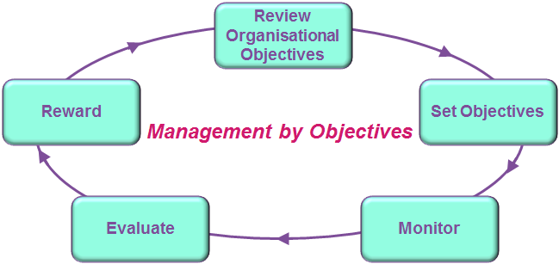
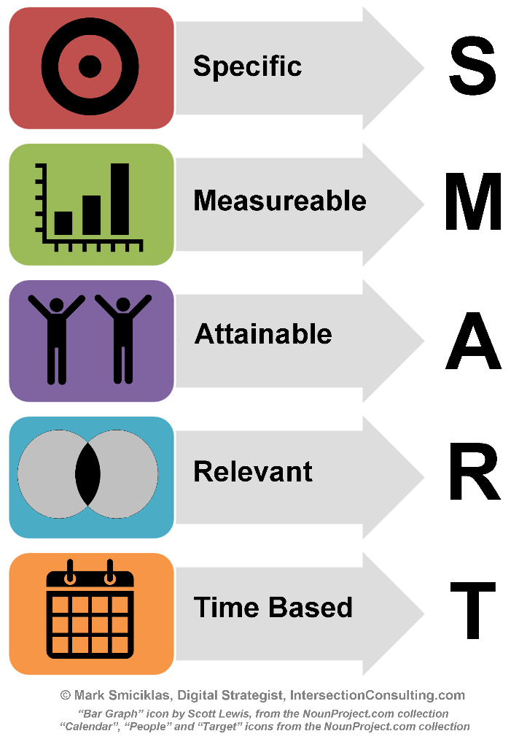
Traditional Approach to Objectives
Notes:
A big problem many of us face is that traditional HR systems push us into approaches that don’t work well for modern software development
Most systems push for SMART objectives and Management by Objective

Slide 7
Problems with SMART Objectives
Increase code production rate to __(#) lines of code per __(unit of time) by __(date)
Notes:
Helpful library of templates
Here’s one they suggest for software developers…
What could go wrong? The mind runs wild with other possibilities….

Slide 8
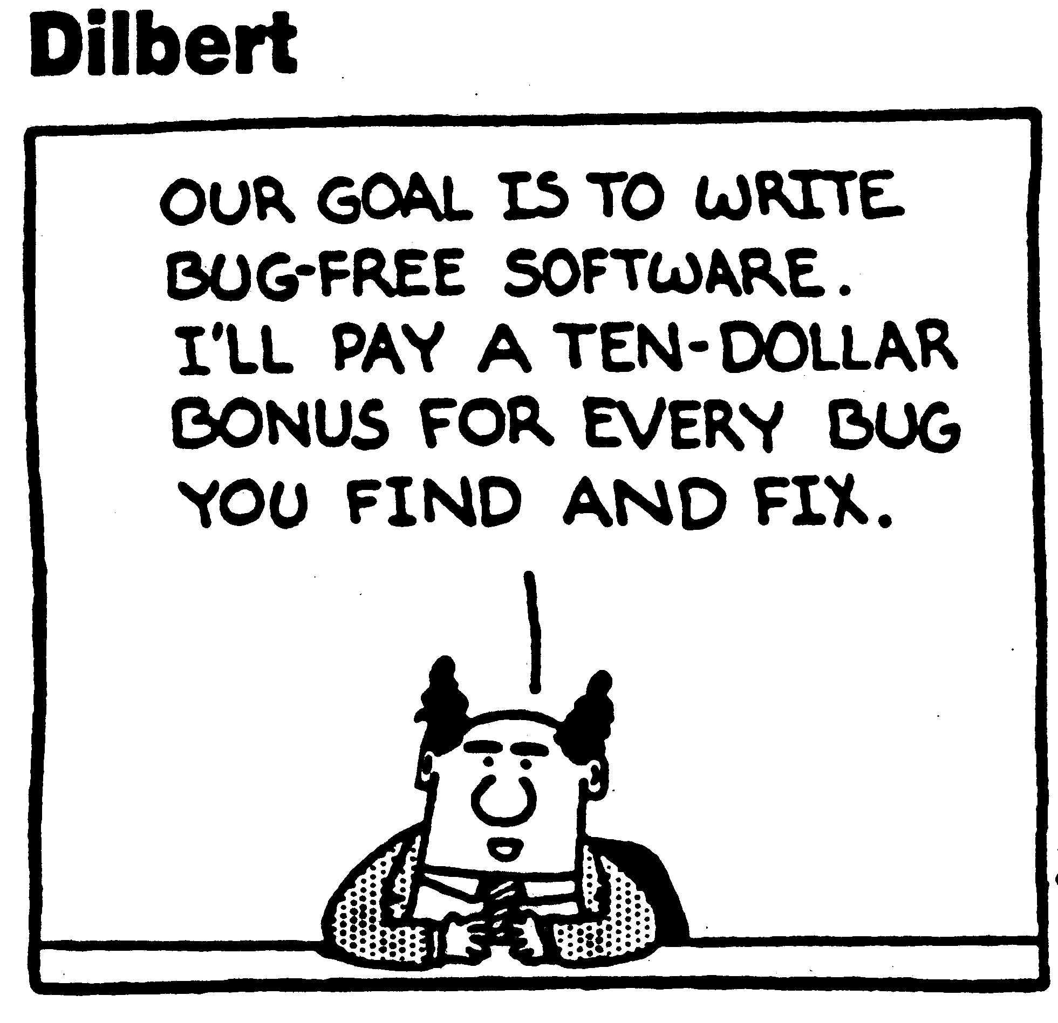
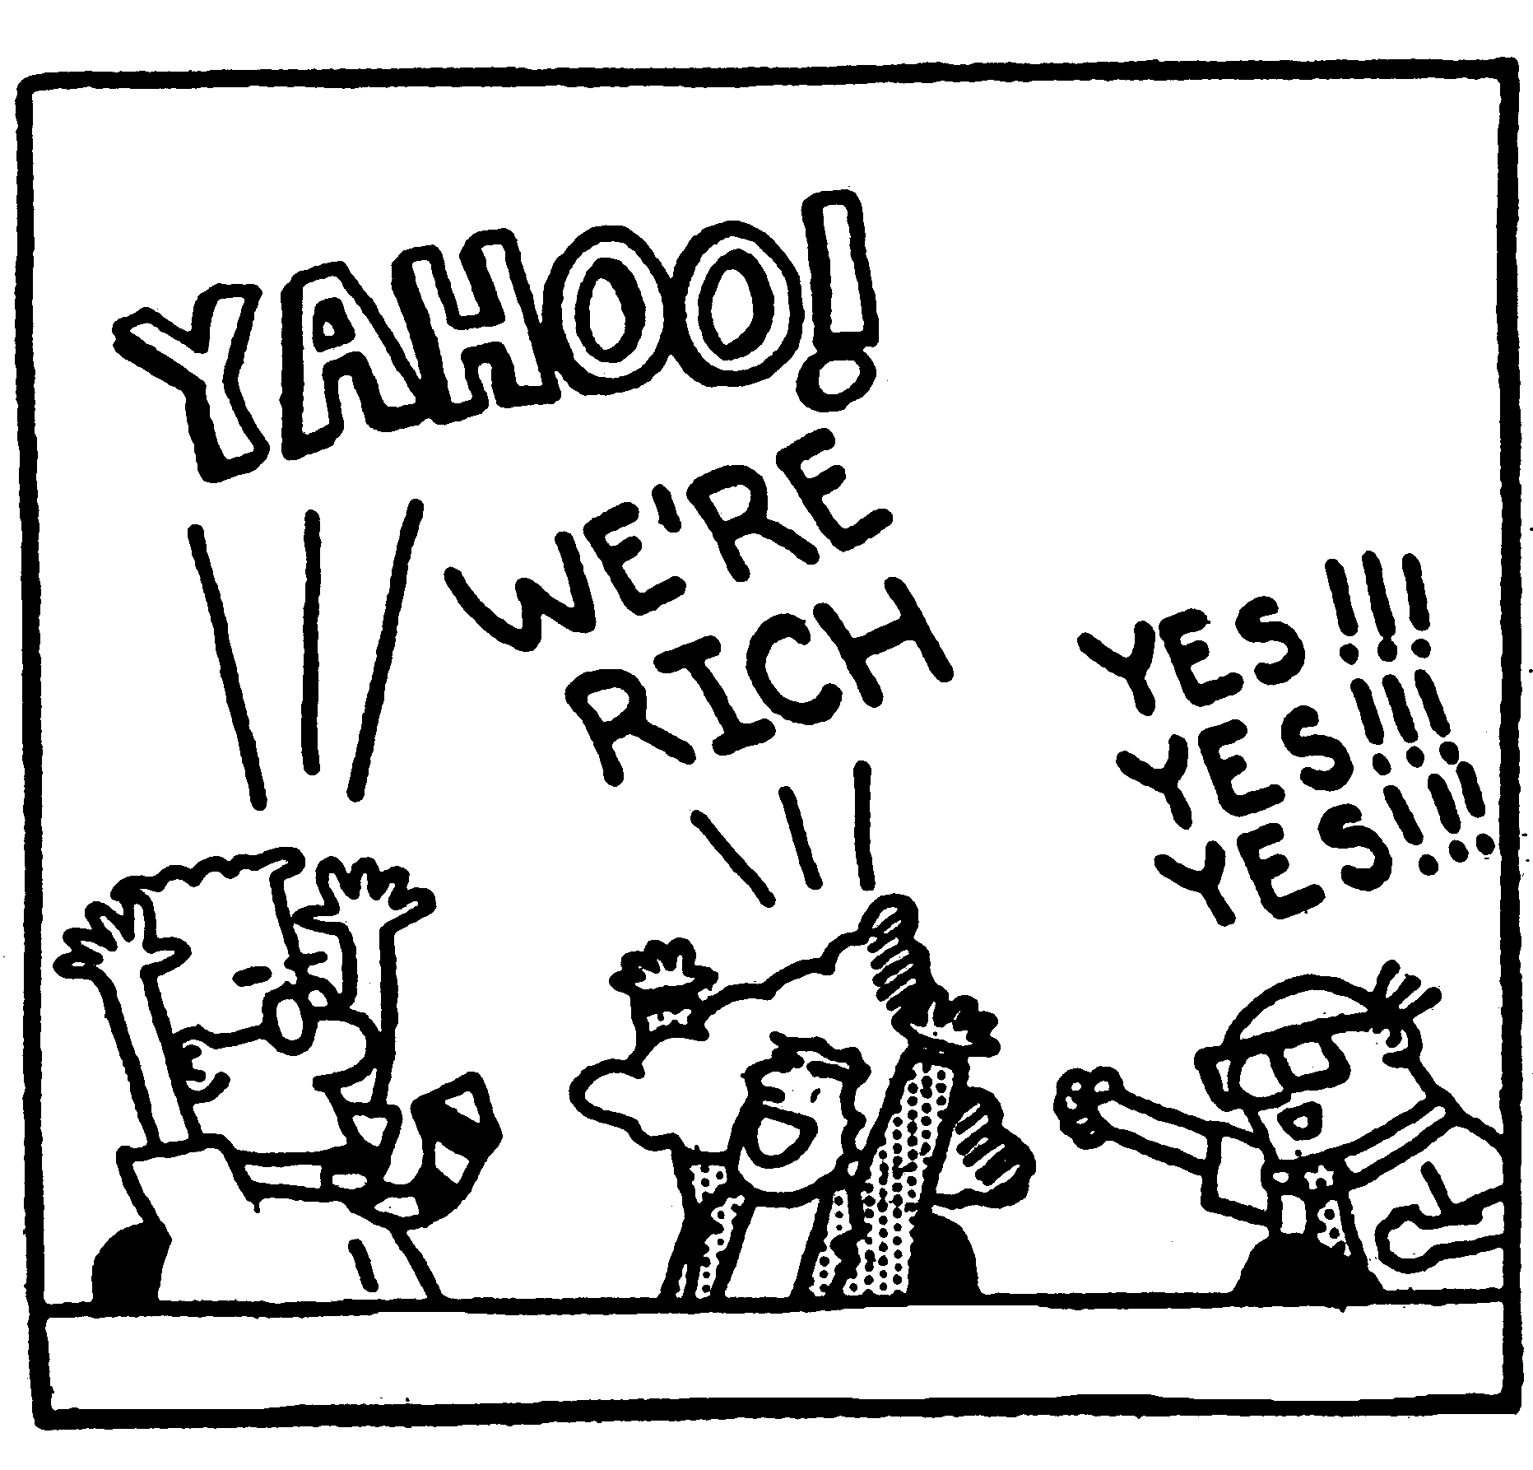
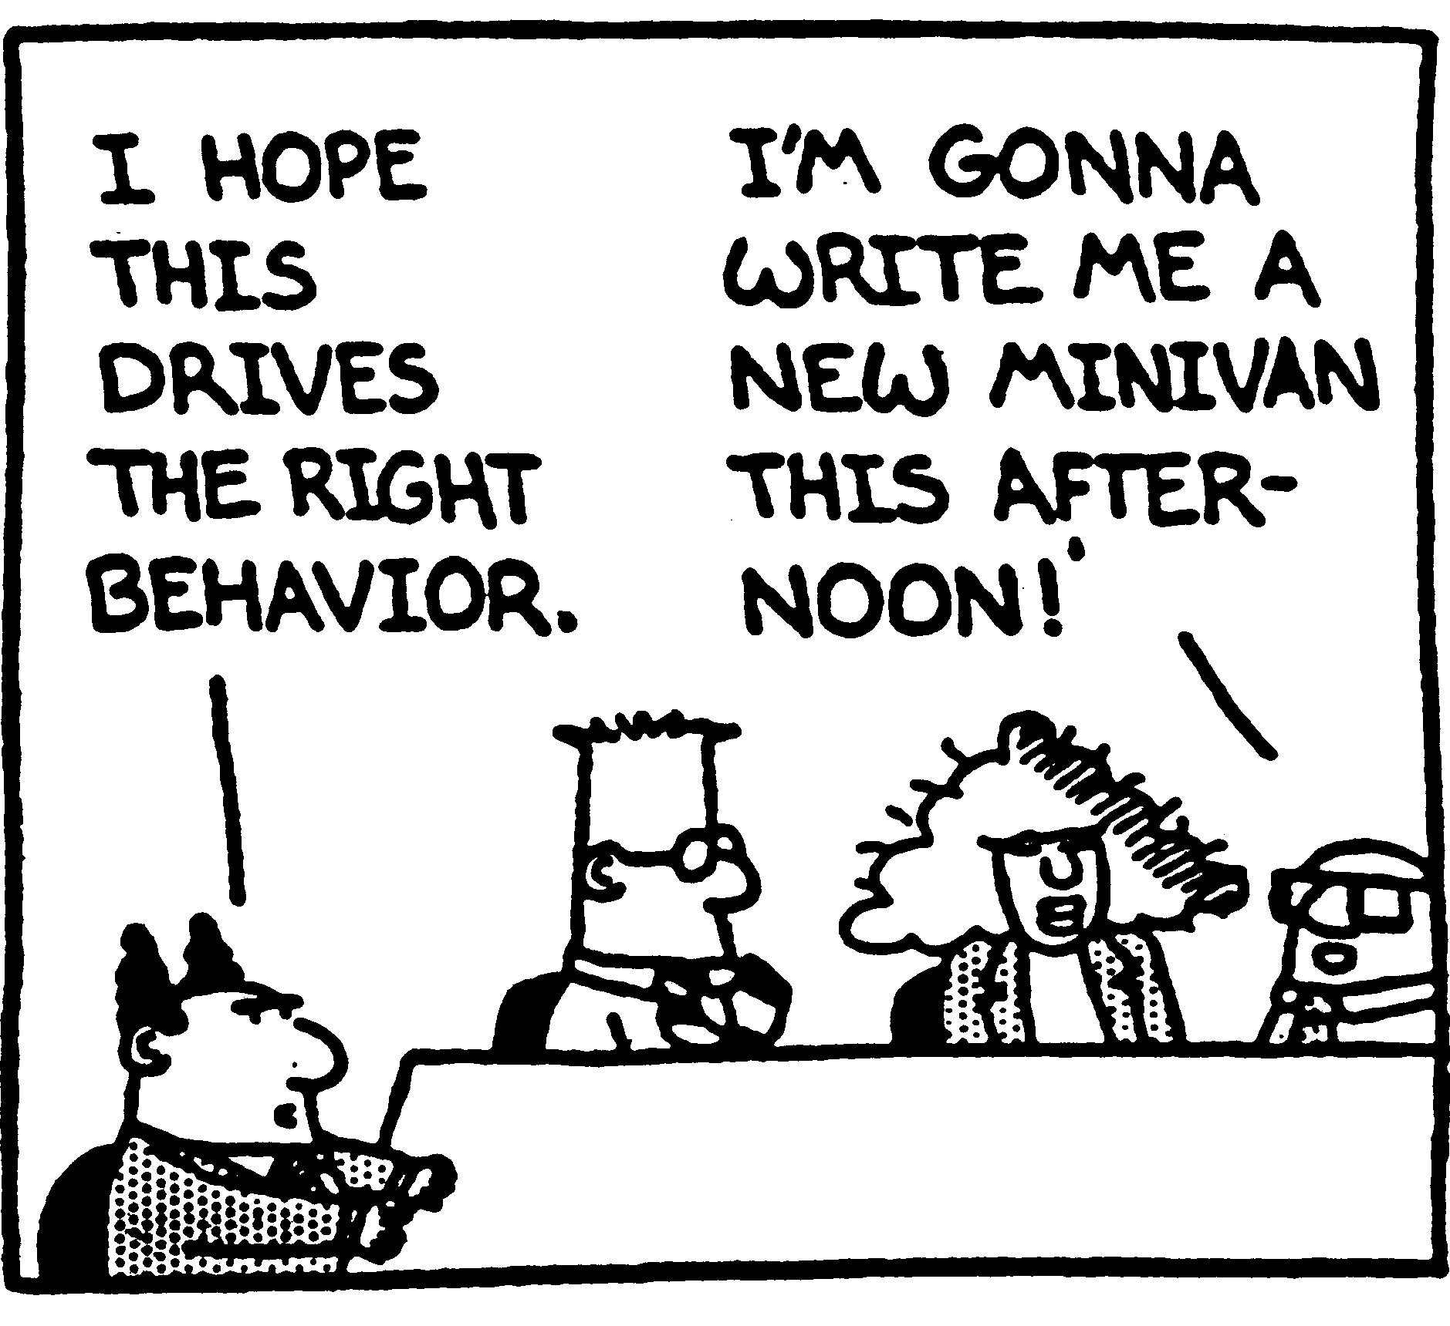
SMART Objectives and unintended consequences
Notes:
Fix N defects by date D
Create Y unit tests per day
- Provide comments on X% of lines of code
Common pattern - “Deliver feature X by date Y”.
Problems: changing priorities
dis-incentivizing teamwork and long term thinking

Slide 9
SOS - SMART Objectives Suck
Do not comprehend uncertainty
Unintended consequences
Myopic approach to career coaching
Behind every objective is a subjective
Notes:
They are poorly suited to the constantly changing nature of software development. What a developer is asked to work on often changes weekly or even more frequently.
Managers struggle with this mismatch, finding work-arounds that are idiosyncratic and inconsistent across the org.
SMART objectives offer little insight into the difference between a colleague’s performance and the expectations of the next level up. Hence, very little support for career development.
SMART objectives often tend to steer colleagues to aim for individualistic achievements.
SMART objectives applied to software development try to force false objectivity onto inherently subjective efforts.
- SMART objectives are a solution to a problem we already have a better solution for. We use the tight feedback loops of agile development practices to build accountability into our work on a daily basis.

Slide 10
SOS - SMART Objectives Suck
Do not comprehend uncertainty
Unintended consequences
Myopic approach to career coaching
Behind every objective is a subjective
Notes:
They are poorly suited to the constantly changing nature of software development. What a developer is asked to work on often changes weekly or even more frequently.
Managers struggle with this mismatch, finding work-arounds that are idiosyncratic and inconsistent across the org.
SMART objectives offer little insight into the difference between a colleague’s performance and the expectations of the next level up. Hence, very little support for career development.
SMART objectives often tend to steer colleagues to aim for individualistic achievements.
SMART objectives applied to software development try to force false objectivity onto inherently subjective efforts.
- SMART objectives are a solution to a problem we already have a better solution for. We use the tight feedback loops of agile development practices to build accountability into our work on a daily basis.

Slide 11
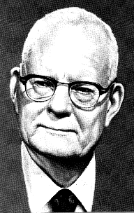
Abolish management by objective and annual performance reviews
W. Edwards Deming
Notes:
Demming wrote about abolishing performance reviews in his book “Out of the Crisis” and also included the message in his 14 points as point #12.
But he never really said what to do instead…

Slide 12
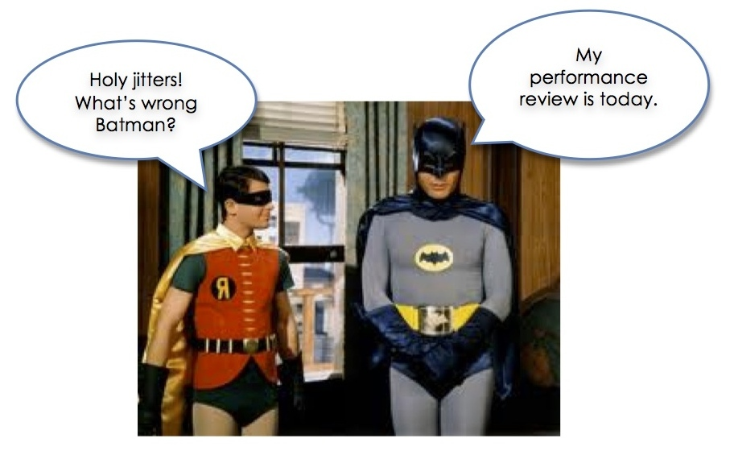
Do performance reviews have to suck?
Notes:
Todd and I are here because we believe that no – they do not have to suck.
Conversation:
- What’s expected of them
- How they are doing against those expectations
- What they can do to grow their career
Align - rewards and promotions - agile value system
That wouldn’t suck!
Brian
make a difference in people’s lives

Slide 13
Guiding principles
Notes:
Along our journey to find something better, some guiding principles emerged.

Slide 14
Values are what we value
Notes:
Here’s one of them, inspired by Reed Hastings’ presentation on Netflix Culture:
Values are what we value
That is: the things we say we value should also be the things we reward and use when making decisions like promotions or letting people go.

Slide 15
Discovering the Core Responsibilities
Delivery
Business Engagement
Teamwork
Quality
Initiative and Innovation
Deliver technical solutions
Partner with customer stakeholders
Collaborate with teammates
Build quality into software from the ground up
Take initiative and innovate
Notes:
Todd for years – great success
Merged with clusters - put together a set of Core Responsibilities
The critical ways that software developers create value for our business.

Slide 16
Value is what we value
Impact is the primary measure of career growth
Impact = Behaviors + Skills + Opportunity
Coach
Evolve
+
=
Foster
Develop
+
Create
Seize
Notes:
Another guiding principle we used is:
Value is what we value…
Impact is our primary measure of career progression. To grow impact:
- Managers coach behaviors, foster skill development and create opportunities
- Colleagues evolve behaviors, develop skills and seize opportunities

Slide 17
With a promotion comes higher expectations
Notes:
A third guiding principle:
With a promotion comes higher expectations
In general as colleagues progress through the levels of a particular career path, it's not the core responsibilities that change but rather expectation levels and scope of responsibility.
A promotion is not a reward for past work or loyalty, but rather a reflection of an increased level of responsibility.

Slide 18
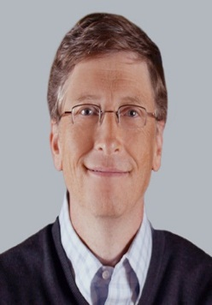
Delivery against Expectations
Associate
Senior
Sr. Principal
Core Areas

Slide 19
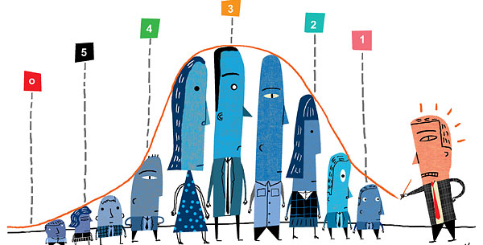
We value career development over performance ratings
Notes:
Our fourth guiding principle is:
We value career development over performance ratings
Supporting career development is our primary goal; integration with HR rating systems is a secondary goal.
Our company like many others has had an organizational mandate to produce performance ratings that feed into HR systems meant to provide accountability. Although we’re interested in finding better ways to support that need, the real reason we’re here is because we passionately believe that people leaders can make a difference in people’s lives – and overall business success - by investing in career development coaching.

Slide 20
What we did
Notes:
So let’s spend a bit of time talking in practical terms about how we built a new kind of framework and rolled it out.
At a high level we:
- Discovered the Core Responsibilities
Designed a set of expectation levels that mapped to our existing corporate job levels
Partnered with HR to gain stakeholder buy-in
Rolled out a pilot program
Let’s look at each of those steps in a little more detail…

Slide 21
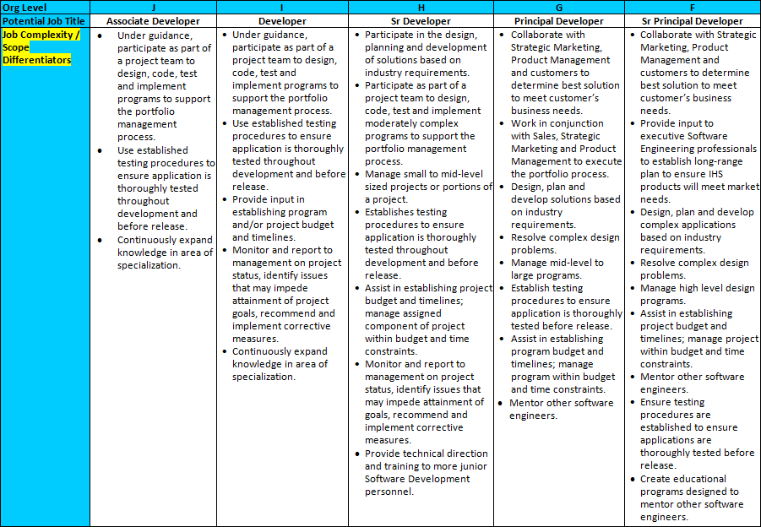
Discovering the Core Responsibilities
Testing
Notes:
Iterative, collaborative - directions
jumbled mess of corporate speak and confusing content
lack of clarity and support around career progression
job descriptions no help at all.

Slide 22
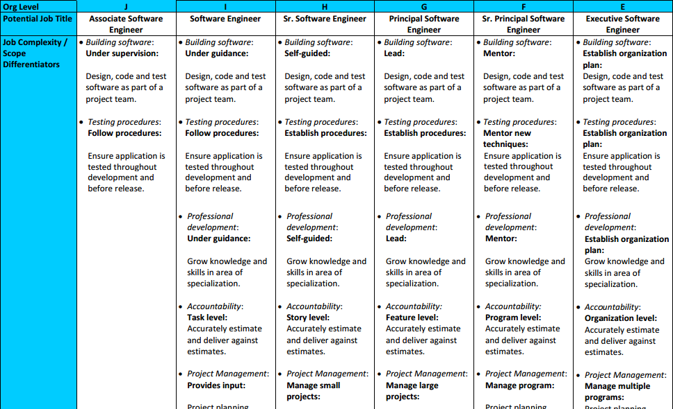
Testing
Notes:
We figured - cleaning up, clearly laying out expectations for each level
Frustrated with SMART – better way?
Andy suggested – evaluate based on what’s in there
Clusters!

Slide 23
Discovering the Core Responsibilities
Delivery
Business Engagement
Teamwork
Quality
Initiative and Innovation
Deliver technical solutions
Partner with customer stakeholders
Collaborate with teammates
Build quality into software from the ground up
Take initiative and innovate
Notes:
Todd for years – great success
Merged with clusters - put together a set of Core Responsibilities
The critical ways that software developers create value for our business.

Slide 24
Build quality into software from the ground up
Key contributions to consider:
Clean code
Automated unit & integration tests
Peer review
Reduction of technical debt
Notes:
Here’s one of them – Quality
“Key Contributions to consider” – important aspects
manager give feedback - how contributing
Cheat sheet

Slide 25
Expectations by level
Associate Software Engineer | With direction
Software Engineer | With support
Senior Software Engineer | Self-directed
Principal Software Engineer | Leader
Senior Principal Software Engineer | Mentor
Executive Software Engineer | Visionary
Notes:
Patterns – generalized expectation levels
Behavior-focused, all 5 – evaluate on own contribution levels, contrived
Promotion – expectations go up

Slide 26
Core Responsibility Framework
Delivery
Customer Focus
Teamwork
Quality
Initiative & Innovation
Impact
Behaviors
Recognized
Corporate
Resource
Leader /
Extraordinary
Contributor
Deep and/or
Broad
Leader /
Extraordinary
Contributor
Feature
Self-Directed
User Story
With Support
Simple User Story
With Direction
Notes:
5 CRs…
Set of expectations by level…
Suddenly we had a framework on our hands
Accomplish
What we expect
Performing against
Where to focus - improving
Next level up
Opportunities to grow

Slide 27
Partnering with HR
Abby Britt,
Sr HR Manager
Notes:
This is Abby Britt – side by side – great sponsor
Convince this audience
HR org - substitute

Slide 28
Review Organizational Strategic Intent
Measure Results of individuals relative to job expectations
Establish Projects and Initiatives aligned with Intent
24 hours
1-4 weeks
Iteration Backlog
Release Backlog
Backlog tasks
Potentially Shippable
Product Increment
Notes:
- Software developers experience constant change; they may not know what they’ll be working on from one week to the next.
Also our agile development process already provides a robust mechanism for driving clarity of goals and accountability
In Agile development we already have a good framework so another approach could work better

Slide 29
Pilot program rollout
Notes:
So we were ready.
pilot program in 2015, 200 software developers.
Support materials, training, 1:1 coaching
The experiment began…

Slide 30
Performance Evaluation Model
Delivery
Customer Focus
Teamwork
Quality
Initiative & Innovation
Impact
Behaviors
Recognized
Corporate
Resource
Leader /
Extraordinary
Contributor
Deep and/or
Broad
Leader /
Extraordinary
Contributor
Feature
Self-Directed
User Story
With Support
Simple User Story
With Direction
Notes:
Blue columns – 5 CRs
Orange gradients – progressively higher levels of behavior and impact
Illustrate & communicate – dots
Dean the Coding Machine – delivery, productivity – above and beyond
1995 – legacy app – tech debt – no interest in learning, automation fad
Sr SW Eng – stuck? Next level?
Red line – expectations – self directed, chasing, initiative, provide tests
Manager – sit down, coaching msg, visualization

Slide 31
John the Journeyman
Impact
Behaviors
Delivery
Customer Focus
Teamwork
Quality
Initiative & Innovation
Recognized
Corporate
Resource
Leader /
Extraordinary
Contributor
Deep and/or
Broad
Leader /
Extraordinary
Contributor
Feature
Self-Directed
User Story
With Support
Simple User Story
With Direction
Notes:
Can they choose from what is on the table?
Can we give them the latitude to adjust the dots for their story?

Slide 32
Tail of Two Developers
Ed
Oz

Slide 33
Oz – I get no respect
For some reason people pay no attention to the man behind the fire wall.
I’m gonna become a full stack developer and show what I can do

Slide 34
Oz’s Performance Review
I exceeded expectations!!!!
When I started the code was toxic. It was spewing crap all the time.
I turned that manure producer into a functioning control center

Slide 35
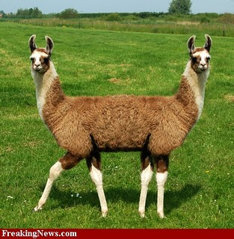
Later – What’s wrong with this picture?
Ed
Oz

Slide 36
Oz the Whole Stack Developer
Impact
Behaviors
Delivery
Customer Focus
Teamwork
Quality
Initiative & Innovation
Recognized
Corporate
Resource
Leader /
Extraordinary
Contributor
Deep and/or
Broad
Leader /
Extraordinary
Contributor
Feature
Self-Directed
User Story
With Support
Simple User Story
With Direction

Slide 37
Other Archetypes

Slide 38
Heather the Hero
Impact
Behaviors
Delivery
Customer Focus
Teamwork
Quality
Initiative & Innovation
Recognized
Corporate
Resource
Leader /
Extraordinary
Contributor
Deep and/or
Broad
Leader /
Extraordinary
Contributor
Feature
Self-Directed
User Story
With Support
Simple User Story
With Direction

Slide 39
Ivan the Individualist
Impact
Behaviors
Delivery
Customer Focus
Teamwork
Quality
Initiative & Innovation
Recognized
Corporate
Resource
Leader /
Extraordinary
Contributor
Deep and/or
Broad
Leader /
Extraordinary
Contributor
Feature
Self-Directed
User Story
With Support
Simple User Story
With Direction

Slide 40
Tessy the Team Angel
Impact
Behaviors
Delivery
Customer Focus
Teamwork
Quality
Initiative & Innovation
Recognized
Corporate
Resource
Leader /
Extraordinary
Contributor
Deep and/or
Broad
Leader /
Extraordinary
Contributor
Feature
Self-Directed
User Story
With Support
Simple User Story
With Direction

Slide 41
Irene the Innovator
Impact
Behaviors
Delivery
Customer Focus
Teamwork
Quality
Initiative & Innovation
Recognized
Corporate
Resource
Leader /
Extraordinary
Contributor
Deep and/or
Broad
Leader /
Extraordinary
Contributor
Feature
Self-Directed
User Story
With Support
Simple User Story
With Direction

Slide 42
Quincy the Quality Evangelist
Impact
Behaviors
Delivery
Customer Focus
Teamwork
Quality
Initiative & Innovation
Recognized
Corporate
Resource
Leader /
Extraordinary
Contributor
Deep and/or
Broad
Leader /
Extraordinary
Contributor
Feature
Self-Directed
User Story
With Support
Simple User Story
With Direction

Slide 43
Paula the Perfectionist
Impact
Behaviors
Delivery
Customer Focus
Teamwork
Quality
Initiative & Innovation
Recognized
Corporate
Resource
Leader /
Extraordinary
Contributor
Deep and/or
Broad
Leader /
Extraordinary
Contributor
Feature
Self-Directed
User Story
With Support
Simple User Story
With Direction

Slide 44
Alex the Architecture Astronaut
Impact
Behaviors
Delivery
Customer Focus
Teamwork
Quality
Initiative & Innovation
Recognized
Corporate
Resource
Leader /
Extraordinary
Contributor
Deep and/or
Broad
Leader /
Extraordinary
Contributor
Feature
Self-Directed
User Story
With Support
Simple User Story
With Direction

Slide 45
Tim the Enchanter….er Technologist
Impact
Behaviors
Delivery
Customer Focus
Teamwork
Quality
Initiative & Innovation
Recognized
Corporate
Resource
Leader /
Extraordinary
Contributor
Deep and/or
Broad
Leader /
Extraordinary
Contributor
Feature
Self-Directed
User Story
With Support
Simple User Story
With Direction

Slide 46
Doug the Domain Expert
Impact
Behaviors
Delivery
Customer Focus
Teamwork
Quality
Initiative & Innovation
Recognized
Corporate
Resource
Leader /
Extraordinary
Contributor
Deep and/or
Broad
Leader /
Extraordinary
Contributor
Feature
Self-Directed
User Story
With Support
Simple User Story
With Direction

Slide 47
Stan the Shy Guy
Impact
Behaviors
Delivery
Customer Focus
Teamwork
Quality
Initiative & Innovation
Recognized
Corporate
Resource
Leader /
Extraordinary
Contributor
Deep and/or
Broad
Leader /
Extraordinary
Contributor
Feature
Self-Directed
User Story
With Support
Simple User Story
With Direction

Slide 50
How do managers like it?

Slide 51
Manager Feedback
100%
Notes:
This is an overwhelmingly positive response. Clearly a good indicator that the managers found it to be an improvement.
…unless they were just saying that because they knew the system had executive support. But I don’t think that was the case We have a rather open trust environment where if there were issues the managers were not afraid to speak up.

Slide 52
Manager Feedback
85%
Notes:
Not bad for a first year of the program. Certainly we would like to move the needle on this one a bit more.

Slide 53
Manager Feedback
92%
Notes:
Maybe the managers liked the system because it simplified their life. They no longer had to come up with SMART objectives. So we asked the managers to give their perception of the impact on our colleagues. They felt that overall it was positive.
So we could declare victory!!!!!
But maybe not yet. Maybe we should survey some of our other stakeholders, namely our customers, our colleagues. What do they think of the new system?

Slide 54
How do colleagues like it?

Slide 55
Colleague Feedback
73%
Notes:
What does the survey show? Some people have long toes! Some people will hate performance reviews no matter what. Or maybe they loved or felt comfortable with the old SMART objectives. But overall we had positive response from our colleagues.

Slide 56
Colleague Feedback
57%
Notes:
This is the one we really want to see grow. Pretty darn good for a first year rollout. But we know we can improve we will continue to monitor how this evolves.

Slide 57
Colleague Feedback
68%
Notes:
Again a generally positive reaction from our colleagues. Even though the descriptions are subjective, the colleagues now have something more concrete to look at relative to job expectations. This enables the critical conversations that we want to have.

Slide 58
Inspecting and adapting

Slide 59
Challenges integrating with HR systems
HR rating model emphasizes “performance” over career growth
Coarse-grained HR performance ratings
Redundancies in paperwork
Title inconsistencies across the company
Notes:
Concerns that 3.0 is a “poor” rating when in reality it might be perfectly applicable to a great performer who just got promoted.
The range of useful ratings is very narrow for the scoring model, making it very difficult to achieve appropriate overall ratings.

Slide 60
Refining the Structure
 | Behavior | Impact
Associate Software Engineer | With direction | Simple User Story
Software Engineer | With support | User Story
Senior Software Engineer | Self-directed | Feature
Principal Software Engineer | Leader / Extraordinary Contributor | Broad and/or Deep Impact
Senior Principal Software Engineer | Leader / Extraordinary Contributor | Recognized Corporate Resource
Notes:
As you’ve seen in the exercise, we’re now expressing the expectation levels in terms of both behaviors and impact.
This has brought greater expressive power to our framework, which helps us better address the development needs of colleagues growing into the higher levels. One of the things we’ve always emphasized is that this is just a framework – managers need to adapt it to each individual’s context.
One of the things we’re already seeing is that the more we add to the system – for example, better support for special cases – the more complex it gets. The more complex it gets, the less accessible it is.
In short, we are increasingly suspecting that less is more.

Slide 61
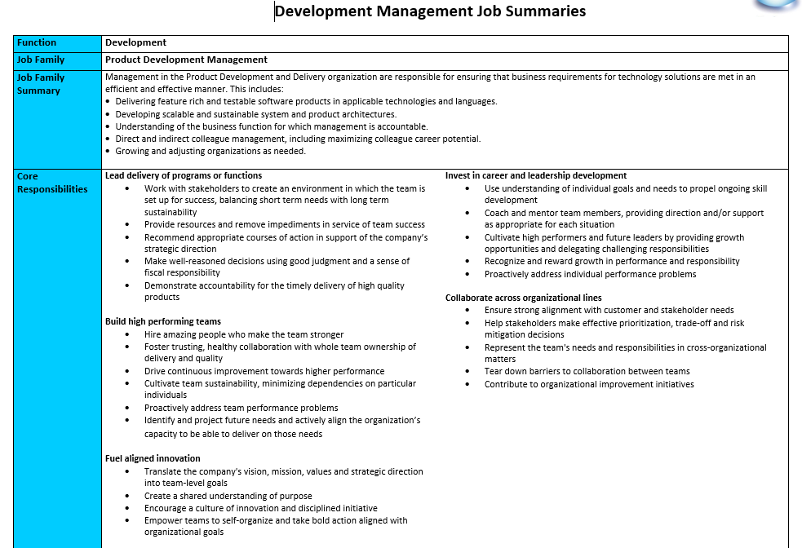
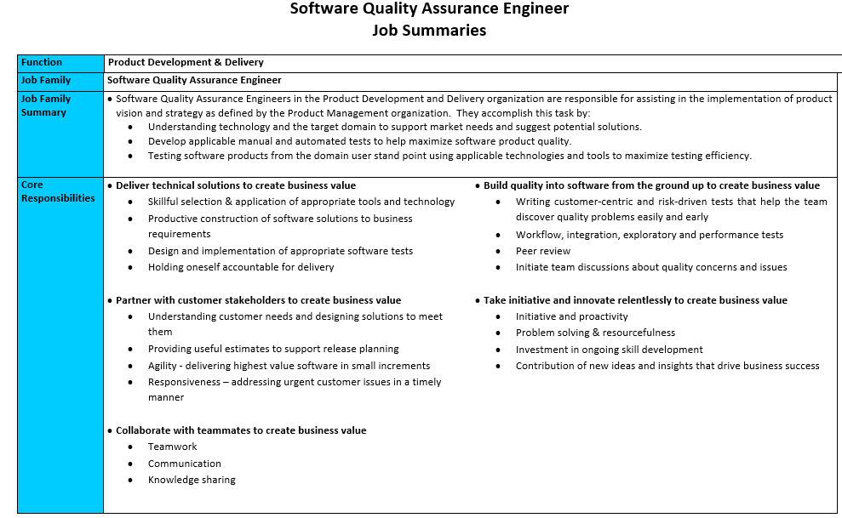
Beyond software developers
Notes:
2 more roles
Different directions
Mgrs – ground up
SQA similar

Slide 62
Shared Core Responsibilities
Delivery | Deliver technical solutions
Business Engagement | Partner with customer stakeholders
Teamwork | Collaborate with teammates
Quality | Build quality into software from the ground up
Initiative and Innovation | Take initiative and innovate relentlessly
Notes:
agile teams - shared responsibilities - whole team ownership
CRs reinforce that philosophy - more similar than different

Slide 63
Quality: Build quality into software from the ground up to create business value
Key contributions to consider:
Developer | SQA
Clean code | Write and execute tests to detect issues early
Automated unit & integration tests | Workflow, integration, exploratory and performance tests
Peer review | Peer review
Reduction of technical debt | Be a quality advocate on the team
Notes:
Customize - highlight the specific ways - shared team goals.

Slide 64
What about Leaders?

Slide 65
People Leader Behaviors and Impacts
 | Behavior | Impact
Manager | With Support | Team
Sr. Manager | Self Directed | Team(s)
Director | Leader of Leaders | Team of Teams
Sr. Director | Leadership Mentor | Business Area
VP | Organization Visionary | Department
Notes:
As you’ve seen in the exercise, we’re now expressing the expectation levels in terms of both behaviors and impact.
This has brought greater expressive power to our framework, which helps us better address the development needs of colleagues growing into the higher levels. One of the things we’ve always emphasized is that this is just a framework – managers need to adapt it to each individual’s context.
One of the things we’re already seeing is that the more we add to the system – for example, better support for special cases – the more complex it gets. The more complex it gets, the less accessible it is.
In short, we are increasingly suspecting that less is more.

Slide 66
People Leader Core Responsibilities
Delivery | Lead delivery of quality programs or functions
Teamwork | Build high performing teams
Innovation | Fuel aligned innovation
Coaching and Mentoring | Invest in career and leadership development
Collaboration | Collaborate across organizational lines
Notes:
agile teams - shared responsibilities - whole team ownership
CRs reinforce that philosophy - more similar than different

Slide 67
Do performance reviews have to suck?
Notes:
No, ours don’t suck.
We use them to help people get better at the things that create business value.
Everybody wins – colleagues, managers and the company itself.

Slide 68
Traditional MBO
Set goals cascaded down to individuals
Measure the performance against those goals
Reward based on performance against goals
Hope that drives the right behavior and career advancement

Slide 69
Our Approach
Establish the behaviors and skills that are core to building organizational capacity
Provide ongoing guidance and feedback to each employee to help them grow
Reward based on promotion scale
Establish goals at the team, department and organizational level

Slide 70
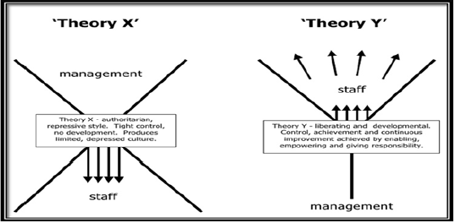
Theory X vs. Theory Y

Slide 72
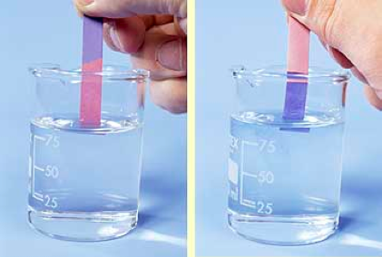
Litmus Test
Are you making your team, others on your team, and the organization better?

Slide 73
Contact
Todd Little
todd@leankanban.com
toddelittle@gmail.com
www.toddlittleweb.com
www.linkedin.com/in/toddelittle/
@toddelittle
Andrew Tuttle
andrew.tuttle@ihsmarkit.com
www.linkedin.com/in/andrewltuttle

Slide 74
Questions?

