Slide 1

Leading
Global Teams
Todd Little
VP Product Development
IHS

Slide 2
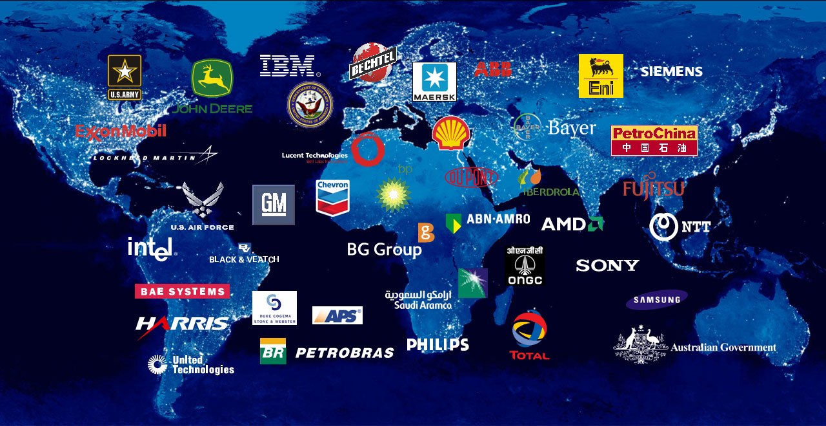
We have a diversified customer base
2
Notes:
8/6/2015 9:37 AM
2
Our acquisitions have added many more customers to this list.
Over the years, we have been able to develop an outstanding client list
We have a powerful global reach:
We serve more than 55,000 customers in over 100 countries
IHS helps customers solve mission critical problems with critical information and insight
We see things from a customers point of view…

Slide 3
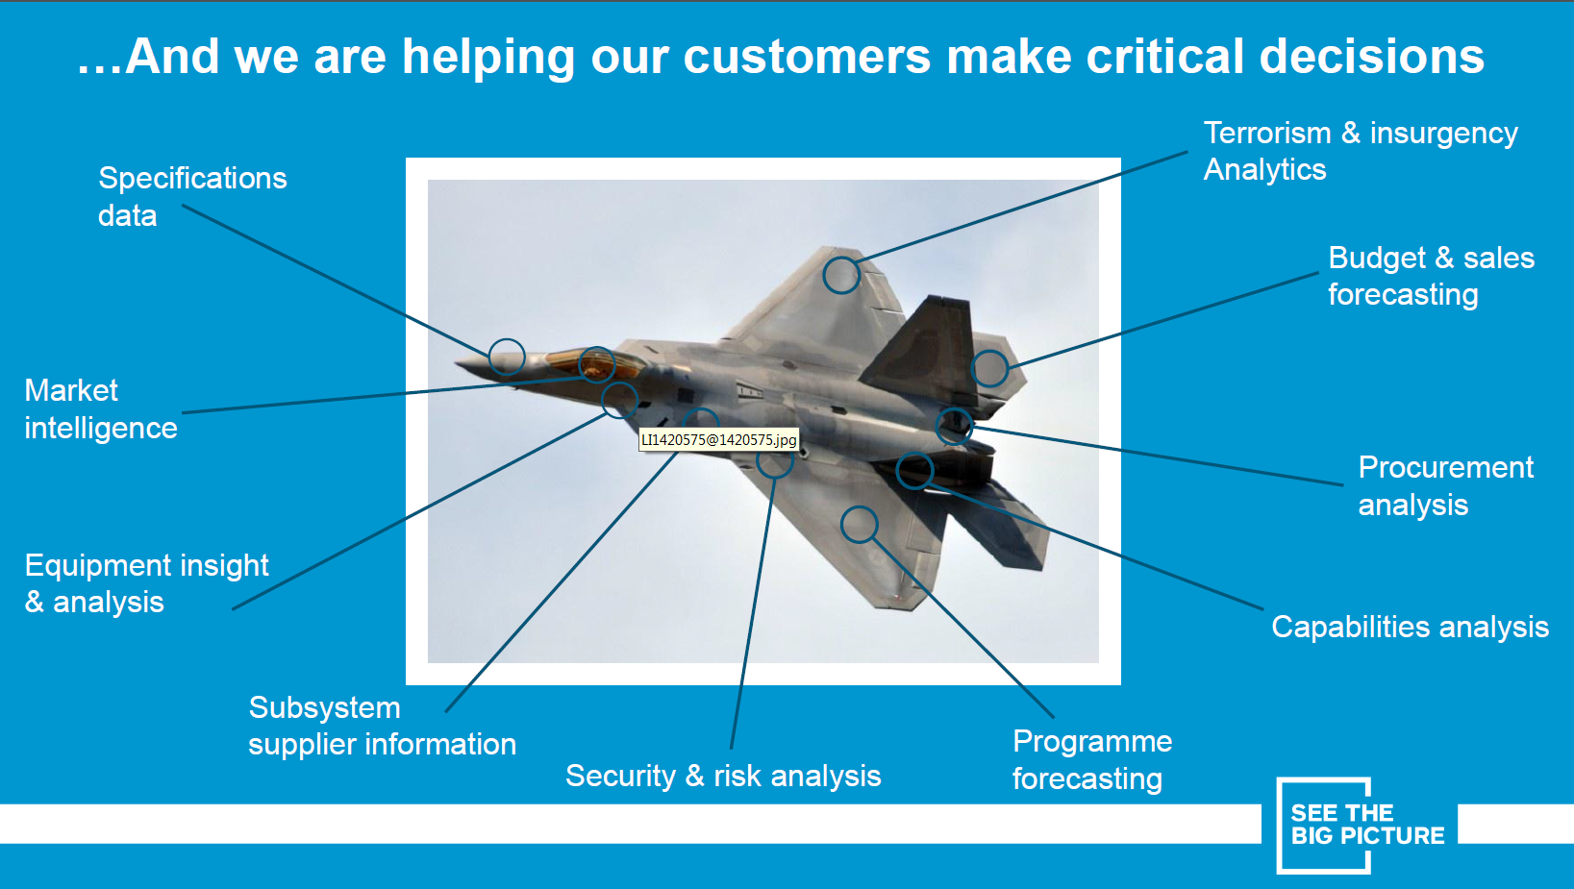
About IHS

Slide 4
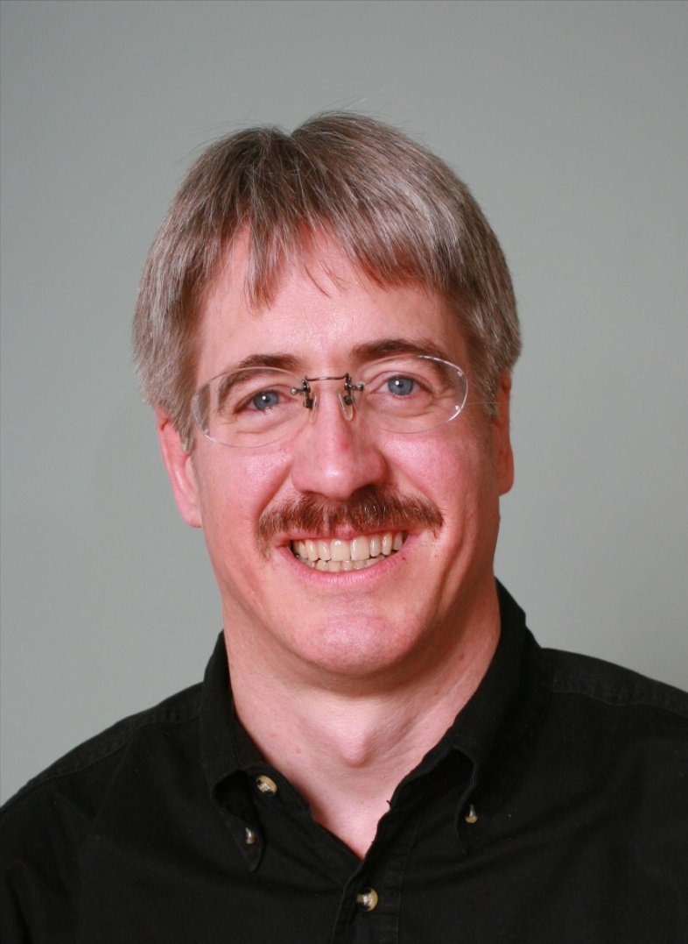
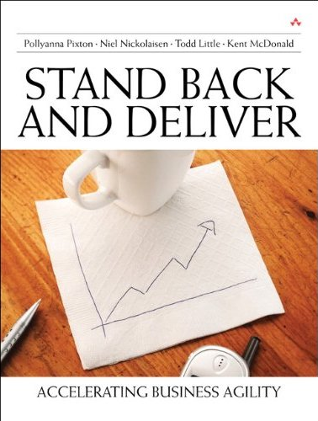
About Todd
Chemical & Petroleum Engineer
30+ Years in Software Development
Co-founder of Agile Development Conference 2003 (Salt Lake City)
Conference Chair
  2004 (Salt Lake City)
  2005 (Denver)
  2006 (Minneapolis)
  2011 (Salt Lake City)
Agile Alliance Board
Co-founder and past President of Agile Leadership Network

Slide 5
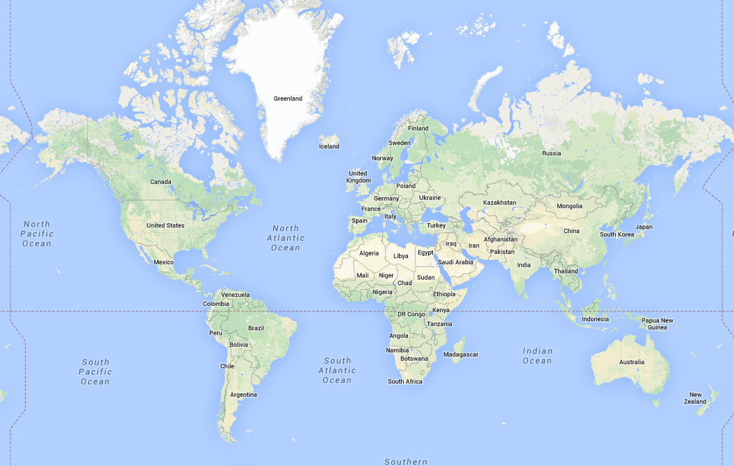
Globally Distributed Teams

Slide 6
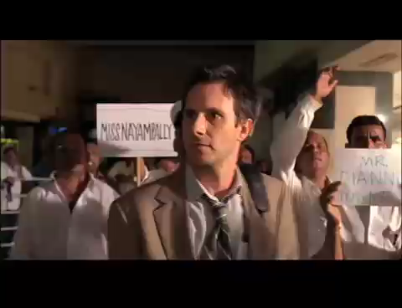

Slide 7
Exercise
What are the biggest challenges with distributed teams?
When does it make sense to use global teams?
What have some of you tried that worked or created learning?

Slide 8
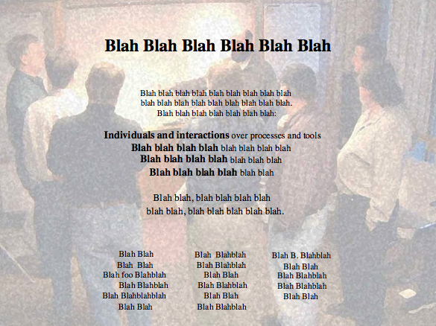
Alexey Krivitsky

Slide 9
Long Ago and Far, Far Away…

Slide 10
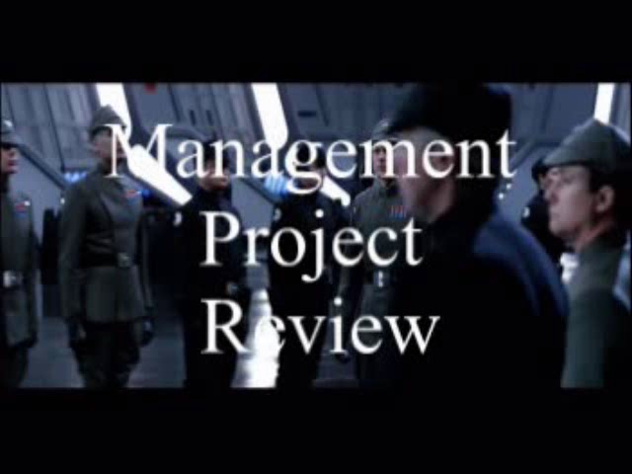

Slide 11

Agile Leadership

Slide 12


From Coding Monkey to Empowered Ewok

Slide 13
Trust/Ownership Model
Trust
Abdication
Energy & Innovation
How do we
get here?
Micromanagement
Conflict
Control
Low
Team Ownership
High
The Agile Culture: Pixton, Gibson, Nickolaisen

Slide 14
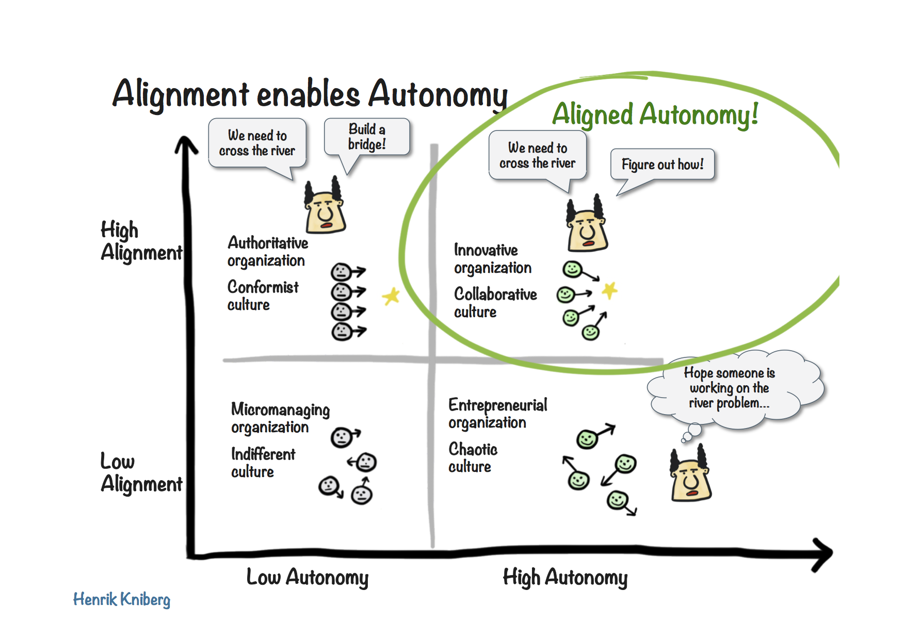
Autonomy and Alignment

Slide 15



Case Study I
Integrating Software by Integrating People
Oil and Gas Software Company Acquires Market Leaders in each Sub-Domain
Value Proposition is in creating integrated workflows

Slide 16
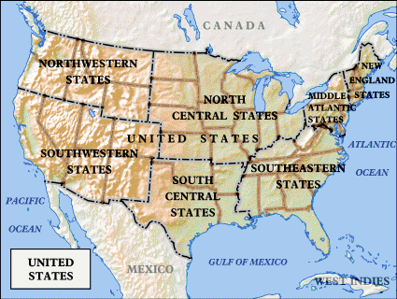
But software is developed in Houston, Austin, Denver and Calgary

Slide 17
Acquisition Culture Challenges
Geographic Culture
Individual Company Culture
Product Pride
Domain Pride

Slide 18
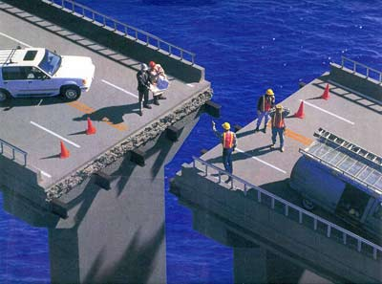
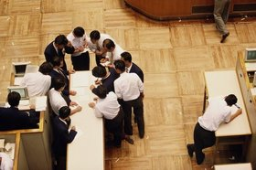
What the Leaders Did
The best way to integrate our software is to make sure we integrate our people

Slide 19
Alexey Krivitsky

Slide 20



Get Alignment on the Purpose
Value Proposition is in creating integrated workflows
Input
Output
I² Enterprise

Slide 21
Prioritization
#1 Integration
#2 Integration
#3 Integration

Slide 22
Integrating People
Creating the Future
Friday@4 Weekly
PMM Quarterly
Developers’ Conference Yearly

Slide 23
Creating the Future
One week exposure to Company and vision
All new employees from around the world

Slide 24

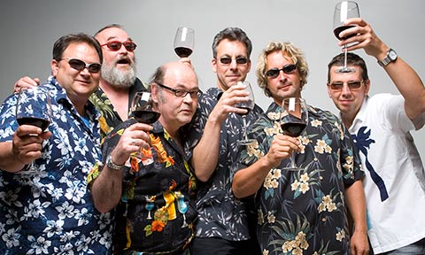
Friday’s @ 4
Informal setting
Opportunity for news

Slide 25
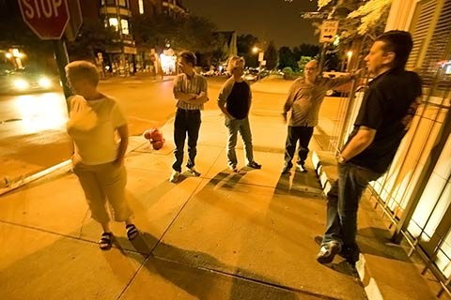

Product/Project Managers’ Meeting
Quarterly
Face to Face
2 days

Slide 26
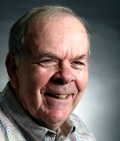

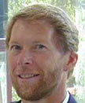
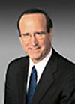
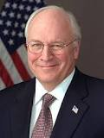
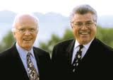

WorldWide Developers’ Conference
4 Day event
Annual
Everyone collocated
People
Purpose
Passion

Slide 27


The Bottom Line
Revenue grew
Market share grew

Slide 29

Alas
x
Creating the Future
Friday@4 Weekly
x
PMM Quarterly
x
Developers’ Conference Yearly
x

Slide 30

Struggle to Re-Invent

Slide 31
Case Study II
Too many Indians, not enough Chiefs
Problem:
  A 5 year arrangement with an offshore outsourcer had not progressed as rapidly as Sr. Executives had hoped
Presumed Answer:
  Find an outsourcer that will promise that they will provide good talented developers and strong domain experts.

Slide 32
Dialog
PO Story: As a user a I need a flimflam so I can flam the flim.
Remote Dev: WTF is a flimflam?
Remote Team: IDK. Let’s send a query to PO and Dev Lead.
Dead Time
Dev Lead or PO: Crap! I need to write every little detail about a flimflam.

Slide 33
Dialog
PO Story: much more detail about the flimflam
Remote Dev: Now I get it. I can start designing and coding.
I wonder what they mean by the flimflam must have a whatchamacallit?
Remote Team: WTF is a whatchamacallit? Better ask the PO or Dev Lead.
Dead Time
Dev Lead or PO: Crap!

Slide 34
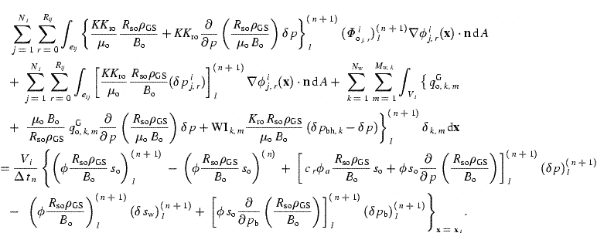
Petroleum Reservoir Simulation
It’s NOT Rocket Science

Slide 35
Case Study II
Too many Indians, not enough Chiefs
Results:
Join and Jolt – 3 times. Then finally hire PE that was pretty good. Lasted 2 months.
Made very little progress in 12 months

Slide 36




Managing the Coming Storm
Inside the Tornado
Project Kickoff
When will we get the requirements?
All in good time, my little pretty, all in good time
But I guess it doesn't matter anyway
Just give me your estimates by this afternoon
Team Unity
Not so fast! Not so fast! ... I'll have to give the matter a little thought. Go away and come back tomorrow
No, we need something today!
Ok then, it will take 2 years.
No, we need it sooner.
Doesn't anybody believe me?
I already promised the customer it will be out in 6 months
You're a very bad man!
Notes:
We look at a typical software project…..

Slide 37


We’re not in Kansas Anymore
Developer Hero
I may not come out alive, but I'm goin' in there!
Reorg
The Great and Powerful Oz has got matters well in hand.
My! People come and go so quickly here!
Testing
"Hee hee hee ha ha! Going so soon? I wouldn't hear of it! Why, my little party's just beginning!

Slide 38


What We did
Romania
  3 Software Developers
  3 Reservoir Simulation Experts
  Owner was Professor of Reservoir Simulation (and a benevolent dictator)
  Communicated in the language of reservoir simulation
Vietnam
  4 automation test experts
  Specialized in Action Based Testing
  Communication from domain experts (US and Romania) via Camtasia videos.
3 Dev
3 PE Test

Slide 39
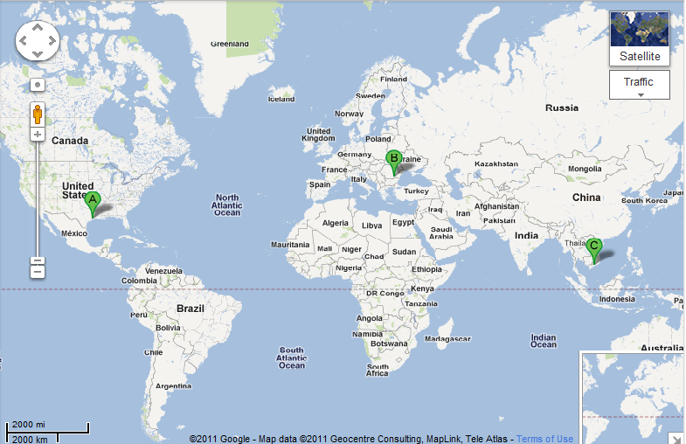

Global Expertise
(Houston, Bucharest, Ho Chi Minh City)
3 Dev
3 PE Test
15 Dev
6 PE Test
2 Pgm Mgr
2 Prod Mgr
4 Auto Test

Slide 40
The Bottom Line
97% Reduction

Slide 41
Distributed Challenge: Time Shift
8 hours
12 hours

Slide 42

Think Globally and Optimize the Whole

Slide 43
Leadership and Domain Matters

Slide 44
Empowered Distributed Teams
Autonomy
Leadership
Domain
Dev
Test
Trust
Ownership

Slide 45
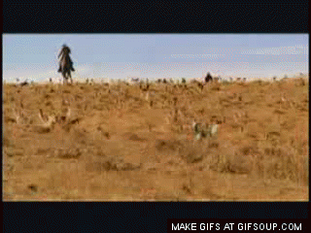
Case Study III
Herding Cats

Slide 46

Grumpy Cats
3 years into a “1 year” project

Slide 47
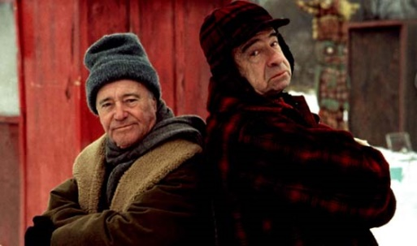
Grumpy Old Men (and Women)

Slide 48
Globally Distributed Teams

Slide 49
Everyone had suggestions
Business: We need a new manager to hold them accountable!
PMO: Their process is broken. They should be using SAFe!
Dev Team: The Business doesn’t know what they need!
Dev Team: We know what we are doing! Just let us do it!
Dev Team: The team in India requires too much babysitting!
Project Manager: India team has capacity but US team doesn’t give them anything
Business: The India team are the only ones that demo at the showcase!
Bossman: Just Fix It!

Slide 50
What I did
Agile Coaching
  Changed how team used Story Points
  Produced a meaningful Release Backlog
  Extracted development velocity and scope creep
  Used velocity to forecast probable delivery date (significantly later than they had signed up for)
  Continued to track both development and scope creep velocities to provide evolving forecasts.

Slide 51
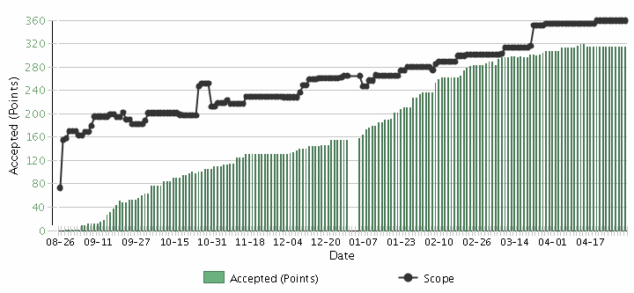
Burnup Chart
Scope Creep
Velocity

Slide 52
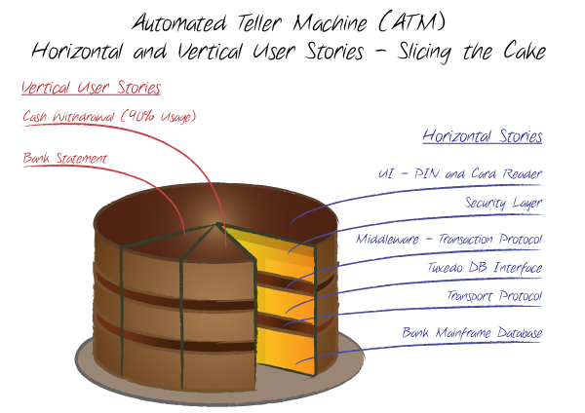
What I did
Agile Coaching (part II)

Slide 53
What I did
Staffing
  I didn’t change the manager
  Replaced the 4 India contractors with 2 US employees
  Added 2 developers at IHS Bangalore office with strong Oil & Gas background

Slide 54

Went on my own witch hunt

Slide 55
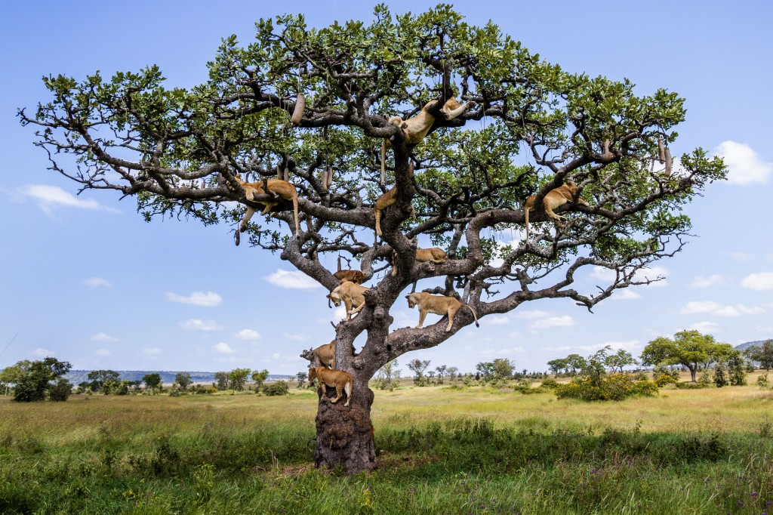

Slide 56
Trust/Ownership Model
Trust
Abdication
Energy & Innovation
Dev Team
Micromanagement
Conflict
Business
Control
Low
Team Ownership
High

Slide 57



Slide 58
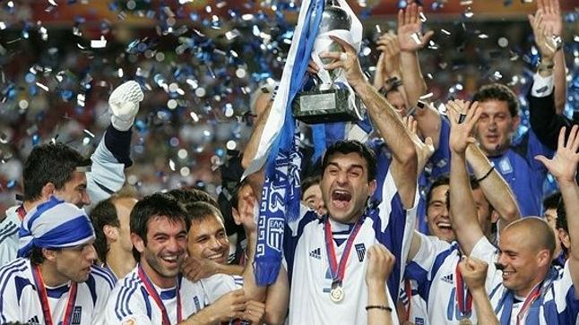
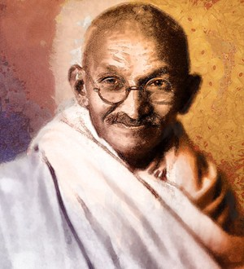


Path to Greatness
+
=

Slide 59

Collaborating with Non-Collaborators
Creative
Tension
Collaborator
Collegial
More useful
Drive to
Purpose
Collaboration
Non-
Collaborator
Compliance
Combative
Common Practice
Agree
Disagree
Agreement

Slide 60
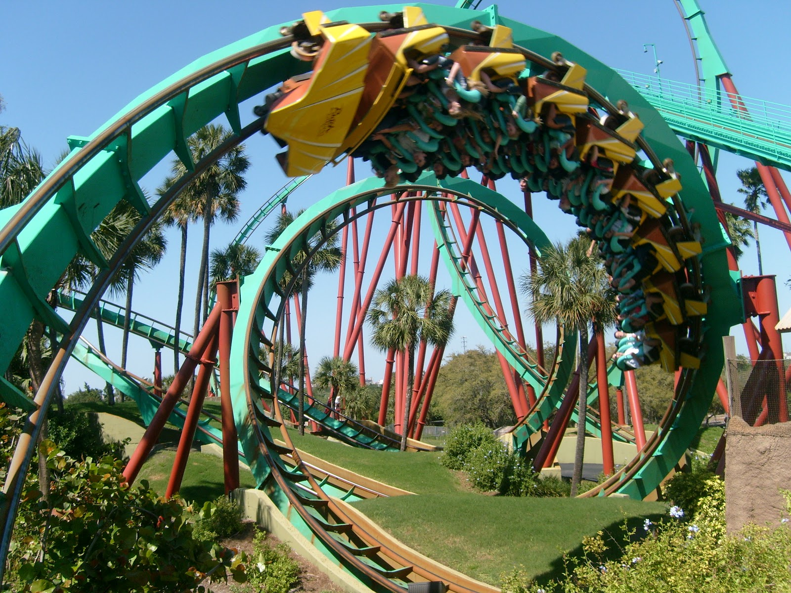
How Has it Gone?

Slide 61
Herding Cats

Slide 63
Trust/Ownership Model
Trust
Abdication
Energy & Innovation
How do we
get here?
Micromanagement
Conflict
Control
Low
Team Ownership
High

Slide 64

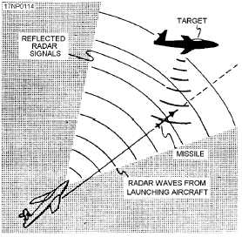
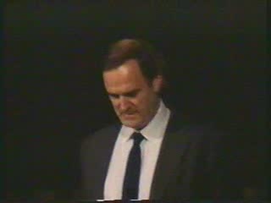
Gordon the Guided Missile

Slide 65
Control Systems
Processes
Inputs
Inputs
Inputs
Command & Control
Processes
Inputs
Inputs
Inputs
Agile Leadership
Outputs

Slide 66
Trust/Ownership Model
Trust
Abdication
Energy & Innovation
How do we
get here?
Zone of
Stable Control
Micromangement
Conflict
Control
Low
Team Ownership
High

Slide 68
Recipe for Global Leadership
Clarify purpose and priorities to ensure alignment
Autonomous remote teams
Focus on relationships
Hard Work
Rinse and Repeat (but keep teams together)

Slide 69
Empowered Distributed Teams
Autonomy
Leadership
Domain
Dev
Test
Trust
Ownership

Slide 70

Contact
Todd Little
  todd.little@ihs.com
  toddelittle@gmail.com
  www.toddlittleweb.com
  www.accelinnova.com
May the Force Be With You

