Slide 1
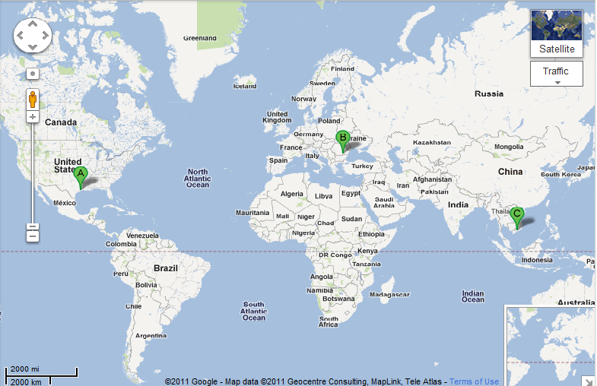
Leveraging Global Talent for Effective Agility
Todd Little
Sr. Development Manager, Landmark/Halliburton
Suzanne Elliott
Sr. Quality Manager
Landmark/Halliburton
Joe Hughes
VP
Logigear
Florin Simion
Principal
Simco
Notes:
Over the past 3 years Landmark has been incorporating Agile methodologies in our development processes.

Slide 2






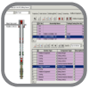

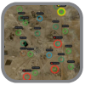

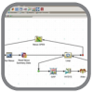
Landmark E&P Ecosystem
Collaborative Applications – Data Management – Modern Platform – Expert Services
DecisionSpace Platform
Geosciences
Reservoir
Drilling and Completions
Production
Services and Support
BASIN
GEOPHYSICS
GEOLOGY
EARTH
MODELING
FIELD
PLANNING
SIMULATION
DESIGN
REPORTING
SURVEILLANCE
REAL-TIME
OPTIMIZATION
Data Management

Slide 3
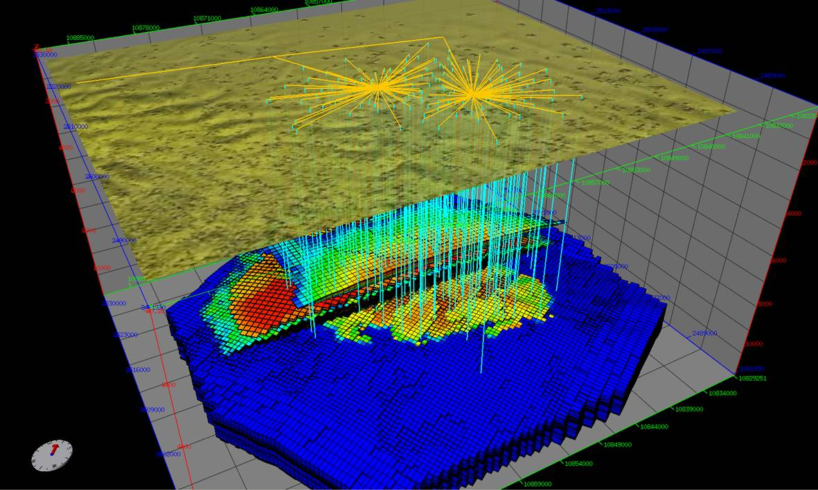
Nexus Reservoir Simulation
Next Generation Reservoir Simulation

Slide 4
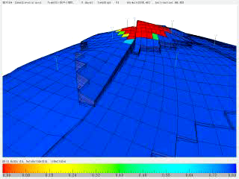
Petroleum Reservoir Simulation

Slide 5
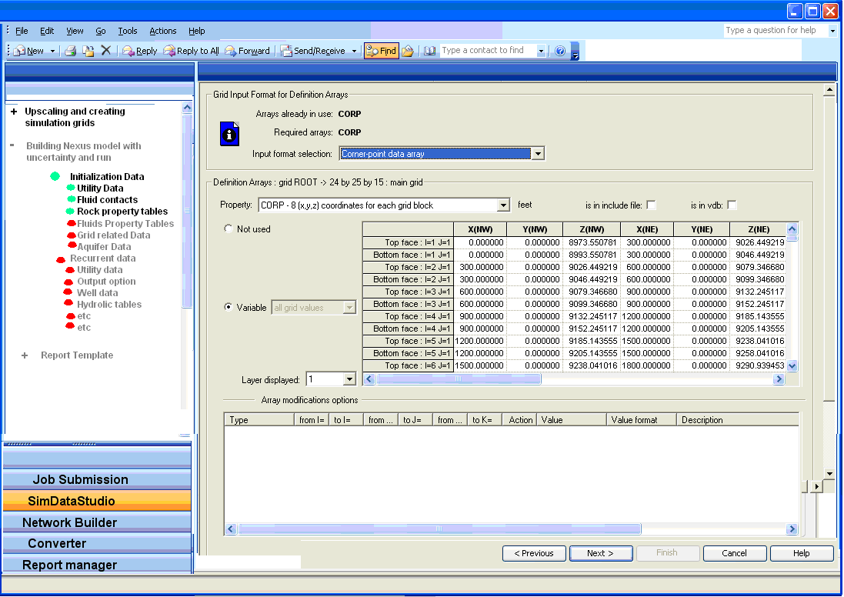
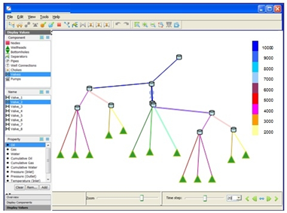
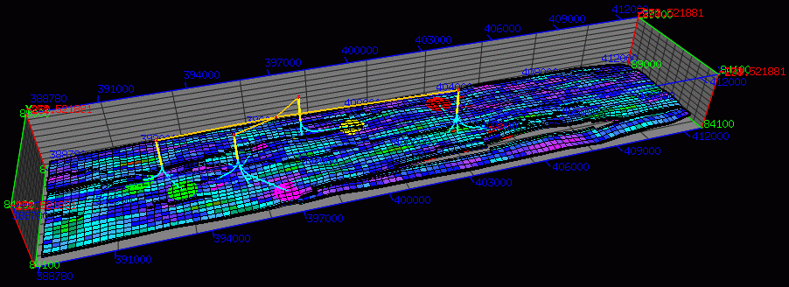

System Workflow
User Interface
Graphical Pre-Processing
Graphical Post-Processing
High Performance Cluster

Slide 6
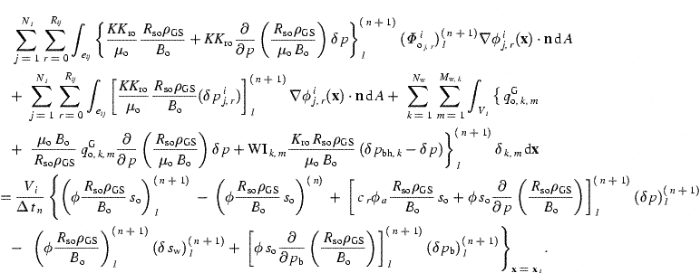

Computing
Challenges
Some Simulations take hours or even days, or even …
Our Testers are Petroleum Engineers, not Test Automation Specialists
Numerical Simulation is an approximation and as such is subject to round-off and/or perturbation differences

Slide 7




Managing the Coming Storm
Inside the Tornado
Project Kickoff
When will we get the requirements?
All in good time, my little pretty, all in good time
But I guess it doesn't matter anyway
Just give me your estimates by this afternoon
Team Unity
Not so fast! Not so fast! ... I'll have to give the matter a little thought. Go away and come back tomorrow
No, we need something today!
Ok then, it will take 2 years.
No, we need it sooner.
Doesn't anybody believe me?
I already promised the customer it will be out in 6 months
You're a very bad man!
Notes:
We look at a typical software project…..

Slide 8


We’re not in Kansas Anymore
Developer Hero
I may not come out alive, but I'm goin' in there!
Reorg
The Great and Powerful Oz has got matters well in hand.
My! People come and go so quickly here!
Testing
"Hee hee hee ha ha! Going so soon? I wouldn't hear of it! Why, my little party's just beginning!

Slide 9
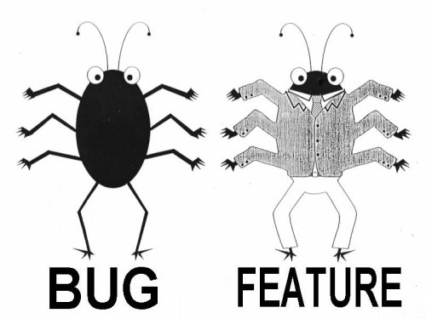
Lan Cao - Estimating Agile Software Project Effort: An Empirical Study
2X
Uncertainty,
Notes:
Lessons learned: If uncertainty is high, work on it earlier. Reduce Technical Debt—Get to potentially shippable at each iteration. Finding and fixing the last bugs has high uncertainty – plan on there being uncertainty.

Slide 10
System Workflow
User Interface
Graphical Pre-Processing
Graphical Post-Processing
High Performance Cluster

Slide 11
Test Automation Workflow
Input
Simulate
Output
Difference Engine
Report
Baseline

Slide 12
Testing and Automation Strategy
Customer Models
Weekly
Complexity of Tests
Nightly
Mid-Tier
GUI Tests (automated)
Smoke Tests (manual)
Nightly
Developer Tests
Every Checkin
Breadth of Coverage

Slide 13
Simulator Regression Tests over time
Customer X
Customer Other

Slide 14


Global Expertise
(Houston, Bucharest, Ho Chi Minh City)
3 Dev
3 PE Test
15 Dev
6 PE Test
2 Pgm Mgr
2 Prod Mgr
4 Auto Test

Slide 15
The Bottom Line
97% Reduction

Slide 16

Distributed Teams

Slide 17
Context Leadership Model
High
Uncertainty
Low
Low
High
Project Complexity

Slide 18

Context Leadership Model
High
Colts
Bulls
Simple, young projects.
Agility to handle uncertainty
Need agility
Structure to cope with complexity
Tight Teams
Uncertainty
Cows
SheepDogs
Complex, mature market
laissez faire
Need defined interfaces
Low
Low
High
Project Complexity

Slide 19
Partitioning
Colt Project
SheepDog Project
Bull Program
Cow Project
SheepDog Project
Search for Loose Coupling and Strong Cohesion

Slide 20
A Tale of 4 Projects within a Program
 | A Cow | A Colt | A SheepDog | A SheepDog | A Bull Program
Team Size | 20 | 8 | 2 | 5 | 35 (4 teams)
Distributed | Global (3 sites) | Global (2 sites) | Local | Global (4 sites) | Global (4 sites)
Scrums | 3/week | Daily | Daily | 2/week | none
Iteration Length | 3 weeks | 1 week | 1 week | Iterationless | 3 weeks

Slide 21

Outsourcing Challenges

Slide 22
















Outsourcing Challenge: Proprietary Data

Slide 23
Outsourcing Challenge: Time Shift
8 hours
12 hours

Slide 24

Outsourcing Challenge: Xenophobia

Slide 25
Key Take Aways
  Find and Correct Defects Early to Reduce Uncertainty
  A Testing Strategy Helps to Maximize Efficiency
  Test Automation Helps to Maintain Velocity
  Outsourcing Can Work When Used Judiciously.
  Treat Outsourcer as a Partner
  Cost Effective Global Talent
  Distributed Teams Can be Effective
  Test Automation Does not Replace Exploratory Testing

Slide 26

Leverage Global Talent

Slide 27

Think Globally and Optimize the Whole

Slide 28
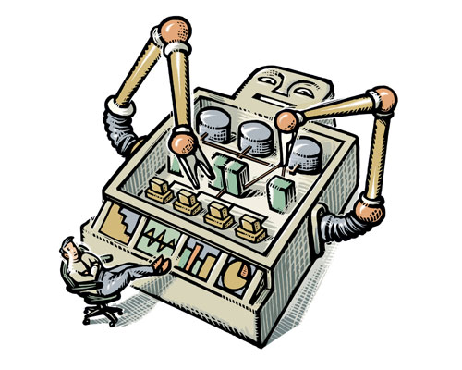
Automate – Automate - Automate

Slide 29
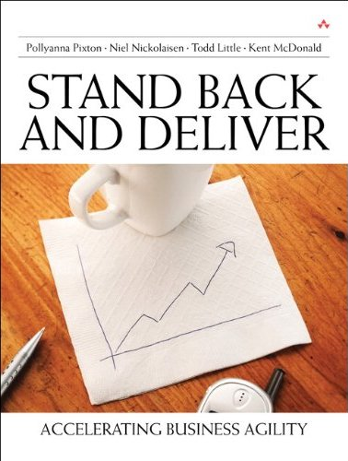
Contact
Todd Little
  tlittle@lgc.com
  www.toddlittleweb.com
Joe Hughes
  joeh@logigear.com
  www.logigear.com

Slide 30
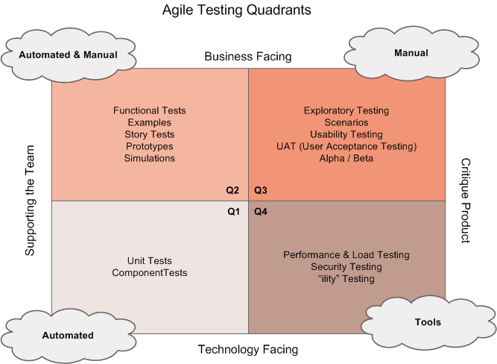
Testing Quadrants
GUI Tests (automated)
Smoke Tests (manual)
Exploratory Testing
Customer Models
Mid-Tier
Developer Tests
Customer Models

Slide 31
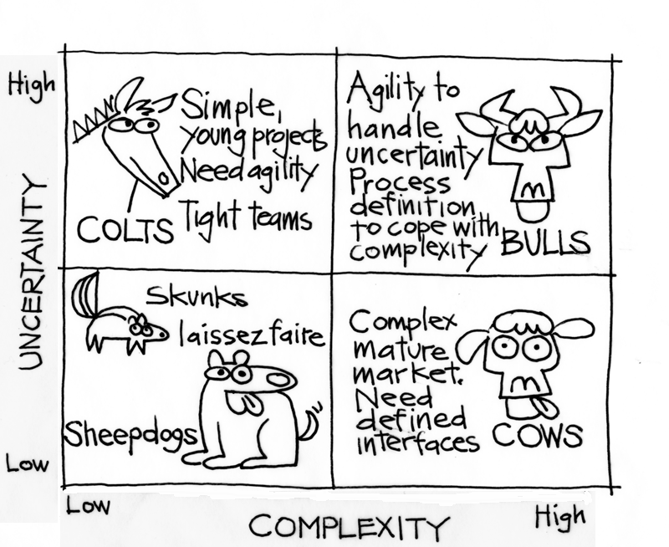
Context Leadership Model

Slide 32






Landmark Software and Services
Reservoir /
Fluid data
Production data
Geophysics
Engineering
Seismic data
Structural /
Stratigraphic data
Common Model
Representation
Common Model
Representation
Velocity data
Well data
Geology

Slide 33
Uncertainty and Complexity
Uncertainty |  | Complexity
Attribute | Range | Attribute | Range
Market | Mature or New | Team Size | <5 to > 100
Technical | Proven or New | Mission Critical | Speculative or Business Critical
# Customers | 1 or many | Team Location | Local or Distributed
Duration | 3 months or 2 years | Team Maturity | New or Experienced
Change | Change control or Embrace change | Domain Gaps | Gaps or Team of domain experts
 |  | Dependencies | None or Several

Slide 34
Context Leadership Model
High
Colts
Bulls
Uncertainty
Cows
SheepDogs
Low
Low
High
Project Complexity

