Slide 1

From Product Discovery to Product Delivery
Todd Little
Chairman, Kanban University

Slide 2
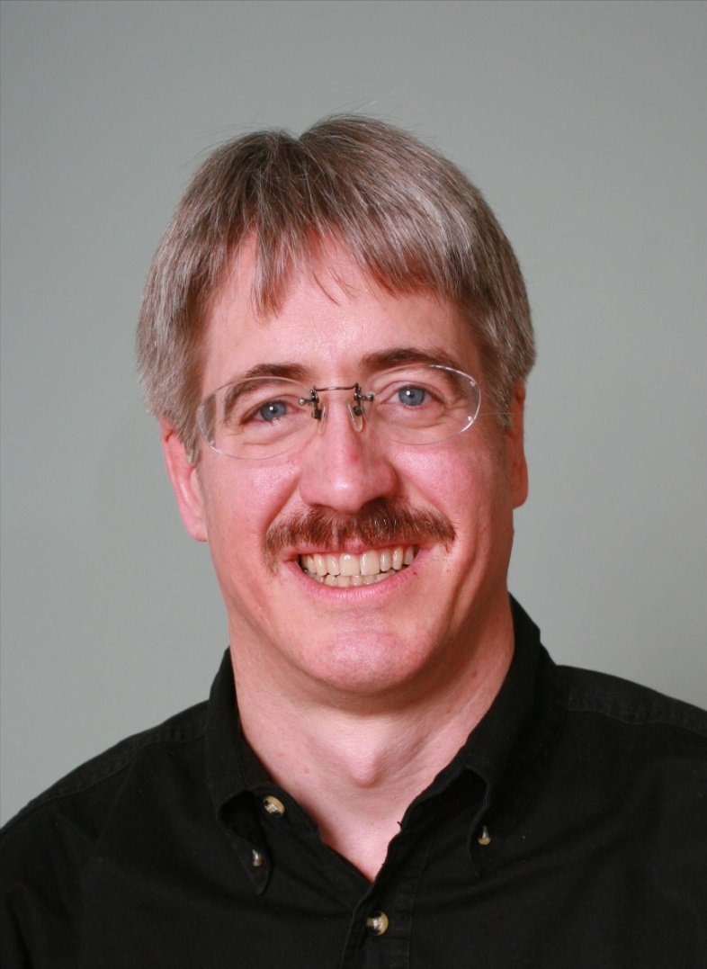



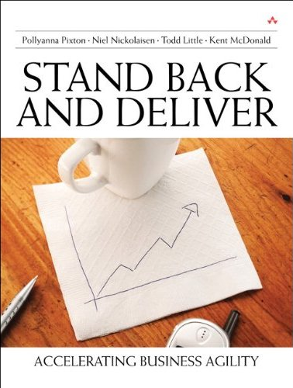



About Todd
Chemical and Petroleum Engineer
Executive roles as VP Product Development, Director of Software & Technology
@toddelittle

Slide 3
What does your product pipeline look like?

Slide 4
Idealized Product Pipeline
Phase progression indicates increasing investment and decreasing risk.
Portfolio
Review
Phase
Review 1
Phase
Review 2
Phase
Review 3
Phase
Review 4
Idea
Generation
E
N
T
E
R
Phase 1:
Concept
Investigation
Phase 4:
Post
Release
Current
Product
Support
Phase 2:
Feasibility
Phase 3:
Development
E
X
I
T
Does the idea fit roughly with our strategy and resource availability?
If yes, then
concept document
approved
& sub-team allocated
Does the product make sense from marketing, technical & financial perspectives?
If yes, then
concept
approved
& full team
allocated
What is the product spec?
Can we develop it within budget and schedule?
Can we produce it at the required cost & volume?
If yes, then
prototype
approved
& full team
allocated
Has the product been fully verified and validated?
Have production objectives been met?
If yes, then
full manufacturing
approved
& sub-team
allocated
Is the product meeting safety, efficacy and business targets in the market?
If yes, then
closeout
approved
& handoff to
product support

Slide 5
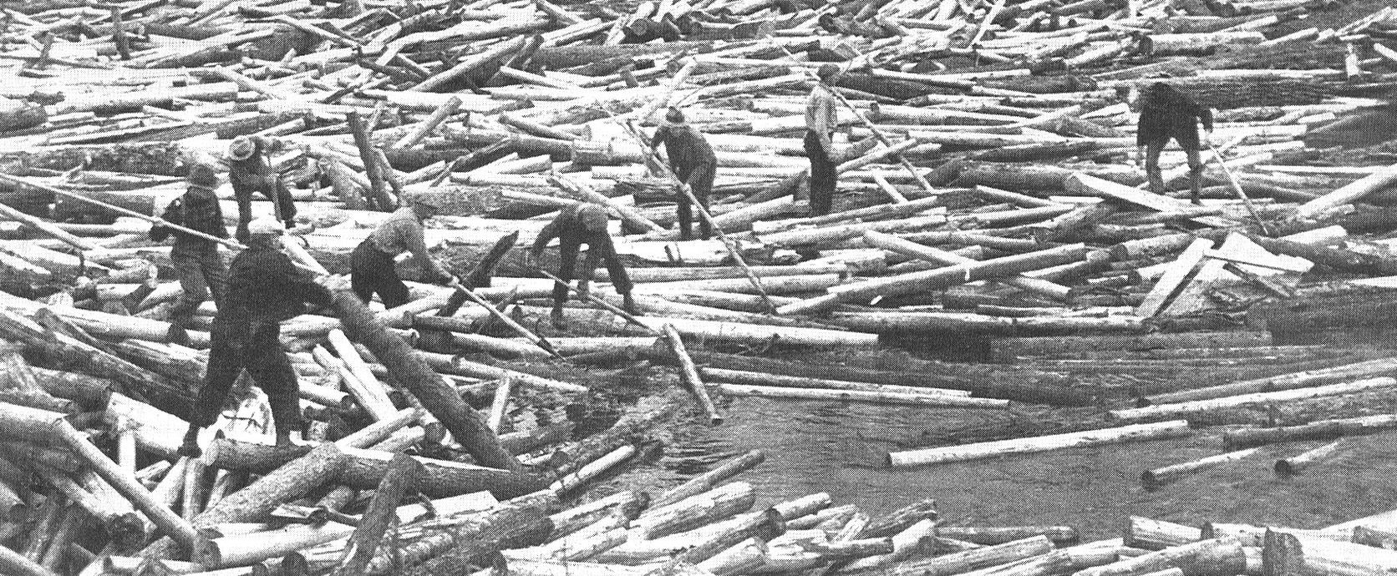
Is this your Product Pipeline?

Slide 6
Group A
Senior
Management
Injector
Marketing Inputs
Screen 1
Department Changes
Screen 2
Final Evaluation

Slide 7
Group B
Q
u
a
l
i
t
y
C
o
n
t
r
o
l
R
e
s
e
a
r
c
h
O
E
M
C
u
s
t
o
m
e
r
C
o
n
t
.
M
a
r
k
e
t
i
n
g
E
n
g
i
n
e
e
r
i
n
g
S
t
r
a
t
e
g
i
c
P
l
a
n
n
i
n
g

Slide 8



Inside the Tornado
Project Kickoff
When will we get the requirements?
All in good time, my little pretty, all in good time
But I guess it doesn't matter anyway
Just give me your estimates by this afternoon
Team Unity
Not so fast! Not so fast! ... I'll have to give the matter a little thought. Go away and come back tomorrow
No, we need something today!
Ok then, it will take 2 years.
No, we need it sooner.
Doesn't anybody believe me?
I already promised the customer it will be out in 6 months
You're a very bad man!
Notes:
We look at a typical software project…..

Slide 9


We’re not in Kansas Anymore
Developer Hero
I may not come out alive, but I'm goin' in there!
Reorg
The Great and Powerful Oz has got matters well in hand.
My! People come and go so quickly here!
Testing
"Hee hee hee ha ha! Going so soon? I wouldn't hear of it! Why, my little party's just beginning!

Slide 10
We want this
Innovation
Revenue
Predictability
Efficiency
AI
Market Influence
Late projects
API
Integration
OKRs
Cloud
Blockchain
Agile

Slide 11


Slide 12
Kanban Upstream Product Pipeline
Ideas
Ideas
Problem Hypotheses
Market
Analysis
Problem Validation
Solution Validation
Solution Development
Solution Deployment
Ideas

Slide 13
Ideas
Kanban for Product Managers
Cleanup on aisle 9 – Help fix the Scrum failures
Pursue advanced training for alumni
Focus on growth outside of IT/Software

Slide 14
Ideas
Kanban for Product Managers
Cleanup on aisle 9 – Help fix the Scrum failures
Pursue advanced training for alumni
Focus on growth outside of IT/Software

Slide 15

Outcomes from Scrum Transformations
Scrum worked for us, and we continue to get better. | Scrum helped a bit, but we haven’t gotten much better lately.
Scrum has been a disaster. | Scrum didn’t really help, but didn’t really hurt either.

Slide 16
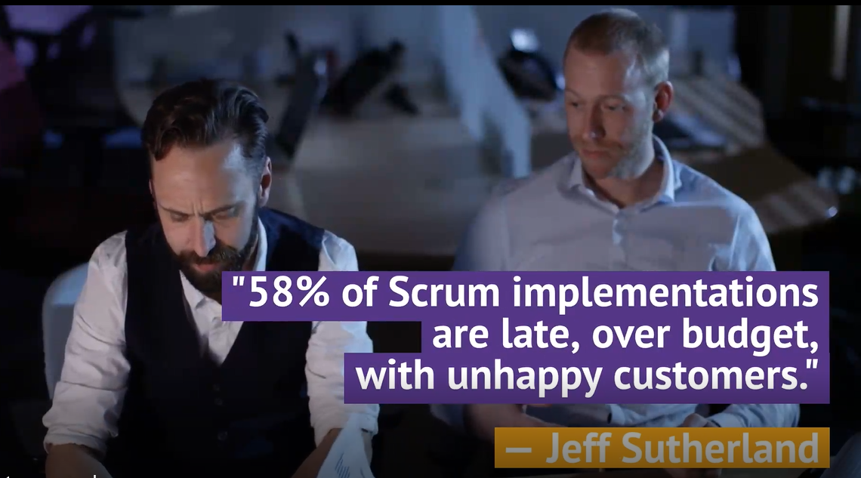

Target CSMs
Not as AKTs. The AKT candidates will continue to come we don’t need to draw more at this time.
But primary target for
  TKP, KSD
And key target for
  KMM/KCP and KMM Plus.
  Or a new KMM for Scrum class

Slide 17
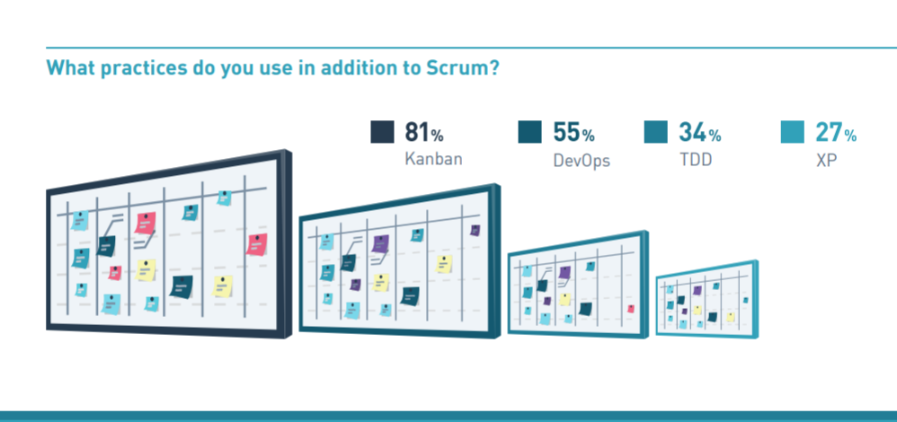
2019 Scrum Master Trends (Scrum.org)

Slide 18


Slide 19
State of Kanban 2022

Slide 20
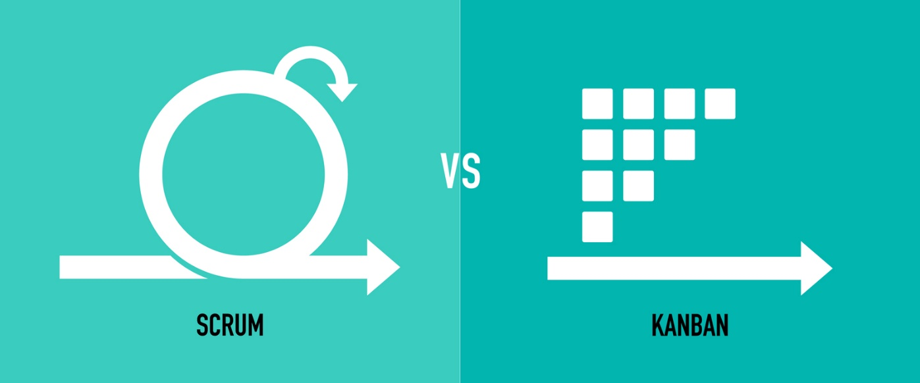

Scrum vs. Kanban
Scrum Glasses
  Scrum is a Framework, so Kanban is a Framework
  Scrum is for Products, Kanban is for Operations
  Kanban is just a board
Kanban Community
  Scrum Sucks!
  Losers!
  But one of our values is Respect!
  Start with what you do now!

Slide 21
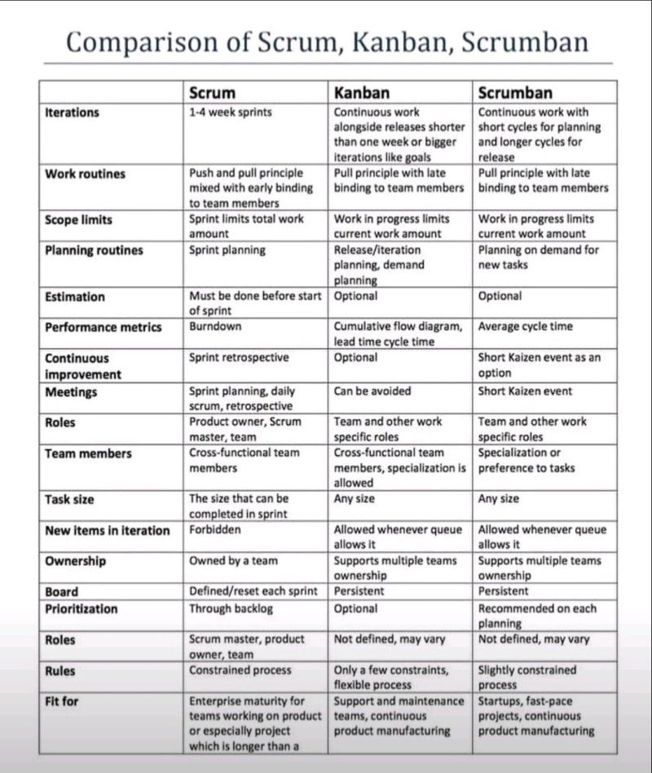
Wrong
Wrong
Wronger
Scrum Lens

Slide 22
Kanban is not a framework
Kanban is not just a board
Kanban is not something you install
Kanban is not a transformation
Any Kanban vs. Scrum comparison makes no sense
Kanban is a management method for improving the delivery of knowledge work using evolutionary change
While not a transformation, Kanban can be quite transformational
Kanban is an unframework

Slide 23
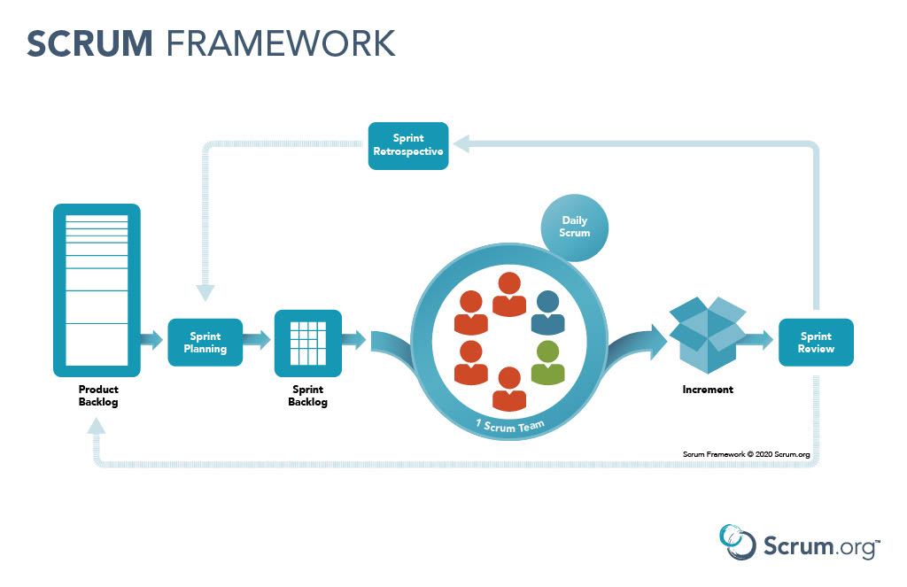
Start with what you do now

Slide 24
Market Analysis

Slide 25
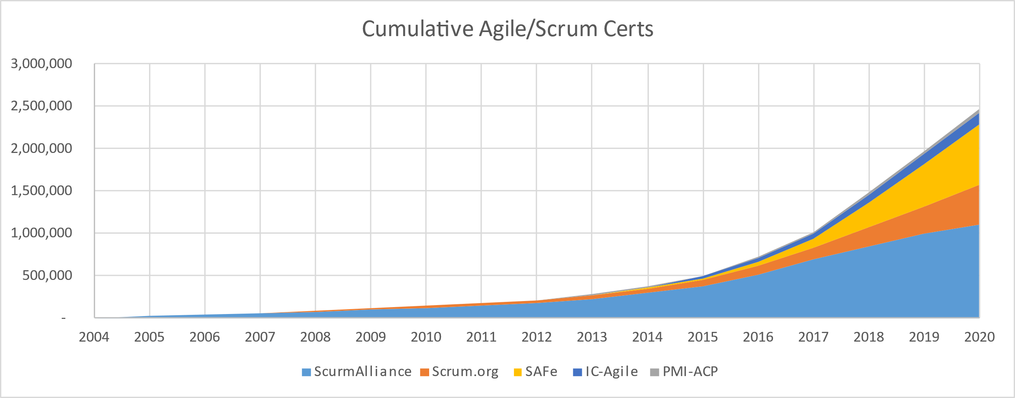

Slide 26
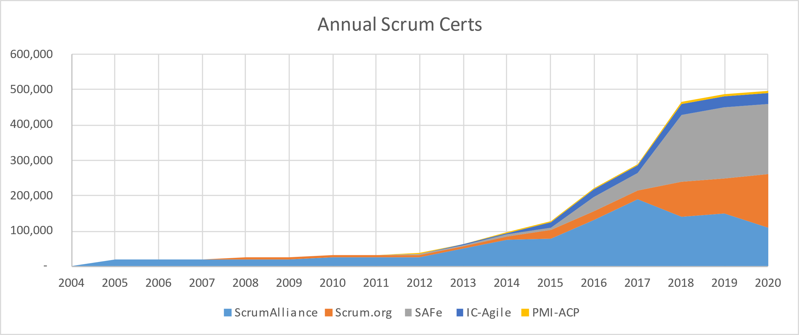

Slide 27
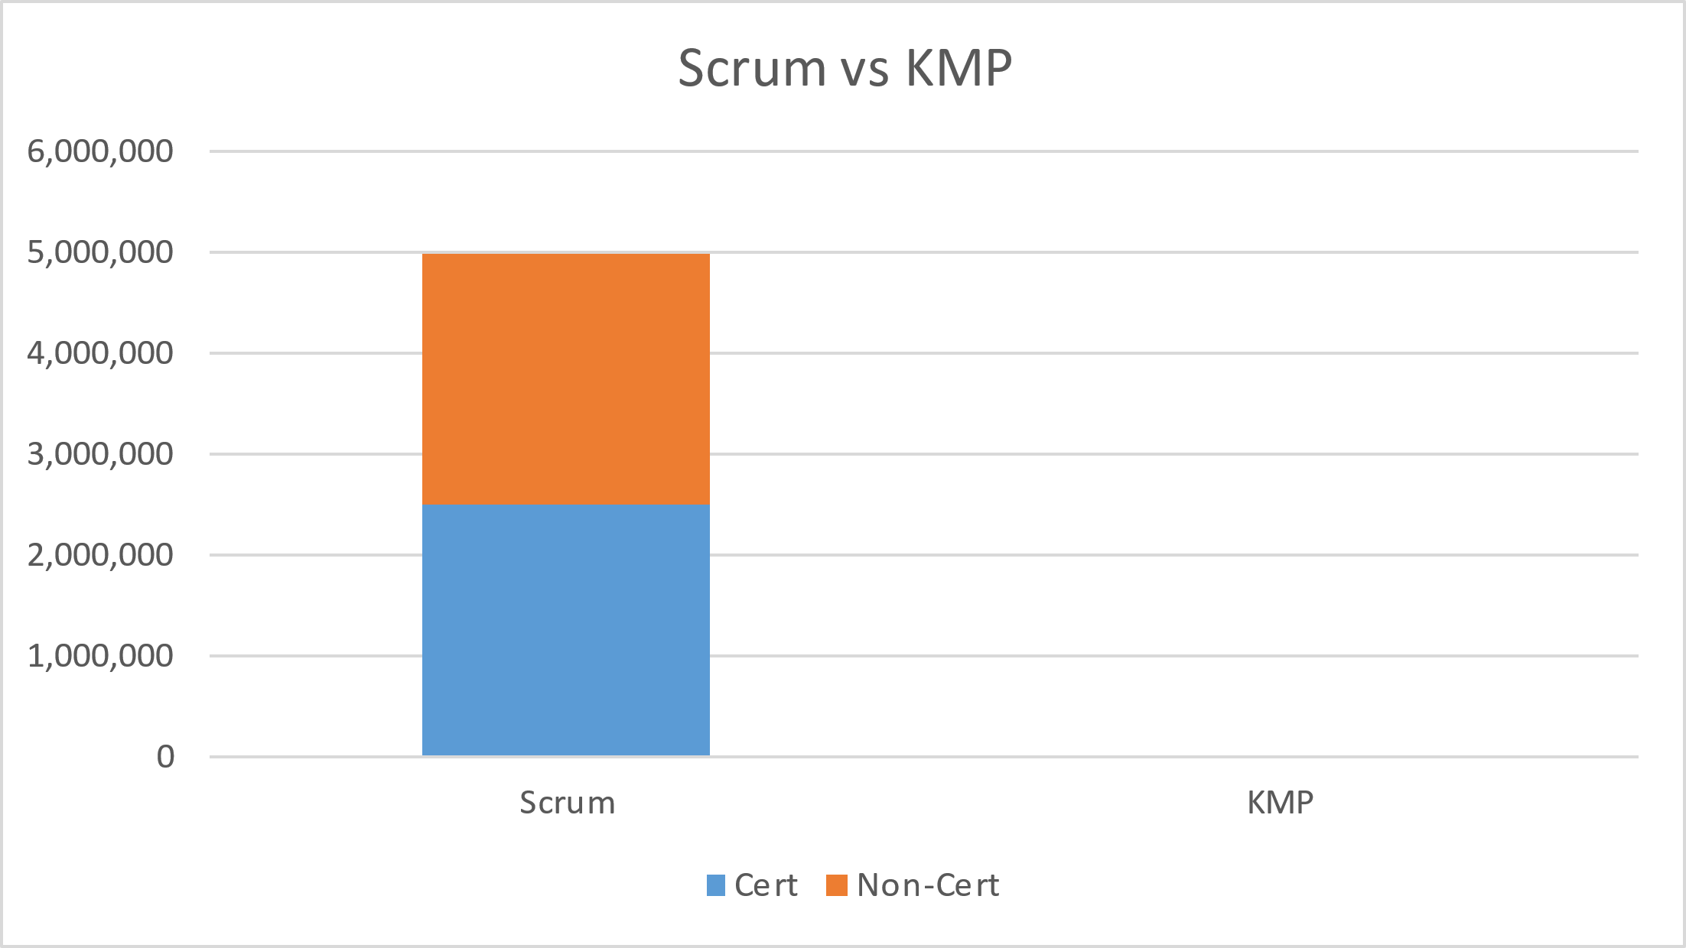
Cumulative Scrum and KMP Training

Slide 28
Market Analysis Hypothesis

Slide 29
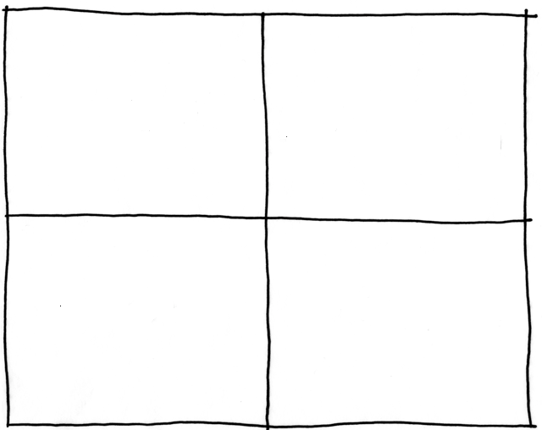
Segmenting the Market
Seem satisfied early adopters seeing some benefits.
May be a huge market, but one that does not see any urgency
Outside IT
Oblivious
Rare Birds
58% of Scrum implementations are late, over budget with unhappy customers
Scrummer Boys
They don’t want results, they want to avoid accountability – If they go, they’re going SAFe
Laggards
Inside IT
Agile in Motion
No Agile Yet

Slide 30
Segmenting the Market
Outside IT
Oblivious
Rare Birds
Scrummer Boys
Laggards
Inside IT
Agile in Motion
No Agile Yet

Slide 31
Rare Birds
Outside IT
Rare Birds
Oblivious
Inside IT
Scrummer Boys
Laggards
Agile in Motion
No Agile Yet
Outside IT already doing something “agile”
  Probably lightweight implementation of Scrum or a personal/team Kanban board.
  Those coming from Lean often are drawn straight to Kanban
  Some influenced by IT or agile coaches try to make Scrum work
  A few mature implementations but these are likely the exception.
  Probably pretty satisfied that they are early adopters seeing some benefits.

Slide 32
Oblivious
Outside IT
Rare Birds
Oblivious
Inside IT
Scrummer Boys
Laggards
Agile in Motion
No Agile Yet
Outside IT and not doing anything “agile”
  May not see a need
  Pain of current methods may be unfelt
  May already accept low service quality levels
  May not have significant uncertainty
  May already be mature with structured processes
  May be a huge market, but one that does not see any urgency

Slide 33
Scrummer Boys
Outside IT
Rare Birds
Oblivious
Inside IT
Scrummer Boys
Laggards
Agile in Motion
No Agile Yet
Inside IT already doing something “agile”
  Highly dominated by Scrum or SAFe.
  A significant number (80%) think they are doing some Kanban
3 Sub-Categories
  Scrum Works
    Some success with Scrum or SAFe. Made some progress and generally happy with the results. Checked the box on agility and not feeling pressure to improve.
  Scrum Stall
    Similar to Vanguard, they had some success with Scrum or SAFe but now have stalled out. It feels incomplete. The pain has returned. They may be looking for new solutions, but may also be worn out from transformation fatigue.
  Scrum Sucks
    They jumped on the bandwagon but have not gotten much if any benefits. In fact, the feeling is that things are worse. Many of these were late majority or laggards that are trying to follow a recipe, be it Scrum or SAFe. They are in a bit of no man’s land as they think they don’t know if they should revert to their prior ways, try to salvage what they can from Scrum, or try something else.

Slide 34
Laggards
Outside IT
Rare Birds
Oblivious
Inside IT
Scrummer Boys
Laggards
Agile in Motion
No Agile Yet
Inside IT and not doing anything “agile”
  Late majority traditional.
    They have held off for a long time. Most will be inclined towards SAFe. Not only is it what the masses have gone with, it is what is most aligned with the traditional control structure of the organization.
  Late majority chaos.
    They are literally oblivious, and don’t know where to start. This might be an open market that does not necessarily have a SAFe or Scrum bias.
  Startup mentality.
    They are smarter than everyone else and think they are already more agile than those losers “doing agile.” They most likely have low tolerance for Scrum and even less for SAFe. They might see some things in Kanban that they align with, but also think they are so smart that they can do it on their own.

Slide 35
What does this mean?
Aggressively pursue positioning Kanban as a way to improve the existing Scrum market without threatening Scrum practioners’ identity.

Slide 36
Segmenting the Market
Outside IT
Oblivious
Rare Birds
Scrummer Boys
Laggards
Inside IT
Agile in Motion
No Agile Yet

Slide 37
Kanban University SWOT Analysis
Strengths | Weaknesses
Kanban University is the defacto standard Kanban works Kanban Maturity Model Evolutionary Change Enthusiastic Network | Low market penetration Market thinks Kanban is a board Market thinks Kanban is a Transformation We can’t stop people from selling Kanban (Fair Use) Inertia – try harder at what is not working
About 2.5 million certified Scrummasters Probably another 2.5 million uncertified They value training or certificates Pain Persists - 58% of Scrum implementations fail to reach their intended goal | Legitimate Competitors Slumlord competitors
Opportunities | Threats

Slide 38
Customer
Surveys

Slide 39

Product Management Trap

Slide 40
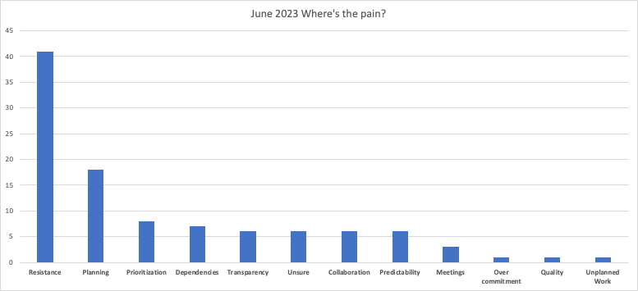
Pains We’ve Discovered
How do I improve flow/predictability
How to I handle resistance

Slide 41
Reach out to Potential Customers
Customer Interviews
30 interviews reached out via LinkedIn
Asked about Scrum and Product ownership
Themes:
Strategic Alignment
Overload
Changing direction and priority
Resistance and Influencing
Pragmatic Institute Joint Survey
1000 responses from PI customer base
Common themes validated and quantified
Up – across (i.e. marketing) – out (customers) – internal (delivery))

Slide 42
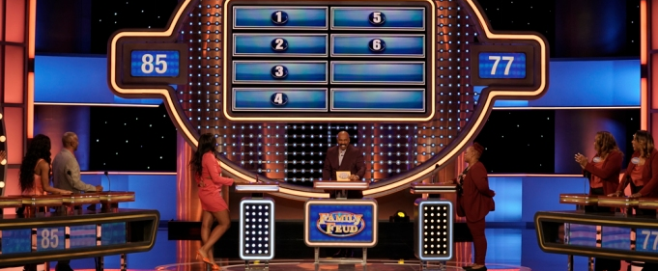
Agile Product Feud

Slide 43
Recurring Issues in Product Development

Slide 44
Feedback
Loops

Slide 45
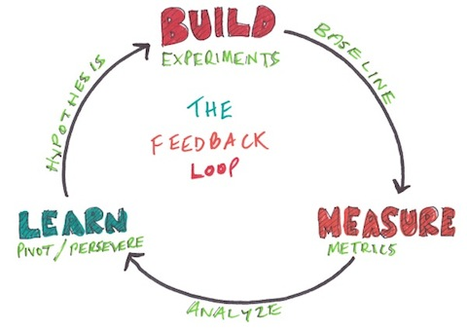
Lean Startup

Slide 46
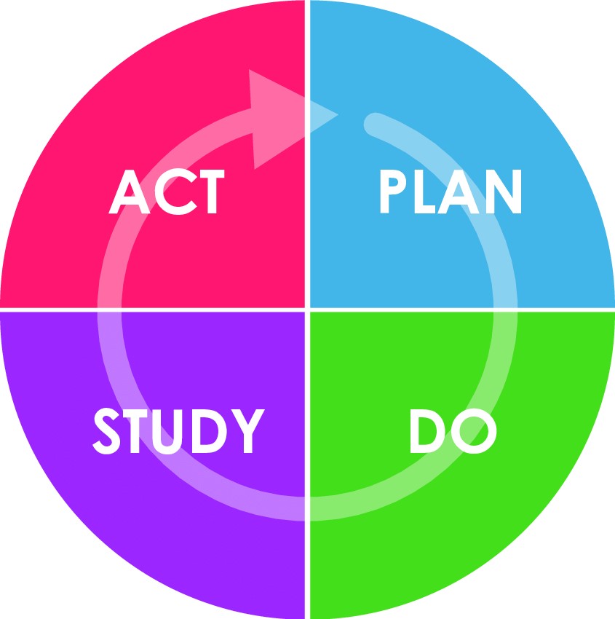
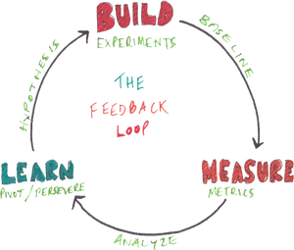
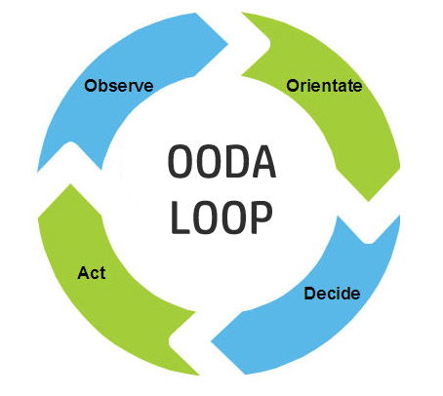
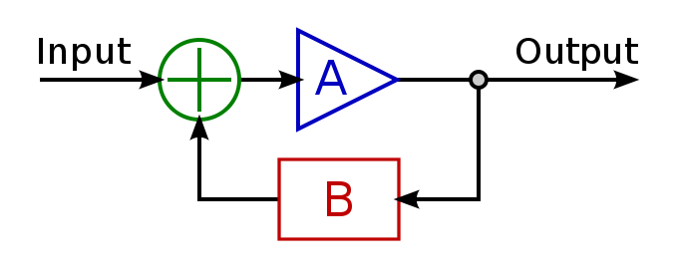
Other Feedback Loops

Slide 47
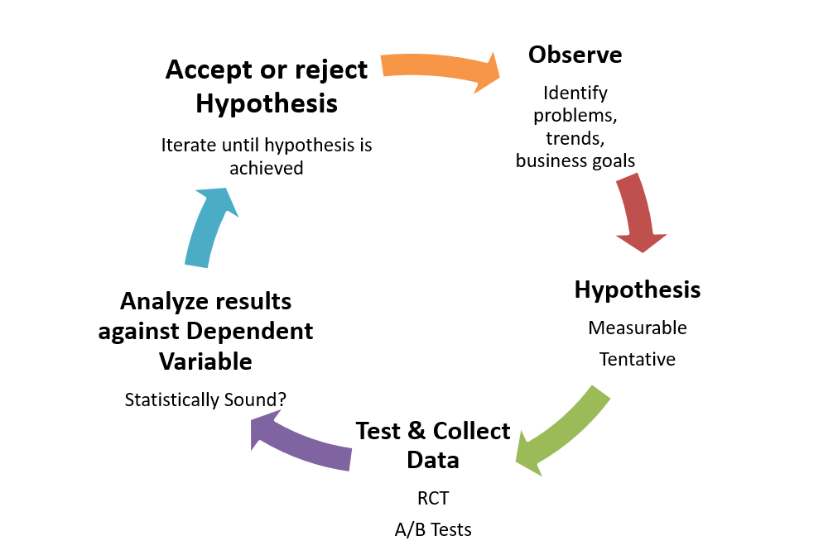
The Scientific Method

Slide 48
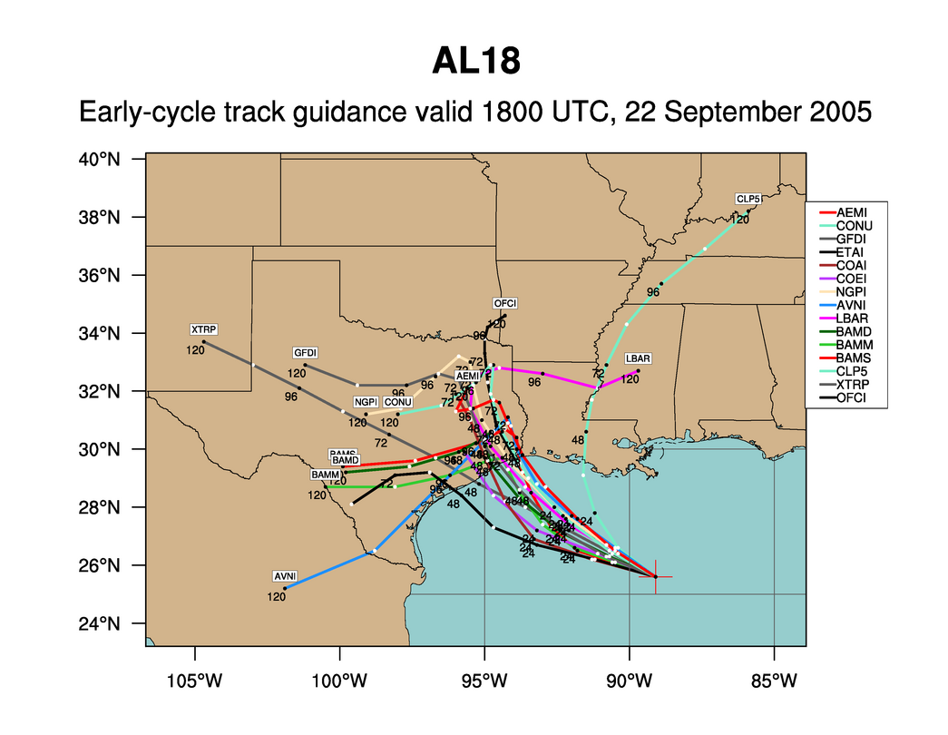
Hurricane Rita
Notes:
We like to use forecasting a hurricane track as an analogy to software development. This is an example of the various news agencies early forecast of hurricane’s Rita track. One thing we know is that all of these tracks are wrong.

Slide 49
Hurricane Rita
Notes:
The actual path of Rita is shown in yellow. Planning of software is much like this. Almost everything we do is “new” and when we followed a more waterfall model, we took lots of time designing and gathering estimates of tasks before starting. From that initial Plan, the one thing we really knew, was that the project would not turnout looking like the plan and it would change. We know that as we gain more knowledge during development the plan would be refined many times. So, with Agile, we don’t spend a lot of time in upfront planning.

Slide 50
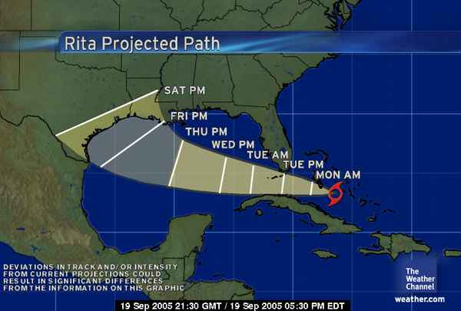

Slide 58
Business Process Value Chain
Market
Product
Development
Sales
Product Company
Specifications
Development
Delivery
Contract Model
Business Need
Development
Delivery
Internal IT

Slide 59
Business Process Value Chain
Market
Product
Development
Sales
Product Company
Specifications
Development
Delivery
Contract Model
Business Need
Development
Delivery
Internal IT

Slide 60
Pre-Marketing

Slide 61
Socializing the Concept - Industry Talks
PMI Houston
Agile DC
DC Business Agility Meetup
Agile India
Lithespeed Lean Agile Meetup
Scrum Gathering Netherlands
Kanban India
Bank of Singapore

Slide 62
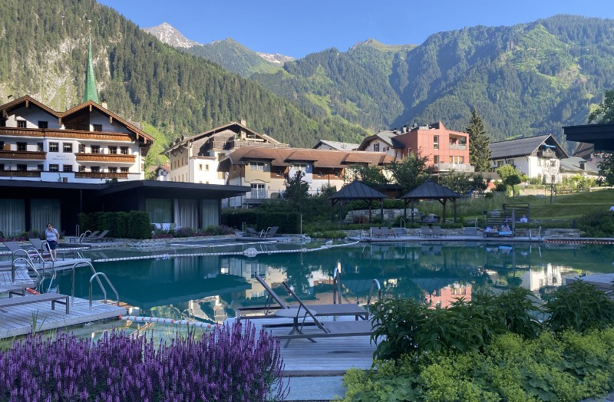
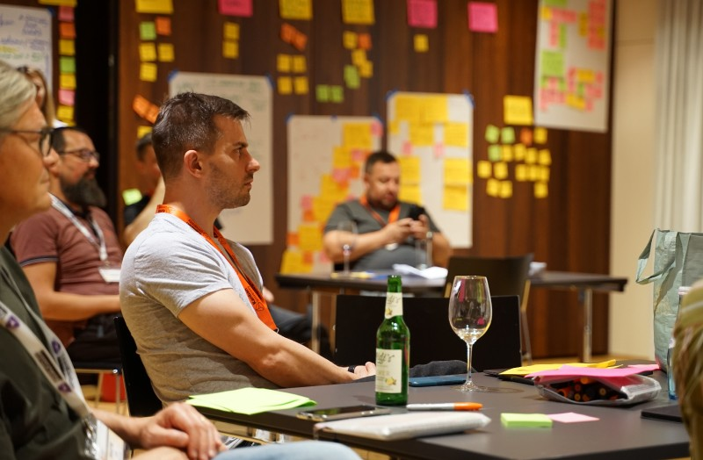
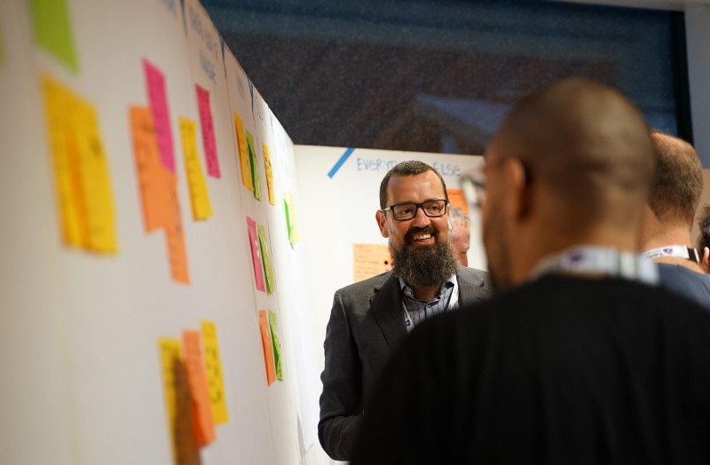
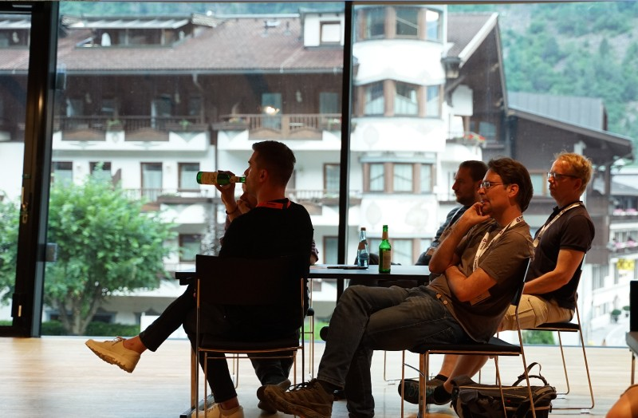
Kanban Leadership Retreat

Slide 63
Marketing

Slide 64
Marketing Goals
Position the Kanban Method as complementary to Scrum to help managers go farther without another overhaul of their process and operations.
Position Kanban University as the top destination for training and education to incorporate Kanban in existing Scrum practice.

Slide 65
Key Messages
Kanban vs Scrum is automatically wrong. It’s an incorrect paradigm.
Kanban makes whatever you’re doing better
Kanban applied to Scrum makes Scrum better - Scrum Better with Kanban

Slide 66
SCRUM BETTER
WITH
KANBAN
David Kaufer
KDMC Marketing

Slide 67
VISION
For the Scrum practitioner who believes in Scrum and wants to achieve more with it while maintaining their identity

Slide 68
MARKETING GOALS
Position the Kanban Method as complementary to Scrum to help managers go farther without another overhaul of their process and operations.
Position Kanban University as the top destination for training and education to incorporate Kanban in existing Scrum practice.
Provide education and marketing support for AKTs to help them communicate the messaging and expand their class offerings to the wider Scrum audience.

Slide 69
KEY MESSAGES: KANBAN & SCRUM
Kanban vs Scrum is automatically wrong. It’s an incorrect paradigm.
Kanban makes whatever you’re doing better.
Kanban with Scrum as a starting point will make Scrum better.

Slide 70


SCRUM BETTER WITH KANBAN!
The campaign builds off our Rosie character with the addition of new Scrum characters who Rosie works with to teach them how to Scrum better with Kanban.

Slide 71
Problem/Solution Validation

Slide 72


Who wants to play?
We hoped for 4 people
We got more than 15

Slide 73
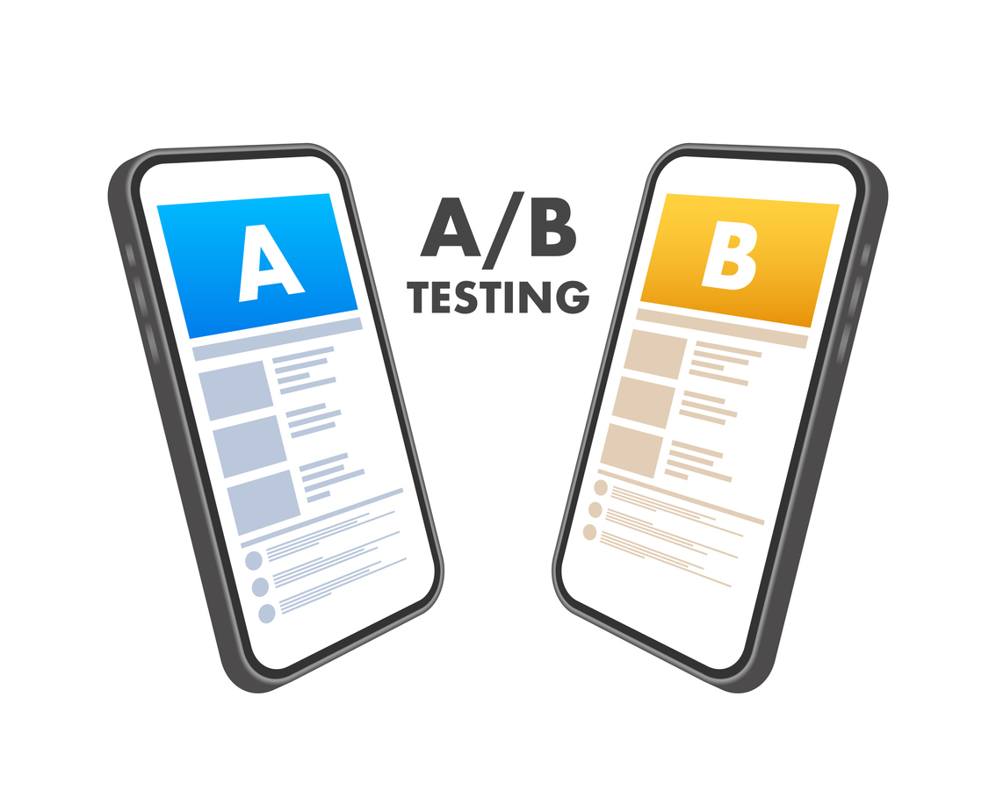

Slide 74
A/B test
A: Modified version of Kanban University Team Kanban Practitioner class with evolutionary change “translated” into Scrum language
B: Focus on problem identification within and beyond the Scrum Framework and use of evolutionary change with Kanban principles and practices

Slide 75
CAB

Slide 76
Problem/Solution Validation

Slide 77
CAB

Slide 78
So How did it go?

Slide 79
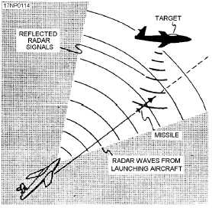


Gordon the Guided Missile

Slide 80

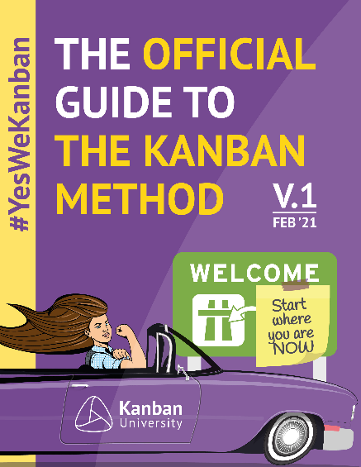

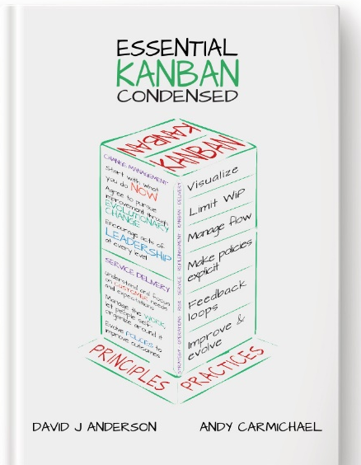
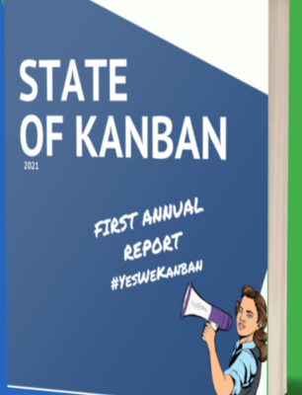
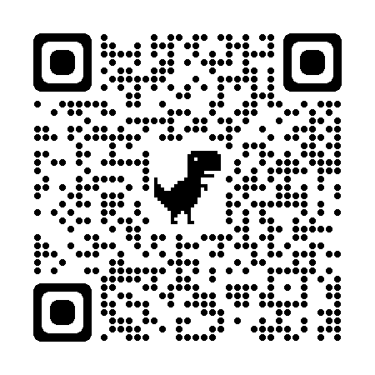
How to get started with Kanban
Kanban Guide | Case Studies | Blue Book
Essential Kanban Condensed | State of Kanban Survey | www.kanban.university

