Slide 1



The Value Uncertainty
Product Simulation Game
Todd Little
CEO Lean Kanban

Slide 2
Purpose
A fun game to explore how risk and uncertainty impacts our decisions and behaviours in software development.

Slide 3


Establishing Norms

Slide 4
Backgrounds
Agile Experience
Industries
Roles

Slide 5
Form teams
Create a team name
(1 minute)

Slide 6


Slide 7
Goal of the Game
Produce a Software Release in 3 iterations of 10 days per iteration
Prioritize and re-prioritize the backlog to optimize value delivery before the fixed release date
Be the team that delivers the most points
  Delivered Value + “Commitment Points”

Slide 8



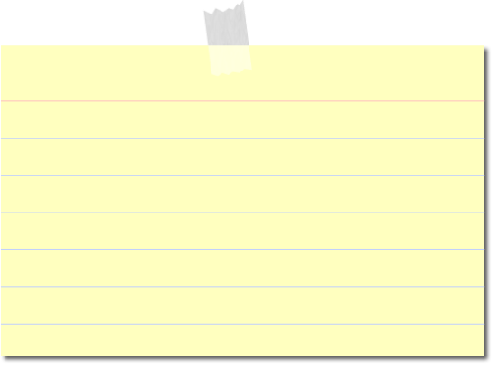
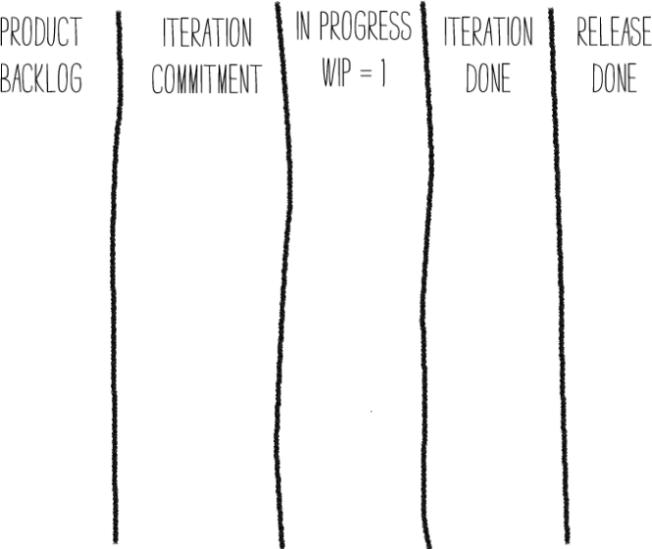
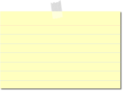
Artifacts (5)
4 Dice
ID: 1
Test: Roll 3 dice - 2 or more dice are the same
Value: Sum of all dice
10 User Stories
1 Score Card – Write Your Team’s
Number at the Top
Value – Uncertainty Estimation Matrix
Iteration
Plan
In
Progress
(WIP = 1)
Accepted
XL
L
M
S
 | S | M | L | XL
Scrum Board

Slide 9
Roles (3)
Score Keeper – Update the score sheet after each day of the iteration
Sticky Minder – Move the Stories,
keep the Scrum Board up-to-date
Dice Roller – Rolls the Dice

Slide 10
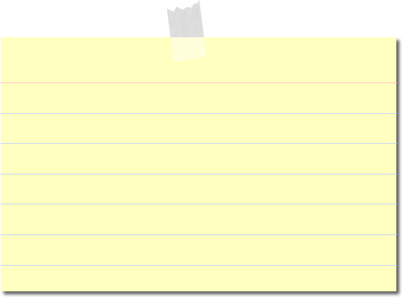

Example Story
ID: 1
Test: Roll 3 dice - 2 or more dice are the same
Value: Sum of all dice
Fail;
Story Not Accepted
Day 1:
Success;
Story Completed
Day 2:
Cost = 2 days
Value = 3 + 1 + 3 = 7
Notes:
Read the story. Some stories will require you to roll 1 dice. Stories others 2 dice, 3 dice, etc…
Each story has a different way of calculating the value.

Slide 11
Example: Relative Sizing
ID 1
ID: 4
Value: product of dice
Test: Roll 3 dice -
Three consecutive integers (straight)
Value: Sum of all dice
Test: Roll 3 dice –
2 or more dice are the same
Which story has a higher potential value?
Product > Sum
Which story has a higher potential cost?
3 consecutive integers harder than 2 or more dice are the same

Slide 12
Clarification
ID: 5
Test: Roll 3 dice – no 1s and no 2s
Value: Sum of all dice
Meaning: None of the 3 dice are 1s or 2s

Slide 13
Release Planning

Slide 14
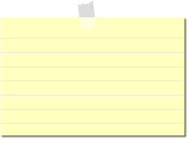
Estimation and Prioritization: Place stories by relative cost and value
XL
L
M
S
 | S | M | L | XL
ID: 4
ID:1
Value
Cost
Notes:
Find User Story #1, identified by the black border. Place Approximately in the “middle”. This is going to be our reference for relative estamiting.
Do this now.
We have just compared User Story #4 to User Story #1, and we know it is both larger in cost and value, so place it somewhere to the right and above User Story #1.
Do this now.
You will have 5 minutes to do this relative estimation with all other user stories. Like all estimates, it will be difficult to be precise, so you will have to make an educated guess.
Begin now.

Slide 15
Estimation and Prioritization: Place stories by relative cost and value
XL
L
M
S
 | S | M | L | XL
Value
Cost
Notes:
Find User Story #1, identified by the black border. Place Approximately in the “middle”. This is going to be our reference for relative estamiting.
Do this now.
We have just compared User Story #4 to User Story #1, and we know it is both larger in cost and value, so place it somewhere to the right and above User Story #1.
Do this now.
You will have 5 minutes to do this relative estimation with all other user stories. Like all estimates, it will be difficult to be precise, so you will have to make an educated guess.
Begin now.

Slide 17
Mini-Retro
How is this like estimating in software?
How is it not like estimating in software?
What can we learn from this?

Slide 18
Goal: Prioritize the backlog to maximize your team’s score by the end of the release

Slide 19
Release planning
Must Commit to at least 6 stories
  For each story committed and delivered you will get 10 commitment points
  If you miss your commitment you will get 0 commitment points.

Slide 20
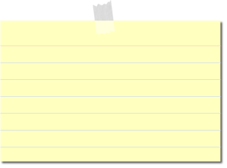


Plan the Release
Must commit a minimum of 6 stories for the release
You can choose to commit more, but you forfeit all commitment points for the release if you miss any committed story
Release
Plan
Iteration
Plan
XL
L
M
S
 | S | M | L | XL

Slide 22
Iteration Planning

Slide 23
Stories and Scoring
Release is 3 iterations,
  10 “days” per iteration.
  1 Roll of the dice per day
WIP limit of one story in progress at a time
You can earn 5 extra “commitment” points for each COMMITTED story you deliver.
  Forfeit all commitment points for an iteration if any committed stories are missed.
Must commit to AT LEAST 2 stories per iteration.
You may choose to commit to more – BUT you lose ALL commitment points for that iteration if you miss ANY commitment.
Score = Delivered Value + Commitment Points

Slide 24
Plan the First Iteration
Must commit a minimum of 2 stories to each iteration
You can choose to commit more, but you forfeit all commitment points for that iteration if you miss any
Release
Plan
Iteration
Plan
XL
L
M
S
 | S | M | L | XL

Slide 26

Simulation Example
ID: 1
Test: Roll 3 dice - 2 or more dice are the same
Value: Sum of all dice

Slide 27
 | # Stories Committed to Iteration | Roll (Day) |  |  |  |  |  |  |  |  |  | Total of Accepted Value | # Stories Completed | Iteration Commitment Met?(Yes/No) | Commitment Points
Iteration |  | 1 | 2 | 3 | 4 | 5 | 6 | 7 | 8 | 9 | 10
1
3
X
ID: 1
Test: Roll 3 dice - 2 or more dice are the same
Value: Sum of all dice
Iteration
Plan
In
Progress
(WIP = 1)
Accepted

Slide 28
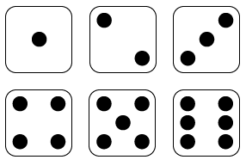
 | # Stories Committed to Iteration | Roll (Day) |  |  |  |  |  |  |  |  |  | Total of Accepted Value | # Stories Completed | Iteration Commitment Met?(Yes/No) | Commitment Points
Iteration |  | 1 | 2 | 3 | 4 | 5 | 6 | 7 | 8 | 9 | 10
1
3
X
X
ID: 1
Test: Roll 3 dice - 2 or more dice are the same
Value: Sum of all dice
Iteration
Plan
In
Progress
(WIP = 1)
Accepted

Slide 29
 | # Stories Committed to Iteration | Roll (Day) |  |  |  |  |  |  |  |  |  | Total of Accepted Value | # Stories Completed | Iteration Commitment Met?(Yes/No) | Commitment Points
Iteration |  | 1 | 2 | 3 | 4 | 5 | 6 | 7 | 8 | 9 | 10
1
3
X
X
7
ID: 1
Test: Roll 3 dice - 2 or more dice are the same
Value: Sum of all dice
Iteration
Plan
In
Progress
(WIP = 1)
Accepted

Slide 30
 | # Stories Committed to Iteration | Roll (Day) |  |  |  |  |  |  |  |  |  | Total of Accepted Value | # Stories Completed | Iteration Commitment Met?(Yes/No) | Commitment Points
Iteration |  | 1 | 2 | 3 | 4 | 5 | 6 | 7 | 8 | 9 | 10
1
3
X
X
7
X
ID: 7
Test: Roll 3 Die – 2 or more 6’s
Value: Product of all dice
Iteration
Plan
In
Progress
(WIP = 1)
Accepted

Slide 31
 | # Stories Committed to Iteration | Roll (Day) |  |  |  |  |  |  |  |  |  | Total of Accepted Value | # Stories Completed | Iteration Commitment Met?(Yes/No) | Commitment Points
Iteration |  | 1 | 2 | 3 | 4 | 5 | 6 | 7 | 8 | 9 | 10
1
3
X
X
7
X
X
ID: 7
Test: Roll 3 Die – 2 or more 6’s
Value: Product of all dice
Iteration
Plan
In
Progress
(WIP = 1)
Accepted

Slide 32
 | # Stories Committed to Iteration | Roll (Day) |  |  |  |  |  |  |  |  |  | Total of Accepted Value | # Stories Completed | Iteration Commitment Met?(Yes/No) | Commitment Points
Iteration |  | 1 | 2 | 3 | 4 | 5 | 6 | 7 | 8 | 9 | 10
1
3
X
X
7
X
X
36
ID: 7
Test: Roll 3 Die – 2 or more 6’s
Value: Product of all dice
Iteration
Plan
In
Progress
(WIP = 1)
Accepted

Slide 33
 | # Stories Committed to Iteration | Roll (Day) |  |  |  |  |  |  |  |  |  | Total of Accepted Value | # Stories Completed | Iteration Commitment Met?(Yes/No) | Commitment Points
Iteration |  | 1 | 2 | 3 | 4 | 5 | 6 | 7 | 8 | 9 | 10
1
3
X
X
7
X
X
36
X
ID: 14
Test: Roll 2 Dice – Both Dice are Different
Value: Highest of two dice
Iteration
Plan
In
Progress
(WIP = 1)
Accepted

Slide 34
 | # Stories Committed to Iteration | Roll (Day) |  |  |  |  |  |  |  |  |  | Total of Accepted Value | # Stories Completed | Iteration Commitment Met?(Yes/No) | Commitment Points
Iteration |  | 1 | 2 | 3 | 4 | 5 | 6 | 7 | 8 | 9 | 10
1
3
X
X
7
X
X
36
X
4
ID: 14
Test: Roll 2 Dice – Both Dice are Different
Value: Highest of two dice
Iteration
Plan
In
Progress
(WIP = 1)
Accepted

Slide 35
 | # Stories Committed to Iteration | Roll (Day) |  |  |  |  |  |  |  |  |  | Total of Accepted Value | # Stories Completed | Iteration Commitment Met?(Yes/No) | Commitment Points
Iteration |  | 1 | 2 | 3 | 4 | 5 | 6 | 7 | 8 | 9 | 10
1
3
X
X
7
X
X
36
X
4
x
ID: 9
Test: Roll 1 Dice – Not a 1
Value: Value of Single Die
Iteration
Plan
In
Progress
(WIP = 1)
Accepted

Slide 36
 | # Stories Committed to Iteration | Roll (Day) |  |  |  |  |  |  |  |  |  | Total of Accepted Value | # Stories Completed | Iteration Commitment Met?(Yes/No) | Commitment Points
Iteration |  | 1 | 2 | 3 | 4 | 5 | 6 | 7 | 8 | 9 | 10
1
3
X
X
7
X
X
36
X
4
X
6
53
4
Yes
15
ID: 9
Test: Roll 1 Dice – Not a 1
Value: Value of Single Die
Iteration
Plan
In
Progress
(WIP = 1)
Accepted

Slide 37
Iteration 1: Special Actions
It is ok abandon a story
  You can come back to it later
It is ok to redo a story
  If you complete a story and find that the market does not value as much as you would like, you can redo the story by pulling it back into the WIP. If you later abandon the new redo story, you keep the value of the completed story. If the value for the rework is higher, then count that value and remove the prior value.

Slide 39
Plan the Second Iteration
Must commit a minimum of 2 stories to each iteration
You can choose to commit more, but you forfeit all commitment points for that iteration if you miss any
Release
Plan
Iteration
Plan
XL
L
M
S
 | S | M | L | XL
But Wait,
Product Management has been busy and has new stories
And they also have new market research on value

Slide 40
Market Feedback on 2 stories
-100% | -50% | -25% | +25% | +50% | +100%

Slide 41
Update for the Market Info for Stories already completed
Column | A | B | C | D | E | F | G | H | I | J | K | L | M | N | O
 |  | Value Accepted
 | # Stories Committed to Iteration | Roll |  |  |  |  |  |  |  |  |  | Total of Accepted Value | # Stories Completed | Iteration Commitment Met?(Yes/No) | Commitment Points
Iteration |  | 1 | 2 | 3 | 4 | 5 | 6 | 7 | 8 | 9 | 10
 |  |  |  |  |  |  |  |  |  |  |  | Sum of ColB:ColK | Count of ColB:ColK where > 0 | "Yes" if ColM >= ColA, else "No" | If ColN == "Yes", then 5 * ColA, else 0
1 | 3 | X | X | X | 7 | X | X | 2 | X | 5 | X | 14 | 3 | Yes | 15
2
3
Adjust |  | +4 | 0
If either of the adjusted stories have not been worked (or if you chose to redo the story) then the value will be adjusted by the factor. Make a note on the story card

Slide 42
Plan the Second Iteration
Must commit a minimum of 2 stories to each iteration
You can choose to commit more, but you forfeit all commitment points for that iteration if you miss any
Release
Plan
Iteration
Plan
XL
L
M
S
 | S | M | L | XL
Remember your release commitment!

Slide 43
 | # Stories Committed to Iteration | Roll (Day) |  |  |  |  |  |  |  |  |  | Total of Accepted Value | # Stories Completed | Iteration Commitment Met?(Yes/No) | Commitment Points
Iteration |  | 1 | 2 | 3 | 4 | 5 | 6 | 7 | 8 | 9 | 10
1
2 | 4 | X | X | X | 10 | X | 3 | X | X | 3 | X | 16 | 3 | NO | 0
3
X
X
7
X
X
36
X
4
X
6
53
4
Yes
15

Slide 44
Iteration 2
It is ok abandon a story
  You can come back to it later
It is ok to redo a story
  If you complete a story and find that the market does not value as much as you would like, you can redo the story by pulling it back into the WIP. If you later abandon the new redo story, you keep the value of the completed story.

Slide 46
Plan the Third Iteration
Must commit a minimum of 2 stories to each iteration
You can choose to commit more, but you forfeit all commitment points for that iteration if you miss any
Release
Plan
Iteration
Plan
XL
L
M
S
 | S | M | L | XL
But Wait,
Product Management has been busy and has new stories
And they also have new market research on value

Slide 47
Market Feedback on 2 stories
-100% | -50% | -25% | +25% | +50% | +100%

Slide 48
Plan the Third Iteration
Must commit a minimum of 2 stories to each iteration
You can choose to commit more, but you forfeit all commitment points for that iteration if you miss any
Release
Plan
Iteration
Plan
XL
L
M
S
 | S | M | L | XL
Remember your release commitment!

Slide 49
 | # Stories Committed to Iteration | Roll (Day) |  |  |  |  |  |  |  |  |  | Total of Accepted Value | # Stories Completed | Iteration Commitment Met?(Yes/No) | Commitment Points
Iteration |  | 1 | 2 | 3 | 4 | 5 | 6 | 7 | 8 | 9 | 10
1
2 | 4 | X | X | X | 10 | X | 3 | X | X | 3 | X | 16 | 3 | NO | 0
3 | 4 | X | X | 10 | X | 2 | 3 | X | 14 | X | X | 29 | 4 | Yes | 20
3
X
X
7
X
X
36
X
4
X
6
53
4
Yes
15

Slide 50
Iteration 3
It is ok abandon a story
  You can come back to it later
It is ok to redo a story
  If you complete a story and find that the market does not value as much as you would like, you can redo the story by pulling it back into the WIP. If you later abandon the new redo story, you keep the value of the completed story.
Remember your release commitment!

Slide 52
 |  | Value Accepted
 | # Stories Committed to Iteration | Roll |  |  |  |  |  |  |  |  |  | Total of Accepted Value | # Stories Completed | Iteration Commitment Met?(Yes/No) | Commitment Points
Iteration |  | 1 | 2 | 3 | 4 | 5 | 6 | 7 | 8 | 9 | 10
 |  |  |  |  |  |  |  |  |  |  |  | Sum of ColB:ColK | Count of ColB:ColK where > 0 | "Yes" if ColM >= ColA, else "No" | If ColN == "Yes", then 5 * ColA, else 0
1 | 3 | X | X | X | 7 | X | X | 2 | X | 5 | X | 14 | 3 | Yes | 15
2 | 4 | X | 8 | X | X | X | X | X | 4 | 1 | X | 13 | 3 | NO | 0
3 | 3 | 4 | X | X | X | 2 | X | 7 | X | 3 | X | 16 | 4 | Yes | 15
Adjust |  | +4 | 0 | 0 | -6 |  |  |  |  |  |  | -2
 |  |  |  |  |  |  |  |  |  | Subtotal: |  | 41 |  |  | 30
Release Commit |  |  |  |  |  |  |  |  |  |  |  |  | 6 | Yes | 60
Release Subtotal |  |  |  |  |  |  |  |  |  |  |  | 41 |  |  | 90
Release Total

Slide 53
Retrospective
What did you learn?
What elements were like software development?
What elements are different in software development?

Slide 54
Story Strategies
How did you choose which story to pick?
Did you abandon a story in the middle of an iteration?
Did you change your strategy at any point?
How did committing influence your decisions?

Slide 55
Estimation and Prioritization
XL
L
M
S
 | S | M | L | XL
Priority
Value
Cost
Notes:
How would we prioritize these stories?
Stories that have high value, at low cost, should easily come first. This area in the green.
Now as we decend through priority, we get thorugh this yellow zone. Do you take a small story with low payoff, or a risky story with high potential payoff? That’s a decision your team can make.
Expensive stories with low payoff, we oviously payoff really low.
There are many decision to be made here.

Slide 56
So what do the statistics say?

Slide 57
Expected Value per day

Slide 58
Expected Value per day

Slide 60
Running a Monte Carlo Simulation
Two Strategies:
  Prioritize lowest cost (meet commitments)
  Prioritize highest expected value (deliver most value)

Slide 63
How do the strategies compare
 | Easiest-First | Highest Expected Value First
Average Delivered Value Points | 104 | 202
Commitment Points | 85 | 49
Avoiding risk can reduce value

Slide 64
What about Risk?
Split stories
Get customer feedback early
High Value may require taking risk

Slide 65
Estimation and Prioritization
XL
L
M
S
 | S | M | L | XL
De-Risk?
Value
Cost
Notes:
How would we prioritize these stories?
Stories that have high value, at low cost, should easily come first. This area in the green.
Now as we decend through priority, we get thorugh this yellow zone. Do you take a small story with low payoff, or a risky story with high potential payoff? That’s a decision your team can make.
Expensive stories with low payoff, we oviously payoff really low.
There are many decision to be made here.

Slide 66
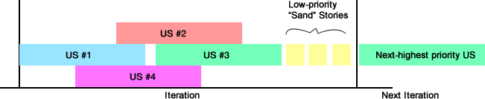
Where is an example of incentivizing sub-optimal decisions?
Why should we not just always be working on the highest-priority thing?

Slide 67
Summary
Uncertainty is an unavoidable aspect of software development
Commitments may influence decisions

Slide 68

leankanban.com

Slide 69
This is what people think Kanban is
To Do
In progress
Done

Slide 70
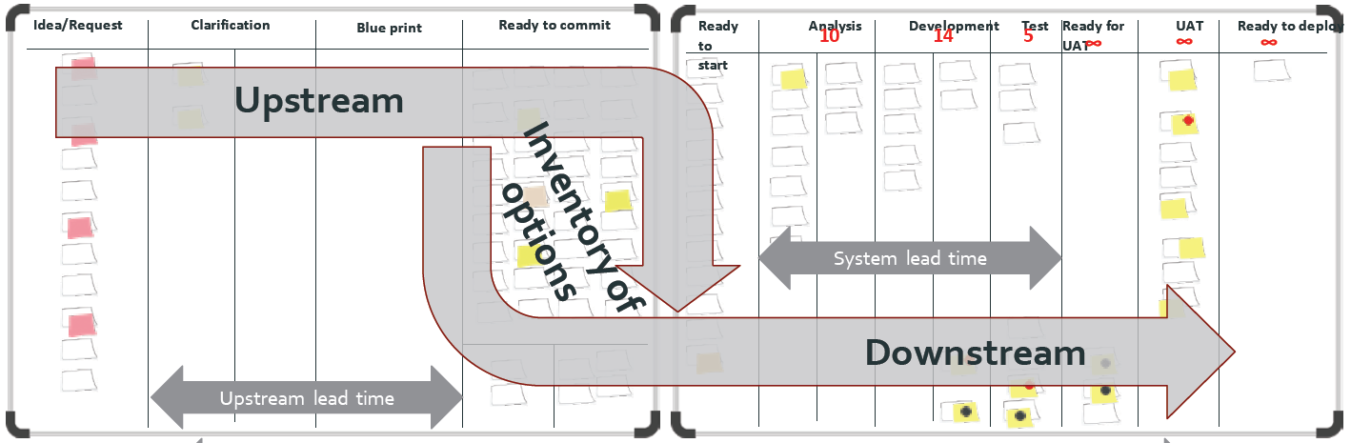
What is Kanban?
The Kanban Method teaches organizations how to understand, visualize and measure systems of work to continually improve and consistently deliver effective results.
The Kanban Method provides a set of proven practices and approaches that scale from individuals and teams to the enterprise.

Slide 71
34,517 Cumulative Globally

Slide 72





The Kanban Trail
 | Badge | Name | Class(es) Required | What can be expected
■ |  | TKP: Team Kanban Practitioner | Team Kanban Practitioner | The basics of Kanban to enable a team to get started
 |  | KMP: Kanban Management Professional | Kanban System Design Kanban Management Professional | The core Kanban practices to work with teams or a team or teams
◆ |  | AKMP: Advanced Kanban Management Professional | Kanban Maturity Model | Playbook to help evolve a team or organization to higher levels of maturity
 |  | KCP: Kanban Coaching Professional | Kanban Coaching Professional (Plus Essay and Interview) | Foundational understanding to be able to resort to first principles evolve solutions

Slide 73
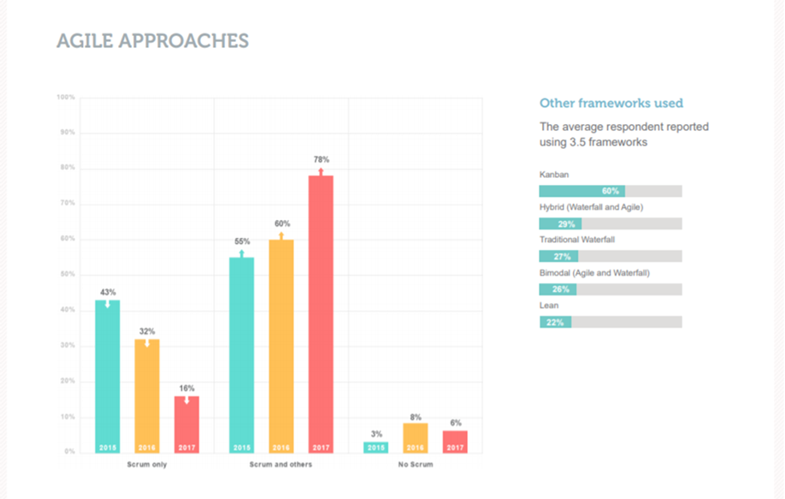
State of Scrum (ScrumAlliance 2018)

Slide 74
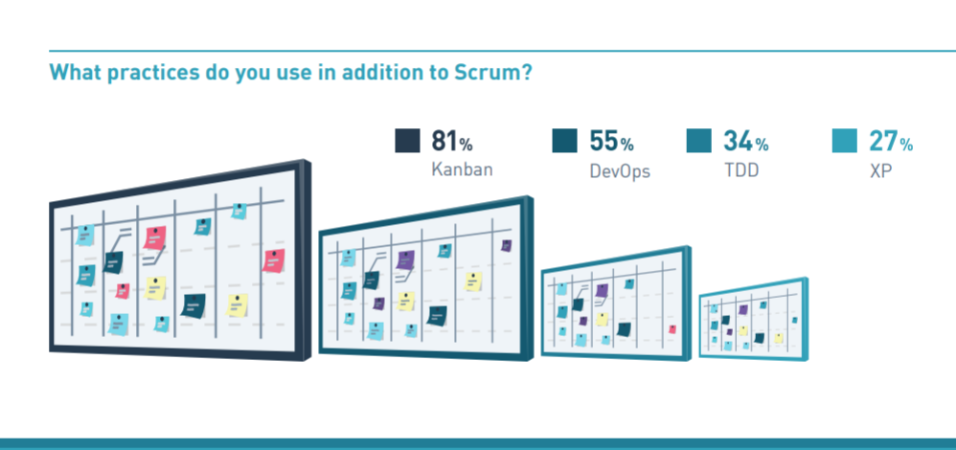
2019 Scrum Master Trends (Scrum.org)

Slide 75
How Most People see Kanban
Agile
Scrum
SAFe
Kanban
Scrumban

Slide 76
How Lean Kanban sees Kanban
Agile
Kanban
Scrum
SAFe
Scrumban

Slide 77
Kanban: The Great Unifier
Chaos
Kanban
SAFe
Scrum
Waterfall
CMMi

Slide 78
leankanban.com

