Slide 1

To Estimate or
#NoEstimates,
that is the question
Alas, Poor Yorick, I knew him well…
Yet another software death march

Slide 2

To Estimate or #NoEstimates, That is the Question
Sean Dunn
Enterprise Agile Coach
Todd Little
VP Product Development
IHS
Chris Verhoef
Vrie University, Amsterdam

Slide 3
How many of you consider it to be a major part of your job to either create estimates or deliver against someone’s estimates?

Slide 4
“
It is difficult to get a man to understand something when his salary depends upon his not understanding it.
”
        Upton Sinclair

Slide 5




Probability Distribution
Estimate/Actual
MEDIAN?
TELL ME HOW LONG
IT IS GOING TO TAKE
WHAT PEOPLE
WANT TO HEAR?
Frequency
MEAN
(P50)?
P90?
Actual/Estimated
DeMarco, Little (approximated)

Slide 6
“
Without risk, information would literally have no value to decision making.
”
Douglas Hubbard,
How to Measure Anything

Slide 7
To Estimate, or #NoEstimates, that is the question:
Whether ‘tis nobler in the mind to suffer
The Slings and Arrows of outrageous errors,
Or to take Arms against a Sea of troubles,
And by opposing, end them? #NoEstimates, so easy;
No more; and by #NoEstimates, focus on value and end
The headaches and the thousands of natural unknowns
That estimation is prone to, ‘tis a consumption
Devouring all resources. #NoEstimates; so easy;
So easy; perchance it seems: ay, there’s the rub;
For in # NoEstimates what surprises may come,
When we develop in earnest and begin our toil.
Must give us pause. There’s the respect
That makes calamity of software’s life;

Slide 8
What do we Estimate?
Notes:
Get the crowd to throw out their ideas. Capture on the flipchart

Slide 9
What do we Estimate?
Release – duration, effort, cost
Feature/Epic – story points, T-shirt sizes
Stories – story points
Tasks – hours

Slide 10
Why do we Estimate?
Notes:
Get the crowd to throw out their ideas. Capture on the flipchart

Slide 11
Why do we Estimate?
Decisions we need to make
  Do we start at all?
  What should we work on next?
  Should we stop and work on something else?
  Should we swarm?
  Should we get help?
  Should we split?
  Should we re-evaluate our technical approach?

Slide 12
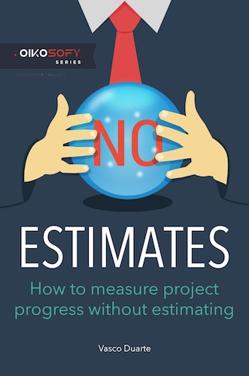
What is #NoEstimates
“#NoEstimates is a hashtag for the topic of exploring alternatives to estimates [of time, effort, cost] for making decisions in software development. That is, ways to make decisions with ‘No Estimates’.”
Woody Zuill

Slide 13
One Approach Suggested by #NoEstimates
Discontinue estimating story points
Instead simply count number of completed stories per iteration (throughput)

Slide 14
We collected and analyzed some real data

Slide 15
About the Data
Data collected anonymously by Vasco Duarte
55 Projects from 9 companies
37 projects came from one organization
…..but the analysis of the data is consistent
https://bitly.com/NoEstimatesProjectsDB

Slide 16
Definitions
 | Instantaneous | Average
Velocity | Story points delivered in an iteration | Average story points delivered over all iterations
Throughput | Number of stories delivered in an iteration | Average number of stories delivered over all iterations

Slide 17
What does the Data show?
2-12% Hardening for 50% of projects
Notes:
First thing we note is that there is not a lot of difference between Velocity and Throughput.
The second thing we note is that neither Velocity nor Throughput address the Hardening cycle that we see in 50% of the projects.

Slide 18
What does the Data show?
2-12% Hardening for 50% of projects
Notes:
First thing we note is that there is not a lot of difference between Velocity and Throughput.
The second thing we note is that neither Velocity nor Throughput address the Hardening cycle that we see in 50% of the projects.

Slide 19
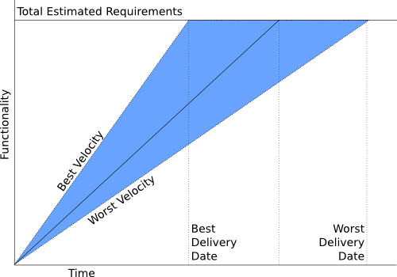
P90/P10 Ratio
P10=10% confidence
P90=90% confidence
Example
P10 = 6 months
P90 =12 months
P90/P10 = 2
P10
P90

Slide 20
Question:
Do we get better at estimating the further we go in a project?
(or: does our velocity become more stable over time?)

Slide 21
What do we see in Velocity?
Discovery: Velocity predictability does not get better over time.
Notes:
Velocity predictability does not get better over time. It starts out sucking (P90/P10 of 4.0 and actually gets a bit worse at 6.0+ This is counter to what we have been led to believe by the Cone of Uncertainty.

Slide 22
Question:
If we just use throughput (story count) to forecast completion, is it any more/less accurate than using velocity (story points)?

Slide 23
What do we see in Projections?
Discovery: Velocity and Throughput provide comparable accuracy in forecasting release date
Notes:
Velocity and Throughput projection error bounds are nearly identical. The ratio of P90/p10 is roughly 4 for both. The ratio of the Velocity P90/P10 to the Throughput P90/P10 is basically 1.0.

Slide 24
How about a Simulation
Simulated 1000 projects with 50 stories per project
  Story Point Distribution
  Estimation Accuracy
  Bucketing Approach
  Hardening Effort

Slide 25
How about a Simulation
Discovery: We can run a computer
simulation that produces results similar to the measured data.
Notes:
Main point here is that we were able to come close to matching the raw data with the simulation,. That let’s us explore some of the parameters to see which ones influence the results.

Slide 26
Simulation Results
No fundamental difference between velocity and throughput projections.
Velocity showed improvement over throughput when:
  Story point distribution was very large
  Estimation Accuracy was very good
Using buckets, such as Fibonacci, power of 2, or even power of 4 did not significantly impact the simulation.

Slide 27

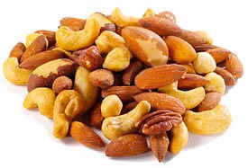
What do the simulations tell us
Estimating Mixed nuts…..

Slide 28
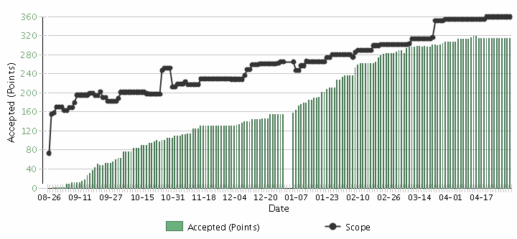
What does this tell us about Estimation?
Decisions to steer towards the release | Velocity and Throughput are equally good AND equally bad predictors, but better than nothing.
Scope Creep
Velocity

Slide 29
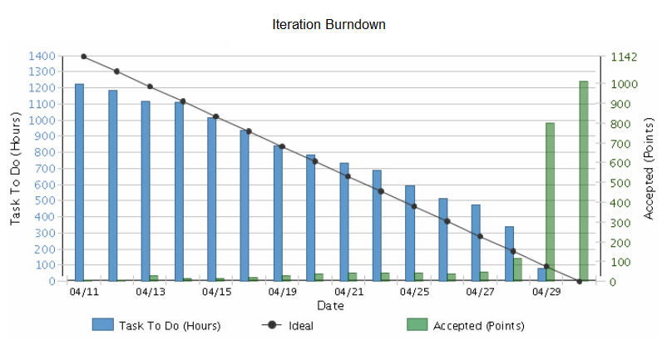
What does this tell us about Estimation?
Decisions to help with managing iterations | Do task estimates add value? What decisions are you making based on what you assume?

Slide 30
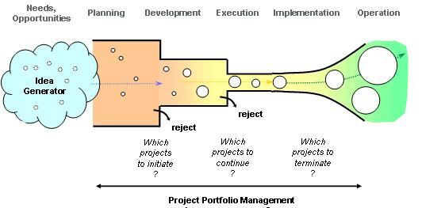

What does this tell us about Estimation?
Decisions at project sanction | Some level of macro-estimation of costs and benefits is likely necessary for business decisions. In general it is waste to spend more time on cost estimation than on benefits.

Slide 31
Comparison to other Research

Slide 32
IEEE Software, May/June 2006
Notes:
This is from an IEEE Software article that I published in May 2006

Slide 33
Accuracy of Initial Estimate

Slide 34
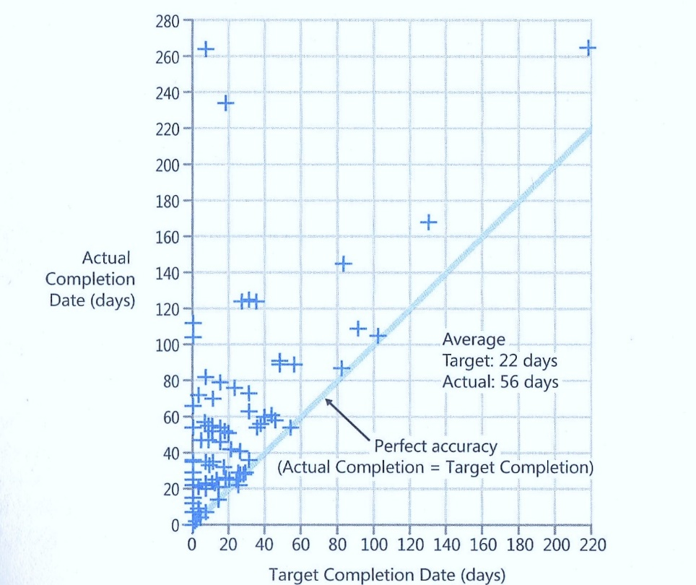
Data From Steve McConnell

Slide 35
Uncertainty
Percentage of Projects
10-20% | Less than or equal to original estimate
50% | Less than 2X original estimate
80-90% | Less than 4X original estimate

Slide 36
Actual vs. Original Estimate

Slide 37
Jørgensen 2013
Put software development project for bid on online marketplace vWorker.com
Received 16 bids.
Reduced down to 6 bids from vendors that had high (9.5) client satisfaction.
All 6 bidders went ahead and built the software

Slide 38
Jørgensen 2013
Highest Estimate 8x the Lowest
Actual/Estimate Range: 0.7 – 2.9 (4x)
Actual Performance Range: Worst took 18X the effort of the best

Slide 39
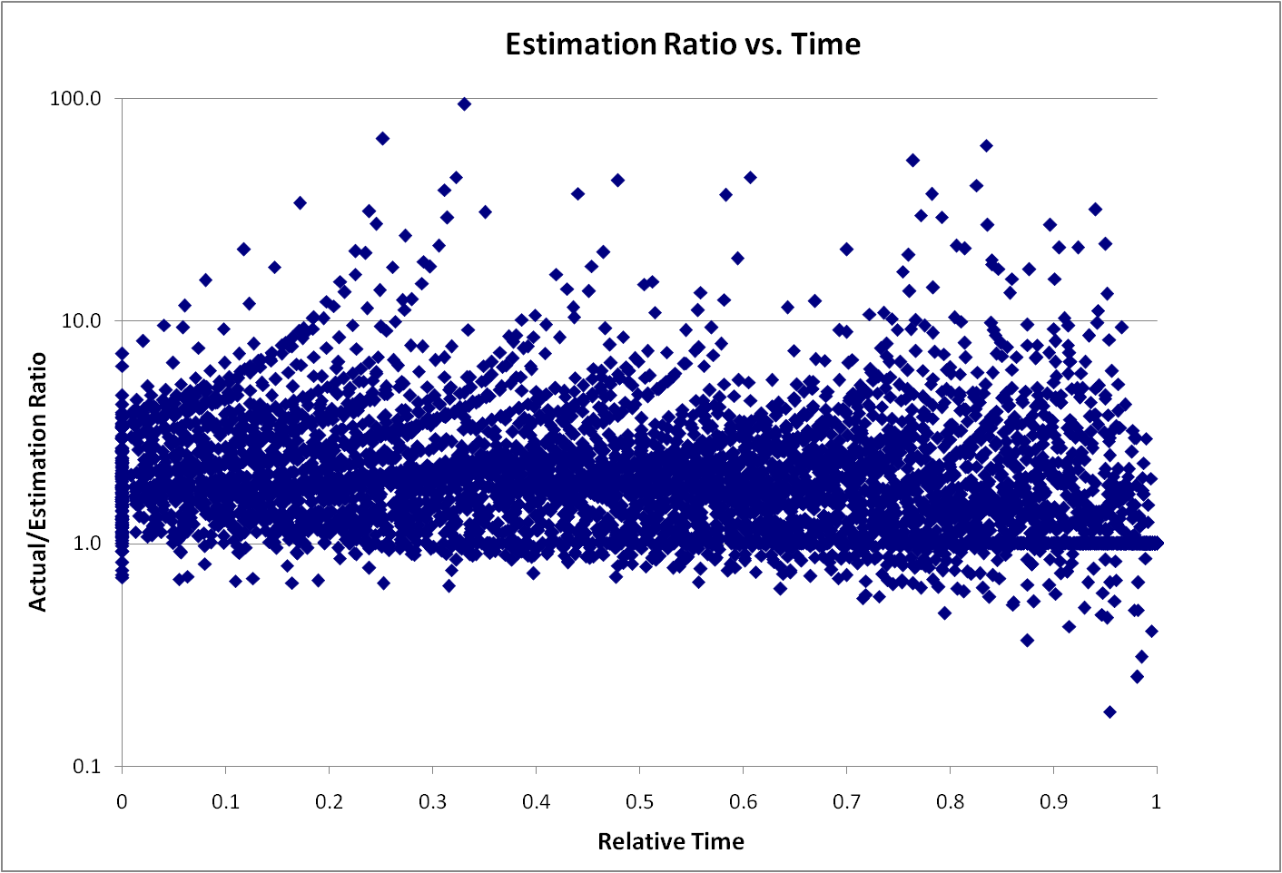
Remaining Uncertainty
4x

Slide 40
Remaining Uncertainty
Story Estimate
Notes:
Why doesn’t uncertainty decrease with time? Why should it? We start implementing stories and our stories adhere to INVEST. Thus they are independent. Thus the delivery of one story is not impacting the uncertainty of a future story.

Slide 41
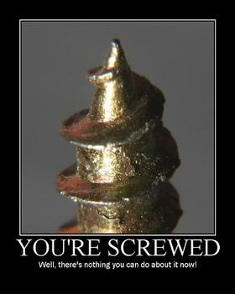
How many of you consider it to be a major part of your job to either create estimates or deliver against someone’s estimates?

Slide 42
Now What?

Slide 43
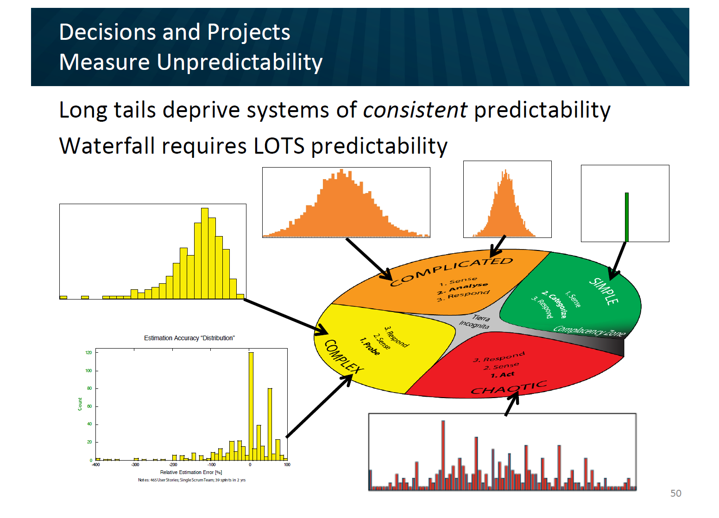
Management Under Uncertainty

Slide 44
The A/B/C List sets proper expectations
A | MUST be completed in order to ship the product and the schedule will be slipped if necessary to make this commitment. The Product Owner will take the heat for the schedule slippage.
B | Is WISHED to be completed in order to ship the product, but may be dropped without consequence.
C | Is NOT TARGETED to be completed prior to shipping, but might make it if time allows.
Only “A” features may be committed to customers.
If more than 50% of the planned effort is allocated to “A” items the project is at risk.
Notes:
(MoSCoW for Pre-Schoolers) But actually an improvement on MoSCoW. The English language is loaded. “Should” implies that if I don’t deliver it is a failure. On the other hand, by calling a “B” a “wish” I’m actually happy if it is delivered. The definition of “A” is critical. It is the Product Owner that is taking the heat for a schedule slip. This is a huge change for many teams.

Slide 45
A/B/C List
50%
25%
25%
A
B
C
D
Typical Delivery
C
A
B
Backlog Plan
Target Delivery Date
50%
100%
Notes:
We devise a plan where we look to lock down the “A” features but we create a buffer capacity by only allocating 50%. If our estimates are close then deliver all the “A”s, but we find that some of the “C”s were actually higher priority and that there were a number of “D”s that were discovered during the development. But, what if the “A”s turn out to be harder than we thought?

Slide 46
A/B/C List
A
50%
25%
25%
B
C
D
Uncertainty Risk
C
A
B
Backlog Plan
Target Delivery Date
50%
100%
Notes:
--The idea is that there is uncertainty in the estimation process. A factor of 2X is a generally sufficient buffer if the team has gotten basic estimation down. Thus is it possible that what is actually delivered is only the “A” items. That is ok and actually expected.

Slide 47
What would Polonius Say?
Neither an Estimator nor a #NoEstimation bigot be, for estimation oft implies a false sense of both accuracy and certainty, while NO estimates may make suboptimal decisions. To thine own self (and team) be true.
“
”

