Slide 1

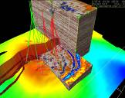
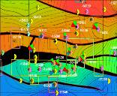
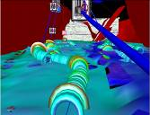
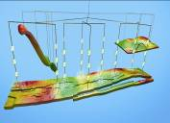
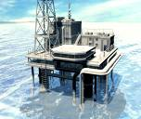
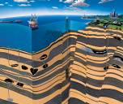
Integrating Software by Integrating People
Todd Little
Sr. Development Manager

Slide 2
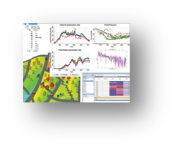
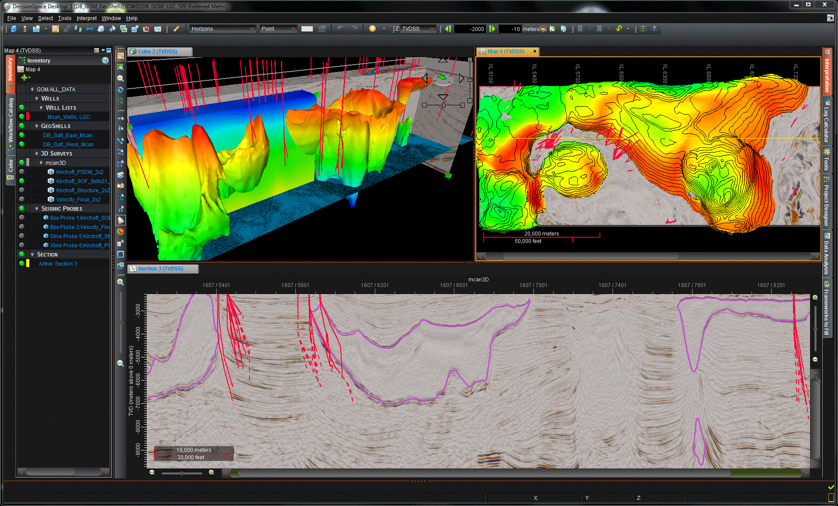
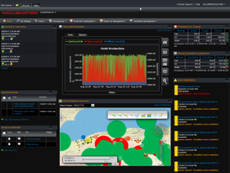
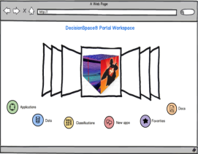
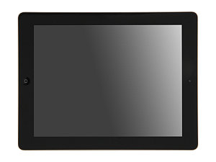
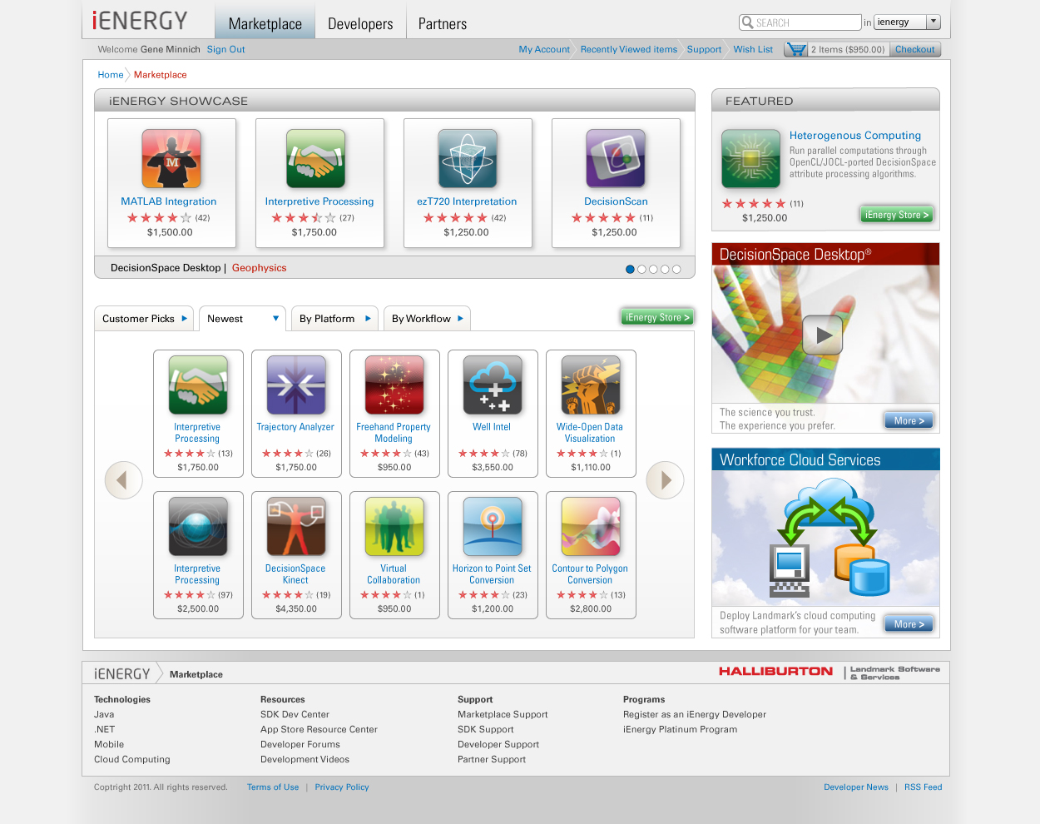
Landmark E&P Platform
Geosciences | Reservoir | Drilling | Production | Data management
Real-time | Your portal
Mobile
High Science
Ecosystem Foundation
Superior experience , Flexibility, Expanded reach
Application Foundation
Building & Customizing richer E&P applications faster
Computer Science
Integration Foundation
Enterprise class Middleware purpose built for E&P applications
Information Management Foundation
Comprehensive, Industry specific data management

Slide 3
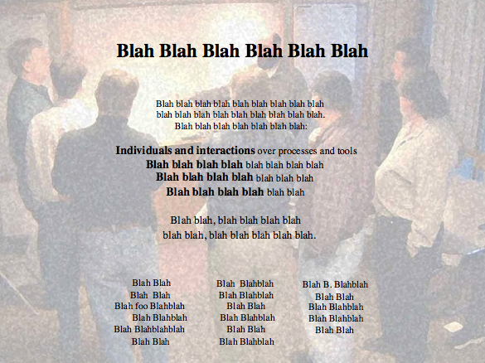

Slide 4
Long Ago and Far, Far Away…

Slide 5
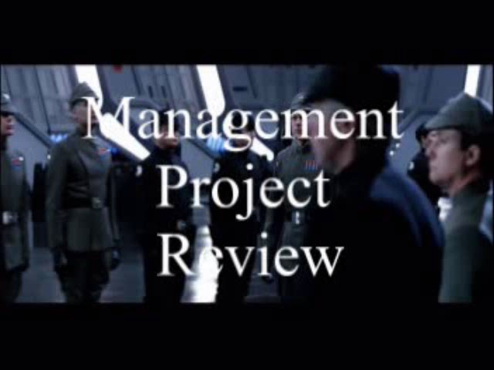

Slide 6
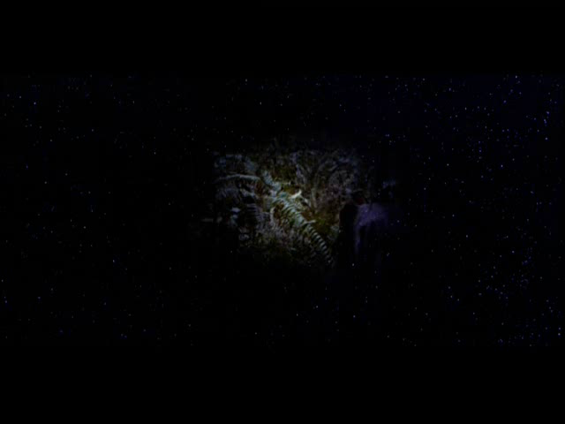
Agile Leadership

Slide 7
Trust/Ownership Model
Trust
Failure
Energy & Innovation
How do we
get here?
Command & Control
Conflict
Control
Low
Team Ownership
High

Slide 8
Enabling the I² Enterprise
Operational Integration
Resource Allocation
Workflow Integration
Data Integration
Notes:
This presentation was created in the spring of 1999 and evolved via a series of presentation to Landmark customers who asked for clarification on the related topics of
What is Landmark’s Unix-to-Windows(NT) transtion strategy? Is NT just for New Era? Just for GeoGraphix?
What’s the real story with Landmark’s New Era project? Is it going to replace all of Landmark’s traditional products? Does it represent Landmark’s Windows NT strategy?
What’s the “big picture” role of GeoGraphix? Is Landmark really committed to making GeoGraphix a market success? Is GeoGraphix going to be made obsolete by New Era?

Slide 9
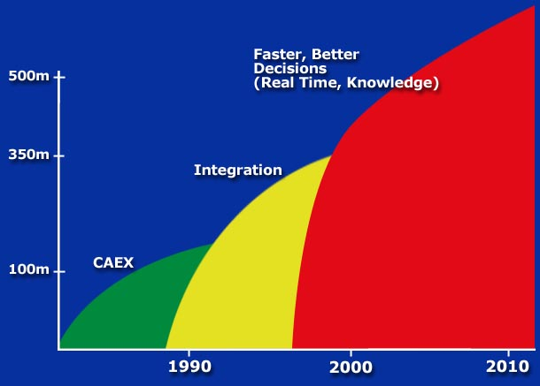
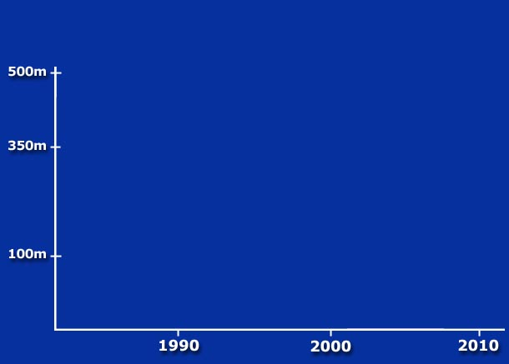
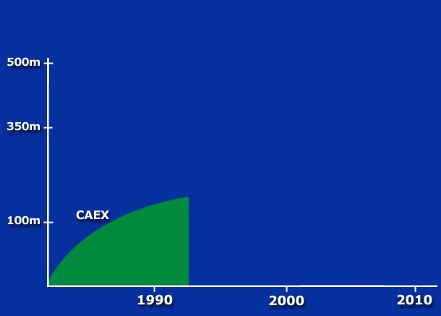
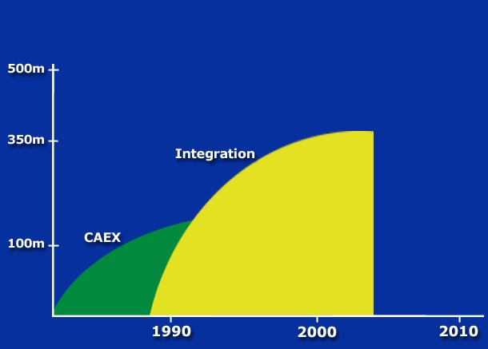
Information to Integration

Slide 10
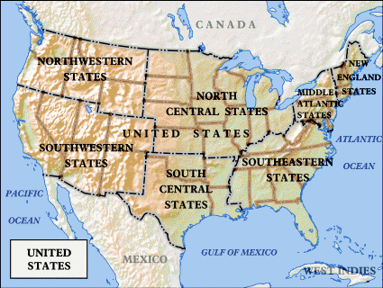
But software is developed in Houston, Austin, Denver and Calgary

Slide 11
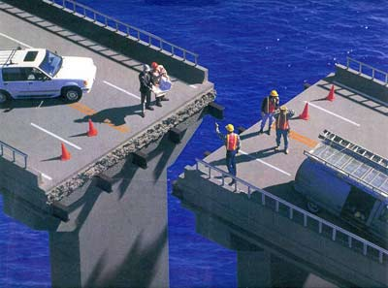
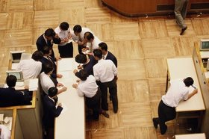
What the Leaders Did
The best way to integrate our software is to make sure we integrate our people

Slide 12
Get the Right People
Passion
Ability
Organizational Fit
Values

Slide 13



Get Alignment on the Purpose
Input
Output
I² Enterprise

Slide 14
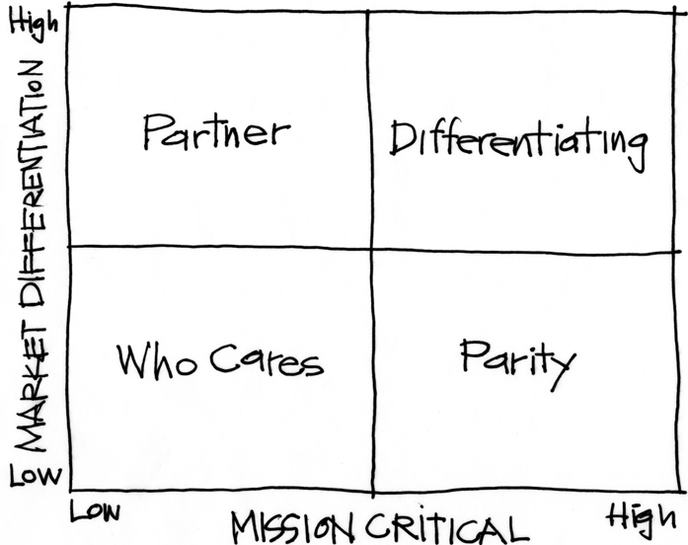
The Purpose Alignment Model
Notes:
[Purpose of slide] [#]
[Information]

Slide 15
In Practice
CAN WE
CREATE A
DIFFERENTIATED
PARTNERSHIP?
INNOVATE,
CREATE
ACHIEVE AND
MAINTAIN PARITY, MIMIC, SIMPLIFY
MINIMIZE /
ELIMINATE
Notes:
[Purpose of slide] [#]
[Information]

Slide 16
A View of Strategy - Landmark
16
INTEGRATION
DATA MANAGEMENT
3D VISUALIZATION
CUSTOMER SERVICE
DEVKIT PARTNER PROGRAM
STANDARDIZED ON ORACLE
USE COMMODITY 2D GRAPHICS
CUSTOM HARDWARE
Notes:
16
[Purpose of slide] [#]
[Information]
© International Institute of Business Analysis®

Slide 17
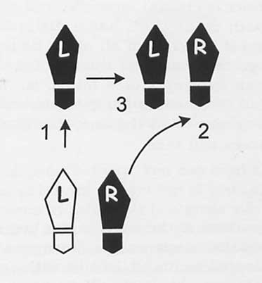
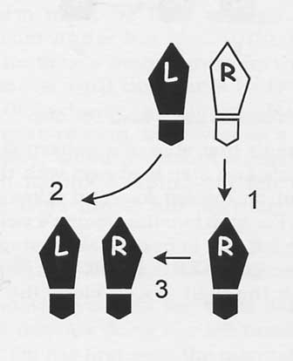
The Texas Two Step
Step Up
Clarify Purpose
Step Back
Test for Success
Ask Questions

Slide 18
Integrating People
Creating the Future
Friday@4 Weekly
PMM Quarterly
Developers’ Conference Yearly

Slide 19
Creating the Future
One Week exposure to Landmark
All new employees from around the world

Slide 20

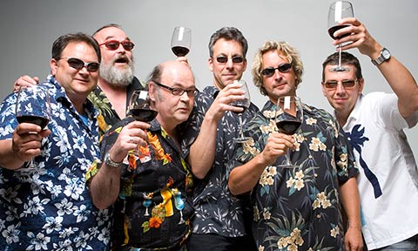
Friday’s @ 4
Informal setting
Opportunity for news

Slide 21
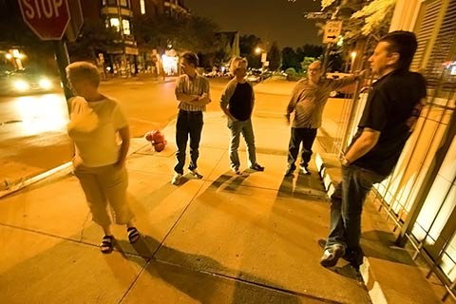
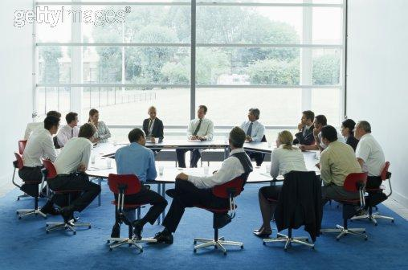
Product/Project Managers’ Meeting
Quarterly
Face to Face
2 days

Slide 22
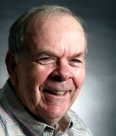
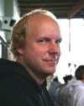
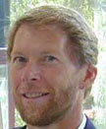
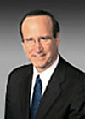
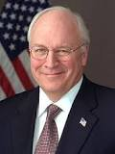
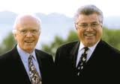
WorldWide Developers’ Conference
4 Day event
Everyone collocated
People
Purpose
Passion

Slide 23


The Bottom Line
Revenue grew
Market share grew

Slide 24
Trust/Ownership Model
Trust
Failure
Energy & Innovation
How do we
get here?
Command & Control
Conflict
Control
Low
Team Ownership
High

Slide 25

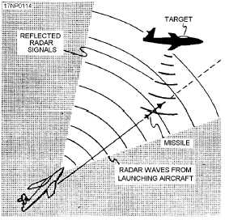
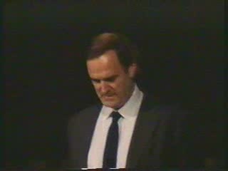
Gordon the Guided Missile

Slide 26
Control Systems
Processes
Inputs
Inputs
Inputs
Command & Control
Processes
Inputs
Inputs
Inputs
Agile Leadership

Slide 27
Trust/Ownership Model
Trust
Failure
Energy & Innovation
How do we
get here?
Zone of
Stable Control
Command & Control
Conflict
Control
Low
Team Ownership
High

Slide 28
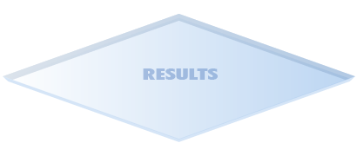




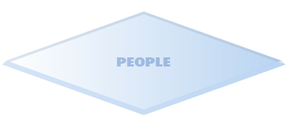
build a cube together
Notes:
28
28

Slide 29

Barriers – Hitting the Wall

Slide 30
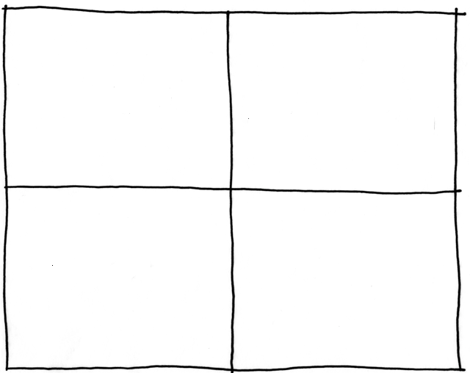
Collaborating with Non-Collaborators
Collaborator
Creative
Tension
Collegial
More useful
Drive to
Purpose
Collaboration
Non-
Collaborator
Compliance
Combative
Common Practice
Agree
Disagree
Agreement

Slide 31
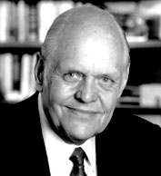
Trust/Ownership Model
Trust
Failure
Energy & Innovation
Command & Control
Conflict
Control
Low
Team Ownership
High

Slide 32

What About Outsourcing?

Slide 33




Integrating Offshore Teams
A - Onshore
  Technical Leader of Offshore team
B - Offshore
  Offshore Team Lead
  Domain Specialist
  2-3 Developers
  Testers
C – Offshore
  Junior Developers and Testers

Slide 35
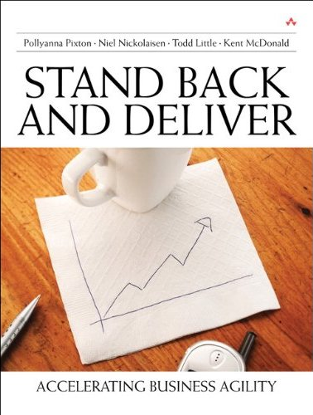
Contact
Todd Little
  tlittle@lgc.com
  www.toddlittleweb.com

Slide 36

Individuals and Interactions

